Slide 1


Unlocking the Potential of Desalination for Agriculture in the Arab Region:
Opportunities, Challenges, and Future Outlook
PLEASE WRITE YOUR SUB TITLE HERE
Dr. Heba Al Hariry,
May 5th, 2025, 7th AWW, 2025
Notes:
Thank you for the invitation, in my intervention today, I am going to provide some insights from FAO latest assessment on Unlocking the Potential of Desalination for Agriculture in the Arab Region. This work was developed under the farmwork of the Water Scarcity Initiative in collaboration with the League of Arab States, The Arab Organization of Agricultural Development and ESCWA. The idea of this regional came as a request from the member countries during the meeting of the high level technical under the framework on the Water Scarcity Initiatives.
Most Arab countries already operate under absolute water scarcity thresholds. The region is Home to over 6% of the world’s population but with access to only 1% of global freshwater resources, the region stands at the frontlines of one of the most critical development challenges of our time: water scarcity. And this challenge is not static—it is intensifying due to rapid population growth, expanding economies, rising energy and food demands, urbanization, climate change, and ongoing social and political pressures.
Desalination is gaining momentum as a key adaptation measure as defined by IPCC—despite its energy demands, it offers a vital supply-side solution in arid zones. Agriculture remains the dominant water user, and with global food demand expected to rise by another 70% by 2050, the stakes are only getting higher the real challenge lies in delivering sufficient quantities of good-quality irrigation water to farmers, in ways that are both sustainable and resilient to future shocks.
The main objective of this assessment which is expected to see the light within the next couple of months is to to provide a comprehensive and structured analysis of the role of desalination in supporting agriculture development across the Arab region. The study explores the agronomic benefits, socio-economic externalities, and environmental considerations of desalination projects, while identifying key limiting factors for their implementation. It further reviews the technological landscape, highlighting both current and emerging desalination technologies and their market dynamics. The report also investigates energy efficiency opportunities within agro-industrial applications and concludes with an overview of relevant policy frameworks, regulations, and strategic planning approaches that shape the development and scaling of desalination for agriculture.

Slide 2
Desalination for agriculture in the Arab region

Slide 3
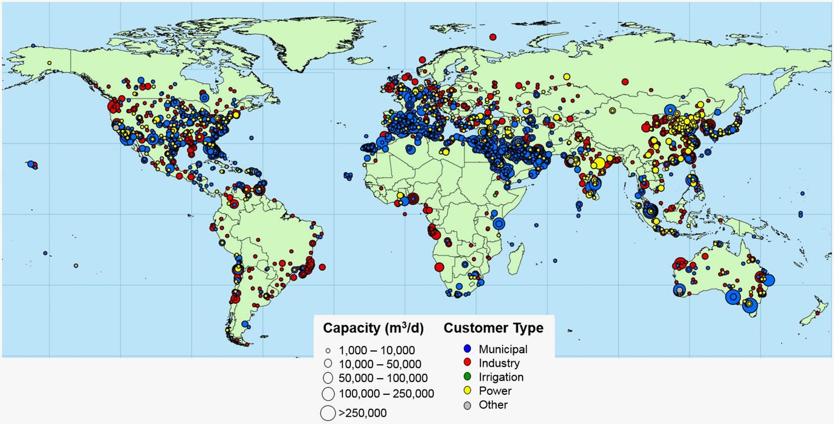
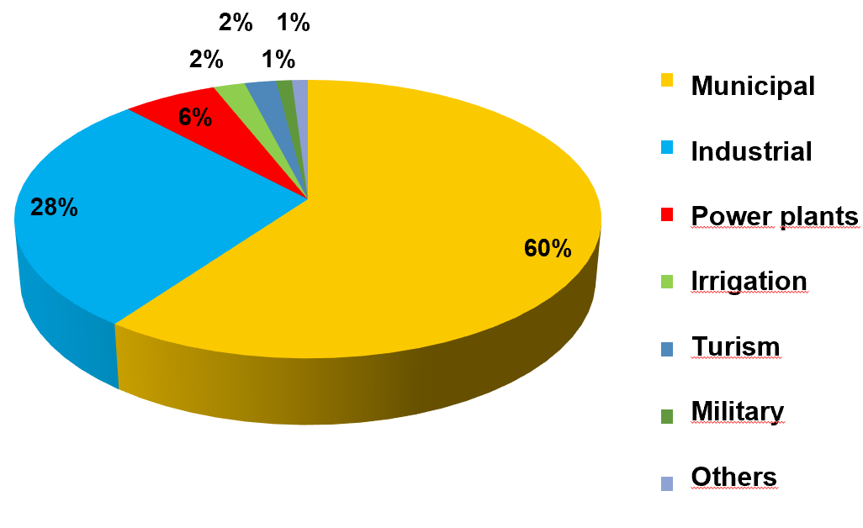
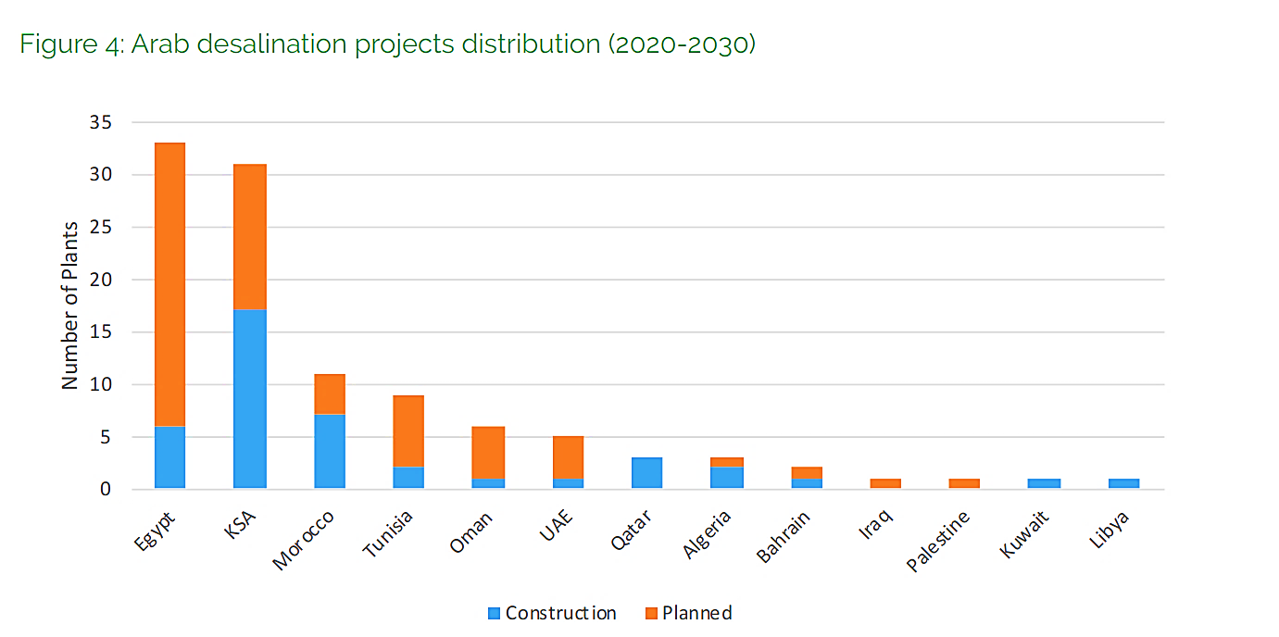
Desalination for agriculture in the Arab region
Desalination for agriculture represents only 2-3% of global desalination capacity.
However, countries such as Spain, Saudi Arabia, or Kuwait (13%) have higher contribution, with Spain in the lead with
> 21%.
Distribution of installed capacity by use
Notes:
Initially, desalinated water as a resource was restricted to use on islands, military bases, industrial sites and hotels (1950–1970). Between 1970 and 1995, it became the main resource for cities in the Arabian Peninsula and it has now become an accepted fact in the states of the Gulf Cooperative Council (GCC) that their future water demand will be met by desalination. Desalinated water can no longer be considered a limited resource because some countries such as Qatar and Kuwait rely 100 % on it for domestic and industrial use, whereas Saudi Arabia reliance is nearly 60 %. ( El Kharraz, 2020)
Figures on recently installed capacity around the world and on rates of expansion confirm the momentum of desalination and its promise to overcome the social, political, territorial and environmental problems of traditional hydraulic solutions conventional solutions such as dams, reservoirs and water transfers are increasingly unable to achieve.
Desalination for agriculture represents only 2-3% of global desalination capacity Furthermore, in a few countries, desalinized brackish water (whose price is typically a third of desalinated seawater) is already widely used by farmers. For instance, 22% of water desalinated in Spain goes to agricultural irrigation. Also, the strengths and opportunities of desalination projects include fast deployment with the potential to help remote communities flourish.
In this respect the number of desalination plants in the Arab region, both planned and under construction, has increased significantly in recent years, as shown lower left corner . Consequently, there is increased emphasis on enabling cost effective desalination technologies to provide water of suitable quantity and quality for agricultural applications.
In fact, many countries have started using desalinated water for agricultural purposes at varying rates to meet their water needs. For instance, in Kuwait where the installed capacity exceeds 1 million m³ /day, only 13% is used for agriculture.
And in Saudi Arabia where, the world’s largest single producer of desalinated water; only 0.5% of its desalination capacity is used for agricultural purposes.
Bahrain implemented a desalination capacity of 620,000 m3/ day while it uses only a small proportion of desalinated water of 0.4% for agriculture while Qatar used only 0.1% of its desalination capacity for agriculture. (FAO, 2024)
Furthermore, if we consider the example of Oman, due to the increased level of soil and water salinization along Al-Batinah region coast, an increasing number of farmers are using small-scale desalination units for producing irrigation water.
North African countries vary in their demand for desalination from the need to supply water to sea resorts, such as in Egypt and in Tunisia, to becoming an alternative to major water transport schemes, such as Egypt in its Sinai development, and Morocco for supply to its southern region.
…………………………………………………………………………………………………………………………………………………………………………………………………………………………………………………………………………………………………….
Other countries such as Libya and Algeria view desalination as a de facto source of water to meet growing demands for fresh supplies. Whereas Syria and Lebanon may not see the need for desalination, Syria (with over abstracted aquifers) still has to consider desalination in its interior far from rivers and the sea.
On the other hand, Yemen, the most water-depressed country in the world, has the additional problem of being forced into a combination of desalination and major transport schemes. Iraq is likely to experience severe water-treatment requirements equivalent to desalination, and it will also need solutions involving desalination in its southern territories. (Beltrán & Koo-Oshima, 2004)
In Abu Dhabi, for example, desalinated and recycled water users demonstrate greater water efficiency per square meter of cultivated land compared to groundwater farms in Al Ain and Dhafra. The reason behind these huge capacities in the region, as indicated in figure 3, is the technological improvements which led to a drop in the cost of desalination. Currently, the global market is led by Saudi Arabia with a total cumulative capacity of 15,378,543 m3/d followed the United Arab Emirates (UAE) with 10 721,554 m3/d. (El Kharraz , 2024)

Slide 4
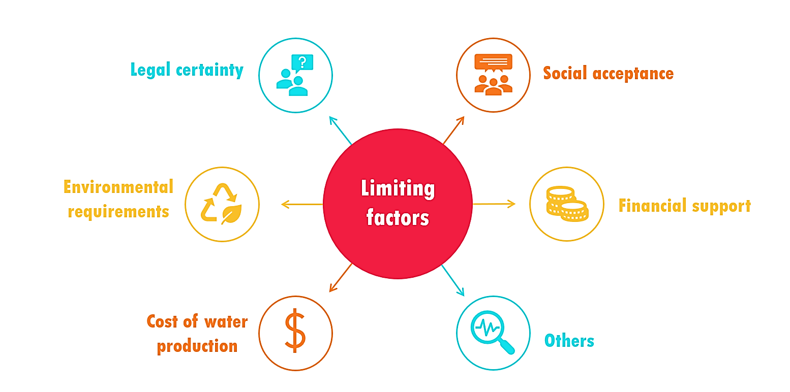
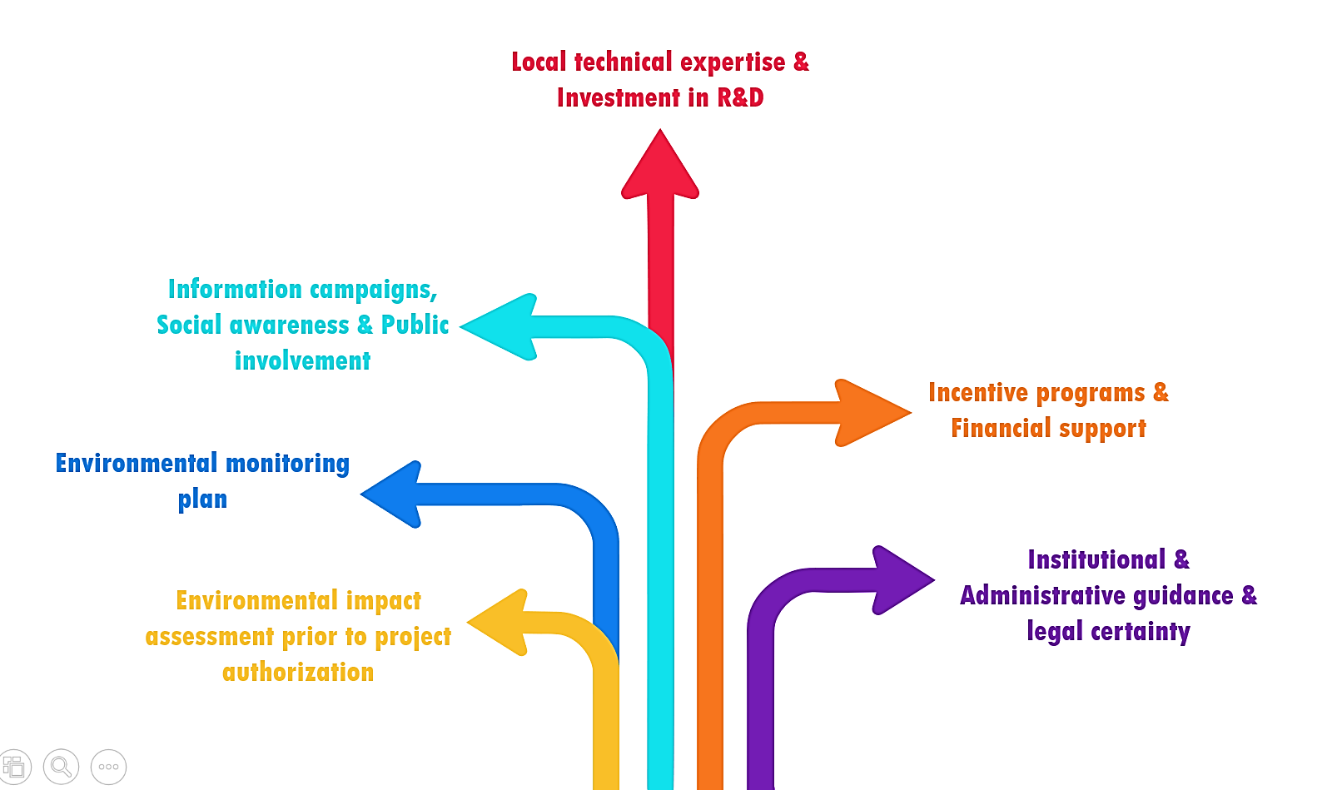
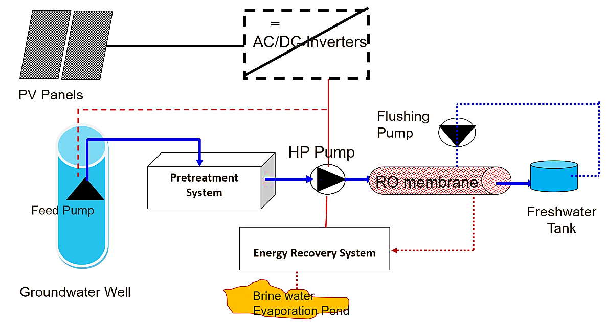
Requirements for desalination development
Limiting factors used to assess desalination development
Major requirements used to assess desalination development
Notes:
The launch of desalination plants involves several major challenges, including the need for a comprehensive technical expertise file for the use in agriculture to assess desalination development. To evaluate the main requirements and most limiting factors for the development of desalination projects in different countries, a survey of 34 international desalination experts was carried out.
The obtained results showed high heterogeneity of environmental and socio-economic requirements across different countries which I am going to discuss within the next couple of slides.
Major requirements to assess the development of project included : Read from slides.
Key data required, includes information on water distribution and usage for irrigation to enhance agricultural efficiency, as well as quantitative and qualitative aspects of resources such as rainfall, infiltration, flows, recharge, and water quality.
On the main limiting factors:
The main barriers identified for desalination development were the cost of produced water, The wider application of desalination technologies for agriculture is mainly limited by its relatively high cost, another factors was the need for agriculture to be close to saline and brackish water feedwater sources as well as a safe and cost-effective disposal of the brine.
The main barriers identified low financial sup­port, and stringent environmental requirements.
It was also observed that social acceptance of desalination projects is normally high and does not represent a limiting factor for their development. However, low levels of environ­mental requirements and/or public involvement have been identified as issues and these should be improved in some countries.

Slide 5
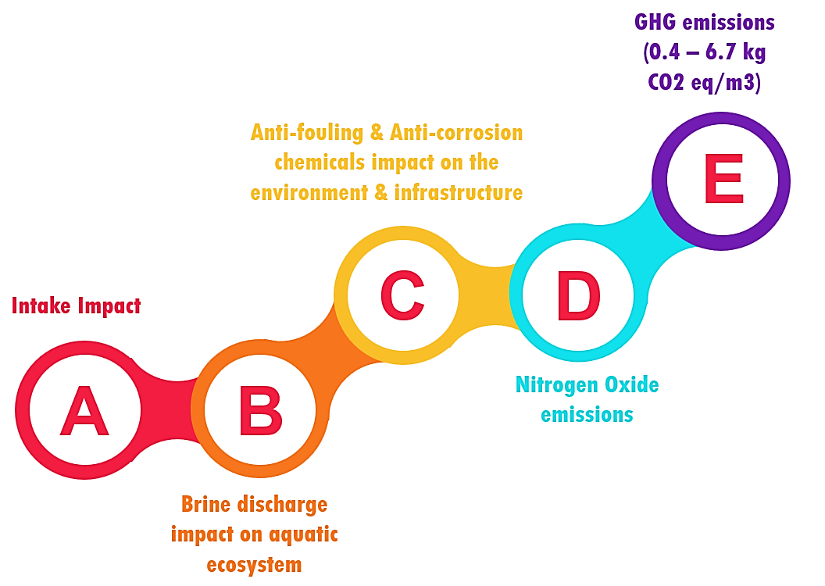
- Desalination promises to overcome the social, political, territorial and environmental problems of traditional hydraulic solutions and contribute in ways that conventional solutions such as dams, reservoirs and water transfers are increasingly unable to achieve.
- Desalination not only taps an inexhaustible resource but also has the potential of effectively removing water from political, territorial and ecological conflict. It is, therefore, an alternative with multiple “wins” and few losses at least in comparison to those of the more traditional alternatives.
- Local employment opportunities during the construction and operation of desalination plants are another benefit, but easy access to water also means more work and education opportunities for women who might otherwise be tasked with the time-consuming work of sourcing and carrying water.
Agronomic Opportunities and Socio-Economic externalities of desalination projects
Major environmental challenges associated with desalination projects development.
Notes:
Environmentally speaking, water, air quality, ocean space, water reservoirs, and other factors may all be adversely affected by desalination facilities. The environmental consequences of these facilities, as depicted in the figure above, are typically considered at the national level, and their acceptability and mitigation requirements vary depending on the context.
Now speaking about environmental regulations, it is vital to underscore that, to date, there are unfortunately no specific standards for environmental impact assessments, only guidelines provided by the United Nations Environment Program (UNEP). Environmental impact assessments (EIAs) have not yet been incorporated into management policies. Despite the availability of technology and management strategies to mitigate impacts, established standards and comprehensive EIA studies at both local and regional levels are needed
An additional potential environmental impact is associated with the potential disposal of RO membranes at the end of their life in landfills. Annually, 14,000 tons of membranes are disposed of in landfills worldwide. While incineration of membranes for thermal use is feasible, the associated side effects call for a more sustainable alternative. Therefore, providing these obsolete membranes with a new life cycle may be a solution. chemical treatments for obsolete RO membranes to facilitate their recycling and use in less demanding applications such as greywater or some wastewater treatment.
Now with respect to Socio-Economic externalities, desalination projects can have both positive and negative impacts on traditional farming communities. issues that are being examined by social scientists are, for instance, the financing of desalination plants; the sometimes negative reactions of citizens to this new resource; the health dimensions of desalted water; the creation of relative scarcities given the higher costs with particular impacts on farmers and poor urban dwellers.
. Positive impacts include improved water security, expansion of arable land, introduction of higher value crops, and economic diversification. However, costs, social unrest, environmental concerns, resistance to new technologies, and dependence on external inputs can contribute to negative impacts.
To ensure successful adoption of desalination projects, farmers in Arab countries need education and support through training on new technologies, access to affordable technologies and inputs, financial support (creating financial support programs, loan facilities, etc.), and community engagement. A comprehensive approach that takes into account the necessary economic and social aspects must be adopted to ensure that desalination projects contribute positively to the long-term well-being of traditional farming communities.

Slide 6
Incorporating desalinated water in agriculture can have varying agronomic effects. Key concerns include its lack of essential nutrients, leading to higher fertilization needs, especially for greenhouse crops. Additionally, its unique chemical composition may degrade soil structure due to sodicity, negatively affecting crop yield, with potential toxicity from high levels of boron and chloride.
Replacement of traditional irrigation water resources with DSW show that the combined use of DSW with traditional resources is the most efficient option, rather than irrigating with DSW alone.
The correct application and management of specific quality regulations, mixing and management modelling, technical means on the farm, as well as water and soil monitoring can mitigate these risks for agricultural irrigation with desalinated seawater.
Desalination for agriculture: Water quality concerns
Notes:
Now with respect to Water quality:
Incorporating desalinated water in agriculture can have varying agronomic effects. Key concerns include its lack of essential nutrients, leading to higher fertilization needs, especially for greenhouse crops. Additionally, its unique chemical composition may degrade soil structure due to sodicity, negatively affecting crop yield, with potential toxicity from high levels of boron and chloride
Post-treatment of the water produced is required in all technologies, especially in distillation processes that require mineralization. The post-treatment aims to stabilize the produced water and make it compatible with the distribution network and the end-user requirements. Adjustment of pH to approximately 8 is required. On the other hand, carbonation or use of other chemicals such as lime may be applied, and blending with some source water may be done to increase alkalinity and TDS and stabilize the water. Addition of corrosion inhibitors like polyphosphates may be necessary
Replacement of traditional irrigation water resources with DSW show that the combined use of DSW with traditional resources is the most efficient option, rather than irrigating with DSW alone.
The correct application and management of specific quality regulations, mixing and management modelling, technical means on the farm, as well as water and soil monitoring can mitigate these risks for agricultural irrigation with desalinated seawater.
Deionization is necessary in the production of green hydrogen as it helps achieve the very low conductivities required by many electrolysers. It is the final step in preparing ultrapure water by removing any remaining ions, ensuring the purity of the hydrogen produced. On the other hand, carbonation or use of other chemicals such as lime may be applied, and blending with some source water may be done to increase alkalinity and TDS and stabilize the water. Addition of corrosion inhibitors like polyphosphates may be necessary. ( El Kharraz, 2020). In the case of green hydrogen production, the cost of water typically makes up less than 2% of the cost of hydrogen production (Santana et al., 2024).

Slide 7
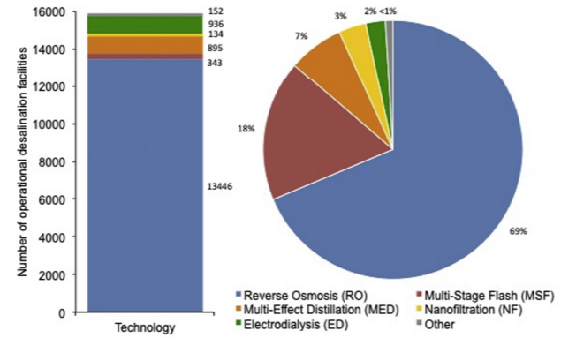
What Desalination technologies for agriculture?
Technologies | Energy use, kWh/m3 | Total, US$/m3
RO | Brackish water, 0.7–2.0 Seawater, 1.6–12 Submarine water, 2–2.5 | 0.38–1.5 0.55–2 Solar, 1.3 large plant, 2–6.5 small plant
FO | Brackish, 0.25 | Not available
ED | Brackish, 1.6–2.3 | 0.47
Direct contact MD | Sea, 40 | Solar, 15–18 Geothermal, 13 Solar Pond, 0.4–1.3 Waste heat, 1.1–1.5
Air gap MD | Sea | Solar, 18.3 Waste heat, 5.3
Vacuum MD | Sea, 1.2–3.2 | Solar, 16 Waste heat, 2
HDH | Brackish | Solar, 3–6.4 Geothermal, 1.2
CDI | Brackish, 0.13–0.59 | Not available
Notes:
Ever since desalination was initially invented in antiquity, more than 20 different technologies have been used for seawater desalination, broadly categorized into three groups: thermal processes, membrane separations, and emerging technologies. (FAO, 2024) The schematic diagram down below illustrates major desalination technologies and their relative contributions to worldwide installed capacity for seawater and brackish water desalination. MSF accounts for 44.4%, RO 41.1%, MED and other thermal methods 8.4%, ED and other methods 6.1%. (Humplik, Lee, Fellman, & Rahman, 2011) .
There are also other emerging technologies which are either limited by unit size or they are still under development at pilot scale among other limitations, such as freezing desalination, humidification / dehumidification, adsorption desalination (AD), membrane distillation (MD), microbial desalination fuel cells, ammonia driven FO (Oasys), capacitive deionization (CDI), and electro deionization (EDI)
There also seems to be a lack of policy and incentives to localize technology, which is coupled with minimal investment in research and development.
Advances in technology and components of desalination systems have led to an almost 80% reduction in energy use for freshwater production over the past two decades. (FAO, 2024) Moreover, innovations and improvements in membranes and energy recovery devices have been driving the progress of desalination technologies, especially stand-alone or hybrid RO and FO membrane-based processes which have come to dominate desalination markets in the last 10 years.
A list of energy use and costs for techniques other than distillation. Only two methods can be regarded as being fully commercial: RO and ED with large plants in operation, whilst capacitive deionization (CDI), CDI has a smaller 1 ML/day plant at the commercial stage. The rest are still experimental, although pilot and demonstration systems have been operated successfully.
On the flip side, renewable energy, in particular solar energy is an attractive solution to reduce RO plants carbon footprint, decrease their running costs, and eliminate the link between water prices and fuel costs. In fact, numerous studies and plants focused on using solar PV energy to drive RO plants on a small scale, as illustrated in Figures 13 & 14, and about 32% of autonomous desalination systems are based on PV powered RO units. Fig.15 highlights energy consumption in large-scale desalination plants.
In addition to the plant’s efficiency, the source of energy that drives a desalination plant determines its direct carbon footprint. RO has lower CO2 emissions than thermal desalination technologies. SWRO desalination plants estimated carbon footprint is 0.4 – 6.7 kg CO2 eq/m3. However, this is generally higher than brackish water RO desalination’s estimated carbon footprint of 0.4 – 2.5 kg CO 2 eq/m3

Slide 8
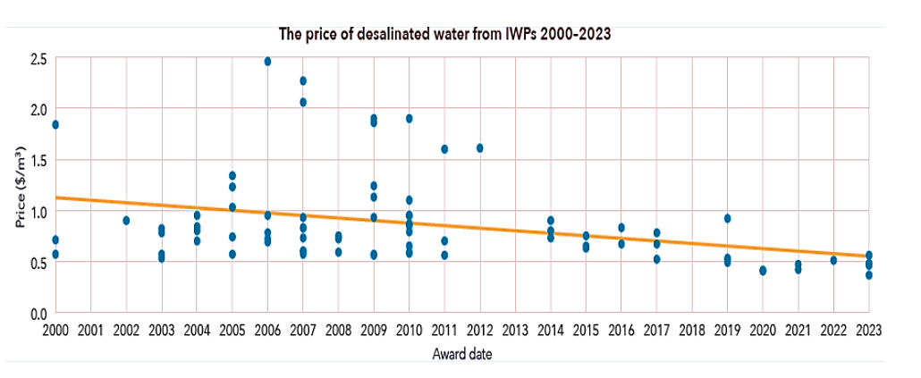
Advances in membrane technologies and energy recovery systems helped cut desalination costs in half over the past 20 years, making desalination now more economically competitive and attractive vs conventional water resources.
Economics of desalination for agriculture
Type of Water | Average cost (USD/m3)
DSW | 0.50 to 2.50
DBW | 0.60 to 2.00
SW | 0.10 to 0.50
GW | 0.30 to 1.00
Rainwater Harvesting | 0.15 to 1.50
Wastewater recycling | 0.30 to 1.15
The evolution of desalinated water price. (FAO, 2024)
Notes:
In the realm of desalination market and technology, several conclusions can be drawn.
Firstly, Cost-saving innovations are significantly advancing in desalination. These include efficient energy recovery devices that recycle high-pressure flows for up to 96% savings, advanced membrane materials with 3–4 times the productivity of standard elements, and novel low-energy filtration techniques such as forward osmosis and membrane distillation.
It is key to recognize that advances in membrane technologies and energy recovery systems helped cut desalination costs in half over the past 20 years. making desalination now more economically competitive and attractive than conventional water resources. Furthermore, membrane technologies can provide fertilizer solution and irrigation water with an acceptable level of nutrients for fertigation. (Suwaileh, Johnson, & Hilal, 2020) In contrast, RO requiring extensive pretreatment, is prone to membrane fouling, and has a complicated configuration, and necessitates skilled professionals for operation and maintenance.
cost-effective desalination for agriculture is most feasible where large volumes of brackish water are available near the ocean, with existing demand for irrigation. These conditions minimize water production and distribution costs. Low-salinity groundwater allows higher recovery rates and the mixing of feedwater with desalinated water. Being close to the ocean also reduces brine disposal costs compared to inland disposal methods.
This reduction in desalination costs can be promoted by prioritizing coastal sites near major demand centers, selecting intake locations with lower biofouling and pollution risks, leveraging existing marine infrastructure for dual purposes, and fortifying facilities, including storage, against natural disasters.
Consequently, desalination of water for agriculture is technically feasible and the appropriate technology is available. However, the major issues for discussion are size of desalination plants; designs; type of crops and areas where desalinated water could be applied; and project financing. Therefore, only economic and environmental considerations can limit its application and must be evaluated and controlled
Other developments include nanotechnology, biomimetics, enhanced hybrid processes, and AI-powered smart system optimization and condition monitoring. These advancements promise substantial reductions in both capital and operating costs, fostering a new era of affordability, especially with regulatory easing. (Herber G. a., 2024) Secondly, the Middle East and North Africa (MENA) region shows remarkable growth and reliability in desalination, meeting escalating water demands effectively. Desalination technologies are adaptable to market requirements, ensuring responsiveness to evolving needs. (Beltrán & Koo-Oshima, 2004)

Slide 9
- As for environmental regulations:
To date, there are unfortunately no specific standards for environmental impact assessments, only guidelines provided by UNEP. EIAs have not yet been incorporated into management policies. Despite the availability of technology and management strategies to mitigate impacts, established standards & comprehensive EIA studies at both local and regional levels are needed.
- Policies must include financial incentives like grants, subsidies, or tax breaks to offset the high costs of desalination for farmers.
Integrating RE sources to power desalination plants can also reduce environmental impacts and enhance sustainability. Implementing regulations for the safe disposal of brine, such as deep well injection or industrial reuse, is essential for environmental protection.
- Water pricing and allocation policies that encourage efficient use and discourage wastefulness can help reduce overall water demand, making desalination more feasible.
- Finally, continued R&D are needed to improve desalination efficiency and reduce costs, thereby making it a more viable solution for agriculture.
Policies/strategies and Regulatory frameworks
Notes:
With respect to Existing policies, Regulatory frameworks & Planning strategies.
the desalination sector in the Arab region faces significant challenges due to inadequate policies and regulatory frameworks. Some Arab countries have yet to achieve a balanced approach to water policies, and even where such policies exist, they are often not applied effectively for their intended purposes. Additionally, laws and legislation do not sufficiently address all the issues, and there is a notable failure in implementation and enforcement. Furthermore, the lack of cooperation with both Arab and international peers exacerbate these challenges, hindering the sector's progress.
An example of regional strategies related to desalination, the 5+5 (including Algeria, Morocco, Tunisia, Libya and Mauritania from the Arab region) Western water strategy highlights desalination as a vital solution for chronic water scarcity, emphasizing the need for efficient, low-impact technologies and renewable energy use. Promoting legal frameworks and encouraging private sector investment are essential to meet the growing demand for desalinated water.

Slide 10
Currently the cost of desalinated water is still too high for the use of this resource in broad-scale irrigated agriculture. An exception appears to be intensive horticulture for high value cash crops, such as vegetables and flowers (mainly in greenhouses) grown in coastal areas where safe disposal of brines is easier than in inland areas.
Vegetable crops such as those in the solanaceous family (i.e., tomato, potato, eggplant and pepper) and the cucurbits family (i.e., watermelon, melon, cucumber and summer squash) are suitable for greenhouse conditions. Success of these crops under controlled cultivation is due to their good adaptation and growth across several cultivation cycles, as well as their economic convenience. These crops represent about 80% of the controlled cultivation in most countries in the Arab region. Subsequently, it is efficacious to use desalinated water for producing these crops under greenhouse conditions.
The use of desalinated water for agriculture will be viable where there is limited access to water that is fit for purpose and it is most likely to be cost effective in a tightly controlled environment, using agricultural practices with the most effective water use and crops with high productivity. Such conditions are often associated with greenhouses and the production of high value irrigated crops.
It is also important to mention that a high level of financial support and subsidies that could be provided to the agricultural sector will make this option more viable.
Desalination cost & Crops Economic viability
Notes:
As a matter of fact, vegetable crops such as those in the solanaceous family (i.e., tomato, potato, eggplant and pepper) and the cucurbits family (i.e., watermelon, melon, cucumber and summer squash) are suitable for greenhouse conditions. Success of these crops under controlled cultivation is due to their good adaptation and growth across several cultivation cycles, as well as their economic convenience.
These crops represent about 80% of the controlled cultivation in most countries in the MENA region. Furthermore, these crops are produced in large quantities in the MENA region. Subsequently, it is efficacious to use desalinated water for producing these crops under greenhouse conditions.

Slide 11
Government regulations and policies play a major role, significantly influencing operations and pricing in the adopted business model.
Financial schemes for desalination projects
Financing modality | Explanation | Example
Multilateral Development Banks (MDBs) | Institutions providing loans and guarantees to support large-scale projects. | Jubail Desalination Plant in Saudi Arabia.
Green Bonds and Climate Financing | Bonds issued to fund environmentally friendly projects with positive impacts. | Poseidon Water Project in Huntington Beach.
Direct Government Funding | Government fully funds the project, especially when water security is a national priority. | Desalination plants carried out by the public company AQUAMED in Spain.
Revenue Bonds | Bonds repaid from the income generated by the plant, often used with long-term sales agreements. | Perth Seawater Desalination Plant in Australia.
Corporate Financing | Large corporations finance the plant independently due to substantial water needs. | BHP Billiton Desalination Plant in Chile.
Public-Private Partnerships (PPPs) | Collaboration between government and private sector to share risks and rewards. | Ait Chtouka Desalination Plant, Morocco.
Notes:
The economic viability of desalination projects often hinges on a delicate balance between public interests and private investment returns, necessitating a comprehensive evaluation of risk-sharing strategies and long-term sustainability considerations.

Slide 12
Key findings

Slide 13
Type of crops: High-value crops that typically yield greater financial returns per unit of water used, making the higher costs of desalinated water more justifiable (e.g. Horticulture products (vegetables, flowers, ornamental plants, Vineyards and Tree fruits). In contrast cotton, rice, or sugar, are unlikely to be effectively supported by desalinated water (lower economic returns and higher water requirements).
Cultivation environment: Greenhouses (controlled environment is particularly suitable for high-value crops and allow for more efficient water use). Vegetable crops such as those in the solanaceous family (i.e., tomato, potato, eggplant and pepper) and the cucurbits family (i.e., watermelon, melon, cucumber and summer squash) are suitable for greenhouse conditions.
Type of desalinated water: BW desalination is more suitable for agricultural production than is SWD. (Brackish water desalination is typically a 1/3 of the cost of desalinating seawater; however, inland brackish water is more often associated with groundwater, which is not an infinitive resource as seawater is considered).
Desalination technology: Membrane technologies (RO & ED) powered with PVs seem to be the best options
Financing Modality: Involvement of the public sector provide more guarantees to the project, facilitates investment and lowers project’s risks. Hence an intermediate approach that balances public sector guarantees with limited financial involvement and attracting private investment while maintaining oversight is well recommended.
Key findings (1/2)

Slide 14
Type of delivery contract: PPPs with long-term BOT contracts (enable municipalities and public utilities to transfer the risks associated with the costs of desalinated water to the private sector, providing a more sustainable and financially viable solution.).
Desalinated water cost: It varies widely globally, ranging from $0.50 to $2.50 per cubic meter for seawater desalination (DSW) and $0.60 to $2.00 per cubic meter for brackish water desalination (DBW). In contrast, desalinated water still costs 1.5 to 4 times more than most traditional freshwater sources like lakes, rivers, and shallow wells.
Affordability for agricultural applications: At present desalinated water is more expensive than conventional water resources. However, advances in membrane technologies and energy recovery systems helped cut desalination costs in half over the past 20 years. Consequently, desalination has become more economically attractive and competitive.
Plant size: Large-scale desalination plants present a more favorable option (more guarantees & easier access to finance associated with the public sector involvement). Additionally, in terms of O&M, small to medium plants are more problematic. But SMEs can be encouraged to deploy PV-RO units for small farmers
Location: Prioritizing coastal sites near major demand centers and safe brine disposal, selecting intake locations with lower biofouling and pollution risks, leveraging existing marine infrastructure for dual purposes, and fortifying facilities, including storage, against natural disasters.
Key findings (2/2)

Slide 15

THANK YOU

