Slide 1




Innovation-based-Approach to Improve Water Use Efficiency
Demonstration Pilot in Zaatari Camp
Abd AlRazag Heysat – May 2025

Slide 2

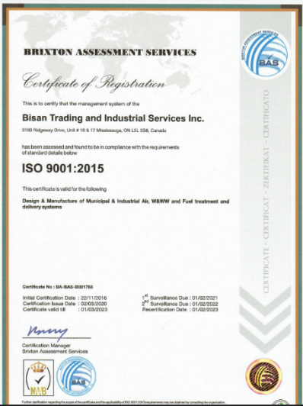
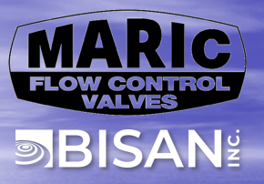


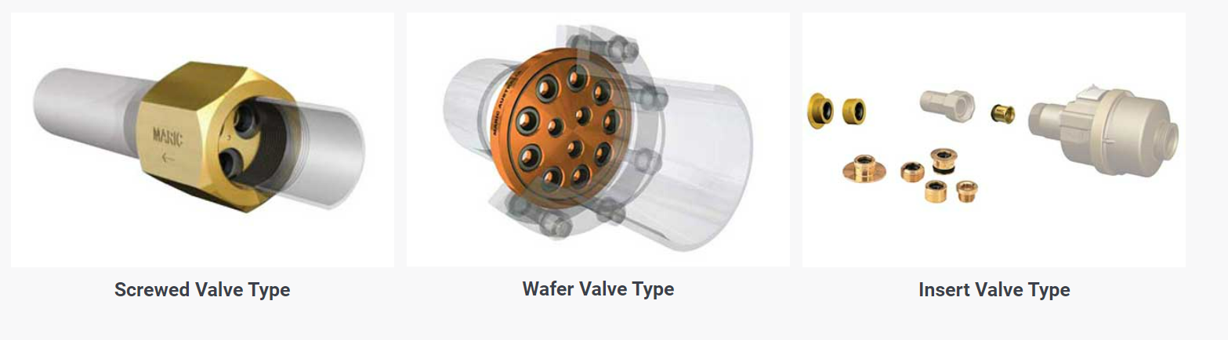
Background
  The Maric Flow Control Valve has been developed to provide a constant pre-set flow rate irrespective of pressure or pressure fluctuations.
How it Works?
  Maric flow control valves limit water flow by means of a carefully designed rubber control ring, with the orifice diameter varying, in response to pressure fluctuations
Low Pressure
Large Orifice
High Pressure
Smaller Orifice
Types

Slide 3
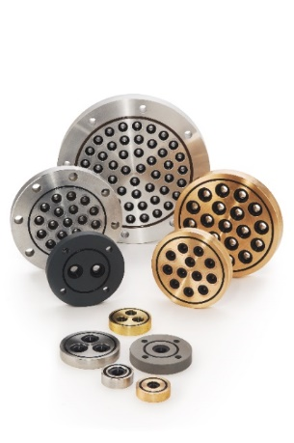
Features/ Why Maric Valves?
  Constant Flow Rate, Regardless of Pressure
  An effective and practical solution
  Respond instantly to changes in water pressure
  Offer the widest range of flow rates available
  Alternative for structural/ rehabilitation works
  Easy Installation
  low cost
  Are highly reliable due to their simple design
  No adjustment or maintenance
  Have a life span in excess of 20 years
  Tamperproof
Elegantly Simple !

Slide 4
Zaatari Camp
Historical Background – Problem Statement and Solution Basis
Problem/ Issue
Increased water demand due to the population growth.
Limitation/ Decreased availability of water quantities.
O&M management challenges of local work environments.
Difficulty in achieving fairness in the quantities of water supplied to end users.
Main goal to achieve
The Main Goal of the project is to achieve fairness in end user's water share of total supplied water, through out conducting:
Thus by
Aiming to
Equalization of water quantity
Similarity of water arrival period of Time
Reducing the water quantity supplied to the areas of Highest share
Increasing the water quantity supplied to the areas of Lowest share
Achieve Water Supply Fairness

Slide 5
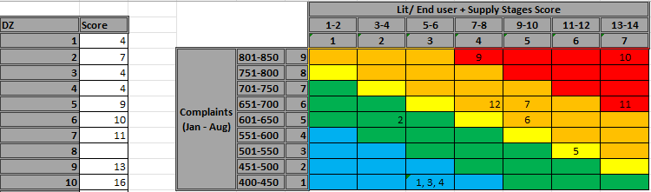
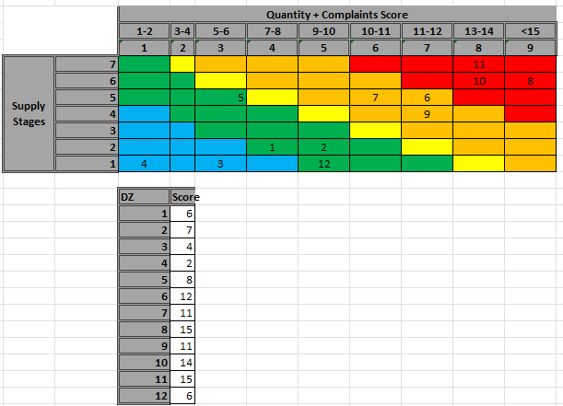
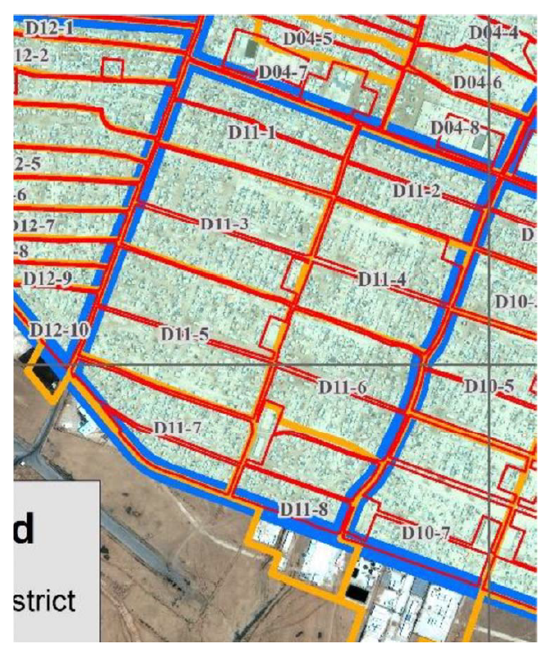
Piloting Zone Selection
The Most Impacted Districts has been selected as the piloting Zone based on reflecting several factors into a selection matrix.
District 11 was selected as a pilot zone.
(Phase I) Developing Hydraulic Modeling for the Pilot Zone
Data was imported to the model
  - Water Network Layout
  Water Pumping Schedule (One Year Record)
  Critical Points Identification and Water Demand Variety
  Number and location of end users for each zone within district 11
  Supply pump specification & feeder chamber elements
  Operational information, steps/ stages

Slide 6
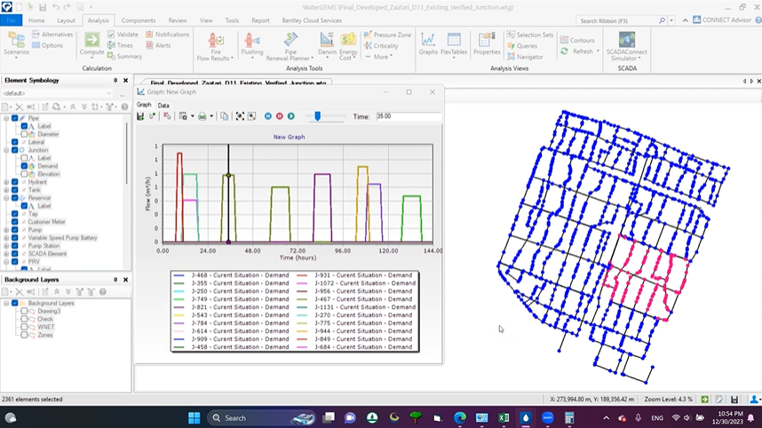
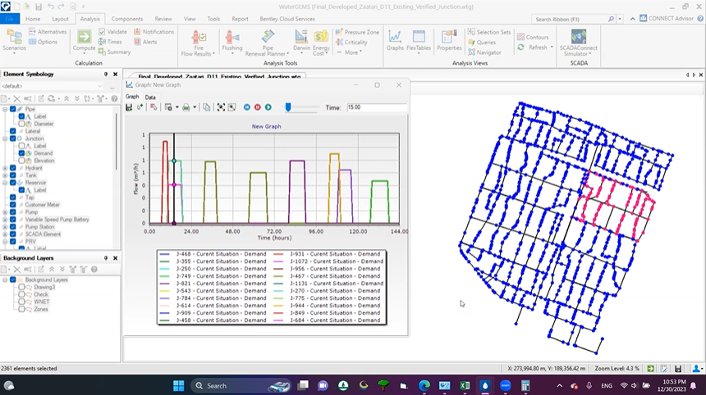
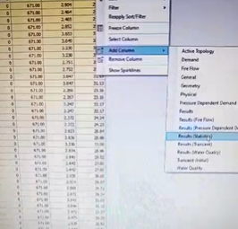
(Phase II) Implementing the Pilot
Hydraulic Model Calibration and Testing
The implementing of the pilot started with improving the Hydraulic Model with another package of data was collected from the field and through the operation team, in order to gain a Well Calibrated Live Operational Model that reflects the real condition of the water behavior through the supply.
Several tests were accomplished as a prior step to the Maric Valves selection and allocation process, in order to make sure of the model realistic.

Slide 7
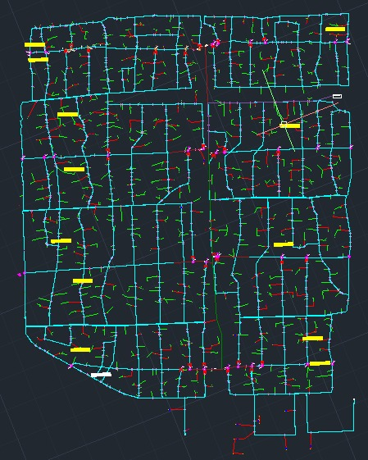
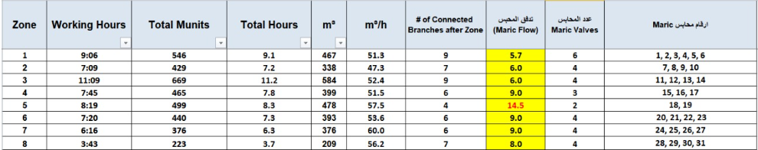
Maric valve selection & allocation
The process of Maric Valves Selection and Allocation was mainly aim to determining the following:
Number of the Maric Valves needed.
Water Flow Rate for each Maric Valve.
The specific location to install each Maric Valve.
Minimum number of needed valves to be installed which performs the best results.
Which was conducted based on:
The Well-Calibrated Hydraulic Model.
The General Hydraulic & Operational Standards & Equations.
The Specific Criterias of Maric Valves Selection.
Resulted that the number, locations & each flow rates of the Maric Valves was determined

Slide 8
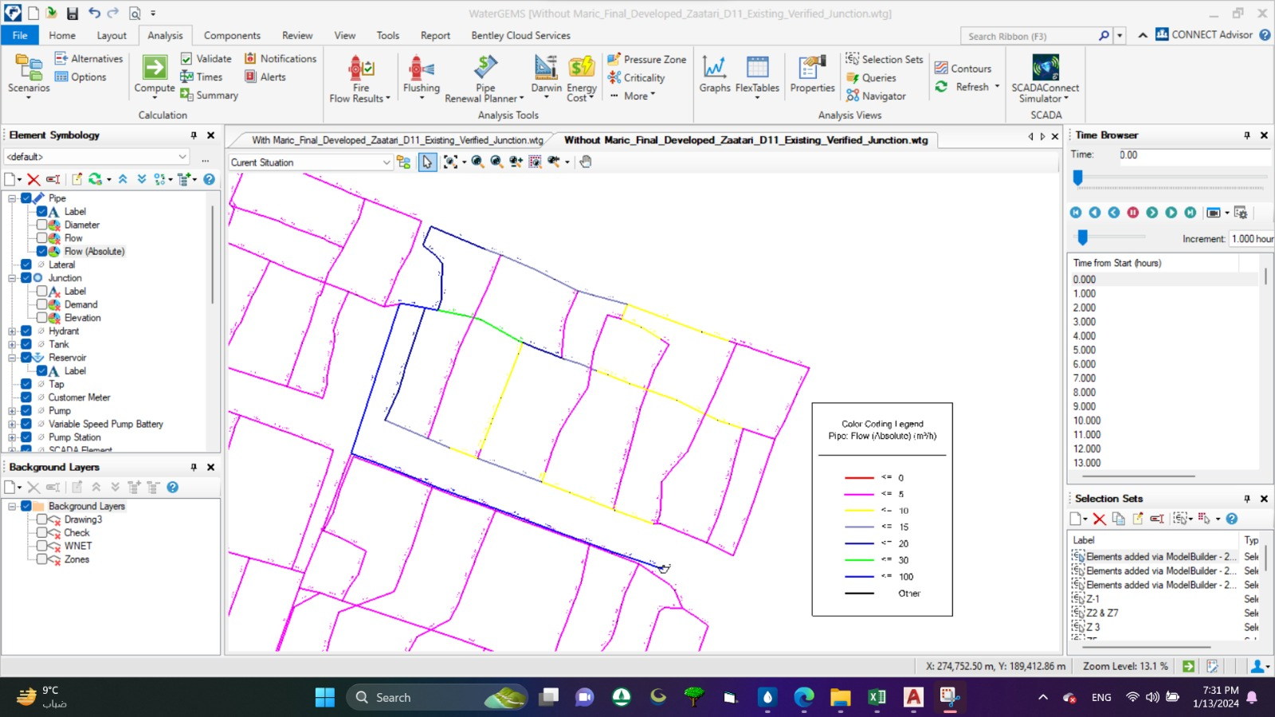
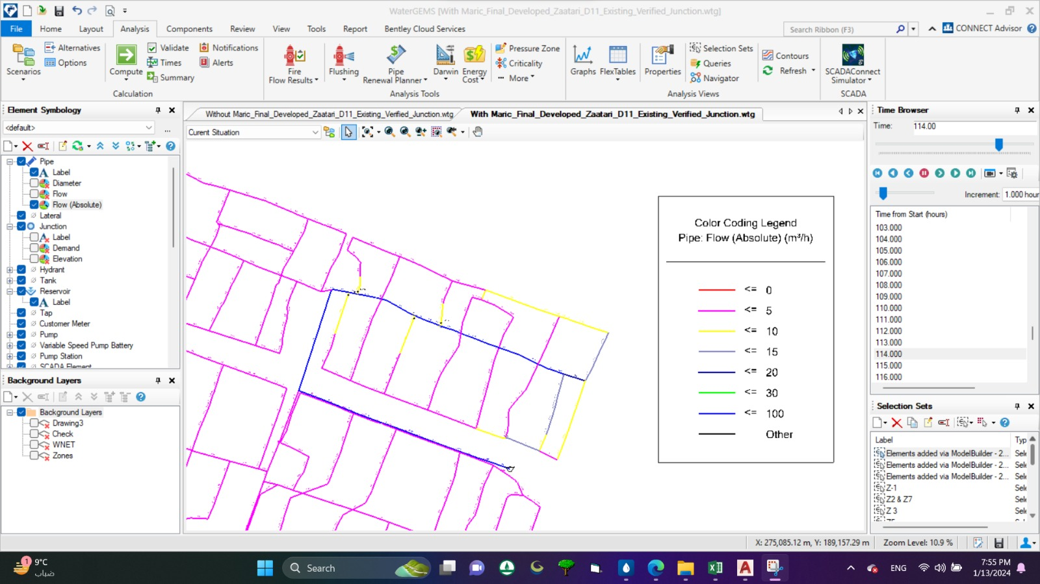
Hydraulic Model Simulation/ Maric Impact
After completion of the Maric Valves selection and allocation process, another double check was conducted through the well-calibrated hydraulic model in order to ensure the well completion of the process.
The double check was conducted through importing the selected specified Maric Valves at the determined locations and run a simulation of the Hydraulic Model in order to gain a realistic result.
Showing:
Expected result/ impact (Operational)
Expected fine-tuning needed (If any)
Supply flow rate reduction/ increase and pumping time increase/ decrease.
Before Maric Installation
After Maric Installation
Zone 2 as an Example

Slide 9
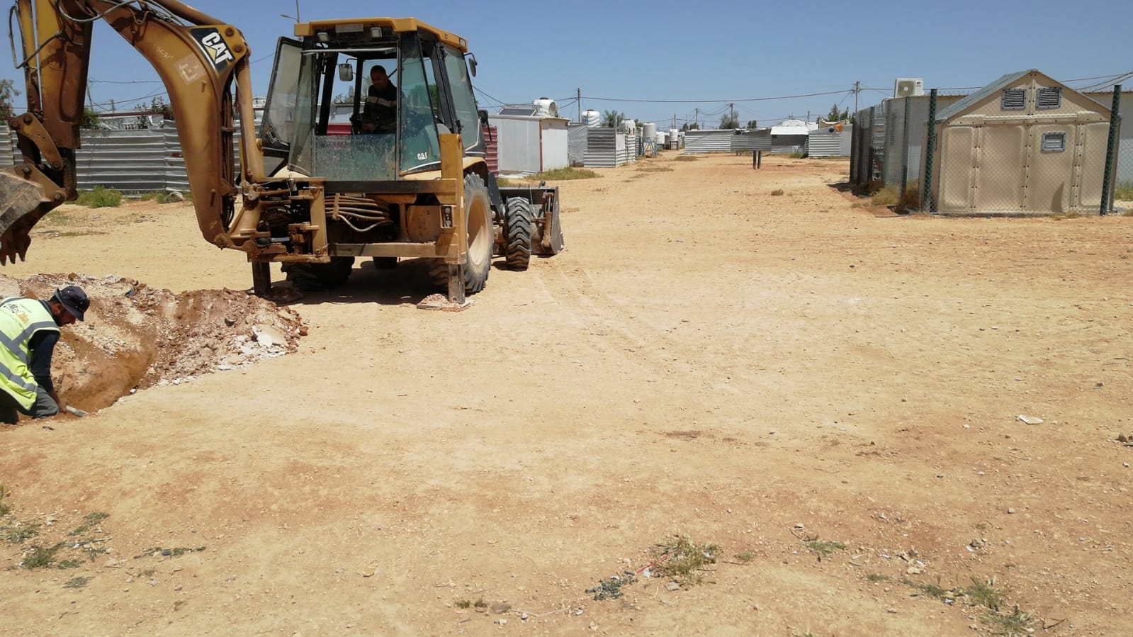
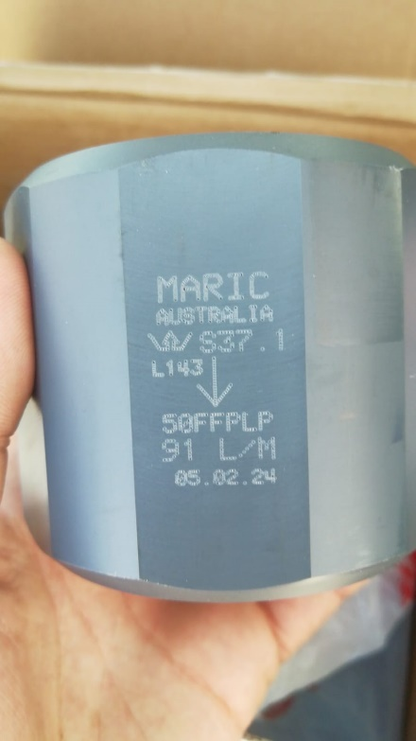
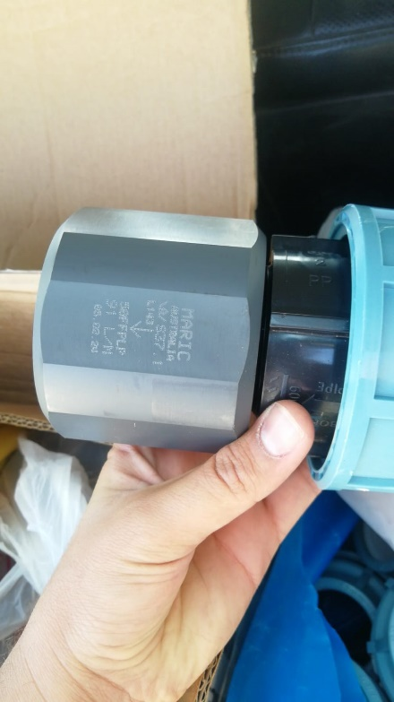
Maric valves installation on site
Based on the result of Maric Valves selection and allocation, each specified Valve of the determined 31 Valves for all of district 11, was well installed on the determined location.
Monitoring and follow up
Field observations of the Water Supply Cycles following the Maric Installation was accomplished in order to monitor the impact
Same Supplied Water Quantities Pump Flow Rate
Supply Hours Water Supply Fairness

Slide 10
Impact
Decreased Pump Flow Rate
As a result of the decreased pump flow rate and increased supply hours the field observation following the Maric Valves Installation reported that the main challenge was the Social Impact, especially at an environment such a refugee camp, which appeared through the increase in the number of violations/illegal connections that occurred on the network, which required to conduct a campaign to handle the situation and removing these connections.
Increased Water Supply Hours
More Violations
End Result
Maric Valves was very helpful to achieve the fairness between end users by improving the operational efficiency of water system, by equalization the water share of total supplied water during supply cycle.
Provided that monitoring and actions taken if needed, according to the operational and hydraulic recommendation.

