Slide 1


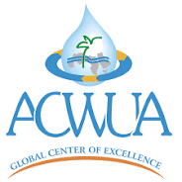

Institutionalization of Climate Resilient
Water and Sanitation Safety Planning
(CR-WSSP)
Future Vision for proposed institutional
set up
Presented by:
Eng.Abeer Alassaf
Facilities safety and protection Section/WAJ

Slide 2
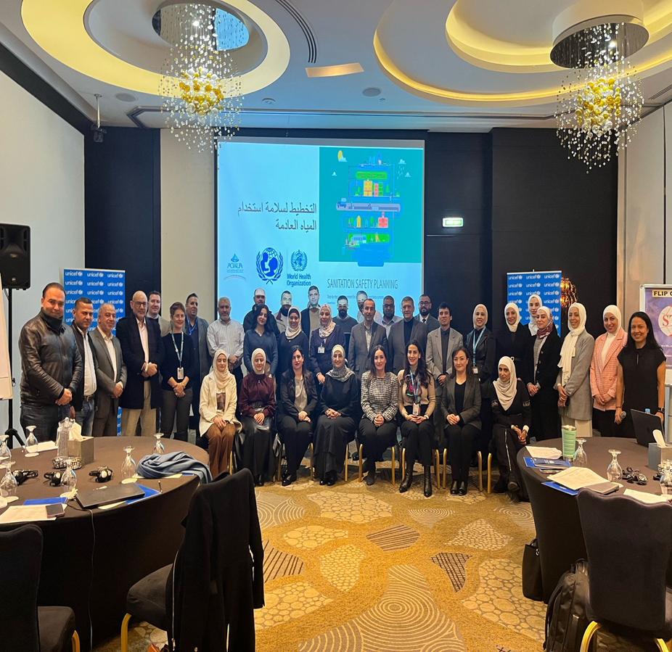

FREE
PPT TEMPLATES
INSERT THE TITLE
OF YOUR PRESENTATION HERE
ALLPPT.com _ Free PowerPoint Templates, Diagrams and Charts

Slide 3
Institutionalization - CR-WSSP
INSTITUTIONAL ASSESSMENT – MAIN FINDINGS:
Both utilities and WAJ demonstrate a clear willingness to adopt climate-resilient water and sanitation safety planning.
History of implementation of WSP in previous years, and existing structures can be leveraged to improve existing capacities in Water sector institutions
Through interviews and discussions, it became evident that there should be two levels of adoption when it comes to institutionalization.

Slide 4
First level
The first level involves institutionalizing at Water Utilities (Miyahuna, Yarmouk, Aqaba)
This is justified by the utilities' desire to improve their operations
Utilities recognize that the proposed tool and methodology (CR-WSSP) can support achieving these improvements.

Slide 5
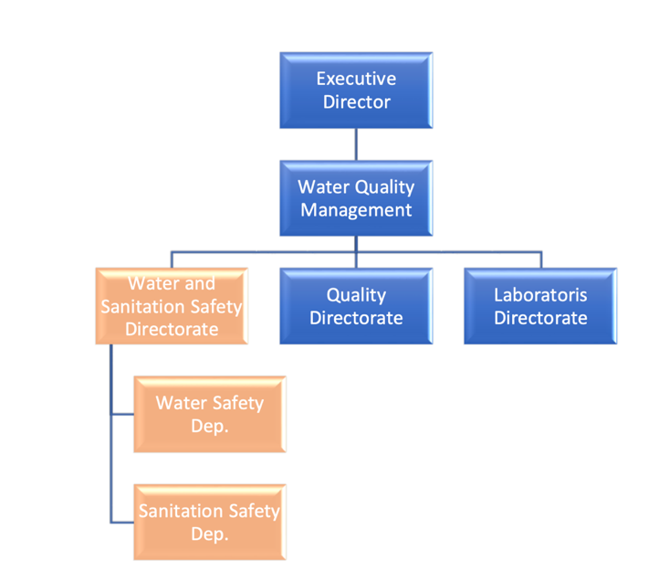
Proposed institutional arrangement at
Miyahuna for inclusion of CR-WSSP

Slide 6
Proposed institutional arrangement for inclusion of CR-WSSP at AWC and YWC
CR-Water Safety Planning Department
CR-Sanitation safety planning department
Other divisions according to the organizational structure of each company
Executive Director
Laboratories , water and wastewater safety directorates
.

Slide 7
Second Level
The second level focuses on the essential internal auditing
of the entire CR-WSSP process, which should be carried out by WAJ to ensure improved water and sanitation services.
The proposed host for these auditing activities is the Water
and Wastewater Quality and within the Laboratory and
Quality Affairs Division, as it already houses the Water
Safety Planning Department

Slide 8
Proposed institutional arrangement for
CR-WSSP at WAJ
Drinking water quality control department
Water quality remote monitoring department
Technical support department
Laboratories and Quality Affairs
Secretary General of WAJ
Minister of Water and Irrigation
Wastewater control and environmental department
Climate resilient wastewater safety planning department
Watershed protection and climate resilient water safety department
Studies and development department
Monitoring and evaluation department
Water and Wastewater Quality and Safety Directorate
Water safety plan

Slide 9
Recommendations
To strengthen climate-resilient water and sanitation safety planning, it will be necessary to mandate their implementation by utilities.
Proposed adjustments to the institutional arrangements at WAJ and its affiliated companies will necessitate capacity building and skill enhancement for employees, focusing not only on various aspects of CR-WSSP but also on coordination and management competencies
Developing a National Roadmap is essential to outline the priorities established by national authorities for water and sanitation safety planning. This roadmap should also define the criteria used to set these priorities within the broader framework of integrated water resources management
Support for employees at the established departments in companies will support retainment of competent human resources
Delegating authorities to the established departments at WAJ will ensure the sustainability of the proposed institutional set up for CR-WSSP

Slide 10
Recommendations
Further improvement on CR-SSP institutionalization will demand close coordination with the private sector along the sanitation chain. This specific point is crucial though presents a challenge for the process
Establish sustainable funding mechanisms for the development and implementation of CR-WSSPs
Investing in public awareness campaigns is essential to promote the adoption of Climate Resilient Water and Sanitation Safety Planning (CR-WSSP) and to encourage greater voluntary compliance
A comprehensive institutional restructuring of the MWI and WAJ will enhance organizational integrity, eliminating fragmented approaches that often lead to more complex, less effective, and less efficient institutions
A clear communication plans need to be developed at utilities to ensure better coordination and implementation of the developed plans

Slide 11


Slide 12


ALLPPT.com _ Free PowerPoint Templates, Diagrams and Charts

