Slide 1




Building Resilience through Green Innovations (BRAKA)
Almoayied Assayed, Director
Water, Environment and Climate Change Centre
Royal Scientific Society, Jordan
May, 2025

Slide 2
BARAKA project: Summary
Donor: European Commission – Jordan Delegation, EuropeAid/174783/DD/ACT/JO, Green Innovation Projects as part of the EU support to Green Economy in Response to the Syrian crisis in Jordan 2021 – 2024
Fund: 1.24M €
Targeted Areas: Amman, Irbid, Jerash, Ajloun, Zarqa, Mafraq and Karak
Duration: 30 months
Implementing Teams: RSS/Water, Environment and Climate Change Centre, National Energy Research Centre and WANA institute

Slide 3
BRA KA
Enhanced sustainable and efficient production
and consumption patterns
Developed Sustainable Energy
and Climate Action Plans (SECAPs)
Enhanced water and wastewater management
at refugee camps
Improved enabling environment for green growth
and resource efficiency in Jordan

Slide 4
BRA KA
Enhanced sustainable and efficient production
and consumption patterns
Climate Resilient Agriculture
Resource Efficiency and Cleaner Production in Industries and Households

Slide 5
Climate Resilient Agriculture Interventions
The impacts of climate change on Ag: droughts, floods, temperature extremes, pests/disease, water, etc.
Climate Resilient Agriculture (CRA) :
Reducing emissions
Increasing resilience
Boosting productivity
While- ensuring food security
CSA : CSA systematically integrates climate change into the planning and development of sustainable agricultural systems.
CSA integrates multiple goals and manages trade-offs.
Notes:
- Contrary to conventional agricultural,
-Ideally, CSA produces triple-win outcomes: increased productivity, enhanced resilience and reduced emissions. But often it is not possible to achieve all three. Frequently, when it comes time to implement CSA, trade-offs must be made. This requires us to identify synergies and weigh the costs and benefits of different options based on stakeholder objectives identified through participatory approaches (see figure 1).

Slide 6
Key characteristics of CSA
Provide Farmers with Ecosystem Services
Multiple entry points
Context specific
Involve the poorest and most vulnerable groups
Ref: FAO, 2021
Notes:
CSA maintains ecosystems services: Ecosystems provide farmers with essential services, including clean air, water, food and materials. It is imperative that CSA interventions do not contribute to their degradation. Thus, CSA adopts a landscape approach that builds upon the principles of sustainable agriculture but goes beyond the narrow sectoral approaches that result in uncoordinated and competing land uses, to integrated planning and management (FAO 2012b; 5 FAO 2013a 2).
CSA has multiple entry points at different levels: CSA should not be perceived as a set of practices and technologies. It has multiple entry points, ranging from the development of technologies and practices to the elaboration of climate change models and scenarios, information technologies, insurance schemes, value chains and the strengthening of institutional and political enabling environments. As such, it goes beyond single technologies at the farm level and includes the integration of multiple interventions at the food system, landscape, value chain or policy level.
CSA is context specific: What is climate-smart in one-place may not be climate-smart in another, and no interventions are climate-smart everywhere or every time. Interventions must take into account how different elements interact at the landscape level, within or among ecosystems and as a part of different institutional arrangements and political realities. The fact that CSA often strives to reach multiple objectives at the system level makes it particularly difficult to transfer experiences from one context to another.
CSA engages women and marginalised groups:To achieve food security goals and enhance resilience, CSA approaches must involve the poorest and most vulnerable groups. These groups often live on marginal lands which are most vulnerable to climate events like drought and floods. They are, thus, most likely to be affected by climate change. Gender is another central aspect of CSA. Women typically have less access and legal right to the land which they farm, or to other productive and economic resources which could help build their adaptive capacity to cope with events like droughts and floods (Huyer et al. 2015). 6 CSA strives to involve all local, regional and national stakeholders in decision-making. Only by doing so, is it possible to identify the most appropriate interventions and form the partnerships and alliances needed to enable sustainable development.

Slide 7
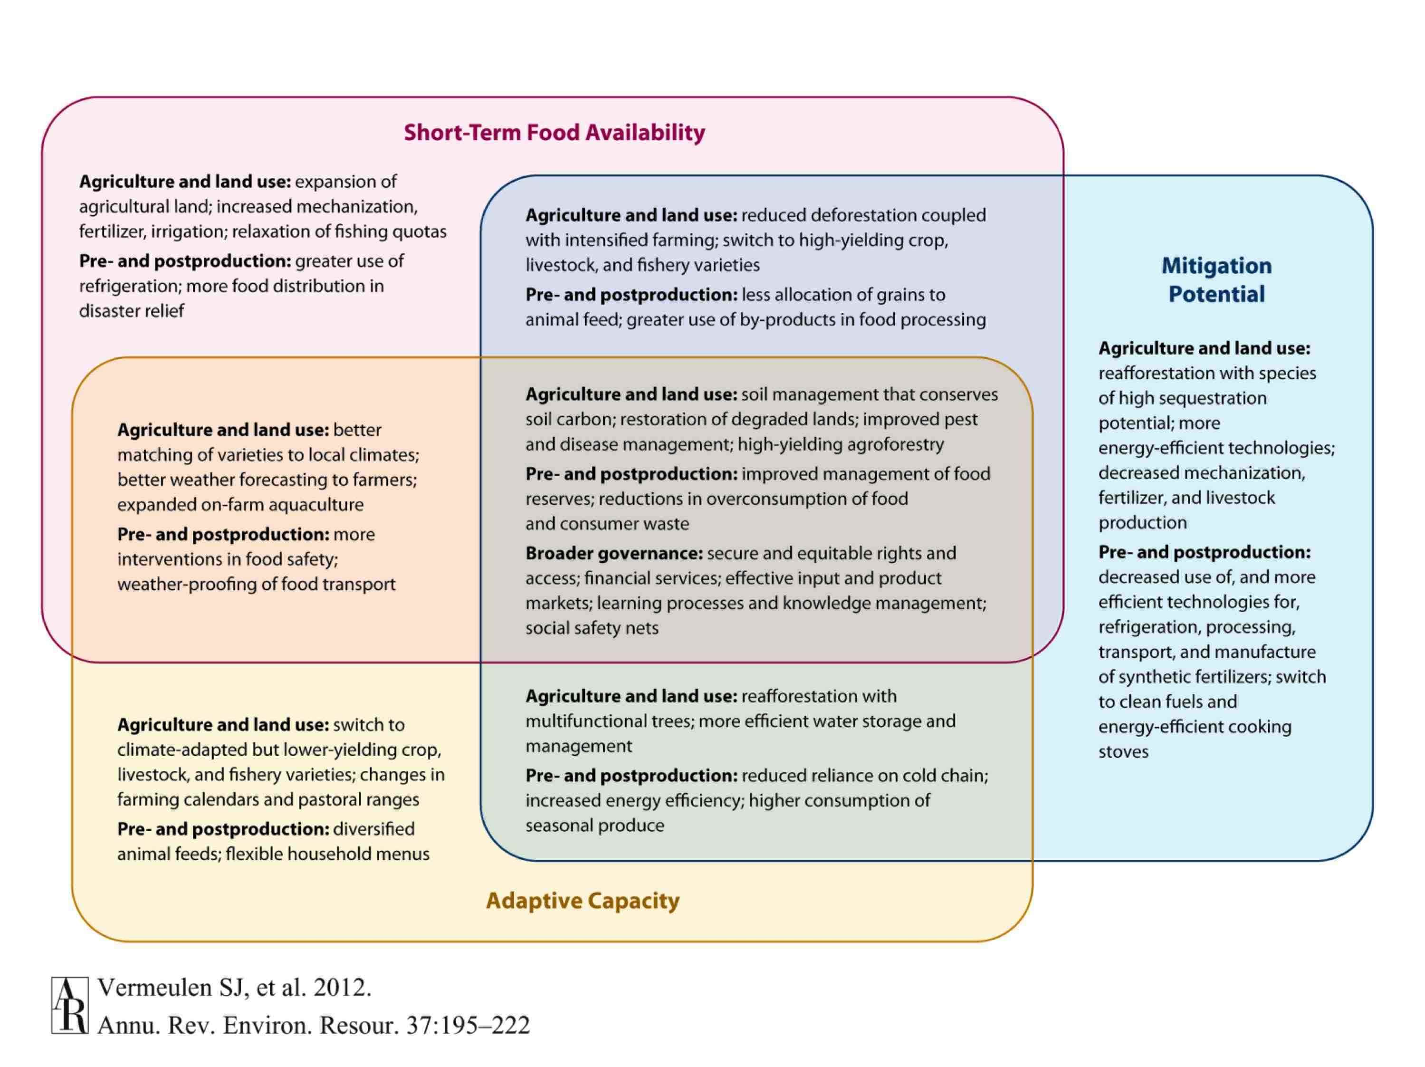
Synergies and trade-offs for adaptation, mitigation and food security

Slide 8
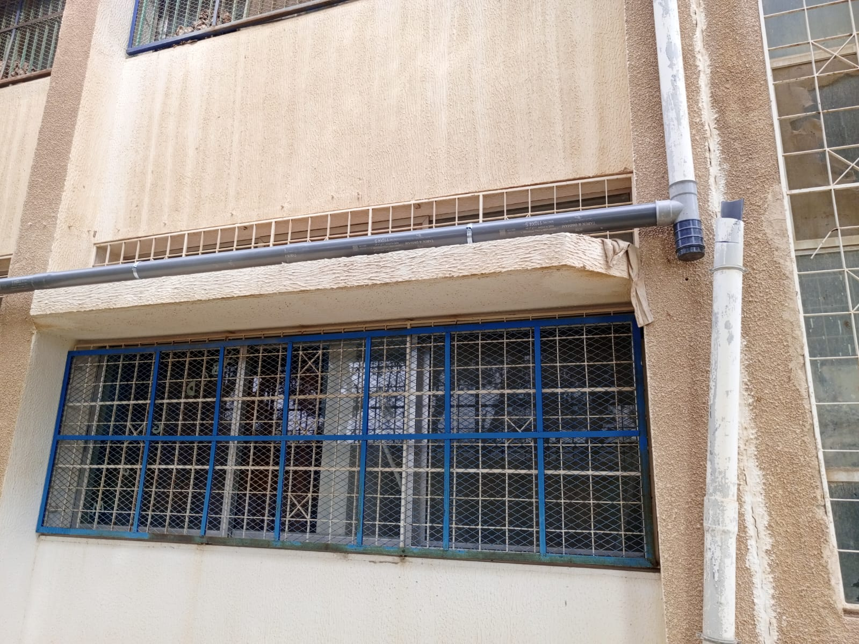
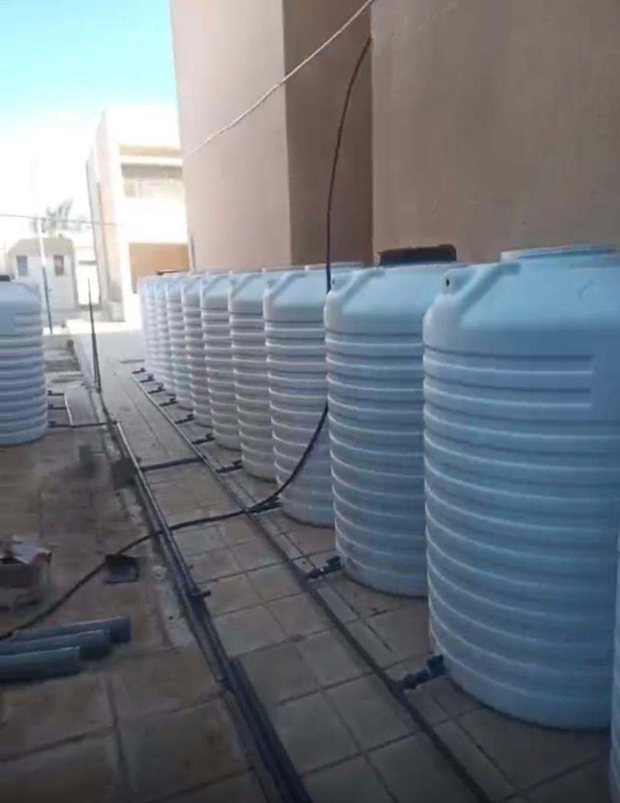
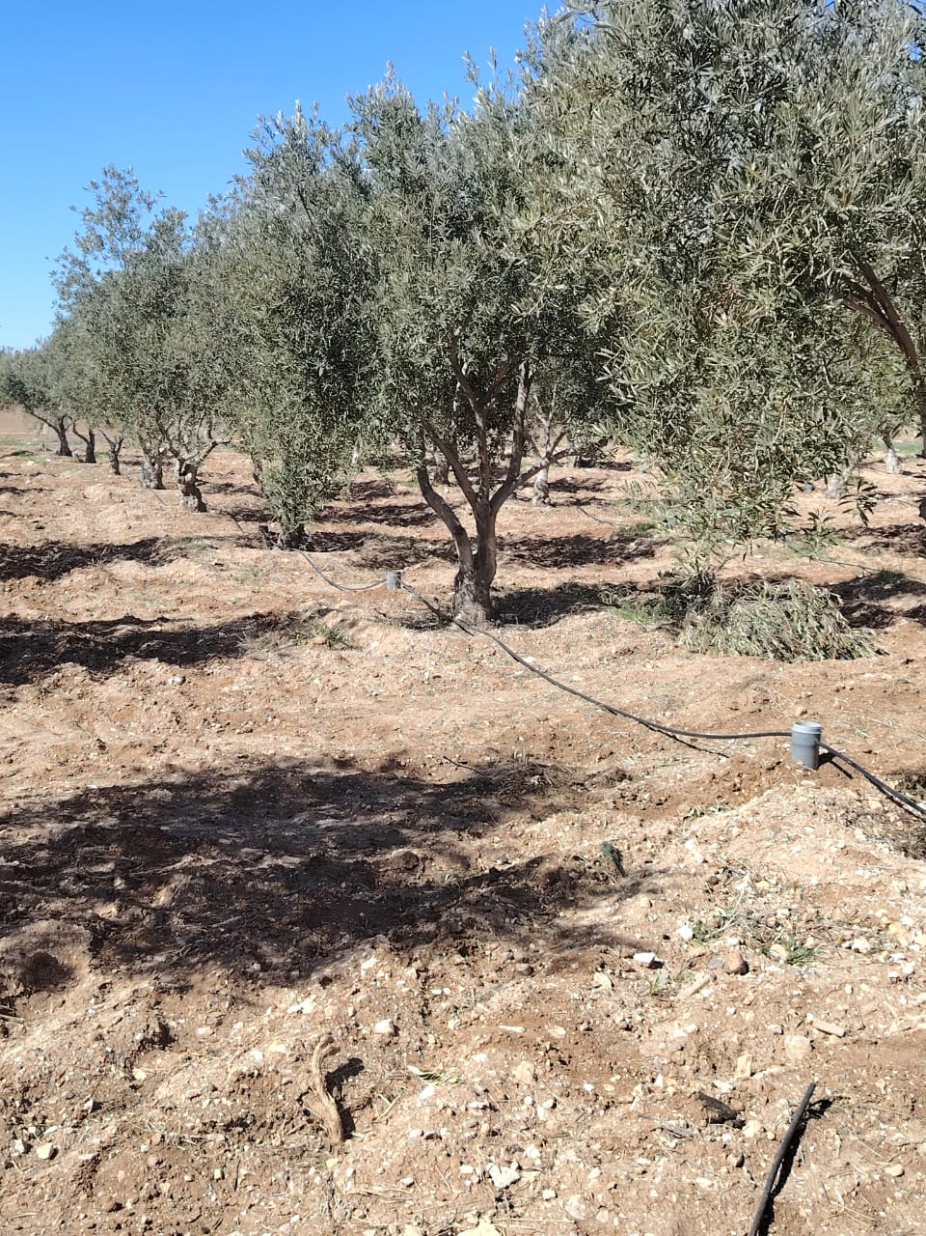
Climate Resilient Agriculture Interventions: BARAKA project
1. Zaid Bin AL Hussain Secondary Vocational School/Karak: Rainwater Harvesting connected with soil moisture sensors fully controlled with online platform linked with weather stations.
Rainwater harvesting from the rooftop

Slide 9
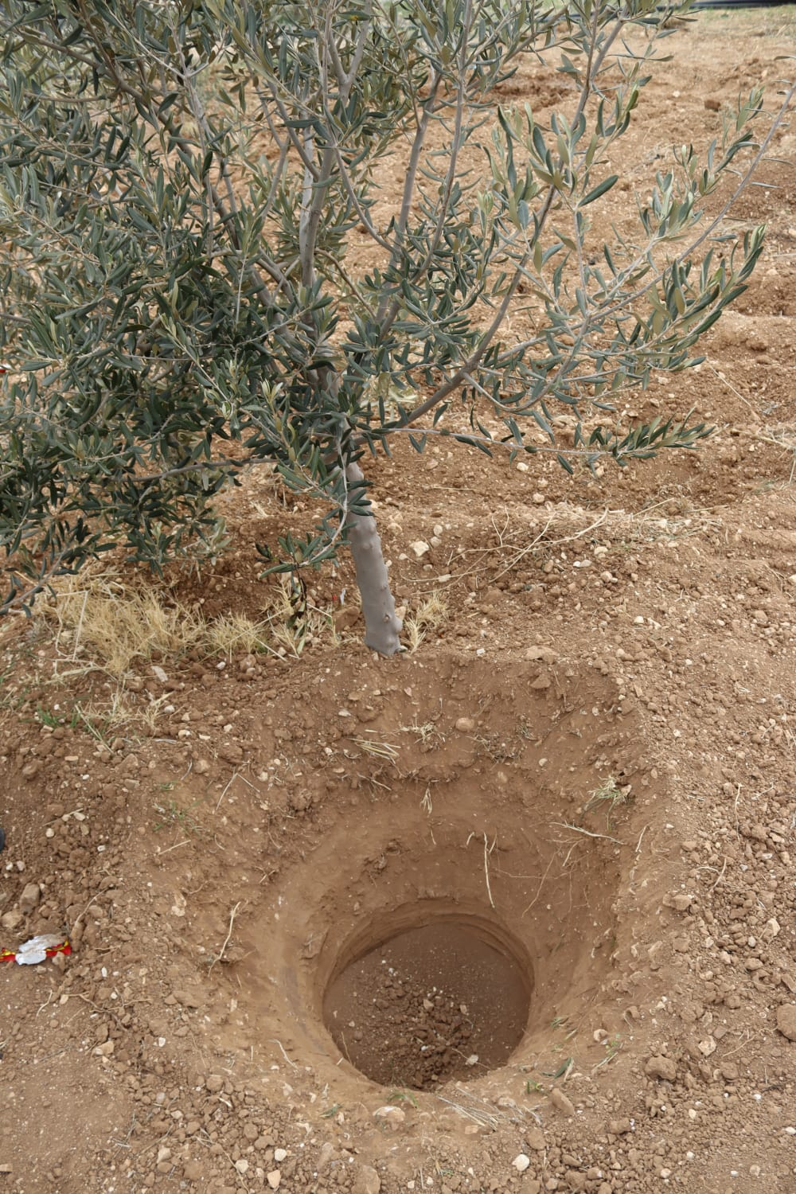
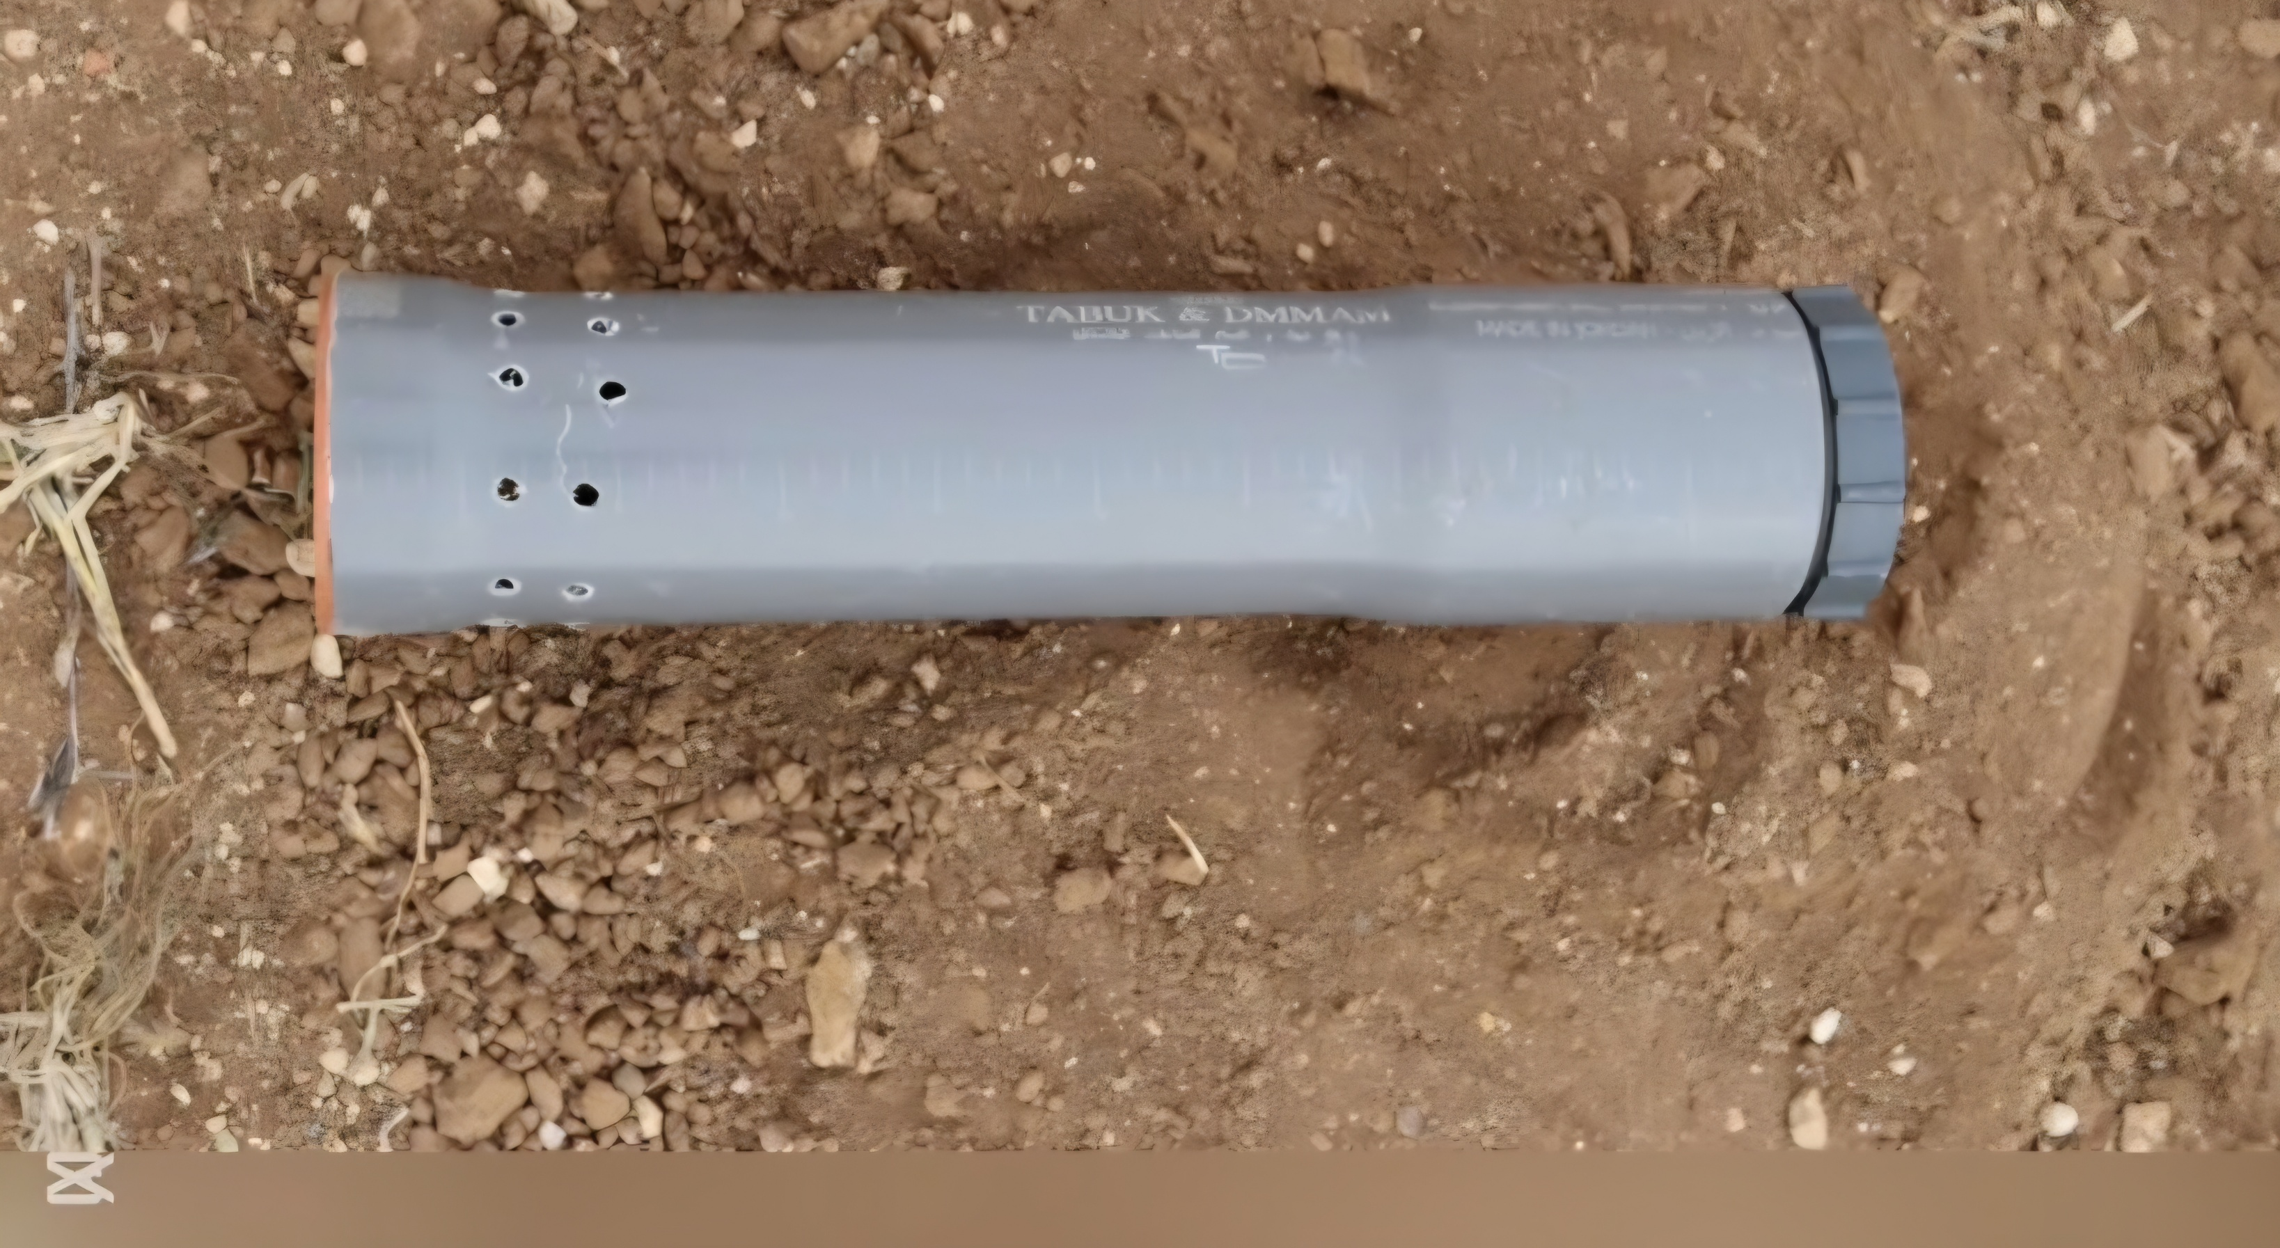
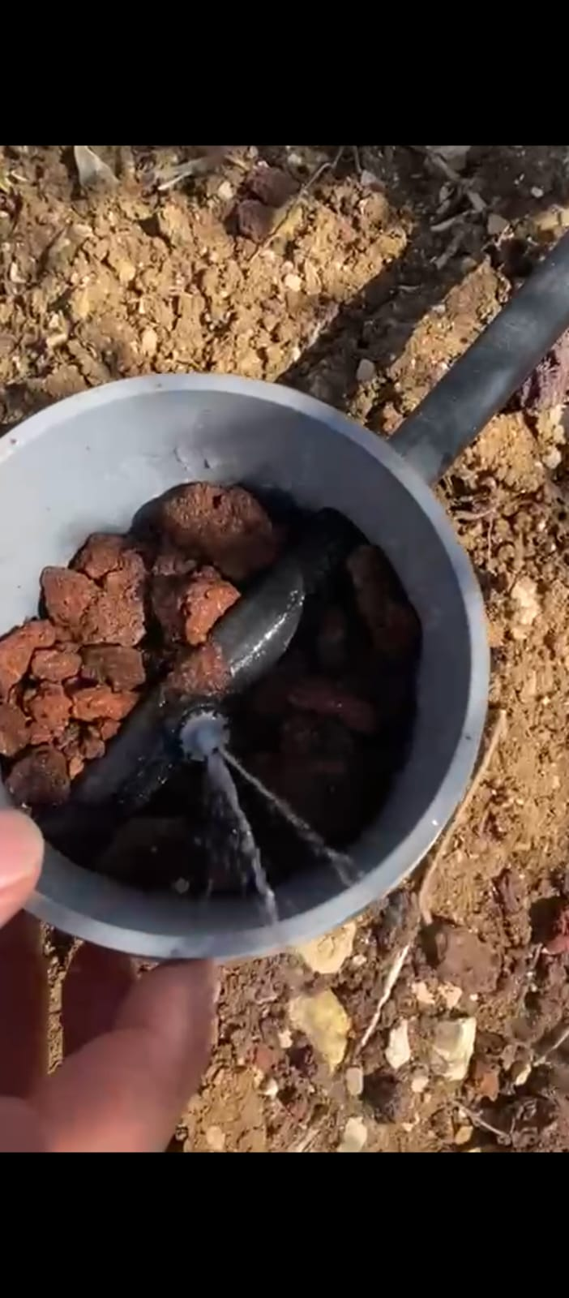
Deep irrigation technique

Slide 10
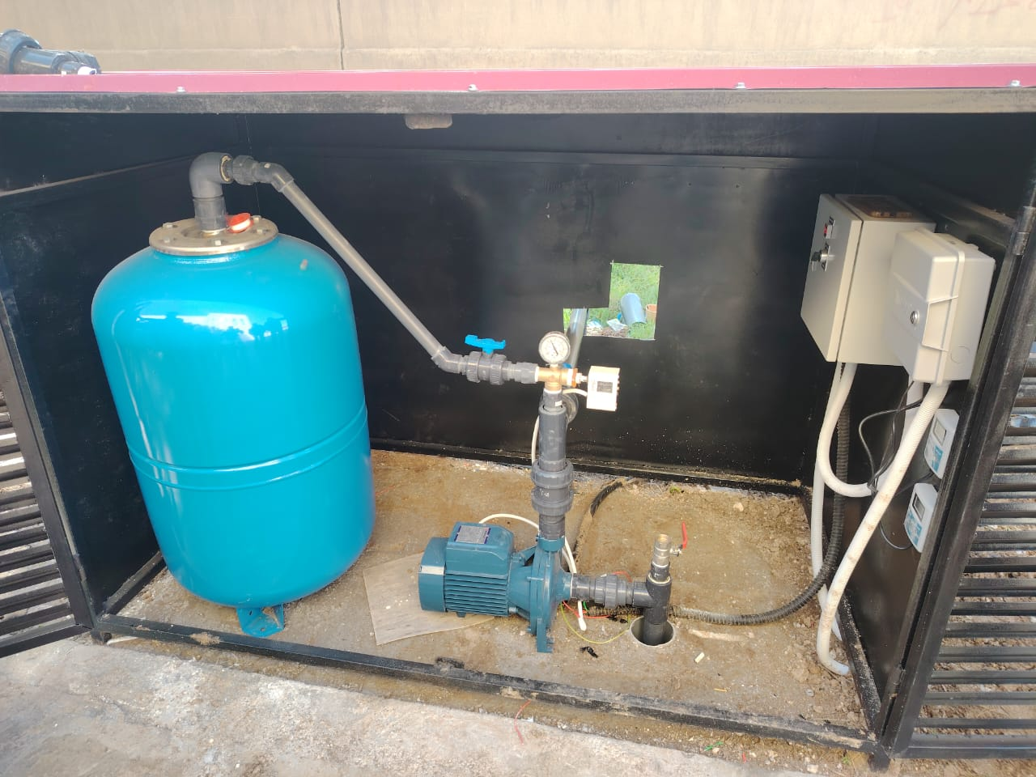
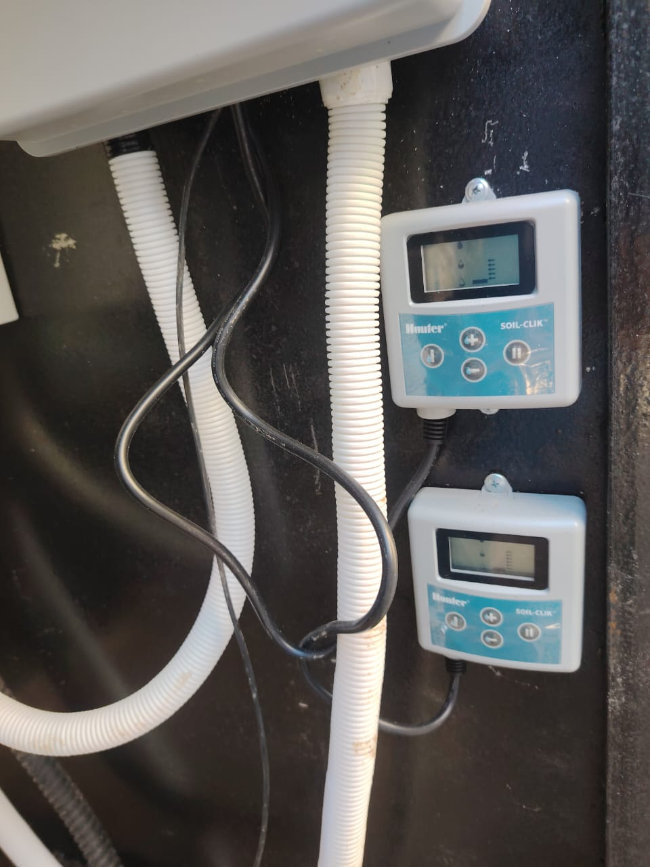
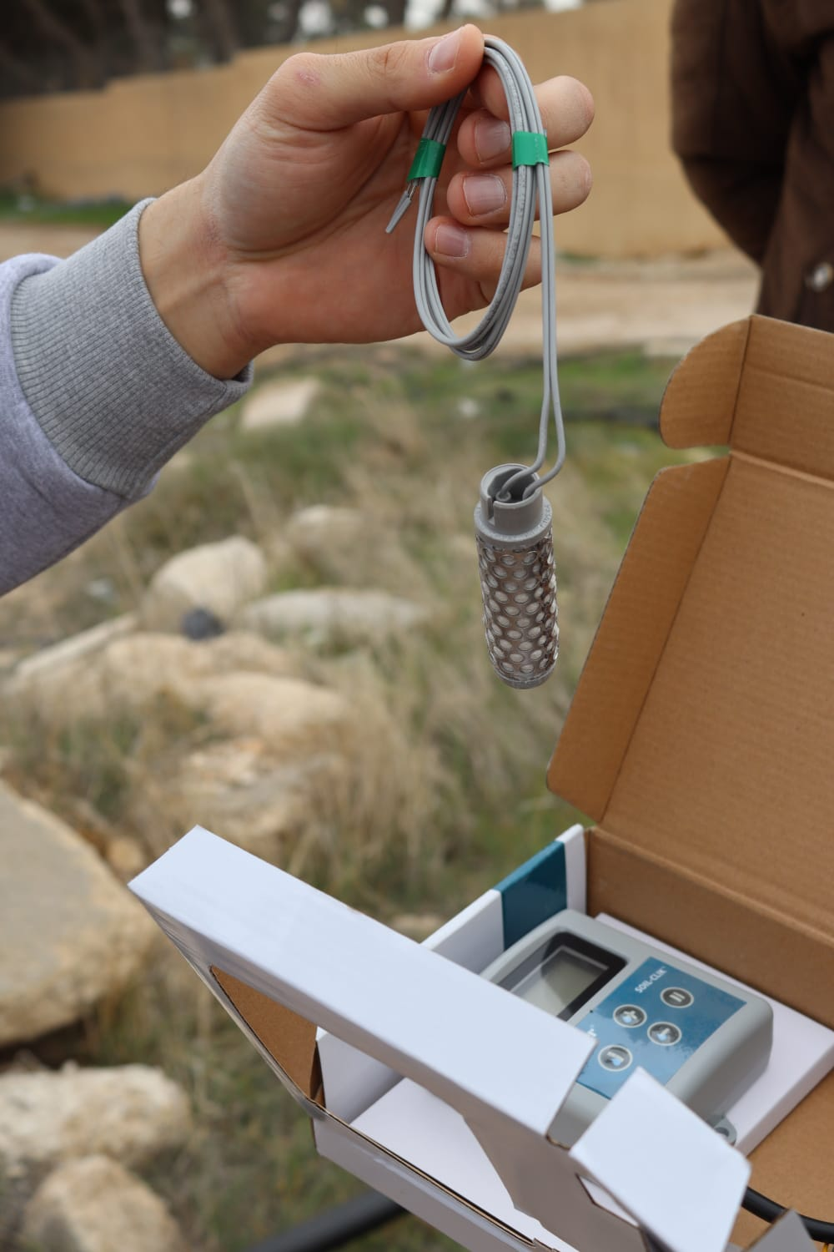
Digital sensors connected with controller

Slide 11
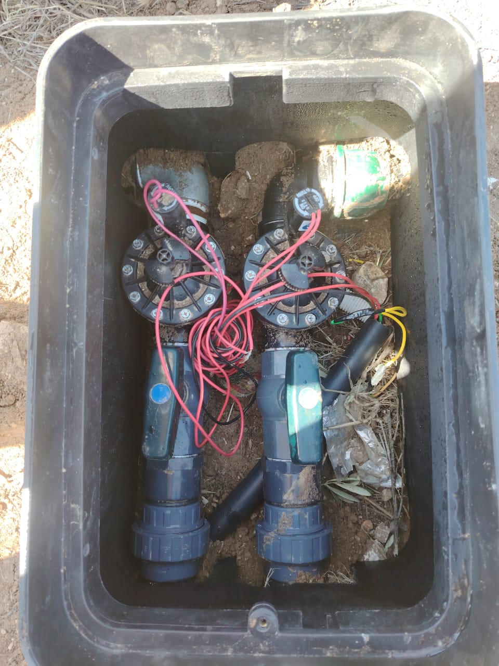
Solenoide Valves connected with the drip irrigation network

Slide 12
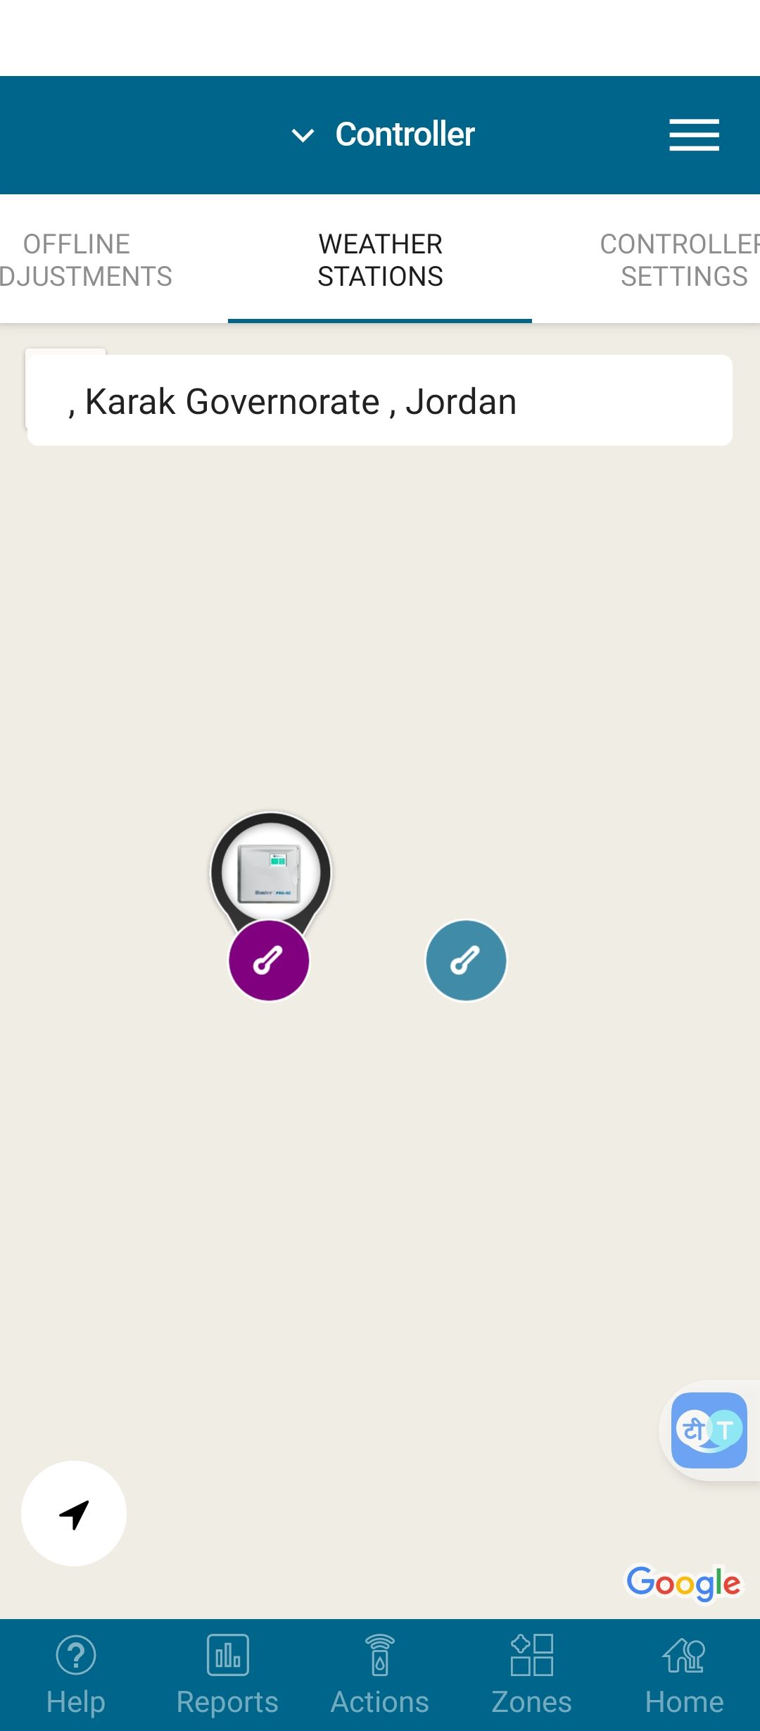
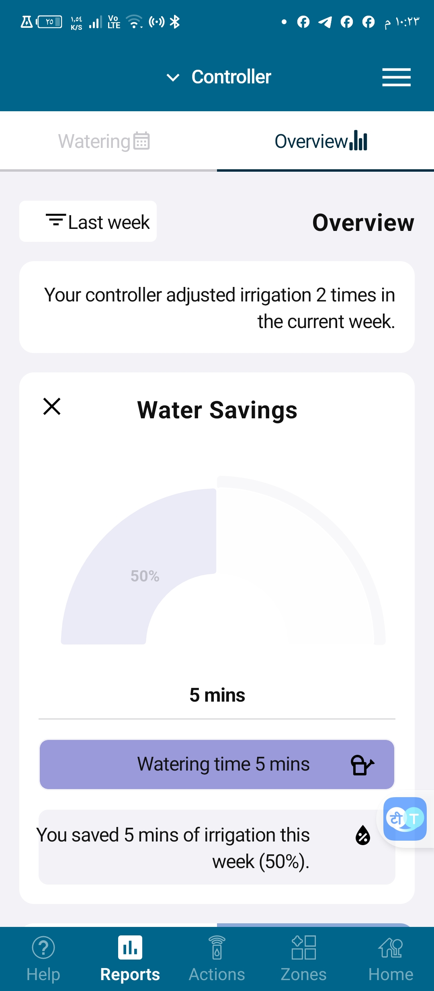
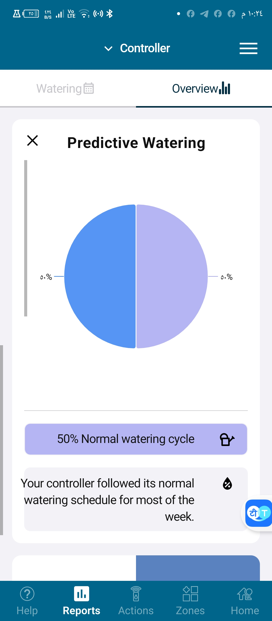
Mobile application on-line controller

Slide 13
The logical statement of the system:
The irrigation schedule is programmed based on time intervals.
If the scheduled irrigation time arrives but the sensors detect sufficient soil moisture, the pump remains off.
If it's time to irrigate Plot A, but the sensors indicate that Plot B is drier, the controller automatically prioritizes irrigating Plot B instead.
If the irrigation time coincides with a signal indicating that rain is expected soon, the entire system remains shut down.

Slide 14
2. Hydroponic and Aquaculture for persons with disabilities
This intervention is being implemented in collaboration with Orient Spirit Development for Adults Centre – Amman.
Hydroponics and aquaculture present structured, therapeutic, and engaging platforms for vocational training tailored to persons with mental disabilities.
These systems involve repetitive, hands-on tasks—such as planting, feeding, monitoring, and harvesting—which help improve focus, coordination, and responsibility in a calm and supportive environment.
Hydroponics allows individuals to grow plants without soil, while aquaculture involves raising fish in controlled environments. Both systems can be scaled and simplified to match varying ability levels, fostering a sense of achievement and independence.

Slide 15
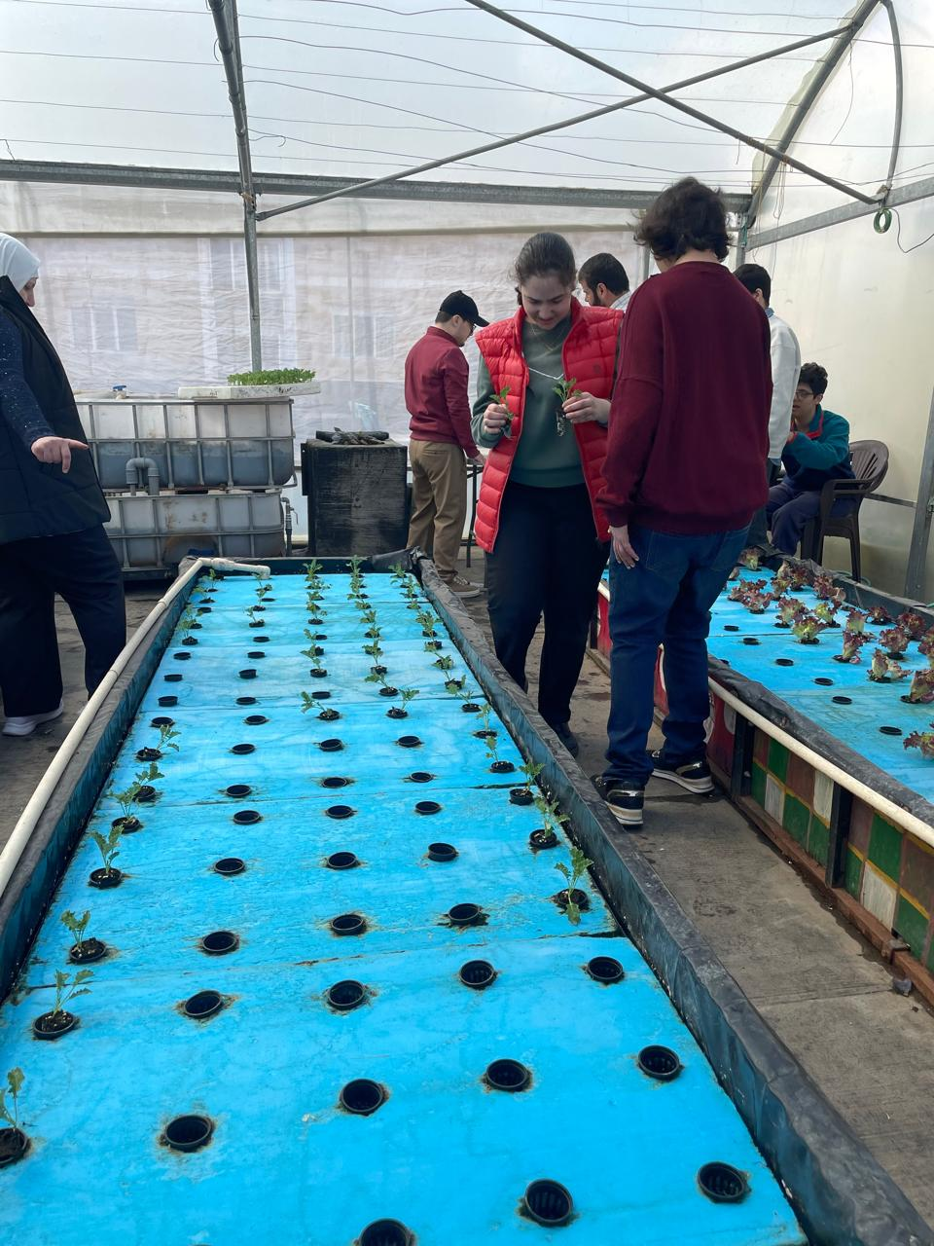
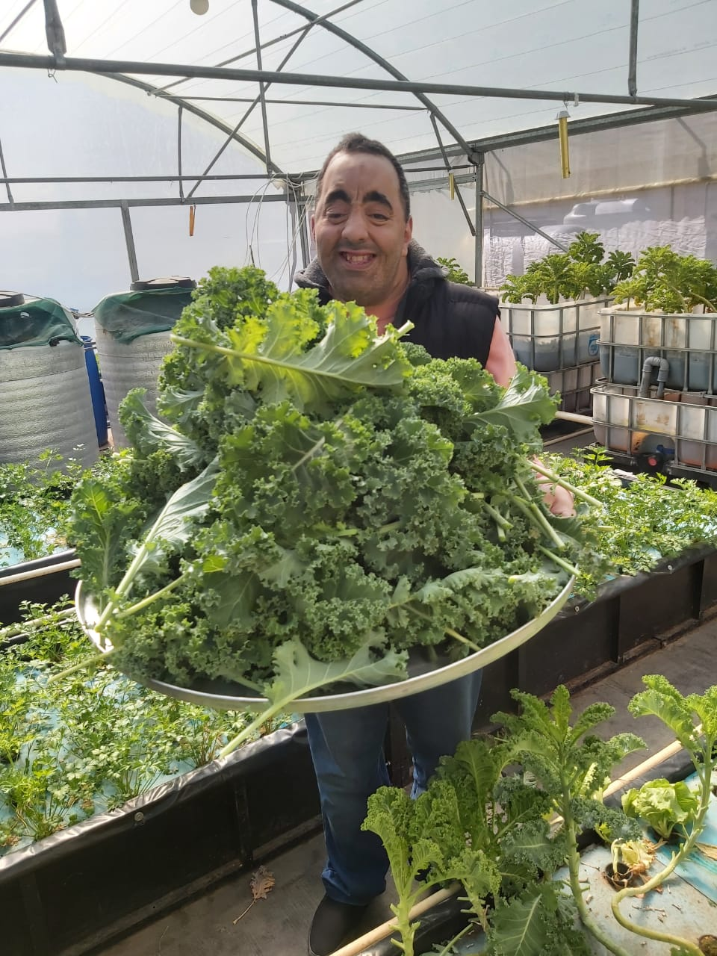
Photos credit: Phelastine Awad, 2025
Photos credit: Phelastine Awad, 2025
Hydroponic and Aquaculture systems at the rooftop of the center – operated and maintained by persons with disabilities

Slide 16
3. Vertical Farming with LED light*
This project advances Controlled Environment Agriculture (CEA) in Jordan to enhance food security, resource efficiency, and climate resilience; It focuses on:
Minimizing water and energy use through hydroponics and solar-powered systems.
Implementing IoT-driven automation to optimize environmental conditions and crop yields.
Providing real-time cultivation data via a mobile application for farmers and stakeholders.
Controlled Environment Agriculture (CEA) for Enhanced WEFE Nexus Performance, Royal Scientific Society , University of Plymouth, University of Oxford, University of West London, funded by RaEng, 2024-2025.

Slide 17
This project integrates Controlled Environment Agriculture (CEA) with IoT, automation, and renewable energy to optimize water use, energy efficiency, and crop production.
System Setup: A vertical farming unit powered by solar and grid energy with IoT sensors (pH, EC, temperature, humidity, CO₂, light intensity) for real-time monitoring.
Data Collection & Optimization: AI-driven sensor data analysis to enhance water efficiency, energy use, and plant health through machine learning models.
Hydroponic Cultivation: Nutrient film technique (NFT) hydroponics reducing water use by 90%, with automated nutrient and climate adjustments.
Impact Assessment: Measuring water and energy productivity, crop yield efficiency, and carbon footprint reduction for scalability and adoption.
Dissemination: Findings shared via workshops, publications, and stakeholder engagement to promote sustainable agriculture solutions.
This data-driven approach enhances resource efficiency, food security, and climate resilience in arid regions.

Slide 18
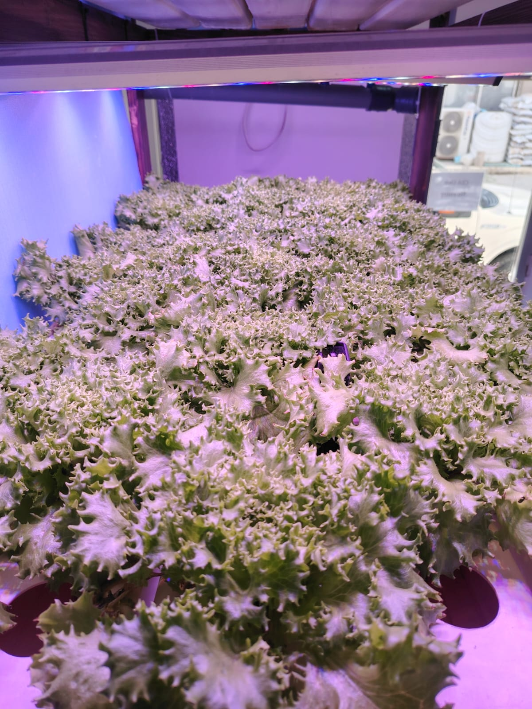
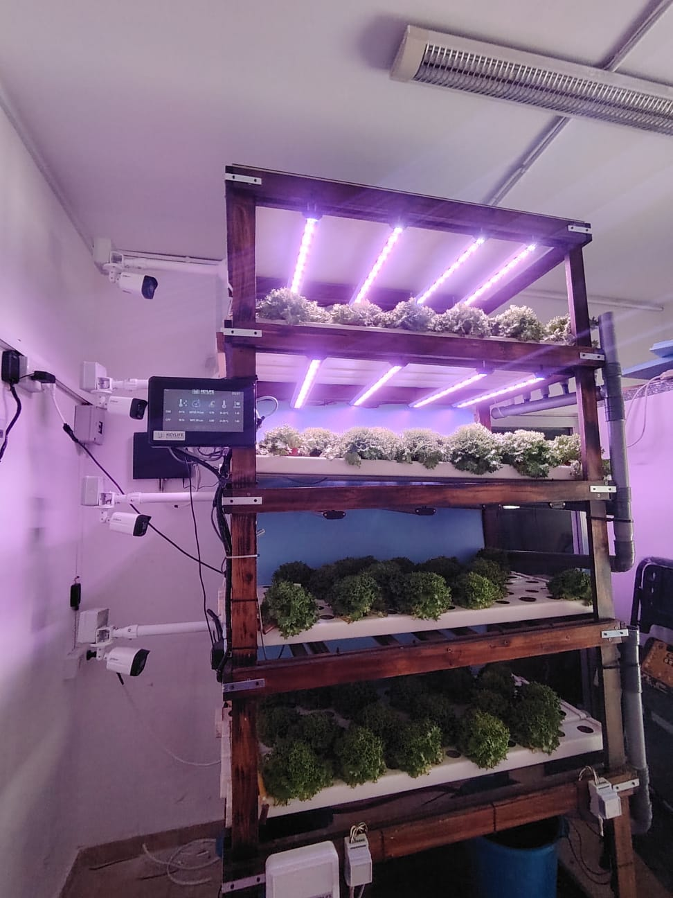
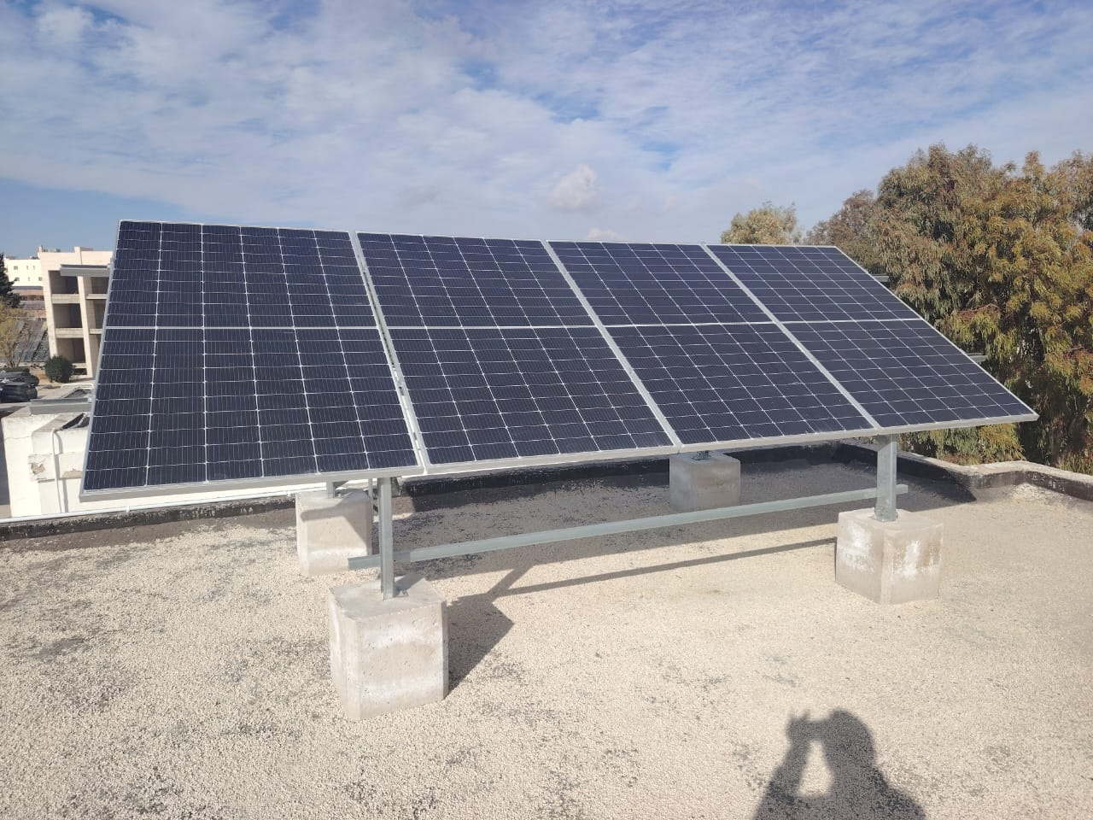

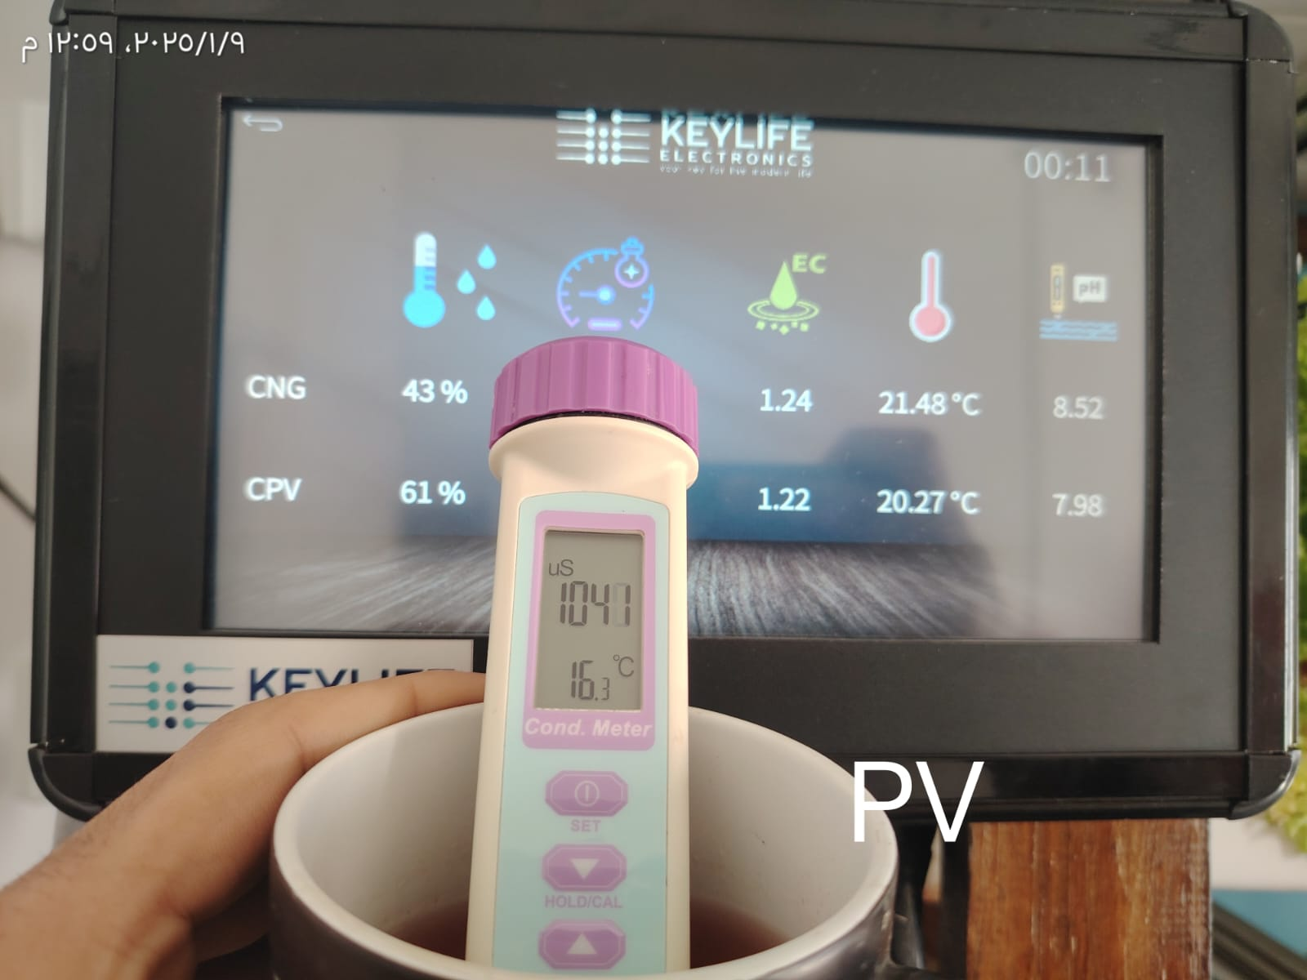

CEA unit with IoT sensors

Slide 19
The End

