Slide 1


Local knowledge and co-learning for Sustaining small-scale water systems 3SWater
Assela Pathirana

Slide 2
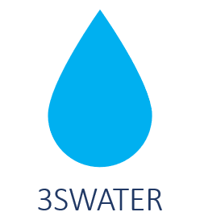
3S Water Project
INVESTIGATE CURRENT SITUATION
PILOTS AND MONITORING
CAPACITY DEVELOPMENT
CITIZEN SCIENCE
HIGHER EDUCATION
Social surveys
Physical/chemical state of (ground) water
Modelling studies
Household level infiltration pits
Impact monitoring
Scenarios (with models)
Water safety plan training
Share insights between Maldives and Jordan
Citizens & Students monitor water quality
Citizen focused web-tools for design
MSc research in Maldives and Jordan
Volunteer researchers (MSc level) from Maldives and Region

Slide 3
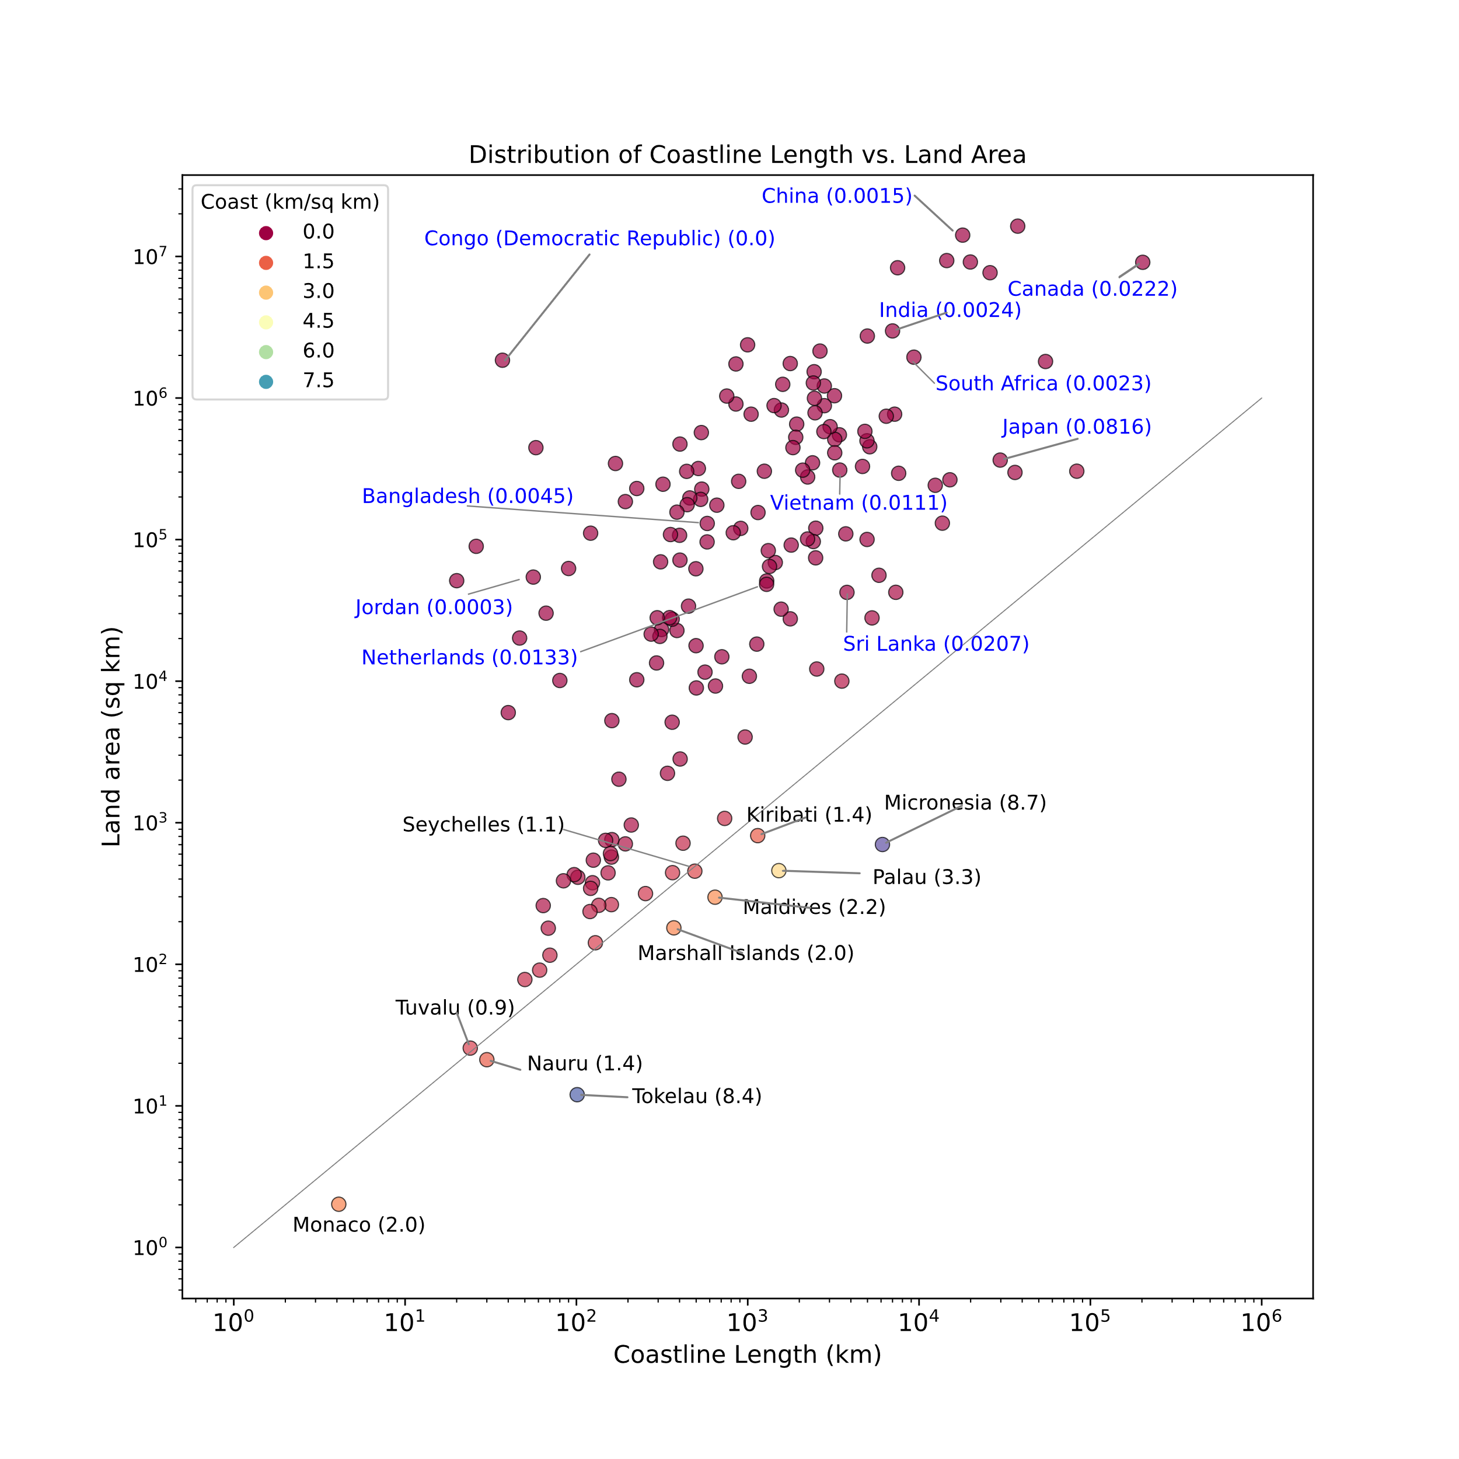
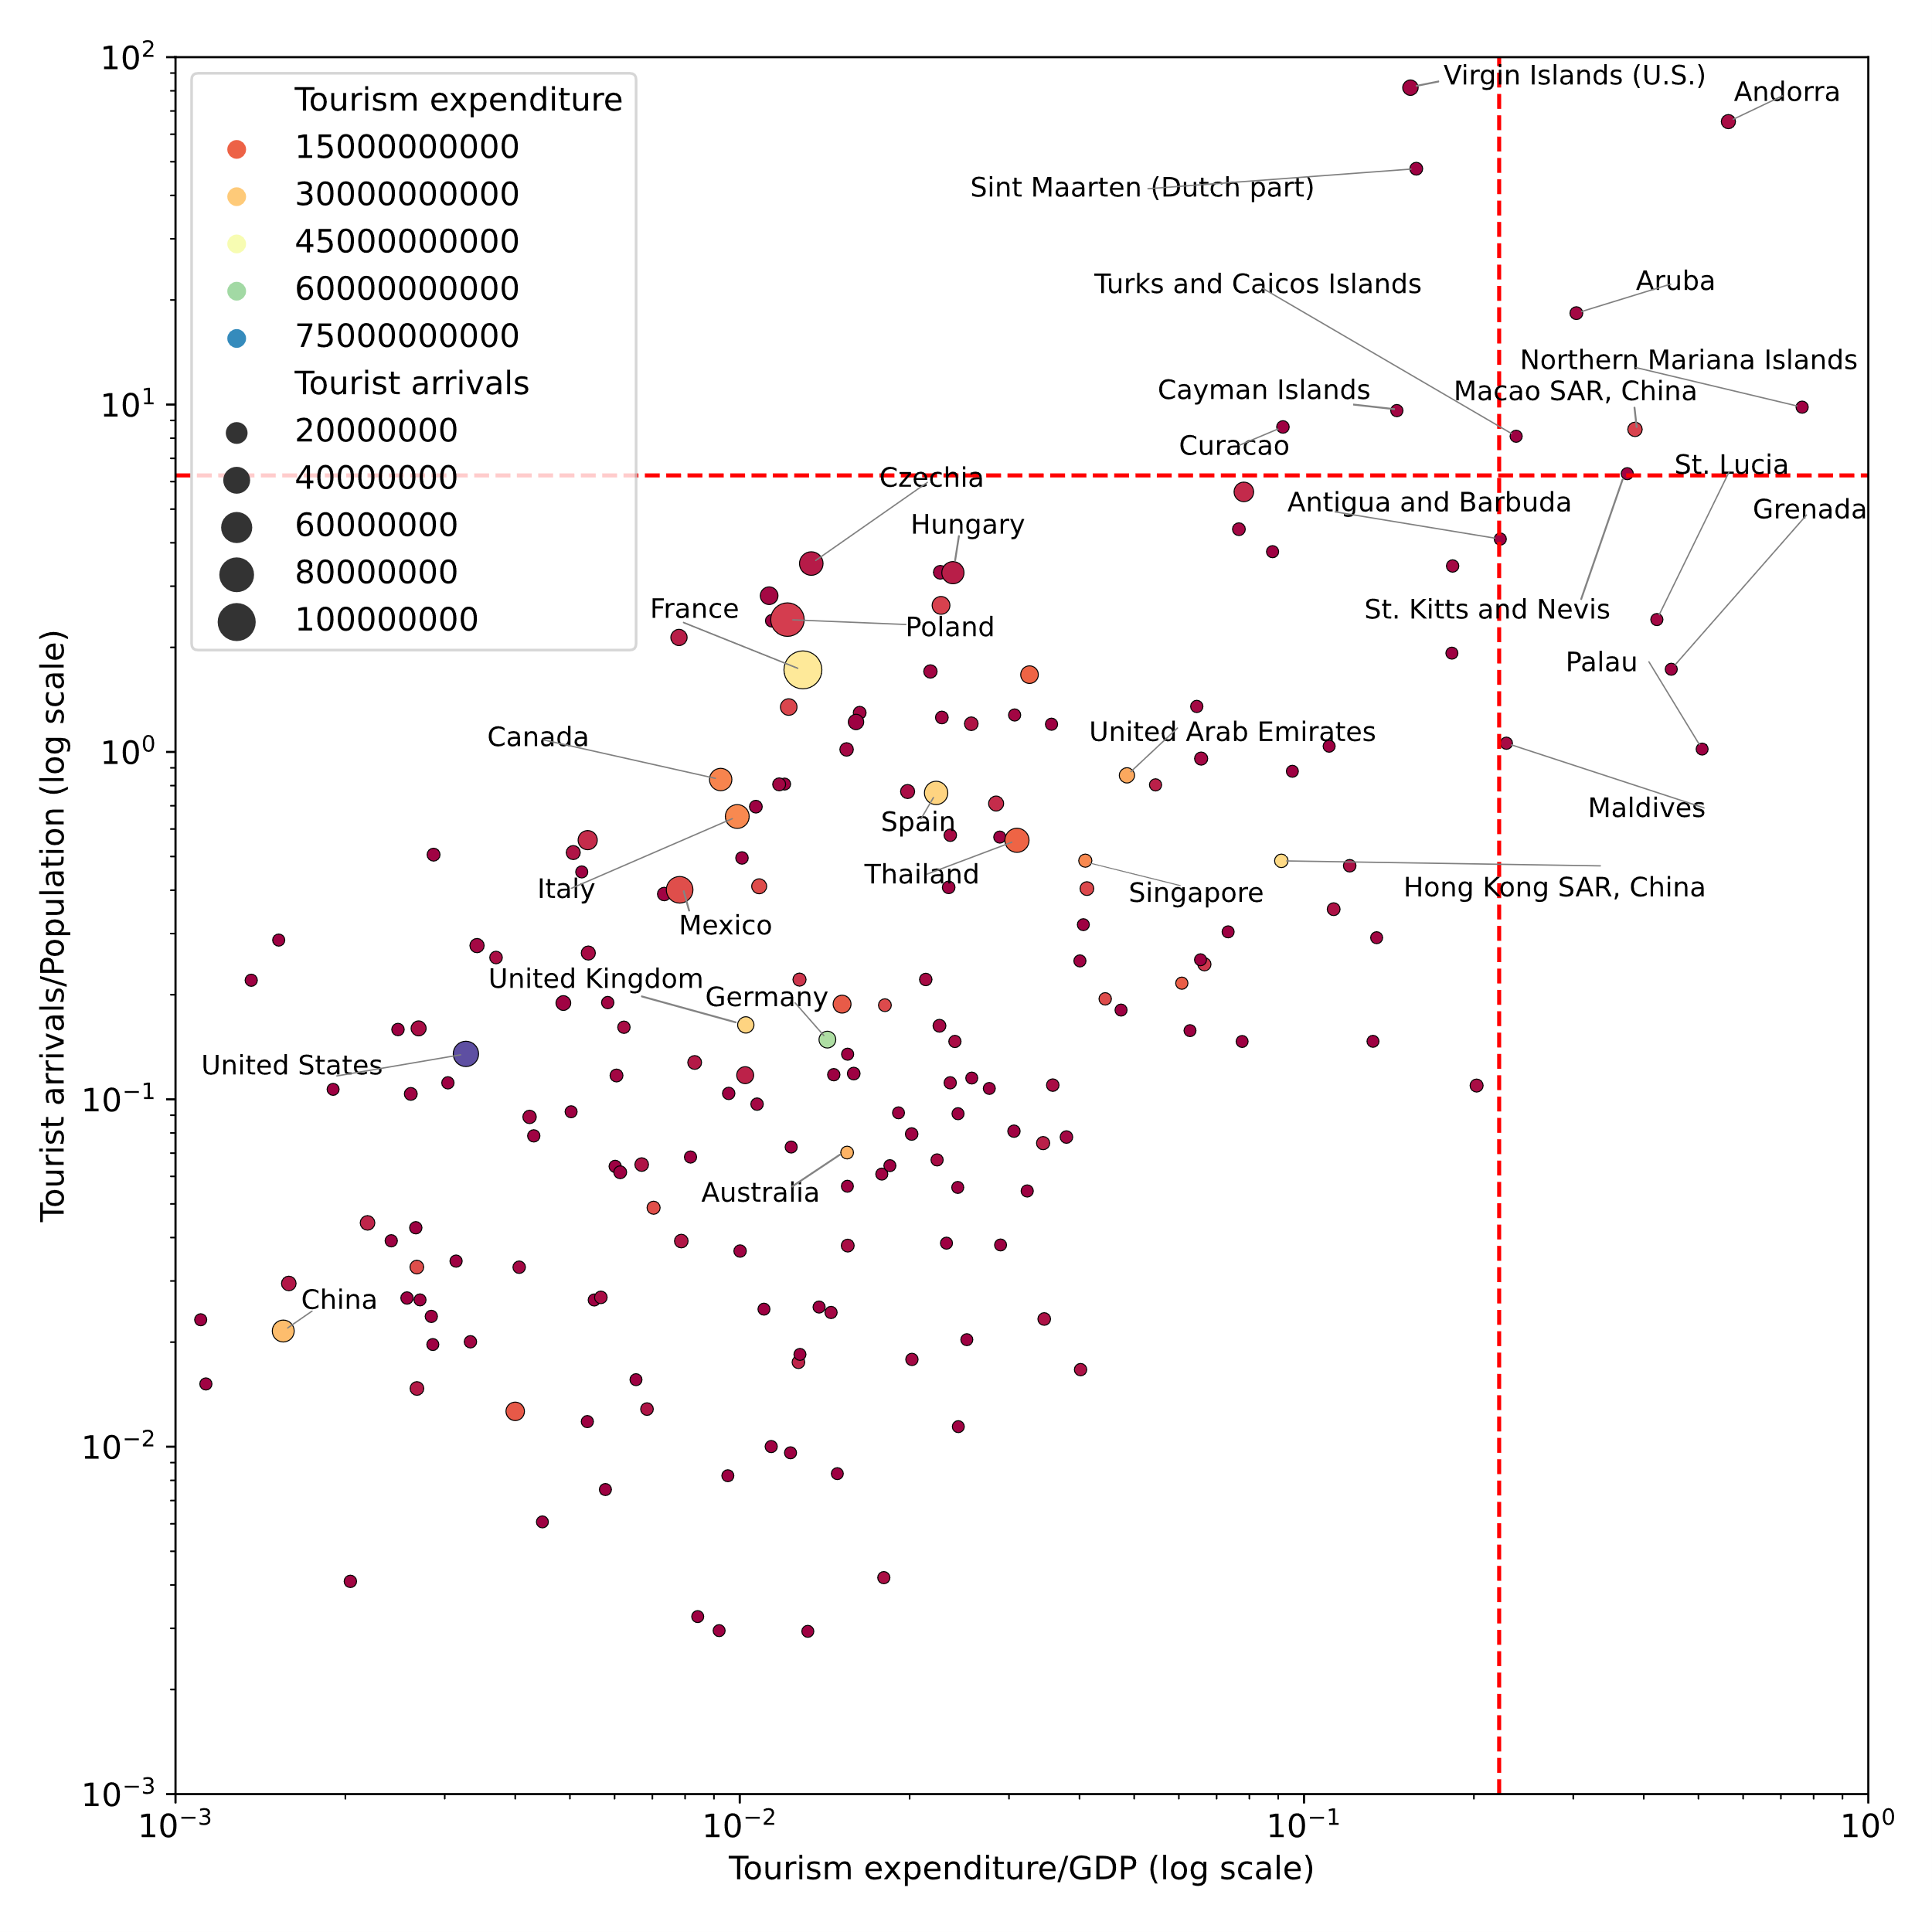
Vulnerability of Small Islands
Images: Pathirana, A., Small Islands: Living Laboratories Revealing Global Climate and Sustainable Development Challenges, Frontiers in Sustainable Cities, 2024 [In press]. All rights reserved 2024-25.
Notes:
Left: : Some small island states have extremely small land area per km of coast length. This makes them, exceptionally sensitive to the changes in the ocean (e.g. sea level rise). Several selected other nations are labelled for comparison. There are ten nations with less than 1 km², of land per km of coastline: Micronesia, Palau, Kiribati, Maldives, Seychelles, Marshall Islands, Tokelau, Nauru, Tuvalu and Monaco. Data source: CityPopulation (2023). Note: Some of the non-independent territories that are not states have been removed.
Right : Tourism expenditure and arrivals. X axis is the ratio of tourism expenditure to GDP. Y axis is annual tourist arrival as a fraction of the population. Dotted lines represent the 95% percentile. Countries that are above at least one of those 95% lines or above the 95% percentile of tourism expenditure or annual arrivals are labelled. Countries with the highest total Tourism expenditure are Australia, China, France, Germany, Hong Kong SAR (China), Italy, Singapore, Spain, the United Arab Emirates, the United Kingdom, and the United States. Those with the highest total Tourism arrivals are Canada, China, Czechia, France, Hungary, Italy, Mexico, Poland, Spain, Thailand, and the United States. But the ratios of these to GDP and population tell a very different story: Countries with both a high Tourism expenditure to GDP ratio and a high ratio of Tourist arrivals to Population include Andorra, Aruba, Macao SAR (China), Northern Mariana Islands, St. Kitts and Nevis, and Turks and Caicos Islands. If we look at one of those conditions then the countries Antigua and Barbuda, Cayman Islands, Curacao, Grenada, Maldives, Palau, San Marino, Sint Maarten (Dutch part), St. Lucia, and Virgin Islands (U.S.) will be added. Out of these 16, 13 are on the SIDS list (with the exception of Andorra, Macao SAR (China), and San Marino).

Slide 4
Islands are often on the planetary frontline of environmental change. Their long shorelines and specialised ecosystems are finely tuned and sensitive places, barometers for the Earth. They are advance indicators or extreme reproductions of what is future elsewhere
- Laura Watts
(2019, In Energy at the End of the World: An Orkney Islands Saga)

Slide 5
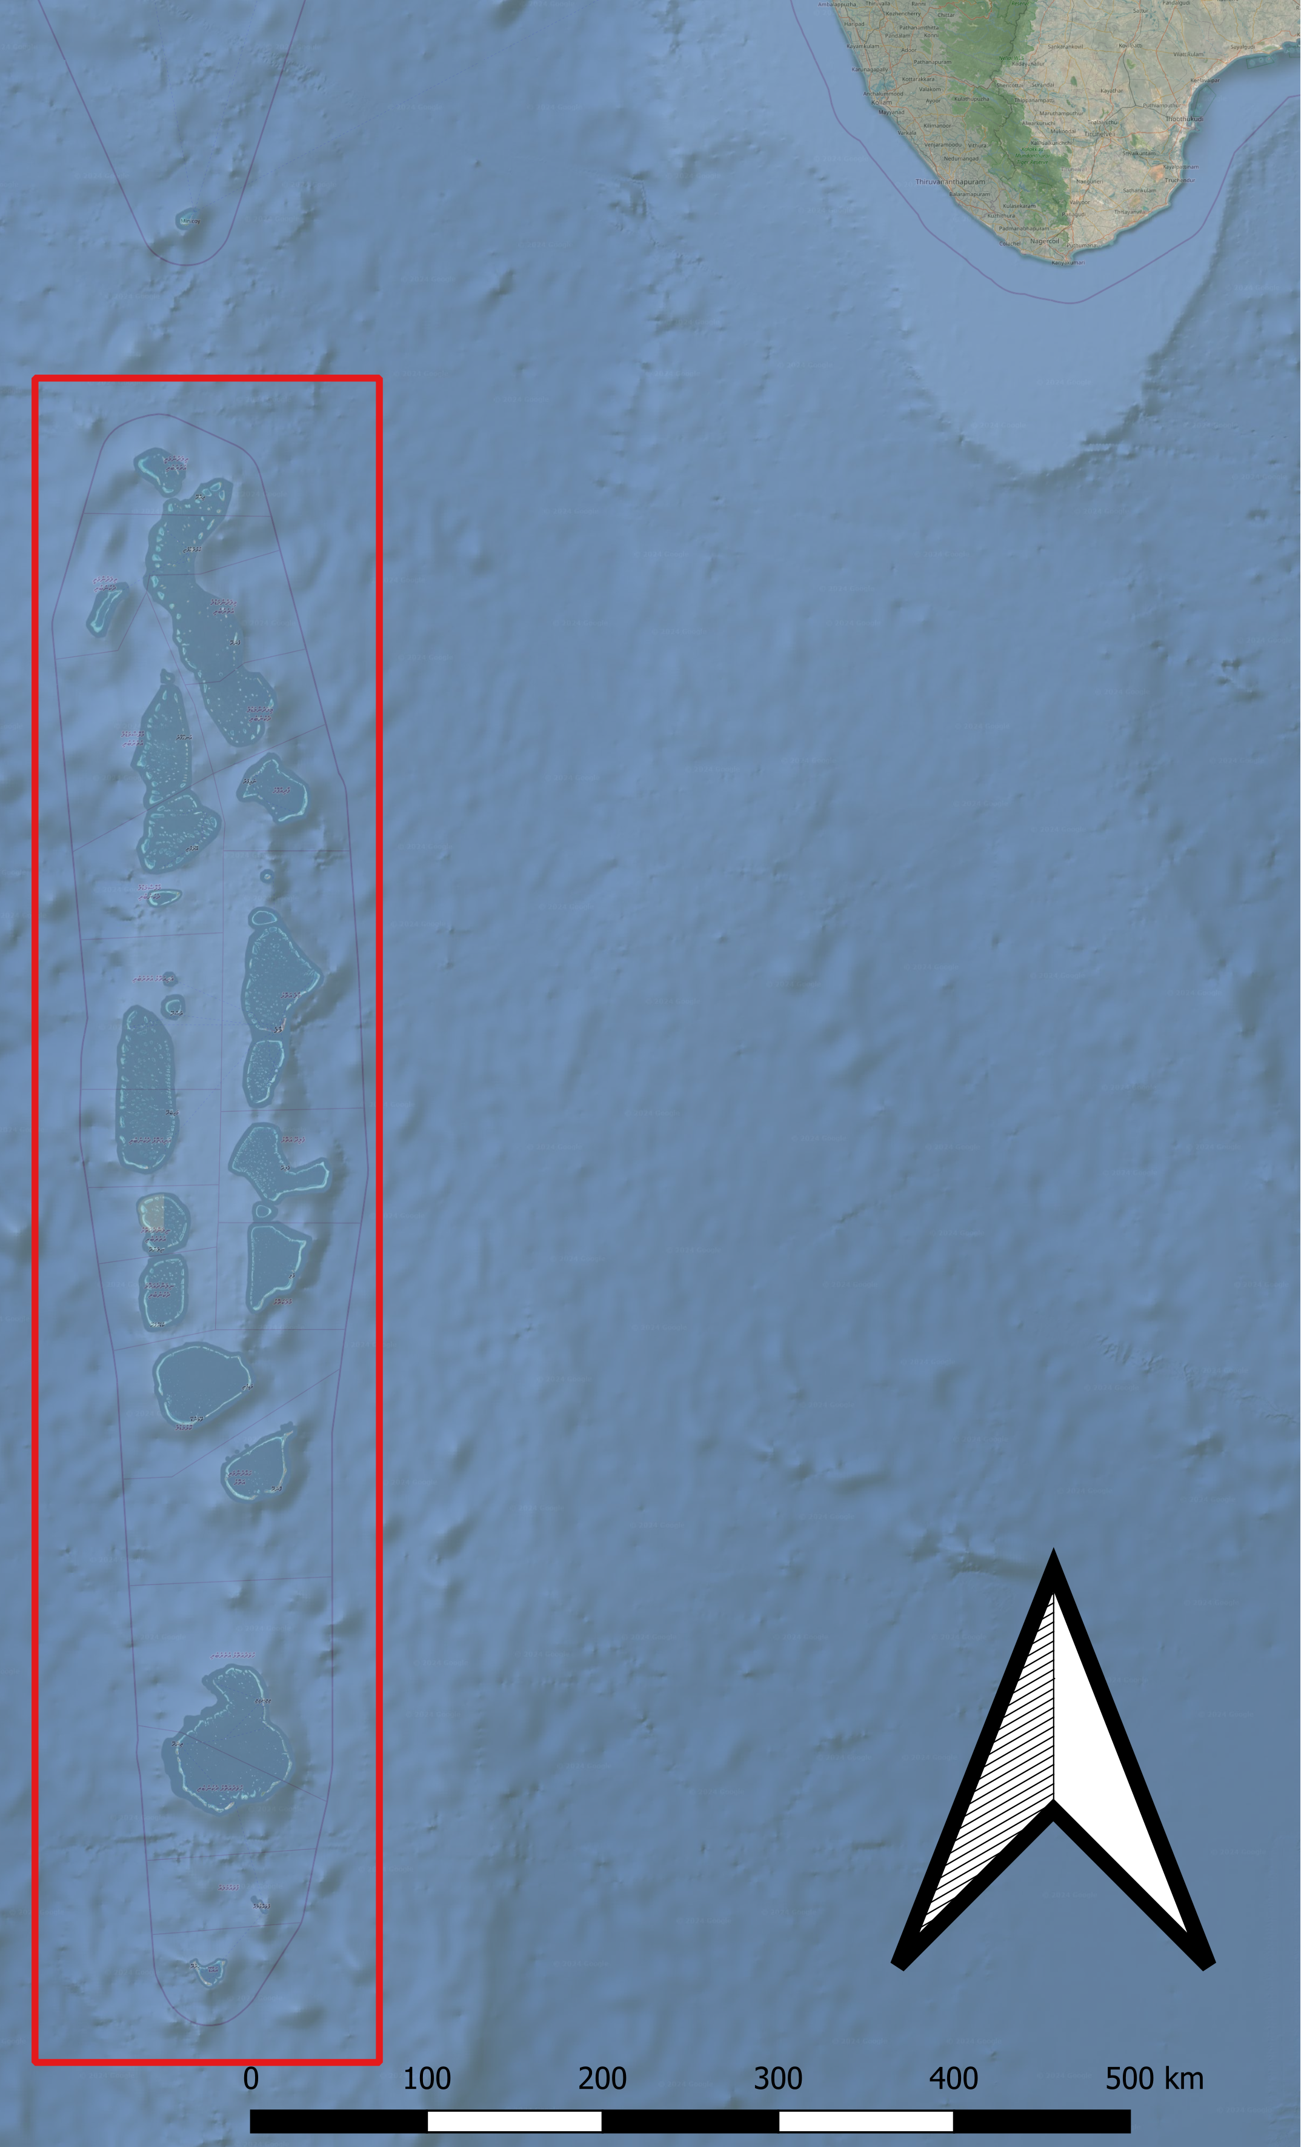
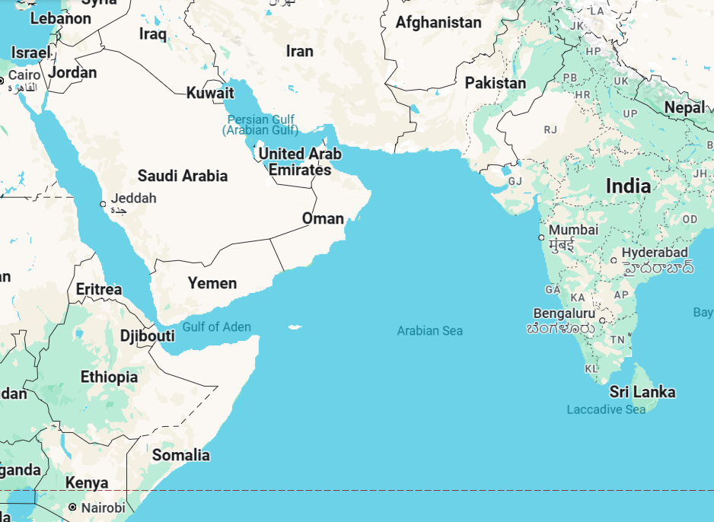
Maldives
Atoll areas are highlighted
Individual islands are too small to be seen!
Notes:
Look at the map of the Maldives shown on top left corner on this slide. Maldives consists of hundreds of small inhabited islands that are distributed over a vast ocean area in the Indian Ocean.

Slide 6
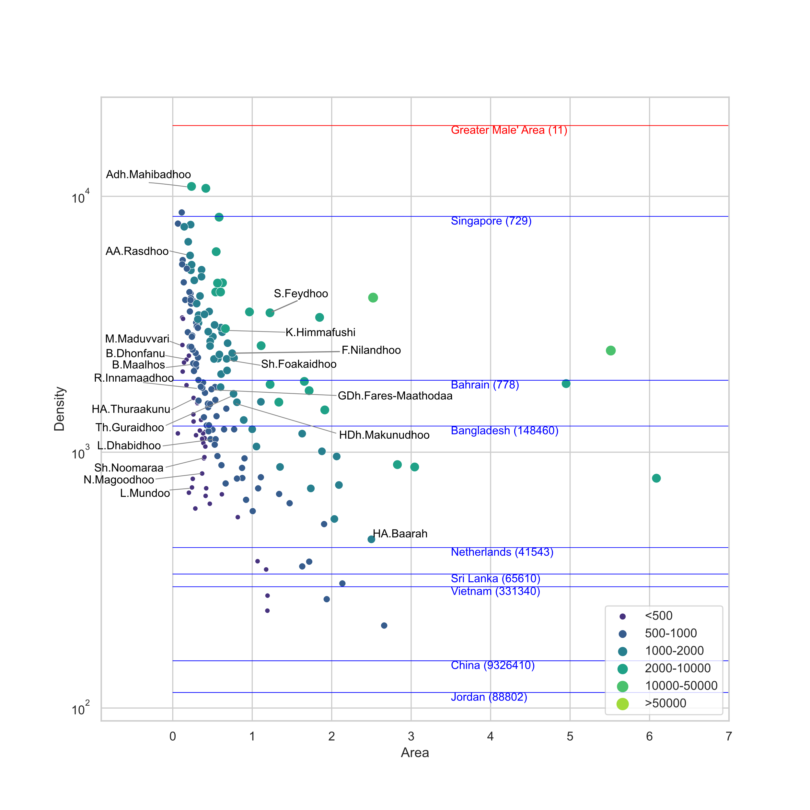
Maldives
– outer islands
Images: Pathirana, A., Small Islands: Living Laboratories Revealing Global Climate and Sustainable Development Challenges, Frontiers in Sustainable Cities, 2024 [In press]. All rights reserved 2024-25.
Notes:
Population density (#/sq. km) vs Area of Maldivian islands (dots). Population densities of selected countries are also shown in their Land area within parentheses. Out of inhabited 186 Maldivian islands, 142 have a population density higher than 1000 inhabitants/km². For clarity, only a few islands are annotated. The Greater Male’ Area – the capital – is shown as a red line. Population size categories are shown in the legend. There are 40 and 113 islands with less than 500 and 1000 inhabitants respectively and only 24 islands with populations greater than 2000. Data source: Census Maldives (2023).

Slide 7
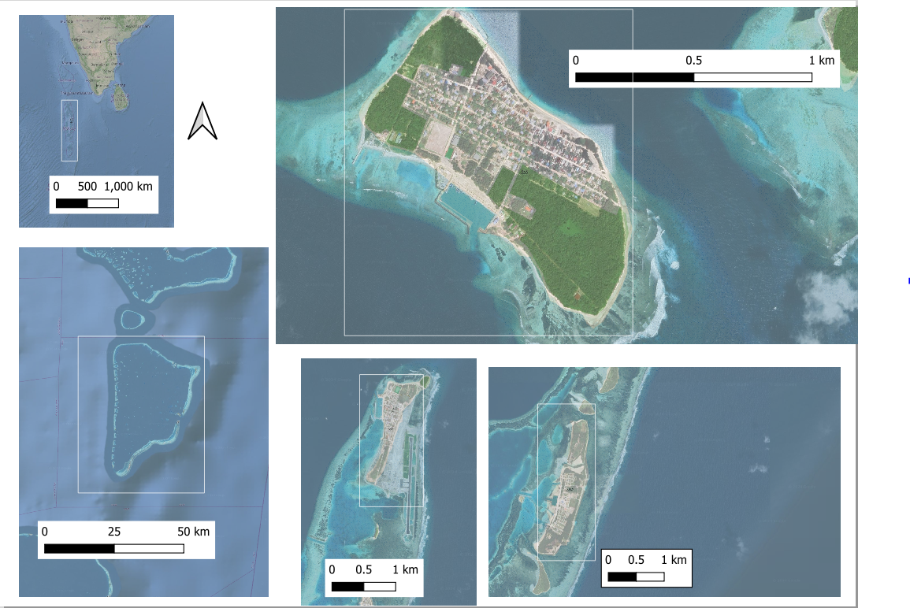
Maldives
Notes:
Look at the map of the Maldives shown on top left corner on this slide. Maldives consists of hundreds of small inhabited islands that are distributed over a vast ocean area in the Indian Ocean. Next look at the maps of the three islands on the right. Most of the outer islands in the Maldives are super small, but they are also densely populated.

Slide 8
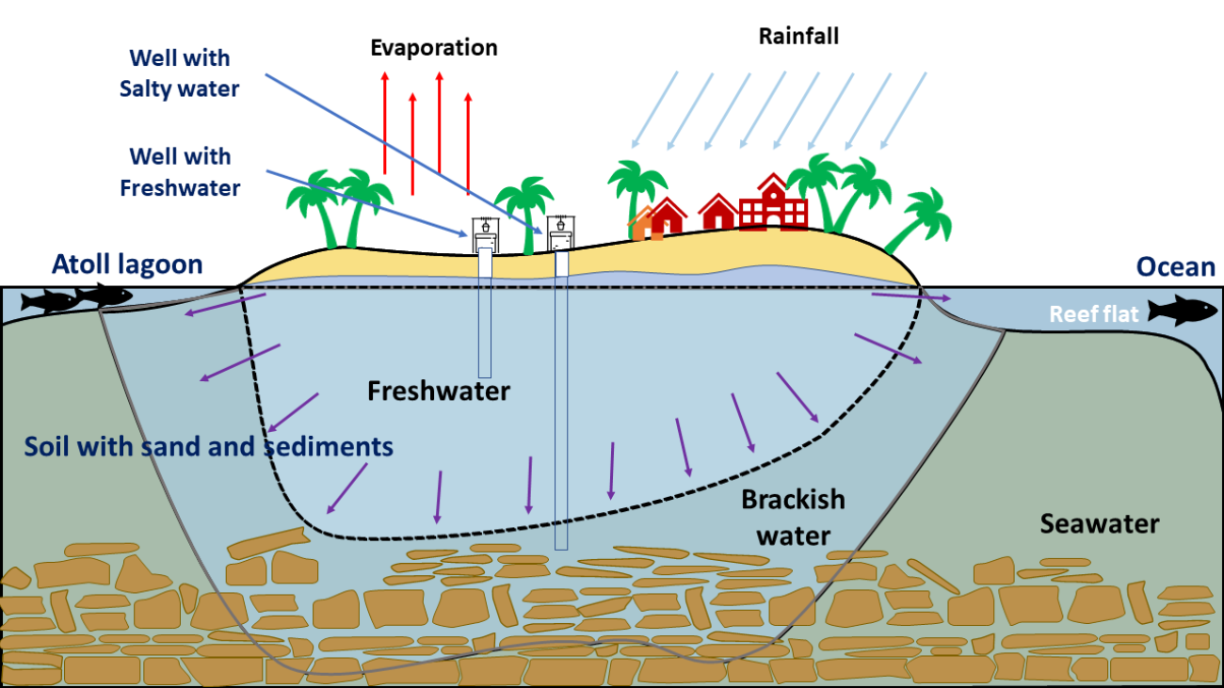
Water resources
Image: Jaleel MI, Ibrahim SA, Hussain A, Mustafa M, Pathirana A. A screening approach for assessing groundwater quality for consumption in small Islands: case study of 45 Inhabited Islands in the Maldives. Water. 2020 Aug 6;12(8):2209.

Slide 9
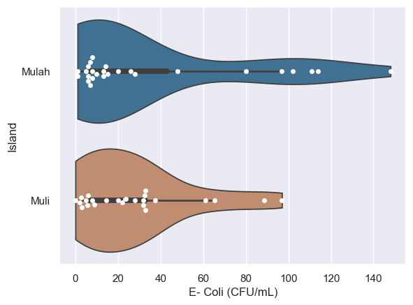
Pathogens in the ground water
WHO Classification | E- coli (CFU/100 mL)
Conformity | 0
Low risk | <10
Intermediate risk | 10 – 100
High risk | 101 – 1000
Very high risk | >1000

Slide 10
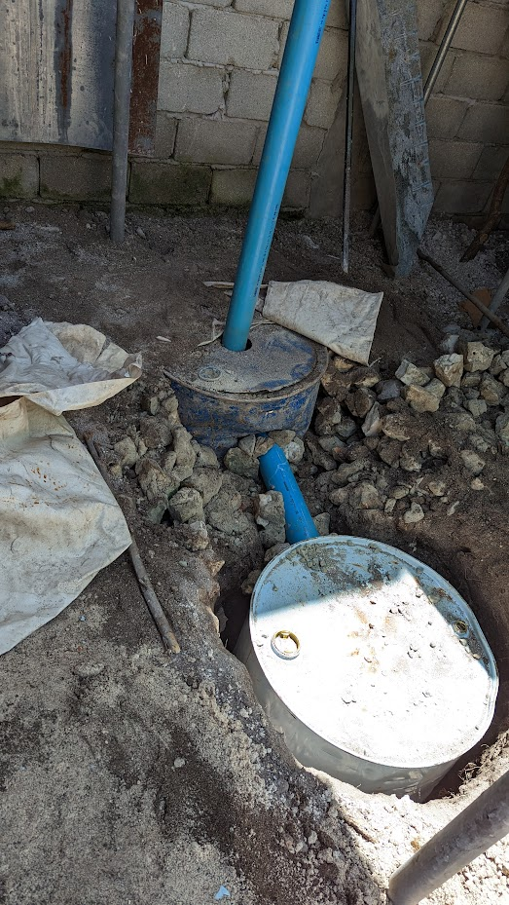
Household infiltration
Local solution, improved
Locally available material
Low cost
Notes:
One of the important tasks of 3SWater is to help islanders to and remedy their groundwater system. An important need is to prevent stormwater from going out into sea and enabling infiltration into the groundwater system. There is evidande that recharging the groundwater system can help not only in quatity but also quality issues of the groundwater.
While intitial investigations we found that the islandars in-fact have a method of encouraging infilitration ( A traditional method using barrels). So, instead of proposing new/complex solutions we adopted that indigenous solution with slight imporovements.

Slide 11
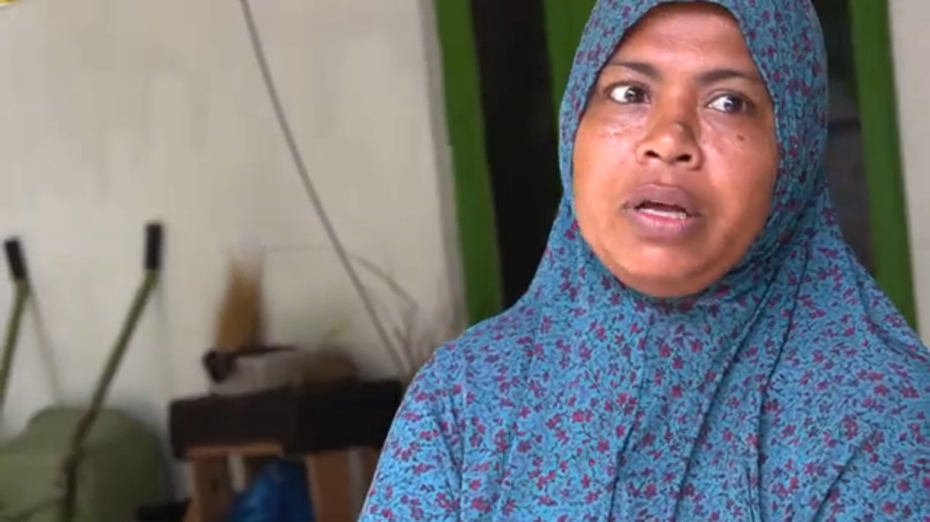
People prefer rainwater
Long tradition
of drinking
rainwater
Today, too,
people prefer
that taste.
2000+ vs 400 mm

Slide 12
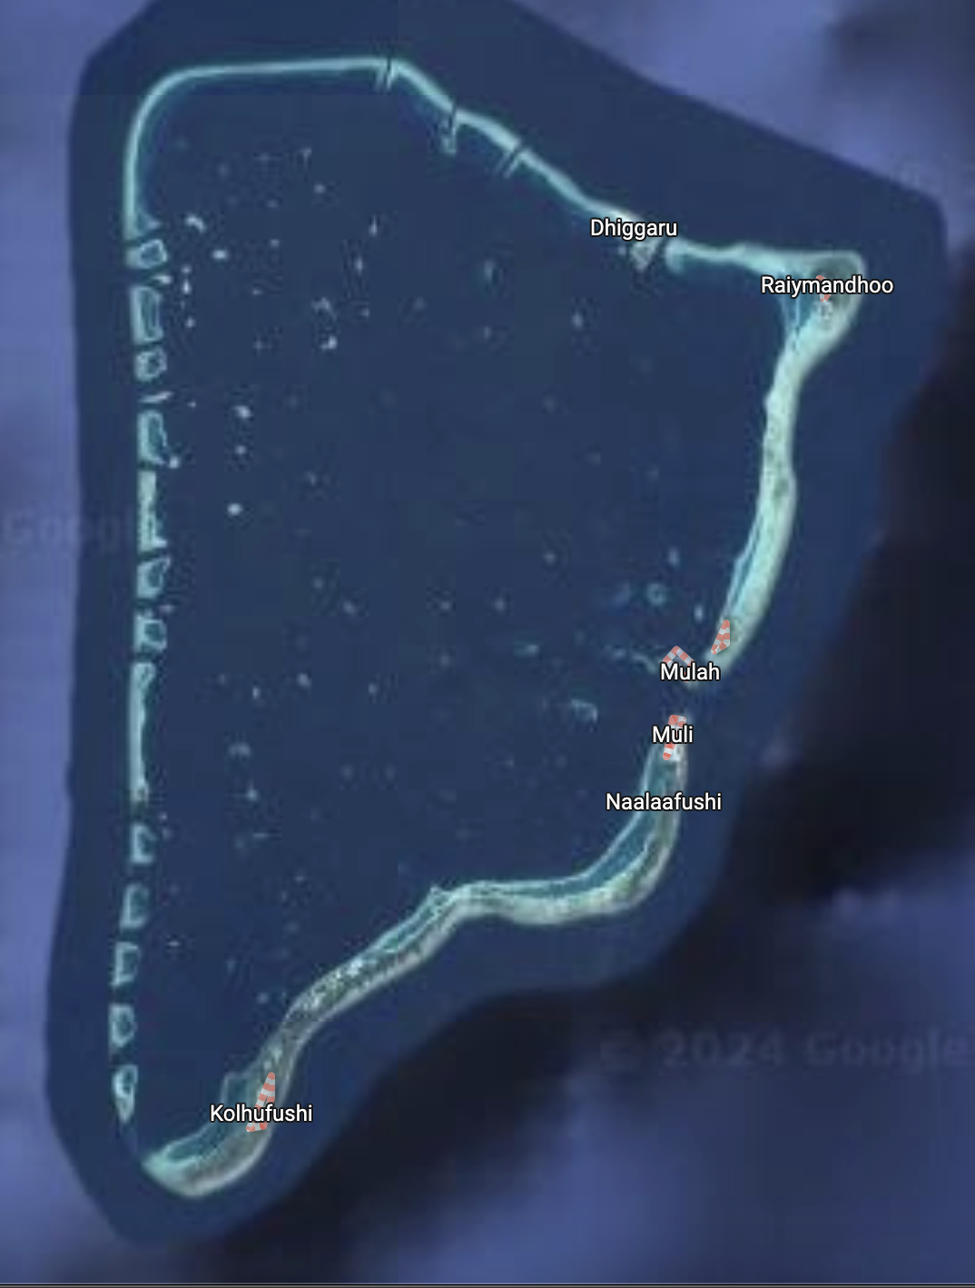
Research Sites (M Atoll)

Slide 13
Maldives
Notes:
Look at the map of the Maldives shown on top left corner on this slide. Maldives consists of hundreds of small inhabited islands that are distributed over a vast ocean area in the Indian Ocean. Next look at the maps of the three islands on the right. Most of the outer islands in the Maldives are super small, but they are also densely populated.

Slide 14



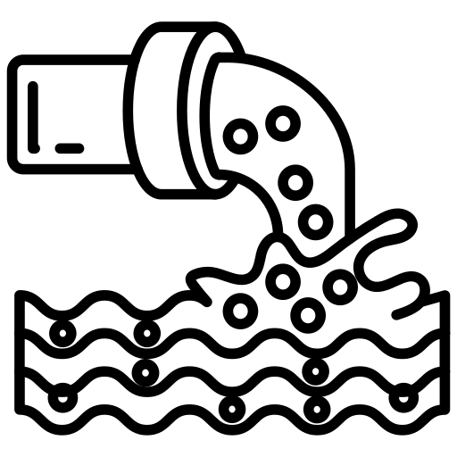
Typical
Water
Supply
Prefiltration
Pump
Membrane
filtration
High Energy Pumping
Intake well
Brine discharge to sea
Inlet > 20m deep
ground
Notes:
Let's look at a schematic of the typical water supply of these islands.
The saltwater is pumped out of groundwater wells more than 20 m deep - well below the freshwater level. While salinity is the same as the ocean, there is some level of quality control because the groundwater is filtered through soil layers.
This saltwater is then pre-filtered and subjected to a membrane filtration process to desalinate the water. This is by far the most energy-intensive process, as it needs pumping at very high pressure through membranes. Desalination separates most of the freshwater from the salt water. The resulting highly concentrated salty water, called brine, and that concentrated brine is discharged into the sea. This brine, which is denser than seawater, has to be discharged to a location with turbulence to avoid settling at the surface, harming aquatic environments.

Slide 15


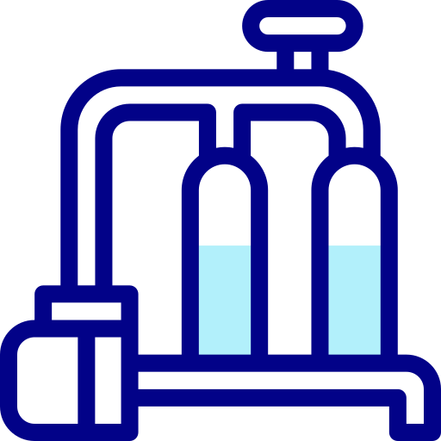
Typical
Water
Supply
Rainwater harvesting
Prefiltration
Ultra filtration
~30%
Pump
~70%
Membrane
filtration
High Energy Pumping
Intake well
Brine discharge to sea
Inlet > 20m deep
ground
Notes:
Rainwater is harvested from selected public buildings like schools, places of worship and government offices. This water is collected into raw water storage tanks and is subject to ultrafiltration, which brings it up to a quality comparable with the, desalinated water.
These two water sources are mixed ideally at about a 70 to 30 ratio.
This dual-source design is expected to achieve two goals: First, it reduces the pumping cost of membrane filtration, reducing the CO2 footprint. Secondly, as rainwater has very little mineral content, it also reduces the hardness of the desalinated water somewhat.

Slide 16



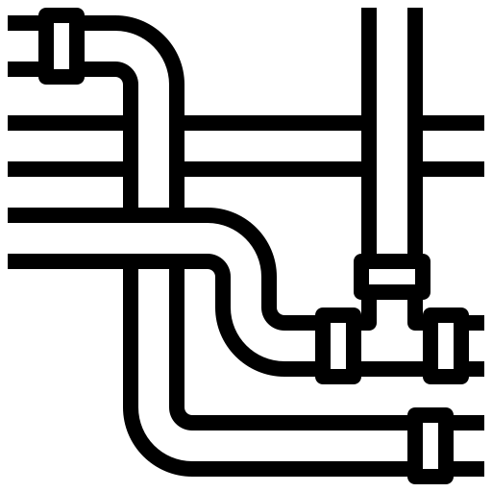
Rainwater harvesting
Solar PV panels for partial offsetting energy
Prefiltration
Ultra filtration
~30%
Treated
Water Storage
Pump
Chlorination
~70%
Membrane
filtration
(In-line) pumping
High Energy Pumping
Intake well
Brine discharge to sea
Inlet > 20m deep
ground
Distribution network
Metered connections
Notes:
At this point, chlorination happens and then the water is stored near the water supply water treatment plant in the treated water storage. Then using inline pumping, the water is provided to the distribution network and finally to the household by metered connections. There is no chlorination at the distribution point, but only before the water mix goes into treated water storage tanks. Many of these designs have solar photovoltaic panels integrated so that some of the energy used, in the high energy use for membrane filtration can be offset using solar power.

Slide 17
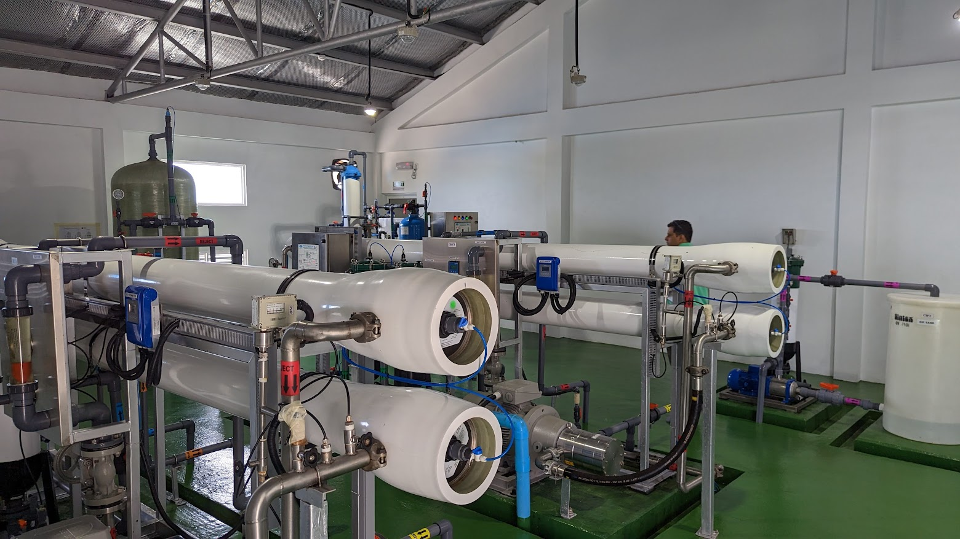
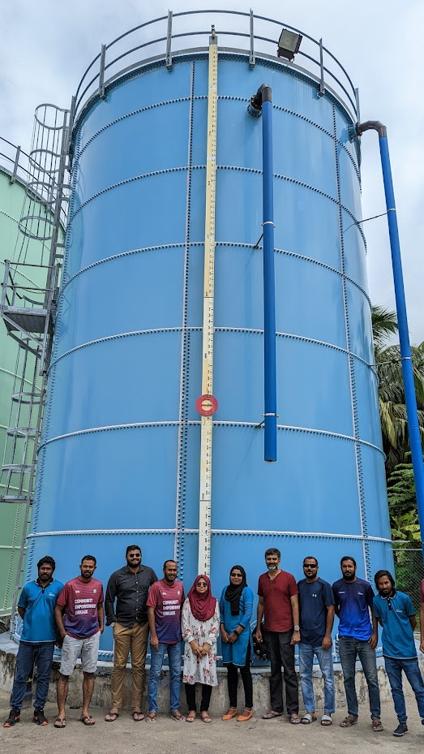
Notes:
Here's a picture of the recently one of the recently introduced water supply schemes. On the left, we have the membrane filtration system. On the right, is one of the several water storage units.

Slide 18
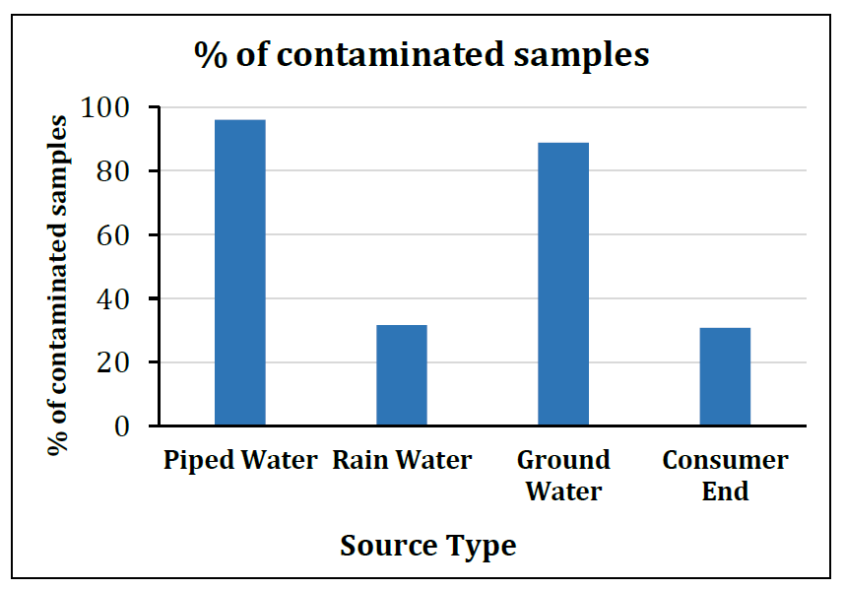
Source: 3s water project
Notes:
Recently we have conducted water quality investigations into the different water sources in some of the islands with piped water supply. We observed that the piped water system in some islands has contamination. This was a remarkable fact as the residual chlorine should address any later contamination. When we looked into the details of this, we realized that, sometimes the required chemicals like the chlorine supplies do not reach water treatment plants in time. So, they are forced to run the system under sub-optimal conditions. On top of that, certain construction and maintenance issues cause groundwater and other contaminated water to leach into the water supply system. Considering that these are very modern, newly built systems showing significant contamination in the piped water supply is a significant finding.

Slide 19
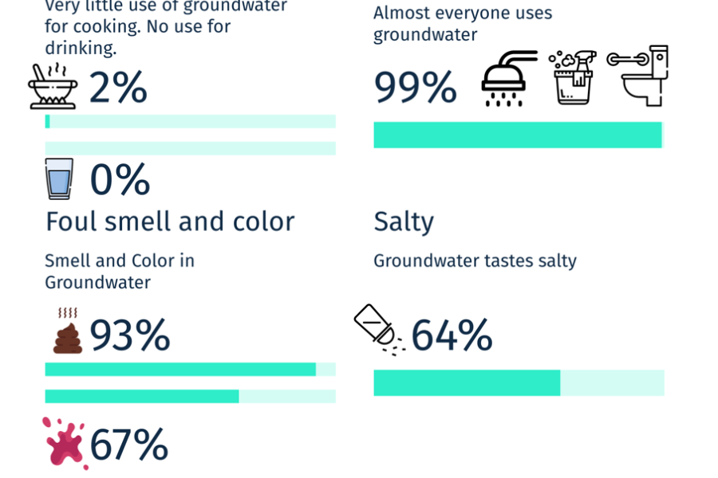
Data source: Jaleel MI, Ibrahim SA, Hussain A, Mustafa M, Pathirana A. A screening approach for assessing groundwater quality for consumption in small Islands: case study of 45 Inhabited Islands in the Maldives. Water. 2020 Aug 6;12(8):2209.
Notes:
People aspire to continue using groundwater. But, it is contaminated.
In 2020, Jaleel and the co-authors published a groundwater quality perception survey covering 45 inhabited islands in the Maldives. This research shows some 93% of households that were interviewed, indicated that their groundwater has a foul smell.

Slide 20

Food for taught
Have the current (complex, expansive) systems solved the water issue? (NO)
Supplying household water. Financially feasible?
Can islands afford the technical capacity needed?
Are there better ‘models’ for water supply?
Aspirations of the islanders?
~2000 mm/y rainfall: Enough water. Can we store it? RWH
Project funded by:

Slide 21

Why this in Jordan
(Middle east)?
3s water
Very different geography
Similar problems
  Pollution
  Lack of water*
Desalination at very different scales
Cross learning possibilities.
Sustaining small-scale water systems – integrating local knowledge and co-learning for preserving aquatic ecosystems and improving quality of life
*Retention problem

