Slide 1
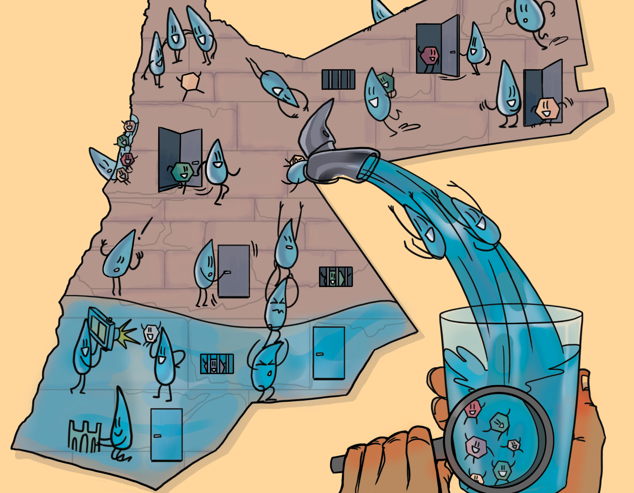

Groundwater Information Plattform
A‘laa Atieh & Rebecca Bahls

Slide 2
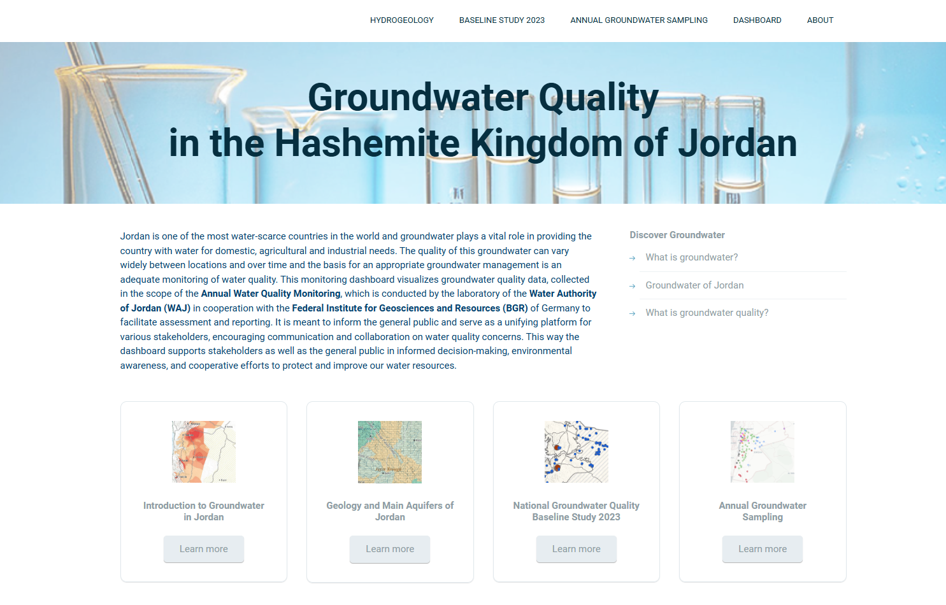

Slide 3
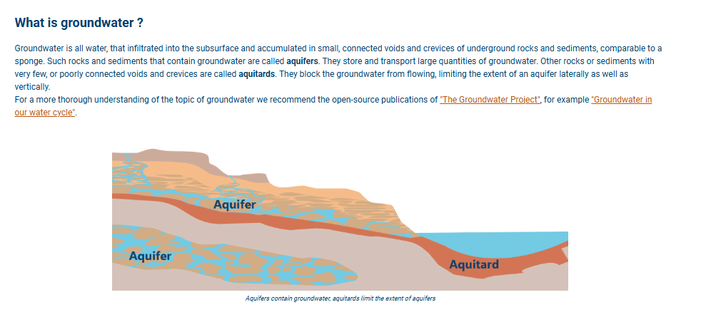
Introduction to Groundwater

Slide 4
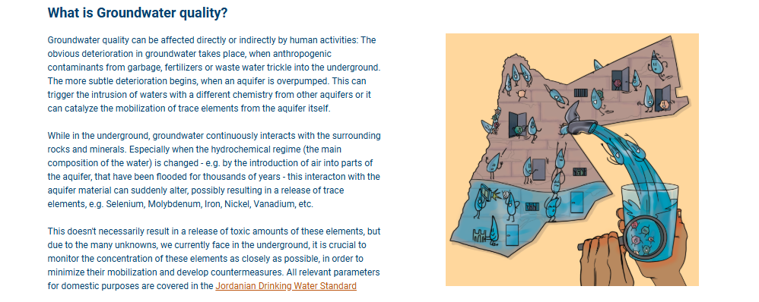
Groundwater Quality

Slide 5
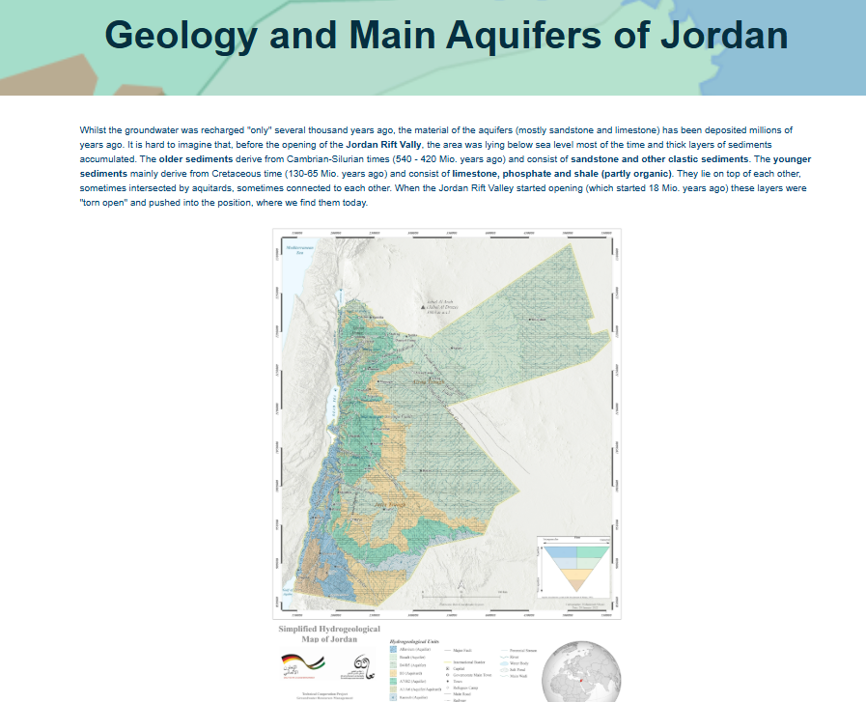
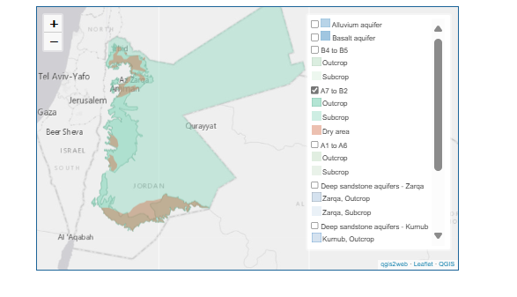
Geology and the main Aquifers
Map with selection function for the different aquifers.

Slide 6
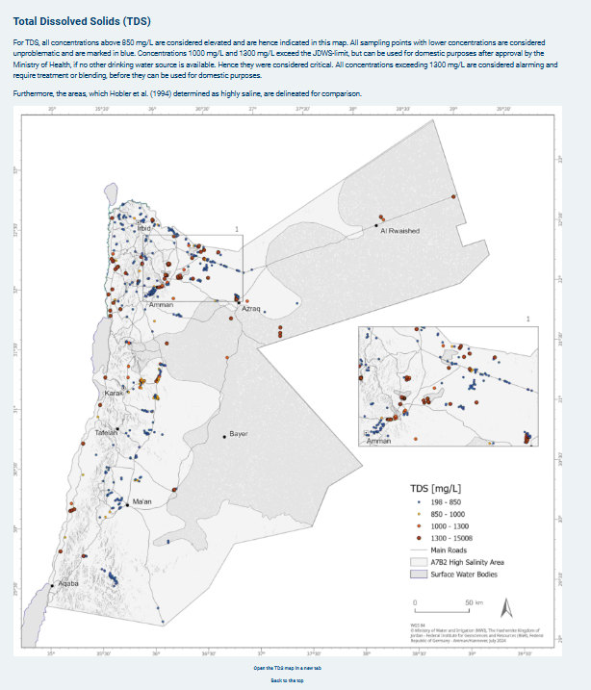
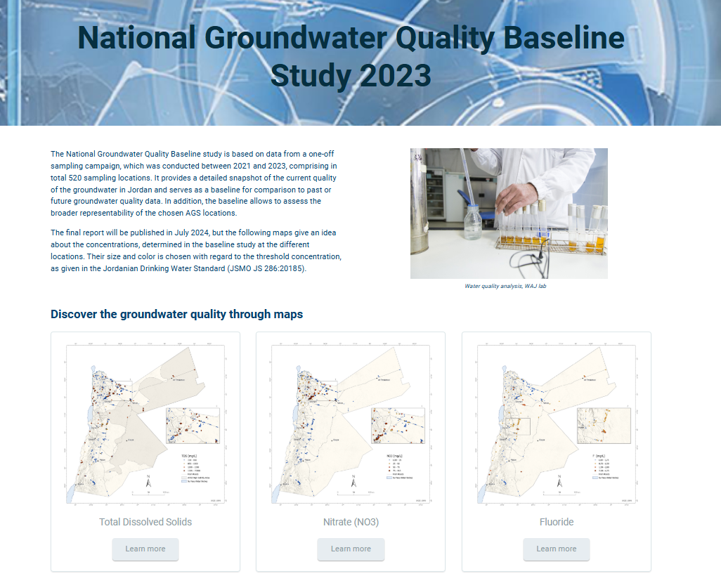
Groundwater Quality Baseline Study

Slide 7
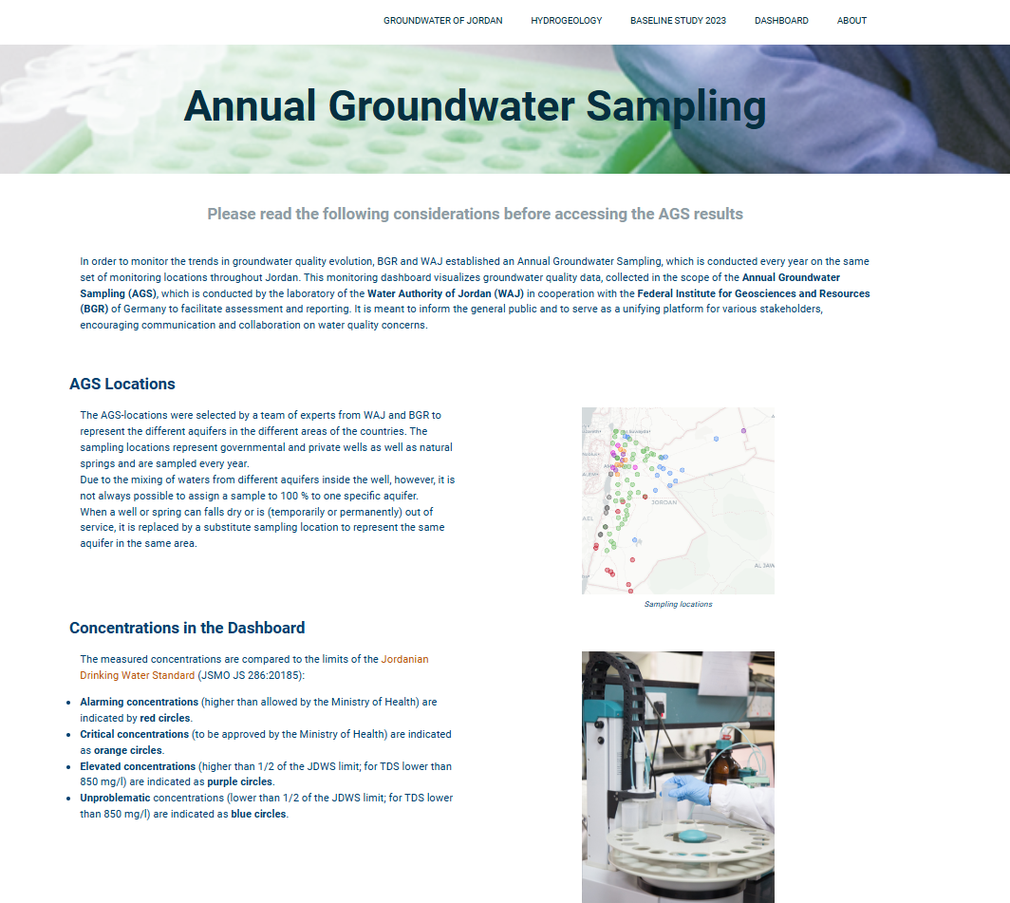
Annual Groundwater Sampling

Slide 8
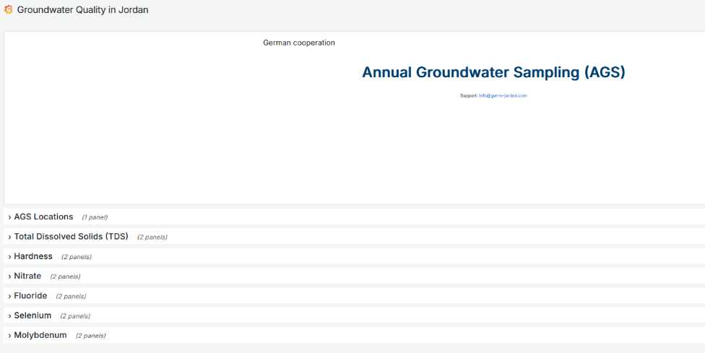
Dashboard

Slide 9
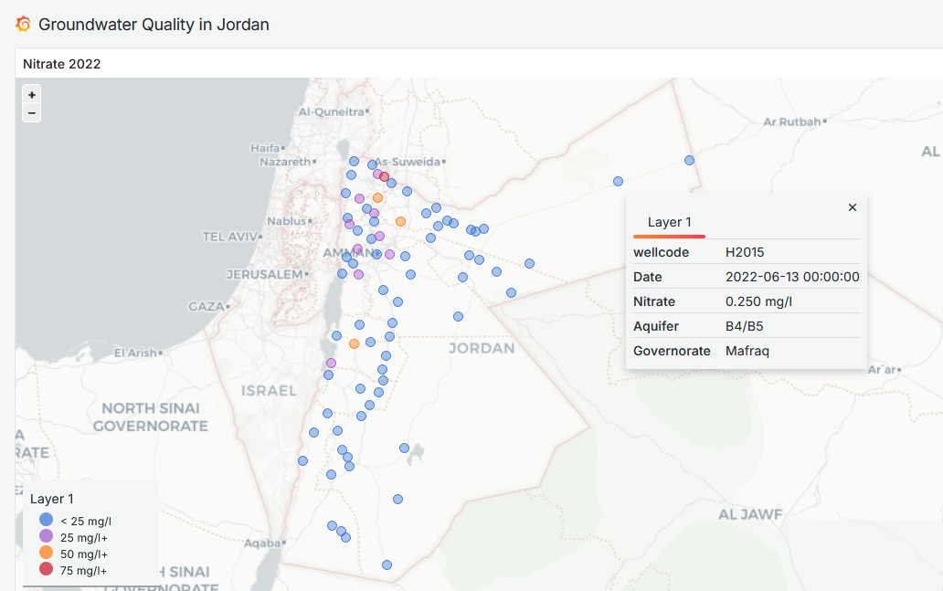

Slide 10
Water year

Slide 11
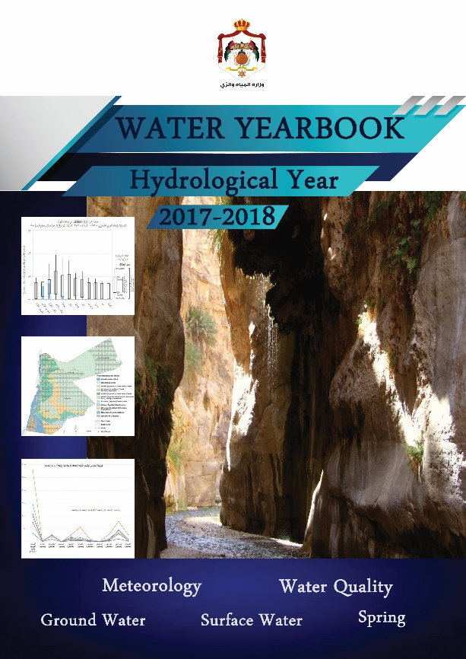





Water Year Book
Notes:
Mandate of the Ministry
Different to all the other Ministry publications….
This

Slide 12
Information
Water year
Notes:
One could say, there are many dashboards or information plattforms available, but this is spesifically for the public, to get a good understanding of the overall situation based on selected and qualtiy controlled parameters.

Slide 13
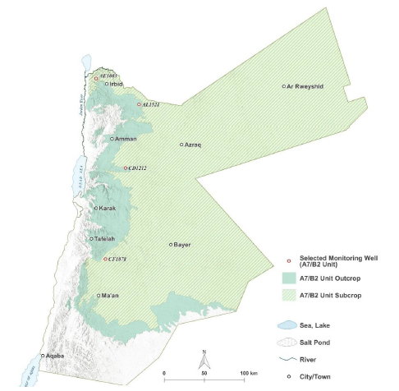
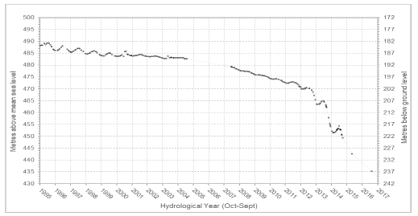
Groundwater Monitoring

Slide 14
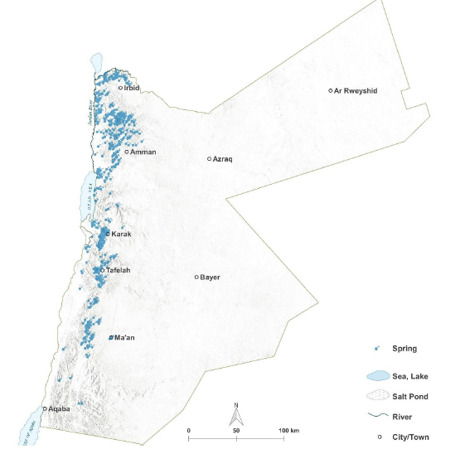
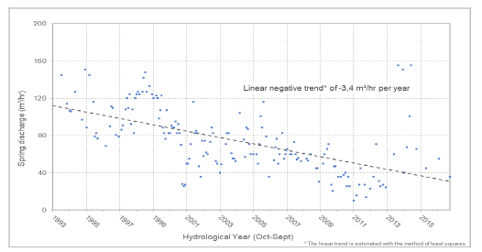
Springs

Slide 15
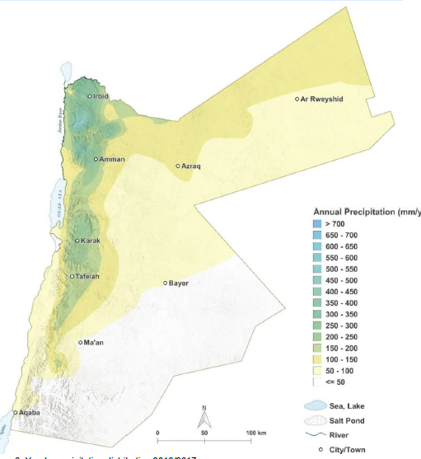
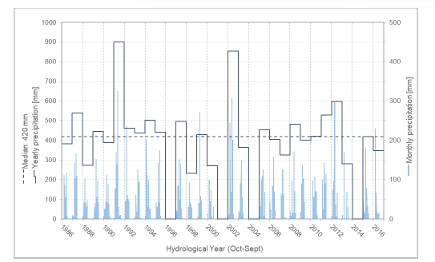
Climate Data

Slide 16
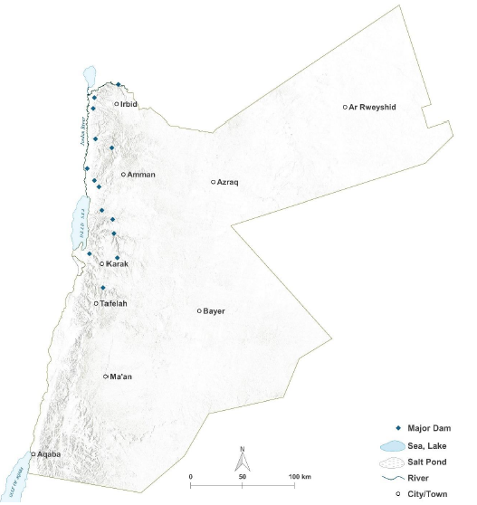
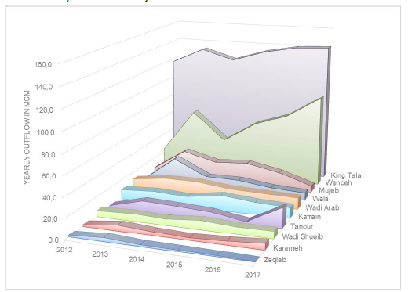
Infrastructure – Dams
Rebecca Bahls &

Slide 17
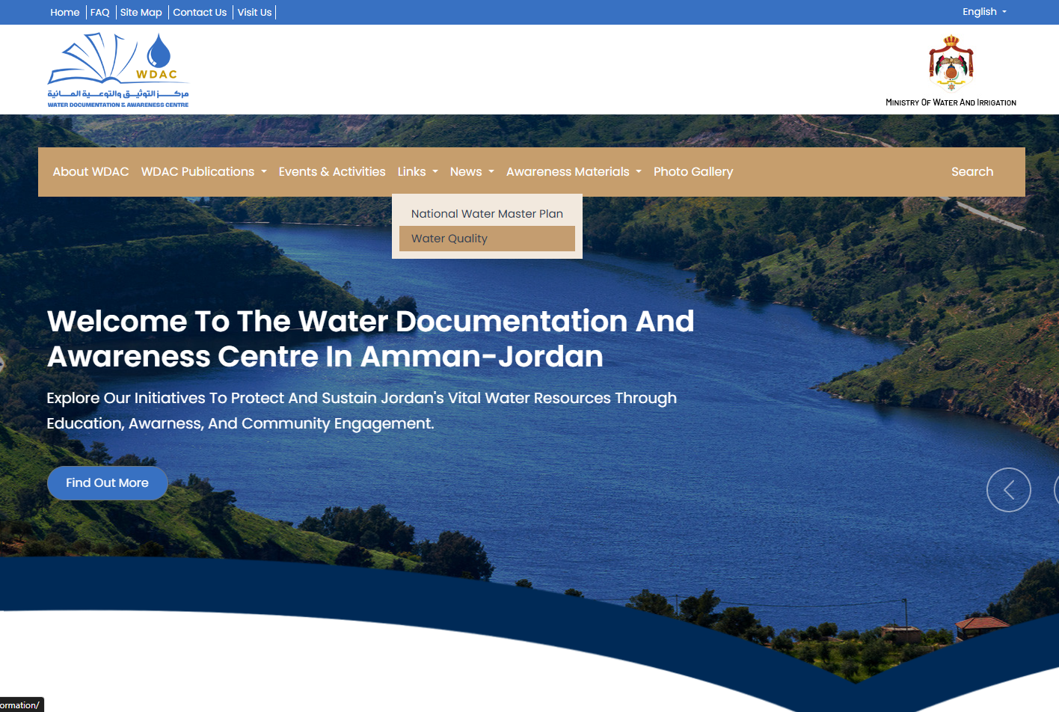
www.groundwaterinformation-jordan.com

Slide 18
Thank you!

