Slide 1




Desalination For Climate Resilience
Ministry of Water and Irrigation
Water Authority of Jordan
Deutsche Gesellschaft für Internationale Zusammenarbeit (GIZ)
04.05.2025

Slide 2
Water Situation In jordan

Slide 3
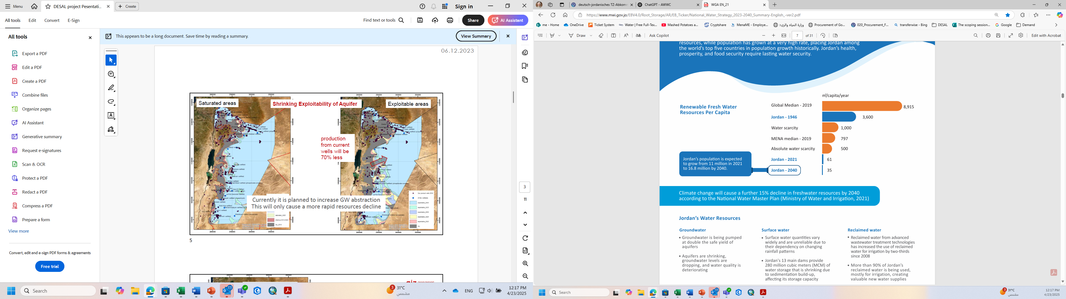
Water Situation in Jordan
Water demand continues to increase ➔ (+50% until 2040)
  Population and economic growth,
  high agriculture demand
Rapid conventional water resources decline ➔ (>30%)
  High groundwater overexploitation (GW use > GW recharge)
  Significant decreasing future exploitability
  Climate change reduces natural resources availability (GW, SW)➔15%
Deterioration of Water Quality
  High salinity
  High siltation
  Contamination
  Heavy metals (some areas)
High NRW ➔ 46.3% (2023)
Per Capita share decreased ➔80 l/c/d ( 80% of policy allocation )
National Water Strategy 2023 - 2040

Slide 4
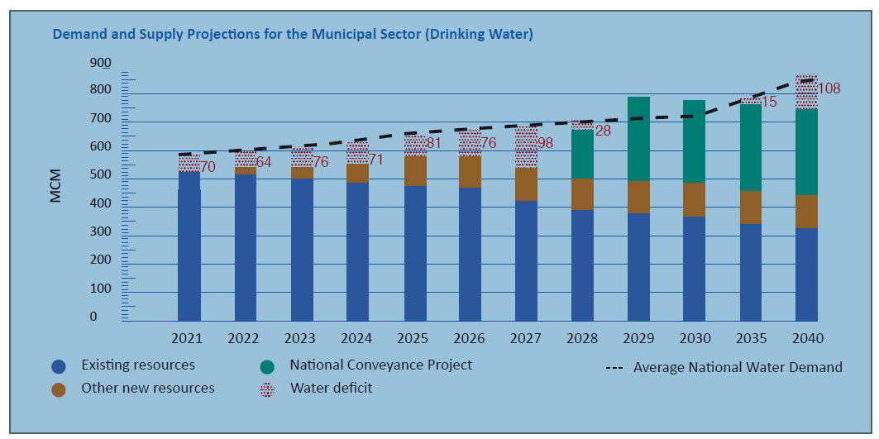
Projected Water Supply and Demand 2040
Future water supply security can only be maintained by massively increasing desalination capacities (brackish and seawater)
Consequently, increased gap in water supply vs demand in 2040➔ (>50%)
National Strategy 2023-2040

Slide 5
Significancy of Brackish Water for Jordan
Brackish water share more than 13% of municipal water supply
Expected to increase as resources became saline affected by overexploitation and deep aquifers
A sole water supply source for many communities
A feasible option for many areas compared with other supply options
Potential new projects in medium term ( additional 50 MCM)
➔ Hisban, Rajib, Adassiya, Kafrein, Dahret Al Ramel and Azraq
Water Budget 2020

Slide 6
Brackish Water Desalination in Jordan

Slide 7
Brackish Water Desalination growth in Jordan
DesalData 2020
Small (S): < 50,000 m³/day
Large (L): > 50,000 m³/day

Slide 8
Brackish Water Desalination Plants in Jordan
# | Plant Name | Governorate | Water Utility | Date of Establishment | Design Production MCMY
1 | Rwaished 1 Rwaished 2 | Northen Badia | Yarmouk Water Company (YWC) | 2000 2008 | 1.06
2 | Mashtal Faysal | Jerash |  | 2009 | 4.56
3 | Kraymeh | Northen Shounah |  | 2021 | 0.88
4 | Znayah | Mafraq |  | 2008 | 0.79
5 | Dab'an | Mafraq |  | 2014 | 0.07
6 | Kufranajeh | Ajlun |  | 2014 | 1.54
7 | Omari | Zarqa | Jordan Water Company (Miyahouna) | 2008 | 0.04
8 | Hesban | Al Balqa' |  | 2022 | 2.60
9 | Zarqa | Zarqa |  | 2002 | 5.26
10 | Zara Ma'in | Al Balqa' |  | 2006 | 47.00
11 | Abu Zeighan | Al Balqa' |  | 2003 | 15.77
12 | Ghour Mazra'ah | Karak | Aqaba Water Company (AWC) | 2003 | 1.34
13 | Ghour Al Safi | Karak |  | 2005 | 1.20
14 | Ghour Fiefa | Karak |  | 2007 | 0.07
15 | Ghuwaibeh | Karak |  | 2006 | 0.05
16 | Mudwwara | Ma'an |  | 2003 | 0.13
17 | Qatar | Aqaba |  | 2003 | 0.13
18 | Bir Mathkour | Aqaba |  | 2021 | 0.18
19 | Rahma | Aqaba |  | 2021 | 0.18
20 | Ar-Reesha (1+2 (2022)) | Aqaba |  | 2002 | 1.80

Slide 9
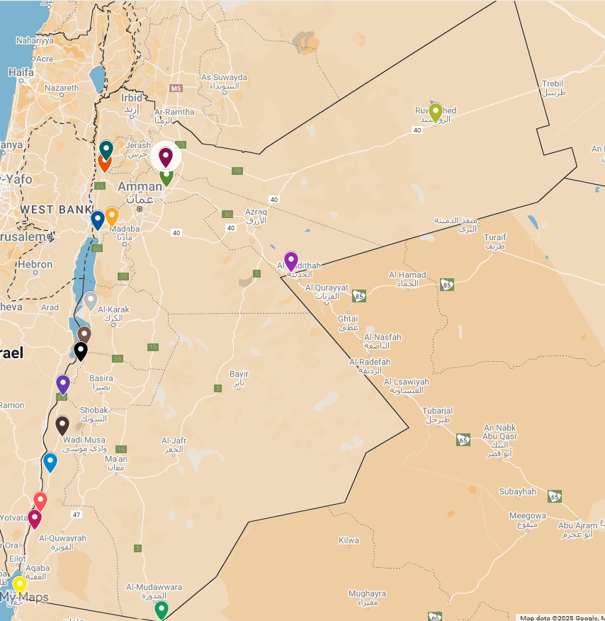
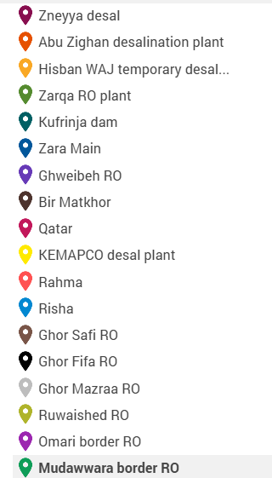
The location of Water Desalination Plants in Jordan

Slide 10
Brackish Water Desalination Fundamentals

Slide 11
General Process Schematic of Brackish Water Desalination
Chlorination
Anti-scalant
Sodium bisulfate
Brackish groundwater
Final water tank
PF
Raw water tank
Brine discharge
Optional:
Aeration
Media filters
Cartridge Filters
Reverse Osmosis
Raw water for blending
Coagulant
Coagulant aid
Chlorination
Anti-scalant
Sodium bisulfate
Brackish groundwater
GF
SM
GF
Brine discharge
Raw water tank
Setling tank
Gravity filters
Cartridge Filters
Reverse Osmosis
Raw water for blending

Slide 12
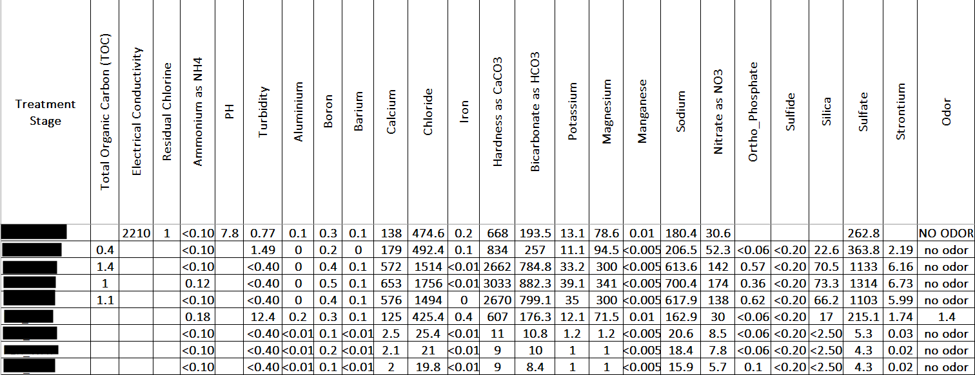
Monitoring of Brackish Water Desalination Plants
Water Quality analysis at the WAJ lab:
Samples are collected on regular-basis from different locations along the treatment line including water resources/wells, raw water tank, after media filtration, RO feed, Permeate, brine, and final water.

Slide 13
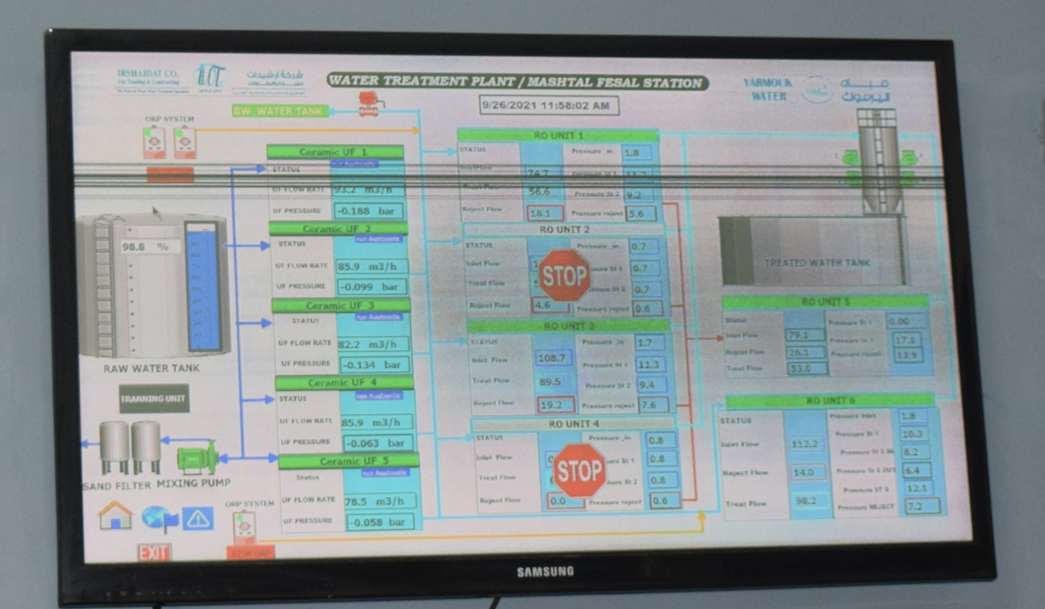
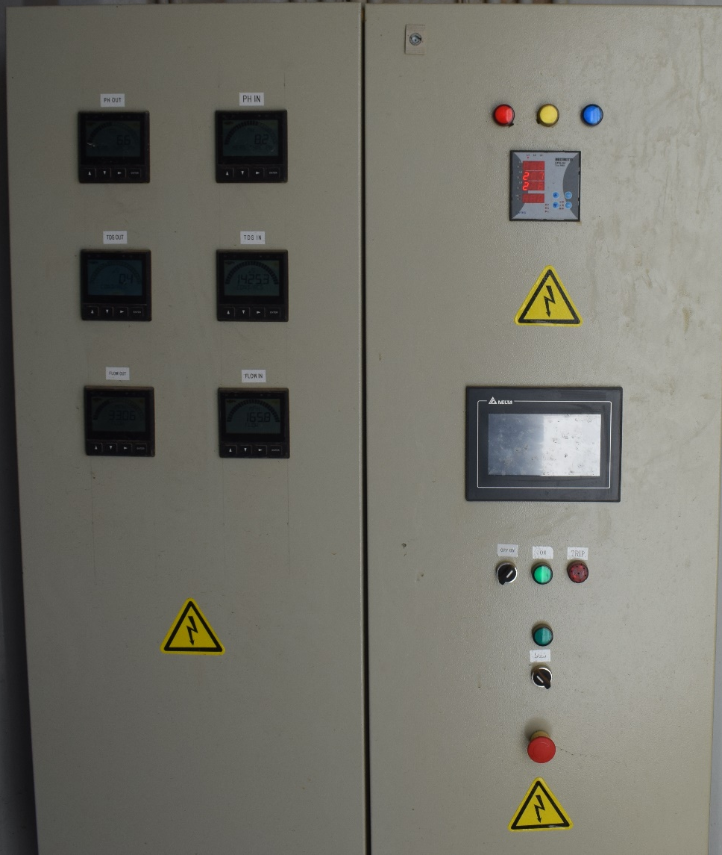
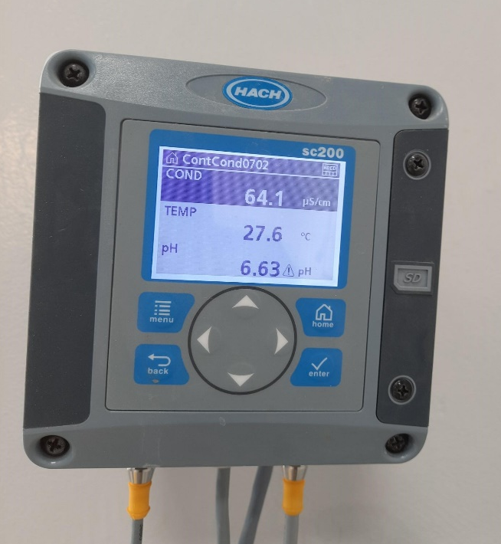
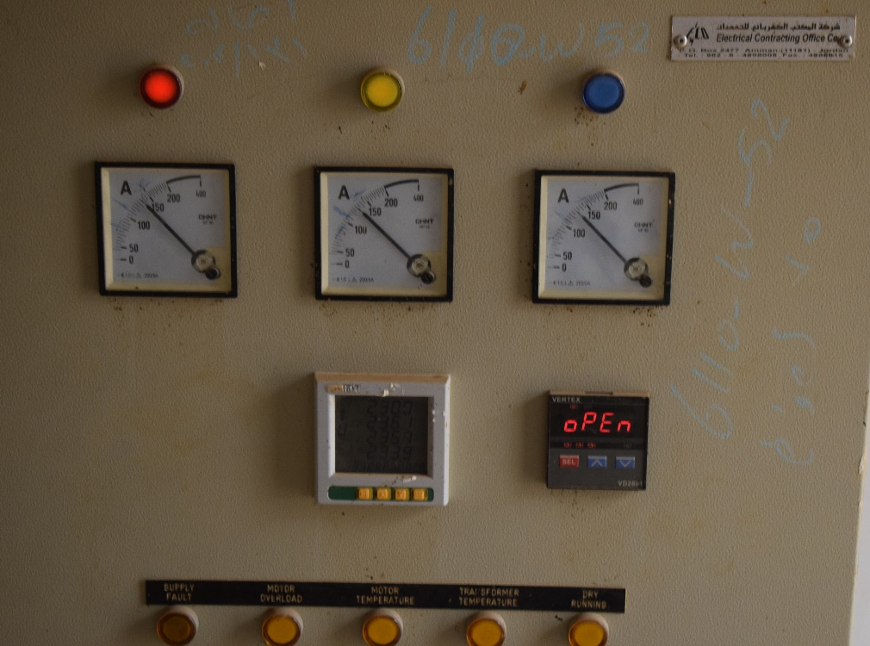
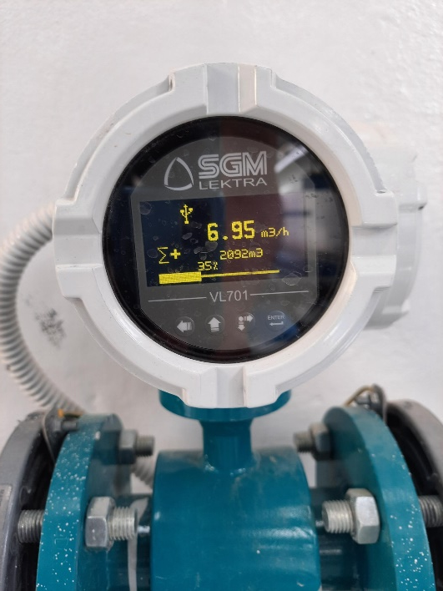
Monitoring of Brackish Water Desalination Plants
Operational parameter monitoring at desalination facilities:
Water quantities (Flow meters or water level sensors)
Water quality monitoring (pH, EC, turbidity, temperature, etc.)
Pressure gauges to monitor the performance of media filters and reverse osmosis system.
Membrane fouling monitoring (silt density index, water flux and permeability)
Power consumption

Slide 14
Operational Cost & Challenges of Brackish Water Desalination in Jordan

Slide 15
Operational Cost of Brackish Water Desalination Plants
Small scale plant (20 m³/h)
Avg. OPEX =0.29$/m³
Remark: Cost does not include ground water abstraction and water pumping through the water distribution system
The operational cost of BWRO desalination plants internationally ranges between 0.39 and 0.66 $/m³ for a range of capacities from 10,000 to 70,000 m³/d and salinity between 2,000 and 6,000 mg/L (Pearson et al., 2021)

Slide 16
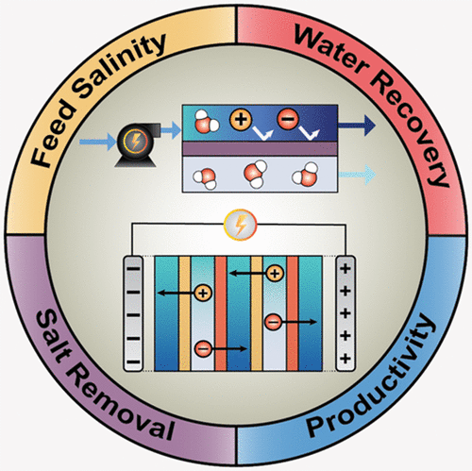
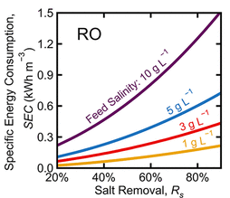
Energy requirements
BWRO requires 10 – 15 bar of feed pressure, depending on the water quality and the design of the system.
This is equivalent to 0.2 – 3 KWh/ m³ (internationally, Ahdab et al., 2020) depending on the size of the plant, the efficiency of the pumps water quality and the design of the plant (recovery, membranes, etc.).
In Jordan, the specific energy consumption (SEC) in BWRO desalination plants ranges between 0.7 – 1.1 KWh/ m³ (without pre-treatment).
Petal et al., 2021

Slide 17
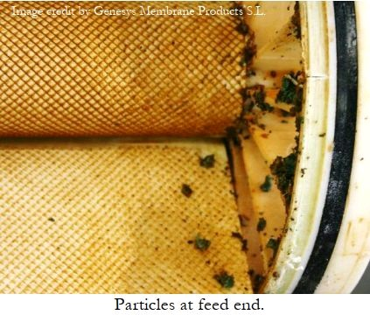
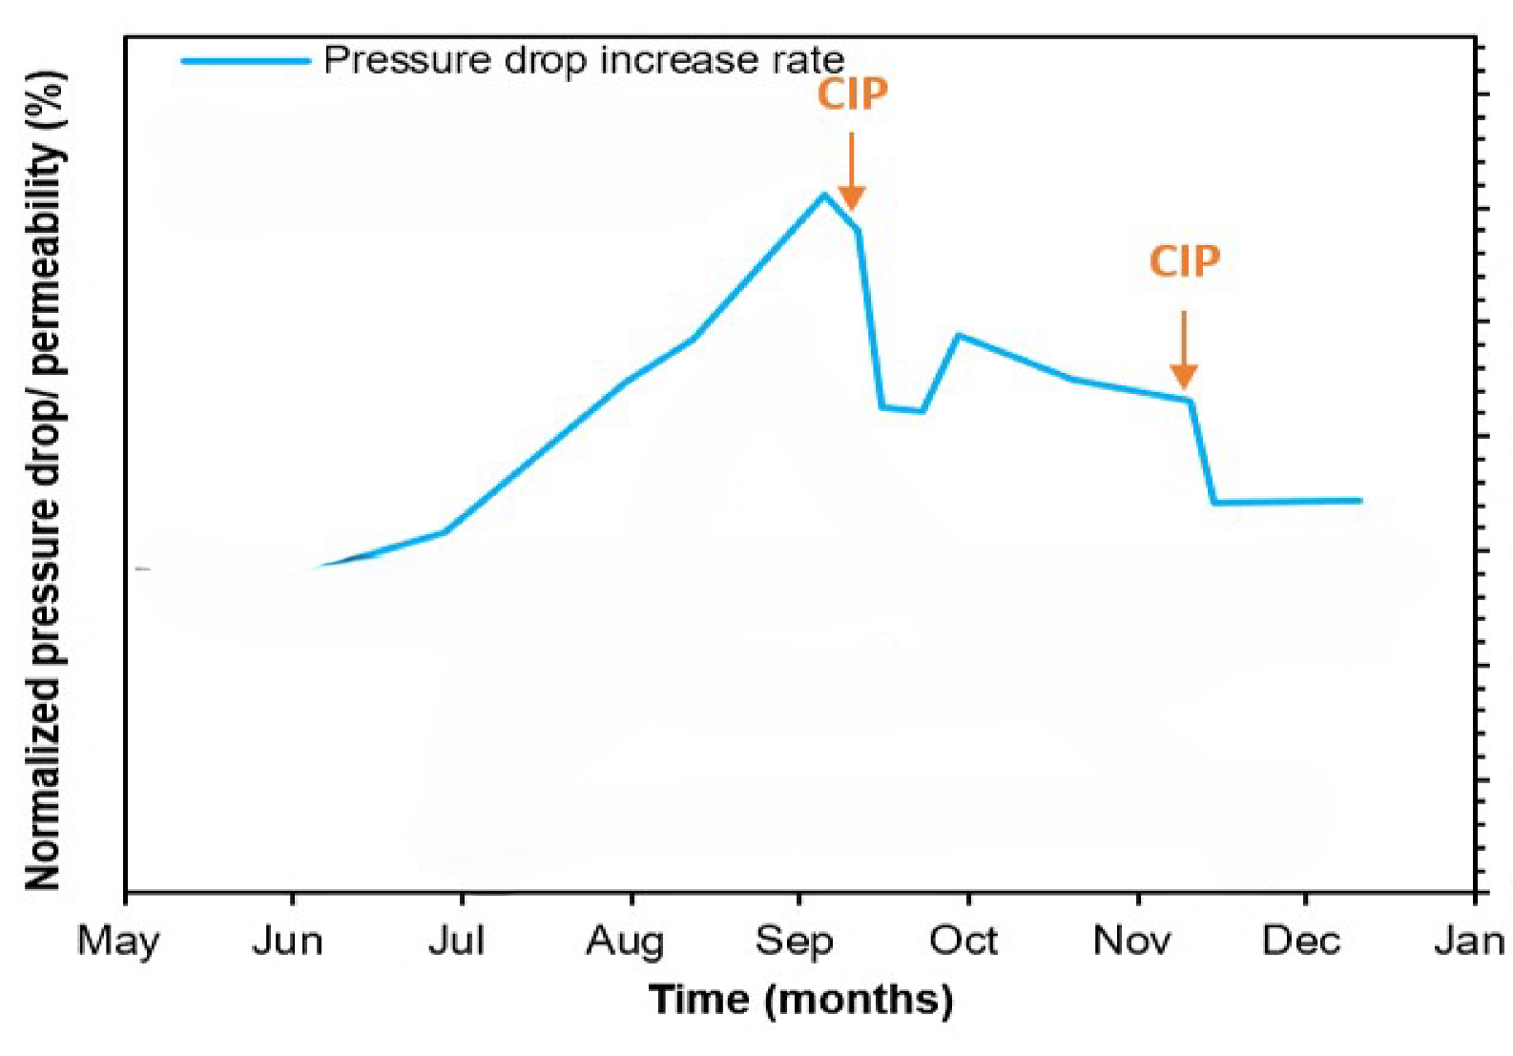
Chemicals requirements
Membrane fouling increases the energy requirements; usually when:
    Normalized permeate flow decreases by 10%
    Normalized pressure differential increases by 15%
    Normalized salt rejection decreases by 10%
Therefore, chemicals are needed to clean the RO system and restore the initial conditions and to avoid specific types of scaling (antiscalant dosing)
Chemicals are also needed for the pre-treatment including:
  Chlorination,
  Coagulation,
  De-chlorination, and
  pH adjustment.

Slide 18
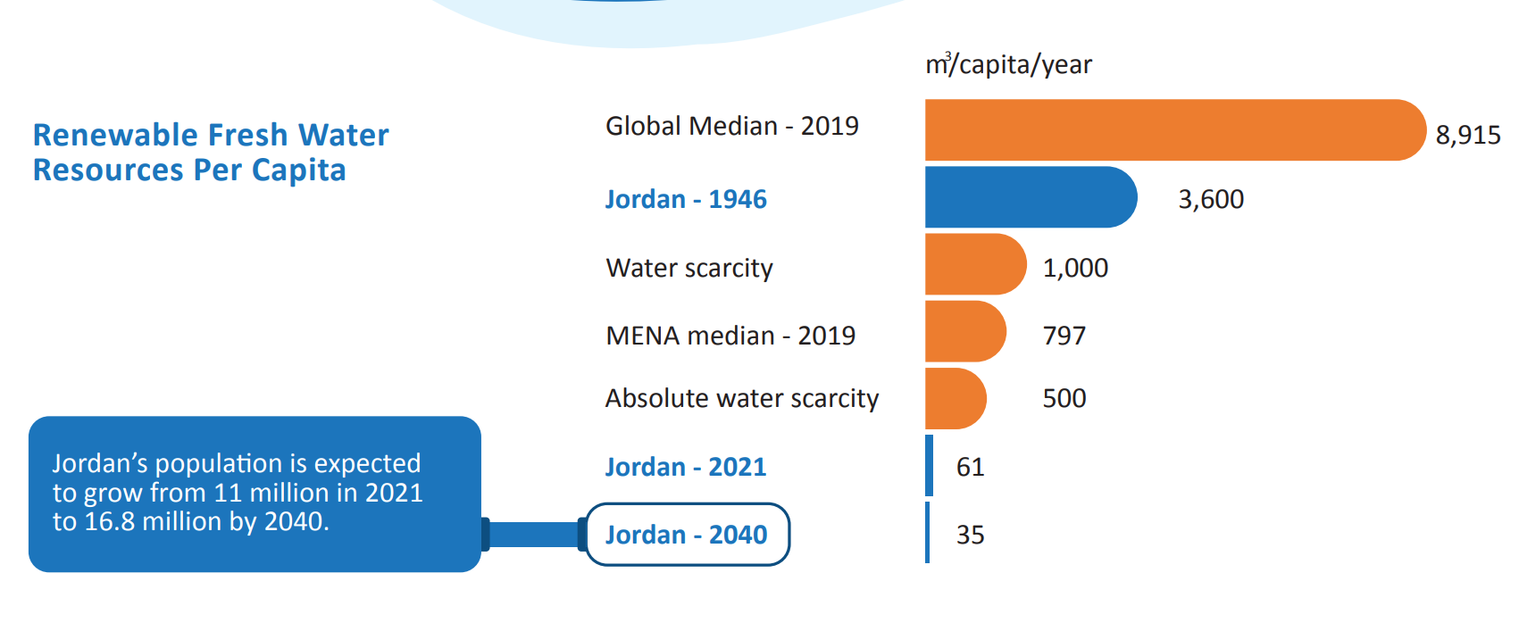
Challenges of Brackish Water Desalination in Jordan
Water Resources Challenges
Water Quantity:
The availability of freshwater resources decrease over time.
Groundwater is being pumped at double the safe yield of aquifers.
Water Quality:
The salinity of ground water increases due to fast abstraction.
Contamination of the ground water aquifer due to agricultural and industrial activities.
Significant water quality variation.
Radioactive water problem.

Slide 19
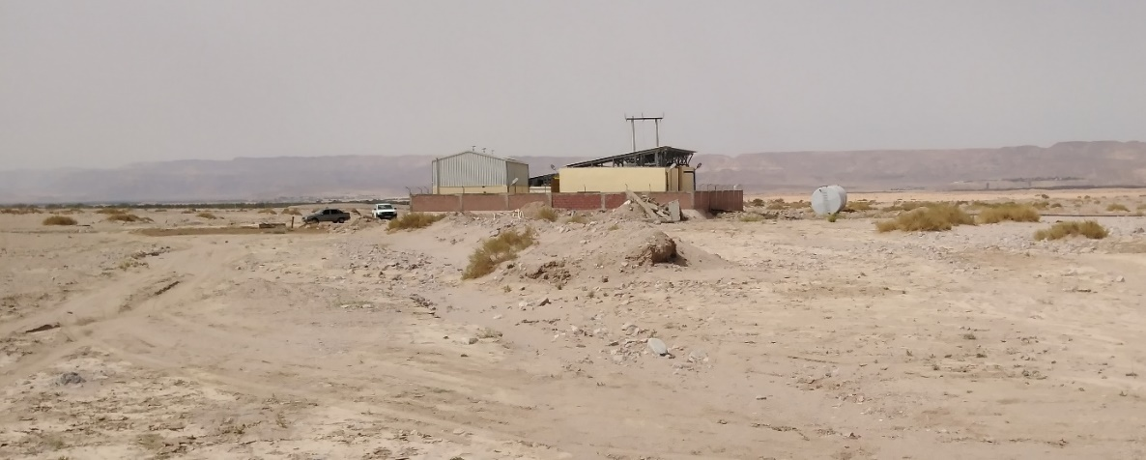
Challenges of Brackish Water Desalination in Jordan
Managerial Challenges:
Staff
Limited numbers of experts in the field of desalination.
Limited well-trained plant operators.
Absence of educational programs/ diploma specialized in water desalination.
Contract:
Short-term outsourced contracts for operation and maintenance.
Farness
Most of the brackish water desalination plant is located in rural areas or villages.

Slide 20
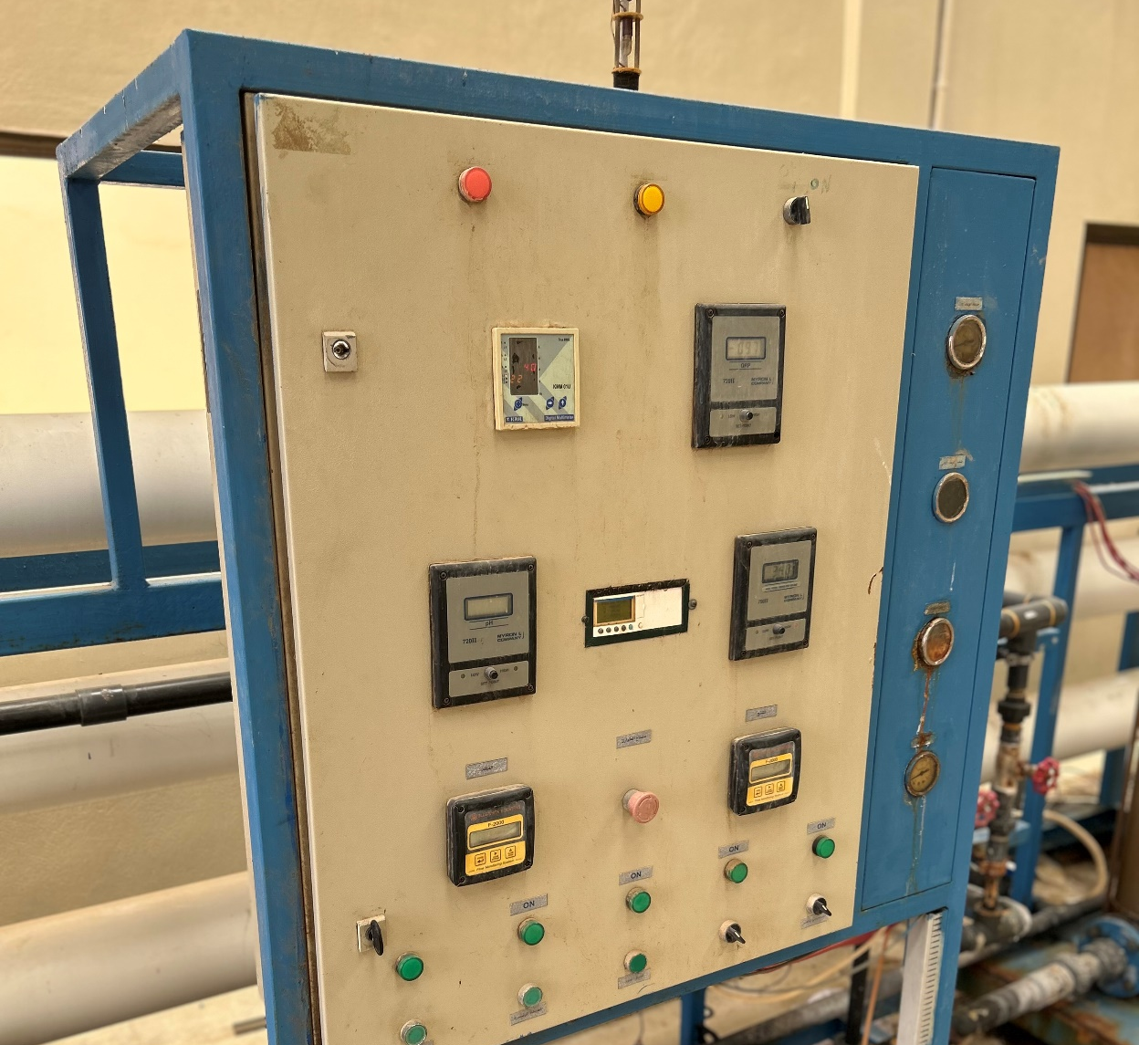
Challenges of Brackish Water Desalination in Jordan
Technical Challenges:
Spare parts
Limited spare parts which leads to delayed responses.
Monitoring system
Limited of robust monitoring system.
The use of advanced and specialized monitoring tools is still needed.
Lack of automated monitoring and operation systems.
Preventive maintenance
Needs for scheduled preventive maintenance.
Financial Challenges:
Unsustainable and insufficient budget.
Unsustainable financial support / aid.

Slide 21
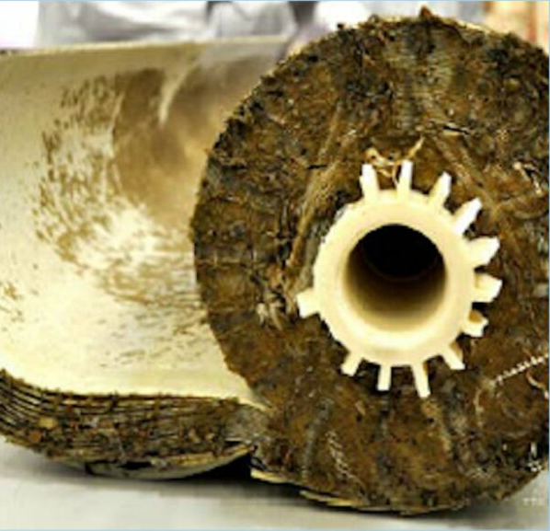
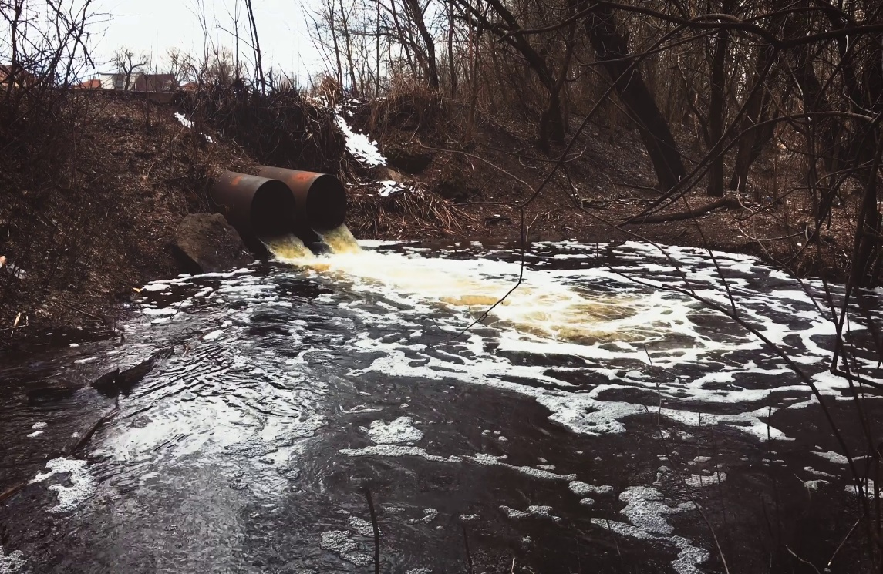
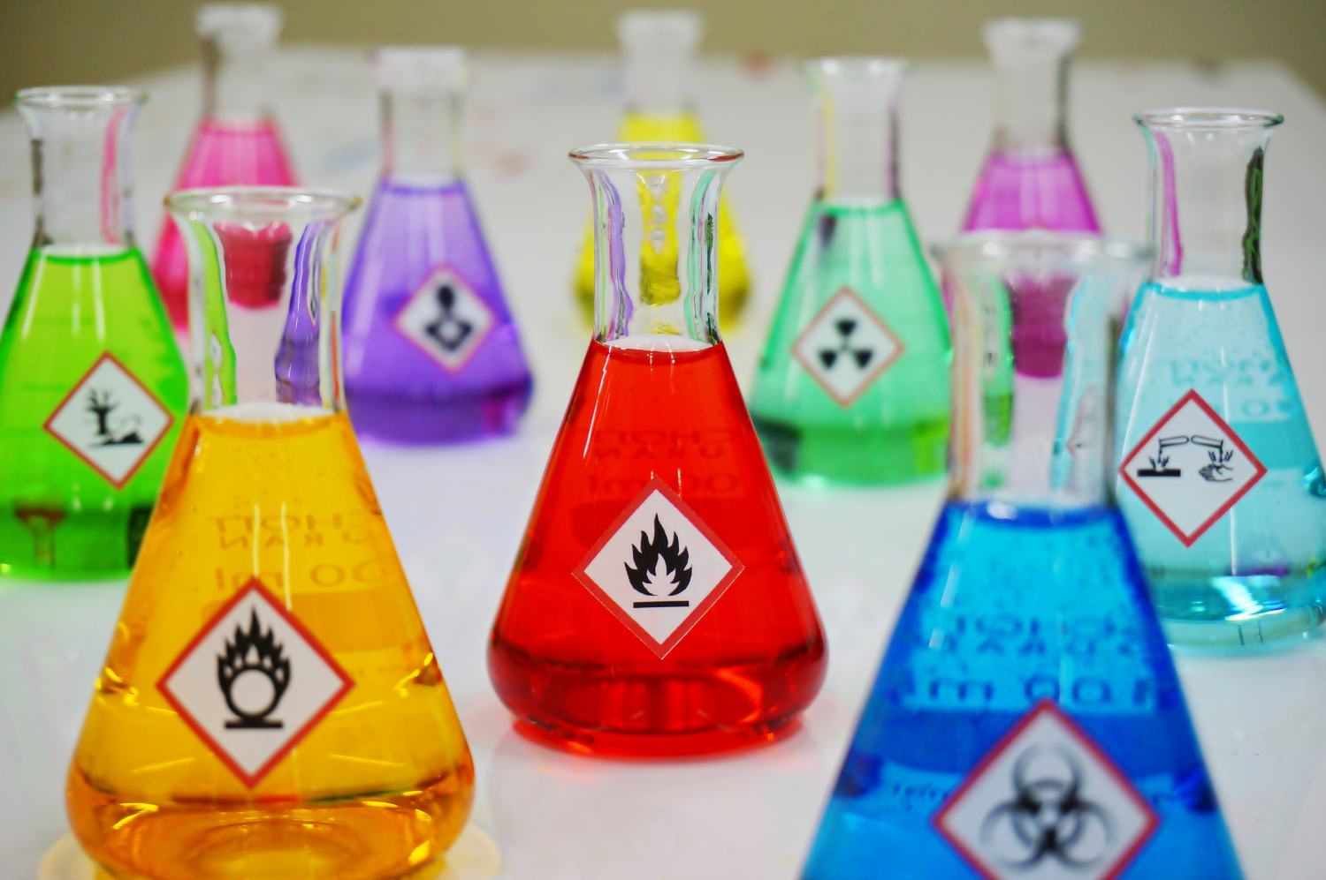
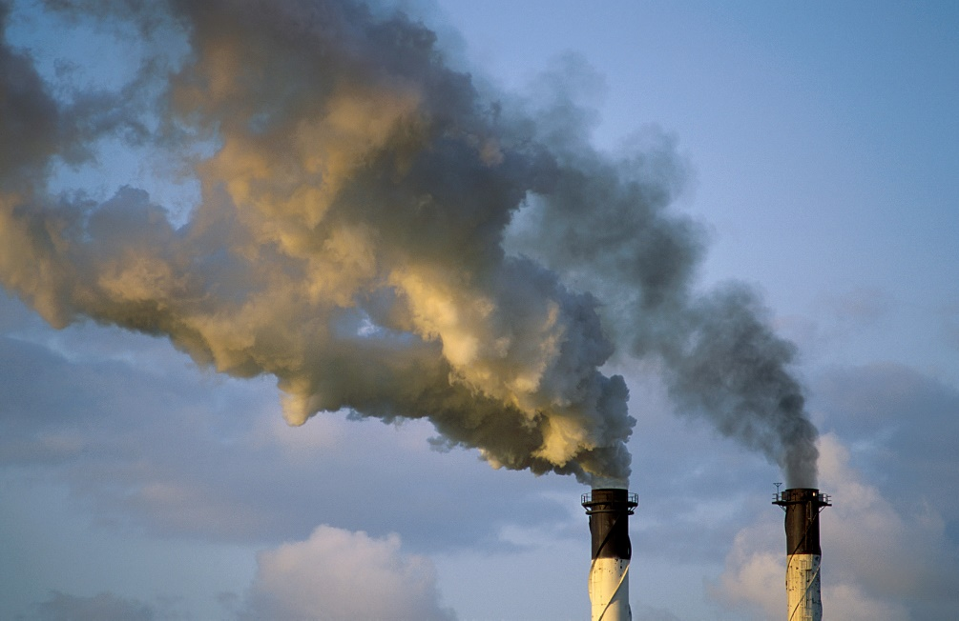
Challenges of Brackish Water Desalination in Jordan
Environmental Challenges:
The discharge of brine
The use of chemicals
The disposals of damaged/fouled membranes
The use of electricity and its side effect (GHGs)
Material use
Energy use and GHGs
Brine discharge
Chemical use

Slide 22
Desalination of Sea and Brackish Water (DESAL1) Project

Slide 23
Desalination of Sea and Brackish Water (DESAL1) Project
Project Objective: The capabilities of the relevant institutions to plan, operate and maintain brackish and seawater desalination plants are improved.
Duration: 4.25 years (08/2020 – 10/2024)
Follow-on activity: SWU until 07/2028
Outputs
Output A: The planning of desalination plants has been improved
Output B: A Desalination Unit has been set up and strengthened (capacity building)
Output C: The regulation of operators of desalination plants has been strengthened
Output D: The management capability of the operators of the existing desalination plants has been improved

Slide 24
Improved Water Security through Desalination in Jordan
تحسين التزويد المائي من خلال تحلية المياه في الأردن - Improved Water Supply through Desalination in Jordan - وزارة المياه والري

Slide 25
Case Study: Rehabilitation of Ghor Safi and Ghor Maz’raa Desalination Plants

Slide 26
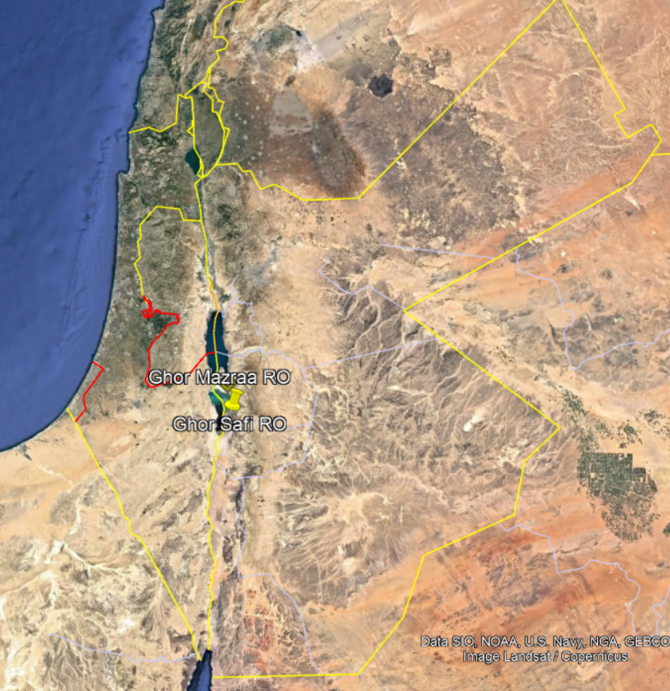
Case Study: Rehabilitation of Ghor Safi and Ghor Mazraa Desalination Plants (2024)
Located in Karak Governorate, Jordan – vital for local water supply.
Ghor Safi Plant:
Capacity: 2.3 MCM/year→ Serves Ghor Safi village
Ghor Mazra’a Plant:
Capacity: 1.4 MCM/year→ Serves Ghor Mazra’a village

Slide 27
Case Study: Rehabilitation of Ghor Safi and Ghor Mazraa Desalination Plants (2024)
Objective:
Improve operational efficiency, water quality, and sustainability of two brackish water desalination plants (Ghor Safi & Ghor Mazraa).
Budget:
The total cost of the rehabilitation works implemented was 276,340 USD (197,386 JOD)
WAJ has rehabilitated 4 desalination plants namely, Ghor Safi, Ghor Mazra’a, Ghor Feifa, and Ghweibah desalination plants with overall cost of 100,800 USD (72,000 JOD)
GIZ has rehabilitated Ghor Safi and Ghor Mazra’a desalination plants with overall cost of 175,540 USD (125,386 JOD).

Slide 28
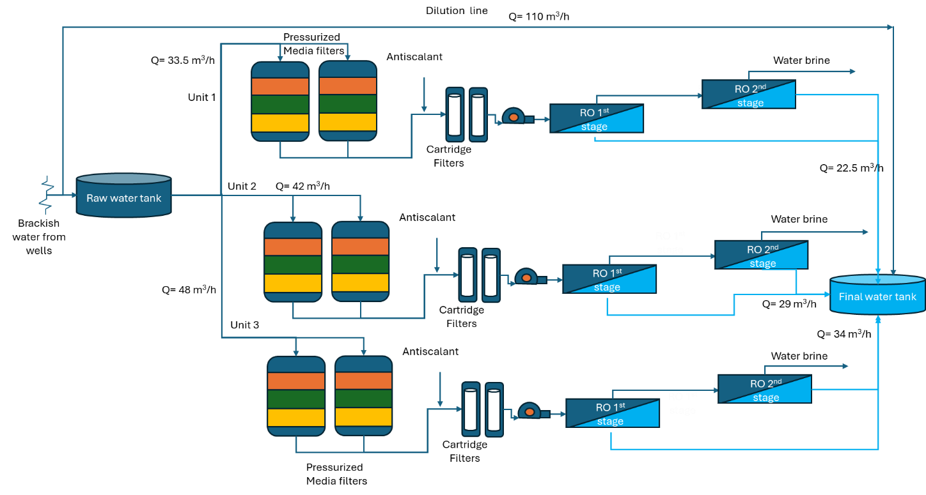
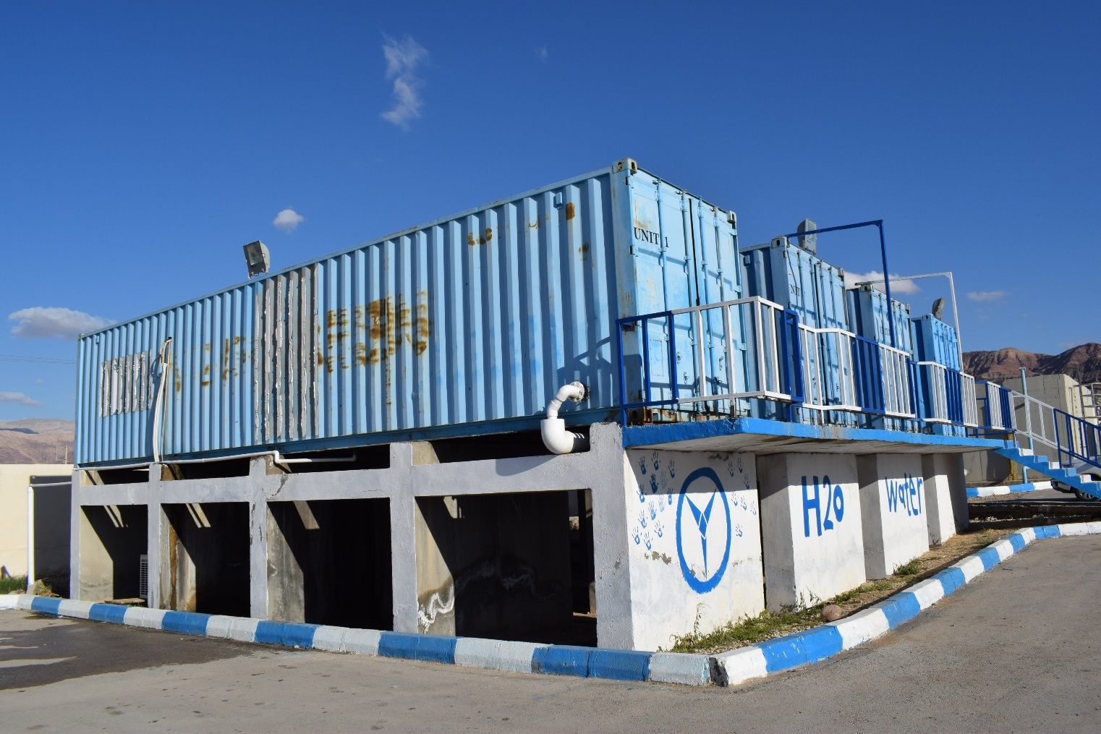
Case Study: Rehabilitation of Ghor Safi and Ghor Mazraa Desalination Plants (2024)
Ghor Safi plant

Slide 29
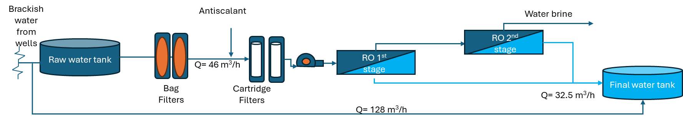
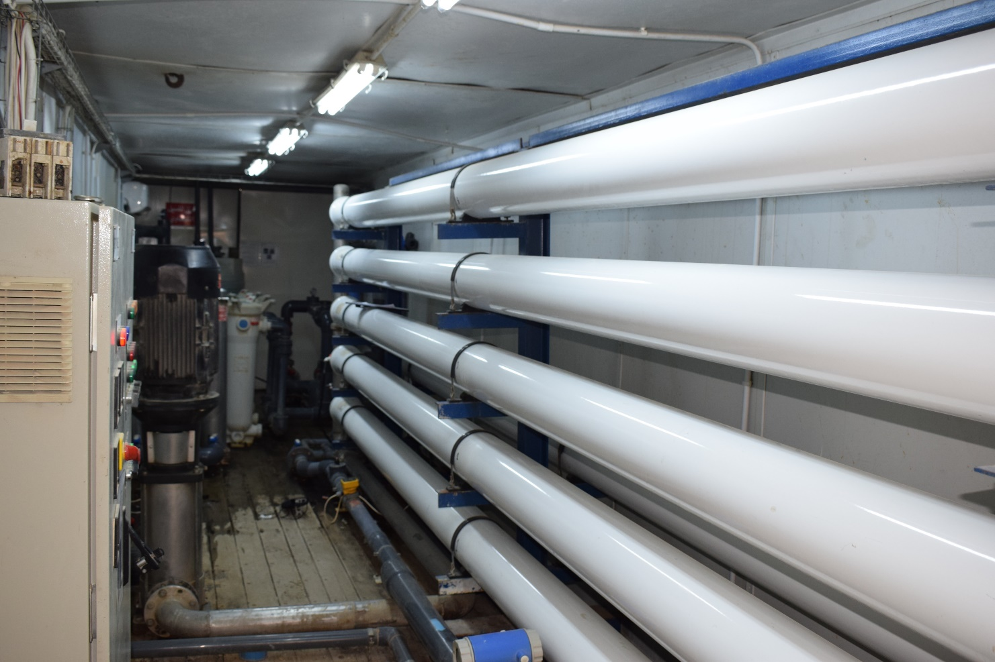
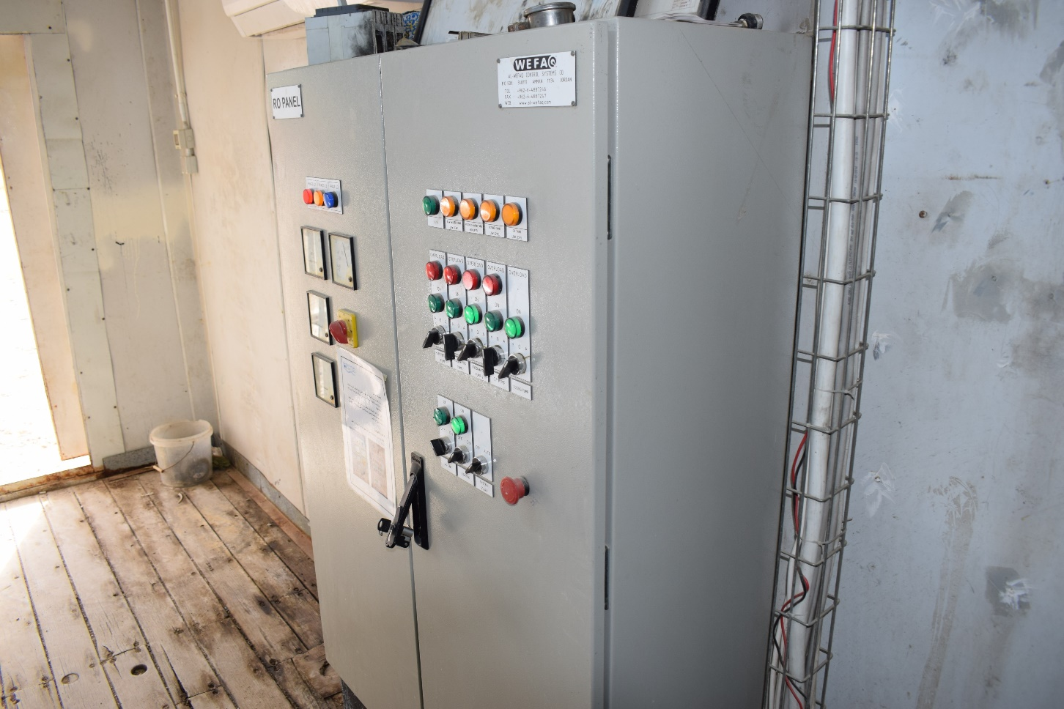
Case Study: Rehabilitation of Ghor Safi and Ghor Mazraa Desalination Plants (2024)
Ghor Mazraa plant

Slide 30
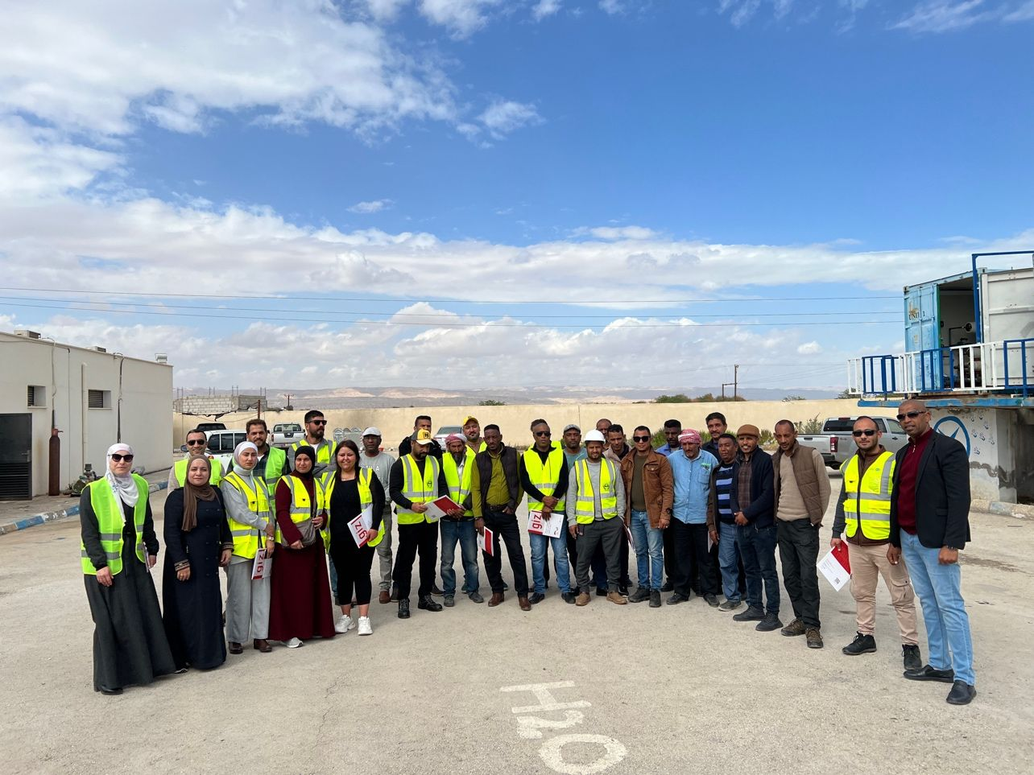
Case Study: Scope of Work
New membrane installation and membrane cleaning: including interconnectors, end caps and brine seals,
Structural improvements: including High-pressure Stainless steel piping, Cartridge filter housings, vessel support structures and cartridge/bag filter supports, valves and sampling upgrade, etc.
Spare parts and assemblies: Head assemblies and permeate adapters and thrust cones.
Control and monitoring enhancements: Control system modernization, improving PLC and HMI system and installation of monitoring equipment (flow meter, EC meter, pH, meter, power meter, etc.)
Capacity-building and On-Job training for WAJ & AWC staff.​
Institutional Impact:
🎓 Trained 25+ WAJ & AWC engineers and operators on SOPs & preventive maintenance.
📊 Introduced performance monitoring templates and reporting system.
🔄 Enabled real-time remote monitoring and control via SCADA.

Slide 31
Case Study: The impact of Rehabilitation on Energy Consumption
To measure the impact of the rehabilitation works implemented, the performance of all units of these two desalination plants was monitored in terms of:
  Power consumption,
  Water quantities produced
  Water quality.
Duration: 6.5 months (Jan to Jul 2024)
The monitored data helped to compare the performance of the plants before and after rehabilitation.
37%
25%
5%
30%

Slide 32
The impact of Rehabilitation: Operational cost
The saving in the operational cost ranges between 8.5 and 19% per unit.
In average, the saving in OPEX was 13%
19%
8.5%
10%

Slide 33
The impact of Rehabilitation: Operational cost

Slide 34
Outlook on Desalination
Strengthening Water Sector Capacities

Slide 35


Strong Water Utility Project (SWU)
Component 5_Objectives:
The capacities of the WAJ and the WUs to increase the quantities of desalinated water provided have been strengthened.
➔ to strengthen the institutional and operational capacities of WAJ and the WUs to monitor, operate, and manage desalination facilities effectively.
Maximize Operational Efficiency
The actual production of desalinated water reaches 70% of the design capacity of existing public desalination plants.
➔ to support planning for desalination infrastructure , whether through the rehabilitation of existing plants or the development of new sources.

Slide 36
Indicators and Main Activities
Indicator 5.1: For 11 of the 21 publicly owned desalination plants, WUs regularly provides data to UPMU for the monitoring of agreed key performance indicators (KPIs), including environmental KPIs.
Indicator 5.2: Investment decisions to improve the infrastructure for the desalination of 5 MCM/year of brackish have been made by WAJ or WU.
Main Activity 5.1: Introduction and anchoring of management tools for the planning, monitoring and operation of desalination plants (e.g. cost-performance assessment, environmental practices, KPIs and digital monitoring (dashboard), SCADA links) at WAJ and WUs
Main Activity 5.2: Support the development of a project pipeline for the rehabilitation and/or new construction of desalination infrastructure, including cost assessment & environmental requirements and financing of smaller rehabilitation measures
Develop Framework of KPIs for Desalination Plants
Integration of SCADA systems to enable real-time data flow and automated monitoring
Undertaking and updating the plants` cost and performance assessment
Rehabilitation measures for existing desalination plant
Strengthening NCPMU management capacities
Activity
Activity
  Regular reporting of KPIs to UPMU
Develop regular operational data reports from the SCADA system
Comprehensive cost & performance assessment for 3 desalination plants conducted by the partners
Rehabilitation of up to three desalination plants
Contract Management system for NC project
Milestone
Milestone
Develop capacity development/ training programs for WAJ/ WUs/ universities staff
Assessment of the Environmental impact (Brine, CO₂ emissions, chemical storage and disposal, etc)
Support the development of potential water resources and new desalination plants
Activity
Activity
Development of training modules/ program on desalination
  A road map for brine management in desalination plants
Milestone
Milestone
Feasibility study for one new potential BW resources

Slide 37
Q & A

Slide 38
The End

