Slide 1
A Pilot Study on the Integration of Anaerobic Pre-Treatment into Existing Wastewater Treatment Plants in Jordan: Preliminary Results
I.Al-Zreiqat, M. Barjenbruch, M. Halalsheh, G. Kassab
Dead Sea, 5th. May 2025

Slide 2
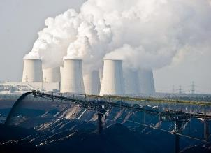
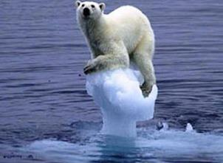
Energy and water quality
Challenges and opportunities
Aim: Improving the energy use at the wastewater treatment plant
  Advanced removal of pollutants (Future requirements for Jordanian regulation)
  High energy demand for treatment and water reuse
Reasons for energy optimization
  Run empty of fossil resources
  Energy crises
  Climate change
    Increase of CO₂-Emissions
    Increase in temperature
  Saving operational costs
Approaches
  Utilizing energy embedded in wastewater (Anaerobic pre-treatment at the upstream of wastewater utilities)
Notes:
Bild 1 BUND Kinderseite; Bild 2 NTV

Slide 3
Energy distribution diagram
Example: Activated Sludge Process
Notes:
Beispiel: Audit Grevesmühlen

Slide 4
ANAJO Project: Overview
Period: 01.01.2022 – 31.08.2025
ANAJO: Wastewater treatment plants in the MENA-Region: Anaerobic pre-treatment to increase energy efficiency and performance of WWTPs in Jordan.
Aim: Developing a novel, climate-friendly anaerobic technology for the treatment of municipal wastewater in combination with a further treatment stage (anaerobic-aerobic).
Objectives:
  Reducing energy demand by incorporating an upstream anaerobic treatment process into the existing plants.
  Demonstrating potentials of energy production from using the embedded energy in wastewater.
  Reducing operational cost of the existing plants.
  Improving sludge management

Slide 5







Partner
Funded by: BMUV
Germany
Jordan

Slide 6
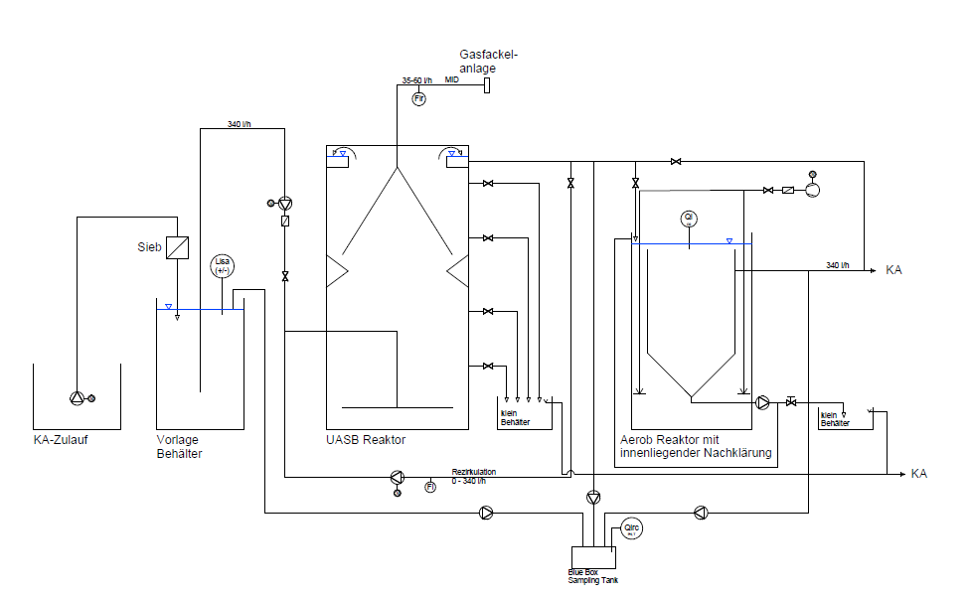
Pilotanlage: Process Scheme
Bluebox
RT:2min.
PT:5min.
Hz
Recirculation rate
Notes:
Wastewater is pumped to the receving tank of the pilot plant (Vorlage Behälter). The feeding pump to the UASB reactor has a constant flow of around 571 Liter/hr. It runs in an ON/Off Mode. The Upflow velocity is controlled through the recirculation pump Water from the UASB reactor is further treated in the activated sludge tank. Water Quality is measured at three different points along the treatment process. The water quality is measured for the following parameters: COD, CODsol., TSS, TN, NH4-N, NO3-N, pH, Temperature.
Organic loading rate design: 3.5 kg COD/m3
Q design: 340 Liter/h
Volume UASB: 2,38 m3
Reactor hight: 2,5
Diameter: 1.1 m

Slide 7
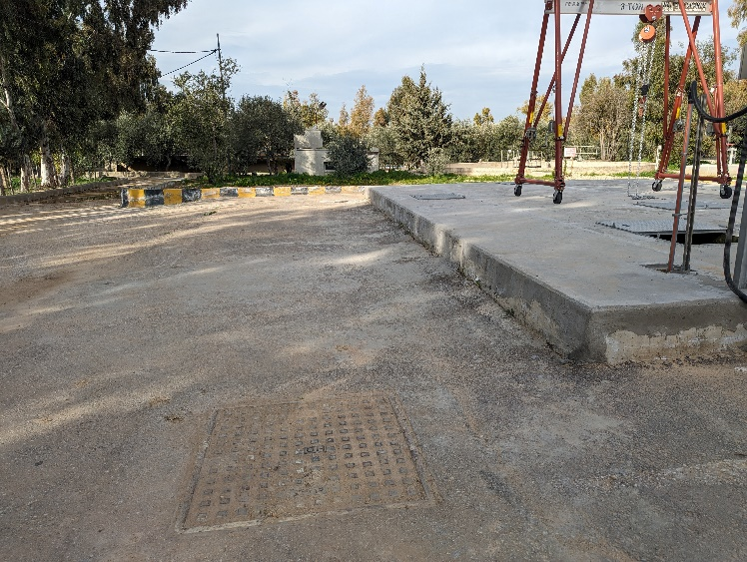
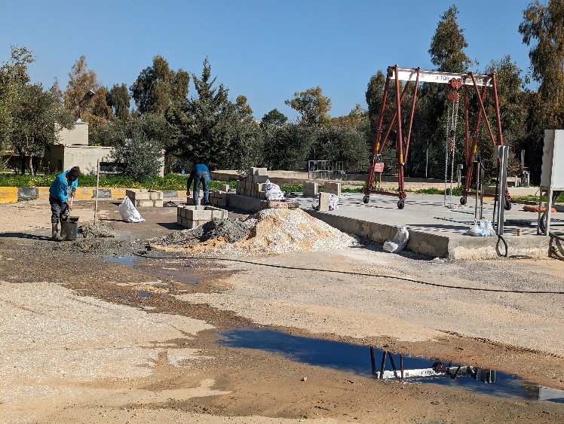
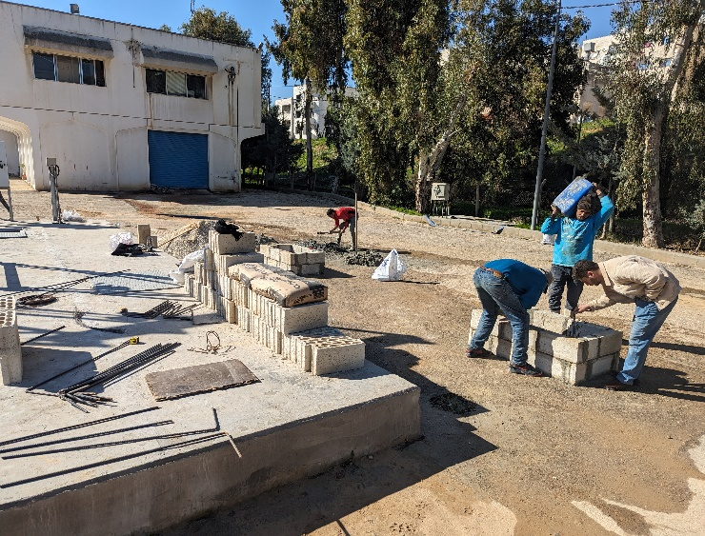
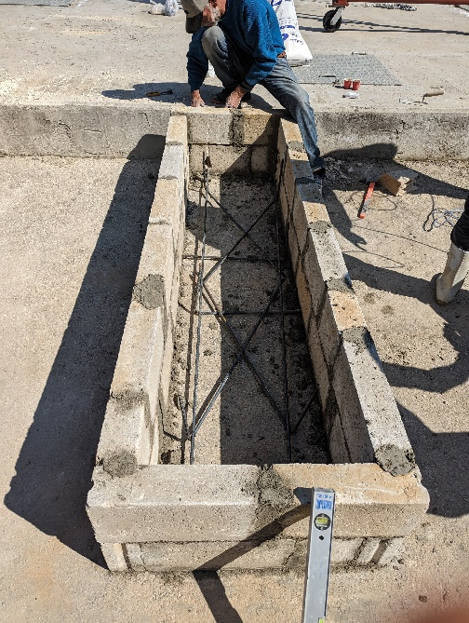
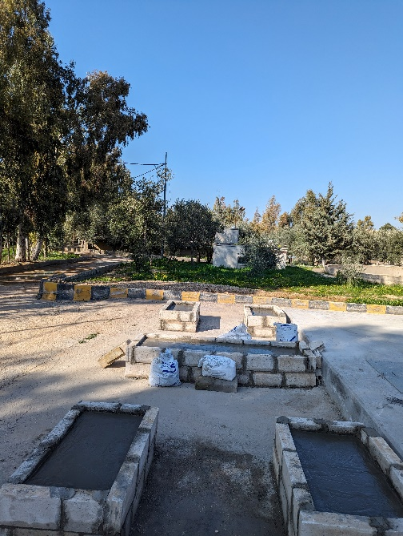
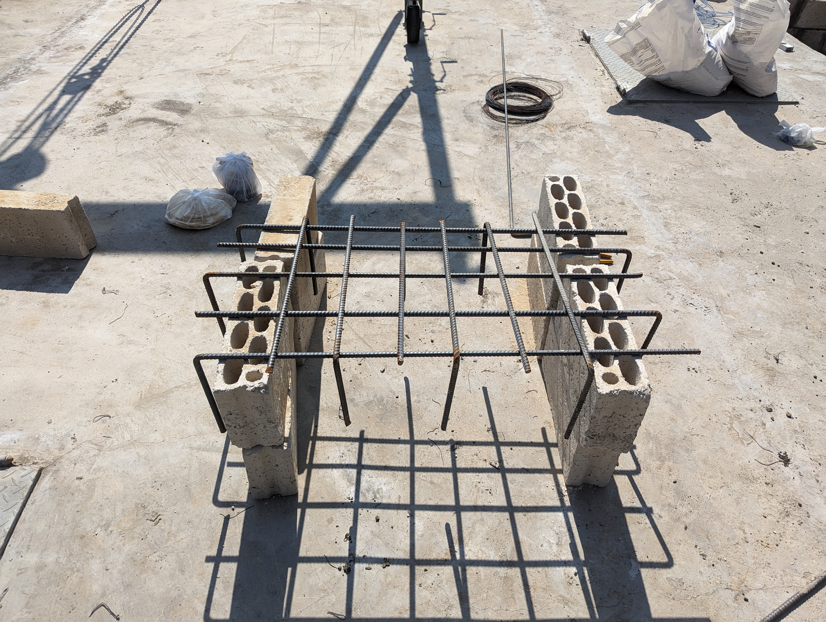
Transport and Installation: Site preparation

Slide 8
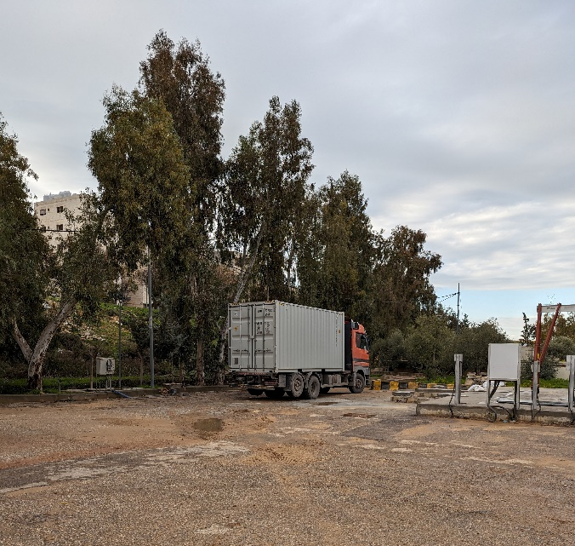
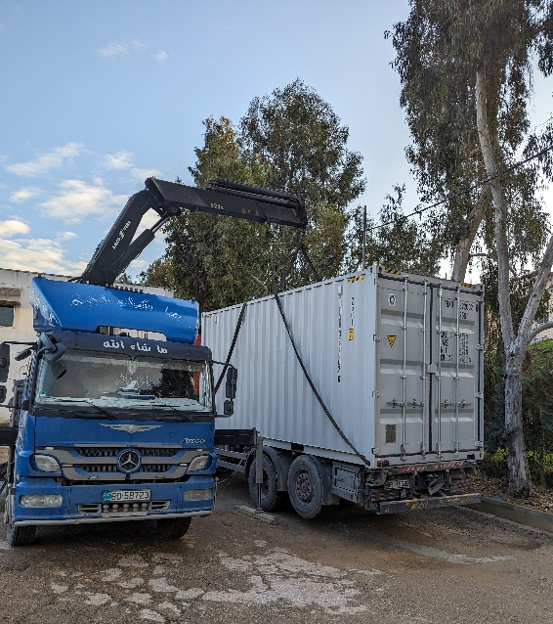
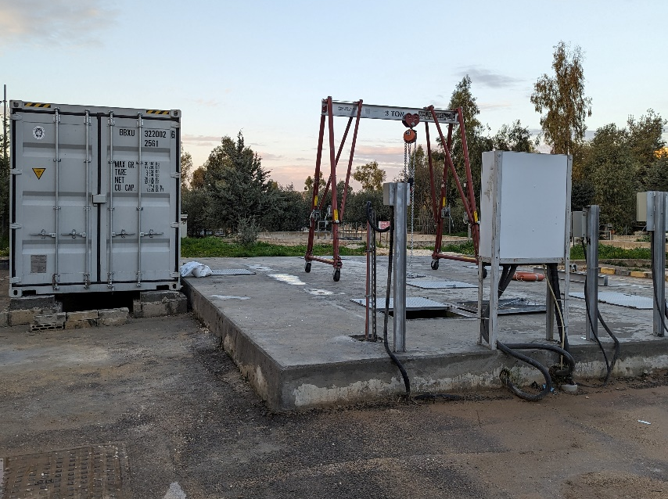
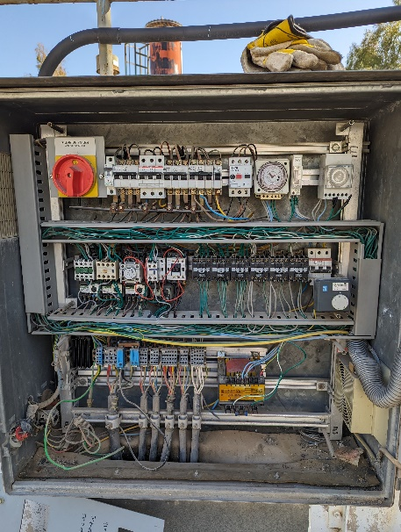
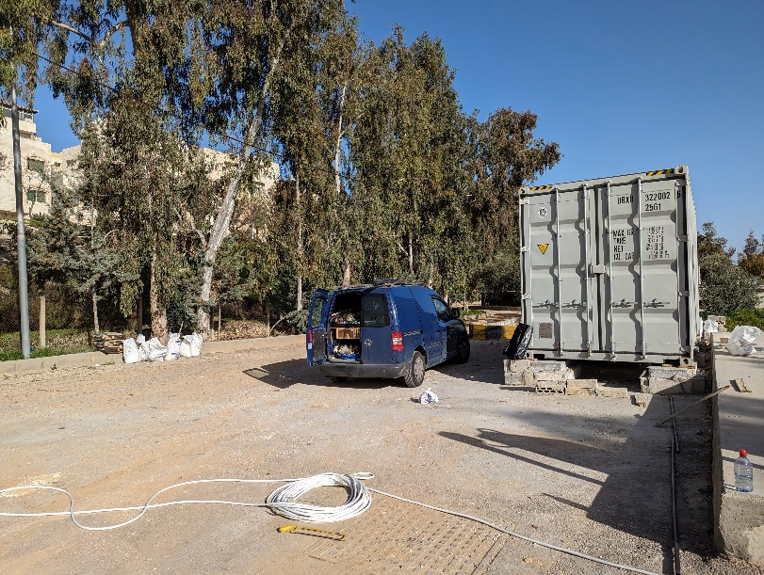
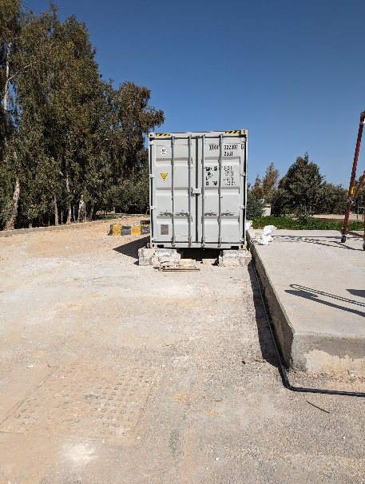
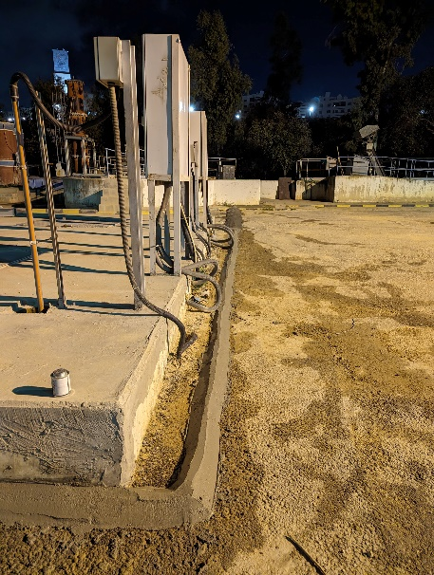
Installation of the pilot plant at Abu-Nusier WWTP

Slide 9
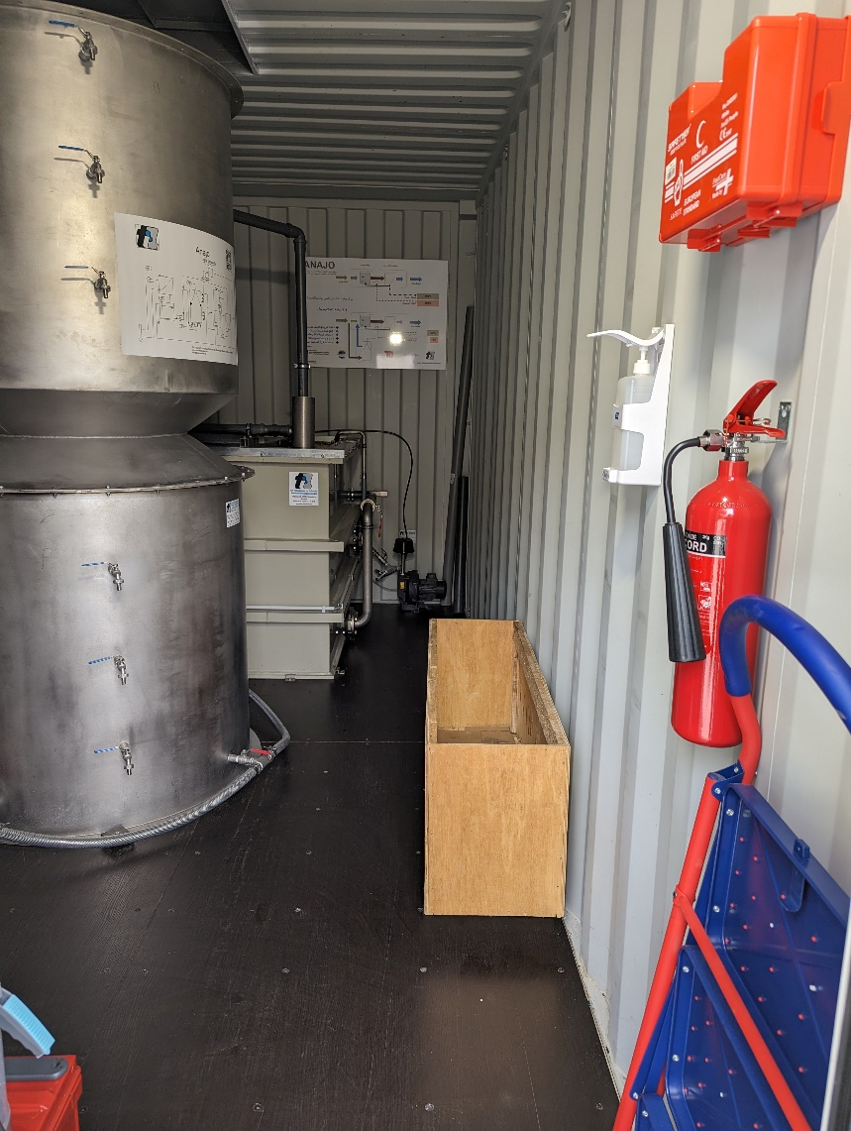
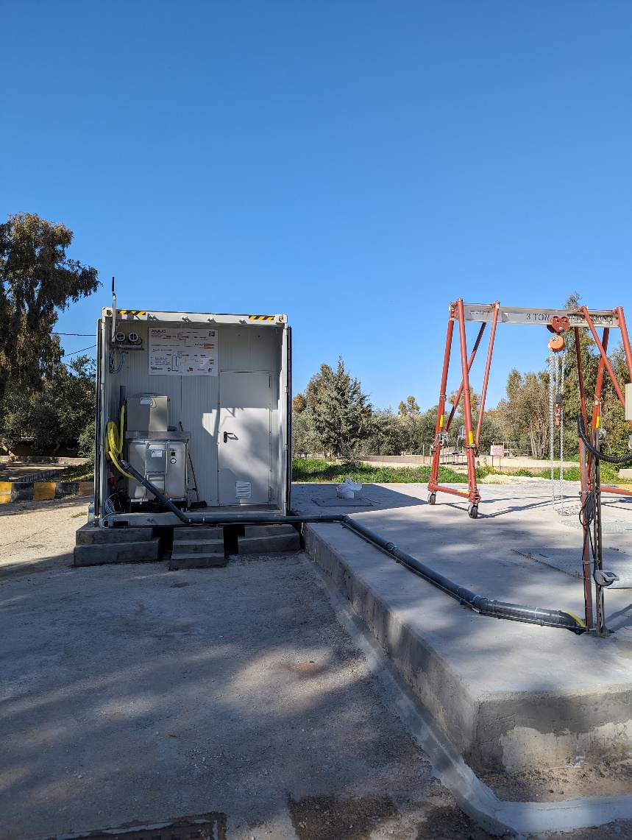
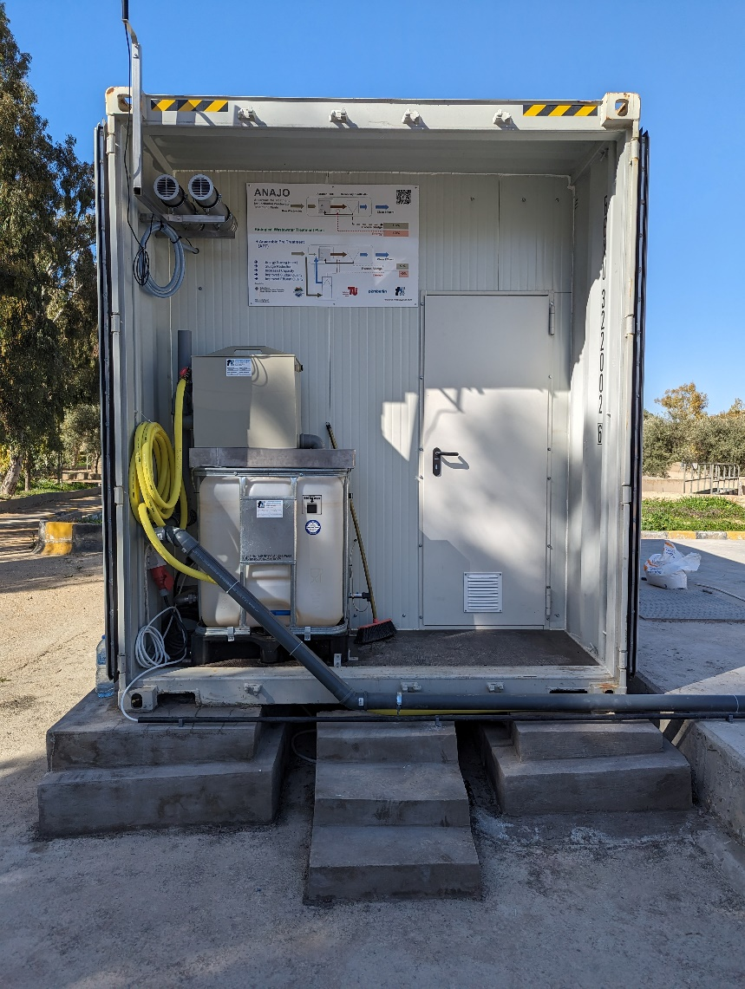
Connecting the pilot plant to Abu-Nusier WWTP

Slide 10
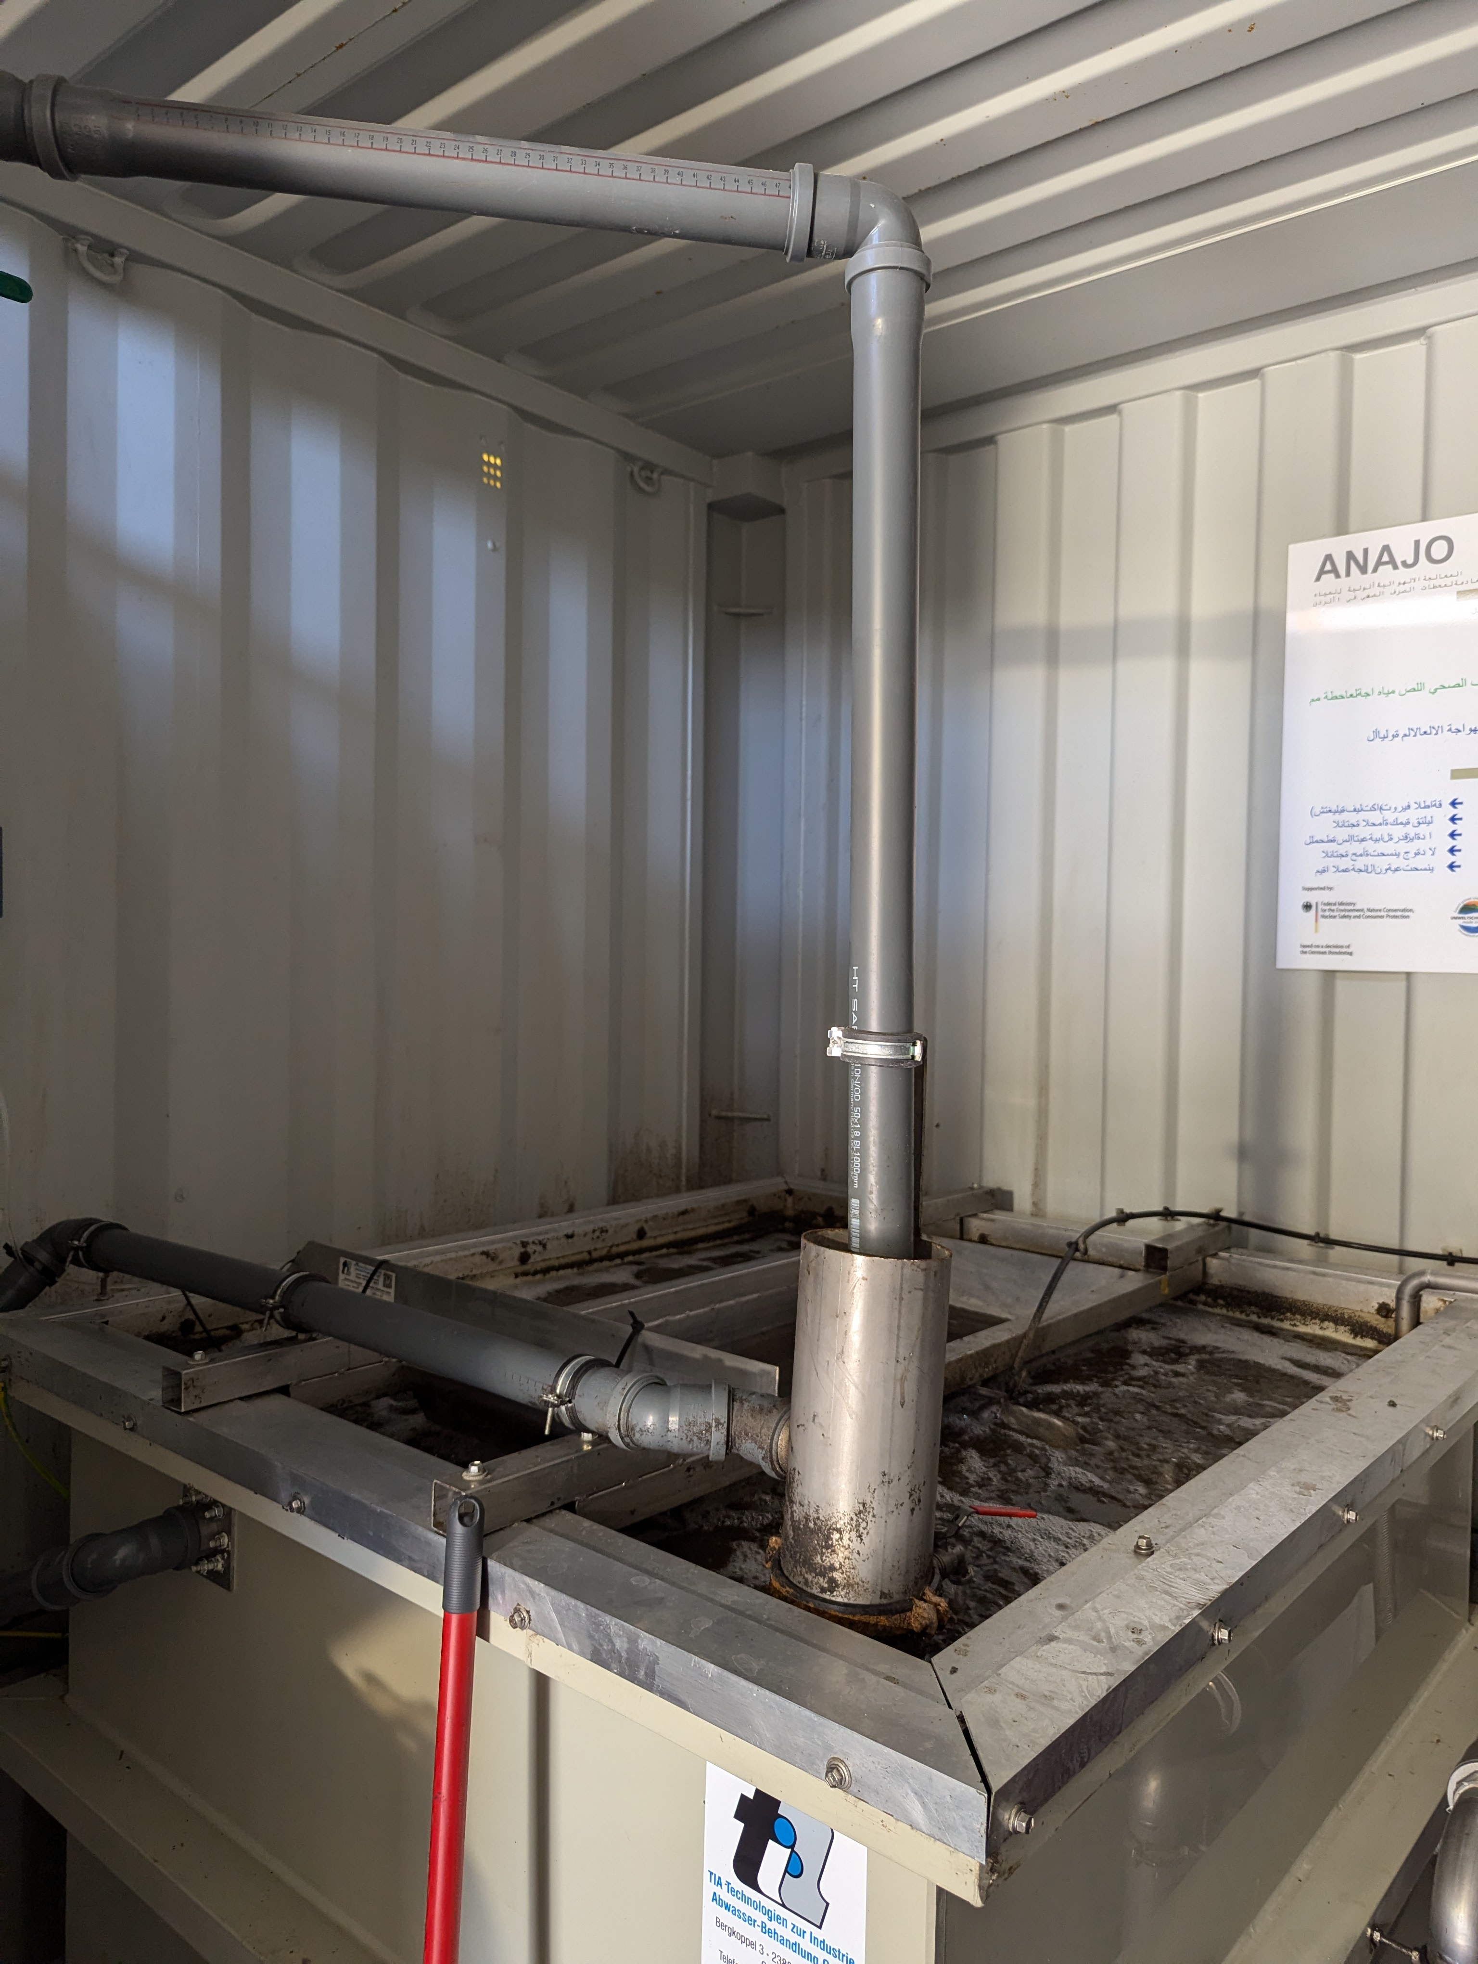
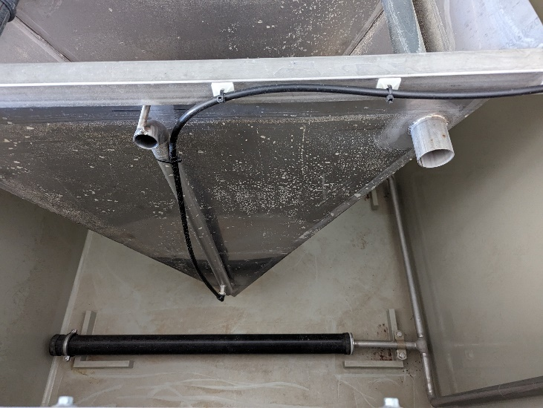
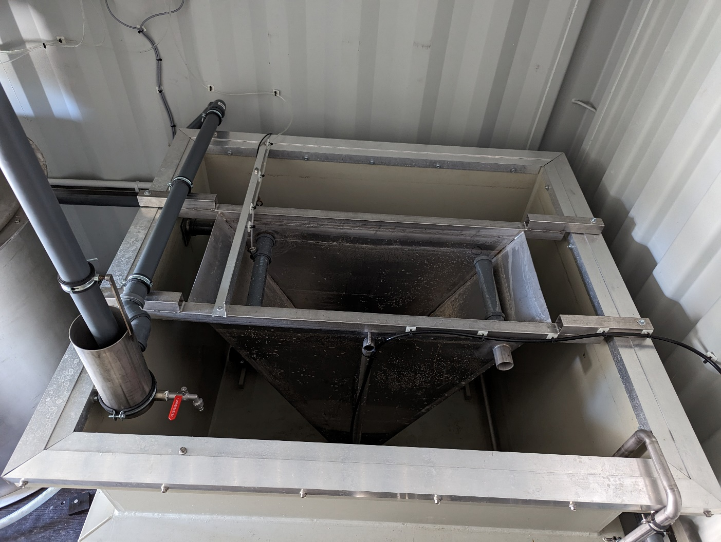
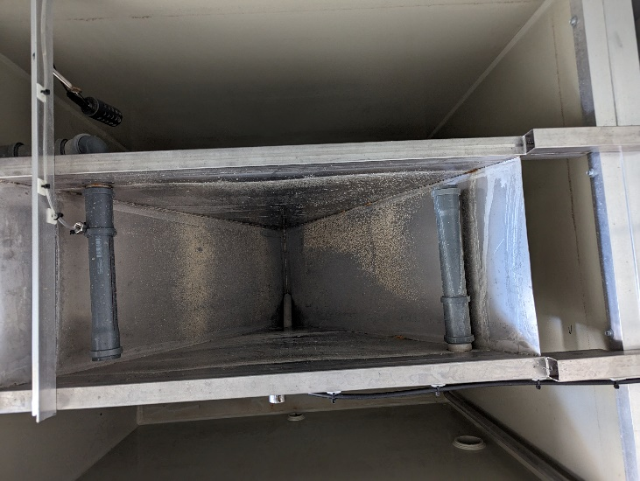
System’s components
Activated sludg- and settling tank

Slide 11
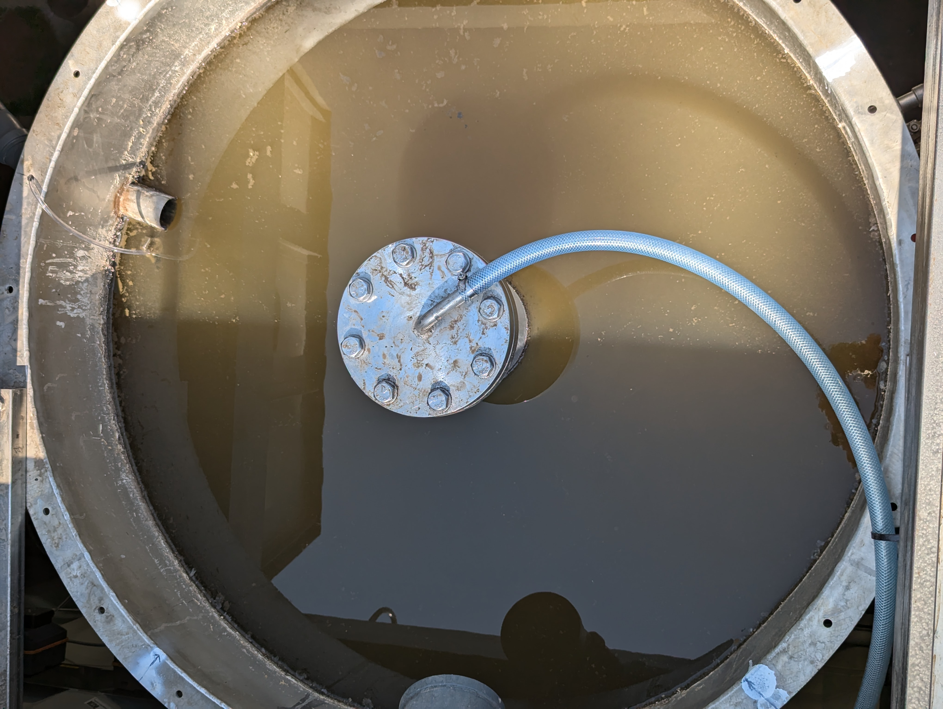
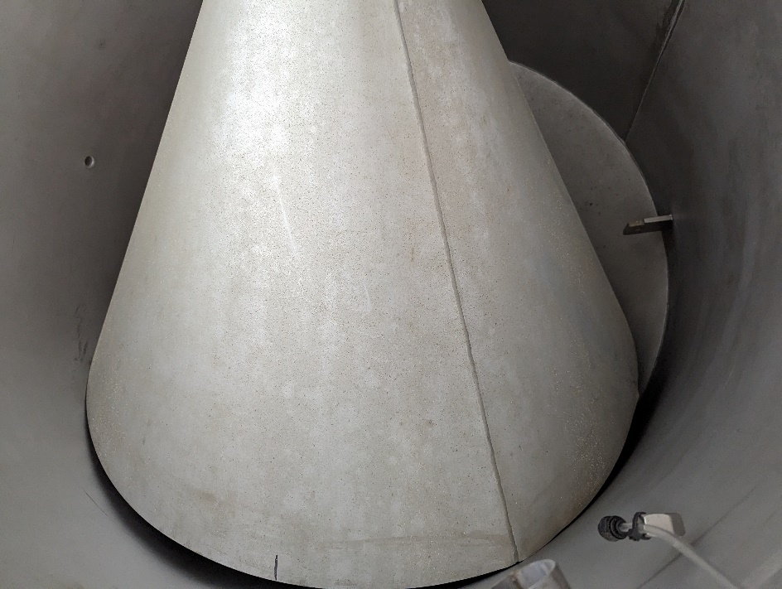
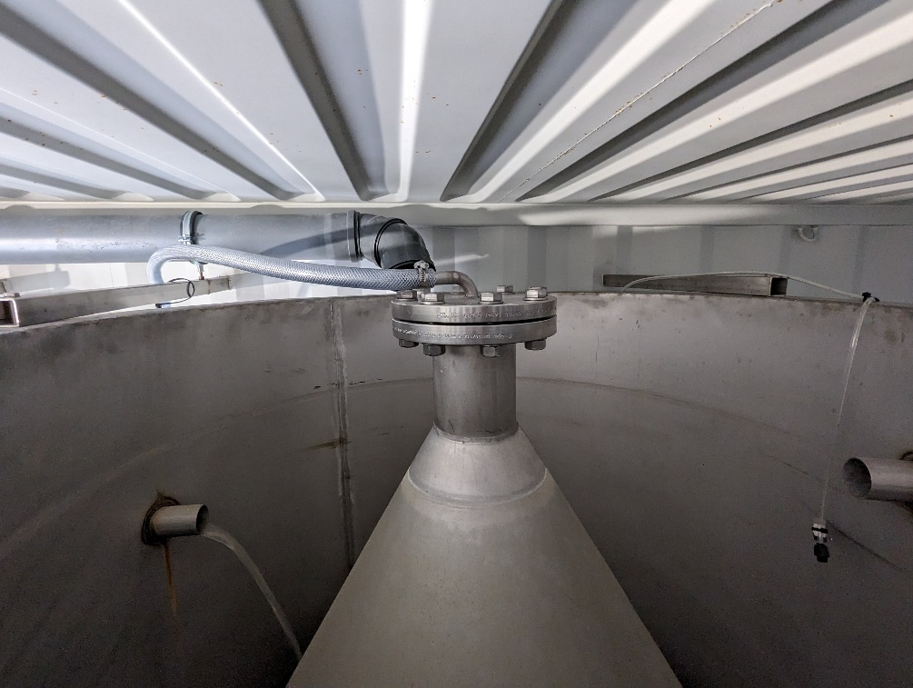
System components
UASB reactor

Slide 12
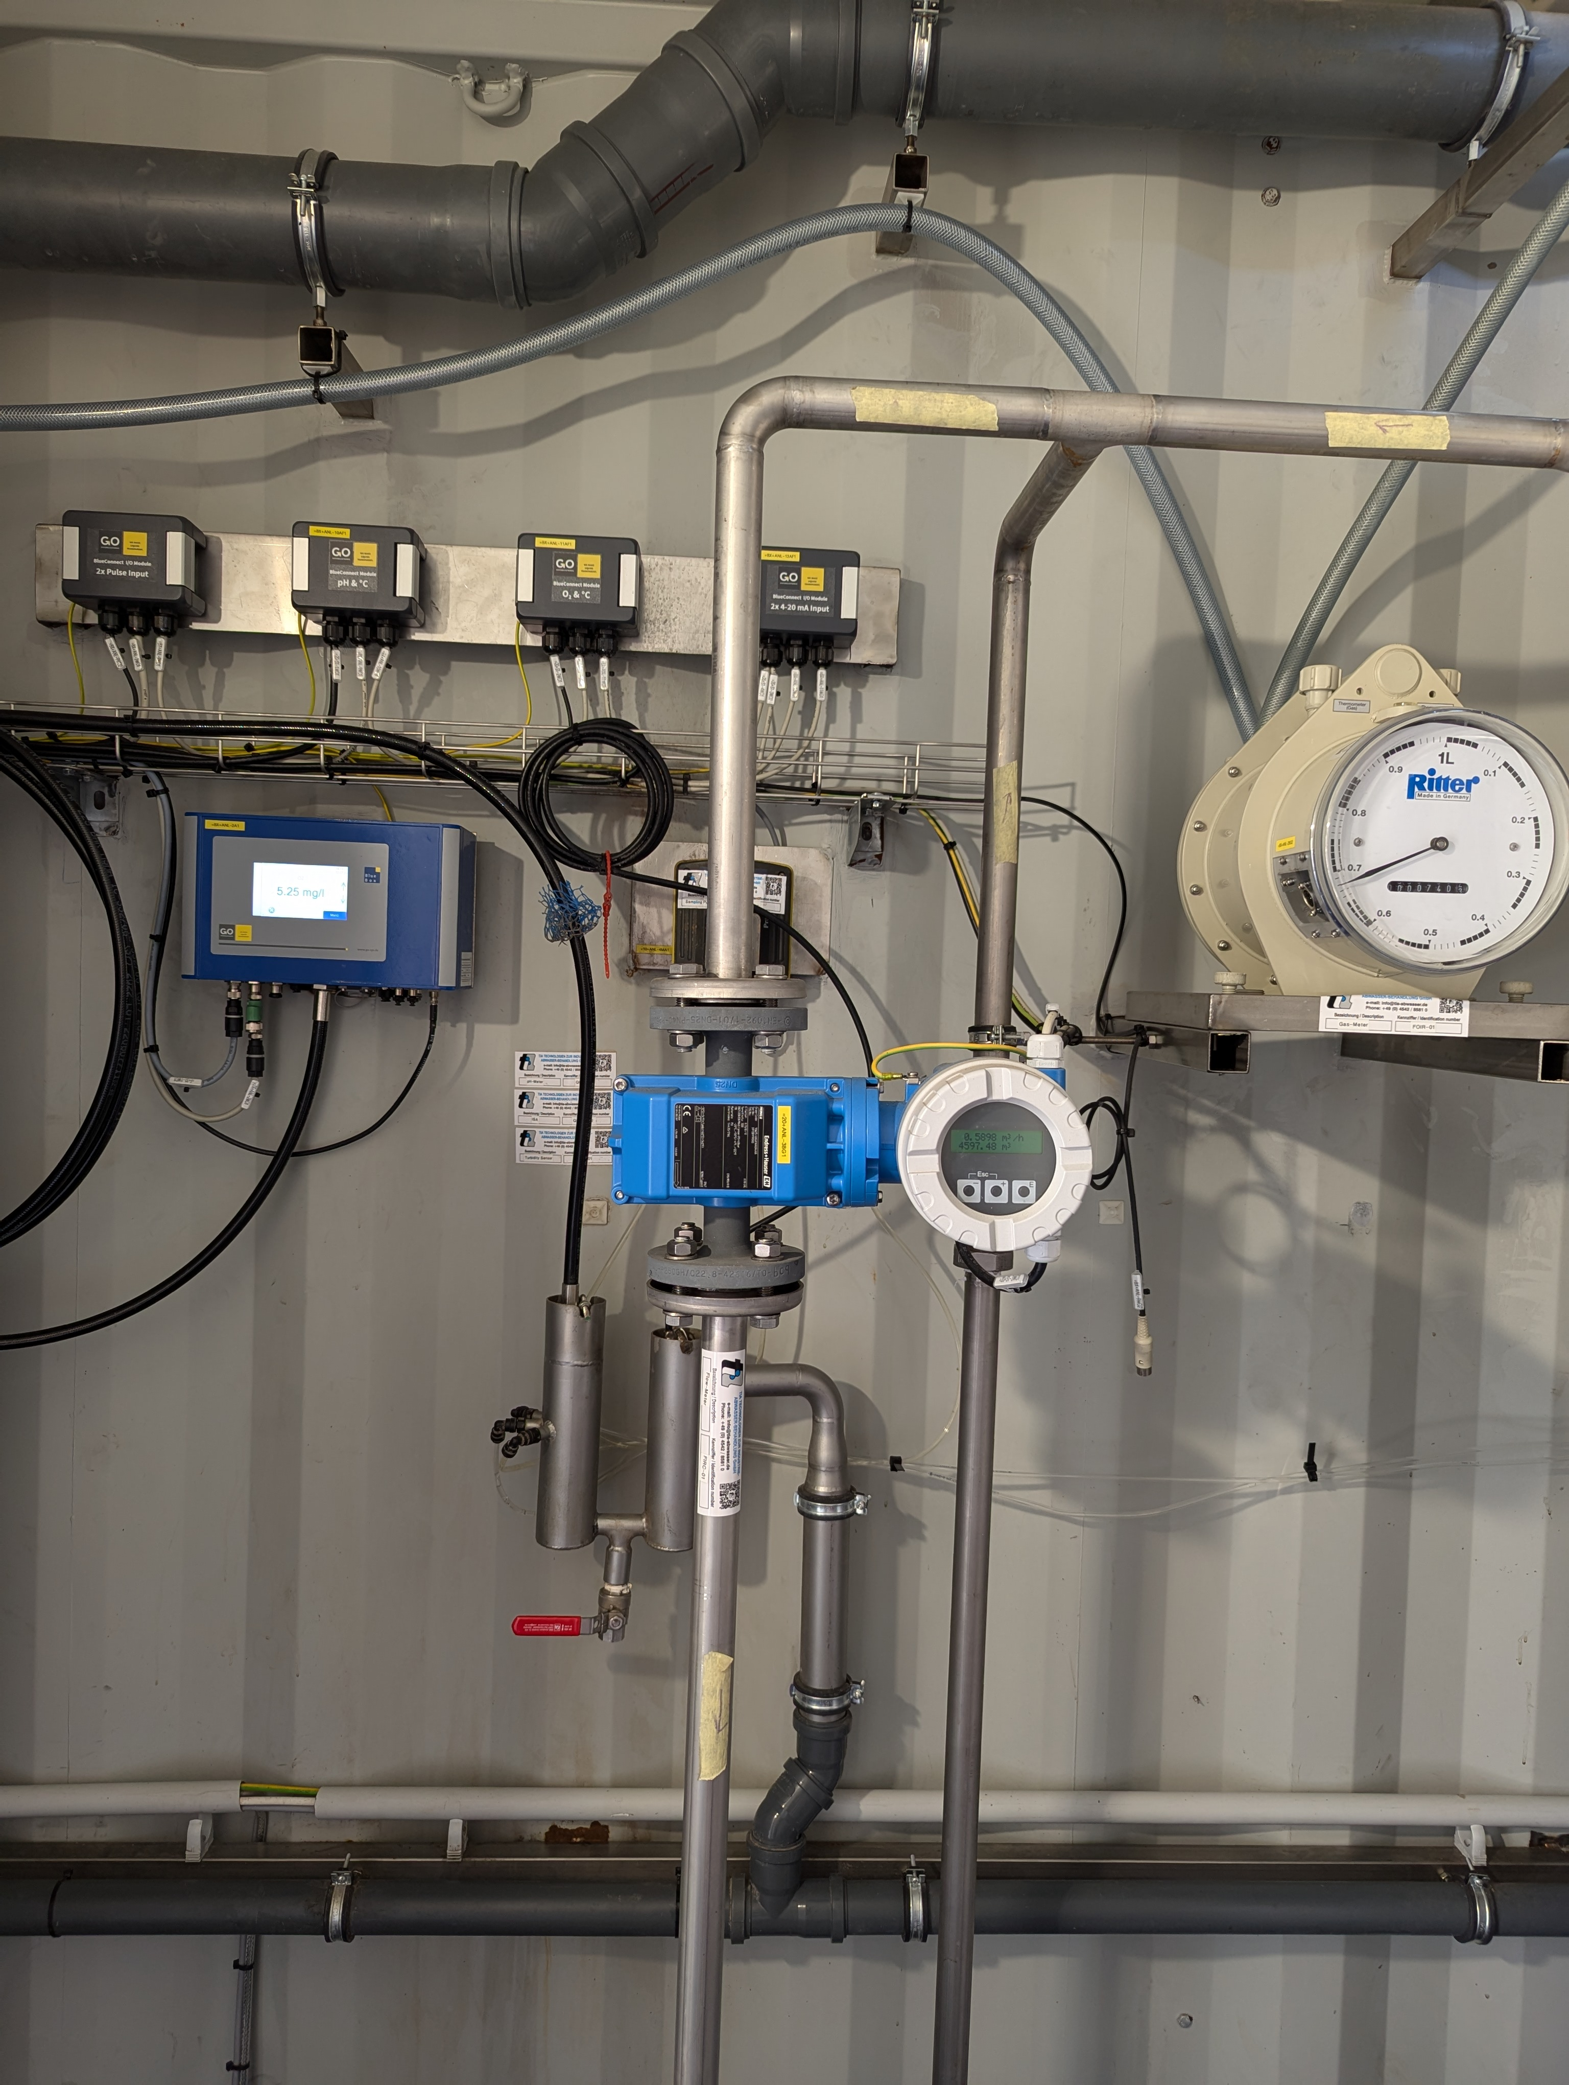
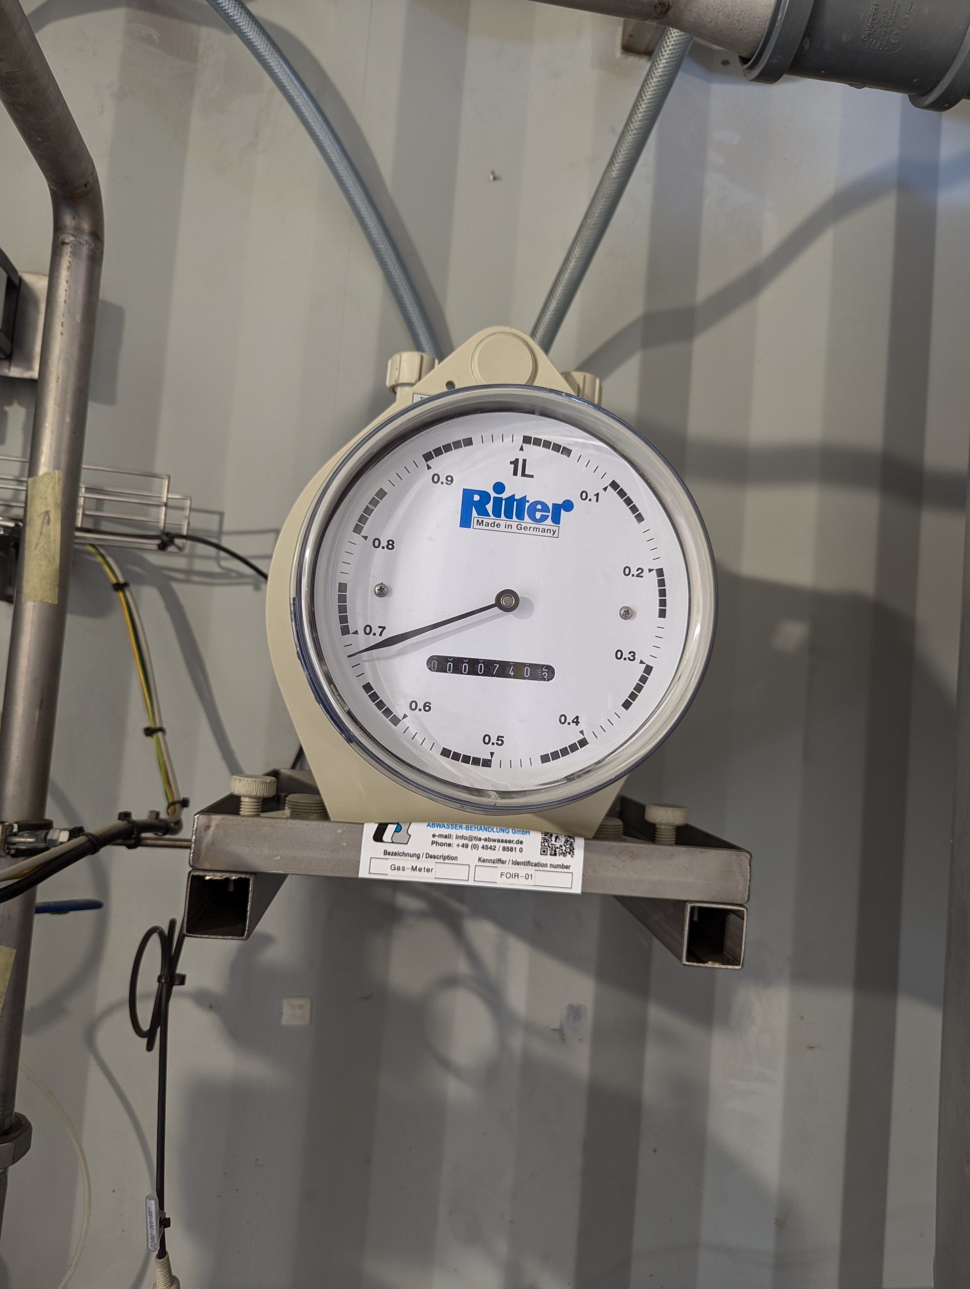
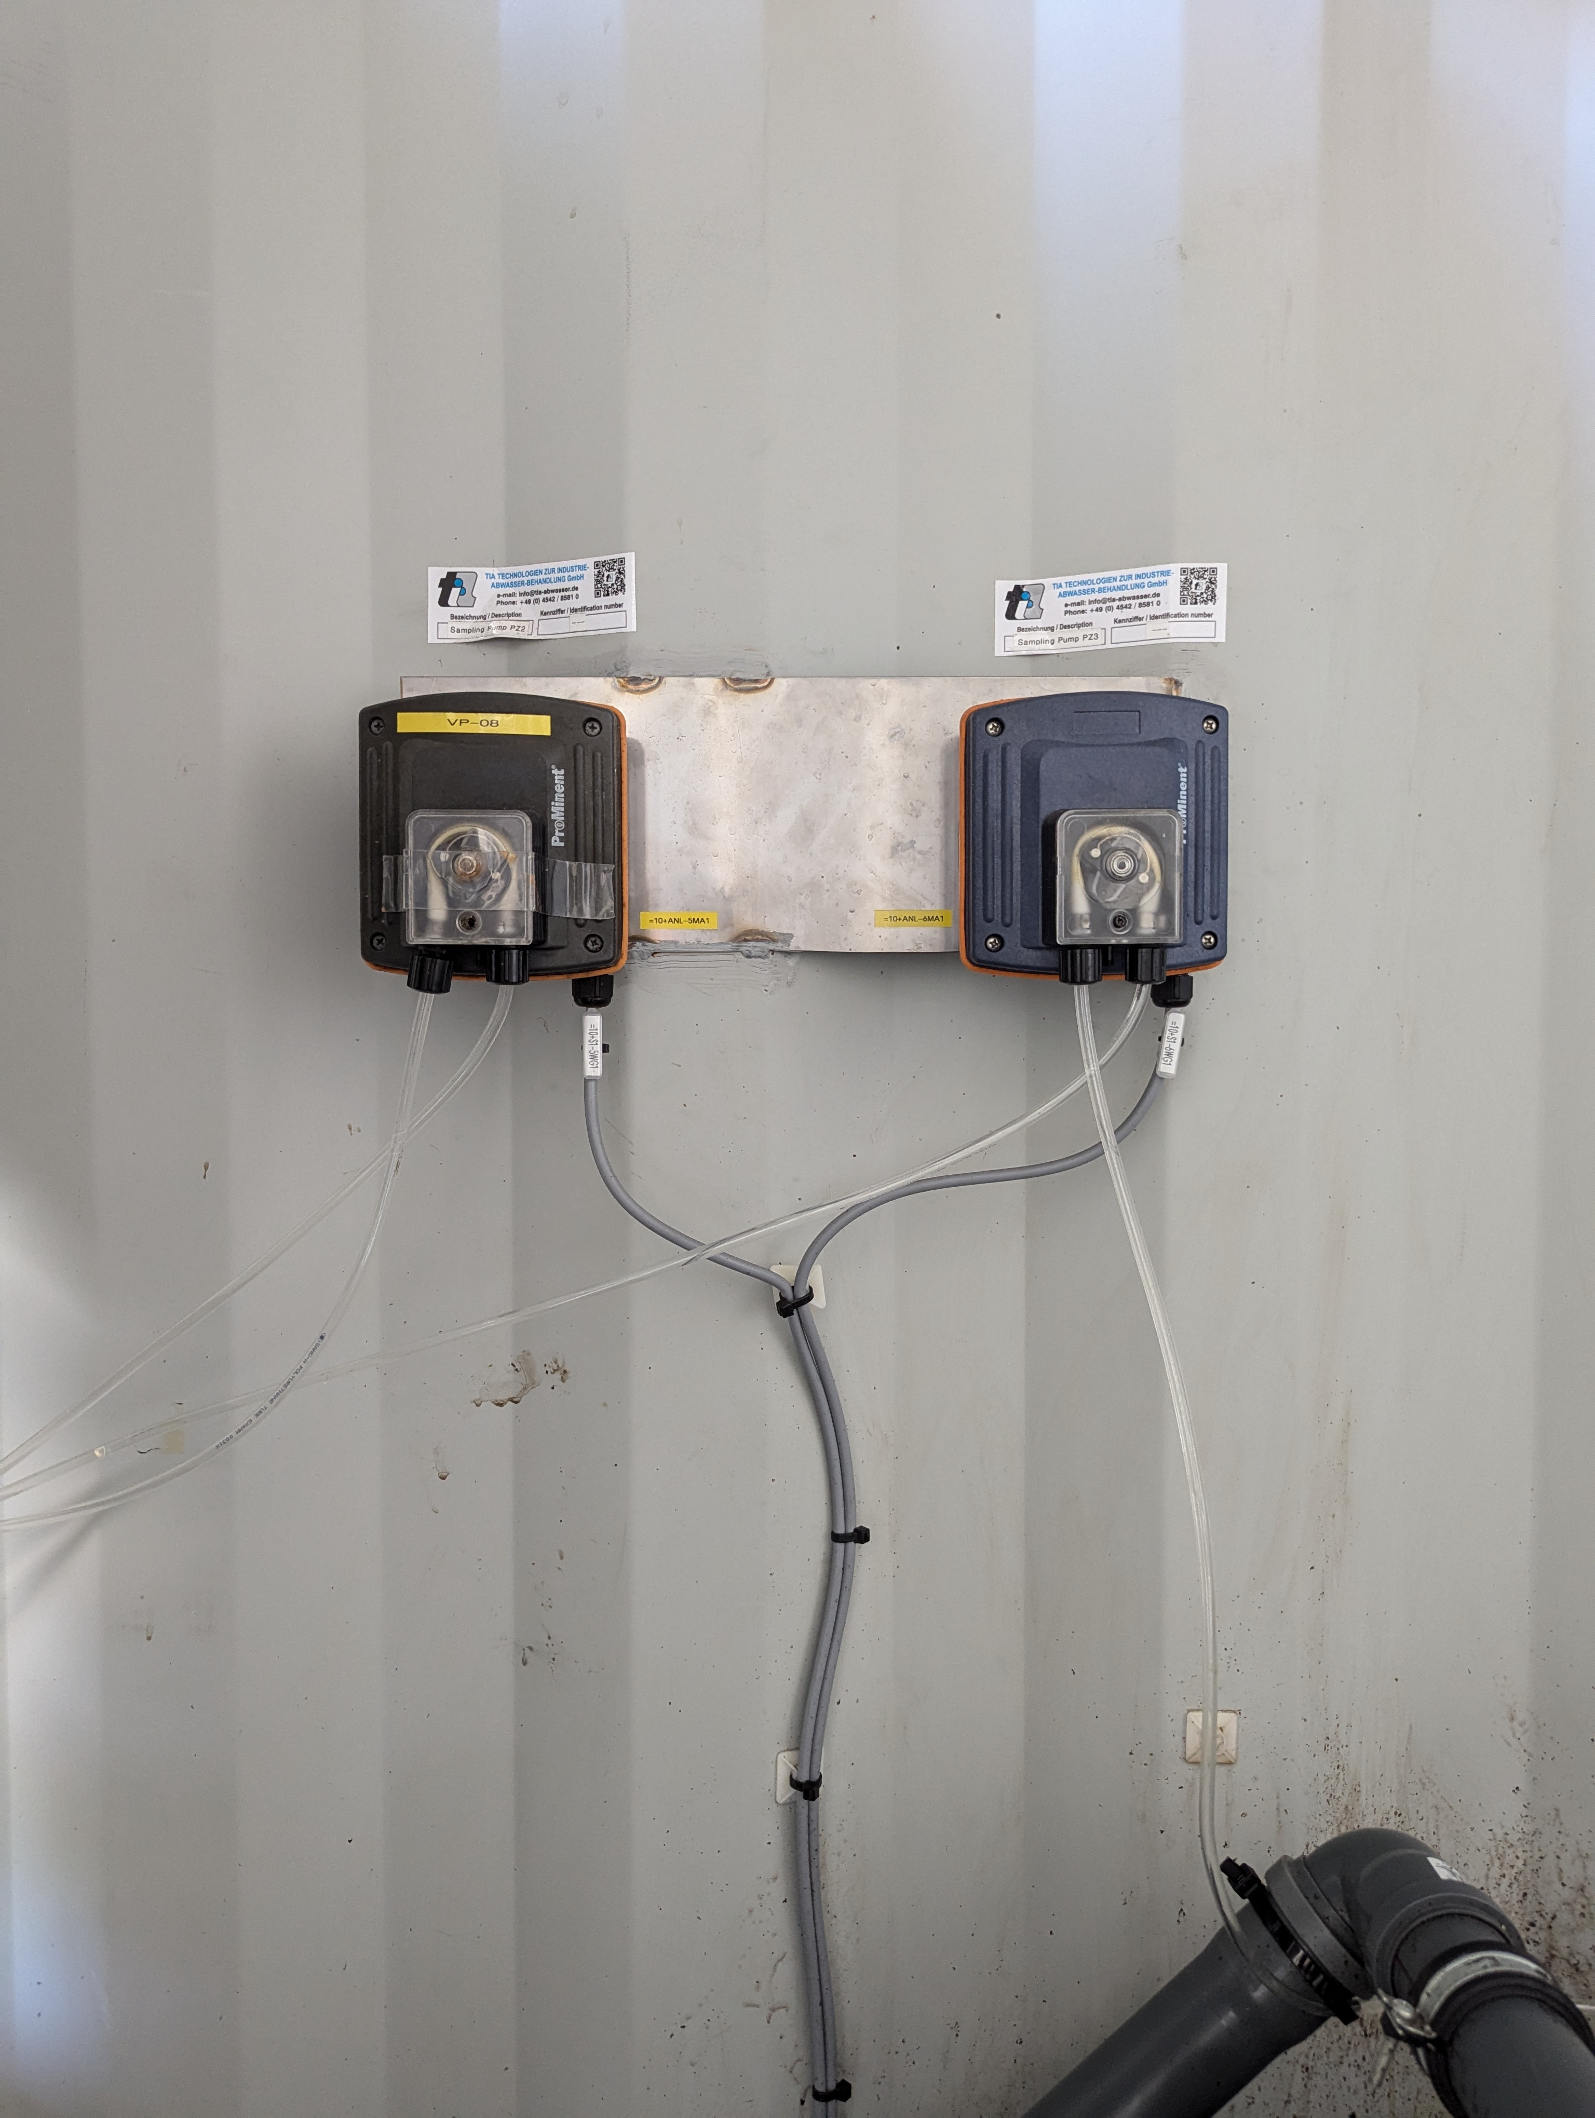
Control and measuring system

Slide 13
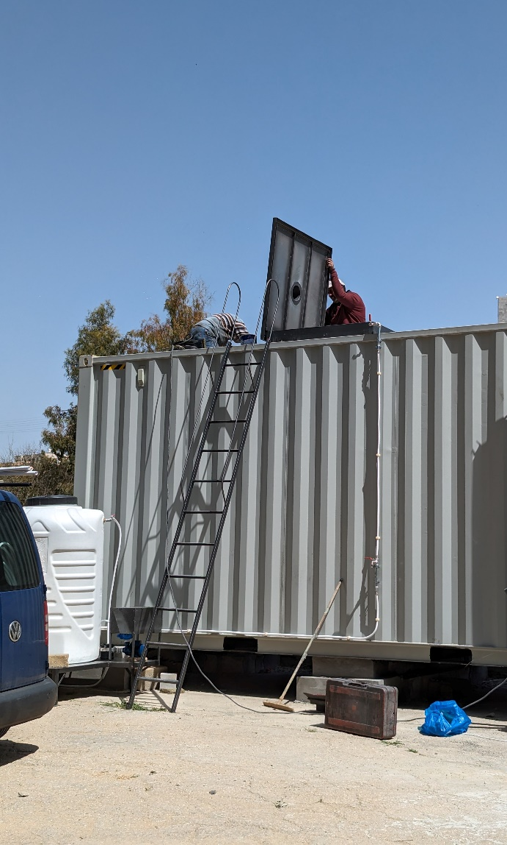
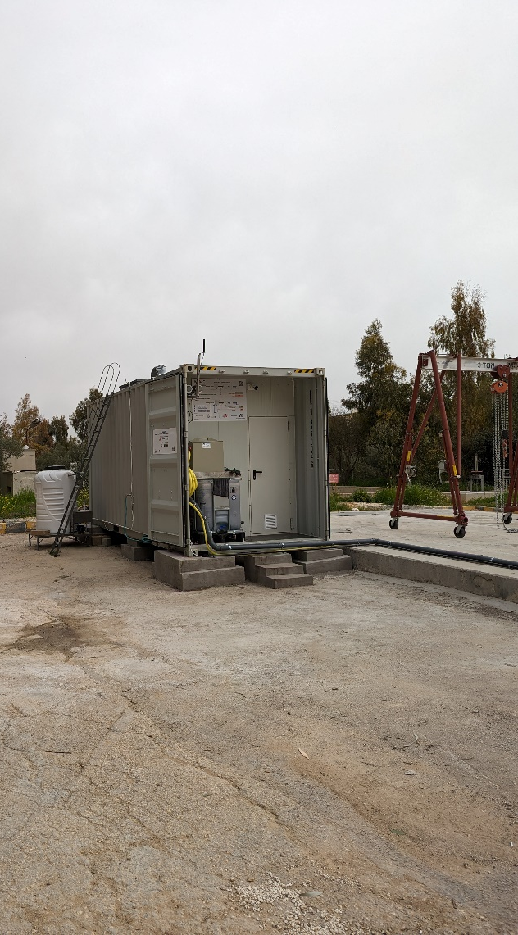
Sicherheitsmaßnahmen u. weitere Ausrüstungen

Slide 14
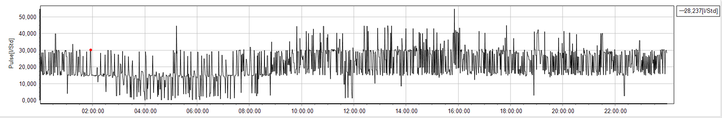
Preliminary Results from the UASB reactor
Parameter | Unit | Min. | Max. | Median | Average
COD_{inf._UASB} | [mg/l] | 467 | 1324 | 956,5 | 936
COD_{inf._sol._UASB} | [mg/l] | 218 | 659 | 465,5 | 447
COD_{eff.._UASB} | [mg/l] | 263 | 587 | 360,5 | 367
COD_{eff._sol.._UASB} | [mg/l] | 115 | 371 | 149 | 156
Gas production | [l/hr] | 3 | 52 | 24 | 24

Slide 15
TS Profile in UASB
_{864 mg/l}
210 cm
_{1821 mg/l}
170 cm
_{10570 mg/l}
90 cm
15278 mg/l
60 cm
25885 mg/l
30 cm

Slide 16
Energy Production from Biogas
USAB Reactor as a Pre-Treatment Unit
Abu Nusier wastewater treatment plant data for 2020
  Flow= 3.947,75 m³/d
  COD_{CH4}= Q_{avr.} × [(S_{o} – S.) − Y_{obs} × S_{o})]
  S_{o, avg.}=1,011 kg COD/m³
  S_{avg.}= 0,441 kg COD/m³
Y_{obs}= Solid yields coefficient→ 0,11 kg Sludge/kg COD applied
COD_{CH4}= 1.811,18 m³ CH₄/d
Q_{CH4}= 694 m³/d
Estimated Energy=6.919 kWh/d

Slide 17
Benefits and sustainability aspects of integrating UASB reactor into the AS systems
Fundamental lower energy demand (no aeration) in combination with the reduction of operational costs
Generating usable energy in the form of biogas
  Increasing energy prices let anaerobic technology boost
High specific loading is possible
  Small reactors are needed
  Small space demand (footprint)
Very low excess sludge production in relation to aerobic treatment with a better dewaterability
  Less pollution in landfills and the environment
Reduction of greenhouse gases
New possibilities in the design of WWTP
  Large plants (new or overloaded), but also rural areas
  Improved effluent values

Slide 18
Summary
Meeting new effluent limits and strict water quality standards increases the operational cost of the WWTP.
Operating of activated sludge system is attributed with high energy costs
Increasing the share of renewable energy in operating the wastewater treatment plants (Hydropower and biogas, and other renewable options) reduces the energy cost of the WWTPs.
Integrating an anaerobic unit at the upstream of the biological treatmen tstage increases energy production and improves effluent water quality
The insights gained from the ongoing research project „ANAJO“ aim to assist the water authorities in its decision-making processes.

Slide 19
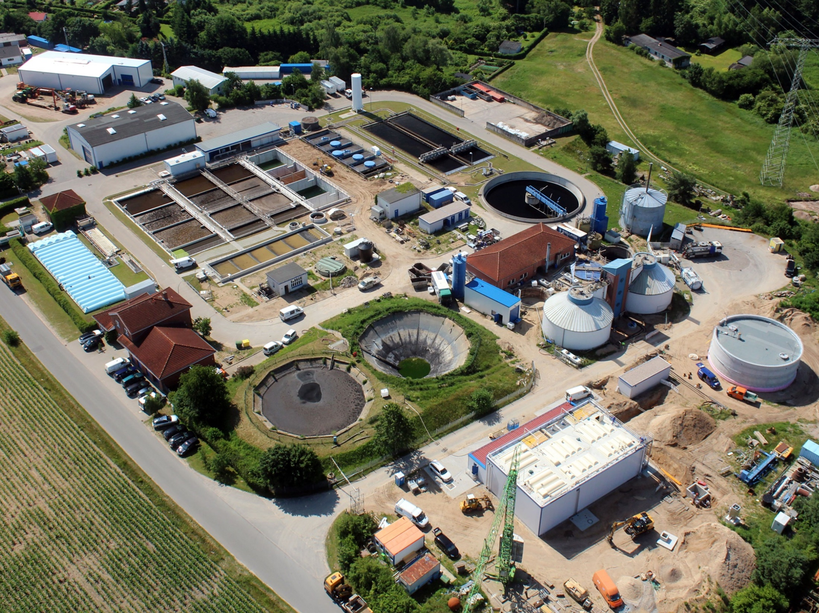
Sewage treatment plants = municipal energy consumer No. 1
1. Step: Reduce energy consumption
in the aeration tank.
(by reducing the organic load)
2. Step: Options to increase energy production
through utilizing biogas (Anaerobic pretreatment / co-digestion)
but: Sewage treatment plants should mainly
purify wastewater and stick to discharge regulation and standards!
[Nach Schröder, 2008]
Notes:
Kläranlagen von der BSR..(optional)

Slide 20
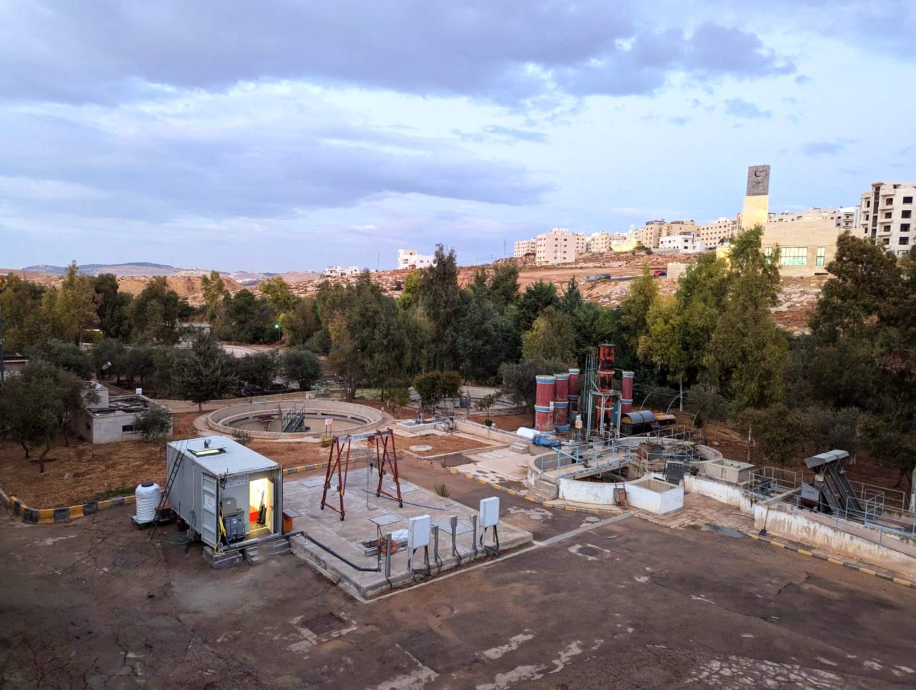

Thank you for your attention

