Slide 1



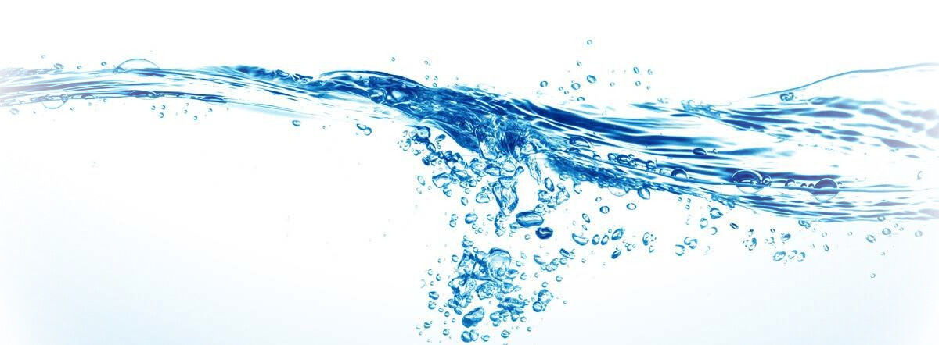
Urban Water Security:
From Comprehensive Assessment to Strategic Management
Samah Jabari, PhD
Palestine Polytechnic University
May-2025

Slide 2
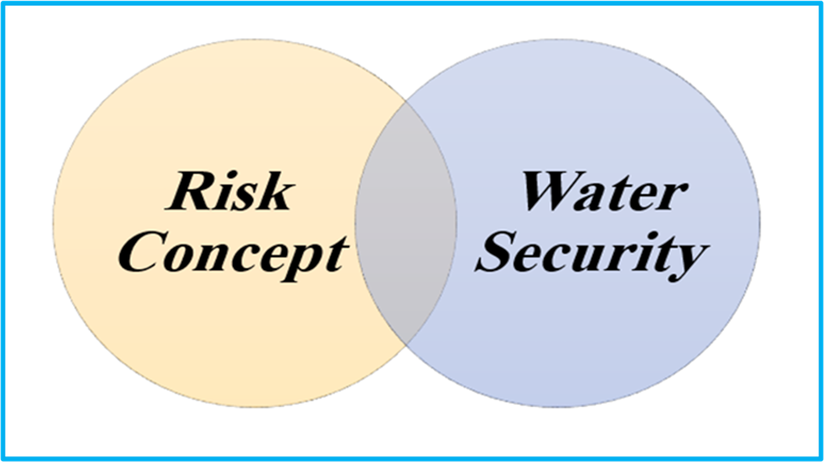
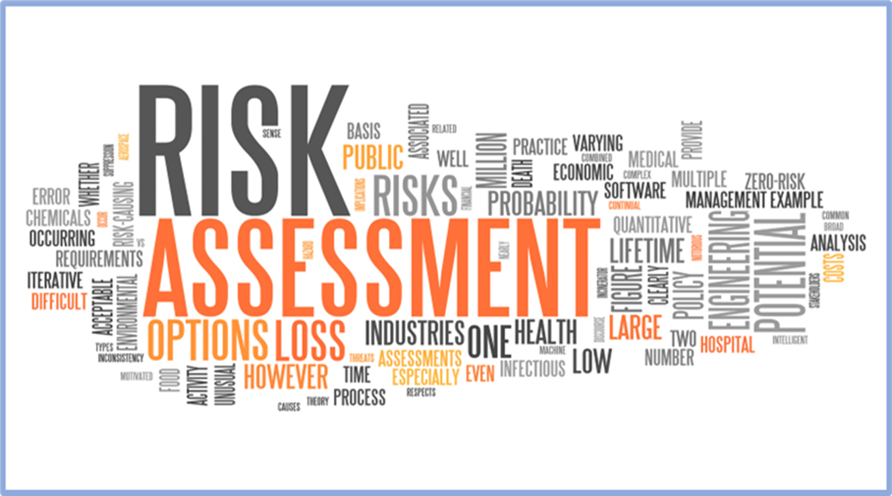
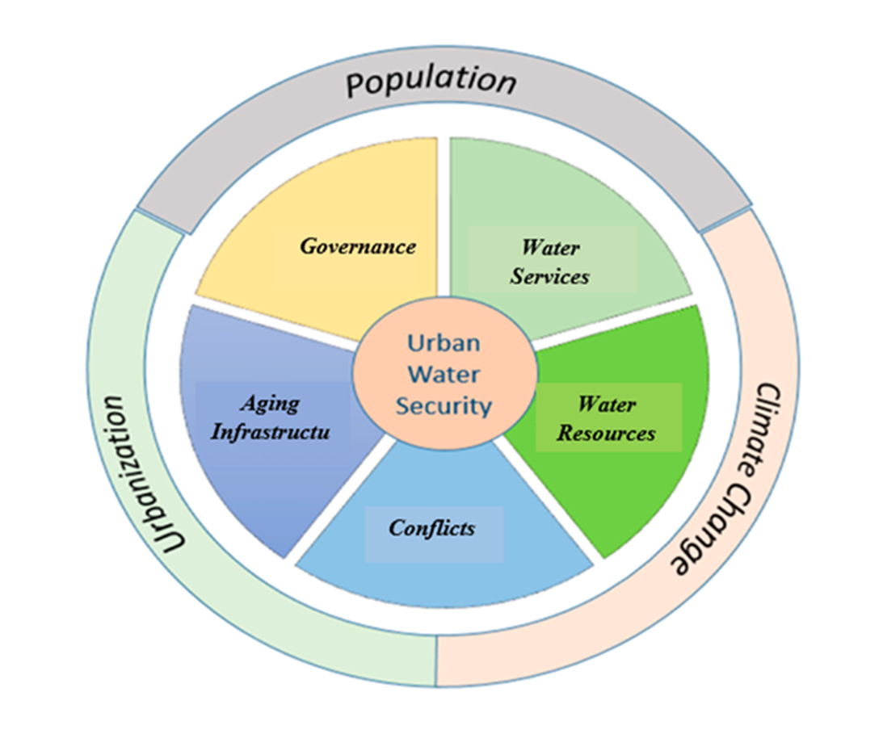
Introduction:

Slide 3
Outline:
1. Global Water Challenges
2. Methodology
3. Application
4. Results and Discussion
5. Management Model
6. Conclusions

Slide 4
1. Global Water Challenges :
.
Climate Change
Decrease in water availability.
Increase in water scarcity.
Over-extraction of water resources.
Intensification of floods and droughts events.
Great impact on water quality.
Deterioration of urban water infrastructures.
Disrupting water services
Population Growth
The world population will reach around 10 billion in 2050.
Huge pressure on natural resources, infrastructure facilities and water consumption.
Urbanization
56 % of the world population live in urban areas.
70 % of the population in developing countries live in unplanned urban areas.
Global water demand expect to increase by 55% in 2050.

Slide 5
1. Global Water Challenges :
Water Governance
“Water Crisis” is a “Governance Crisis”.
Degradation of the water services, water infrastructures and water resources.
Water Conflicts
Catastrophic impact on:
The degradation of water resource.
The destruction of physical infrastructures.
The disturbance of the water governance and management
Infrastructure Aging
Infrastructures deterioration.
Catastrophic impact on quality and efficiency of water service.
Public health and economic activity

Slide 6
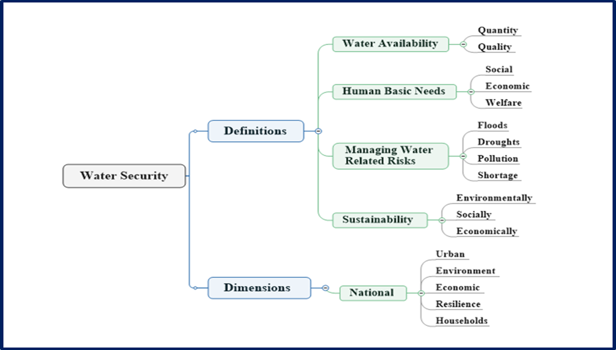

Slide 7
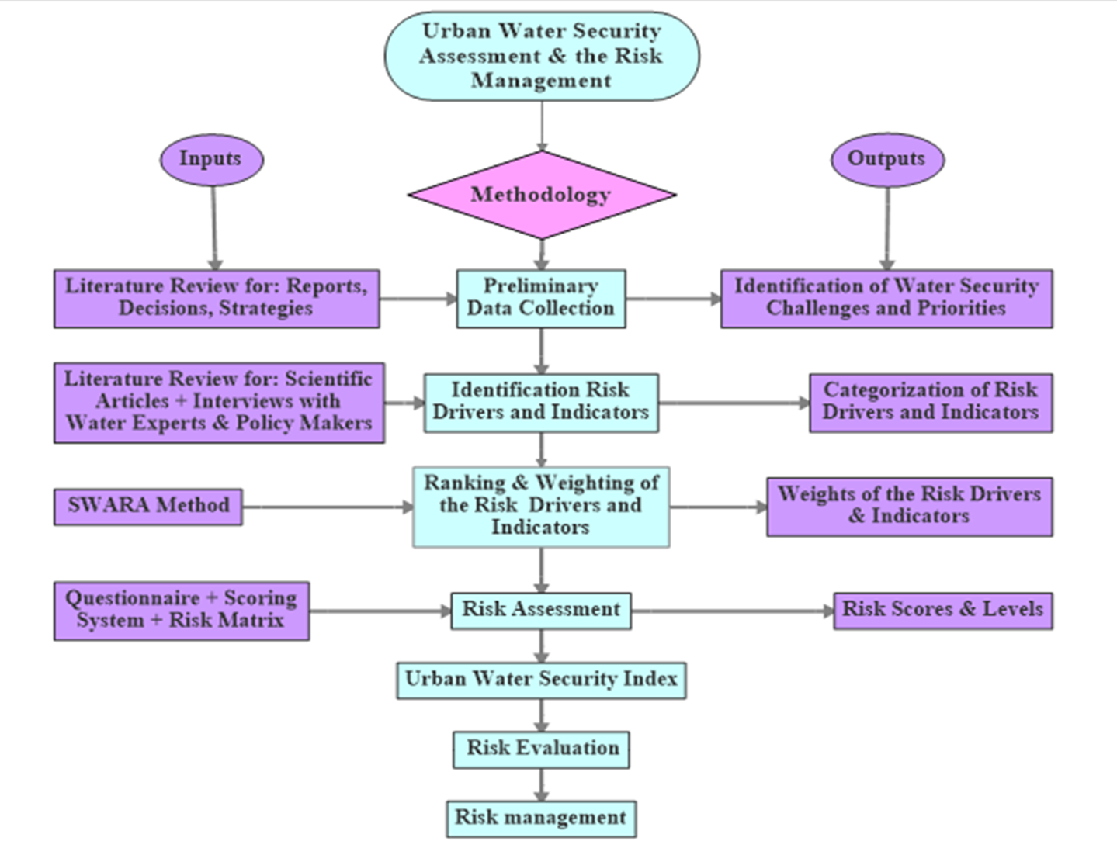
2. Methodology:

Slide 8
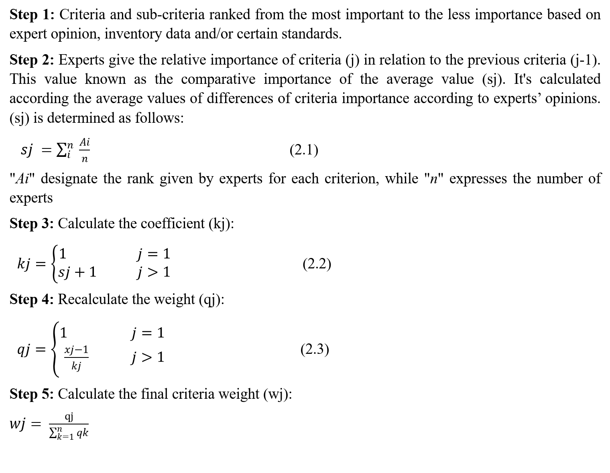
2. Methodology--- continue:
Step 1: Criteria and sub-criteria ranked from the most important to the less importance based on expert opinion, inventory data and/or certain standards.
Step 2: Experts give the relative importance of criteria (j) in relation to the previous criteria (j-1). This value known as the comparative importance of the average value (sj). It's calculated according the average values of differences of criteria importance according to experts’ opinions. (sj) is determined as follows:
$sj =\sum_{i}^{n}{ \frac{Ai}{n}}$ (2.1)
"Ai" designate the rank given by experts for each criterion, while "n" expresses the number of experts
Step 3: Calculate the coefficient (kj):
$kj=\left\{\begin{aligned}1 &j=1 \\ sj+1 &j>1\end{aligned}\right.$ (2.2)
Step 4: Recalculate the weight (qj):
$qj=\left\{\begin{aligned}1 &j=1 \\ \frac{xj−1}{kj} &j>1\end{aligned}\right.$ (2.3)
Step 5: Calculate the final criteria weight (wj):
$wj= \frac{qj}{\sum_{k=1}^{n}{qk}}$

Slide 9
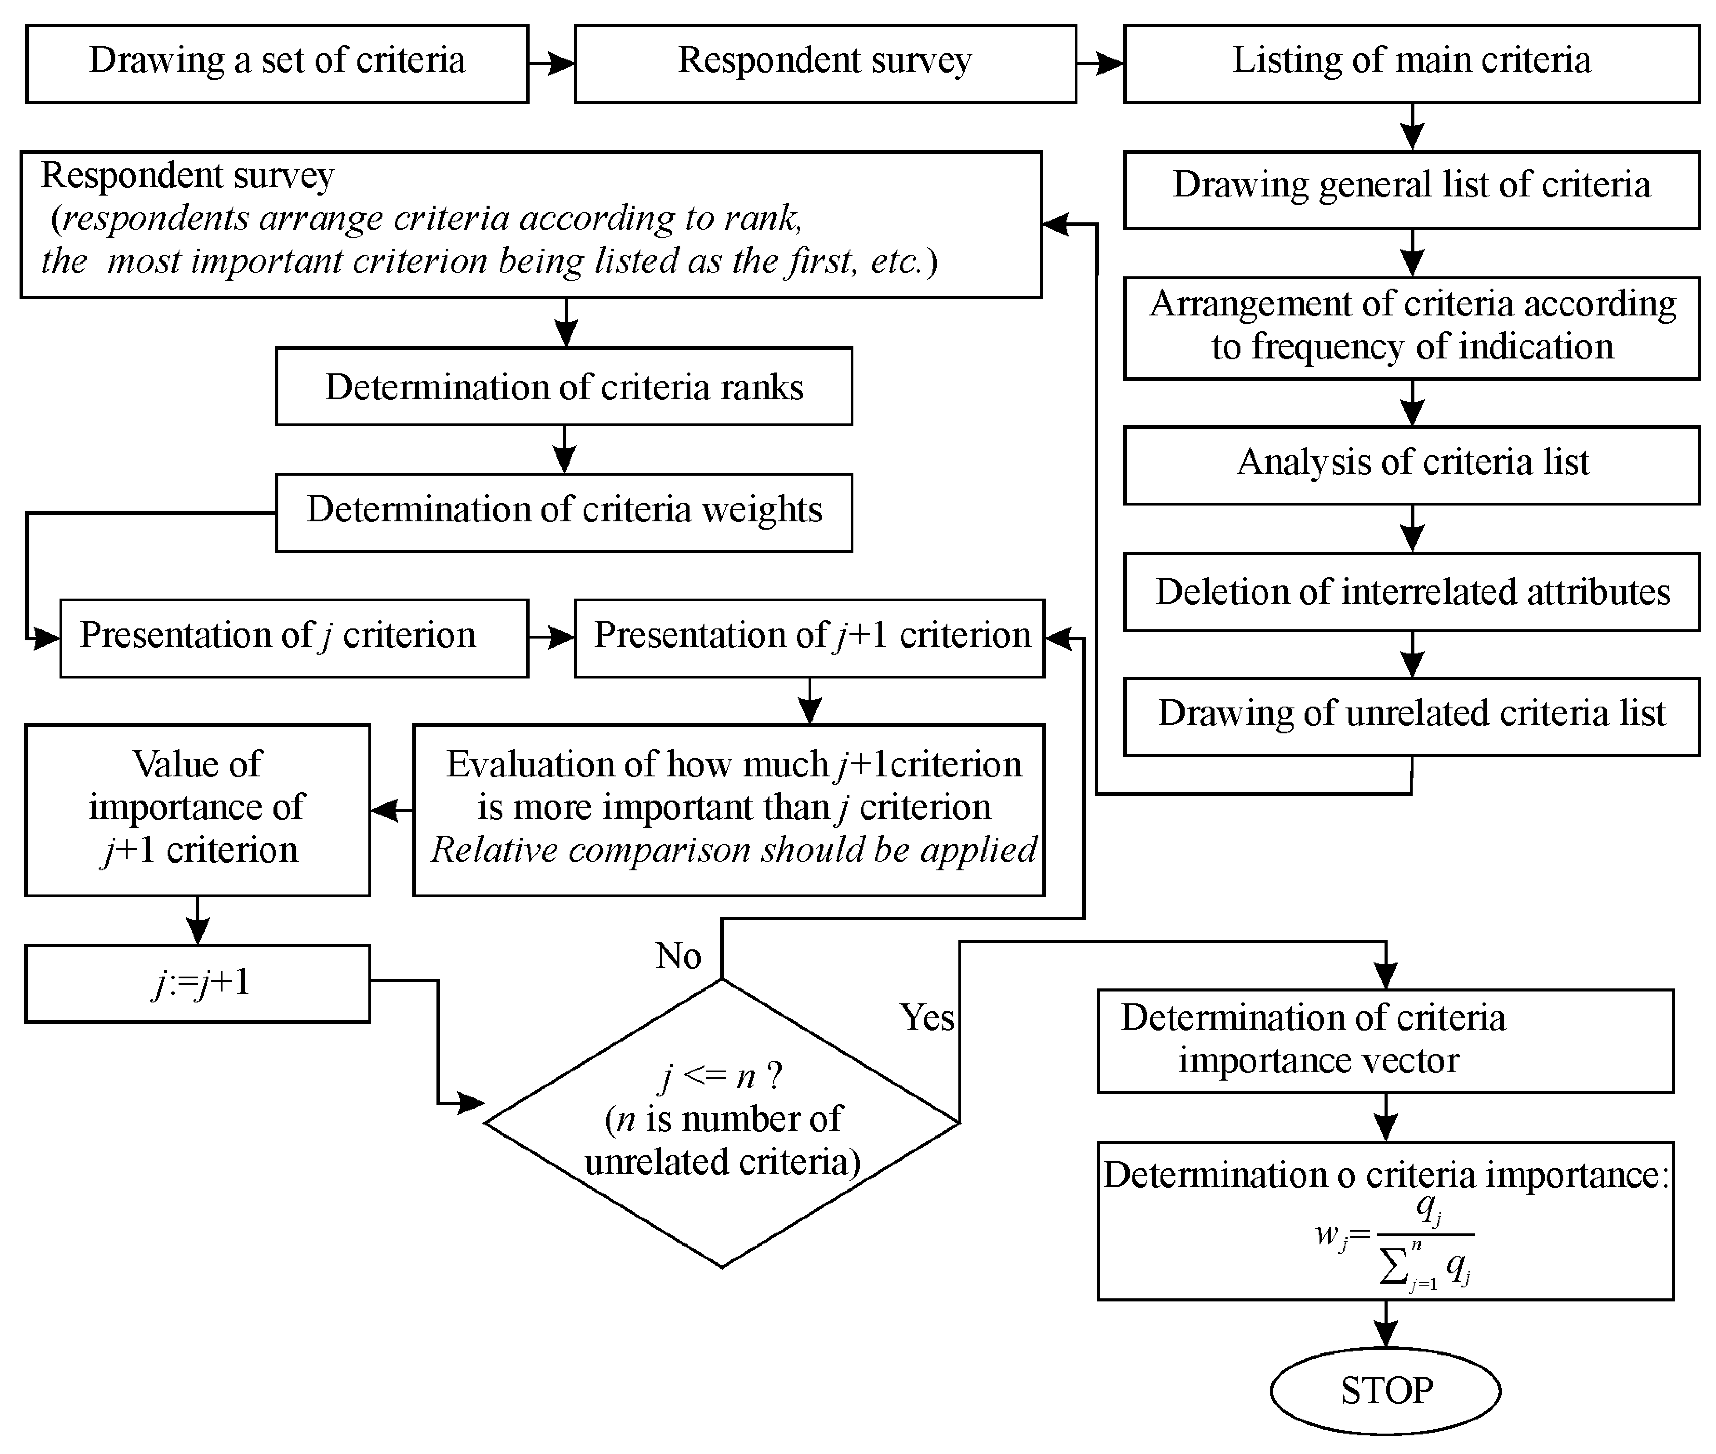

Slide 10
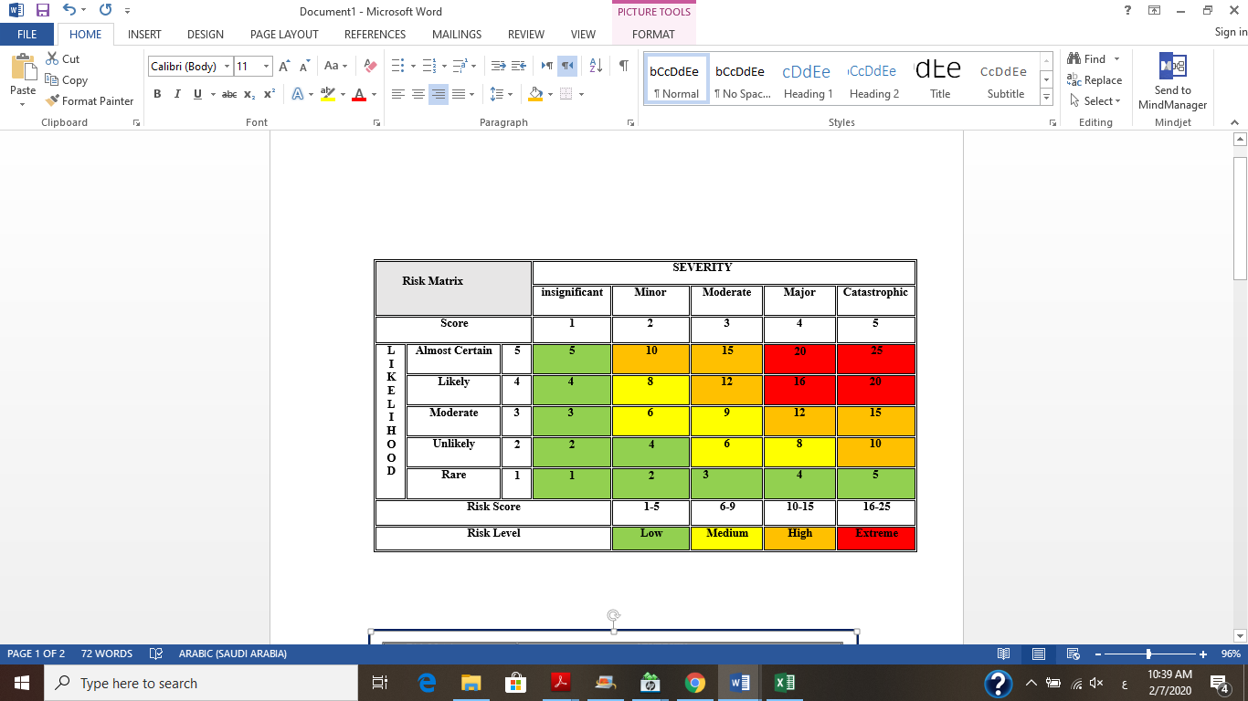
Semi- quantitative Risk Matrix (WHO & IWA, 2001)

Slide 11
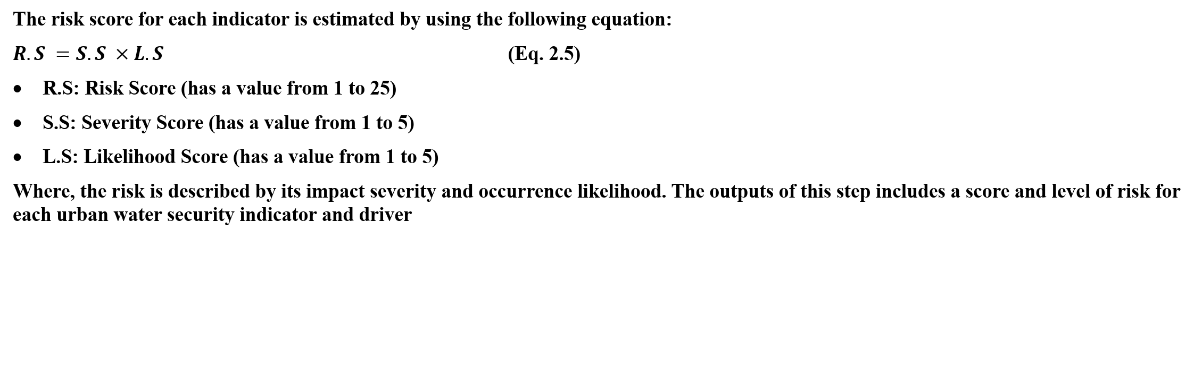
The risk score for each indicator is estimated by using the following equation:
$R.S =S.S ×L.S$ (Eq. 2.5)
R.S: Risk Score (has a value from 1 to 25)
S.S: Severity Score (has a value from 1 to 5)
L.S: Likelihood Score (has a value from 1 to 5)
Where, the risk is described by its impact severity and occurrence likelihood. The outputs of this step includes a score and level of risk for each urban water security indicator and driver

Slide 12
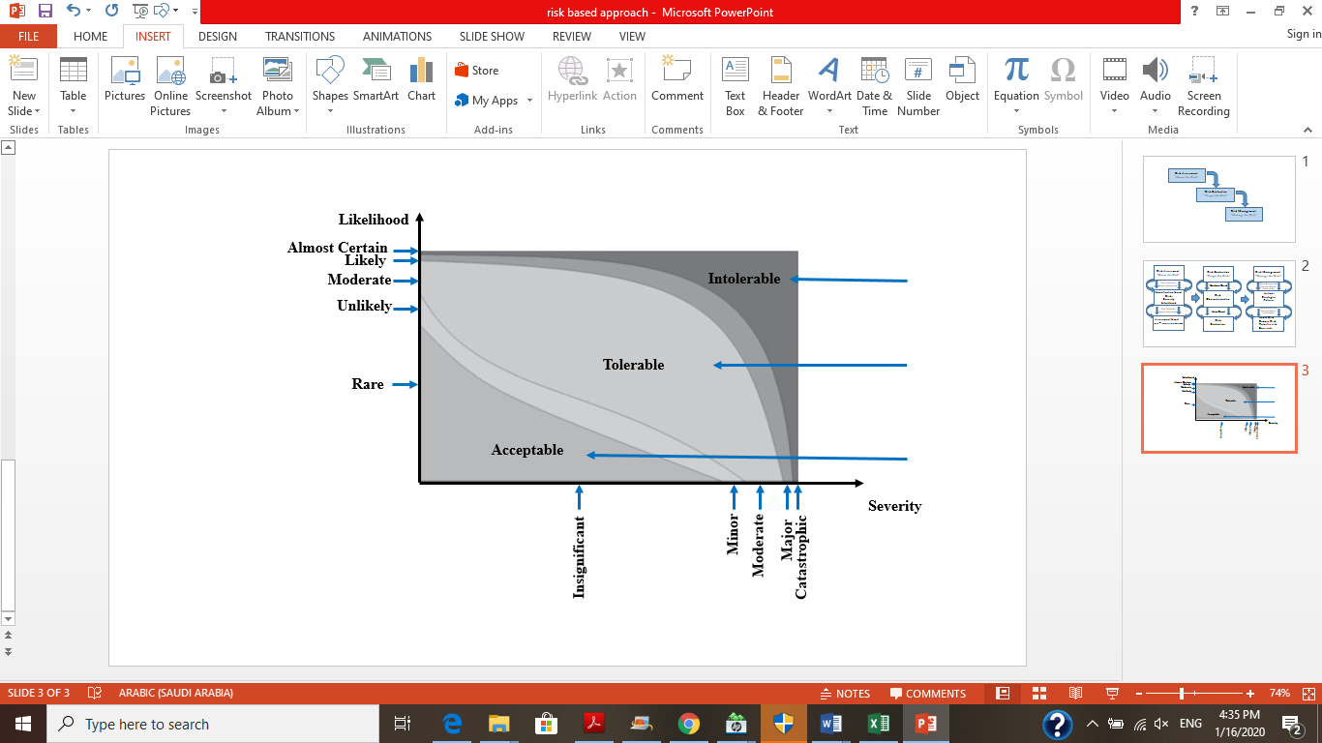
Degree of Risks Acceptability (Klinke and Renn, 2012)

Slide 13
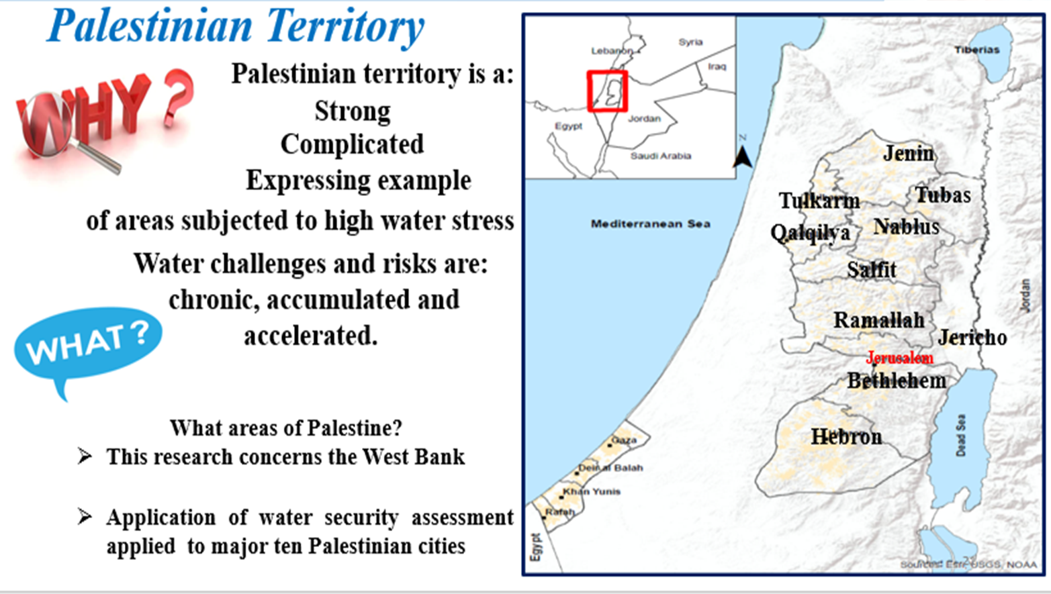
3. Application:

Slide 14
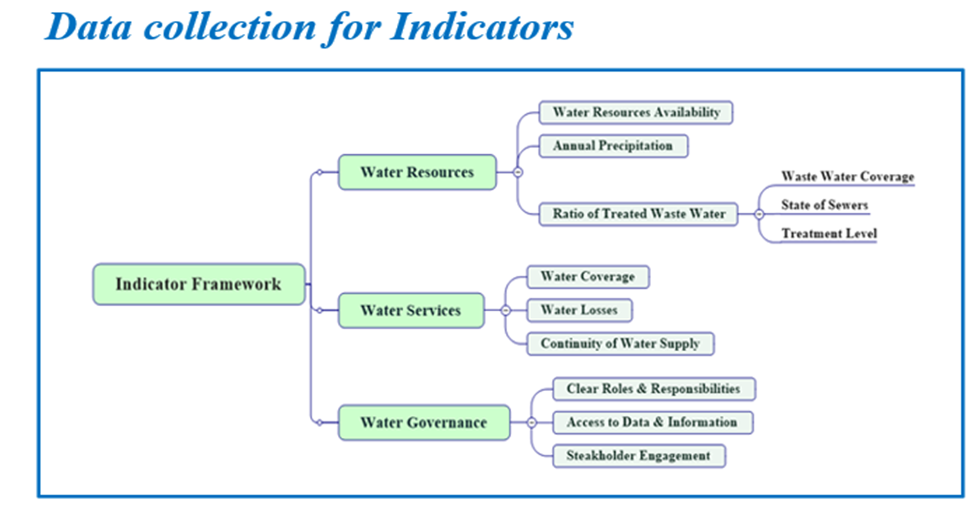
3. Application--- Continue:

Slide 15
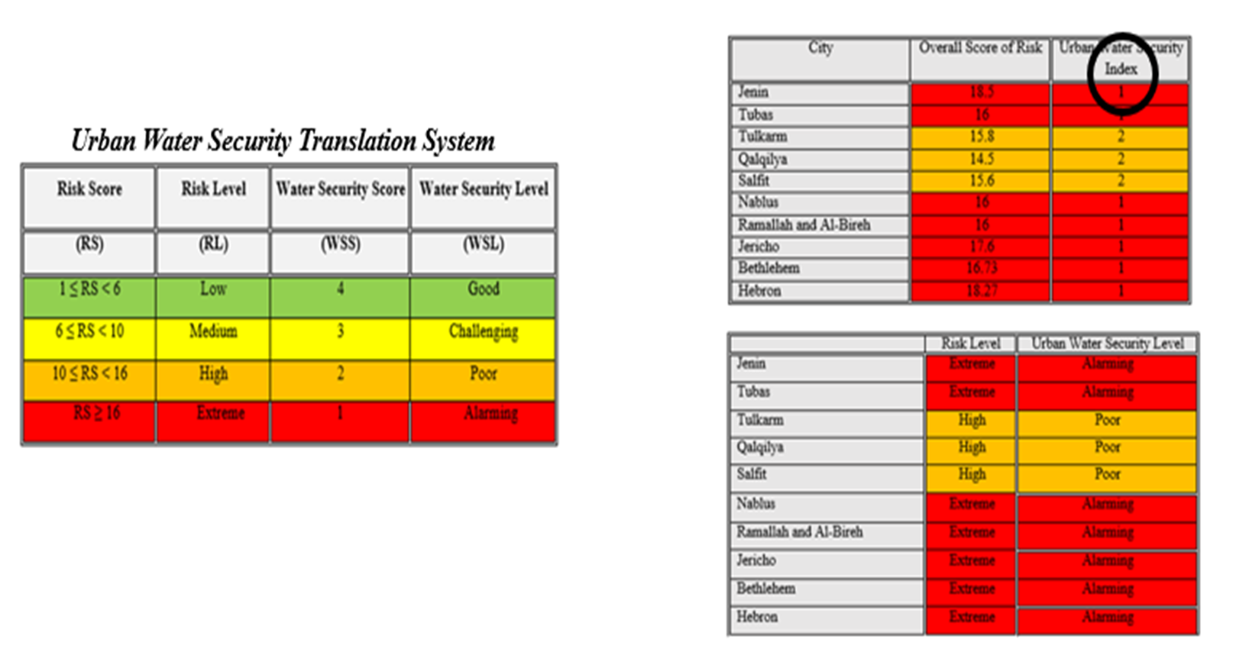
4. Results & Discussion:

Slide 16
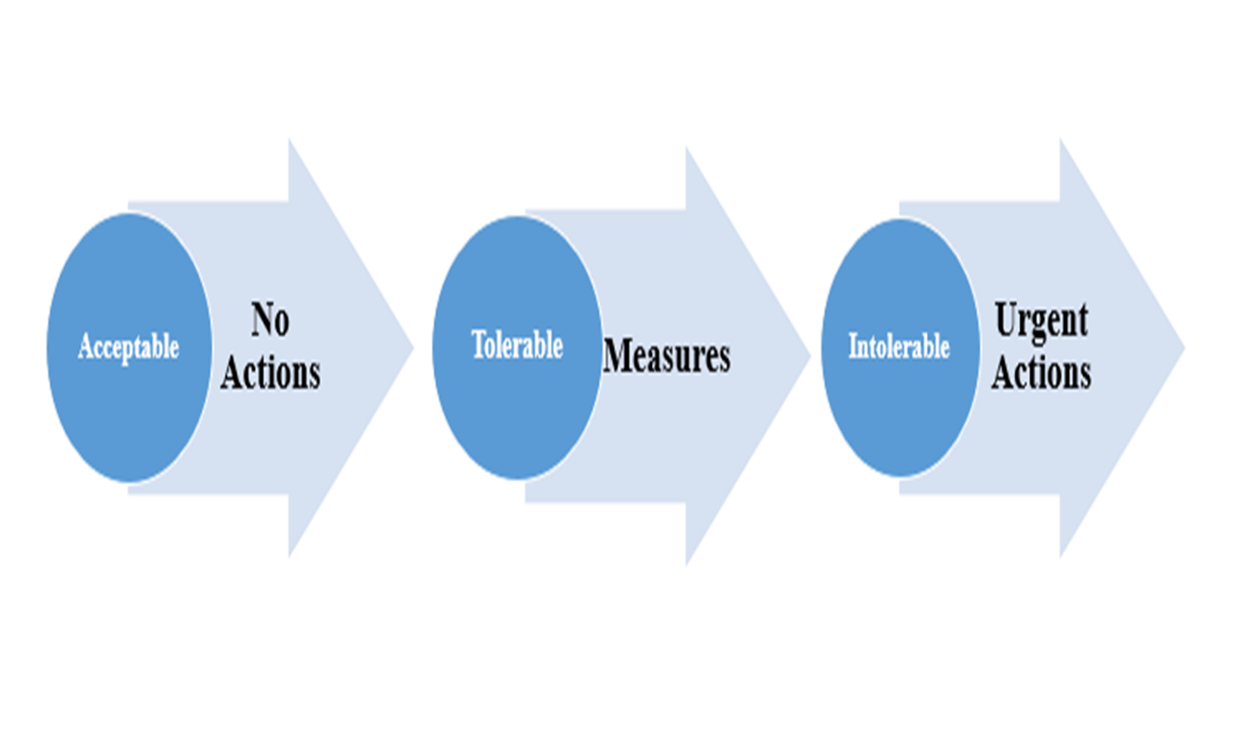
4. Results & Discussion--- Continue:

Slide 17
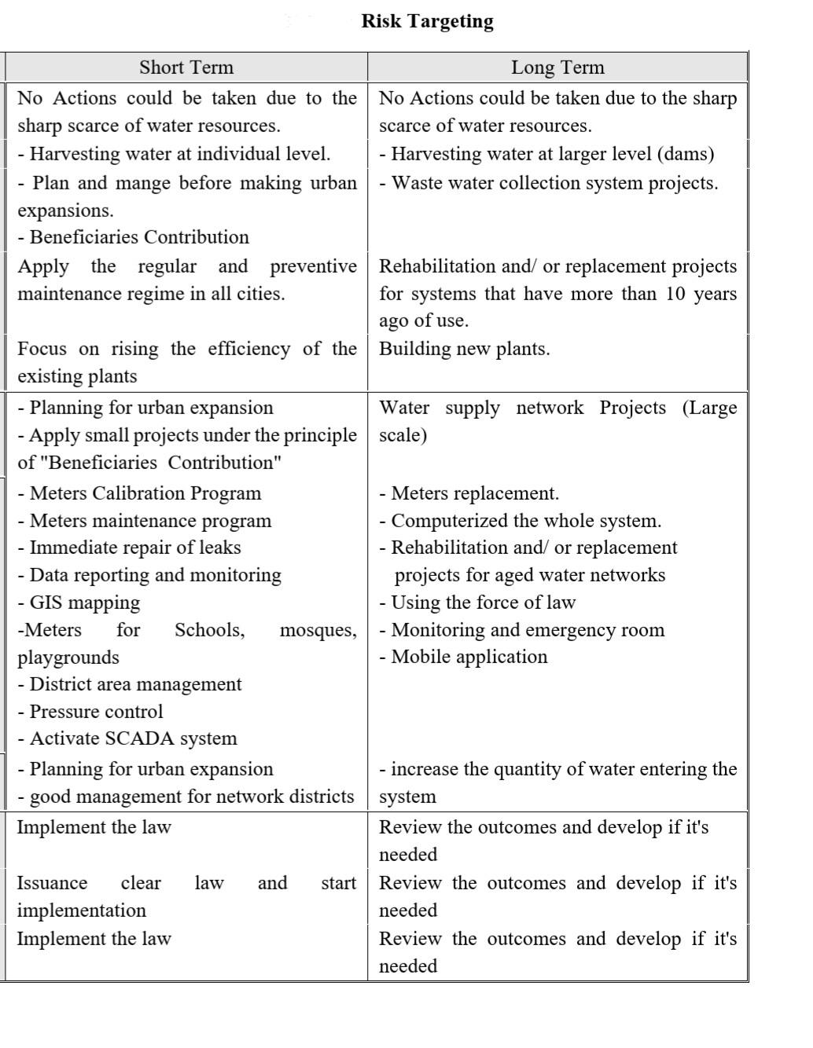

Slide 18
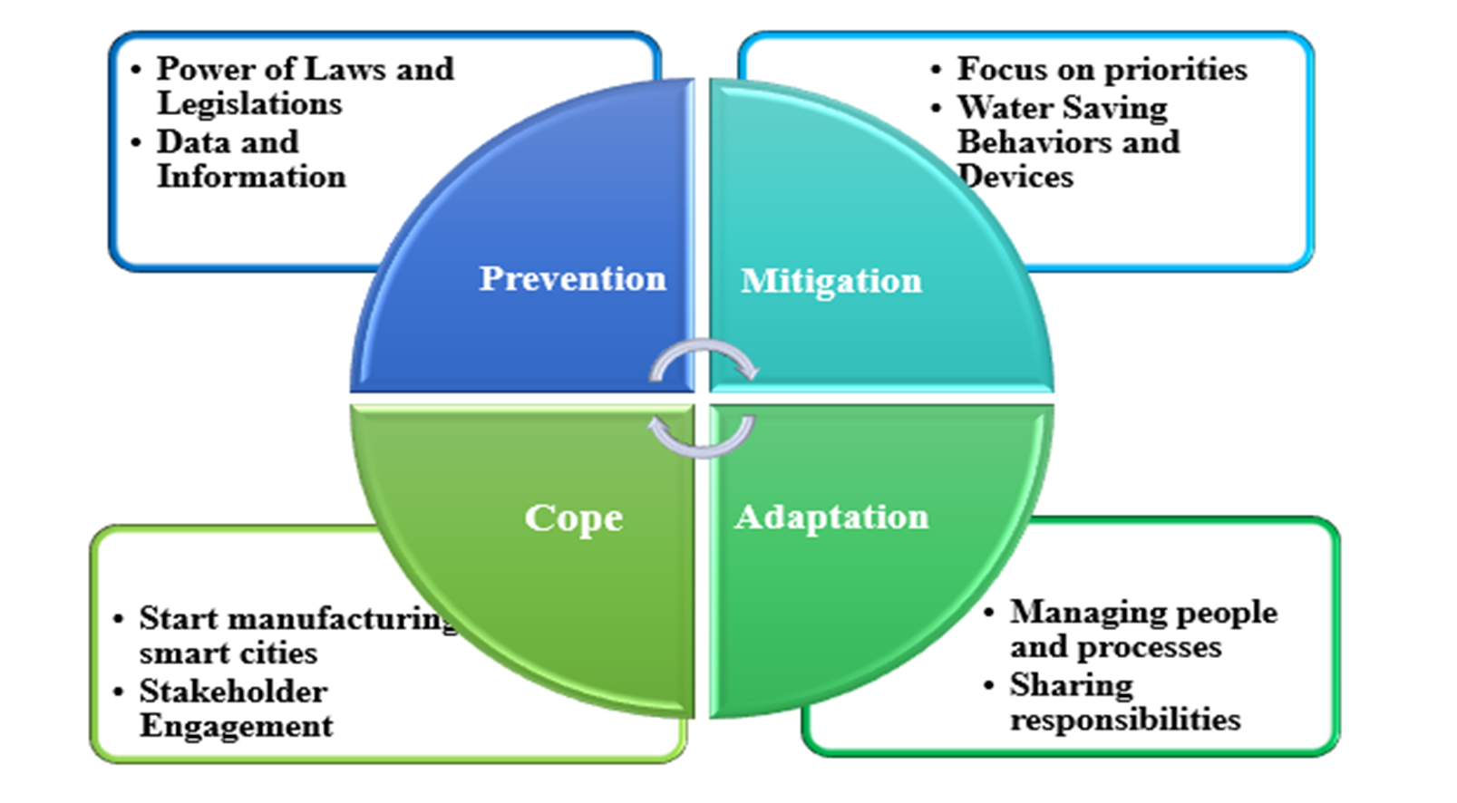
5.Management Model:

Slide 19
6. Conclusion:
Conclusions
Arab area
classified as area under water stresses suffering from dramatic water situation, which could be more dramatic in the future
Urban Water Security
Needs Assessment and actions
Risk concept
is a powerful and active procedure to analyze the water security together with
innovative index system and MCDM method
Water security management model
is needed for water utilities in our Arab cities .

Slide 20
THANKS
for
your listening
Dr. Samah Jabari
PPU

