Slide 1
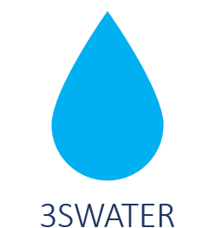



Water Safety Planning for Small Island Water Systems:
Strengthening Local Capacity for Water Safety: From Planning to Practice
Dr. Akosua Boakye-Ansah

Slide 2
Presentation outline
Define safety plans
Explain why a Water Safety Plan is necessary.
Implementation of Water Safety Planning – the 3SWater case

Slide 3
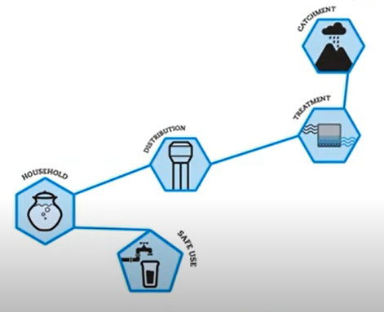
What is a Water safety Plan (WSP)
It is a comprehensive risk assessment and risk management approach that includes all the steps in water supply from catchment to consumer

Slide 4

WSP involves….
….preventing contamination at the source…

Slide 5
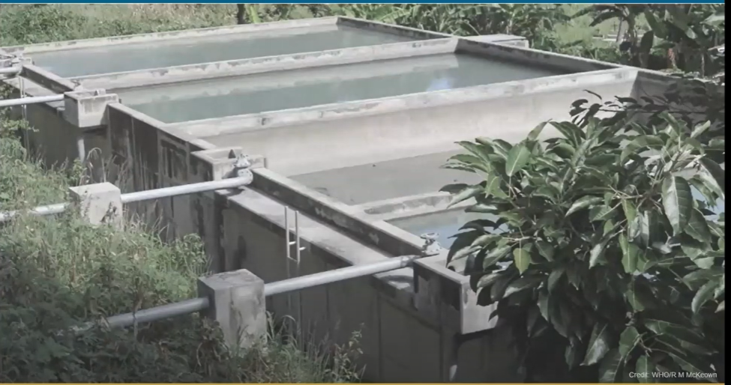
WSP involves….
….removing/reducing contamination through treatment

Slide 6
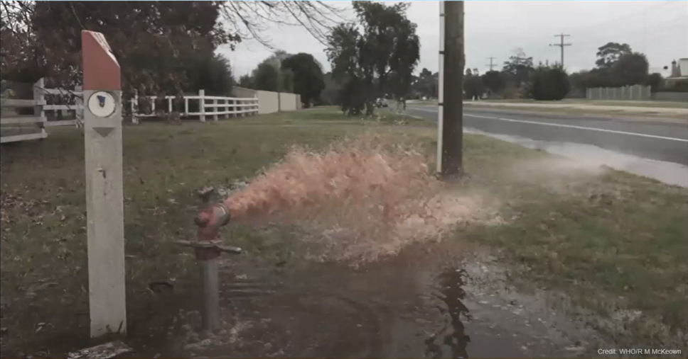
WSP involves….
….preventing recontamination in storage and distribution

Slide 7
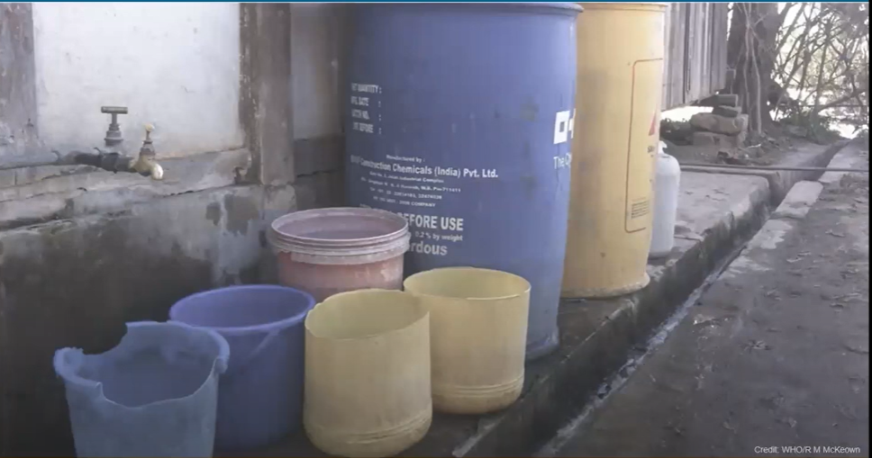
WSP involves….
….preventing recontamination at the household level

Slide 8

Why do we need WSPs?
Without a risk assessment/management approach, water suppliers must rely on END-PRODUCT TESTING to confirm water safety.
Notes:
8
Why do we need WSPs? Well, as you know, water safety planning is a risk assessment and risk management approach. Without this type of approach, water suppliers must rely on end-product testing to confirm water safety, which means testing water quality at the end point of the system, such as a customer's meter or tap.

Slide 9
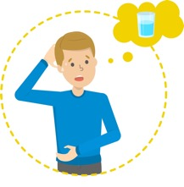
Why do we need WSPs?
END-PRODUCT TESTING SCENARIO
Contaminated water consumed
Water microbially contaminated
Boil water advisory issued to consumers
Day 0
Day 7
Day 9
Day 10
TIME
Water sampled & tested
Test results
* E. coli *
Notes:
9
Let’s have a closer look to an end-product testing scenario. At Day 0, water becomes contaminated with microbes.
CLICK Then everything goes on as normal and in Day 7 the water is sampled and tested.
CLICK Carrying out microbial analysis generally takes one day and a half. So the laboratory reports the test results on Day 9. So it's only by Day 9 when we can find out the water was contaminated with E coli, indicator of faecal contamination.
CLICK It take a while between receiving the results at the laboratory and coordinating with the customer relations department and/or public health authority to issue a boil water advisory. Basically, telling consumers that water is unsafe, so until it's fixed, they need to boil the water. PAUSE. Do you see the problem here?
CLICK. The problem is that between day zero and day 10 consumers have been drinking contaminated water, and possibly getting sick.

Slide 10


Why do we need WSPs?
Water quality testing is an important component of water supply system management…
…but it is not enough to ensure water safety.
Need a proactive approach to ensure water safety through good management of the complete water supply system → WSP
Notes:
10
Water quality testing is important in managing water systems. But, it is not enough to consistently ensure water safety.
We need a proactive approach across the complete water supply system. Or in other words – we need water safety planning!

Slide 11
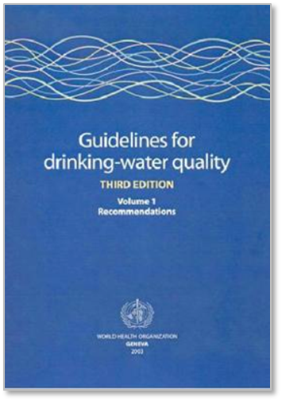
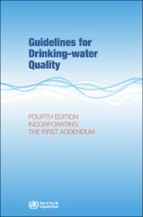
Steps in a Water Safety plan
WSPs introduced by WHO in Guidelines for Drinking-water Quality (3rd Edition, 2004)
Update 4th edition; 2024: urban (large) and small systems

Slide 12
Steps in a Water Safety Plan
WSP components | Urban WSP modules | WSP tasks for small systems
Preparation | 1. Assembling the WSP team | 1. Engage the community and assemble a WSP team
System assessment | 2. Describe the water supply system | 2. Describe the community water supply
 | 3. Identify hazards and hazardous events | 3. Identify and assess hazards, hazardous events, risks, and existing control measures
 | 4. Determine and validate control measures, then assess and prioritize the risks
 | 5. Develop, implement, and maintain an improvement/upgrade plan | 4. Develop and implement an incremental improvement plan
Monitoring | 6. Define monitoring of the control measures (operational monitoring) | 5. Monitor control measures and verify the effectiveness of the WSP 6. Carry out routine operations and maintenance
 | 7. Verify the effectiveness of the WSP
Management & communication | 8. Prepare management procedures | 7. Document, review and improve all aspects of WSP implementation
 | 9. Develop supporting programs
Feedback & improvement | 10. Plan and carry out periodic review of the WSP
 | 11. Revise the WSP following an incident

Slide 13
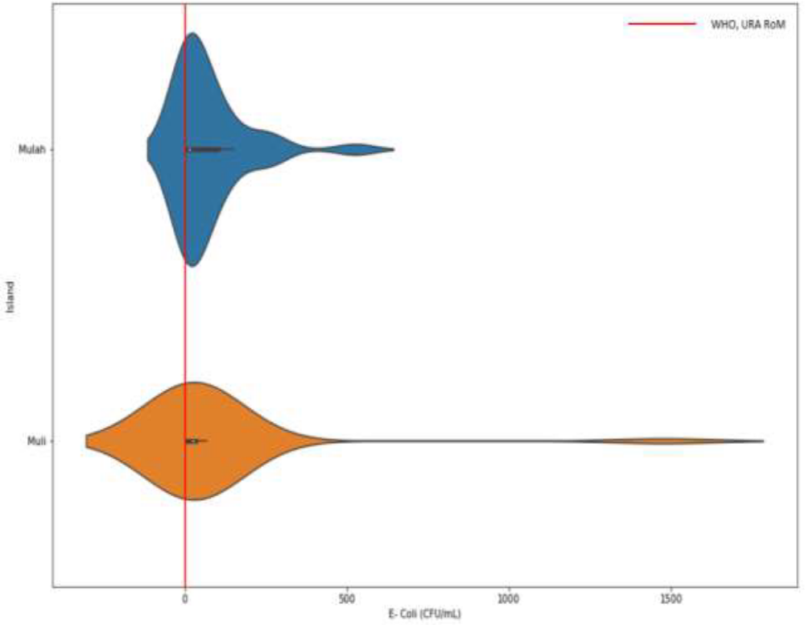
WSP in the Maldives: the need
No WSP for water systems (desalinated/groundwater) on the Islands
Contaminated water at treatment/household level
Distribution of E-coli (CFU/mL) over Mulah and Muli (Source: Fernando, 2023)
Notes:
13

Slide 14
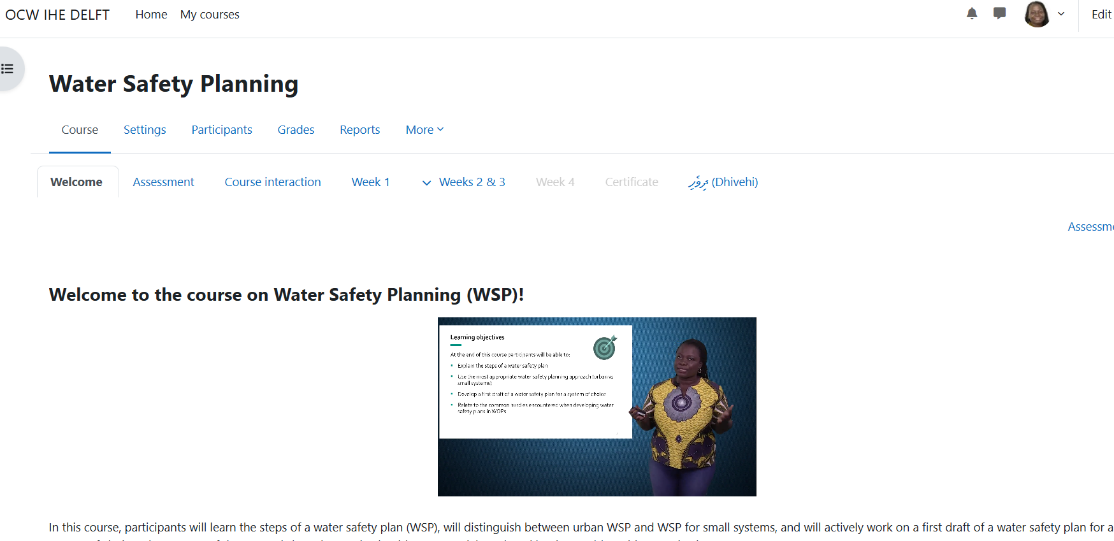
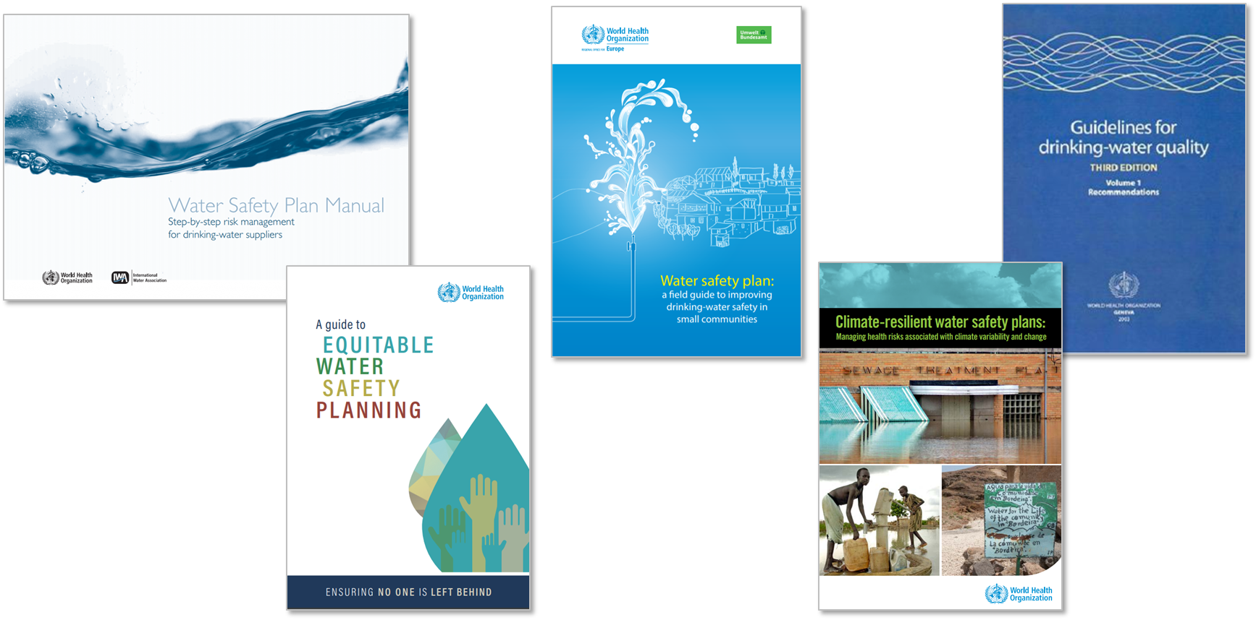


WSP in the Maldives: putting it together

Slide 15
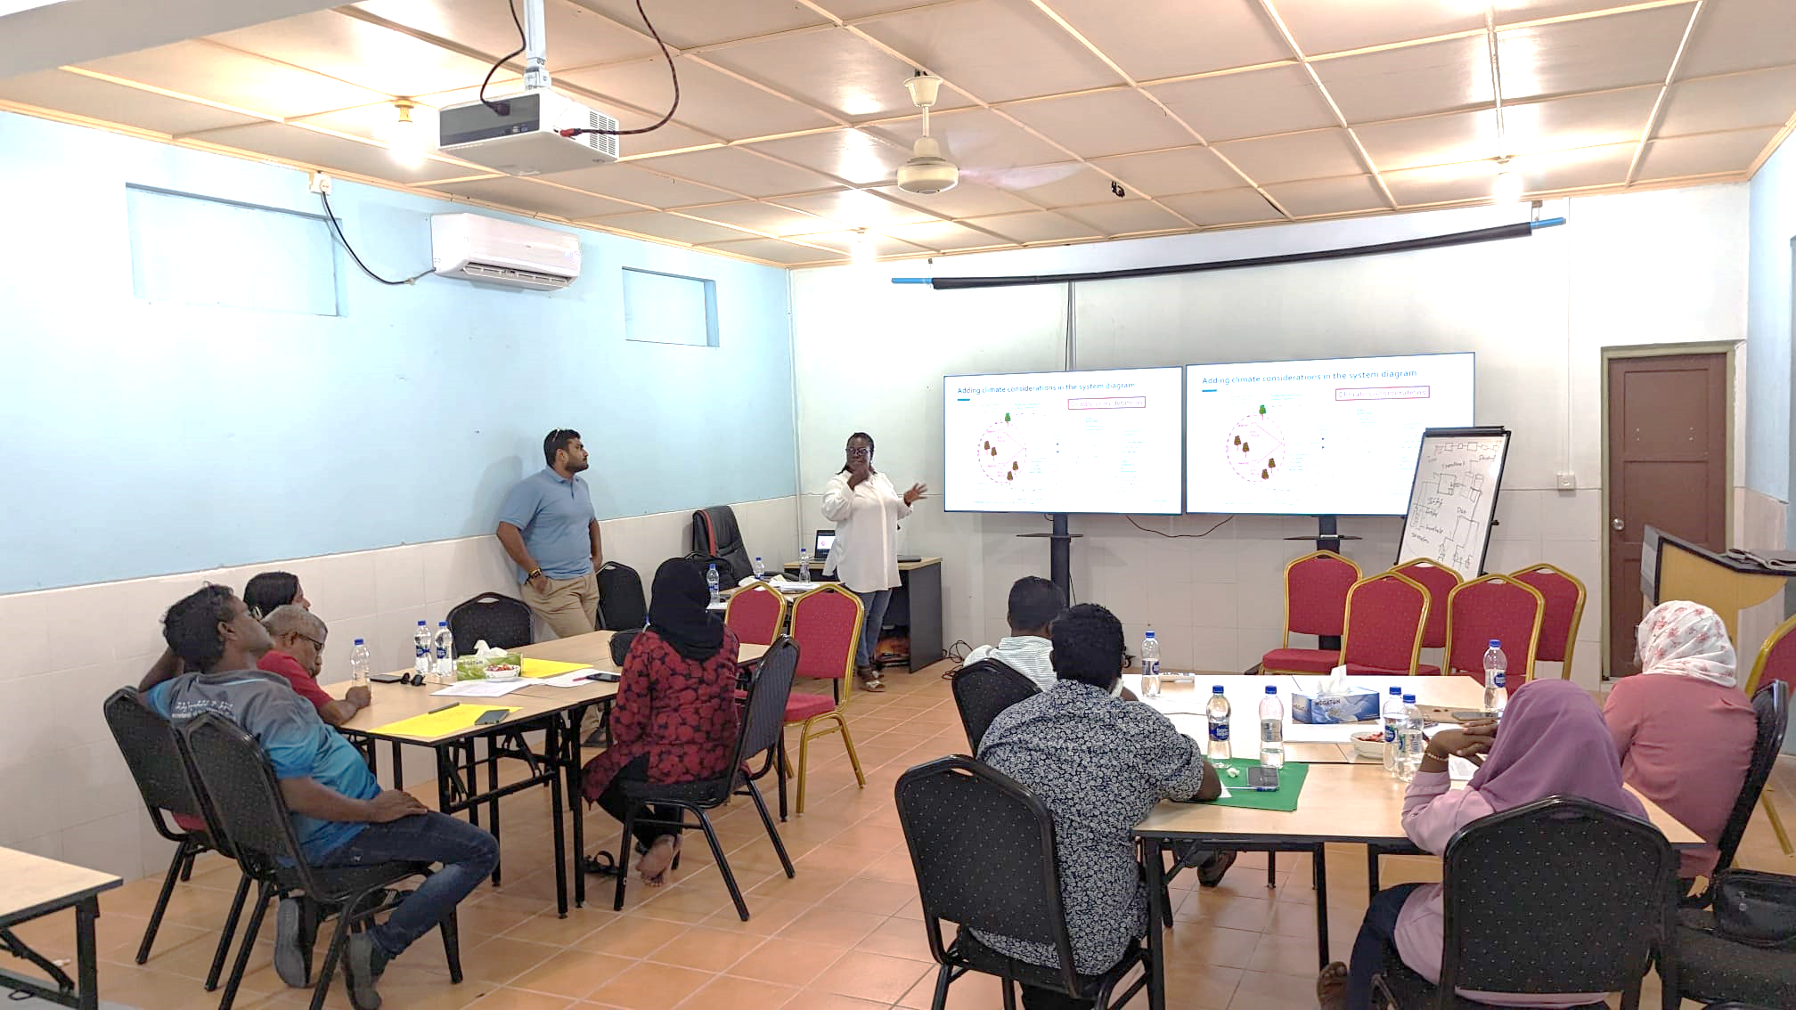
WSP in the Maldives: building capacity
Instructor-led
WSP for small systems
Hosted in Meemu Atoll (Mulah, Muli and Kholufushi Islands)
First run: 15-19 July 2024
Multidisciplinary team
12 staff from the utility, Island council, health department from the Meemu AtulI

Slide 16
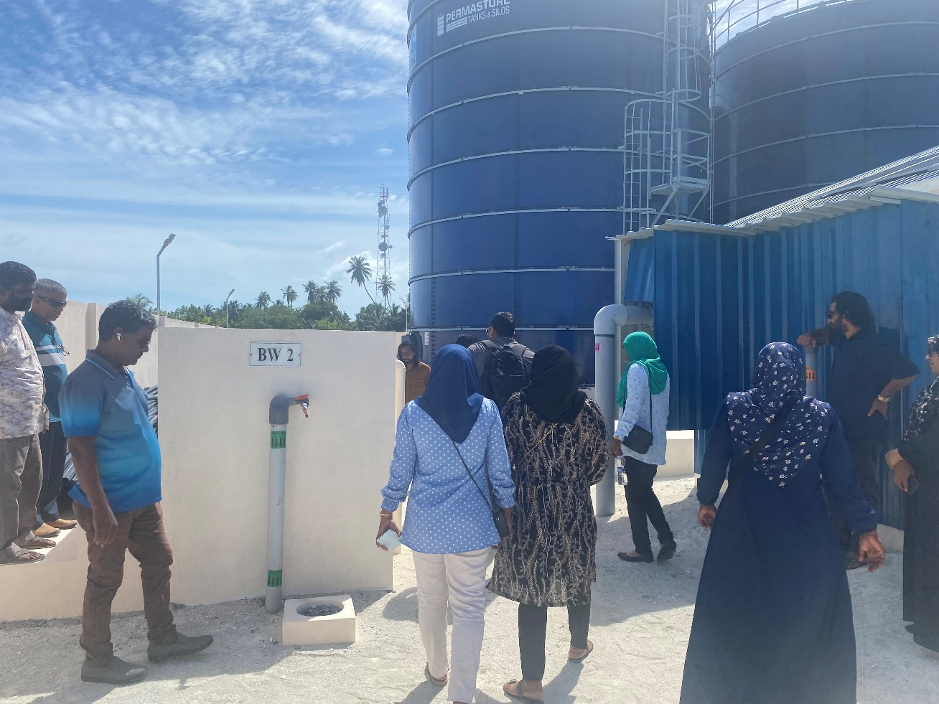
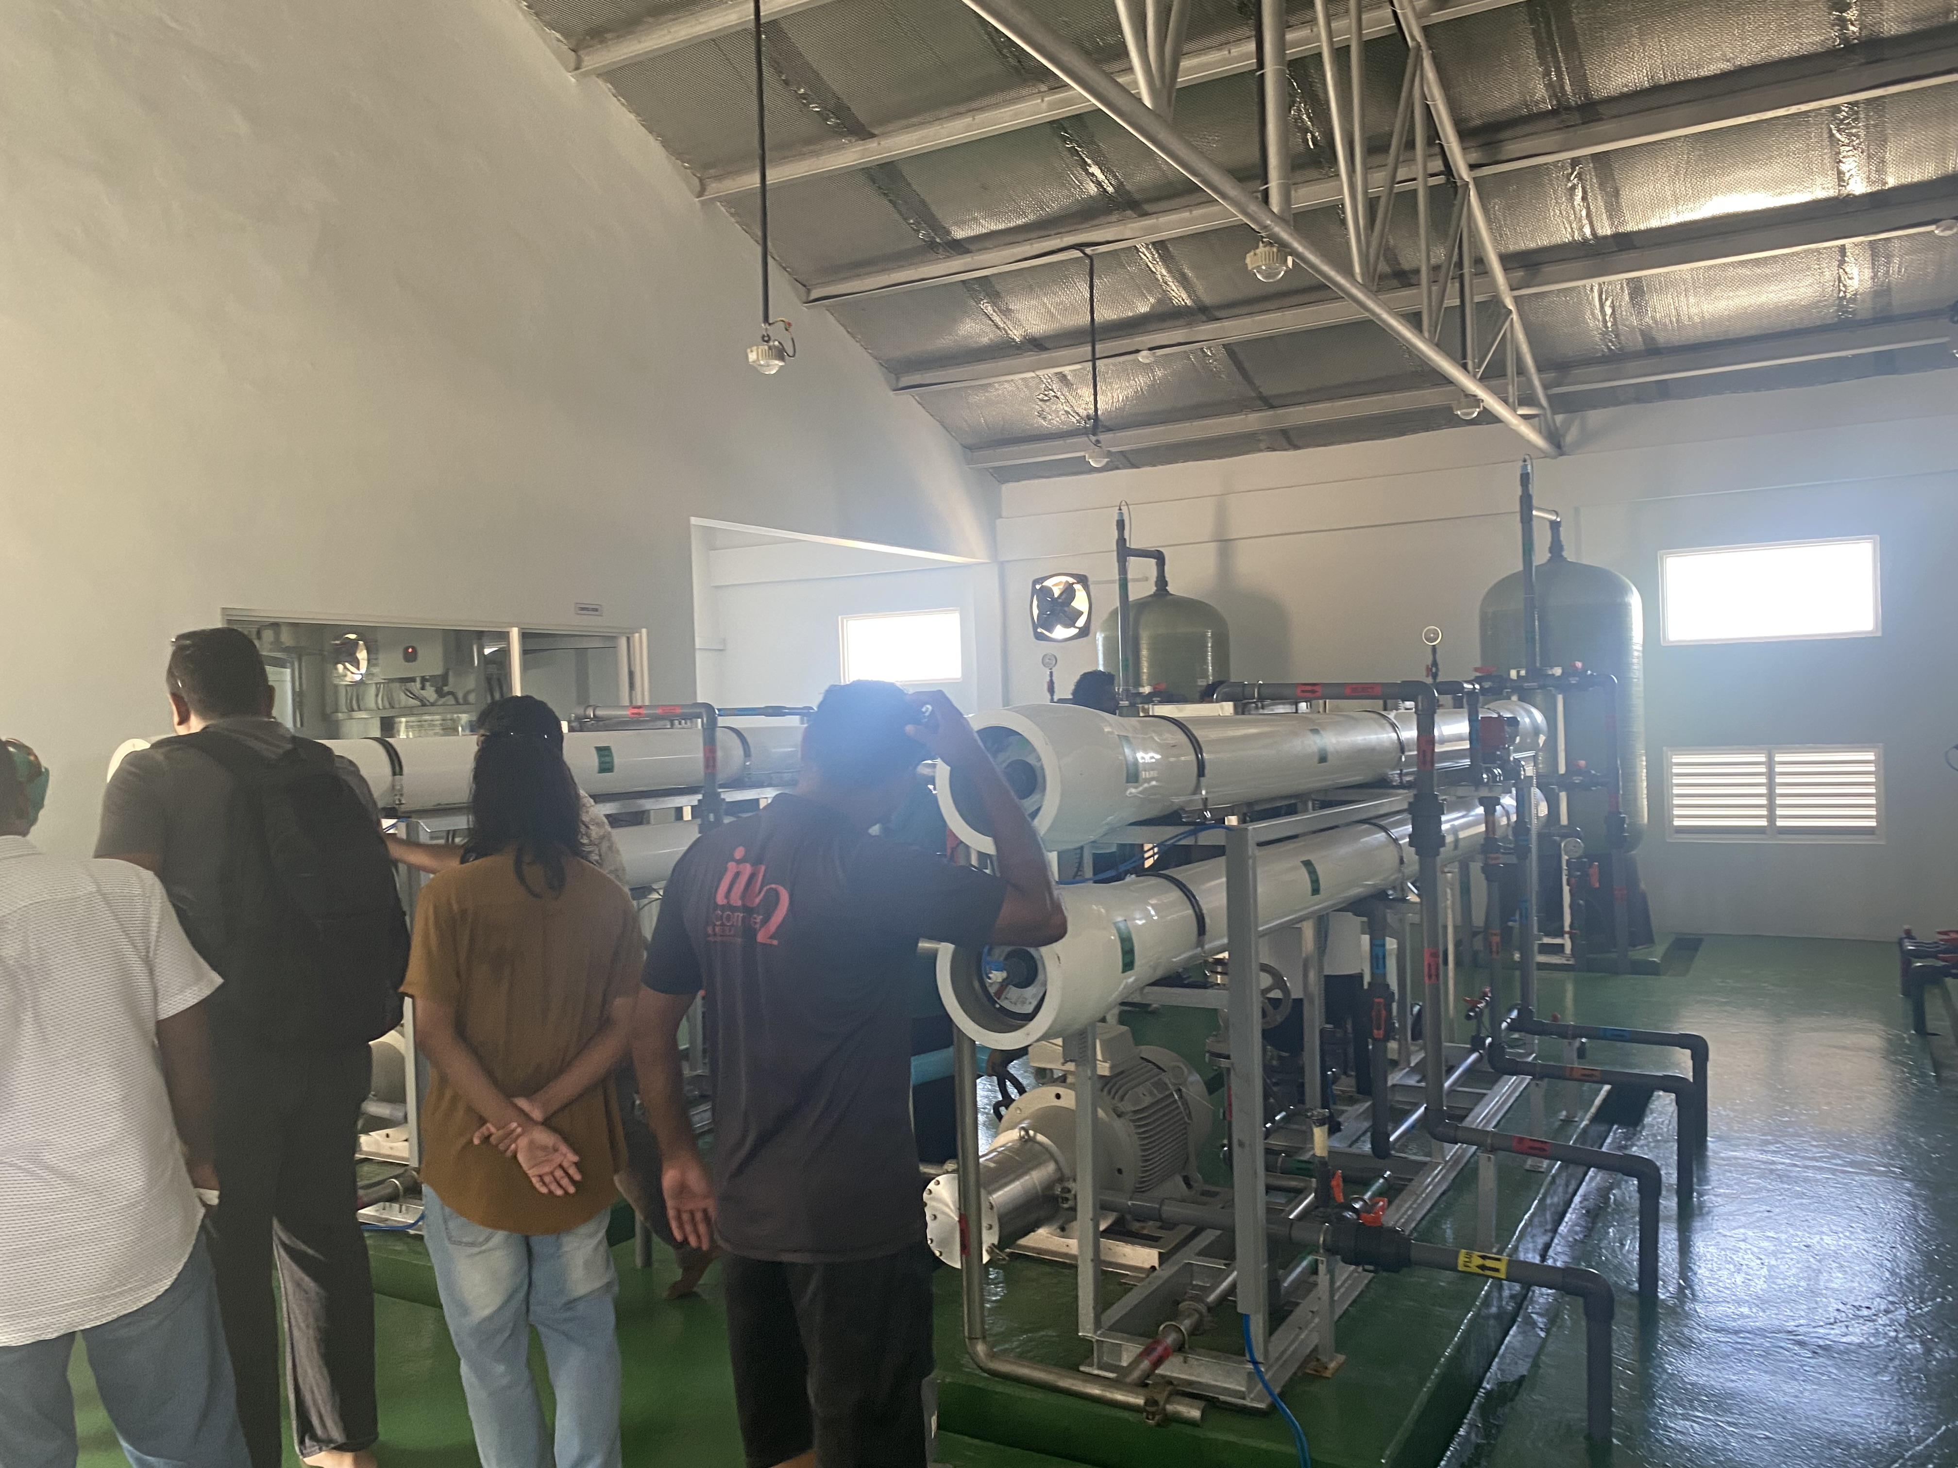
WSP in the Maldives: risk assessment

Slide 17
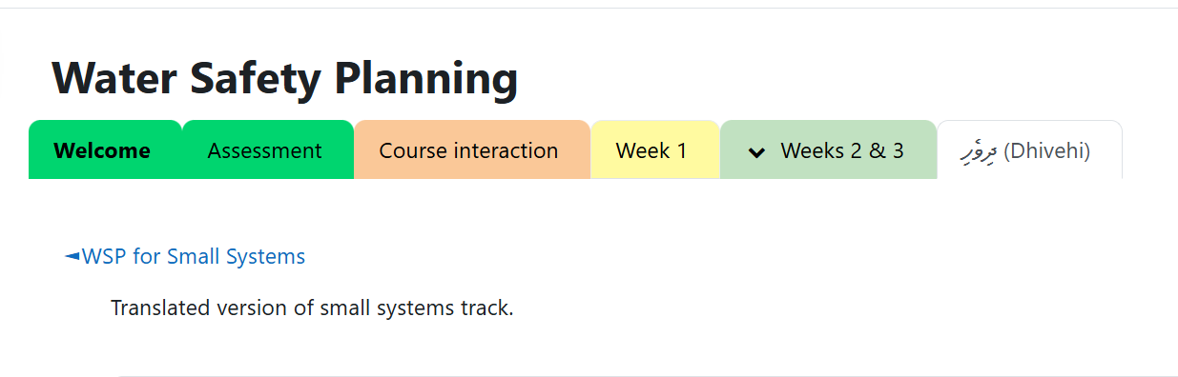
Outcomes from training
12 staff trained on WSP
Draft WSP Plans for islands in the Meemu Atoll
WSP translated to Dhivehi

Slide 18
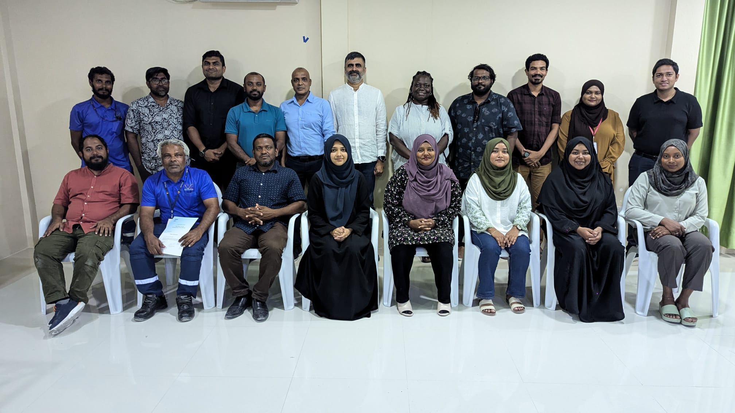
Outcomes from training
Training in Dhevihi in Thulusdhoo (7-8 December, 2024)
14 participants from 8 Islands Kaafu Atoll (K.Thulusdhoo, K.Gulhi, K.Maafushi K.Kaashidhoo, K,Dhiffushi, K.Guraidhoo and K.Himmafushi

Slide 19
Recap
Context-specific Water Safety Plans (WSPs) were developed, tailored to the unique risks and conditions of each local setting.
Local staff (26) capacity was strengthened through hands-on training, ensuring they are equipped to independently implement and update WSPs.
Institutional knowledge was retained locally, promoting sustainability beyond the training period.
Overall water safety has improved, with better risk identification, monitoring, and mitigation practices now in place.

