Slide 1
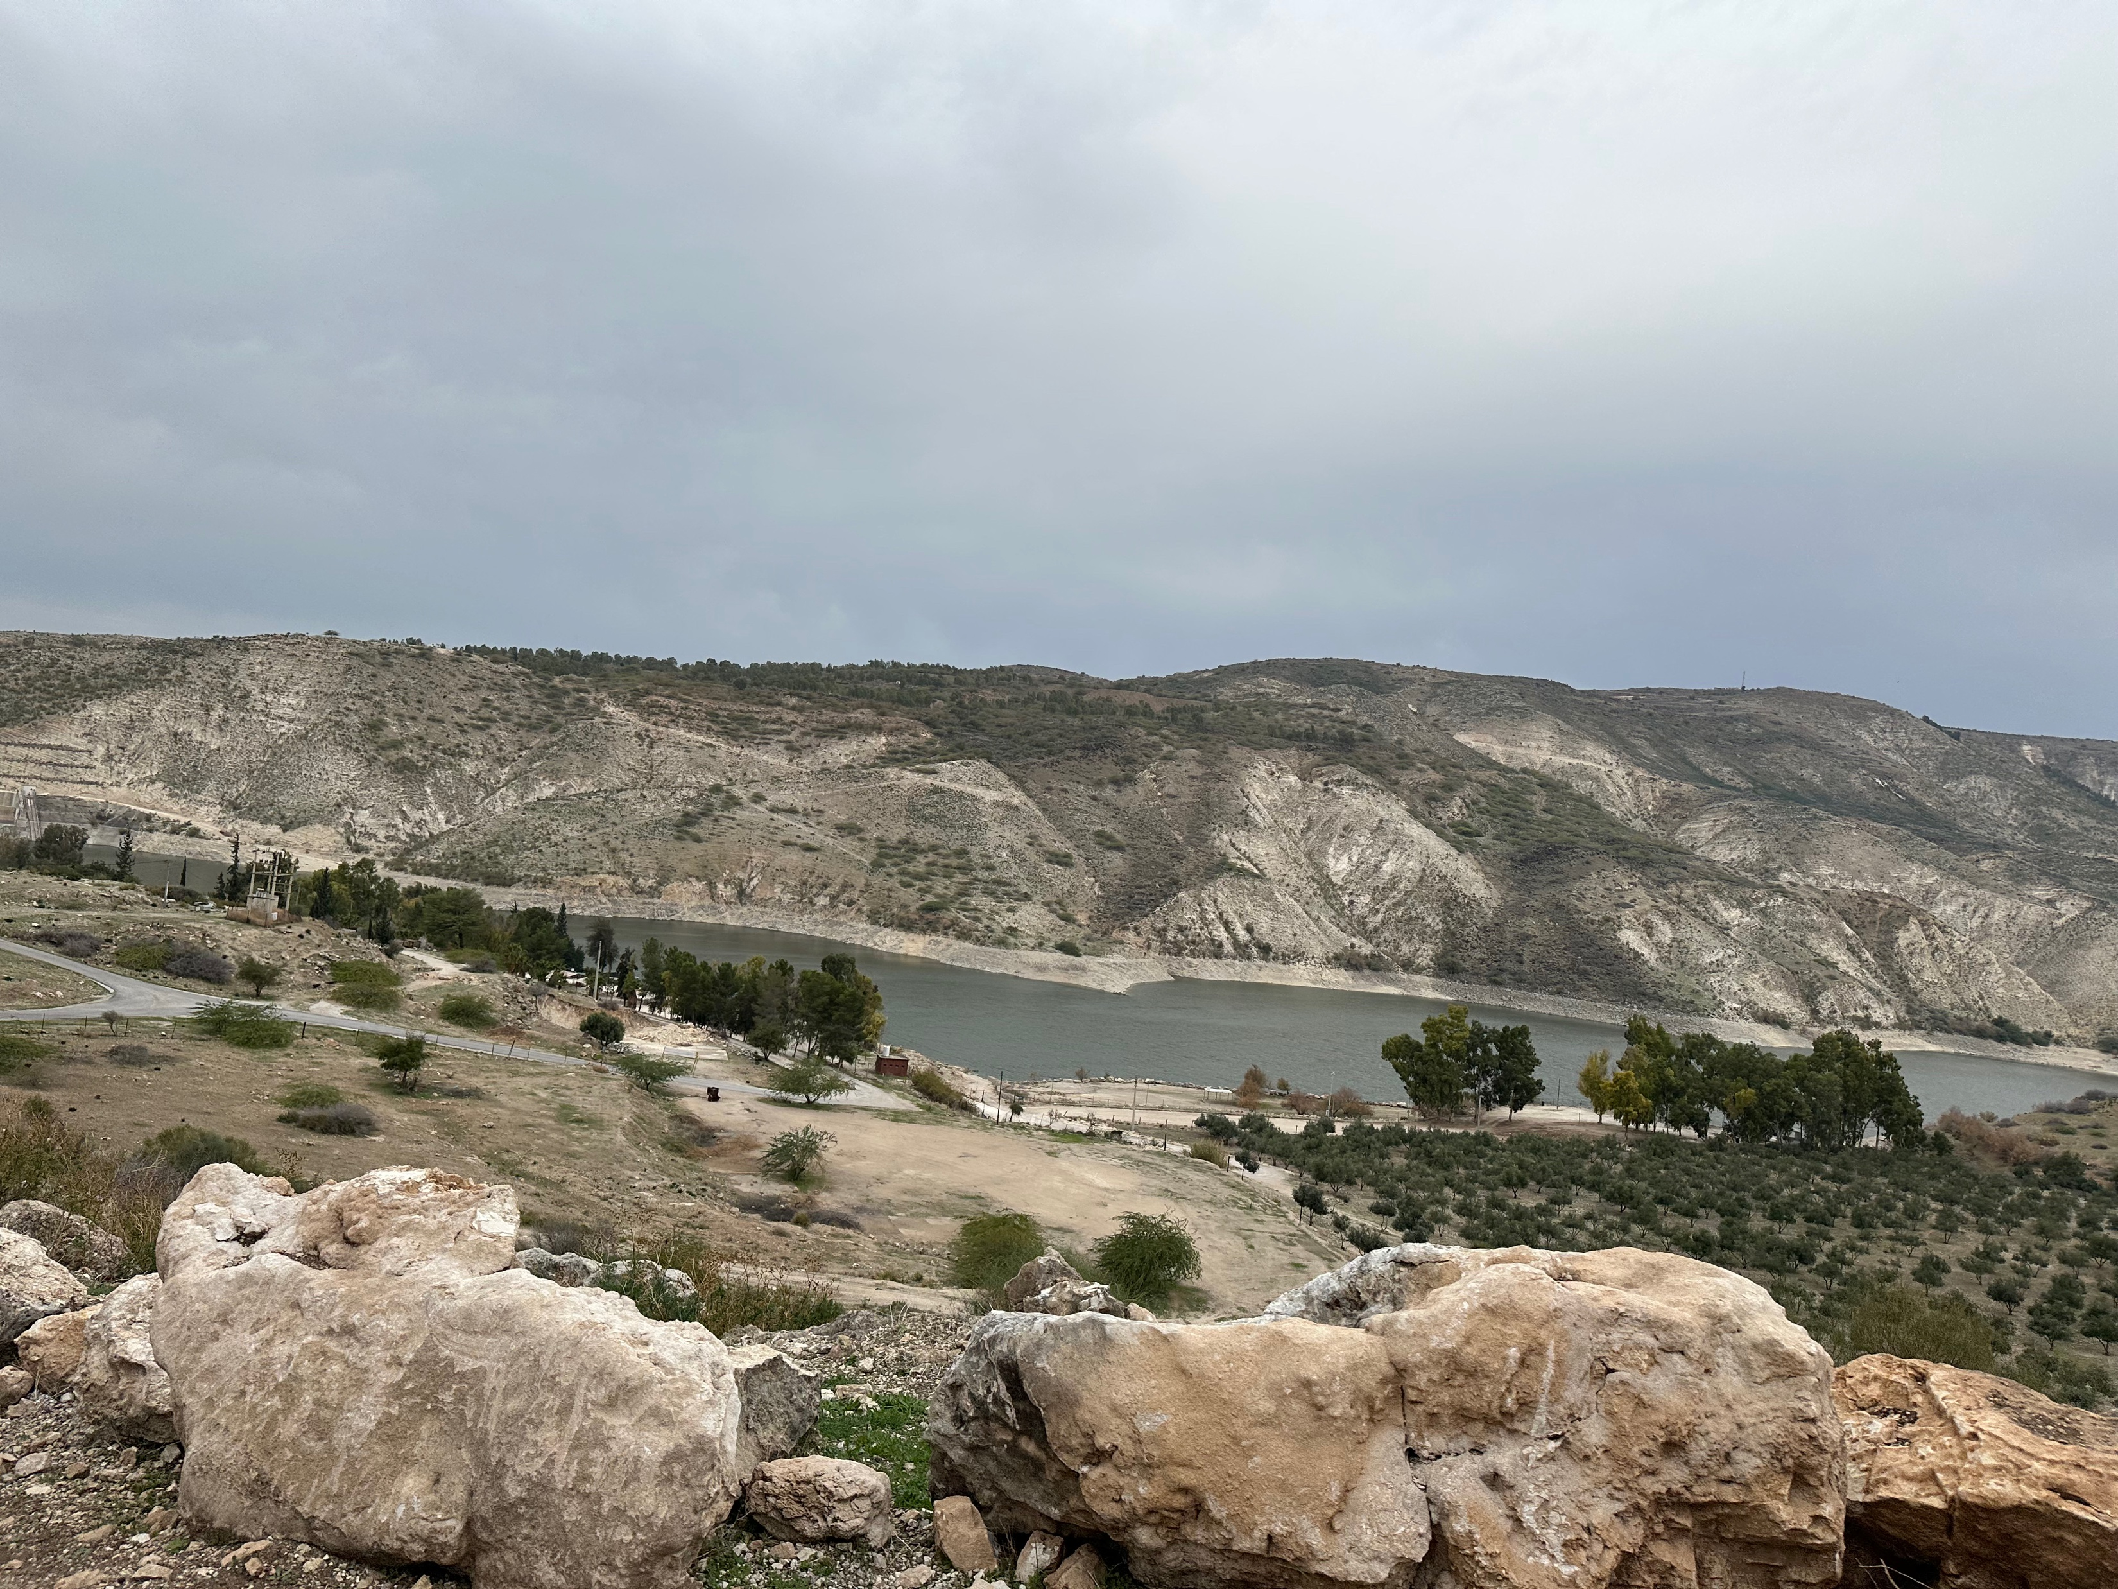


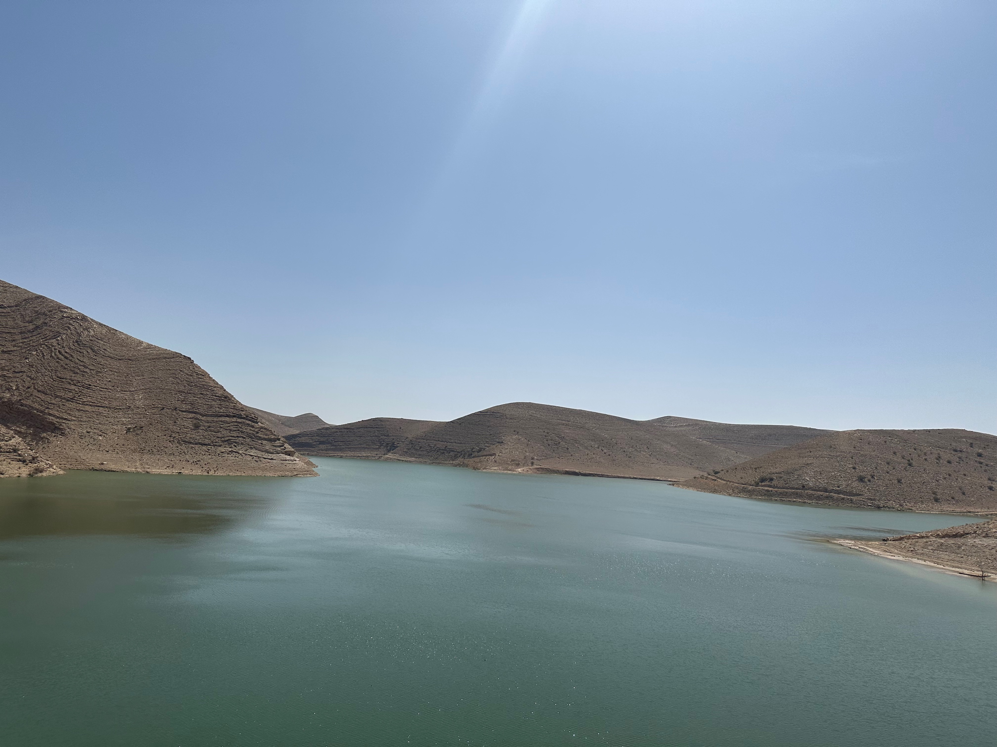
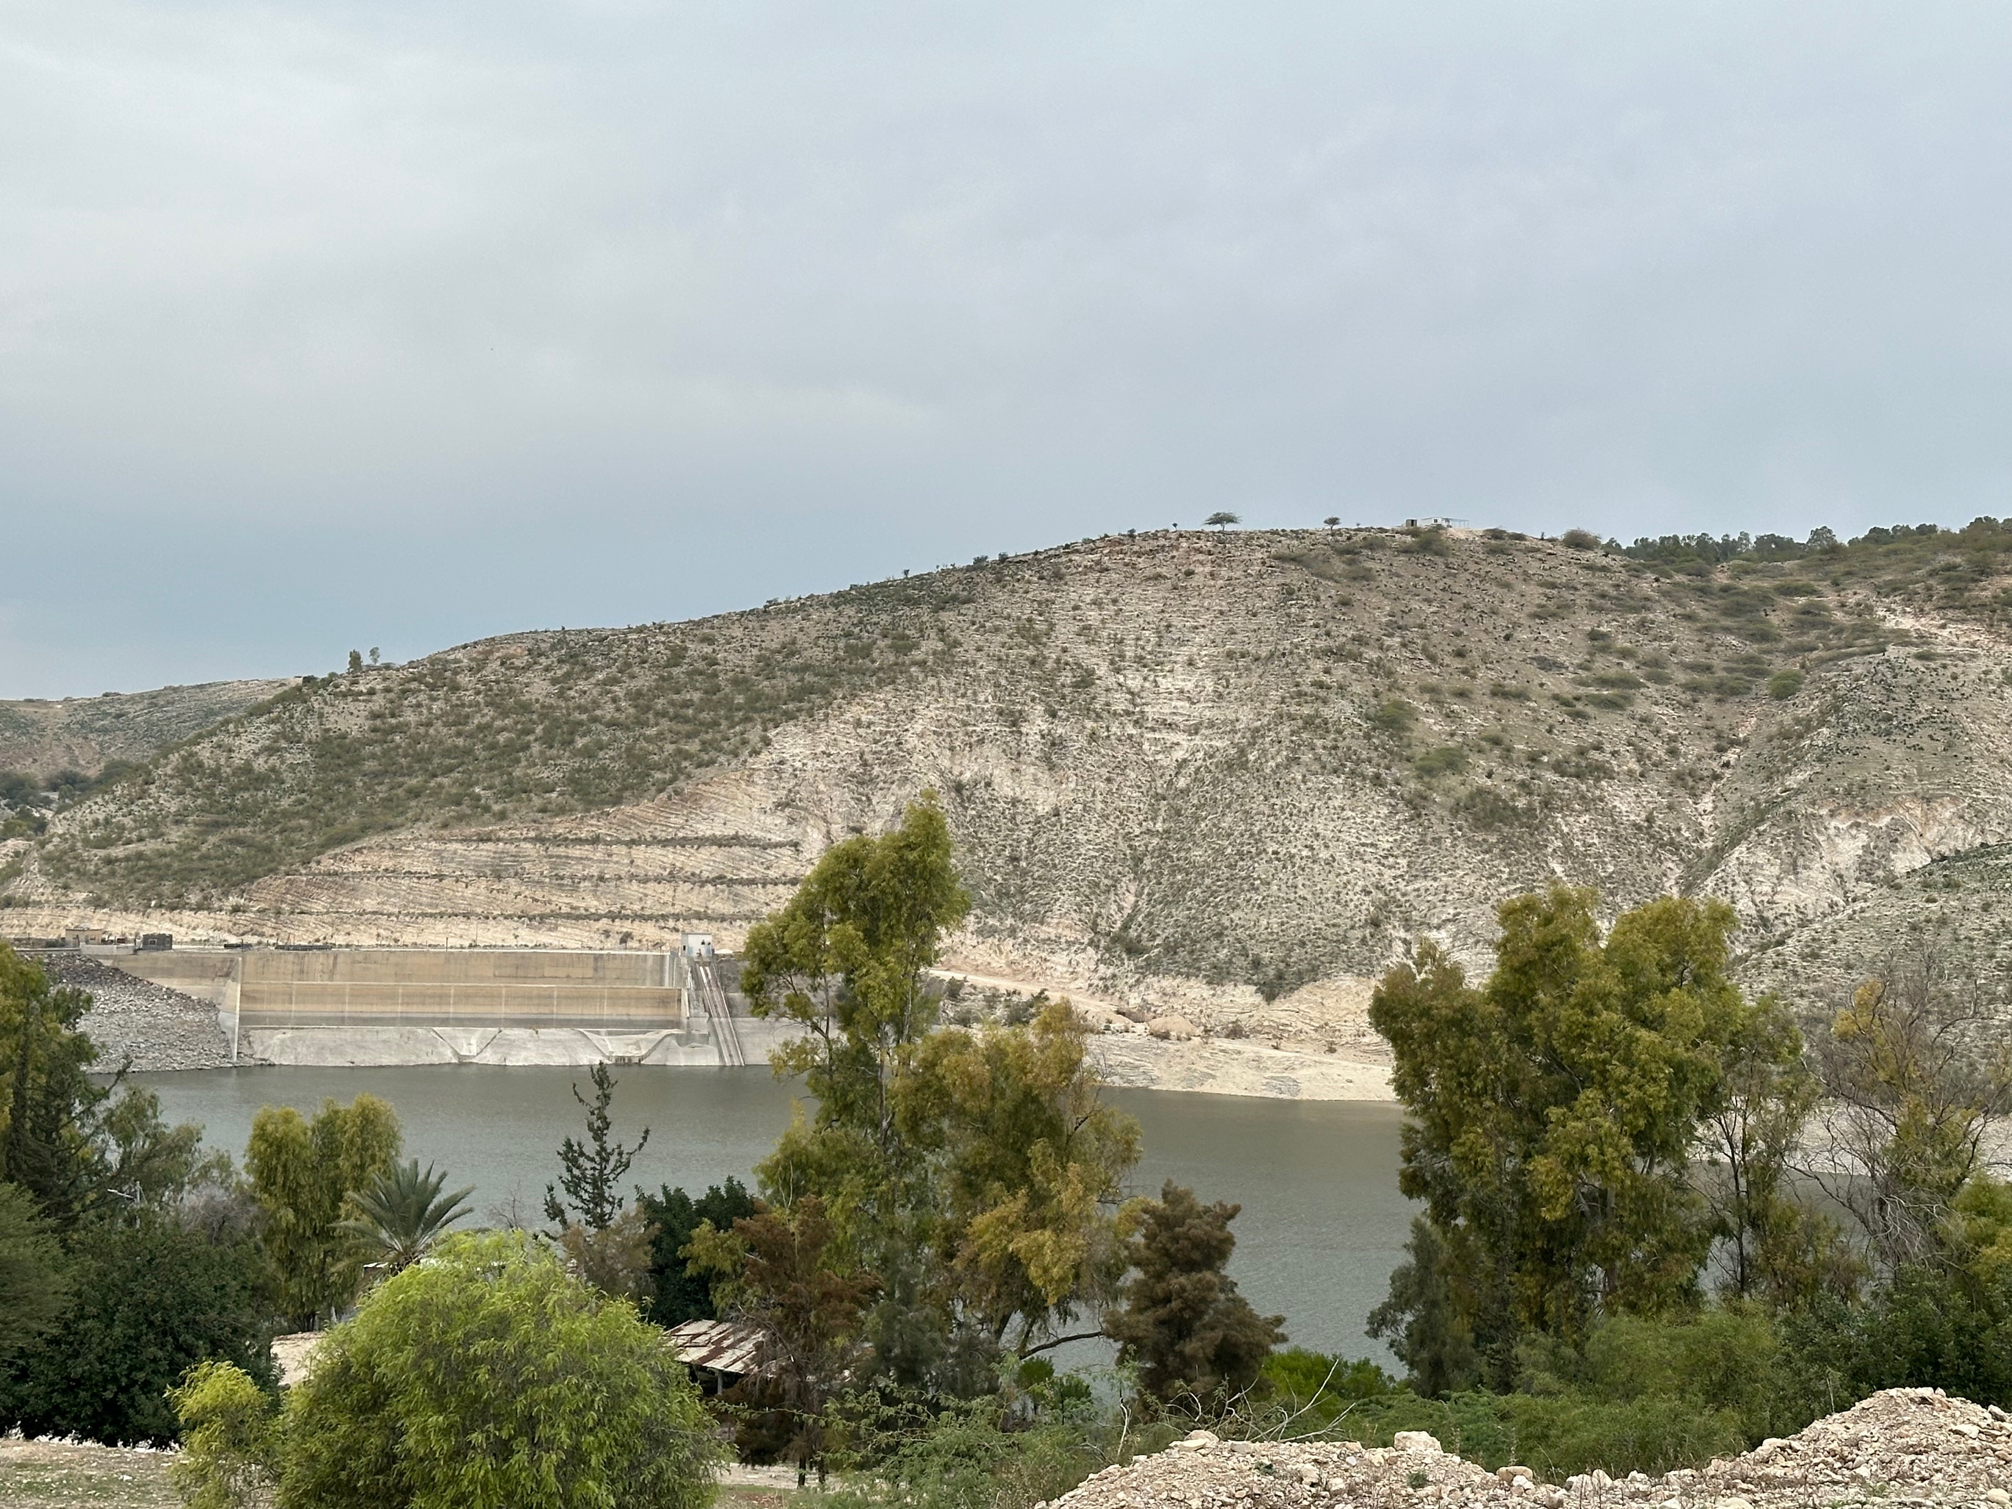


Innovative methodology to prevent and mitigate diffuse pollution from urban runoff (WATERUN)
https://www.waterun.eu

Slide 2



Session preparations
Dania El Banna
Rahmeh Okour
Rahaf Salman
Research Assistant
Research Assistant
Research Assistant

Slide 3
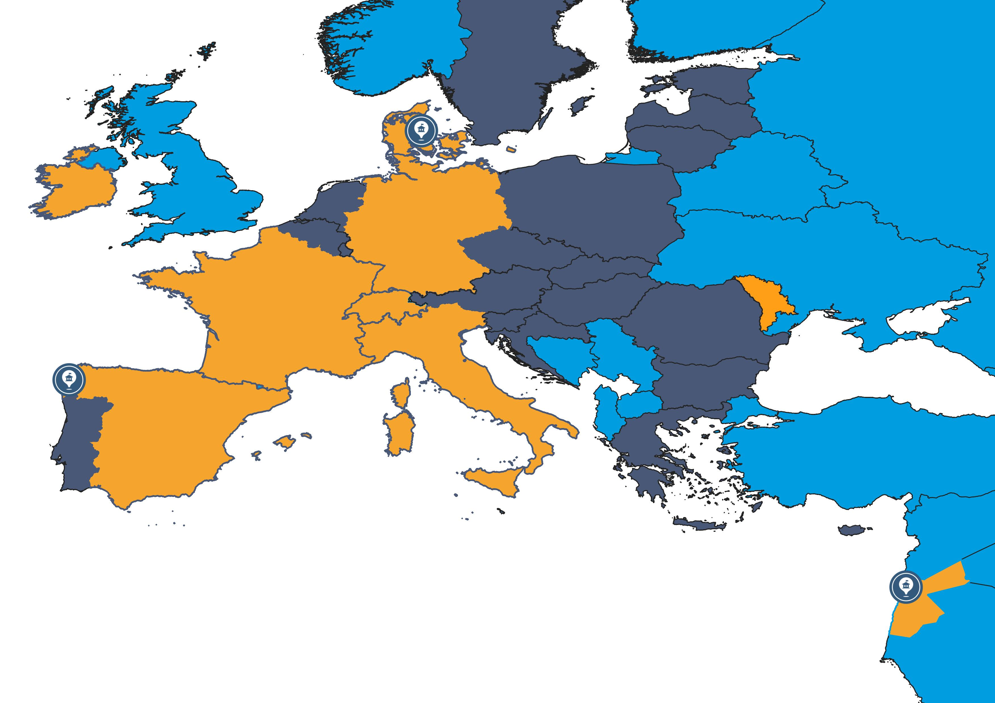














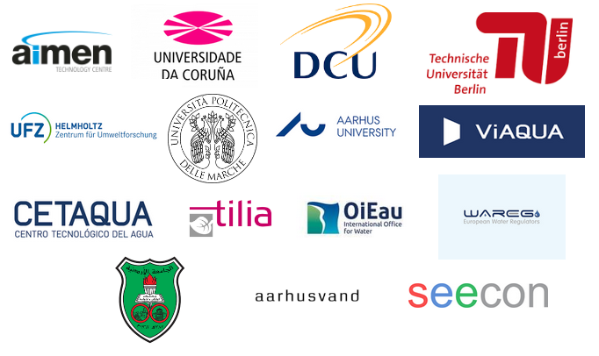

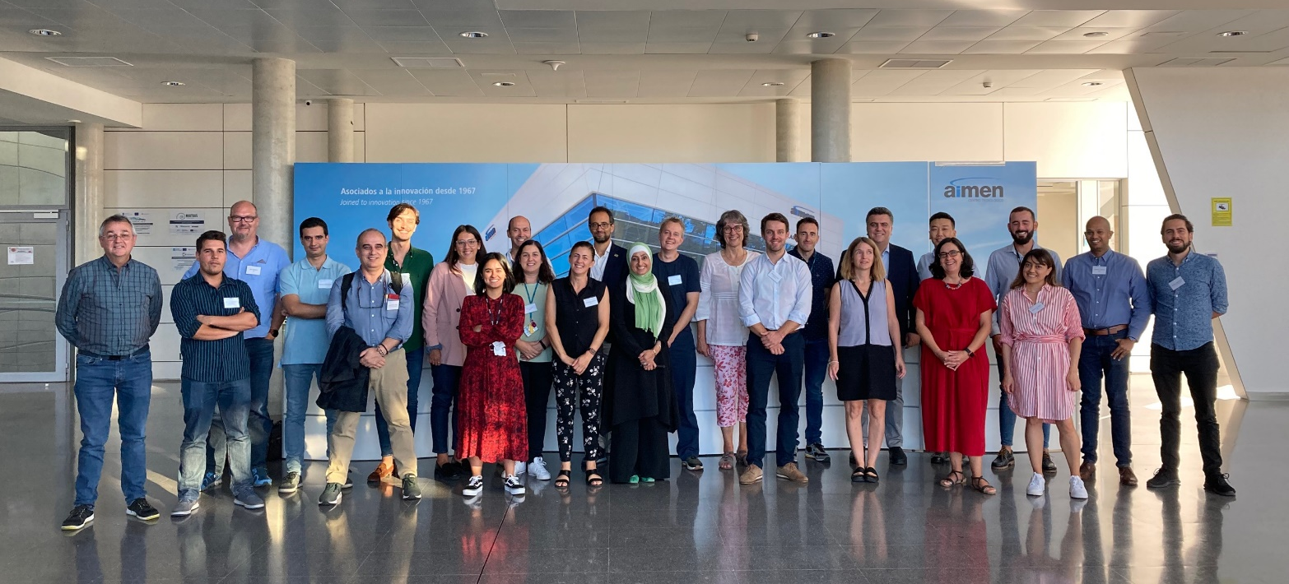
WATERUN project - Consortium
4 years project (2022-2026)
Coordinated by AIMEN
15 partners
Budget: € 3.974.187,50
Notes:
Slide 9 is a proposal to present the consortium, you could even add a picture from Aarhus.

Slide 4
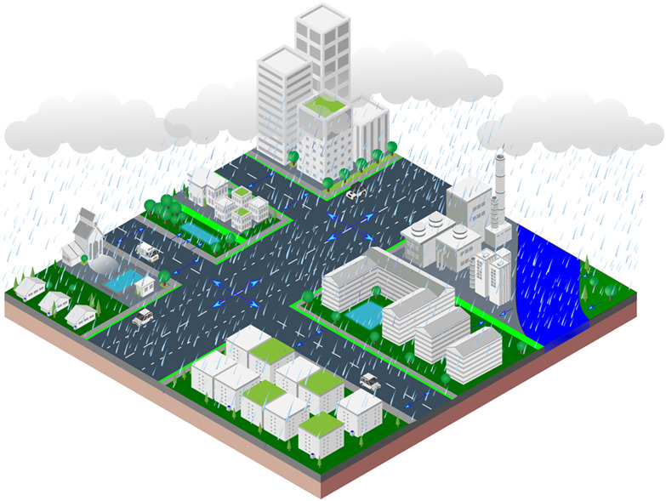











Diffuse pollution in urban areas – Which pollutants?
Pathogens
Monitoring protocols
Sensors
Rainfall
Emerging pollutants
PAHs
Nutrients (N, P)
Heavy metals
Solids
Infiltration
Run-off
Microplastics
https://doi.org/10.1002/wat2.1525
Notes:
A brief introduction of the necessity of the WATERUN project: which pollutants we could have in urban areas due to the diffuse pollution; which are the sources of this diffuse pollution, and what are the possible prevention and mitigation measures we propose (slides 3, 4&5). In these slides, in the green box are named the WATERUN products.

Slide 5
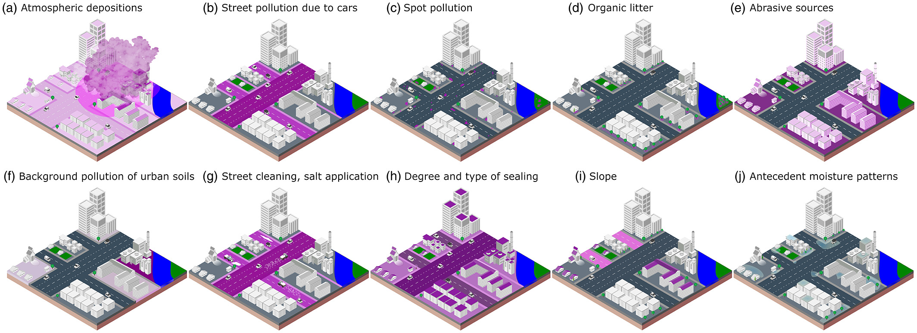
Diffuse pollution in urban areas – What factors and Which sources?
Modelling tool for identification of sources of pollutants
https://doi.org/10.1002/wat2.1525

Slide 6
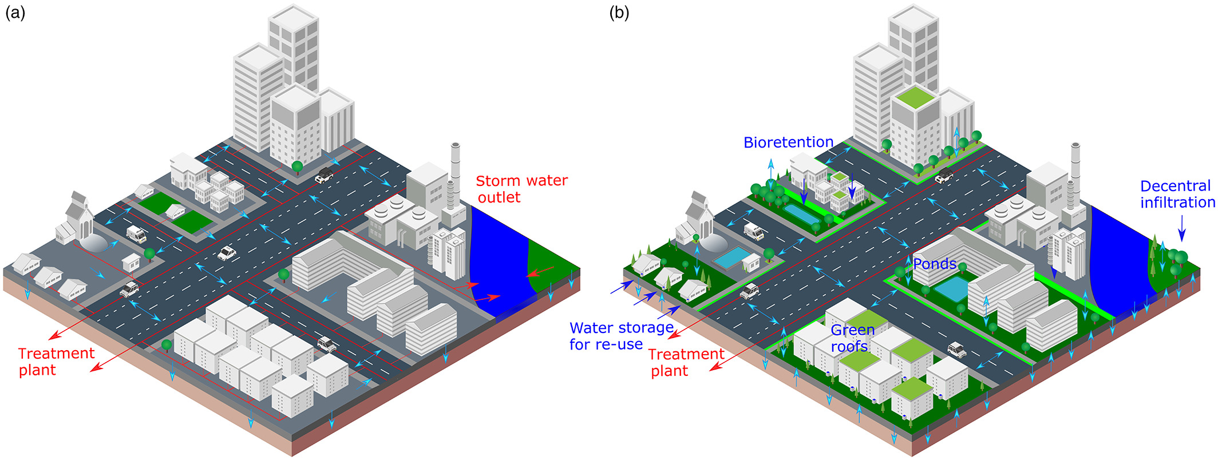
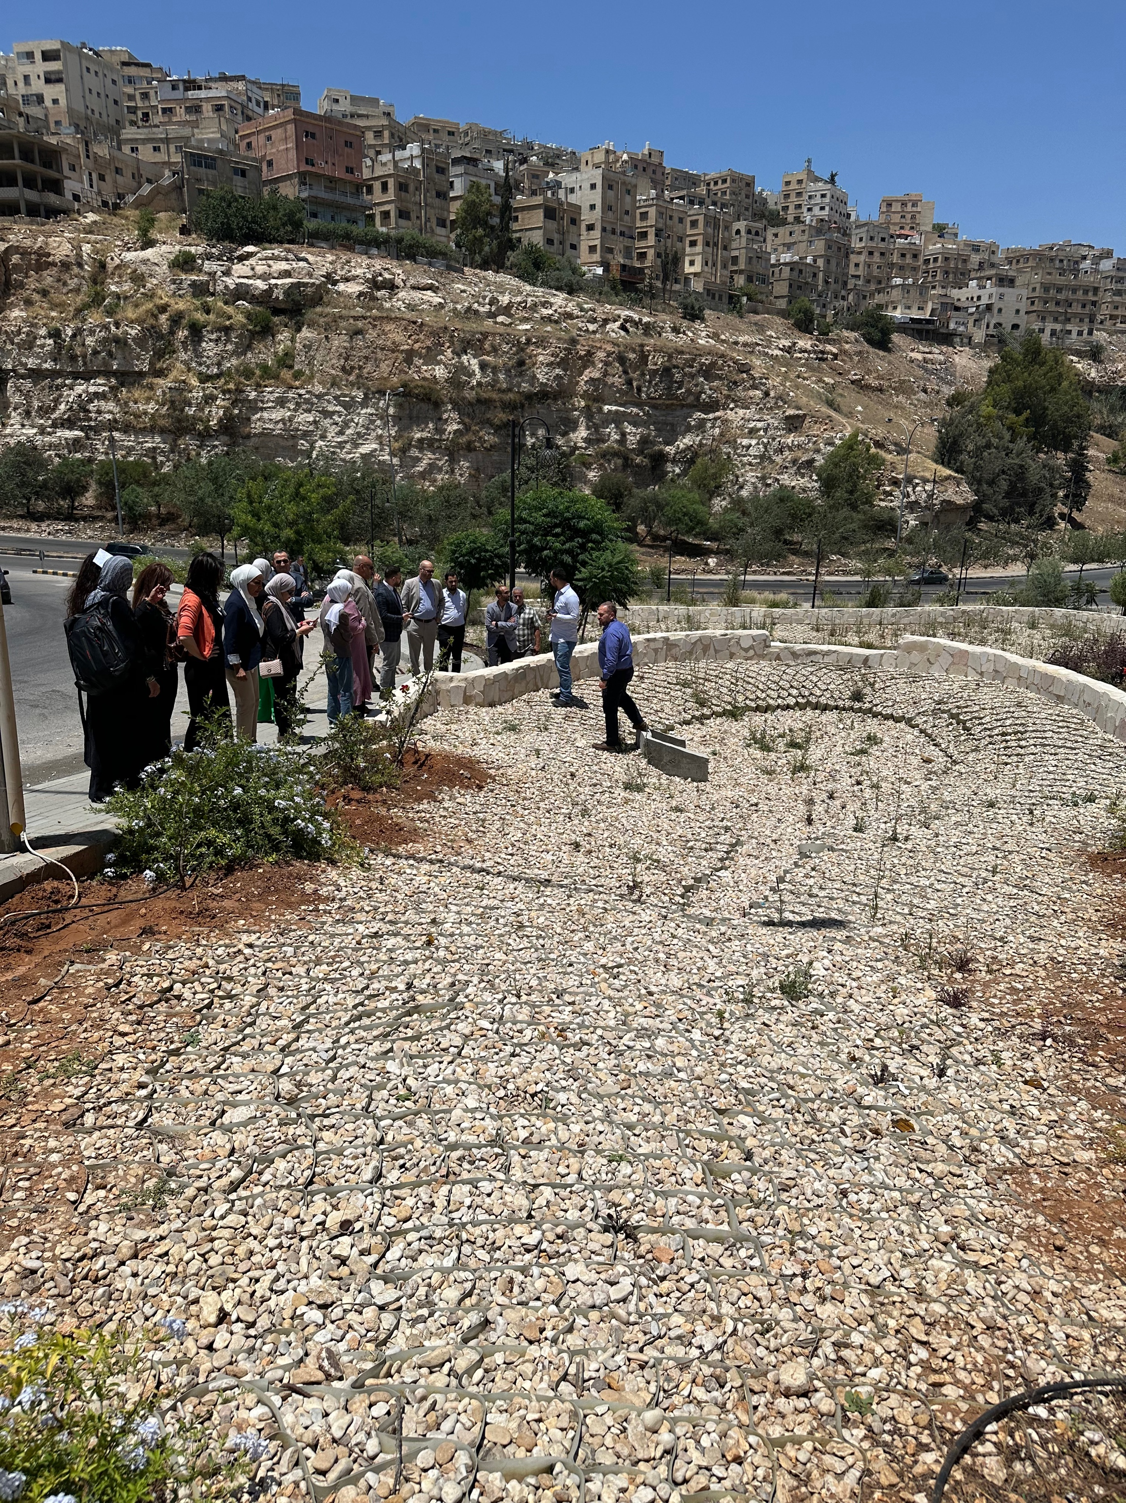
Diffuse pollution in urban areas – Which prevention & Mitigation measures?
Use of Blue & Green infrastructures
Modelling and planning tools
DSS based on risks for water reuse
Current situation
https://doi.org/10.1002/wat2.1525

Slide 7


WATERUN General approach
WHY ?
WHAT ?
HOW ?
Environmental Concern
Project implementation
5-Risk-based DSS
38% of EU surface waterbodies are affected by diffuse sources.
PAHs / heavy metals are the most toxic and concentrated pollutants in UWR, while microplastics are significant emerging pollutants.
Climate change influence significantly UWR (extreme floods, droughts)
Policy compliance (Zeropollution, Green Deal....).
Multi-actor co-creation process: LSB and ISB.
Interdisciplinary consortium.
Validation in 3 climate zones, land use and UWR reuse purpose
  Mapping tool
  EWS
  Risk-based tool
Pollutants
  Policy & governance recommendations
  LCA & techno-economic analysis
  Market uptake & technology transfer
4-Green Infrastucture
1-Monitoring
Santiago de Compostel
Spain
Amman
Jordan
Aarhus
Danmark
  Comprehensive protocol
  Advanced sensors
Prevention and mitigation measures
  SuDS Bioremediation
  Train / ponds
Knowledge gap
R&D Innovation
Complex cityscape where many sources and types of pollutants are present.
Lack of appropriate monitoring strategies.
Unreliable information on the climate change impacts.
Poor efficiency of GI.
Lack of effective regulation & governance fragmentation ).
Sources
Monitoring protocol for UWR and on-site sensors for PAHs and microplastics.
Innovative modelling tools for diffuse pollution control.
GI optimisation for diffuse pollution mitigation.
Risk-based DSS for decision- making.
2-Identification tool
3-Planning tool for SW
  Pollutant connectivity
  Critical areas
  Block Level
  Decentralised approach

Slide 8
Jordan Participation
WP2+WP3 (monitoring and modelling)

Slide 9
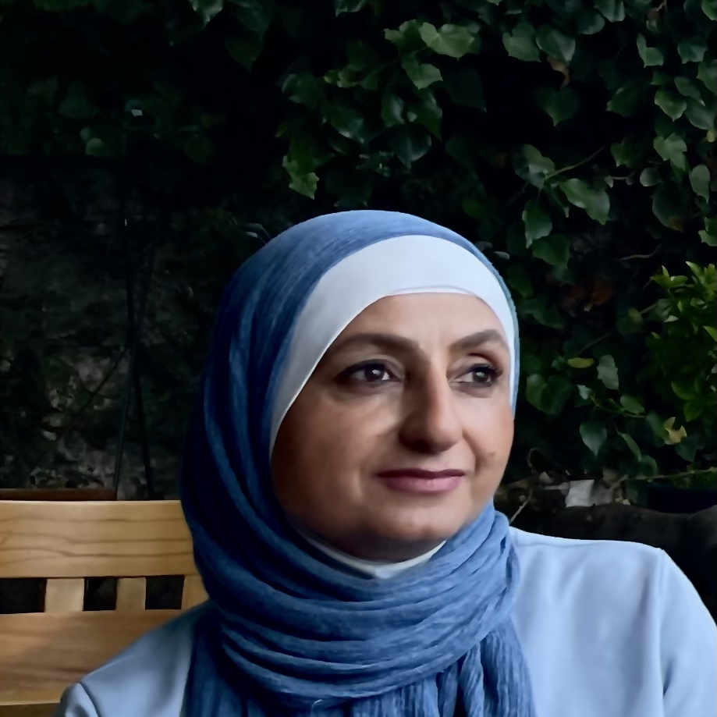
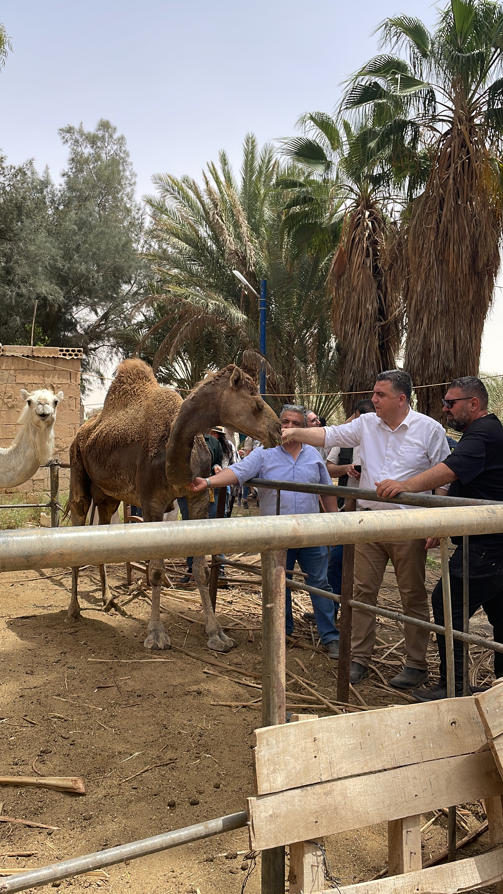
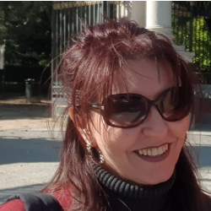
Our Team
Maha Halalsheh
Khaldoun Shatanawi
Ghada Kassab
Environmentalist
Hydrologist
Environmentalist

Slide 10
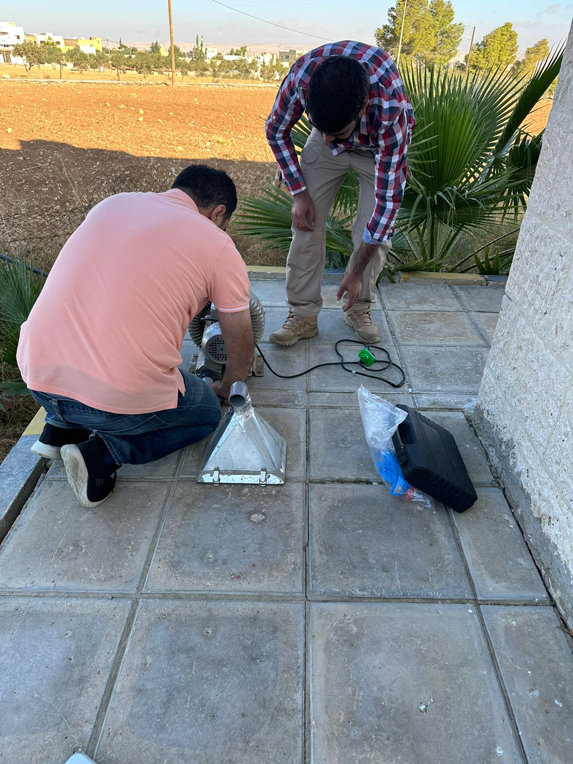
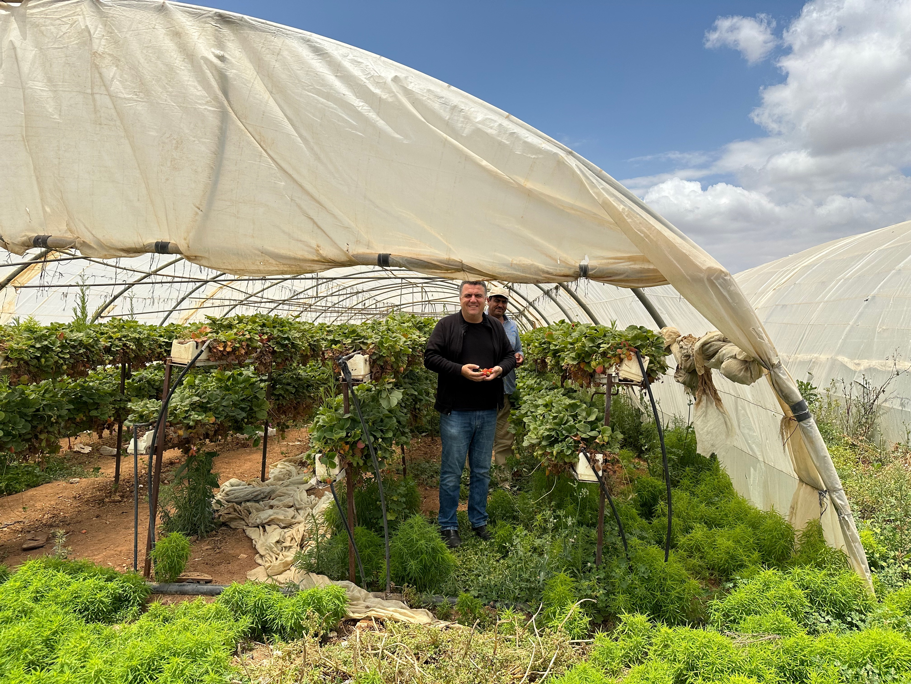
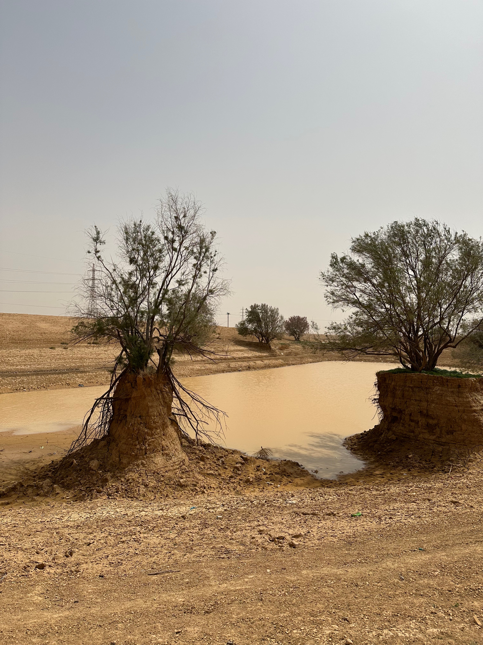
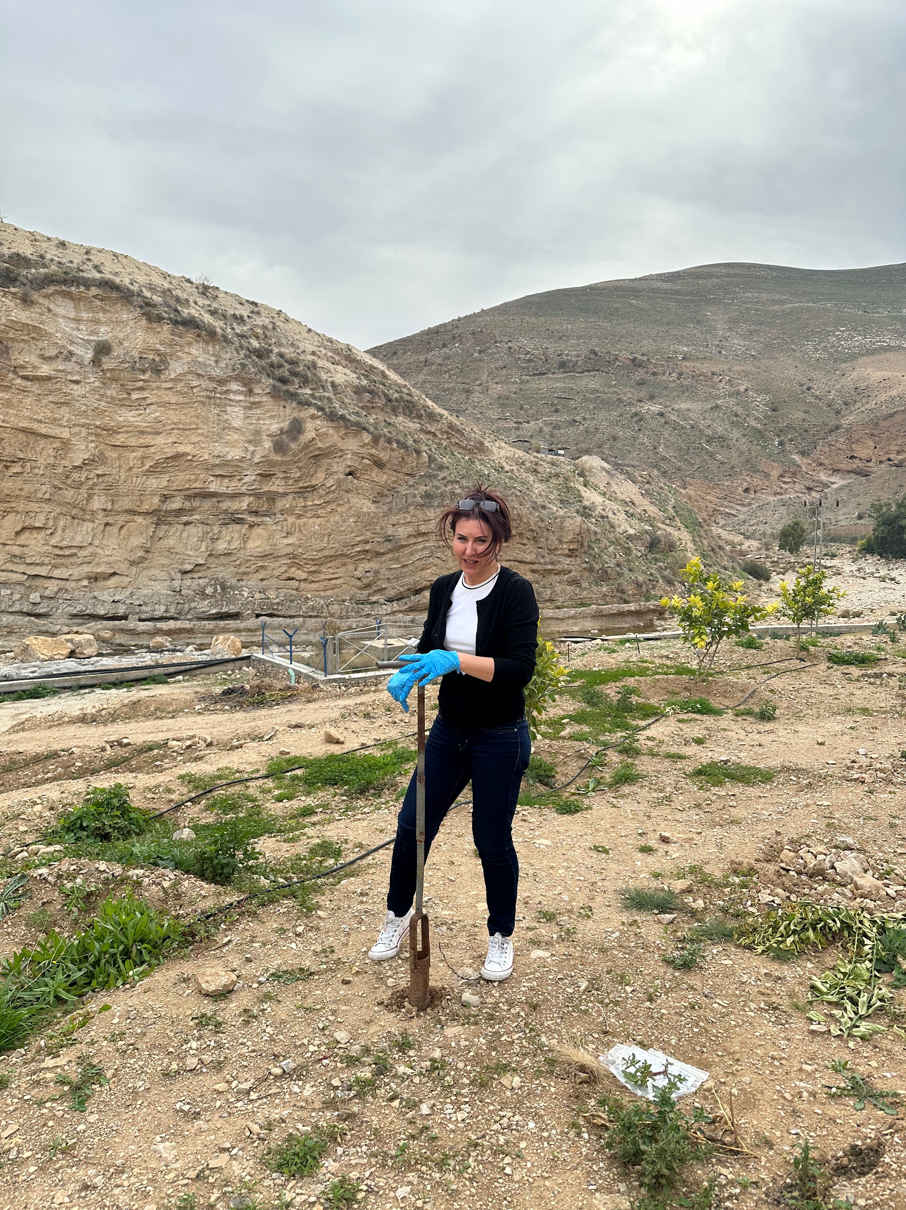
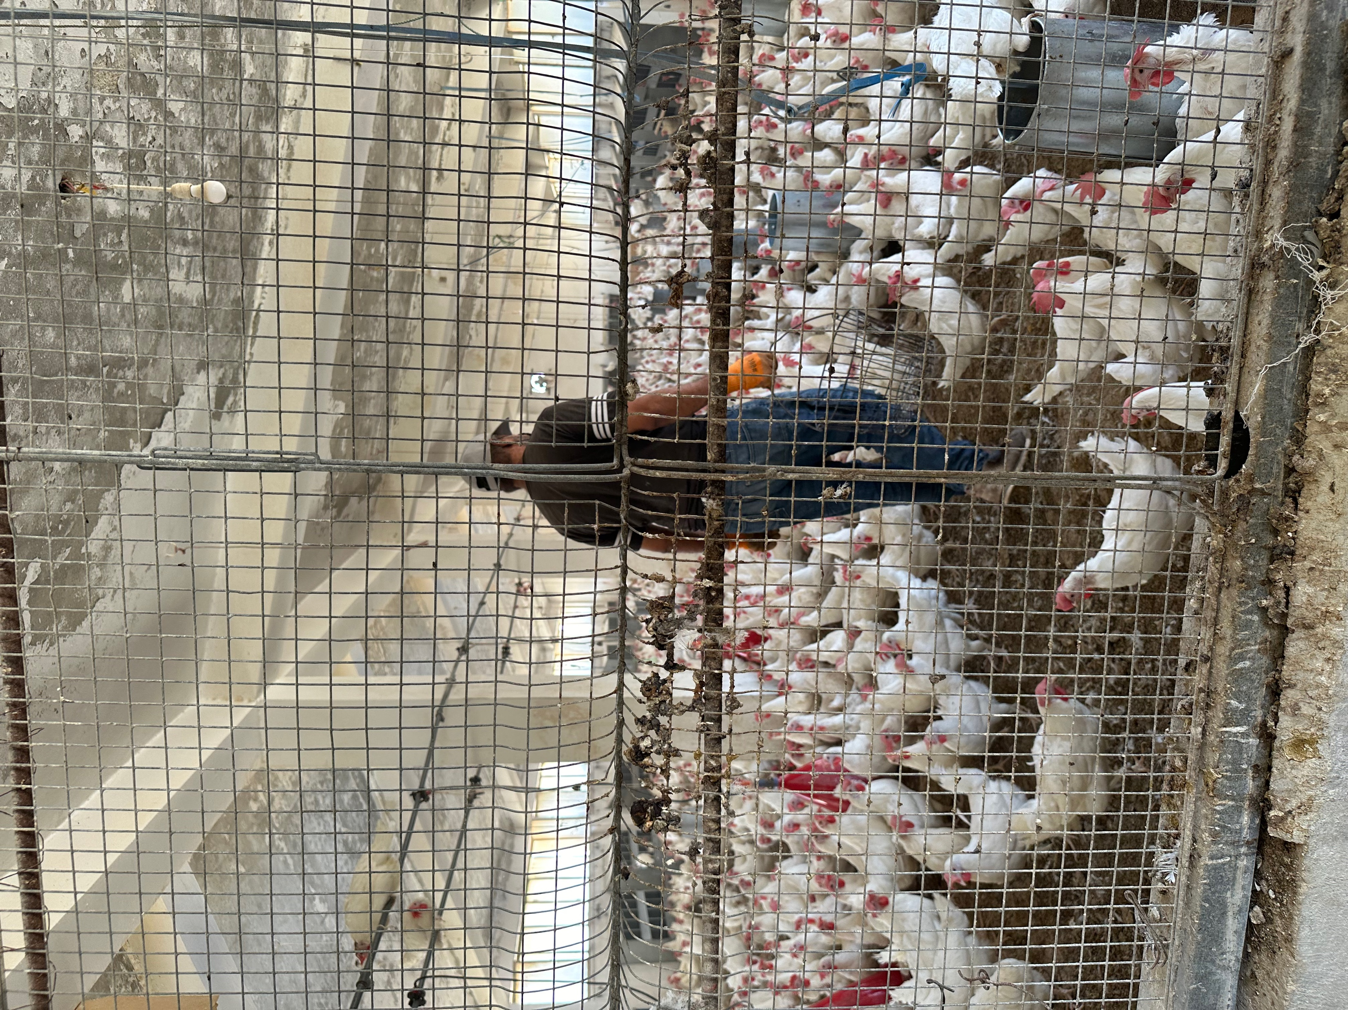
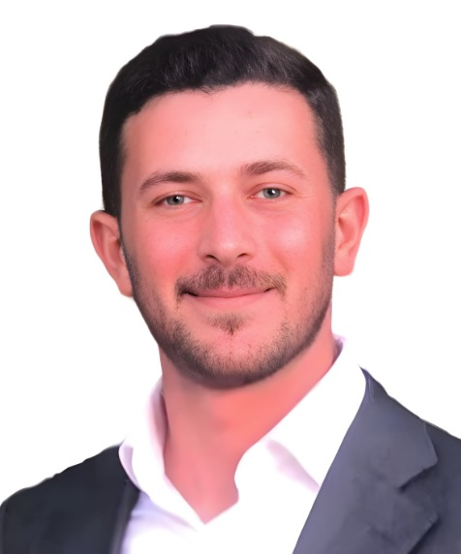

Jordan Case
Supply knowledge dissemination (Top-down approach): Amman case
WP2 (monitoring)
demand knowledge dissemination (bottom-up approach): Selenium elevated concentration (western Jordan)
WP3 (planning tool)
Modeling decentralized solution to contain pollution (MSc scholarship)
Supply knowledge dissemination

Slide 11
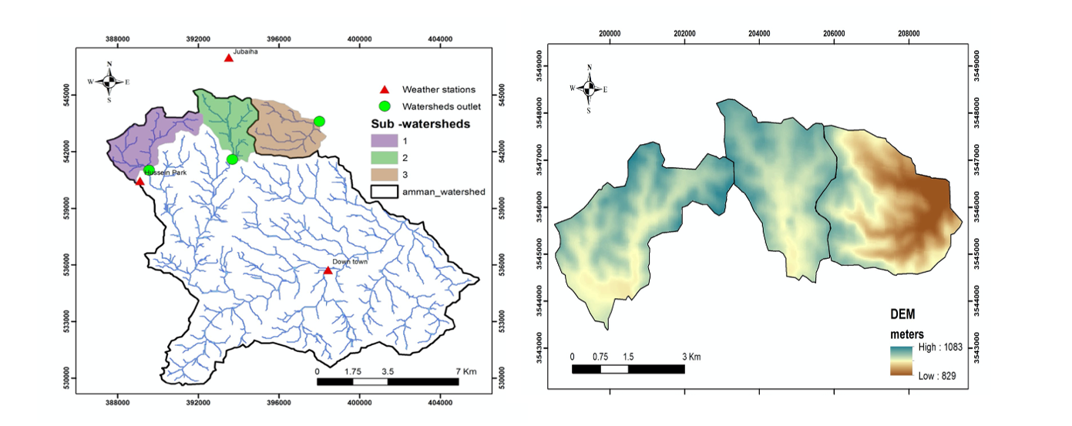
Monitoring Campaign/ Amman 2024
Parameter | Range
PAHs | 4000-7000 ng/g
Al | 4.0-25.0 ppm
Fe | 3.0-22.0 ppm
Ni | 0.02-0.09 ppm
pH | 7.5-7.6
For PAHs:
Air quality parameters (PM2.5, NO₂, O₃, SO₂) were collected from three stations and waiting for traffic Data for main roads of King Abdullah st., Queen Rania st., and Jordan highway
Dry weather analysis will be performed
For HMs:
Fractionation of metals will be performed
Dry weather analysis will be performed

Slide 12
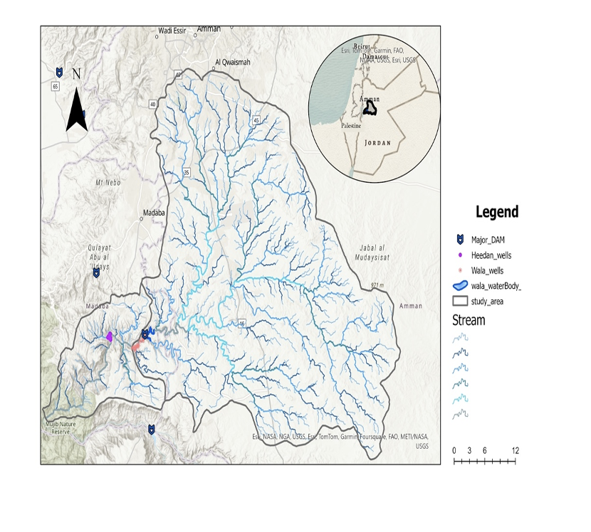
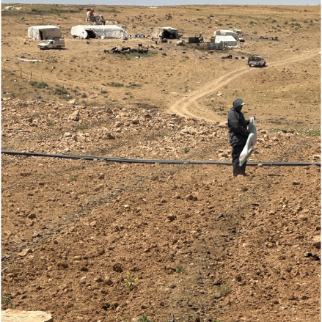
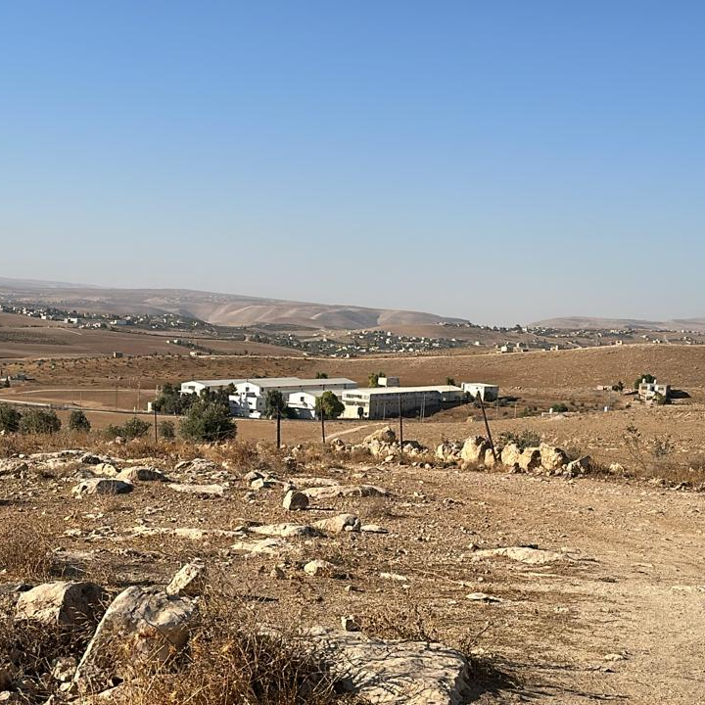

Monitoring and source Identification of HMs
Madaba Catchment area
Poultry farms
MoA records on number of farms
Estimation of manure quantities
Management practices
Challenges in samples’ collection
Previous experience in students’ capacities led to the idea of the competition

Slide 13
Universities’ Competition

Slide 14
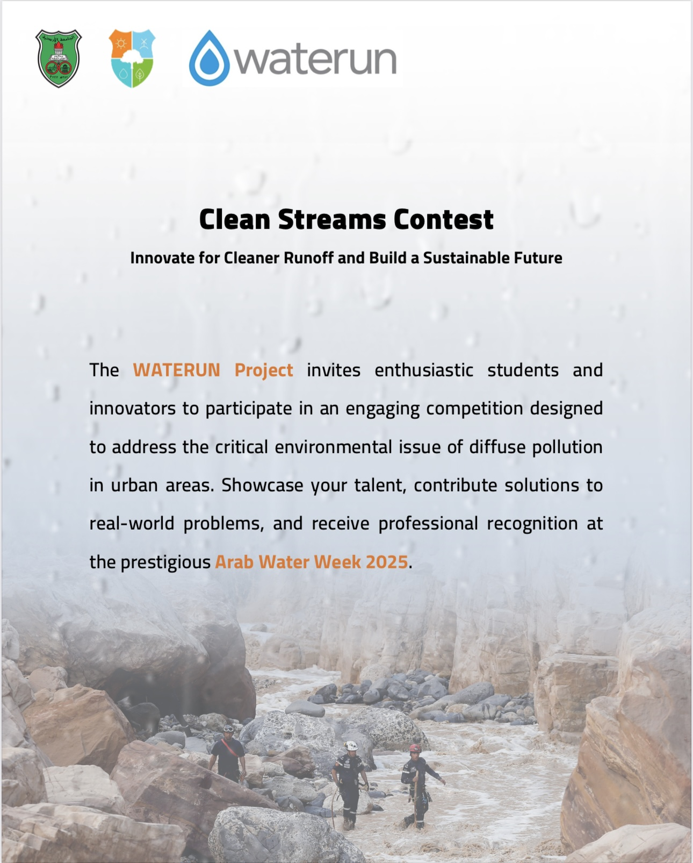
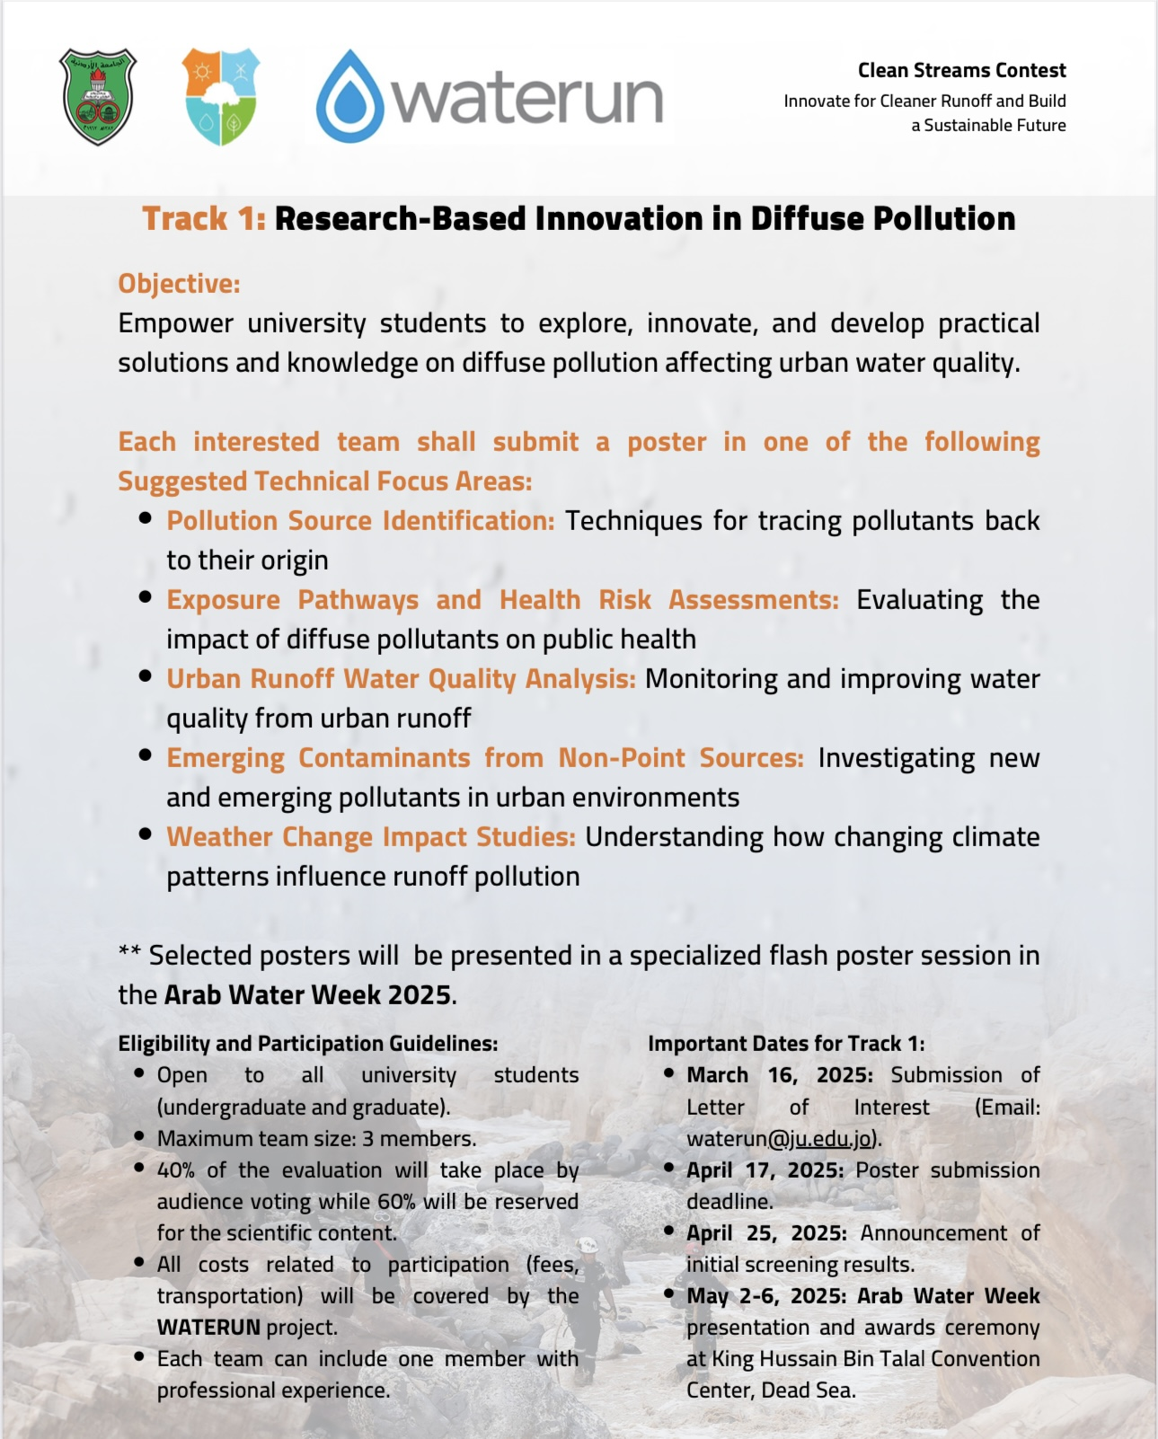
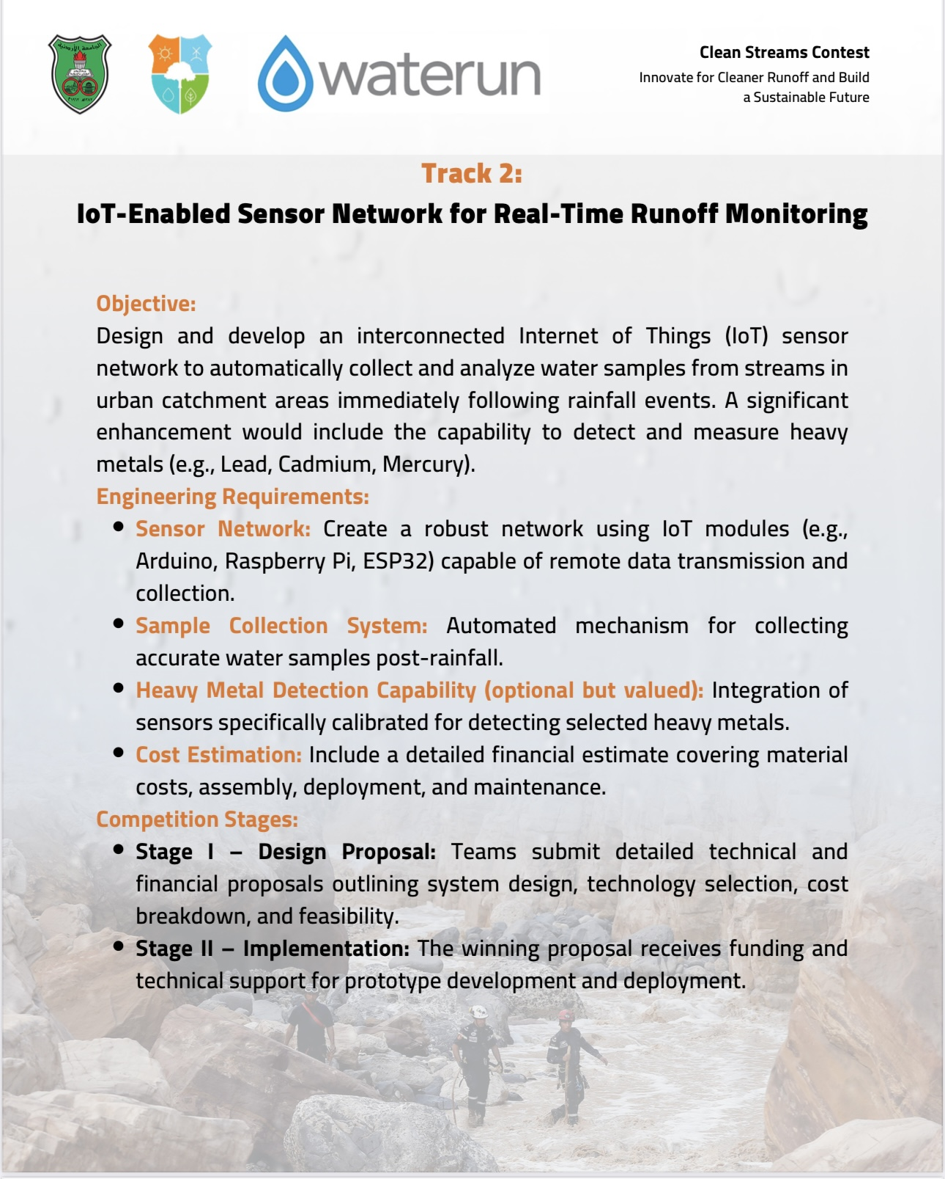
About the competition
Track I
Pollution source identification
Exposure pathways and health risks assessment
Urban runoff water quality analysis
Emerging contaminants from non-point sources
AI in Urban runoff quality monitoring and management
Engage students' interest in the quality of runoff water and the issue of diffuse pollution
Track II
IoT applications for urban runoff sampling and monitoring
Develop a product for WATERUN

Slide 15
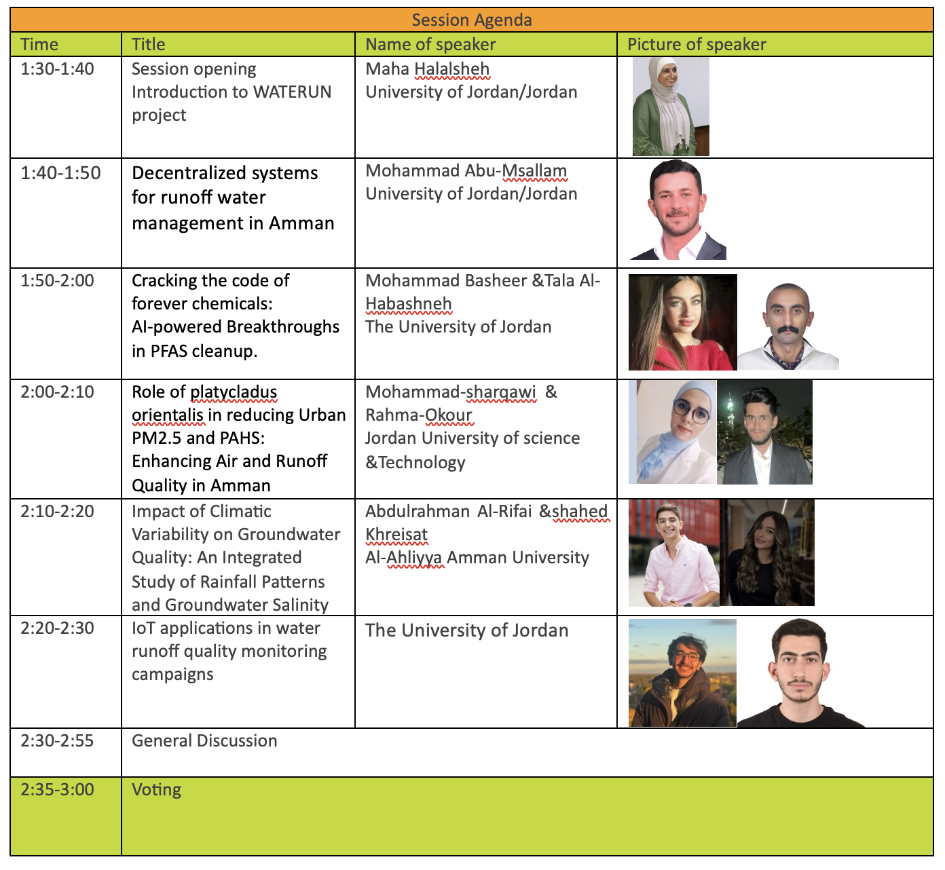

Slide 16
THANK YOU
Insert the Subtitle of Your Presentation

Slide 17


