Slide 1








Bridging Science and Cooperation for Efficient Wastewater Management: Collaboration by Aqaba Water, Columbia University, and GIZ.
Enhancing Wastewater Treatment through Science-Based Approaches
Eng. Hind Al Shdaifat – 4.5.2025

Slide 2
Overview of the Project
Strategic partnership between Aqaba Water, Columbia University, and GIZ
Aim: Enhancing wastewater management
Focus on science-based approaches and effective stakeholder engagement

Slide 3
Objective of the Project
Primary Goal:
To evaluate the integration of Non-Sewered Sanitation (NSS) technologies into existing centralized sewer systems at the Aqaba wastewater treatment plant.
Specific Objectives:
Introduce a pilot wastewater monitoring system
Assess impact on wastewater treatment processes
Improve plant operational performance

Slide 4
Partnership Overview
Aqaba Water
  Local authority responsible for water and wastewater management
Columbia University
  Research and scientific contribution to wastewater technologies
GIZ
  Implementation support and technical expertise in sustainable water management

Slide 5

Pilot Wastewater Monitoring System
System Overview:
  Introduction of advanced monitoring systems at the Aqaba wastewater treatment plant
  Key objectives of the monitoring system:
    Evaluate wastewater quality
    Track treatment performance and operational data

Slide 6
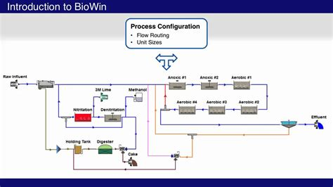
Advanced Modeling Techniques
Activated Sludge Model (ASM)
  Overview and purpose: Modeling biological treatment processes
  Helps predict system behavior and performance under different conditions
BioWin Modeling Program
  Purpose: Detailed simulation of wastewater treatment processes
  Allows for optimization of plant operations and configuration adjustments

Slide 7
Impact of Industrial Wastewater
Challenges:
Assessing the effects of industrial wastewater on treatment performance
Identifying potential disruptions in the biological processes of wastewater treatment
Expected Outcomes:
Enhanced understanding of wastewater treatment dynamics with industrial inputs
Recommendations for improved system resilience

Slide 8
Treatment Configuration and Optimization
Current Treatment Configuration
Overview of existing treatment processes at the Aqaba plant
Optimization Goals:
Improve operational responses to varying wastewater quality
Achieve better treatment efficiency and reduce operational costs

Slide 9
Stakeholder Engagement
Importance of Effective Collaboration:
Engaging local authorities, researchers, and technical experts
Ensuring community involvement and knowledge sharing
Approach to Stakeholder Engagement:
Consultations, and ongoing feedback mechanisms

Slide 10
Expected Benefits
For Aqaba Water:
Improved efficiency of wastewater treatment
Reduced environmental impact
For Columbia University & GIZ:
Practical application of advanced research and models
Contribution to global wastewater management knowledge

Slide 11
Summary of Key Points and Next Steps
Outcomes
Collaboration between Aqaba Water, Columbia University, and GIZ for improving wastewater management
Pilot wastewater monitoring system to evaluate NSS integration
Use of advanced modeling techniques to optimize treatment performance
Next Steps:
Continue monitoring and refining system integration
Share findings for global application in wastewater management

Slide 12
Thank You

