Slide 1
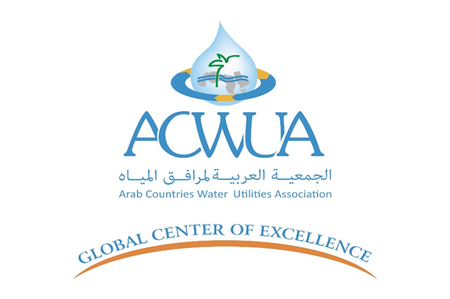



The Priority of DMAs Establishment to Sustainably Reduce NRW in Jordan
Eyad Sahawneh –May 2025

Slide 2
How are DMAs realized in the first place?
Condition Assessment
Design and Modeling
Test & Validate
Establish & Monitor
Sustain & Improve
What are the Challenges and the Theory of How for each Stage?
How is Confidence Factor weighted to satisfactory level?
How are stages integrated into a Continuous Improvement Process?
Is the so-called Wet/ Dry Test being sufficiently creates DMAs?
When is a DMA not a DMA?

Slide 3
How IWS affecting DMAs Establishment?
Inability to conduct necessary tests and verification.
Inflexibility of designing transitionable DMA into a continuous water supply.
Interpretation of inconsistencies that came out of indeterminate triggers.
Equity analysis or, water distribution philosophy.
Characterizing supply variability and operational challenges.
Engineering what is not engineered (standardization of change-driven-approach).

Slide 4
Why DMAs?, Think of Alternatives!
Prioritization and Planning (Technical and Financially)
Understanding and Assessment (Hydraulic Systems)
Sustainability Measures (Maintaining NRW Levels)
Application of Best Practices (Technology, Data Analytics, etc.)
Continuous Improvement (Monitoring and KPIs Operability)

Slide 5
DMAs is a Theory of Change for NRW Reduction
Improved leakage control management and component analysis (background & burst losses, ALR/ runtimes, active/ passive methods, survey planning, technologies, etc.).
Intermittent water supply regime a side and on other side the effect of pressure.
Design criteria, sizing and economics, and DMA planning, tests and meter selection.
Water quality considerations and other associated public health aspects.
Data and analysis: night use/ MNF/ customers consumption & storage/ patterns/ etc.
Leak detection and problematic DMAs, and unauthorized consumption mitigations.
Best practices: managing cascading, hydraulic balance and critical points correlation, Rota cuts, step-test, sector/ WSP/ DZ/ DMA, BABE concept, AZP management, meters, etc.
Top-down and bottom-up reconciliations, water audits and baselining measurements.
Monitoring and Evaluation: benchmarking, KPIs, continuous improvement, etc.
Institutional Support & Governance: SOPs, manuals, re-engineered process, etc.
Assets Management: heatmaps, registers, GIS, tagging, lifespan, resources optimization.
Speed and Quality of Repairs: maintenance planning and management.
Water Distribution: supply and demand management, BCP/ ERP, EE (pumping & storage facilities), saturation time, customer satisfaction, etc.

Slide 6
Validated Methodology to Test & Confirm DMAs
Condition assessment (system, assets, data, records, etc.), data collection and analysis (site measurements/ Q&P, field survey, etc.), investigation & technical studies (EGL/ hydraulics).
Operational understanding (supply and demand patterns, capita share analysis, critical points monitoring, maintenance walkthrough, access locations, valve tightness, etc.).
GIS verification (abounded layer, network attributes, as built drawings, etc.).
Combination of tests upon allowability to ensure triangulation/ cross-check methods.
Localization, segmentation and step-approach of risk triggers categorization.
Use of technology specifically for subsurface utility engineering (GPR, correlators, etc.).
Advanced hydraulic modeling (EPS – estimations, corrections, factorization, etc.).
Stakeholder engagement, OPA & EEF repositories at utility side and focus groups.

Slide 7
An Outlook to Local Operational Issues
Restructuring and Rehabilitation Projects (RFP/ TOR – Construction).
IWS and Utility Service Delivery Requirements + Metering Approaches.
History of CIP, Water Availability and Infrastructure Design Philosophy.
The Impact of both Redundant Pipes and House Connections (Top-Down or Bottom-Up).
Data Reliability, Availability, Completeness, Functionality and Accuracy + Technology/ AI.
Operational Efficiency: Critical Customers & Water Quantities Optimization/ Allocation.
Utility Governance Frameworks: Organizational Effectiveness and Repositories.

Slide 8
What Real-Life Examples Are Saying?
Zarqa Governorate Water Compact (approx. 45 DMAs).
FARA-Projects in the Capital Amman (Restructuring and Rehabilitation).
NRW-PBC in Western and Southern selected DZs of Amman (approx. 65 DMAs).
NRW Demonstration Pilot in Hai Al Nasir – Amman Governorate (Master Plan).
Selected areas of Aqaba City for Pressure Management and Design Interventions.

Slide 9
Key Takeaways
DMAs establishment is a must to aggressively and sustainably reduce NRW.
The Theory of DMA management itself is a shift in the operational improvement.
In the lack of funds, unreliable data, unevaluated assets == DMA establishment can help.
Confirming DMAs requires much more than typically practiced (testing & commissioning).
IWS is challenging, either operationally or at NRW reduction (incl. DMAs establishment).
DMAs establishment include an iterated cycle (from condition assessment to sustain).
It is not only about DMAs establishment, but more on operation, benchmark and sustain.

