Slide 1




Aligning Climate Finance through Enhanced Domestic Policy Coherence
Fayrouz Eldabbagh
6th of May 2025

Slide 2
Political Economy of Foreign Aid
Reforms or adjustments of the Official Development Assistance (ODA)
  A Re-Definition of ODA - goals, means, and impact
  Normative Foreign Policy (Values/Interests)
Notes:
Geopolitical economy context:
ODA has become an instrument of foreign policy reflecting ruling party ideologies rather than as an expression of normative foreign policy goals, means and impact.
DAC to define key spending areas and what to exclude. Critics argue that ODA is spread across too many priorities and is not well-targeted towards the poorest populations or its traditional development aims related to poverty reduction.
Climate action is thought to be partially tackled by ODA, while relying mostly on PPPs

Slide 3
2 sides of a Coin
Reduce Financial Needs
Increase Financial Flows
Domestic Policy Coherence
Public-Private Partnerships; Commercial Banks; Philanthropies
Scientific and Technical Advisory Panel (STAP) of the Global Environment Facility (GEF)
Notes:
1. Existing Funding Gap, especially in climate finance
2. A two-balanced approach can help close this funding gap: 1) increasing the supply of funding through Resource Mobilization, 2) simultaneously reducing the need for funding through Policy Coherence.
3. GEF is currently looking into how their financial resources injected into programming design and implementation could foster PC. Policy Coherence is the main focus of this discussion. How does fostering the alignment of PC reduce financial needs?

Slide 4
Policy Coherence
Across Scope and Scale
Horizontal
(Across Sectors)
Irrigation
Agriculture
Vertical
(Across Governance Levels)
National
Local
Normative
(Across SDGs)
Economy
Social
Climate
Grassroot
Environment

Slide 5
Tools of Evaluating Domestic Policy Coherence
Database of Policies, Laws, and Programs
Mapping of Policy Goals, Outcomes, and Instruments
Assessment of Policy Interactions
Policy Frame
Policy Interactions (relationships):
  Type:
    Synergies (indivisible, reinforcing, enabling)
    Trade-offs (constraining, counteracting, cancelling)
    Neutral
  Intrinsic or dependent on other variables:
    location and context-specific,
    timeframe (long- or short-term),
    governance,
    technology
  Direction of interactions:
    Unidirectional,
    Bidirectional,
    Circular,
    Multiple relationships
Notes:
Tools:
Database of policies, laws, and development programmes: review of policy documents from national strategies to legal frameworks
Location and context-specific: Positive or negative interactions could differ based on the biophysical environment of each geographical location, the type of soil and land, the existence of water resources and their types, and climate. 2. Timeframe (long- or short-term): Positive interactions could be produced in the short-term on land and water, but in the long run, it will negatively influence them. 3. Governance: Negative interactions could be the result of poor governance. 4. Technology: Mitigating trade-offs and creating positive linkages could be the result of adopting new technologies
Unidirectional: A policy goal/intervention (X) affects (Y), but (Y) does not affect (X). o Bidirectional: A policy goal/intervention (X) affects (Y), and (Y) affects (X). o Asymmetrical: A policy goal/intervention (X) affects (Y) in different ways, compared to how (Y) affects (X). o Circular: A policy goal/intervention (X) affects (Y), which affects (Z), which in turn affects (X). o Multiple: A policy goal/intervention (X) affects (Y), (Z), etc.

Slide 6
Institutional Arrangement for Policy Coherence
Power Dynamics (1 Actor)
Injunction
Economic Capital
Social Capital
Knowledge, skills, expertise
Vertical relationships
technology, innovation, and infrastructure
Degree of Organization
Social Network (Partnerships)
Hierarchy
Fund
Technical
Knowledge
Notes:
Domestic policy coherence necessitates assessing the institutional arrangement (scattered l on-going partnerships)
2 tools of evaluation: power dynamics and social network analysis
Power dynamics is assessing the capacities of one actor to act upon the synergies and trade-offs towards the common policy frame
Partnerships is assessed through social network analysis (how strong or weak linkages between different actors/institutions)
Flow of hierarchy: Command and hierarchy.
Flow of Fund The flow of funds means the provision of loans and/or grants.
Flow of Technical Assistance. It comes in two shapes: Soft, which is about capacity-building activities in a water productivity area. Hard, which is about the provision of equipment, technologies, or infrastructure. This technical assistance could be provided through grants or the purchase of these goods and/or services.
Flow of information Agreements, protocols, and coordination mechanisms through reporting mechanisms or meetings.
When the network is designed, it is based on the analysis of each actor, its power and role towards this policy frame.

Slide 7
Egypt Case Study: Policies
A common policy frame: climate-adaptive water productivity (Biophysical; Economic; Social)
Synergies and Trade-offs assessment on:
  Sectoral Policy Linkages 1: Efficient water rationalization increase agricultural productivity, enable climate adaptation, and reinforce water availability for other sectors
  Sectoral Policy Linkages 2: Developing new sources of land and water resources supports higher and sustainable agricultural productivity growth and employment
  Sectoral Policy Linkages 3: Sustaining water quality reinforces food production and competitiveness in local and foreign markets
  Sectoral Policy Linkages 4: Enhancing agricultural commodities competitiveness by balancing food trade and assessing virtual water trade, and their impact on social security, income, and employment of farmers.
  Sectoral Policy Linkages 5: Improving the financial and governance frameworks of biophysical and economic food production and quality, preserves livelihoods and maintains fair incomes
Notes:
Sectoral Policy Linkages 1: Efficient water rationalization increase agricultural productivity, enable climate adaptation, and reinforce water availability for other sectors
Sectoral Policy Linkages 2: Developing new sources of land and water resources supports higher and sustainable agricultural productivity growth and employment
Sectoral Policy Linkages 3: Sustaining water quality reinforces food production and competitiveness in local and foreign markets
Sectoral Policy Linkages 4: Enhancing agricultural commodities competitiveness by balancing food trade and assessing virtual water trade, and their impact on social security, income, and employment of farmers.
Sectoral Policy Linkages5: Improving the financial and governance frameworks of biophysical and economic food production and quality, preserves livelihoods and maintains fair incomes

Slide 8
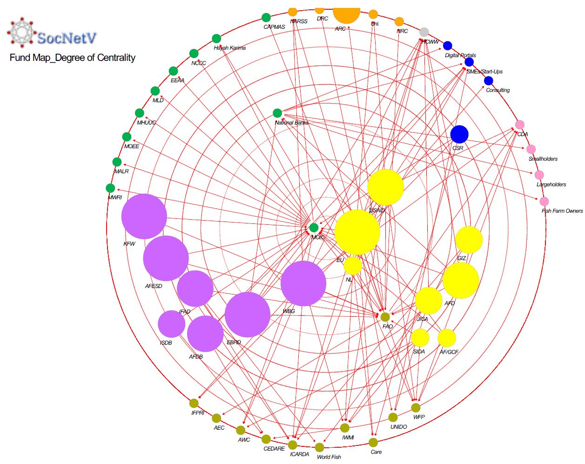
Institutional Arrangement for Policy Coherence
MOIC
Banks
Powerful role of the Ministry of Planning, Economic Development, and International Cooperation
  Mobilization of Resources
  NWFE program
Major Funders of the Policy Frame
Role of National Banks
Funding Gap between National, Local, and Grassroots actors (High risk, extent of profitability of irrigation and agricultural interventions)
Notes:
From scattered support to strategic partnerships because when institutions align their priorities, finance follows
1. Powerful role of the Ministry of International Cooperation
Fostering partnerships, collaboration, and coordination among ministries, donors, and financial institutions.
Mobilize economic and social capital, bridge knowledge gaps, and advance smart technologies for enhancing climate-adaptive water productivity.
These collaborative efforts have crystalized in the Nexus of Water, Food, and Energy “NWFE” program, also known as “fulfilling pledges”. Launched in July 2022, this program aims to put into effect the recently announced Climate Change Strategy 2050 by upscaling adaptation and mitigation measures using various financial tools. It aimed to bring different stakeholders to work on the nexus of water, food, and energy through 9 projects under a NWFE steering committee.
2. The major categories close to the center of the network are donors and financial institutions. The fund social network shows how the World Bank Group, the EU, the Netherlands, and USAID are at the center of interactions in CAWP implementation, followed by AFDB and IFAD.
3. National banks are among the better-positioned actors in the fund social network and have recently increased their power and influence over agrifood systems policies. They cooperate with financial institutions to offer loans to farmers to adopt good agricultural practices and install water-saving techniques. However, small and medium-sized farms face barriers in accessing these bank loans because of their activities being deemed as high-risk.
4. database across sectors will serve the ministry to track allocations and expenditures and identify its needs and areas for improvement, enabling financial coherence between national and international agendas.

Slide 9
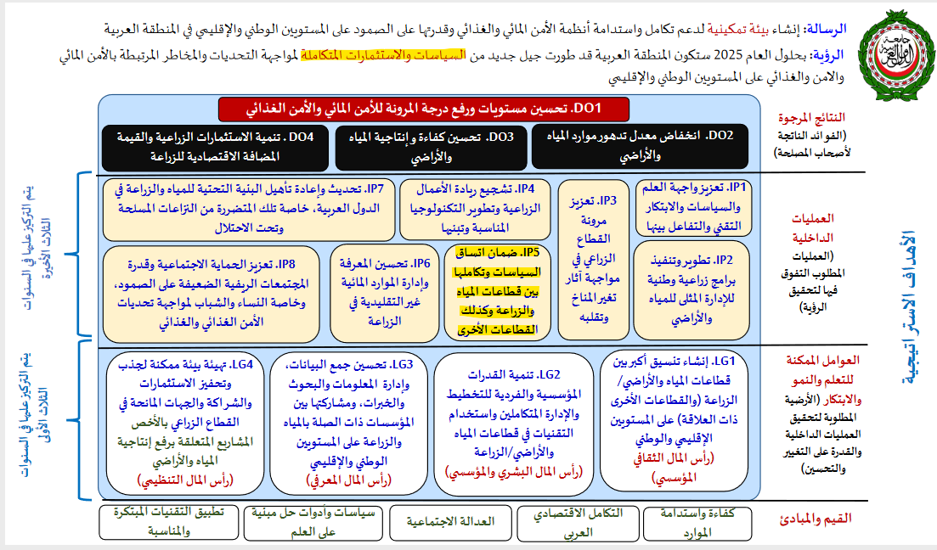
Arab League Regional Inter-Ministerial Committee
IP5: Policy coherence across sectors
Notes:
This study hopes to contribute to amplifying internal processes 5 on policy coherence of the Cairo Declaration 2019 Action Plan.
It aims to work on tools of policy coherence evaluation, identify areas of synergies to integrate investment opportunities, and identify policy conflicts to mitigate interventions that might reduce the intended impact of each sectoral policy.

Slide 10
Over To You …..
[best practices and lessons learned]
What specific areas/mechanisms where financial resources would have the most impact on policy coherence?
What elements/mechanisms should be considered in designing programs that satisfy a coherent policy across sectors?
What are the different mechanisms to engage and involve different government departments?
What are the different mechanisms to engage and involve different stakeholder financial institutions, donors, research institutes, with a specific focus on grassroot and civil society organizations?
Notes:
This study hopes to contribute to amplifying internal processes 5 on policy coherence of the Cairo Declaration 2019 Action Plan.
It aims to work on tools of policy coherence evaluation, identify areas of synergies to integrate investment opportunities, and identify policy conflicts to mitigate interventions that might reduce the intended impact of each sectoral policy.

Slide 11
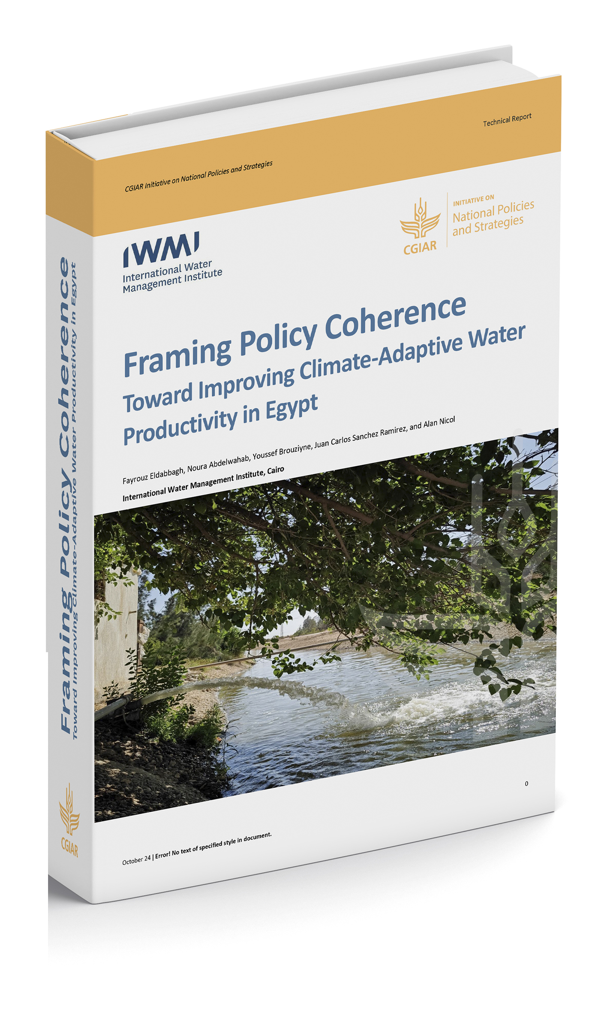

Thank You
Fayrouz Eldabbagh
f.eldabbagh@cgiar.org

