Slide 1
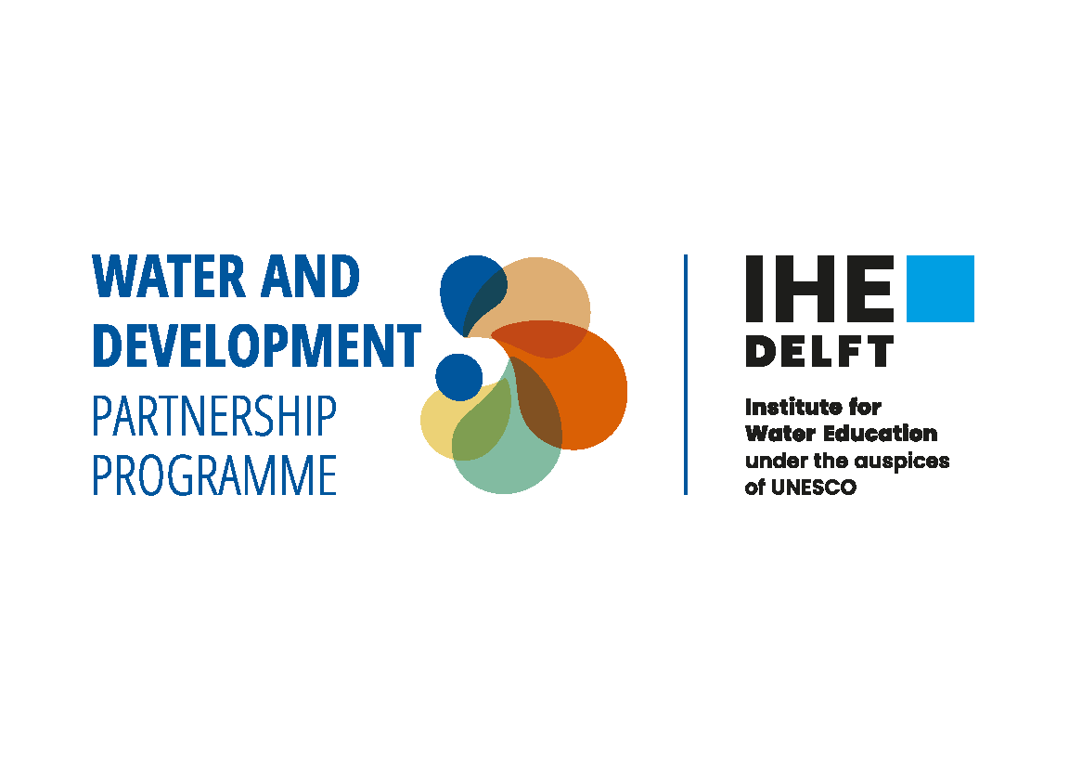

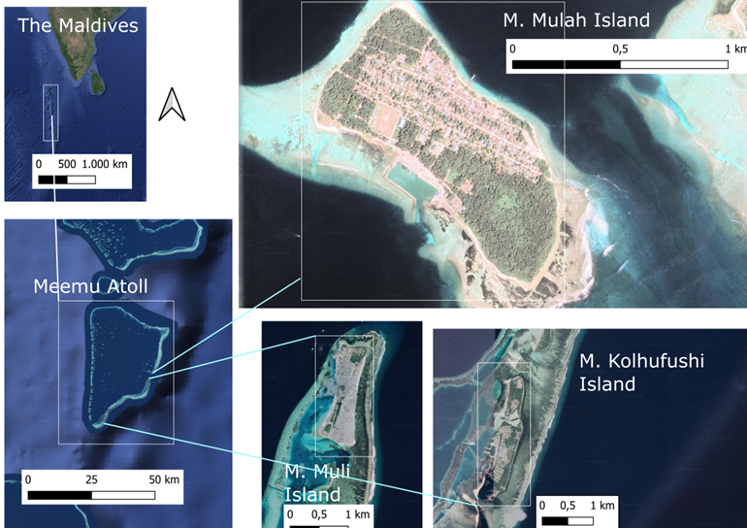

3s water
Sustaining small-scale water systems (3SWater) – integrating local knowledge and co-learning for preserving aquatic ecosystems and improving quality of life

Slide 2
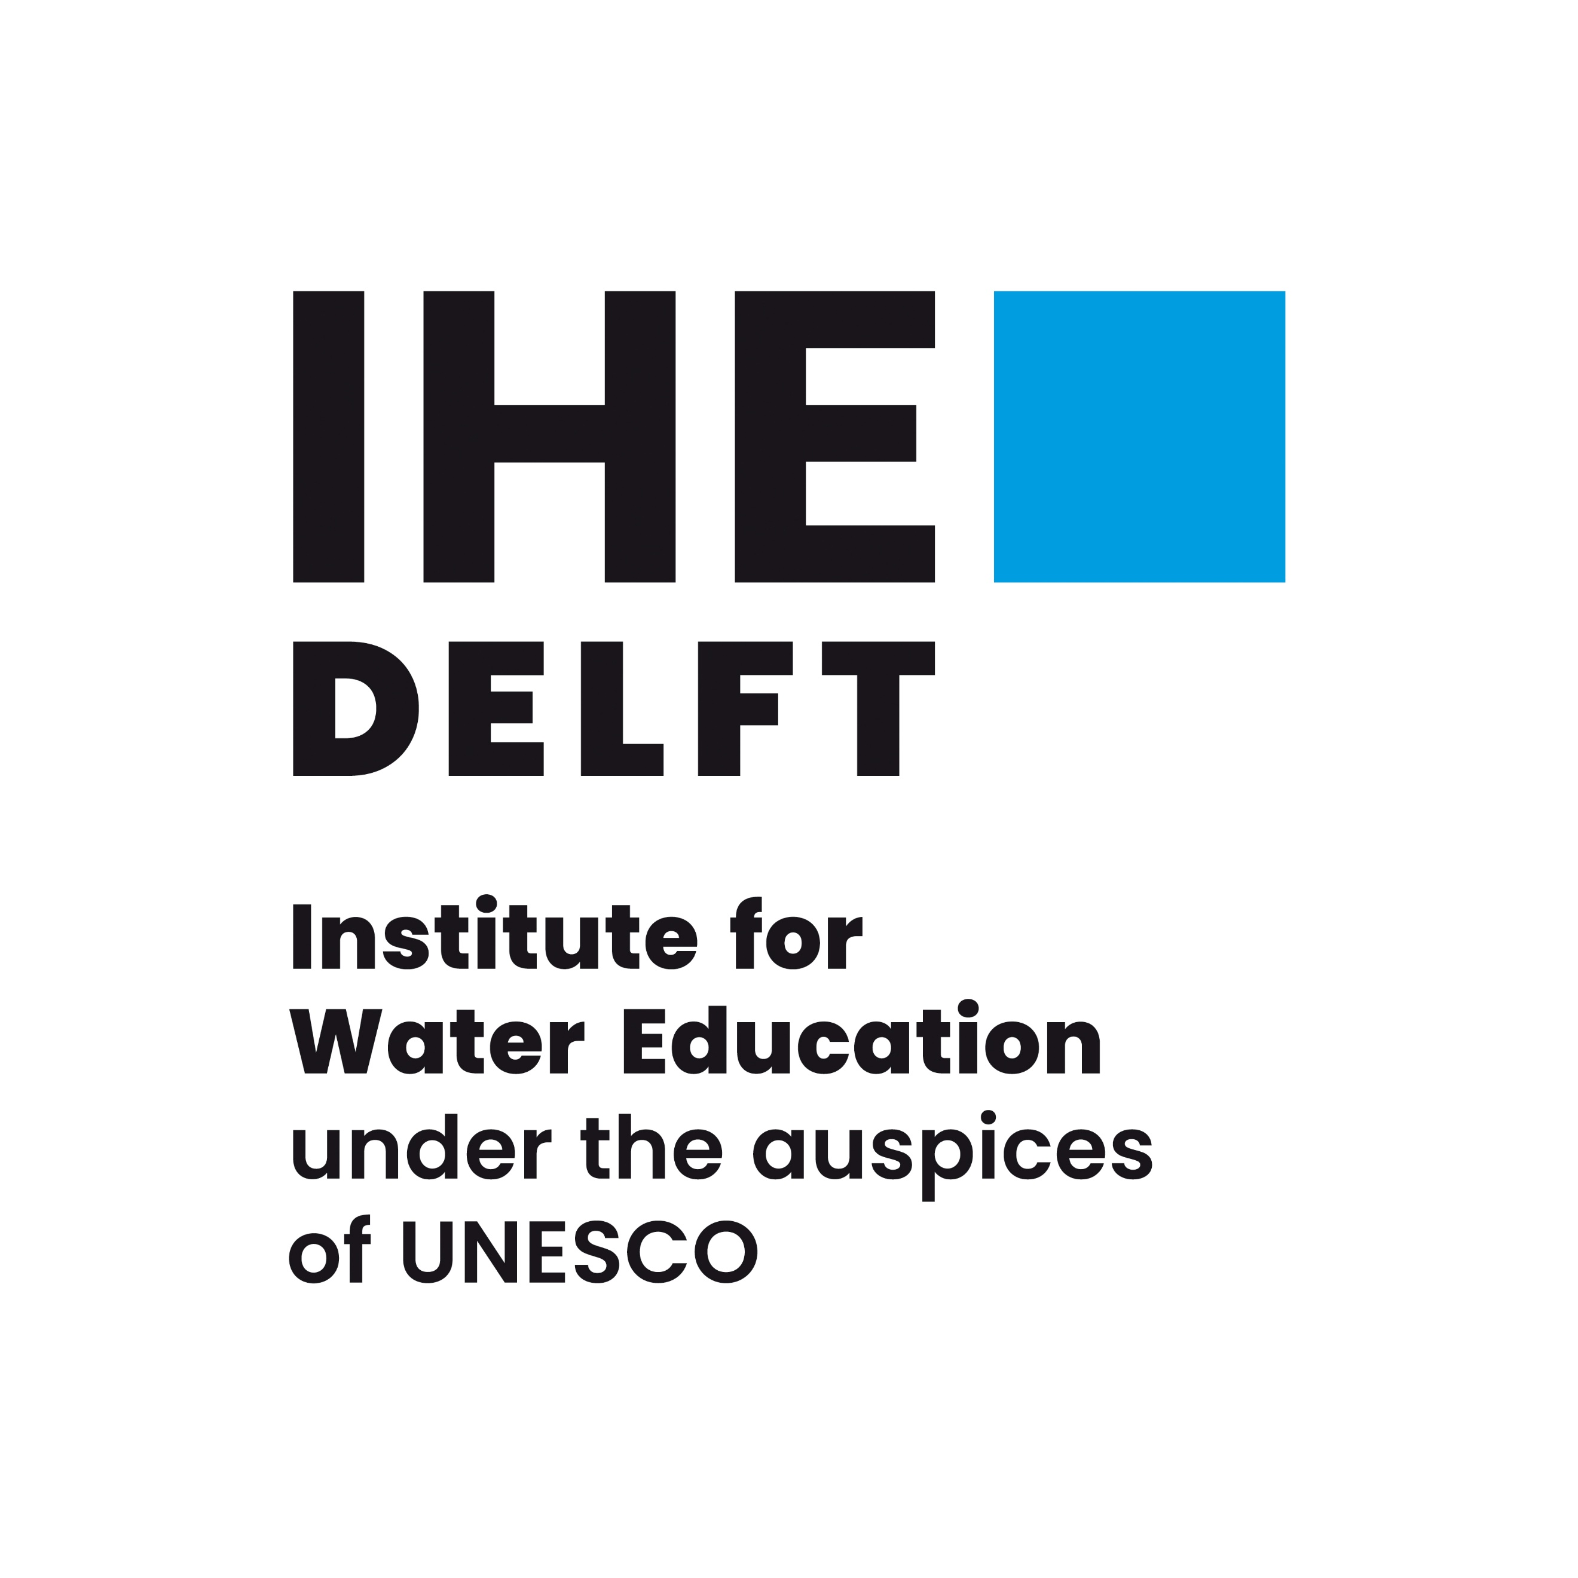


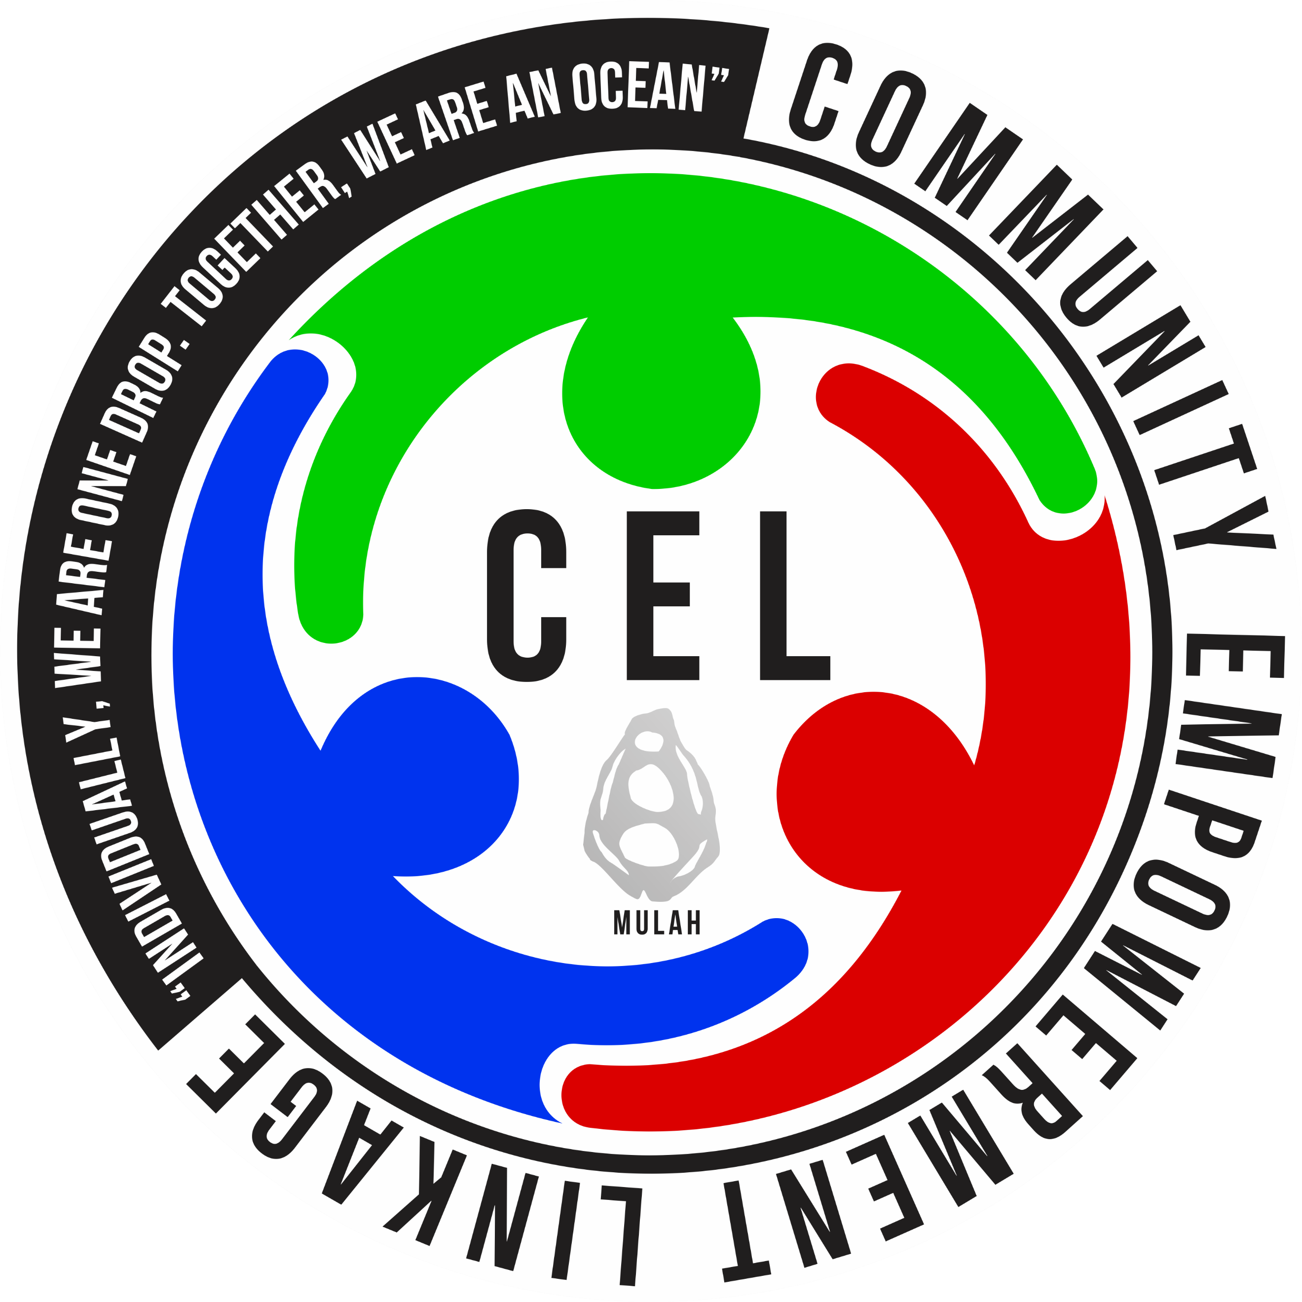
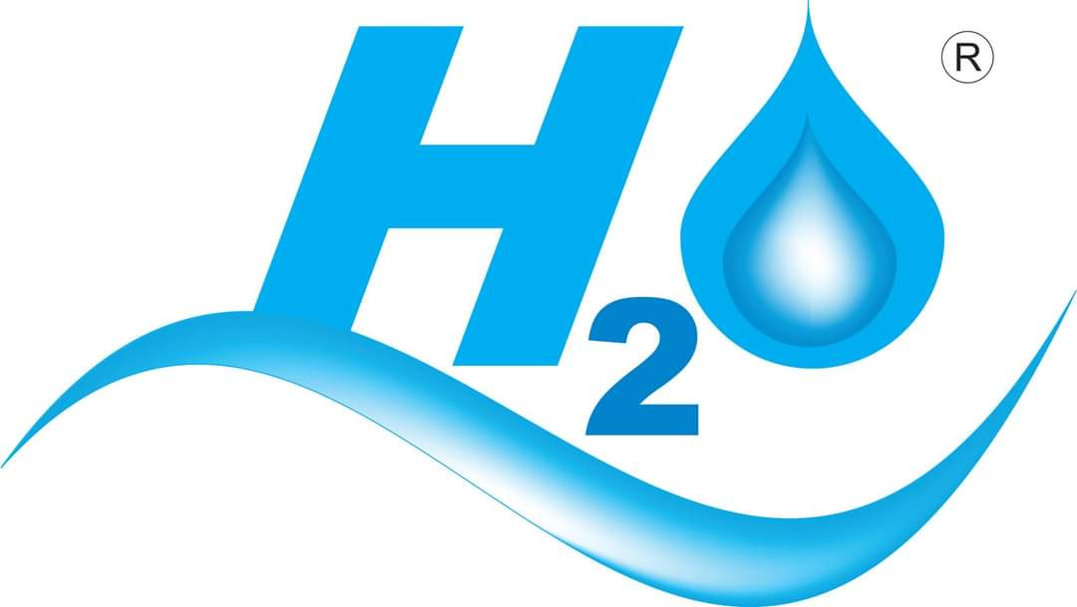

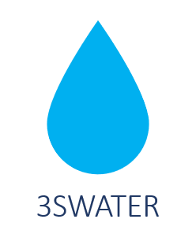
Partners and Donor
CSIR-NATIONAL ENVIRONMENTAL ENGINEERING RESEARCH INSTITUTE
INDIA
THE UNIVERSITY OF JORDAN
AMMAN, JORDAN
COMMUNITY
EMPOWERMENT LINKAGE
MULAH ISLAND
MEMO ATOLL
THE MALDIVES
H20
MALE’
THE MALDIVES
VILLA COLLEGE
MALE’
THE MALDIVES
IHE-DELFT
INSTITUTE FOR
WATER EDUCATION
THE NETHERLANDS
WITH SUPPORT OF DUTCH MINISTRY OF FOREIGN AFFAIRS

Slide 3

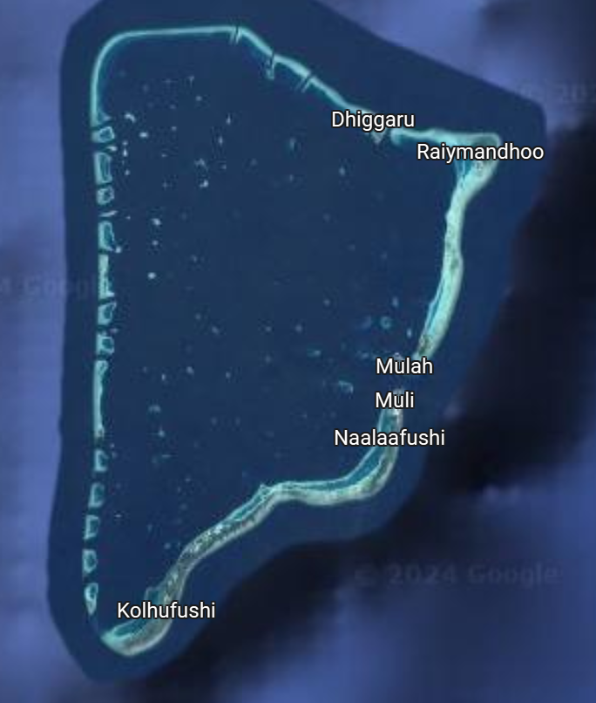
3s water
7th Arab Water Week
4-6 May 2025
King Hussein Bin Talal Conventions Center,
Dead Sea, Amman Jordan
Navigating Water Sustainability in Small and Isolated Islands in the Maldives
Dr Fazeela Ibrahim
Dr Mamdooha Ismail
Dr Aishath Selna

Slide 4
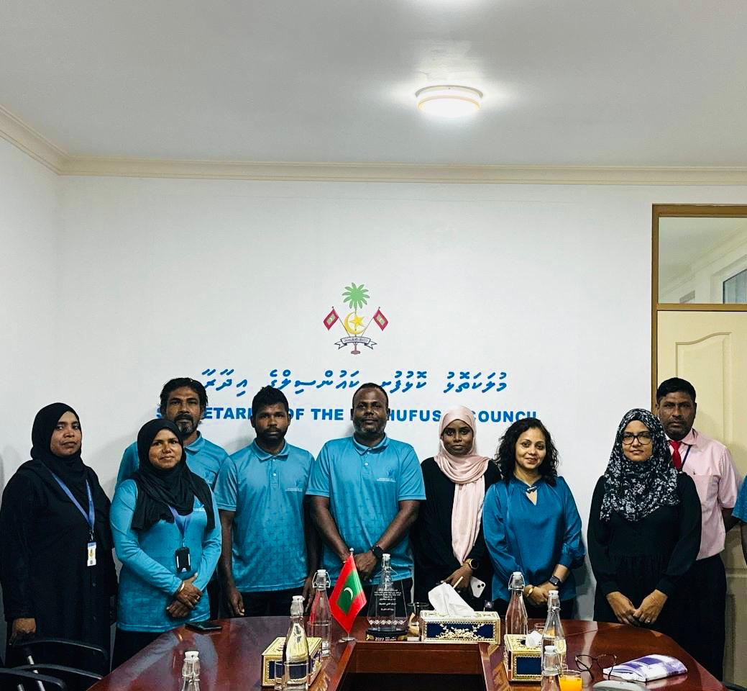
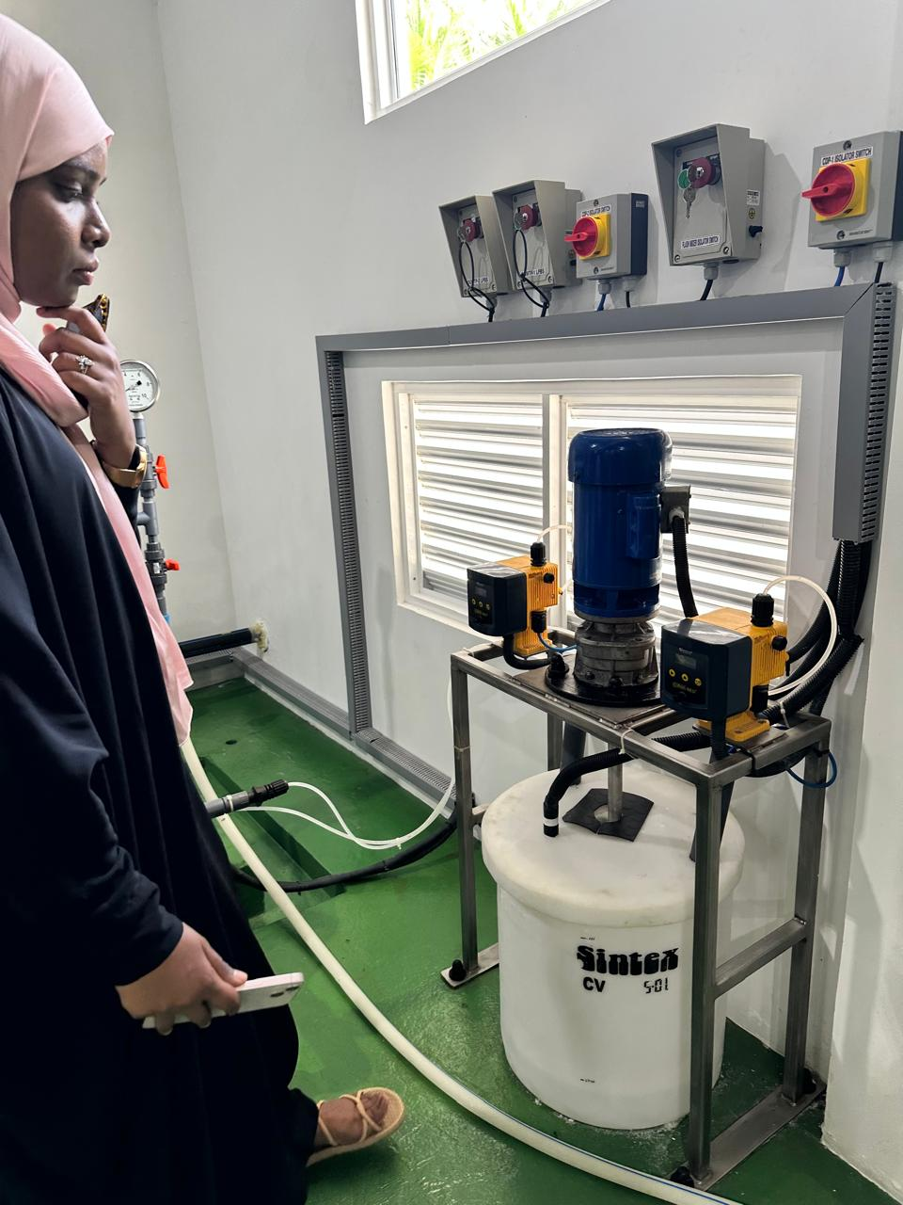
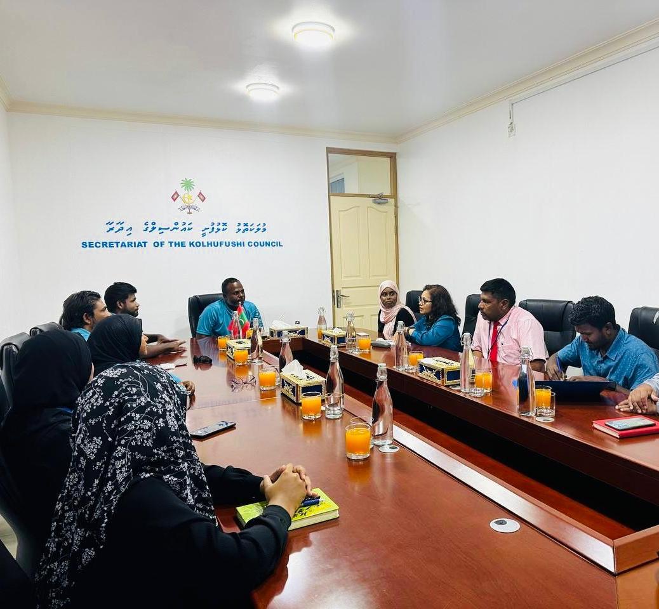
Water Preferences in Meemu Atoll
Higher Education Scholarship: 3 students given scholarship to complete Master of Public Health Program.
Masters Dissertation: Completed study in Kolhufushi, Mulah, and Muli.

Slide 5
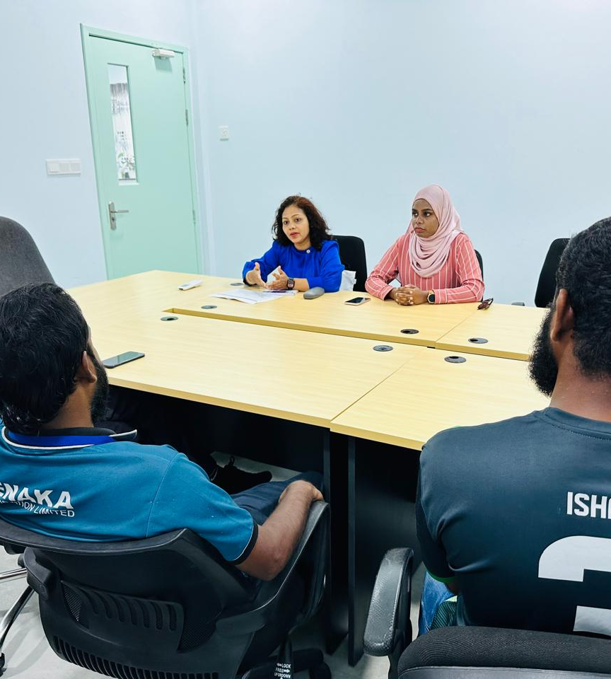
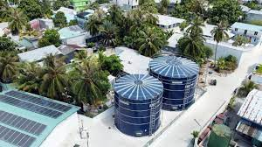
Water Preferences in Meemu Atoll
Research problem: Residents on outer Maldivian islands face challenges with drinking water quality. Despite government investments in desalination plants, many prefer bottled, filtered, and rainwater due to a lack of trust in municipal tap water.
Objective: To examine water preferences (bottled, filtered, rainwater vs. municipal tap) in Kolhufushi, Mulah, and Muli.
Key Findings:
  Bottled water is the dominant choice; rainwater is secondary for cooking.
  Low trust in municipal water due to sensory issues (e.g., chlorine taste).
  Operational challenges (staff shortages, limited public outreach) hinder trust-building.
  NGOs and cultural shifts promote bottled/filtered water use.
Recommendations:
  Improve municipal water safety and communication.
  Develop household filtration programs and investigate the environmental impact of bottled water.

Slide 6
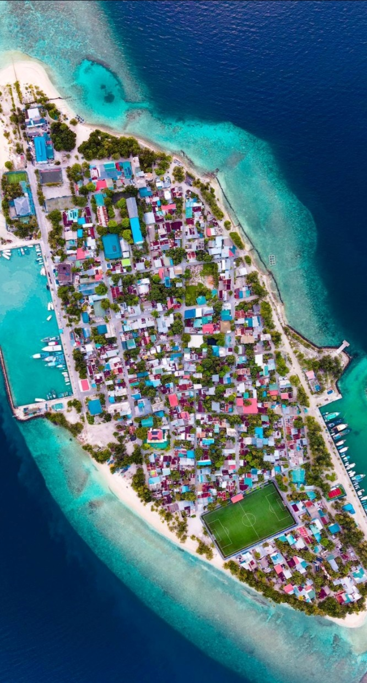
Service Quality of Utility Water in ADh. Mahibadhoo
Research Problem: Mahibadhoo, a highly populated island, struggles with inconsistent water service despite desalinated water availability, forcing residents to rely on unsafe groundwater and rainwater. This highlights gaps in water service quality and reliability, with no prior research on the issue.
Objective: Assess the perceived quality of utility water services in Mahibadhoo.
Key Findings:
  Gaps exist between customer expectations and perceptions (reliability, responsiveness, tangibles).
  Socio-demographic factors influence service quality perceptions.
  Despite desalinated water, residents rely on unsafe sources due to inconsistent service..
Recommendations:
  Improve water service reliability and responsiveness.
  Enhance public awareness of water safety practices and improve service delivery.

Slide 7
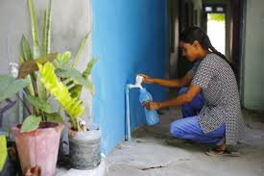
Access to Safe Water in the Maldives
Research Problem: Access to safe and clean water in the Maldives is hindered by geographical constraints, saltwater intrusion, and low awareness of water safety, particularly on islands like M. Muli, M. Mulak, and M. Kolhufushi.
Objective: Identify determinants of water source choice in Muli, Mulah, and Kolhufushi using KAP study.
Key Findings:
  Bottled water (44.5%) and rainwater (42.7%) are primary sources due to perceptions of safety and reliability.
  Knowledge of waterborne health risks correlates with better safety practices.
  Financial constraints impact access to safer water sources like bottled or desalinated water.
Recommendations:
  Raise awareness on safe rainwater practices and the benefits of desalinated water.
  Provide financial support for water treatment systems to improve access.

Slide 8

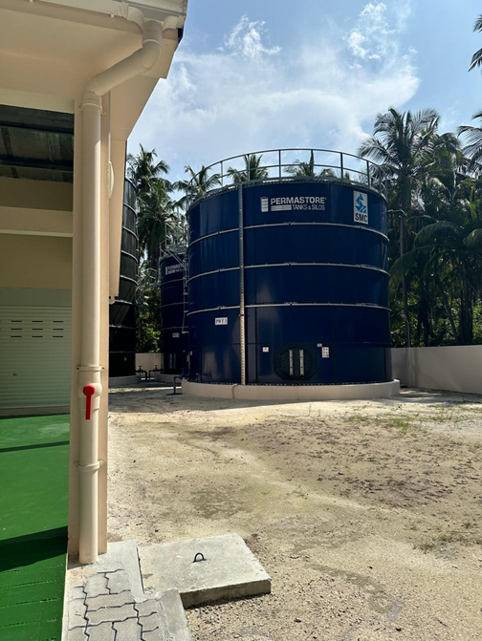
Conclusion
Common Issues:
Water quality concerns, lack of trust in municipal systems, and financial barriers affect water access.
Education on water safety and improvements in infrastructure are critical.
Path Forward:
Foster community engagement, improve water service reliability, and ensure sustainable access to safe water sources.
3s water

Slide 9
Thank you

