Slide 1





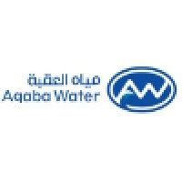


Bridging Science and Cooperation for Efficient Wastewater Management: Collaboration by Aqaba Water, Columbia University, and GIZ.
Enhancing Wastewater Treatment through Science-Based Approaches
Eng. Firas Al Khamaiseh – 4.5.2025

Slide 2
Aqaba Water's Role in the Project
Aqaba Water's Contribution to the Wastewater Monitoring Project
Key Points:
Aqaba Water Company (AW) is a key partner in the wastewater treatment project.
AW's primary responsibilities include providing vital data, technical assistance, and on-site support.

Slide 3
The process
Aqaba water started the collaboration with Columbia University through GIZ in 2022 with a fact-finding mission.
The Columbia University supported Aqaba wastewater treatment plant through a grant from Bill & Melinda Gates Foundation.

Slide 4
Data and Information Provided by Aqaba Water
Sewerage Data: AW provide the sewerage map, including population served, treatment capacity, and discharge standards.
Operational Data: AW share historical influent flows, plant configurations, and treatment process details (e.g., flow rates, solids handling).
Data for Modeling: AW supply essential data for modeling, including internal flow rates, solids residence times, and time-series data.

Slide 5
Coordination with GIZ and Columbia University
  Regular Meetings: AW will conduct ongoing meetings with GIZ and Columbia University to ensure smooth project progression.
  Validation Support: AW will provide technical assistance on-site to validate modeling data from the technical team.
  Collaboration for Monitoring: Support in the procurement and installation of sensors at various levels in the wastewater treatment plant to collect accurate data.

Slide 6
Technical Assistance Provided by Aqaba Water
  On-Site Validation: AQ assist in validating data from modeling exercises through on-site observations and adjustments.
  Operational Insight: AQ’s team offer insights into operational challenges and adjustments necessary for integrating NSS technologies into the existing system.
  Continuous Evaluation: AW work closely with GIZ and Columbia University to evaluate the project's progress and adjust strategies as needed.

Slide 7
The Implementation
Aqaba water created a team to support the consultant in:
Providing data,
Digitizing the WWTP,
Analyzing the sewer connections to the WWTP,
Investigating the different industries within the study area,
Setting priorities for the modeling,
proposing scenarios for the implementation on the findings,

Slide 8
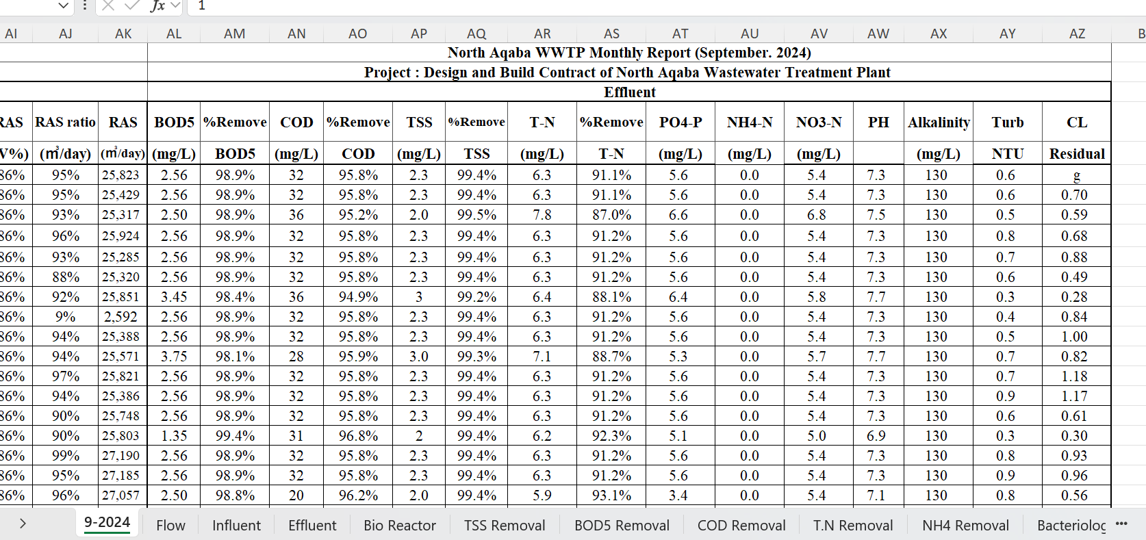
Raw Data

Slide 9
Expected Outcomes from Aqaba Water's Support
Enhanced Wastewater Treatment: AW's input will ensure that the plant's operational data is accurately reflected in the modeling efforts.
Optimized Performance: Through collaboration, AW will help ensure that the wastewater treatment plant can be optimized for better performance, particularly in handling variations in influent.
Sustainability and Innovation: AW's support will help integrate innovative non-sewered sanitation (NSS) solutions into existing systems for more sustainable wastewater management.

Slide 10
Thank You

