Slide 1
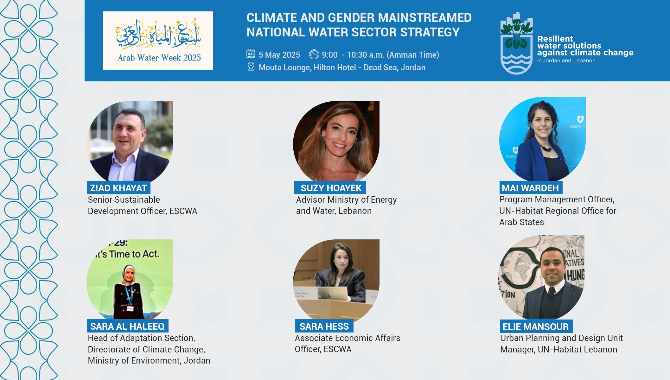

Slide 2

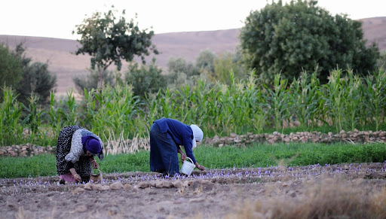

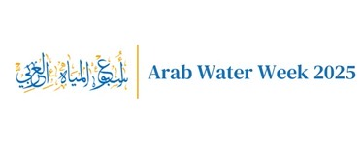

Mainstreaming Cimate Change and Gender in Jordan’s National Policy Making
Eng.Sara Alhaleeq
Head of Adaptation Division
Ministry of Environment/Jordan
Arab Water Week
5th May 2025

Slide 3


Among the most water-scarce countries globally.
Decrease in annual precipitation by 15-20% and an increase in temperature by 1.5–2.5°C by 2050.
The influx of refugees and continued stress on natural resources
Jordan’s
Climate
Vulnerability
Integrating Climate and Gender
Why It Matters
Women, particularly in rural areas, with their roles in water collection, agriculture, and household management.
Water scarcity.
Climate-induced challenges and gender-based violence and hindered girls' access to education
Gender-Differentiated Impacts
Notes:
"Jordan's unique position as a water-scarce nation makes it particularly susceptible to the adverse effects of climate change. These challenges are not gender-neutral; women often face disproportionate impacts due to existing social and economic inequalities. Recognizing and addressing these gender-specific vulnerabilities is crucial. By mainstreaming gender considerations into our climate policies and actions, we can enhance the resilience of our communities and ensure that both women and men contribute to and benefit from climate solutions."

Slide 4
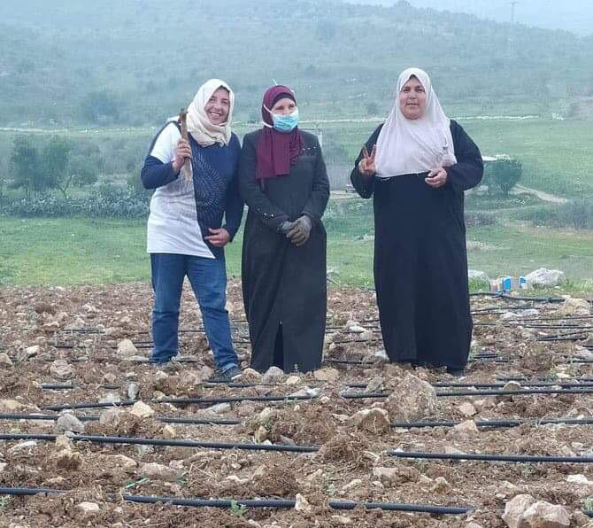

1
Integrating gender perspectives into climate policies ensures that adaptation and mitigation strategies are effective and equitable.
Integrating Climate and Gender
Importance of Gender-Responsive Climate Action
2
Empowering women and involving them in climate decision-making processes can lead to more sustainable and resilient communities.

Slide 5
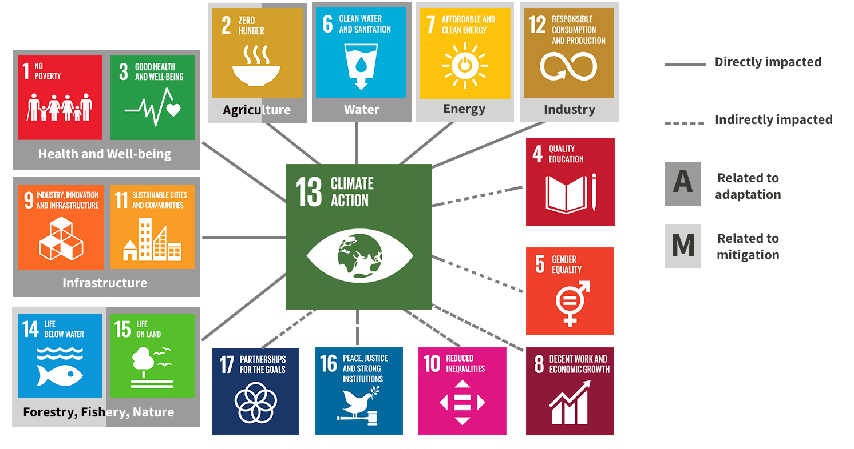

Slide 6

When , and Where to integrate/mainstream Gender with climate change
Determine need for new policy; Monitor legislative or regulatory change and changes in the environment
Monitor & Track
Research & Review
Analyze & Draft
Consult
Finalize
Measure Impact
Monitor adherence and measure impact of policy
Confirm policy is within CRTO mandate; gather evidence and information
Policy/ Project
Development Cycle
Present policy to Council for approval; Post publicly
Review information gathered and develop or update the policy
Post policy for public consultation, review feedback, and revise document as needed

Slide 7
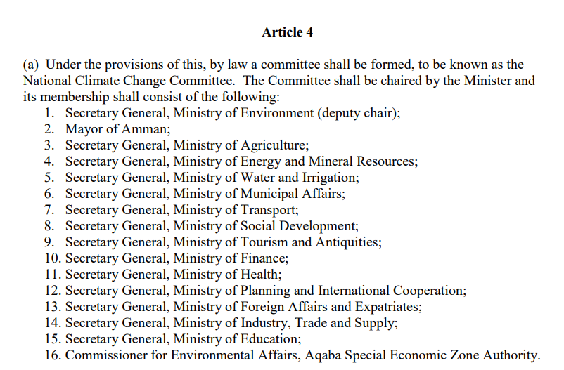
01. On the institutional level
Climate Change Bylaw No. 79 (2019):
Stresses the need for transformative change toward inclusive climate governance.
Recognizes gender equality as a core principle in climate action
Provides legal foundation for integrating gender into national climate systems
Calls for mainstreaming gender in all climate policies, strategies, and actions

Slide 8
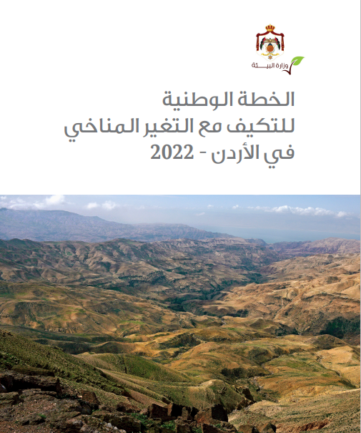
02. Gender in National Adaptation Plan (NAP)
Developed with a gender-sensitive and participatory approach.
Gender and youth explicitly mainstreamed across sectors and actions.
Workshops/trainings held on integrating gender in adaptation planning.
Gender considered a cross-cutting priority for reducing vulnerability.
NAP includes gender-responsive indicators in M&E framework.
Recognizes women and youth as key actors in resilience building.
Notes:
"Jordan's National Adaptation Plan is a testament to our commitment to inclusive climate action. By embedding gender considerations into the very fabric of our adaptation strategies, we ensure that our responses to climate change are equitable and effective. This approach not only addresses the unique vulnerabilities faced by women and youth but also leverages their strengths and capacities, fostering a more resilient and adaptive society."

Slide 9
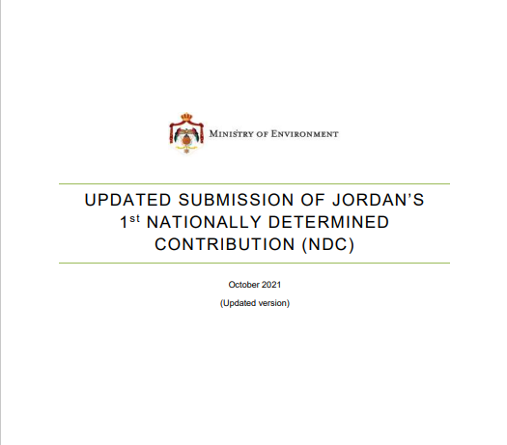
03. Gender in the Updated NDC (2021)
Aligned with NAP and Green Growth Strategy.
Gender listed as cross-cutting priority.
Gender focal points engaged in development process.
Commitment to gender equality in implementation.
Focus on women’s leadership & capacity building.
Gender integrated in key sectors (water, agriculture, energy, health).
Women recognized as key climate stakeholders.

Slide 10
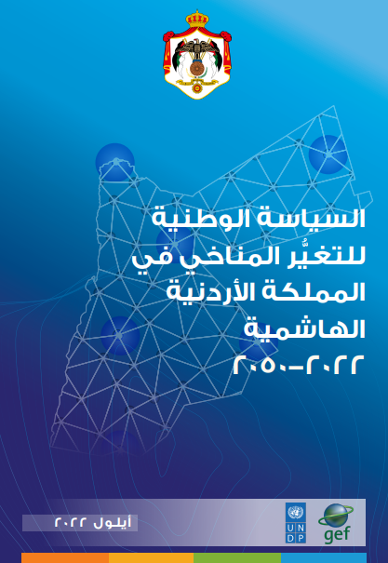
04. Gender in Jordan’s Climate Change Policy (2022–2050)
Gender identified as cross-cutting priority.
Focus on gender-differentiated & child-sensitive planning.
Number of Policy measures, which:
  Promote equal access to climate finance for women and men.
  Build gender-responsive institutional capacities.
  Develop gender-specific indicators for M&E.
  Ensure inclusive participation in planning and implementation.
  Align with international gender & climate agreements.
Notes:
"Jordan’s National Climate Change Policy sets a clear direction for inclusive climate action. Gender is not treated as a standalone topic, but as a cross-cutting element integrated throughout all sectors and at all levels. The policy emphasizes equitable access to climate finance, building institutional capacity, and ensuring women’s participation in decision-making. With gender-specific indicators and alignment to global commitments, this policy reinforces our belief that climate resilience can only be achieved when it is inclusive, just, and responsive to the needs of all segments of society."

Slide 11
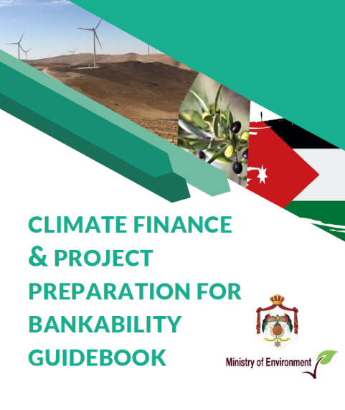
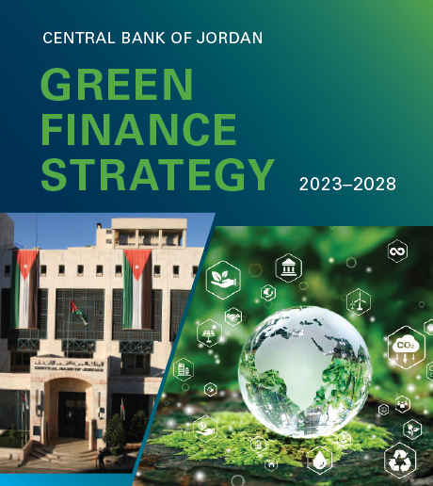
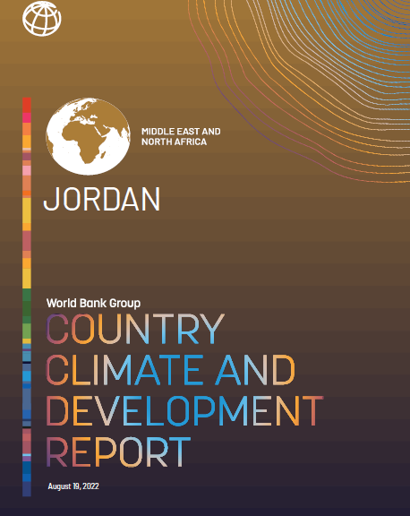
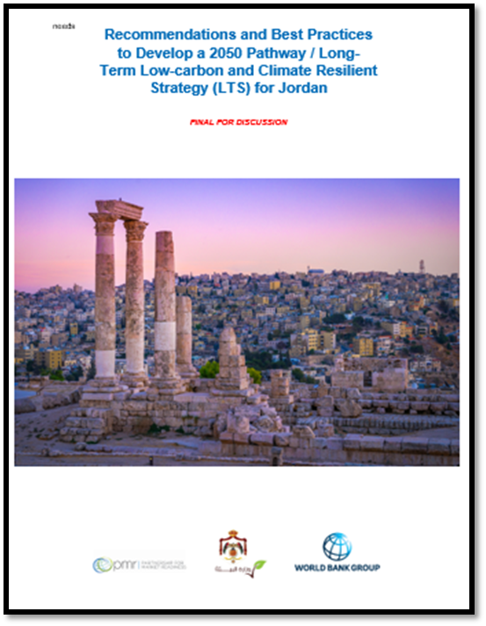
05. Financing Climate Action
💰 Mobilize Funding: Secure domestic and international resources for climate projects.
🤝 Promote Partnerships (PPPs): Foster collaboration between public and private sectors.
🌍 Access Global Funds: Leverage mechanisms like the Green Climate Fund (GCF).
🌱 Encourage Green Investment: Support low-carbon and sustainable technologies.

Slide 12

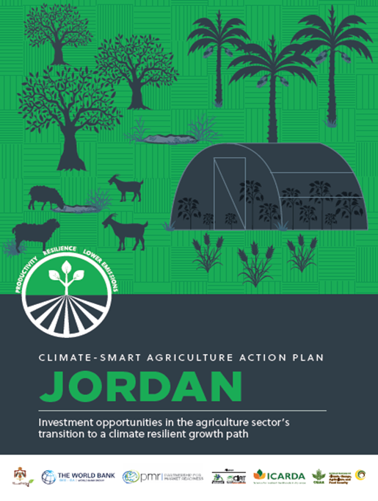
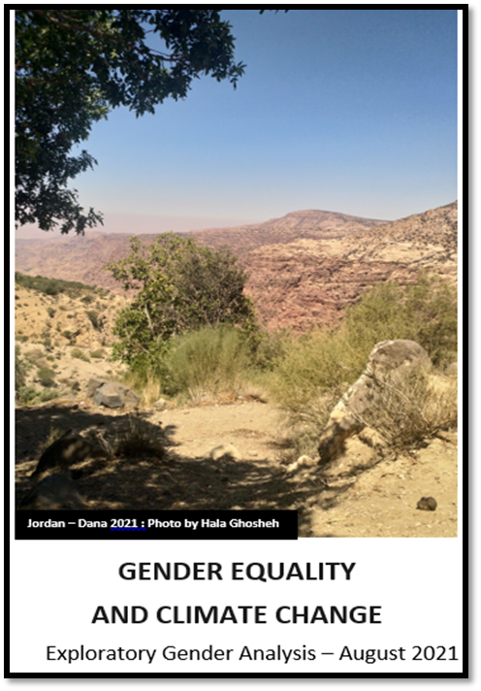
06. Equity and Inclusivity
🧑‍🤝‍🧑 Prioritize Vulnerable Communities
Ensure climate actions are inclusive and address the needs of those most at risk.
🧒🏽 Promote Gender-Responsive & Youth-Led Strategies
Empower women and youth as key actors in climate policy and implementation.
🛠️ In Progress
📌 Citizen Engagement Roadmap
📌 Gender Strategy 2030

Slide 13
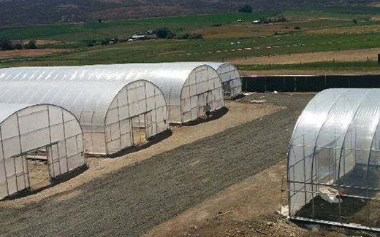
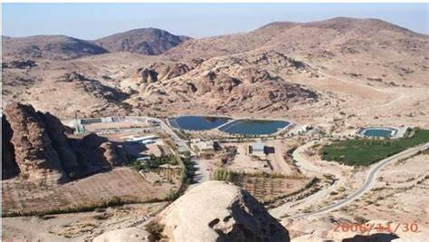
07.1 On the implementation phase:
Building resilience to cope with climate change in Jordan through improving water use efficiency in the agriculture sector (BRCCJ)
Increasing the resilience of poor and vulnerable communities to climate change impacts in Jordan through implementing innovative projects in water and agriculture in support of adaptation to climate change" Programme"

Slide 14
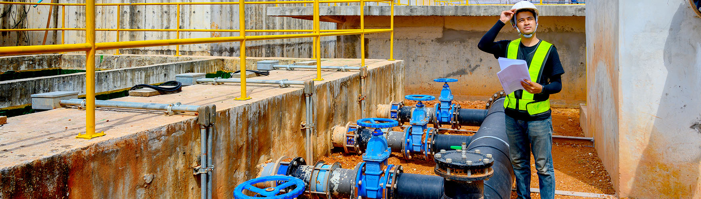
07.2 On the implementation phase:
“Resilient Water Solutions Against Climate Change in Jordan and Lebanon” project
The selection of schools for the installation of rainwater harvesting and greywater treatment systems considered gender mainstreaming during the assessment and site selection phases.
The selection of residential buildings for the installation of rainwater harvesting considered gender mainstreaming during the assessment and site selection phases.
Practical and theoretical permaculture workshops promoted women’s participation by engaging local women’s NGOs in Jerash.

Slide 15

THANK YOU !

Slide 16



The Global Water Operators’ Partnerships Alliance (GWOPA)
Leveraging Solidarity to Mainstream Gender and Climate Action in Water Utilities through WOPs

Slide 17
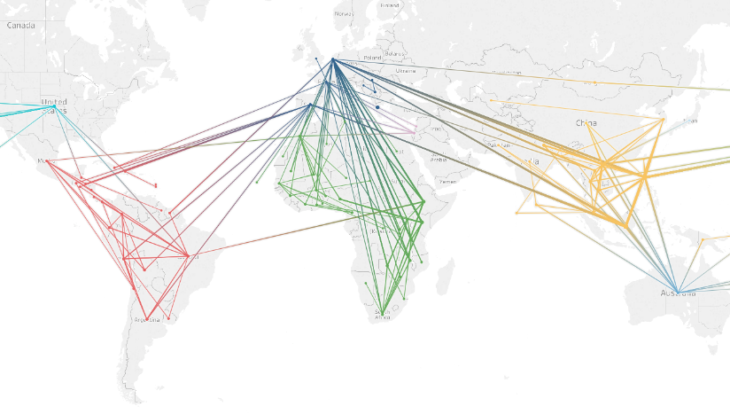


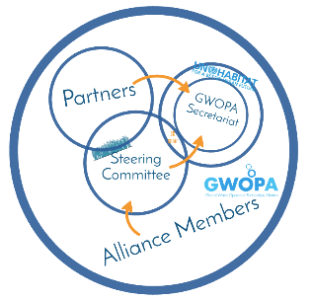

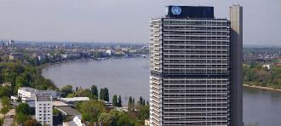
A brief history
Modest improvements in public water operators will have immense impacts on global provision of services.
Operators are effective at Helping one another improve. Let’s scale this up!
2009
2015
2025
2013
2020
2006

Slide 18






What is WOPs?
(Water Operators’ Partnerships)
Focus on building capacity of resident operator staff, rather than “doing it for them”. This way, the benefits last.
Water Operators’ Partnerships (WOPs) are peer-support partnerships between water and sanitation service providers
WOPs
Peer partnerships, meaning that the support comes from professional counterparts with hands-on experience.
partnership
WOPs as a peer support exchange and carried out on a not-for-profit basis
Not-for-profit

Slide 19


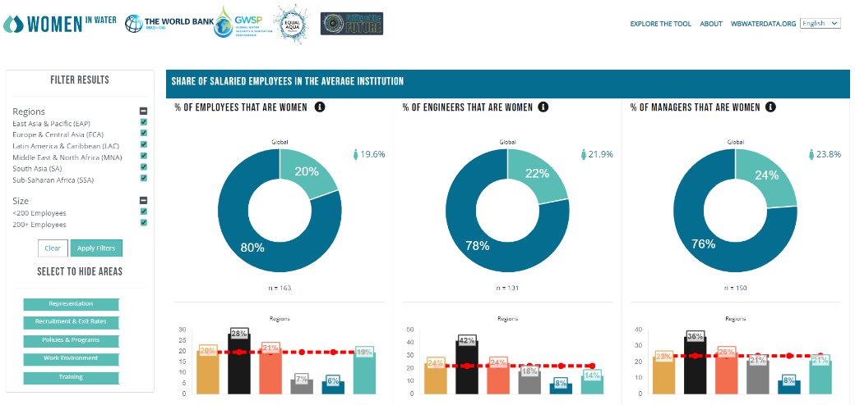
164+
utilities
45 countries

Slide 20


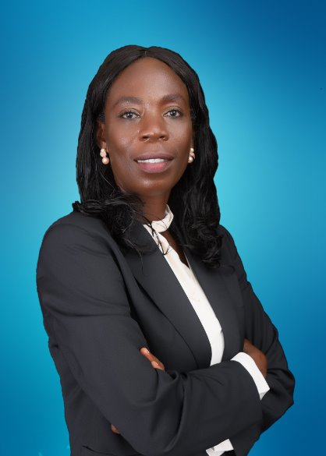

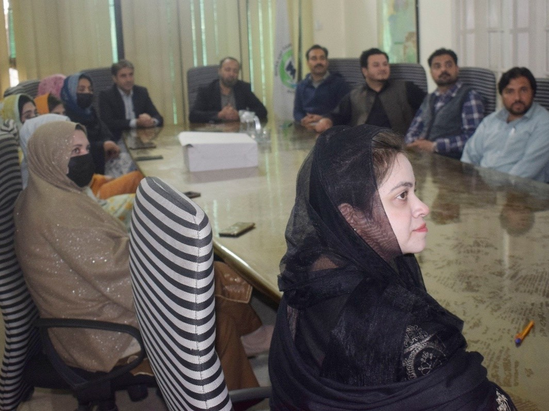
How GWOPA and WOPs tackle the gender issue
1. GWOPA
Amplifying the Voices of Women: conferences, webinars, campaigns and publications, showcase success stories of women leaders, professionals, and innovators
Knowledge Sharing Initiatives:workshops, training sessions and online forums
Networking and Mentorship: connecting aspiring women professionals with experienced mentors and peers who can provide guidance, advice, and encouragement in their career development journey.
Thematic focus encouraged: EU WOP I and II
“Water and sanitation operators are critical players in the efforts to achieve sustainable, equitable, and universal access to services, and I believe that women have a central to play as powerful agents of change.”
Faustina Boachie
Chief Manager, GWCL
Gender Gap diagnosis
Gender policy development and implementation
Women as utility staff
2. GENDER LENSE in WOPS
Women as service users
Women entrepreneurs
Leading behaviour changes
Empowered/decision-making processes

Slide 21
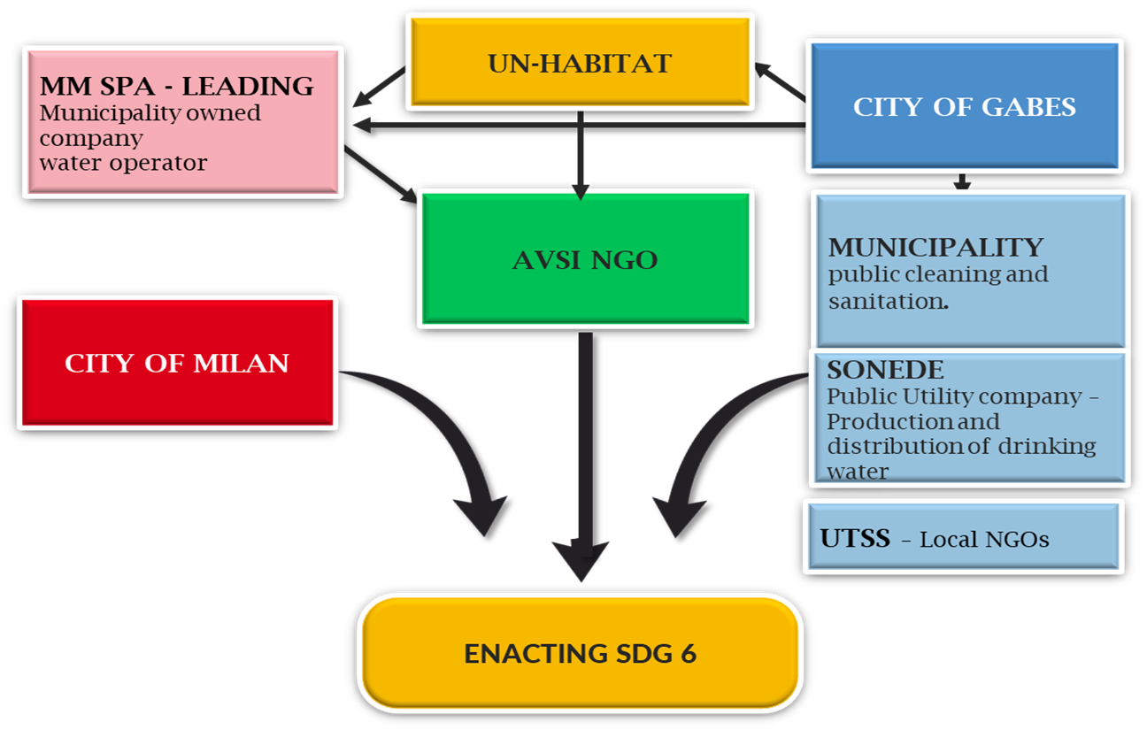
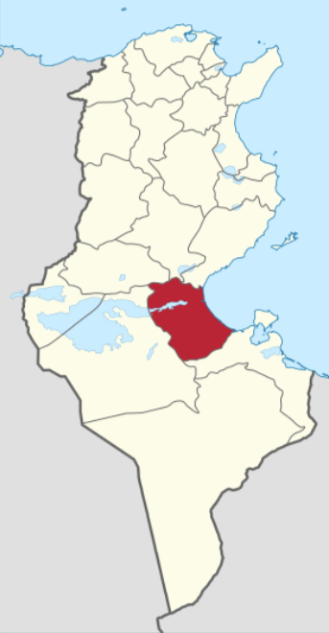
Example of a WOP for Climate Resilience and Gender
ENACTING DDG6: Société nationale d’exploitation et de distribution des eaux (SONEDE), Tunisia, Municipality of Gabes, Tunisia
Supporting Partner: MM Spa, Milan, Italy
Co-Supporting Partners: Municipality of Milan, Milan, Italy/ AVSI Foundation/ Union Tunisienne de Solidarité Sociale (UTSS)
Key data: Duration: February 24, 2022 – February 23, 2025.
Workstream:
A WOP Advancing Climate Resilience and National Water Goals
Improved efficiency through GIS mapping & leak detection – cutting water loss and climate risk.
SUDS for flood control and rainwater reuse – adapting to intense rainfall.
Gender-responsive planning – engaging and empowering women in water leadership and decision-making.
Capacity-building for local teams – sustainable, peer-to-peer knowledge exchange.
Aligned with Tunisia’s Water 2050 strategy – supporting national goals on resource optimization and regional balance.
Contribution to SDGs Targets: 6.1, 4.4 and 6.5

Slide 22
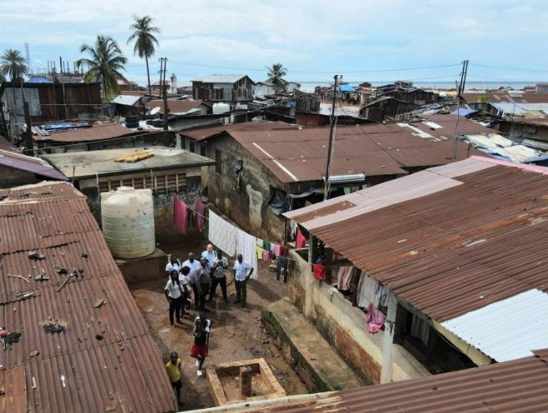
Example of a Partnership
Improving water service delivery to low income urban communities through turning data into actionable insights (GWCL-GVWC)
Beneficiary partner(s): Guma Valley Water Company (GVWC), Freetown, Sierra Leone
Lead partner: Ghana Water Company Limited (GWCL), Accra, Ghana
Additional partner(s): VEI B.V., Utrecht, The Netherlands
Key data: Duration: February 24, 2022 – February 23, 2025.
Work Streams: Customer Relations and Billing
Human Resources Management
Low-income Area Management
Enabling Environment/Governance
Gender Mainstreaming and Social Inclusion: Diagnosing gender, diversity and inclusion in Ghana Water Company Limited
Key achievements:
Strategic Collaborations
Established partnerships with UNICEF and the EU Mission in Africa, leveraging these collaborations for climate resilience and water service improvements.
Pro-Poor Department Establishment:
Fully approved and structured, focusing on improving service delivery for low-income populations, with a strong emphasis on gender equity and inclusive practices.

Slide 23
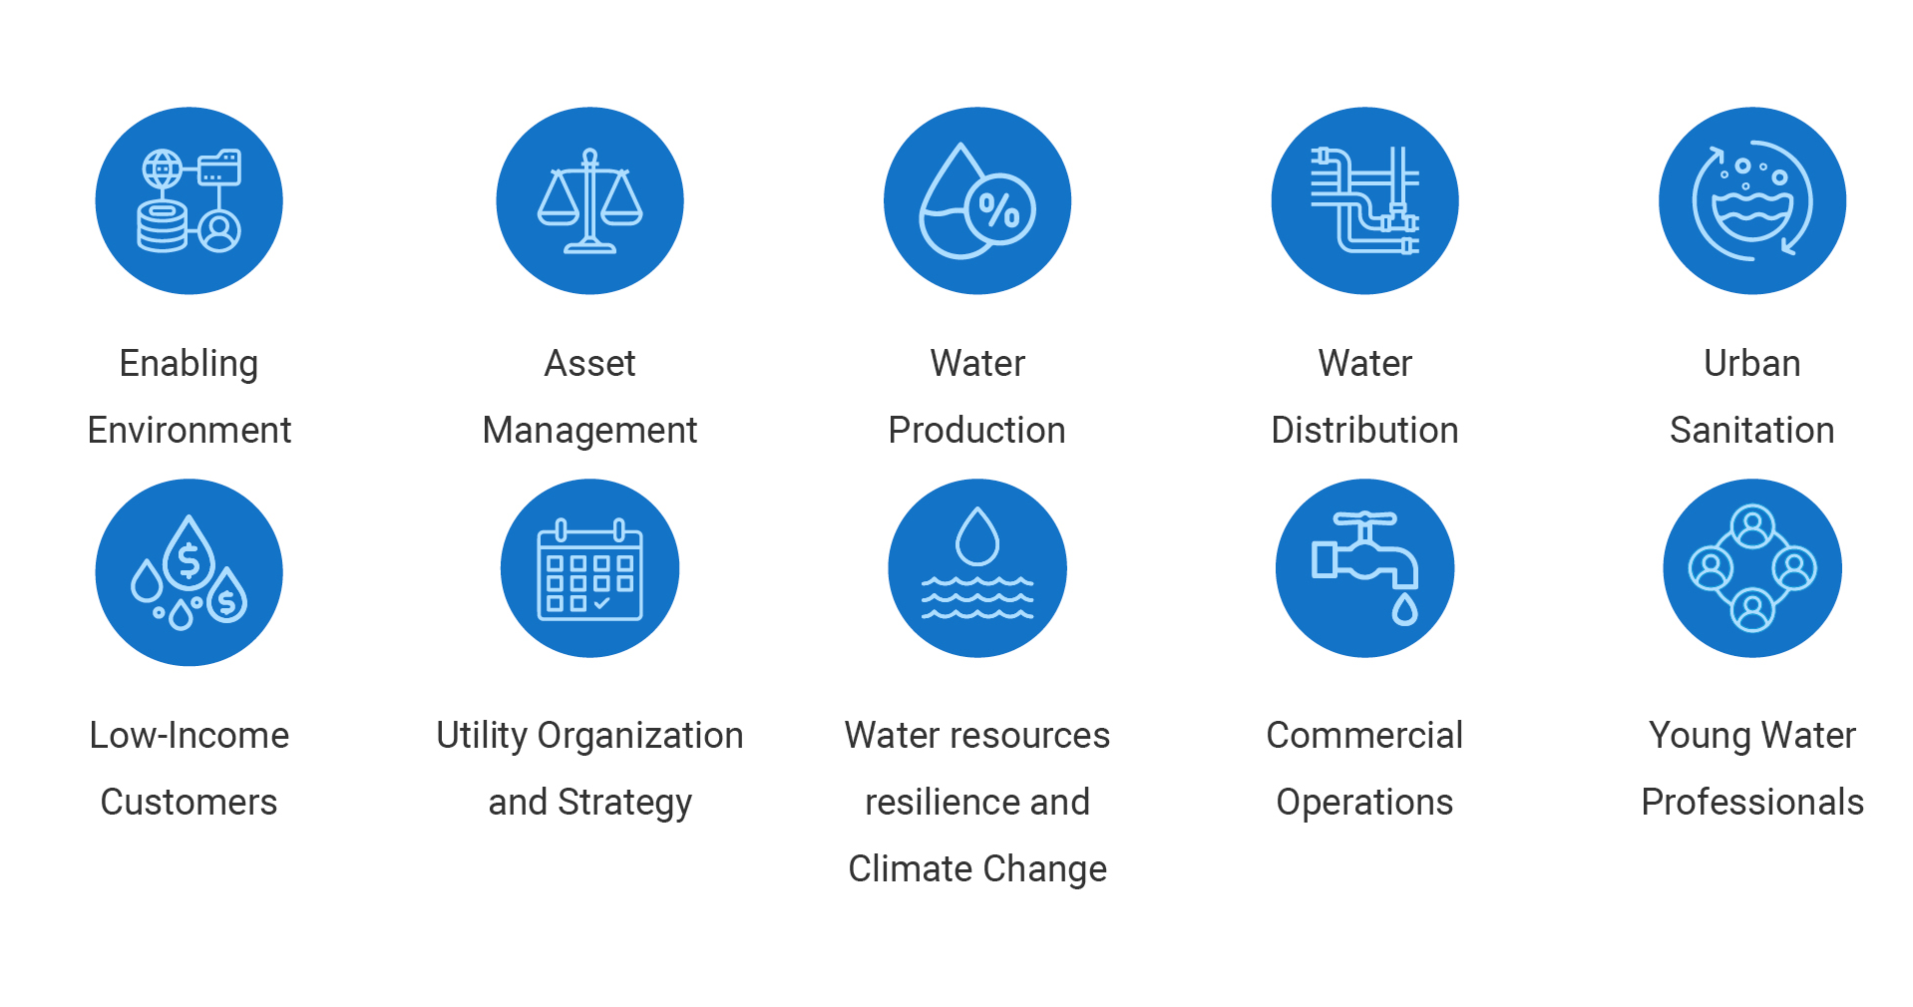
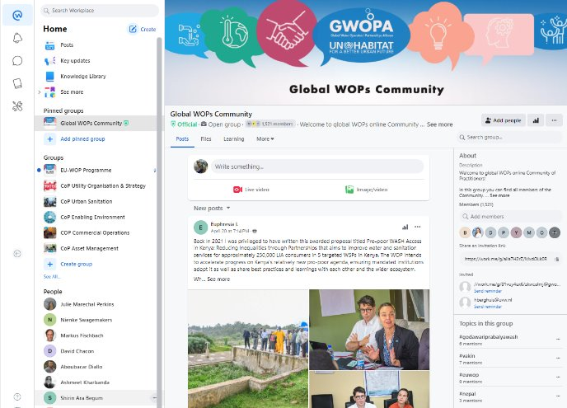
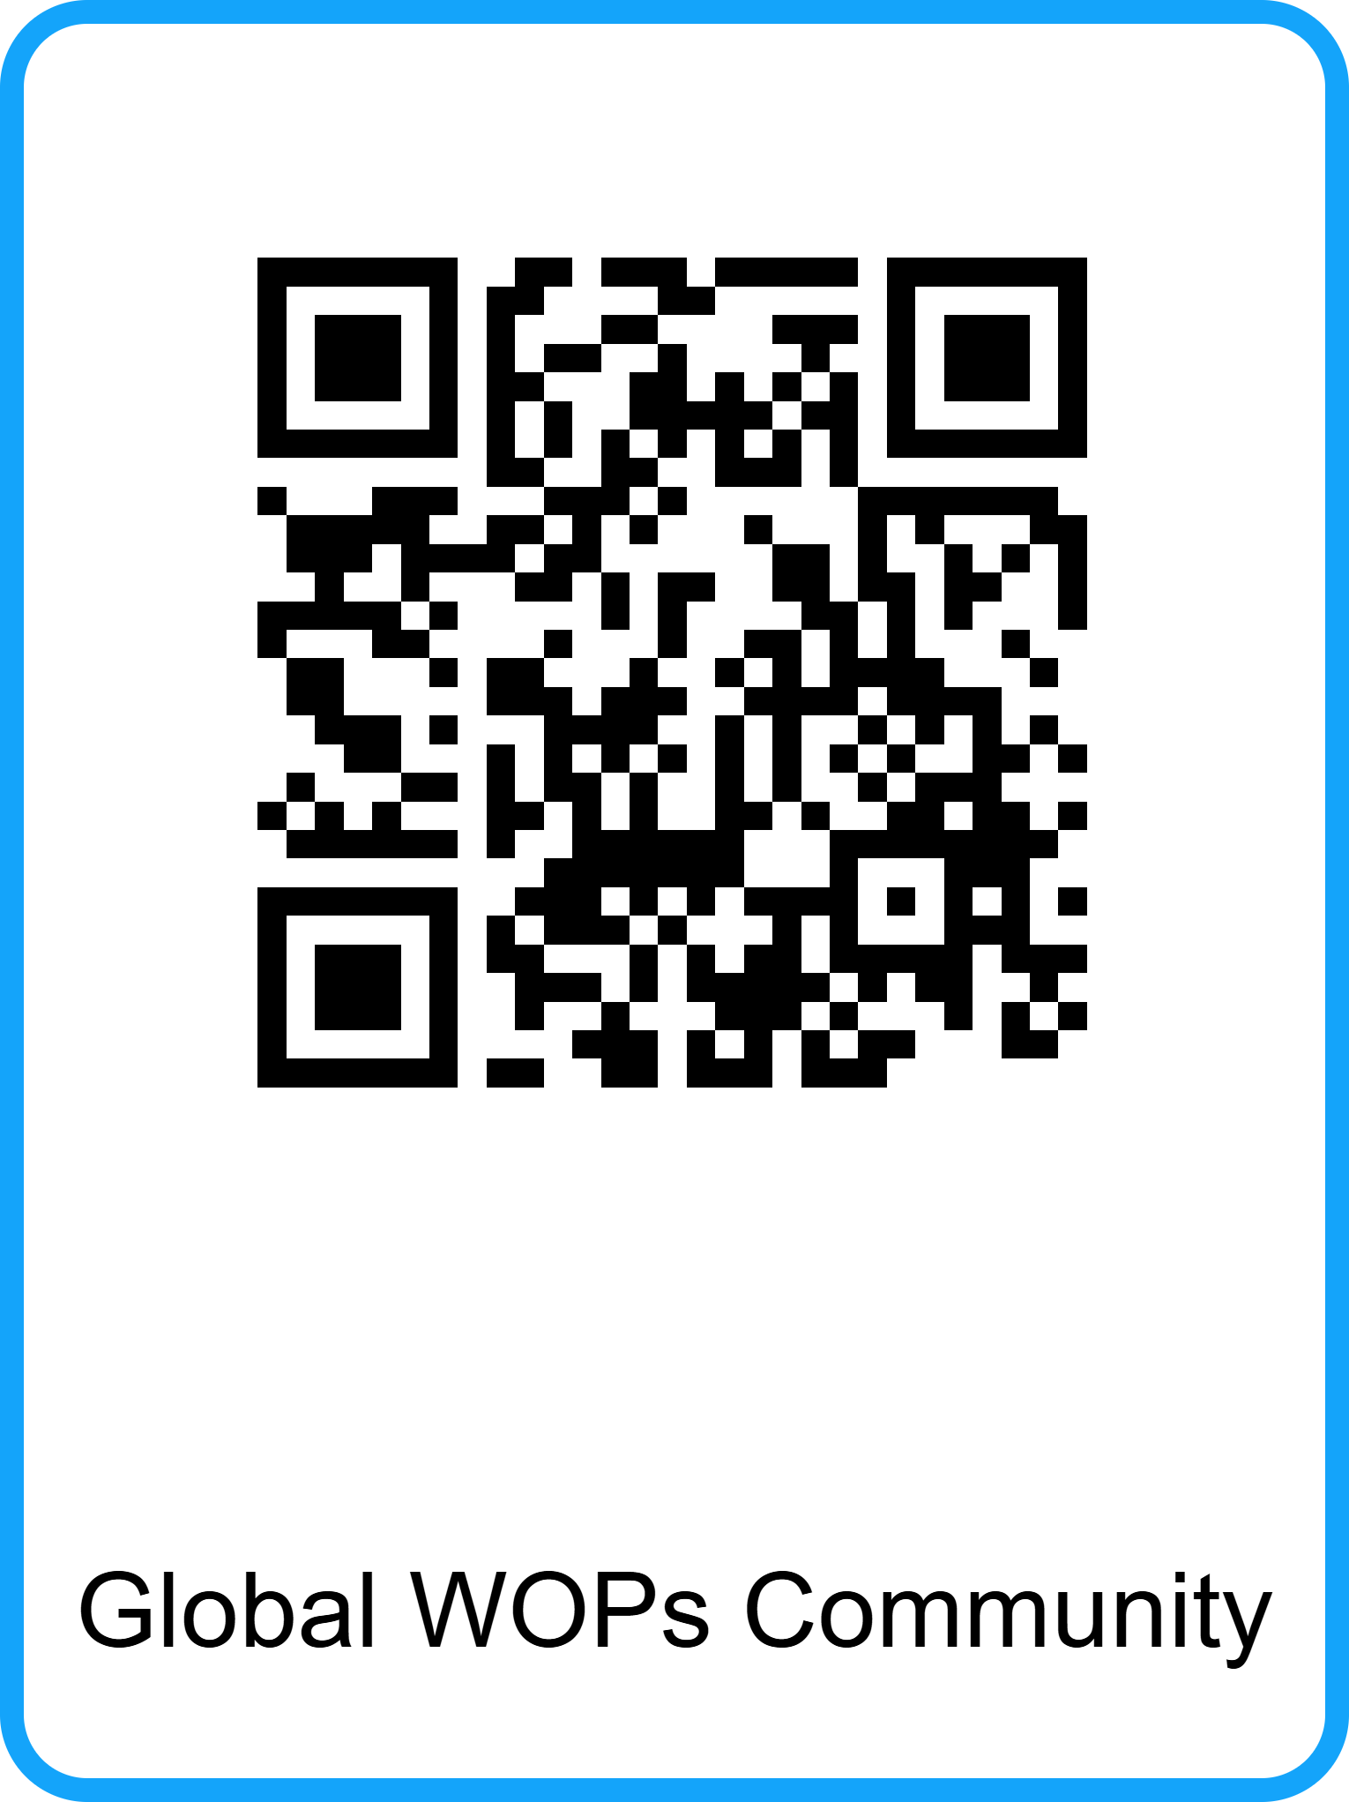

To Lauch CoP-MENA in October
Run in collaboration with WaterWorX
Moderation support
Joint webinars and trainings
Creating an inclusive, open space
Accessible to all
The Global WOPs Community
Co-creating and sharing knowledge on WOPs

Slide 24

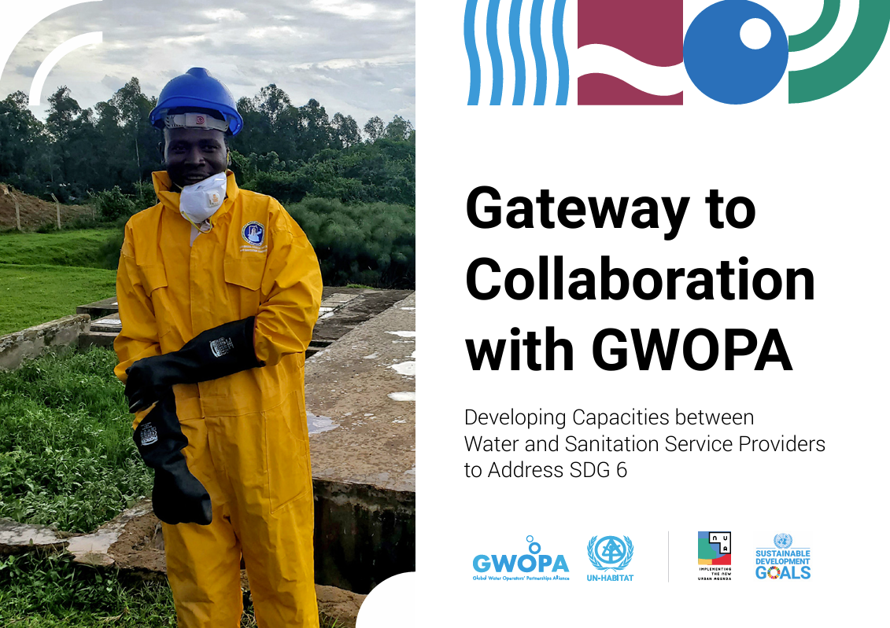
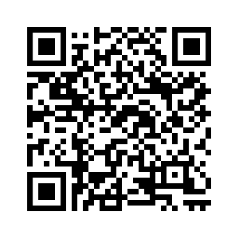

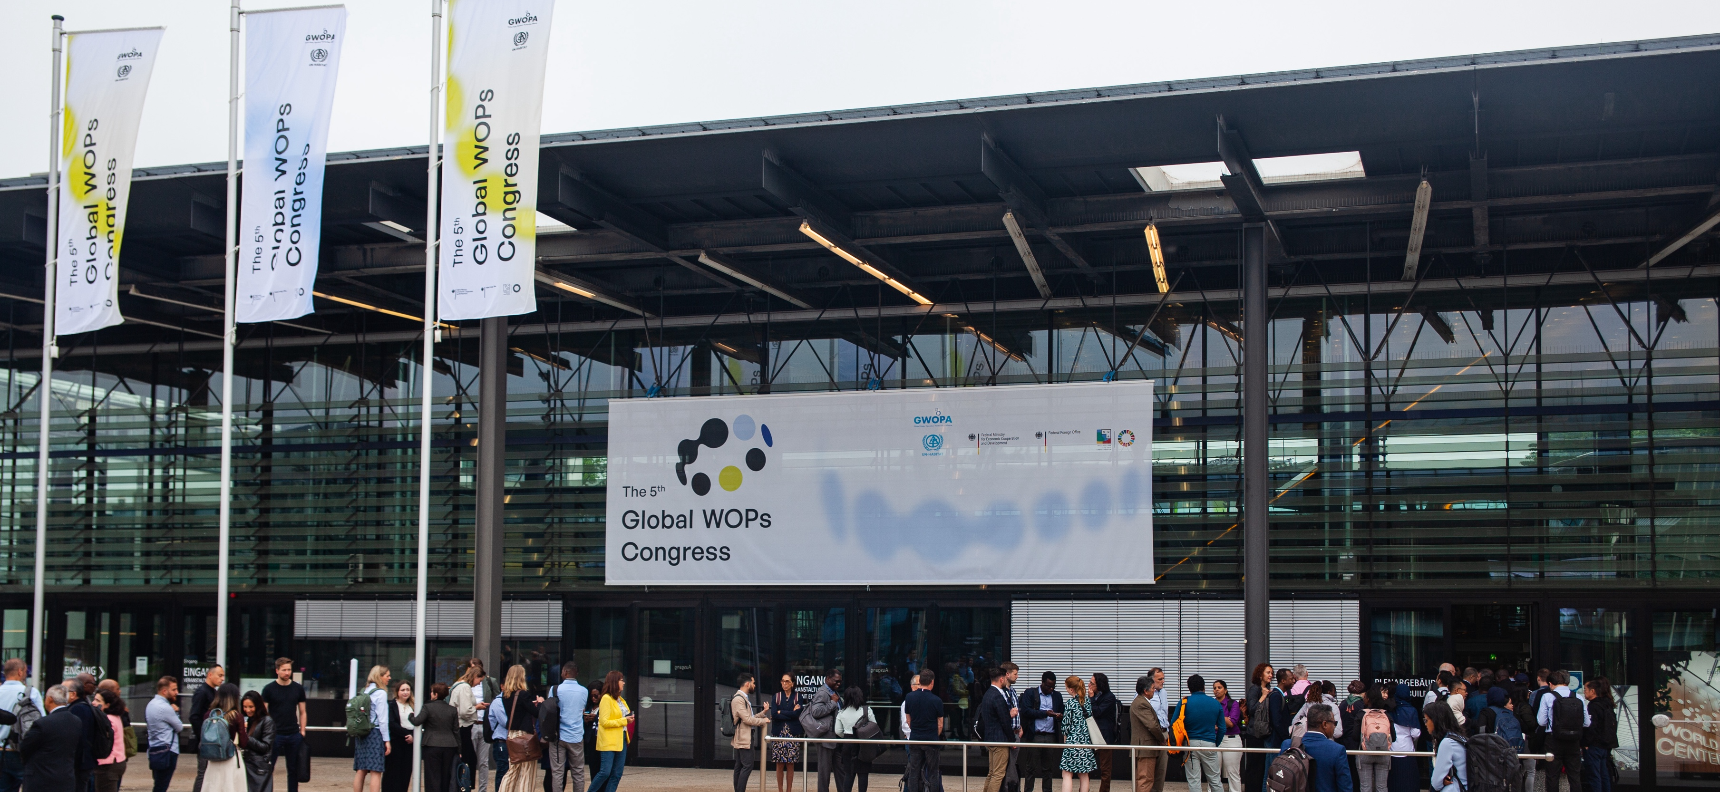

Save the date
The 6th WOP Congress 27-29 October 2025, Bonn, Germany
Find out more about GWOPA
gwopa.org l www.un-habitat.org

Slide 25
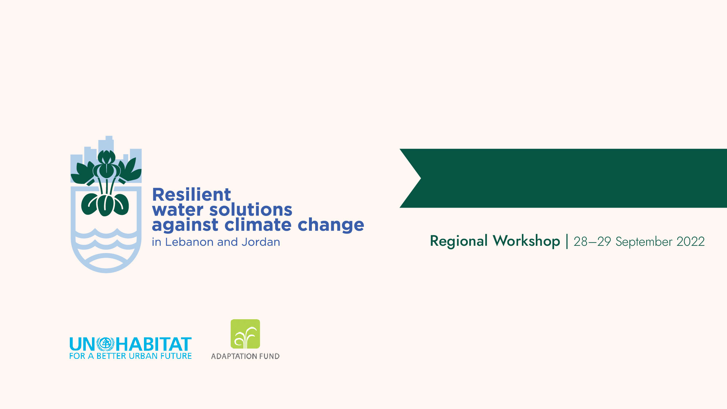


Arab Water Week 2025 – Dead Sea, Jordan
Presented by: Sara Hess
Associate Economic Affairs Officer
ESCWA, Lebanon
Date: 05 May 2025

Slide 26

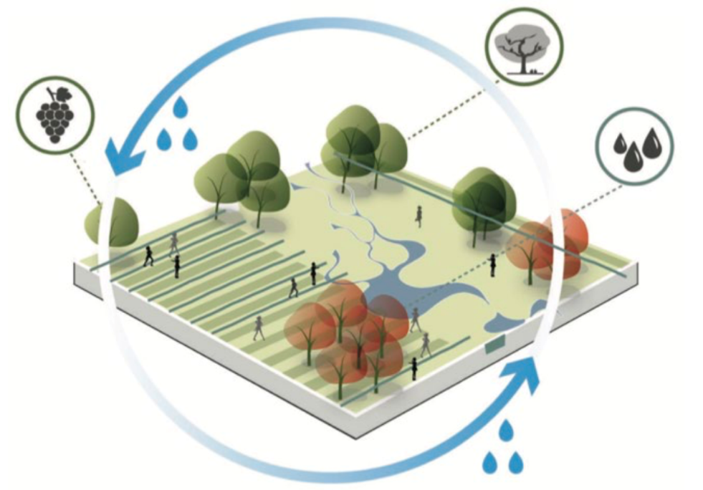

Introduction
Project Title: Increasing the resilience of both displaced persons and host communities to climate change-related water challenges in Jordan and Lebanon
Project Duration: 4 years (Oct. 2021 – Oct. 2025)
Donor: Adaptation Fund (AF)
Implementing entity: UN-Habitat
National Designated Authority: Ministry of Environment
Implementing partners: UNICEF, ESCWA, MORES/SETEC
Project Budget: USD 13,973,509
Target areas: Zahle in Lebanon; Irbid and Mafraq in Jordan

Slide 27


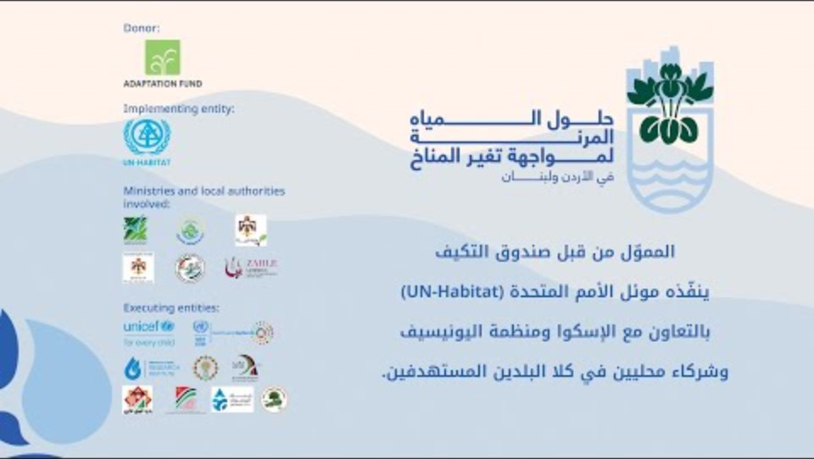
Notes:
Share complete video

Slide 28




Project components
Regional Component
COMPONENT 1
Manage urban risks and vulnerabilities in the context of climate change, especially water scarcity challenges, and urban (population) growth, incl. DPs migration
COMPONENT 2
Improve awareness, ownership and capacities to respond to climate change, incl. to operate, maintain and replicate resilient water harvesting, supply and irrigation systems
COMPONENT 3
Expand unconventional water harvesting and supply options, using innovative and replicable techniques
COMPONENT 4
Project knowledge management and replication, incl. dev. of regional urban risks and vulnerabilities management model in the context of climate change and urban (population) growth (incl. from DPs migration)

Slide 29
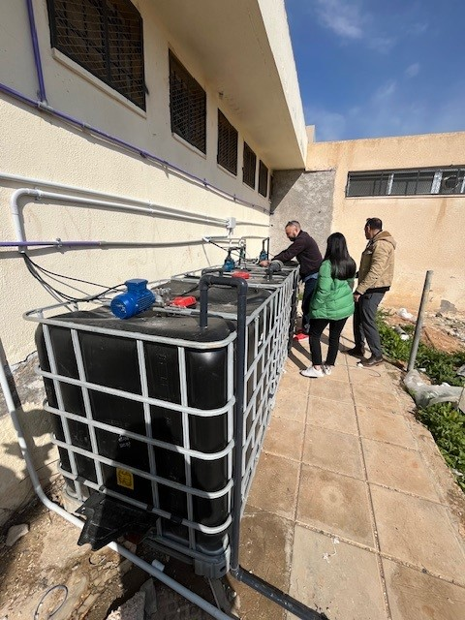
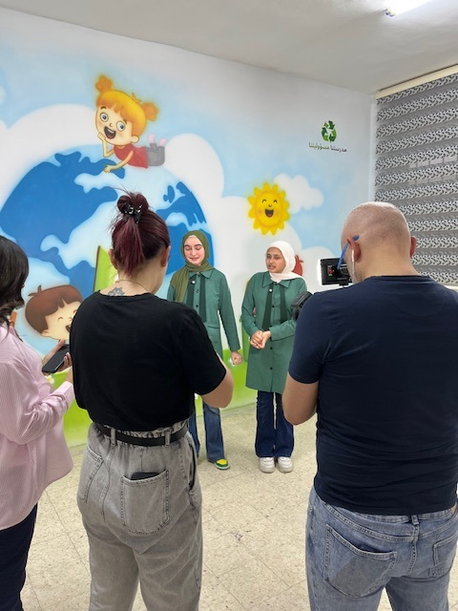
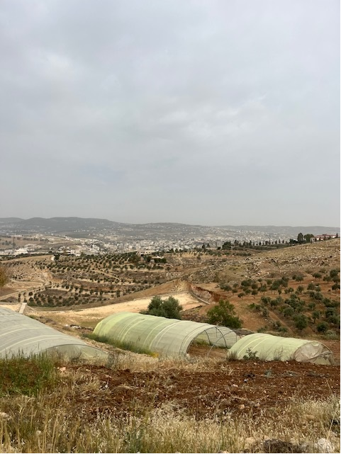
Notes:
Share complete video

Slide 30
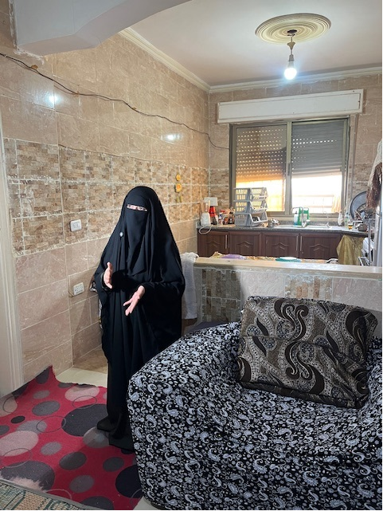
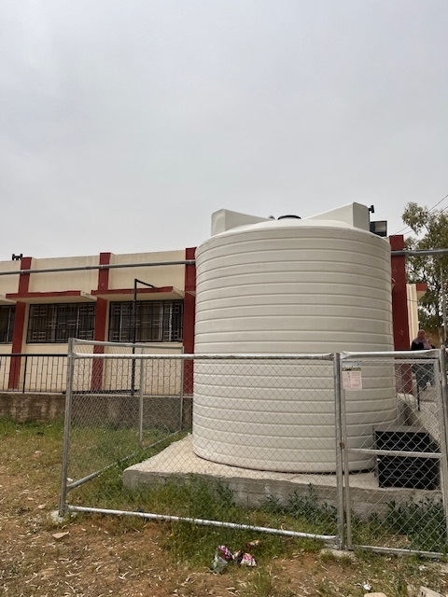
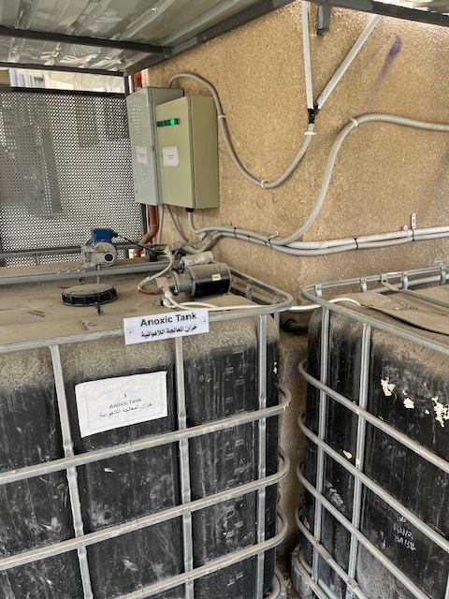
Notes:
Share complete video

Slide 31
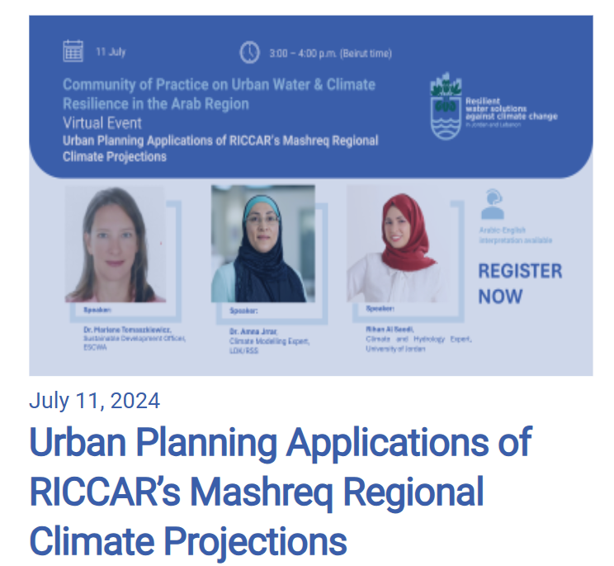
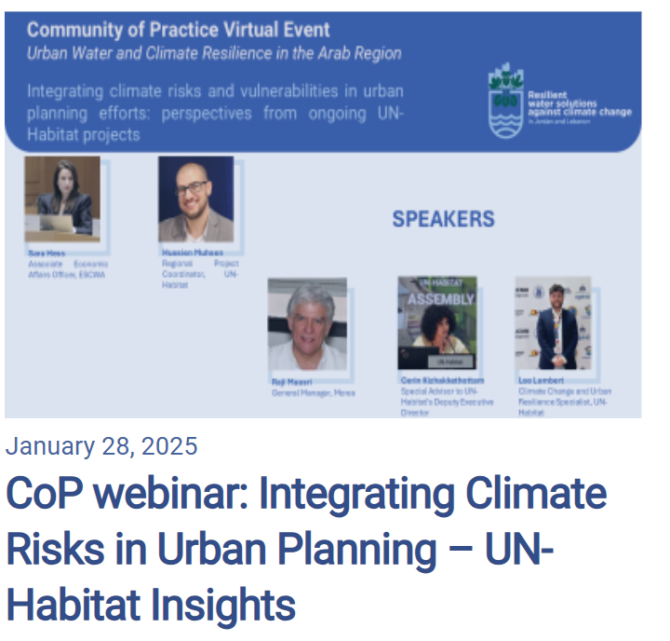
www.rws-ccaf.com
Notes:
Share complete video

Slide 32
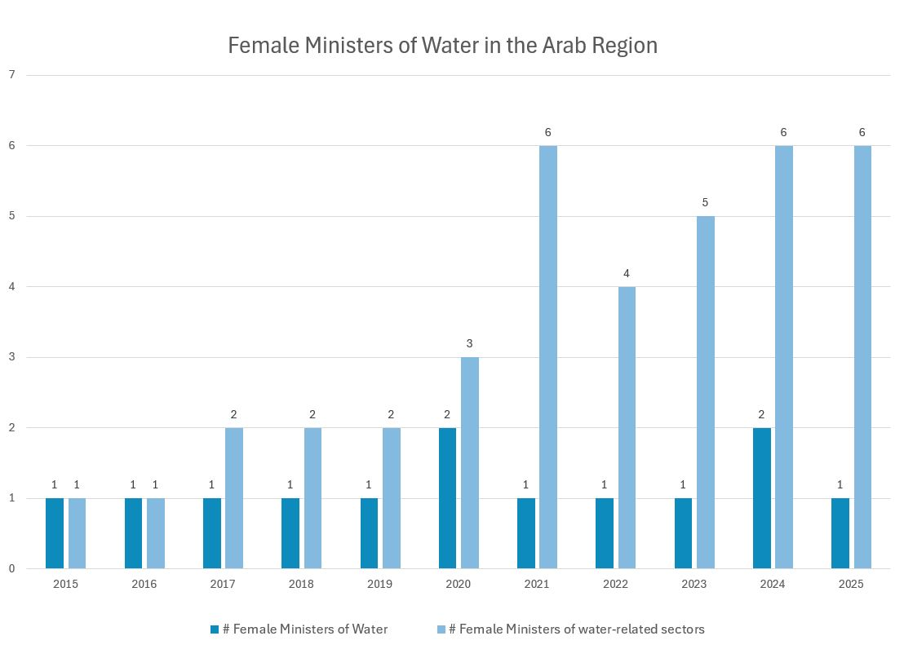
Source: ESCWA using data compiled from Ministry websites, LinkedIn, FAO and news reports.
Notes:
Share complete video

Slide 33
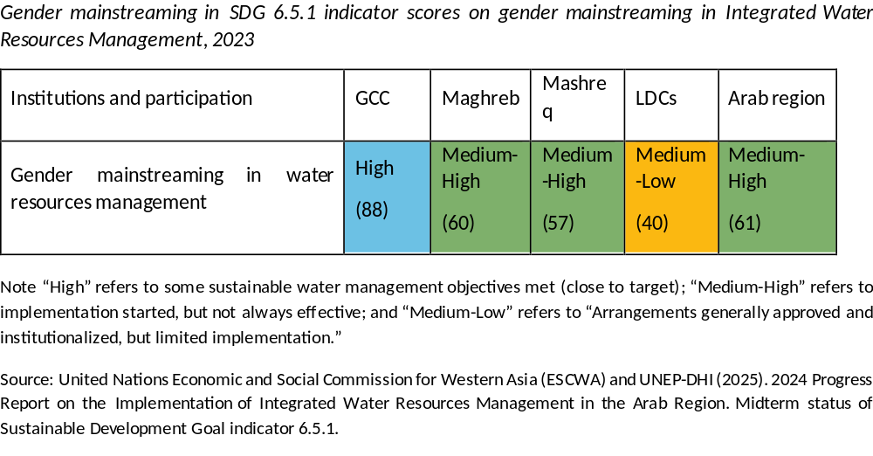
Notes:
Share complete video

Slide 34
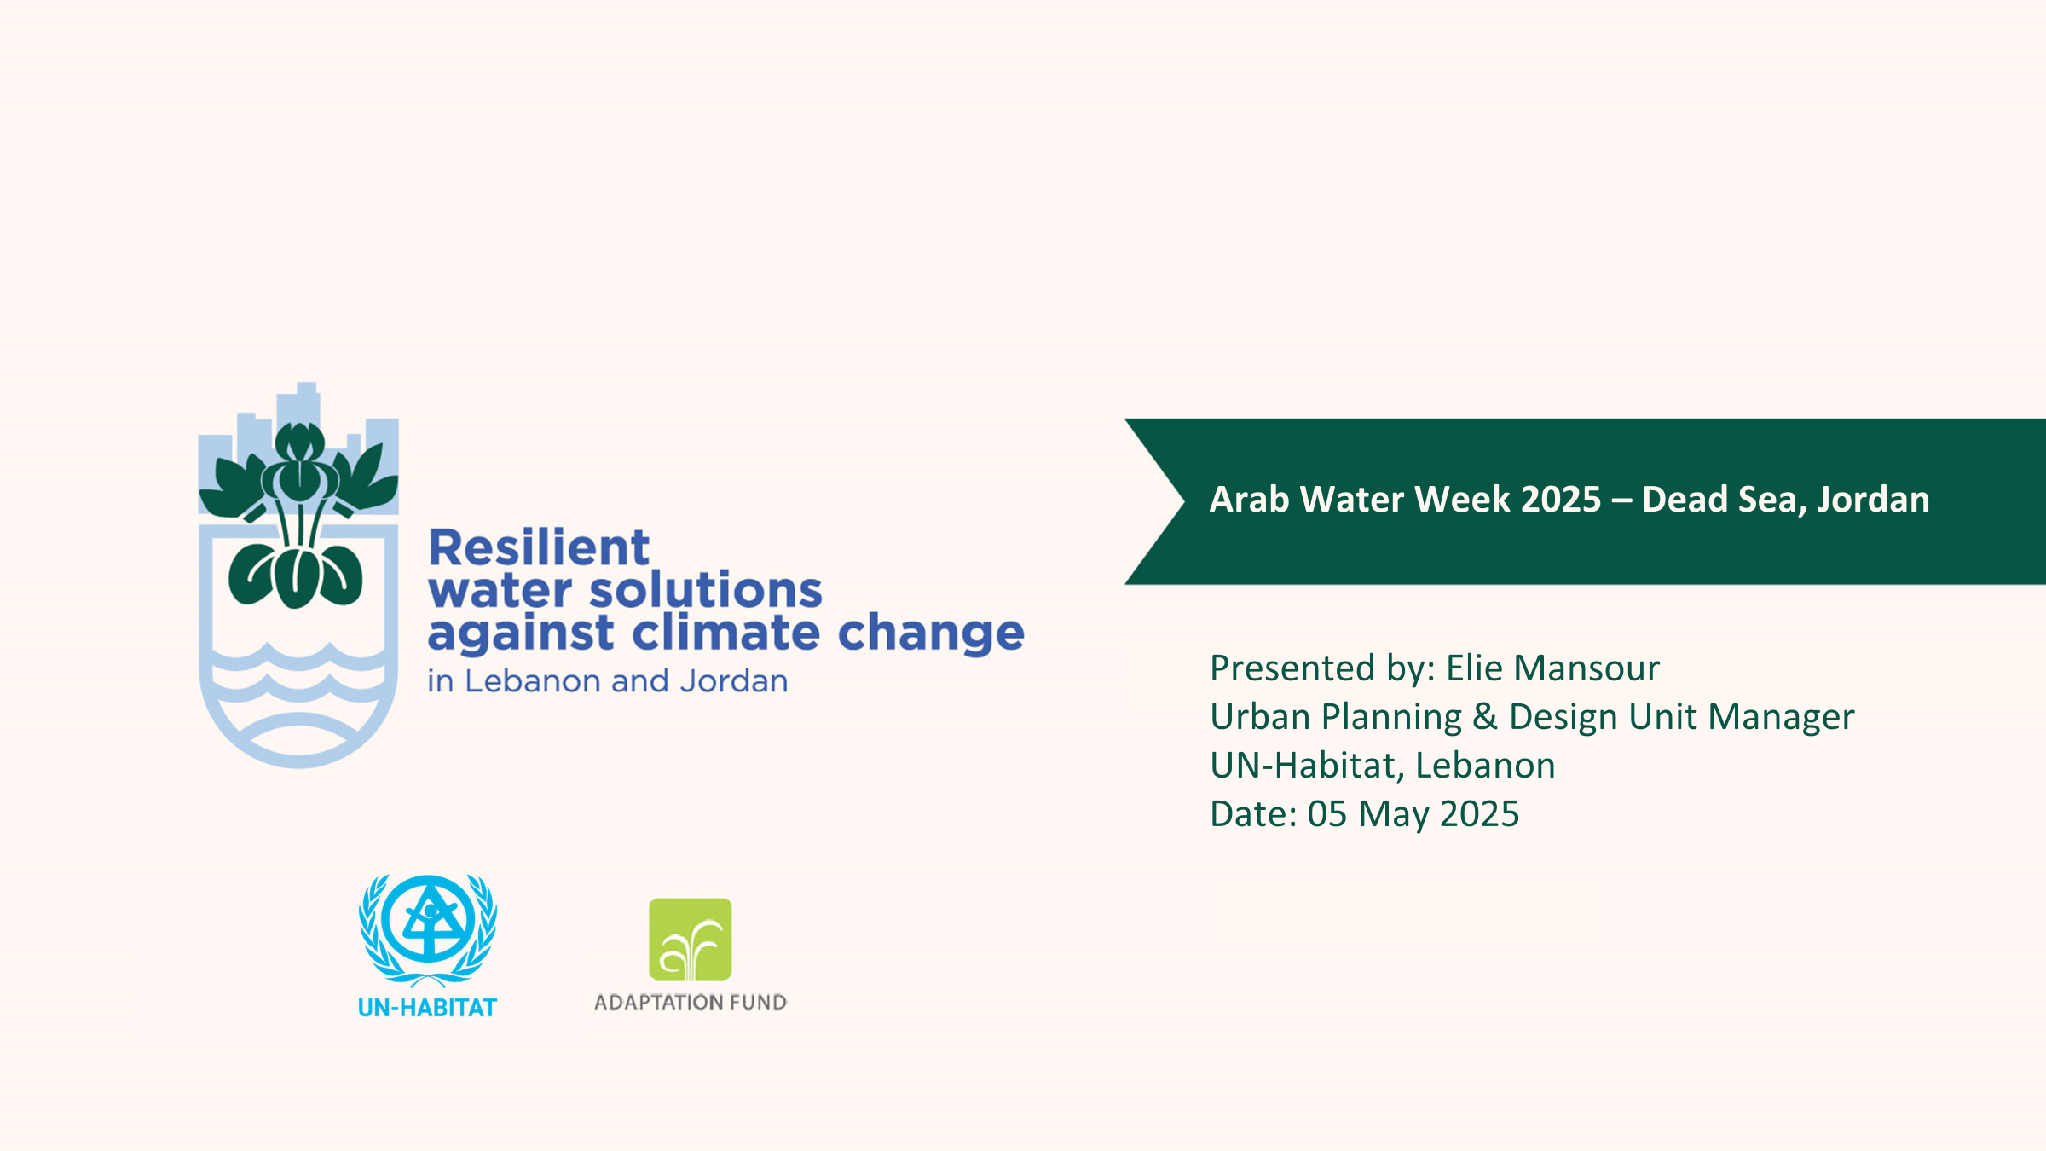

Slide 35
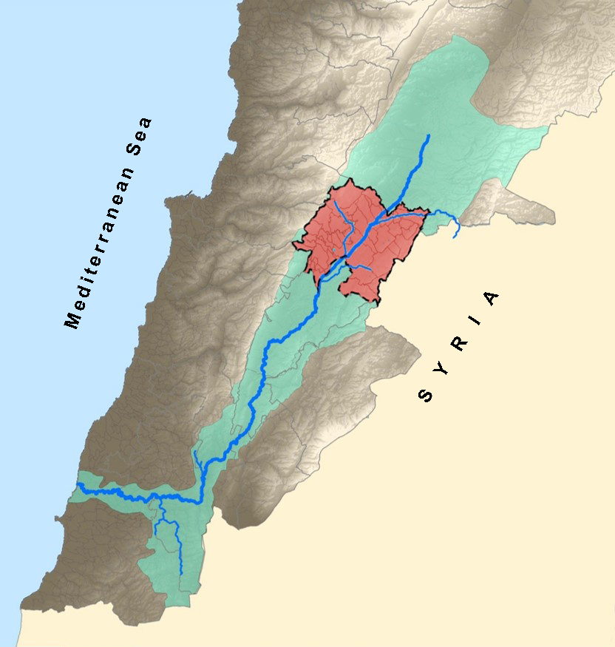
Resilient Water Solutions against Climate Change in Jordan and Lebanon
Project duration: 4 years (October 2021–October 2025)
Donor: Adaptation Fund
In Lebanon, implemented by: UN-Habitat Lebanon, ESCWA, MORES/SETEC,
UNICEF.
Target areas: Zahleh in Lebanon; (Irbid and Mafraq in Jordan)
Overall objective: The project aims to better respond to climate change impacts and vulnerabilities in Lebanon and Jordan, with a focus on water challenges.
Context and Study Area
ZAHLEH DISTRICT (Bekaa Governorate, Lebanon)
It covers an approximate area of 437 km2. It is located in a valley between two mountain ranges at an elevation of 850 m above sea level.
Its agricultural plains are classified by the National Physical Master Plan of the Lebanese Territory (NPMPLT) of high national importance.
Rich in water resources but facing many water related challenges due to poor management.
Highly vulnerable to climate hazards and effects.
Has 29 municipalities and several 16 small localities without municipal councils.
Overall population increased dramatically since 2011 due to the influx of displaced Syrians.
Total population around 263,000 residents (2020 estimates), around half of which are Syrians.
Zahleh District within Litani river Basin

Slide 36

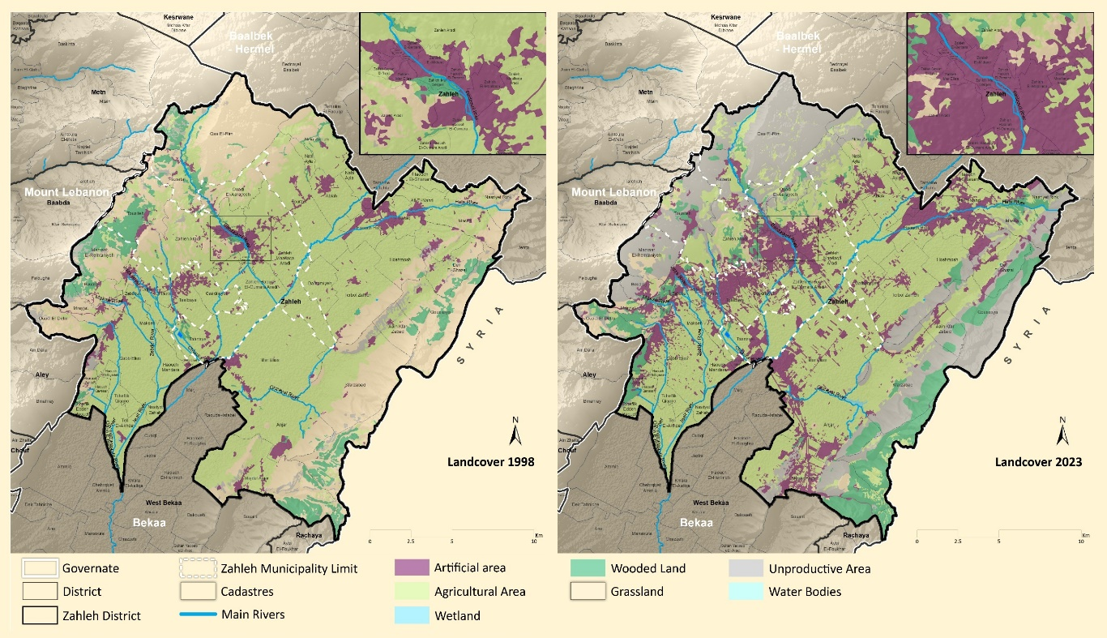
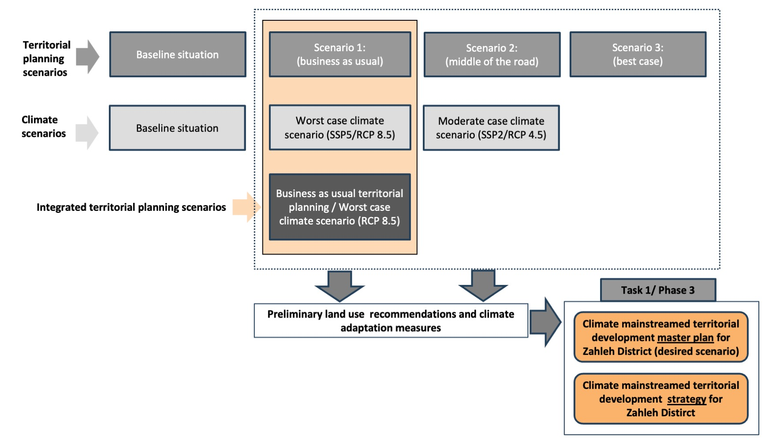
Project Methodology
Phase 1: District Assessment
A desk review of relevant studies and reports
Field investigations (including FGDs, KIIs, and surveys)
GIS mapping and analysis
Stakeholder engagement workshops
District Overview
Climate Dynamics
Urbanization Dynamics
Agricultural Dynamics
Water and Soil Issues
Phase 2: Climate Risk Assessment and Scenario Planning
GIS modelling to map climate hazards and risks
Stakeholder engagement workshops to foster a shared understanding of climate risks and possible adaptation measures.
Developing territorial planning scenarios
Zahleh landcover 1998
Zahleh landcover 2023
Phase 3: District strategy
Articulating a development vision for the district with guiding principles and goals.
Setting objectives and interventions that address land and natural resources management, CC adaptation, and opportunities for territorial development.
Producing a preliminary territorial development map.

Slide 37
Phase 1- District Assessment Datasets
Geology
Soil
Landuse / Landcover
DEM
Contour lines
Rivers
Buildings
Roads
Springs
Wells
Dams
Dumps / Landfills
Reserves, IBAs
WWTPs
Ponds / Lakes
Earthquake
Syrian Camps / Clusters
Historical Disasters
Erosion Risk
Landslide Risk
Fire risk
Seismic Risk
Flooding Risk
Mass Movement
Drought / Desertification
Quarries
Industrial Areas
Schools / Universities
Hospitals / Healthcare centers
Solid Treatment Facilities
Landfills
Population counts
Caves
Historical Sites / Archaeological
Satellite Imagery
Meteorological Stations
Temperature
Humidity
Evaporation
Precipitation
Wind
Pressure
Snow
River / Spring Gauges
Air Pollution
Water Pollution
Major Water Tanks
Water Networks
Waste Water Networks
SDTAL Data
Zoning
Parcelization
Public Lands + waqfs
Agriculture Lands
Major data sources:
CNRS
LRA
LARI
MoEW
MoA
MoE
GDLRC
DGUP
AUB
UNOSAT

Slide 38



Phase 1- District Assessment Data Mapping
ITS, 2023
Population, 2023
Public lands, 2023

Slide 39



Phase 1- District Assessment Data Mapping
Wastewater infrastructure
Subwatershed
Rivers and springs

Slide 40



Phase 2- Scenario Planning
Scenario 1: The cemented plain
Continuation of current urban planning and development trends, high population growth, economic pressures, resource extraction, weak land governance, and poor management of natural resources
Further encroachment of construction on agricultural lands, state-owned lands, the public domain, and flood-prone areas
Increased conversion of agricultural lands to other land uses, leading to loss of fertile soil and land productivity
Scenario 2: Strategic equilibrium
Respects the principles of NPMPLT
Assumes moderate population growth, guided urbanization, and adequate land and natural resources management
Establishment of buffer zones, urban forestry, and green infrastructure will bolster biodiversity and ecological continuity, while simultaneously acting as adaptive measures against climate change
Optimization of agricultural productivity
Scenario 3: Perfectly green
Promote sustainable and planned urbanization, restoration of degraded land, agriculture reclamation, demolition of encroachments on public land communal lands, and protection of natural and cultural landscapes
Implement green infrastructure and nature-based solutions to mitigate climate risks
Stronger community resilience
Improved agricultural adaptation

Slide 41




Phase 2- Scenario Planning
Scenario 2: Strategic equilibrium
Respects the principles of NPMPLT
Assumes moderate population growth, guided urbanization, and adequate land and natural resources management
Establishment of buffer zones, urban forestry, and green infrastructure will bolster biodiversity and ecological continuity, while simultaneously acting as adaptive measures against climate change
Optimization of agricultural productivity

Slide 42
Phase 2- Climate Risk Assessment
Hazards | Considered indicators | Baseline value | Hazard evolution RCP 4.5 | Hazard evolution RCP 8.5 | Source of data
Heat waves | Days with temperatures exceeding 30 degrees | 33 | 97.32 days (293%) | 143 days (433%) | World Bank – Climate Knowledge Portal (2024) Climate mean projections (model: CMIP6)
 | Number of tropical nights > 20*C | 1 day | 23 days (2300%) | 100 days (10000%)
Cold waves | Number of frost days | 30 days | 15 days (-50%) | 2.33 days (-94%)
Precipitation | Precipitation percent change | 80 % | 72.65 % (-8%) | 58.46% (-22%)
Wildfire risk | Days with temperatures exceeding 30 degrees | 33 | 97.32 days (293%) | 143 days (433%)
 | Precipitation percent change | 80 % | 72.65 % (-8%) | 58.46% (-22%)
Droughts | Precipitation percent change | 80 % | 72.65 % (-8%) | 58.46% (-22%)
Desertification
Flood | The flood risk map we are using already corresponds to 100 years projection under a worst-case scenario, used for sewer design. Map was made in 2014 |  |  |  | NCRS
Landslide | Landslide is a hazard that depends very indirectly on available climate variables. In the absence of more specific modelling, it is hard to describe its evolution.
Seismic risk | Seismic risk is not a climate change related risk. It varies at a geological time scale (1000s of years at least).
Vulnerability | Score calculation method
Population | Population density per municipality
Urban area | % of built land / total surface area of municipality
DPs and ITS | % of refugees / total population of municipality
Roads | decreasing buffer around roads, average value per municipality
Agricultural lands | % of agricultural land / total surface area of municipality
Industrial areas | % of industrial areas / total surface area of municipality
Hospitals | decreasing buffer around hospitals, average value per municipality
Education | decreasing buffer around schools, average value per municipality
Water distribution networks | Questionnaire to municipalities with qualitative questions regarding network existence, age, and condition (USAID-BWE study, 2015). For municipalities not covered by this study, this indicator is disregarded.
Wastewater networks
Electricity supply | Whether the municipality is serviced by EDZ (data collected during interview with EDZ, 2024)
Disadvantaged populations | Ranking calculated by UNHCR (2022) based on numbers of displaced Syrians, Palestinian refugees, and deprived Lebanese populations.

Slide 43











$$Risk to Hazard X for municipality Y=Hazard {scoring }_{X,Y}× \frac{\sum_{i}{{weight }_{X, i}×vulne{rability factor}_{X,i}}}{\sum_{i}{{weight }_{X, i}}}$$
Phase 2- Climate Risk Assessment
$$Risk Index for municipality Y= \frac{\sum_{X}{Risk to hazard X for municipality Y}}{Number of hazards}$$
Scoring table:
Final Risk Index maps:
Wildfire
Risk maps:
Floods
Droughts
Heat waves
Current situation
SSP2-4.5 (2100)
SSP5-8.5 (2100)

Slide 44





Phase 2- Climate Risk Assessment – Modelling LULC 2050
Vulnerability of urban areas obtained
via land use modelling (SSP5-8.5)
Predicted future LULC 2050 (SSP5/Business as Usual)
Final Risk Index for SSP5-8.5, 2050
The LULC (2050) is the result of the AI training model. It reflects the SSP5 which describes the future world based on fossil-fueled development.
The risk map shows a global risk strongly concentrated around the riverbeds, which are privileged areas for both agricultural activity and urban settlements.
Vulnerability of agricultural lands obtained
via land use modelling (SSP5-8.5)
LULC 1998 and 2023

Slide 45


Phase 3- District Strategy
District Development Strategy
Recommendations to key concerned stakeholders
(DGUP, MoEW, BWE, MoA, and MoE)
The goals focus on:
GOAL 1: Attain sustainable territorial development
GOAL 2: Protect and restore natural habitats
GOAL 3: Strengthen the resilience of farmers and rural communities to the impacts of CC
GOAL 4: Ensure sustainable water management to meet rising demand while tackling the new CC-related challenges
The vision for Zahleh focuses on:
Preserving its rich heritage and natural wealth
Promoting its diversity and unique character of plains and mountains
Addressing environmental and CC challenges with resilience and innovation
Becoming a leading example of unity, social cohesion and environmental stewardship worldwide.

Slide 46


Thank you!

