Slide 1


H2Auto: An Automated Rainwater Collection And Testing System
Addressing water contamination through innovative technology.
Team: Hamza Jabr, Ammar Aziz, Khaled Barakat.

Slide 2
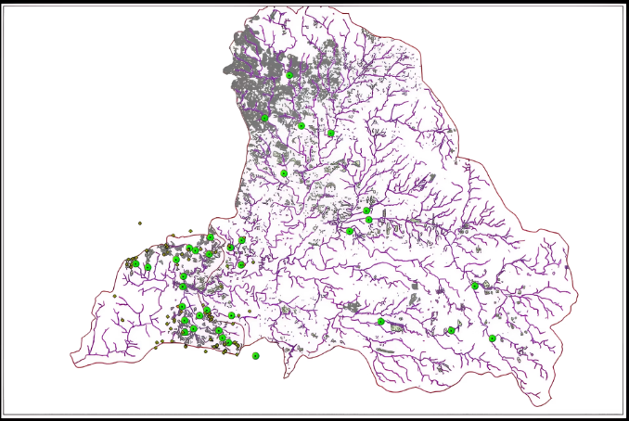
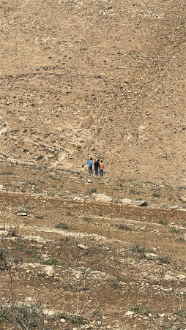

Main Challenge
Hard to Collect Samples
Access Issues
Water disappears before reaching collection spots during rainfall.
Some sites are remote and need constant, reliable monitoring.
Safety Concerns
Testing Limitations
Collecting in heavy rain is risky; requires a safer system.
Current methods are costly, infrequent, and only local in scope.
Tester's safety at stake; manual collection takes hours per sample, costly tests limit coverage.

Slide 3

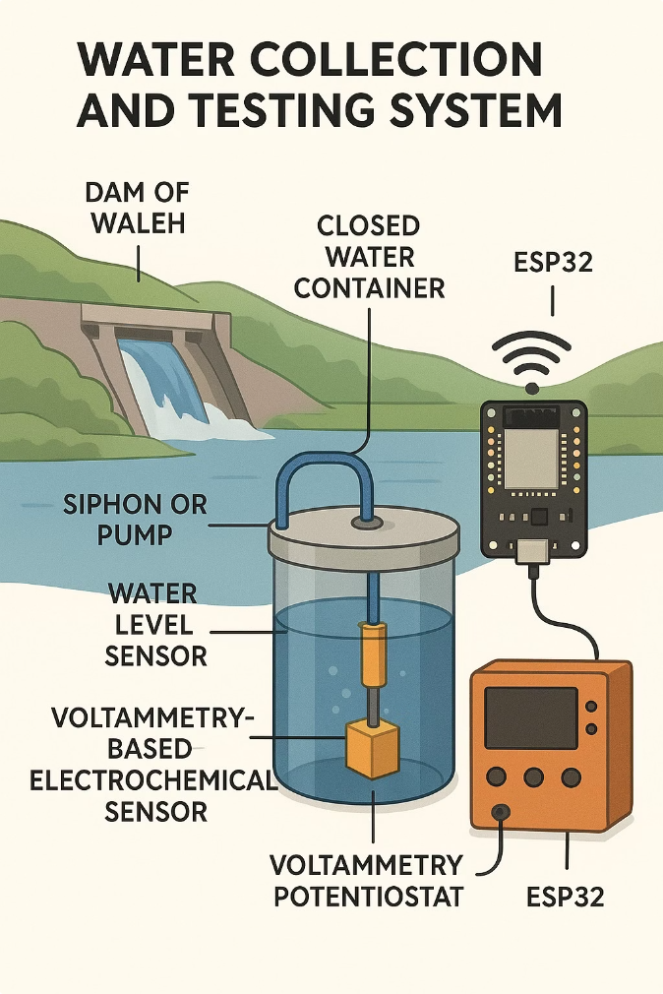





Our Solution: Autonomous Water Collection and Testing
Automated Sampling
System collects rainwater samples without manual intervention.
On-site Testing
Detects heavy metals immediately with built-in sensors.
Real-time Data
Transmits results to cloud for instant access and review.
Cost-effective & Scalable
Designed for wide deployment at low cost across locations.

Slide 4
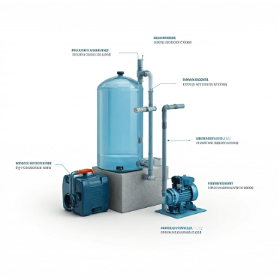
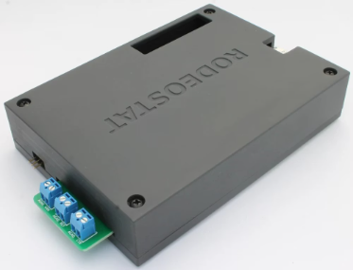
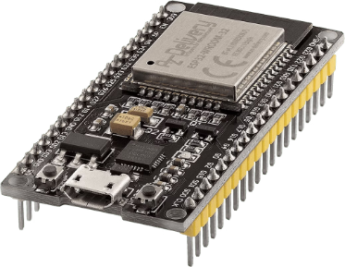
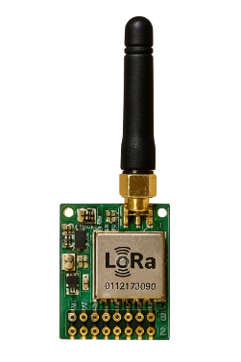







System Design: Hardware Overview
Collection Unit
Potentiostat
Data Controller
Communication
Rainwater capture and filtration for clean sampling.
Voltammetry device for precise heavy metal analysis.
ESP32 microcontroller manages sensors and data flow.
Wireless transmission via LoRaWAN or cellular networks.

Slide 5
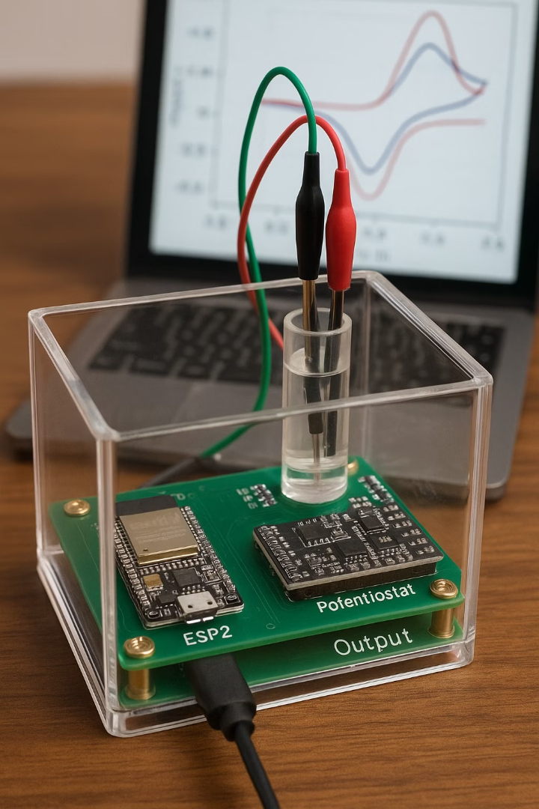




System Design: Software & Hardware Setup
Hardware Setup
Add the potentiostat electrodes in the water sample
Add the automatic buffer solution dispenser in the container
Connect the potentiostat and the control elements in the container to the ESP32 controller
Add small solar panels
Software Setup
The Esp32 controls the following major components in the code:
Water pump
Potentiostat
Buffer Solution Dispenser
LoRa communication module
Water Level Sensor
Results
The data outputs will be plots which are voltage and current signals that will be processed in the code for depending on the calibration requirement for a specific element.

Slide 6
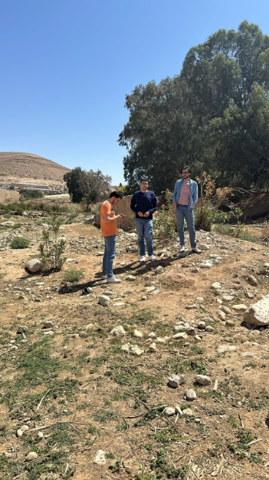
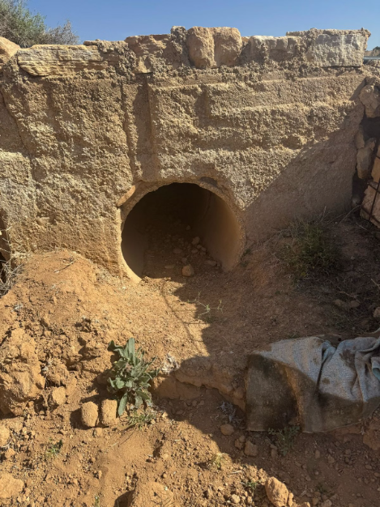
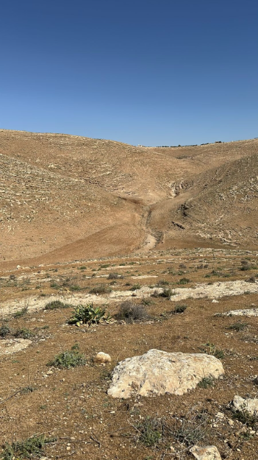


Field Testing: Collection Site Examples
Location 1
Location 2
Location 3
Converging stream; small lake formation
Remote and challenging terrain; dangerous and limited human access.
Rural stream near agricultural land; critical testing stream.

Slide 7



Results: Preliminary Data
Sample Collection
Detection
Over 150 samples gathered in 6 months.
Lead levels exceeded EPA limits in urban park.
Source Identification
Performance
Nearby industrial runoff suspected pollution contributor.
System improved data frequency by 40% over manual tests.

Slide 8






Environmental Impact & Community Benefits
Early Warning
Targeted Action
Empowered Communities
Alerts communities before contamination worsens.
Supports precise pollution reduction strategies.
Accessible data enables citizen monitoring.
Research Support
Data aids policy and scientific studies.

Slide 9

Future Development & Scalability
Additional Sensors
Incorporate pH, turbidity, and other parameters.
Algorithm Optimization
Enhance anomaly detection accuracy with AI.
Mobile App
Enable citizen scientists to contribute data easily.
Scaling Production
Target deploying 1000 units annually worldwide.
Partnerships
Collaborate with NGOs and governments for expansion.

Slide 10


Call to Action & Acknowledgements
Join us in expanding water quality monitoring and protecting health.
Contact: info@h2auto.org | www.h2auto.org
Acknowledgements: Funders, Mentors, Collaborators.

