Slide 1
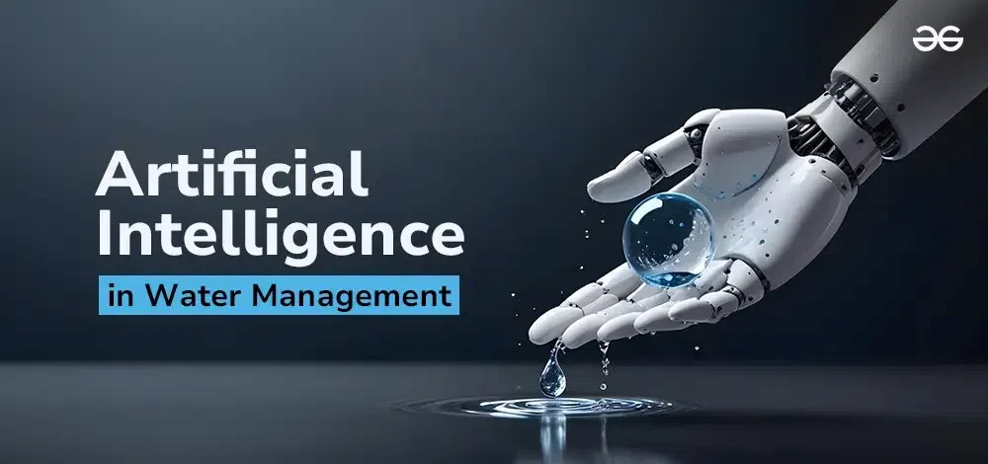
Harnessing Artificial Intelligence in the Water Sector: The Case of Jordan
Exploring how AI can revolutionize water management in one of the world’s most water-scarce countries.
By Dr Hana’a Muheisen

Slide 2
Why AI in the Water Sector?
- Jordan is among the most water-scarce countries globally.
- Climate change, population growth, and refugee influx increase stress.
- Smart, data-driven solutions are essential.
- AI offers efficiency, optimization, and predictive power.

Slide 3
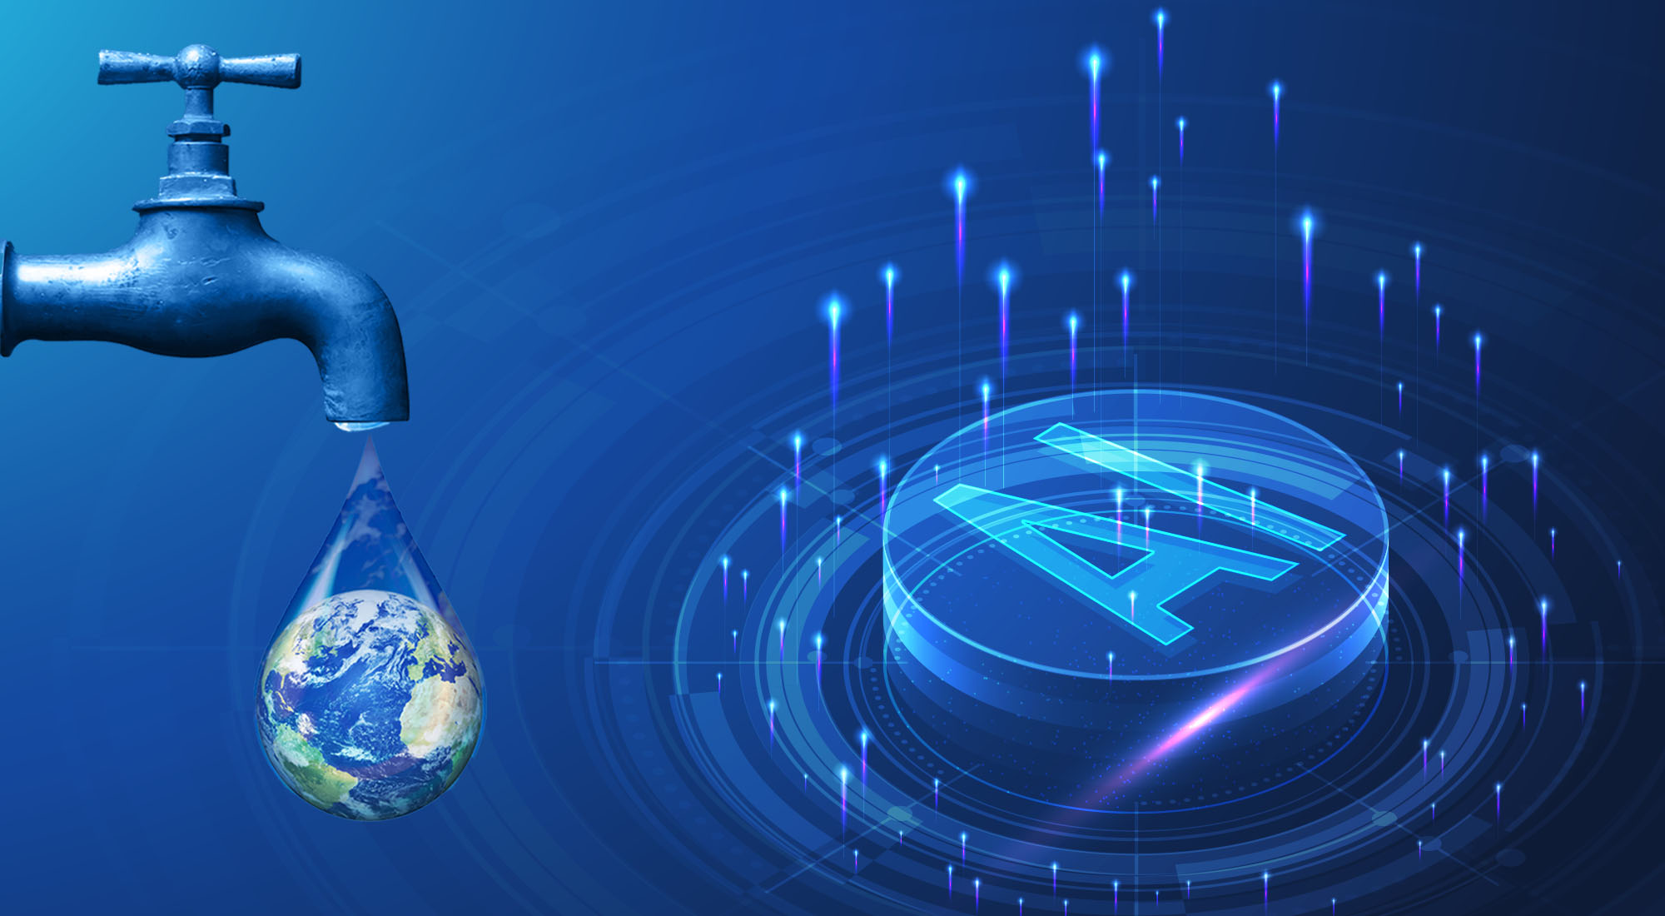
What is AI?
- Artificial Intelligence: machines simulating human intelligence.
- Includes: Machine Learning, Deep Learning, etc.
- Key benefits: Pattern recognition, predictive analytics, decision support.

Slide 4
Challenges in Jordan's Water Sector
- Extremely limited water resources (<100 m³/capita/year).
- High non-revenue water (~50%).
- Overexploited aquifers and aging infrastructure.
- Degraded water quality and limited monitoring.

Slide 5
AI Applications in Water Management
- Leak detection from pressure/flow data.
- Water demand forecasting.
- Real-time water quality monitoring.
- AI in groundwater recharge modeling.
- Process optimization in treatment/desalination.
- AI-powered early warning systems.

Slide 6
AI in Practice – Global & Regional Examples
- Smart metering in Singapore.
- Leak detection in the UK.
- AI-based SCADA in Saudi Arabia.
- Groundwater modeling in Tunisia.

Slide 7
Current AI-Related Initiatives in Jordan
- BGR-supported water quality monitoring.
- Digital twin exploration for desalination.
- Wastewater surveillance (e.g., SARS-CoV-2).
- IAEA isotope data for AI in groundwater studies.

Slide 8
Benefits for Jordan
- Efficient water allocation.
- Real-time quality/leakage monitoring.
- Predictive maintenance.
- Enhanced data-driven decisions.
- Climate-resilient planning.

Slide 9
Barriers to AI Adoption
- Limited digitized data.
- Lack of technical capacity.
- Outdated systems.
- Initial cost of implementation.
- Data privacy and governance concerns.

Slide 10
Recommendations
- Digitize and centralize water data.
- Develop national water AI strategy.
- Collaborate with academia/startups.
- Build capacity of water professionals.
- Pilot AI projects.
- Use international support (IAEA, GIZ, UN).

Slide 11
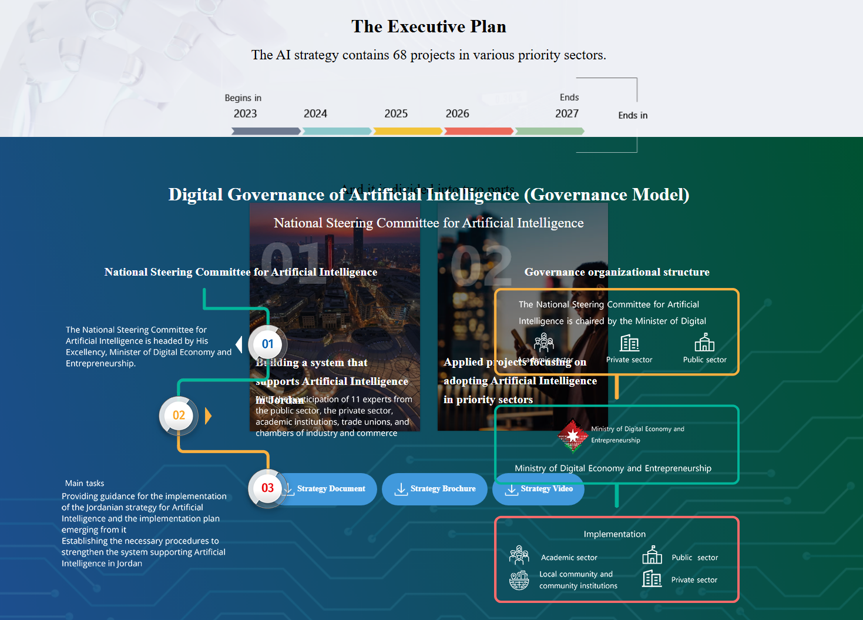
Jordan's Artificial Intelligence Strategy and Executive Plan (2023–2027)

Slide 12
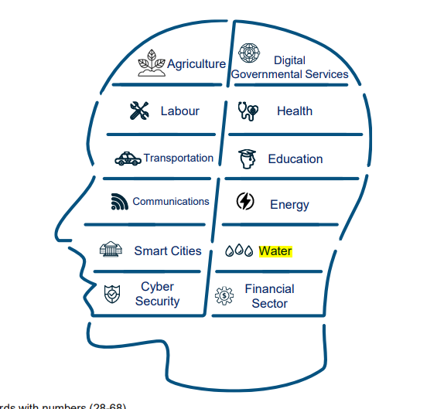

Slide 13
Ongoing Projects
Based on the information available as of April 2025, here is a detailed update on the progress of the three projects listed under the Jordanian Artificial Intelligence Strategy (2023–2027) in the water sector:
Early Leak Detection System (2024–2025)
Implementing Authority: Ministry of Water and Irrigation
Goal: Reduce water loss and improve maintenance operations
Current Progress: No specific information is available regarding the progress of this project to date.
Subscriber Services Monitoring System (2023–2024)
Implementing Authority: Water Authority
Goal: Improve service delivery time and quality
Current Progress: No specific information is available regarding the progress of this project to date.
Preliminary National Water Budget (2024–2026)
Implementing Authority: Ministry of Water and Irrigation and the Jordan Valley Authority
Goal: Improve water distribution efficiency and enhance planning
Current Progress: No specific information is available regarding the progress of this project to date.

Slide 14
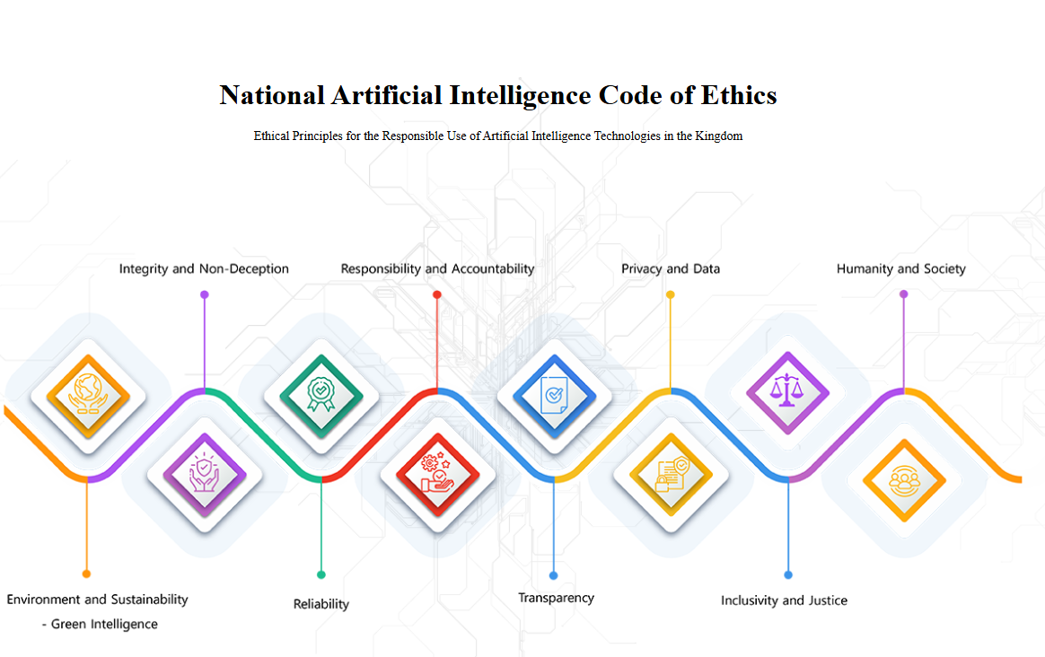

Slide 15
Conclusion
- AI is crucial for water security in Jordan.
- Jordan can lead in AI-water integration in MENA.
- Requires collaboration, data, and training.
- Smart tech ensures water for future generations.

Slide 16
Q&A
Your Questions & Ideas

