Slide 1
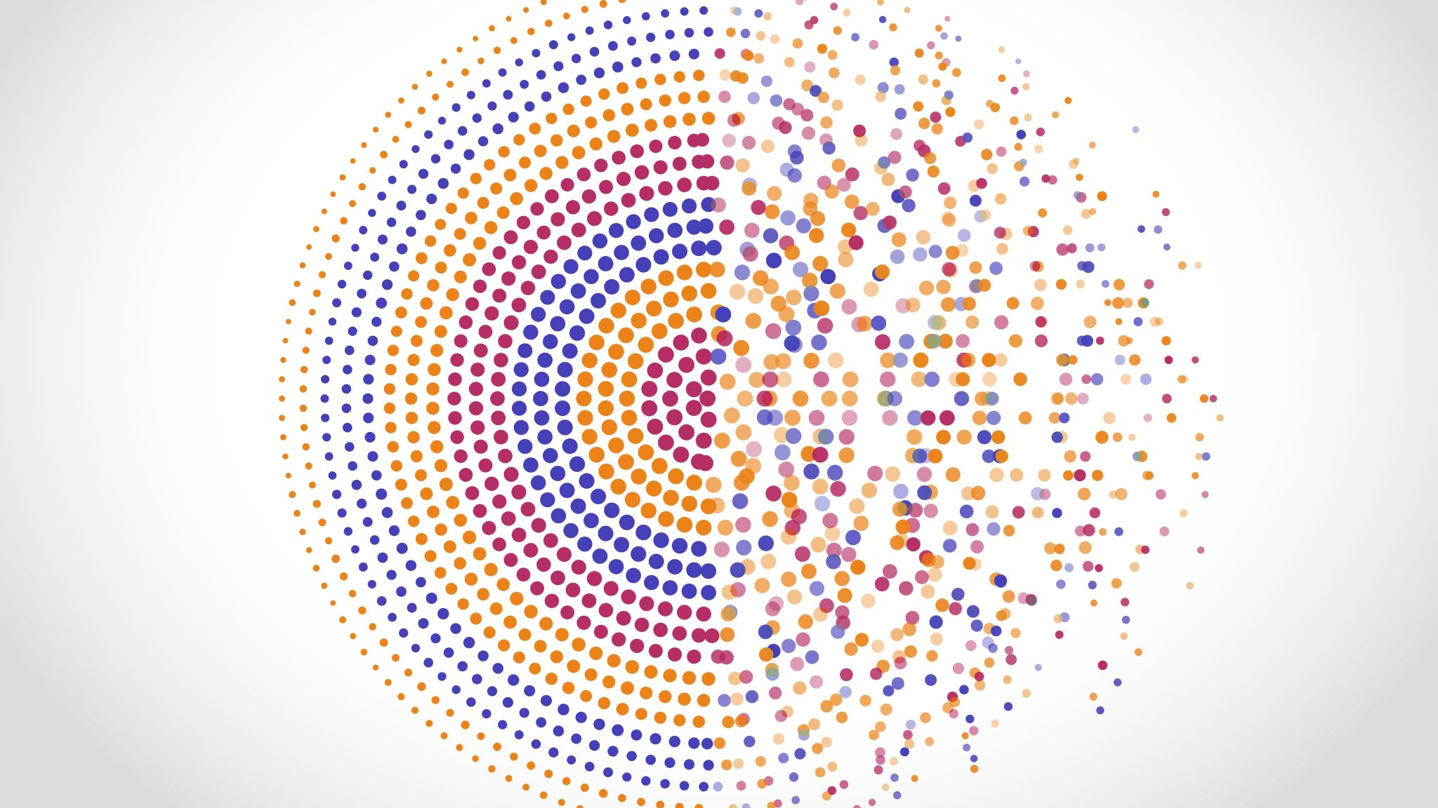

Digital Transformation for Water, Energy , Food and Ecosystem Nexus
Dr.-Ing Hassan Aboelnga
Vice Chair of Middle east water forum

Slide 2

Digital transformation for the WEFE Nexus
Digital transformation is not just a technological upgrade; it is a strategic imperative for creating a more sustainable, resilient, and interconnected Water, Energy, Food and Ecosystem Nexus. Embracing digital solutions is essential for overcoming current challenges and preparing for the evolving demands of the future.

Slide 3
Common myths of Digitalization and WEFE Nexus
Myth: Digitalization Solves WEFE Nexus Challenges Instantly:
Reality: Digitalization is a powerful tool, but it doesn't provide instant solutions to the complex interdependencies of water, energy, and food systems. It requires a holistic and integrated approach to address challenges effectively.
Myth: Digitalization Negatively Impacts Employment in the WEFE Sector:
Reality: There's a misconception that increased automation and digitalization lead to significant job losses in the WEF Nexus. While certain tasks may be automated, digitalization can create new opportunities and enhance overall efficiency, contributing to job creation.
Myth: Digitalization is Only Relevant for Developed Regions:
Reality: Some believe that digital solutions are only applicable in developed regions. However, scalable and context-specific digital technologies can benefit both developed and developing regions, addressing unique challenges in each context.
Myth: Digitalization Focuses Solely on Technical Solutions:
Reality: Digitalization is not only about technical solutions but involves socio-economic factors, governance, and policy frameworks. Effective digitalization requires considering the social and institutional aspects of the WEF Nexus.
Myth: Digitalization Neglects Environmental Sustainability:
Reality: Concerns may arise that a focus on digital solutions could compromise environmental sustainability. In reality, properly implemented digitalization can enhance sustainability by optimizing resource use, reducing waste, and improving overall efficiency.
Myth: Digitalization is Too Costly for WEFE Nexus Implementation:
Reality: While there are costs associated with implementing digital technologies, the long-term benefits, such as resource optimization and improved resilience, often outweigh the initial investment. Digitalization can be tailored to different budgets and needs.
Myth: Digitalization Leads to Overreliance on Technology in the WEFE Nexus:
Reality: There's a concern that excessive reliance on digital technologies might overshadow traditional practices. However, an integrated approach ensures that digital tools complement existing methods rather than replace them entirely.
Myth: Digitalization is Not Inclusive in the WEFE Nexus:
Reality: Some believe that digital solutions exclude certain groups, particularly in rural or marginalized areas. However, inclusive digitalization strategies can be designed to address the specific needs of diverse communities, ensuring equitable access and benefits.
Myth: Digitalization Does Not Enhance Resilience in the WEFE Nexus:
Reality: A common misconception is that digitalization does not contribute to resilience. In fact, real-time monitoring, data analytics, and adaptive technologies can enhance the WEF Nexus's resilience by providing timely responses to changing conditions and risks.
Myth: Digitalization Only Benefits Large-scale WEFE Systems:
Reality: Digital technologies are often perceived as suitable only for large-scale systems. However, scalable solutions exist that can be tailored to the needs of both large and small WEF systems, contributing to efficiency and sustainability.

Slide 4

Definition of Digital Transformation in the WEFE Nexus:
Digital transformation in the context of the Water, Energy, Food and Ecosystem (WEFE) Nexus refers to the strategic adoption and integration of digital technologies across the interconnected systems of water management, energy production, food supply chains, and ecosystem. It involves leveraging advanced digital tools, data analytics, and innovative technologies to optimize the efficiency, sustainability, and resilience of WEFE systems.

Slide 5
Key components of digital transformation within the WEFE Nexus
Data Integration: Connecting and integrating data from various sources within water, energy, and food sectors to gain a comprehensive understanding of their interdependencies.
Real-Time Monitoring: Utilizing sensors, Internet of Things (IoT) devices, and monitoring systems to collect real-time data on water usage, energy consumption, and food production.
Analytics and Decision Support: Employing advanced analytics, machine learning, and artificial intelligence to analyze large datasets, providing actionable insights for informed decision-making.
Smart Infrastructure: Implementing intelligent systems, such as smart grids, precision agriculture technologies, and water management solutions, to optimize resource utilization and minimize waste.
Interconnected Platforms: Developing digital platforms that facilitate collaboration and communication among stakeholders in the water, energy, and food sectors, promoting a more integrated and cooperative approach.
Automation and Optimization: Incorporating automation technologies to streamline processes, reduce operational inefficiencies, and enhance overall performance in the WEF Nexus.
Innovation Ecosystem: Creating an environment that encourages and supports the development of new technologies, fostering innovation in addressing challenges within the WEF Nexus.

Slide 6
Challenges for Implementation of WEF Nexus:
Complex Interdependencies: The interconnected nature of water, energy, and food systems makes it challenging to address issues in isolation.
1
Data Silos and Lack of Integration: Data often exists in silos across different sectors, hindering effective collaboration.
2
Limited Access to Real-Time Information: Lack of real-time information hampers the ability to respond swiftly to changing conditions.
3
Resource Scarcity and Inefficiency: Water scarcity, energy inefficiency, and food wastage contribute to resource challenges.
4
Resistance to Change: Stakeholders may resist adopting new technologies and practices.
5
Lack of Standardization and Interoperability: Absence of standardized systems and interoperability between different technologies.
6
Security and Privacy Concerns: Data security and privacy issues may arise with the collection and sharing of sensitive information.
7
High Initial Costs: The upfront investment required for digital infrastructure can be a barrier, especially for developing regions.
8
Limited Capacity and Skills: Insufficient capacity and skills among stakeholders to effectively implement and manage digital technologies.
9
Regulatory Barriers: Inadequate regulatory frameworks may hinder the deployment of certain digital solutions.
10

Slide 7
Importance of digital transformation in addressing challenges within the WEFE Nexus
Optimizing Resource Allocation:
Digital technologies enable real-time monitoring and data analytics, allowing for precise resource allocation in water, energy, and food systems.
Optimization leads to increased efficiency, reduced waste, and improved overall resource management.
Enhancing Resilience:
Digital transformation enhances the resilience of WEF systems by providing early warning systems for potential crises, such as water scarcity, energy shortages, or disruptions in the food supply chain.
Predictive analytics and modeling contribute to better planning and risk mitigation.
Promoting Sustainability:
Sustainability is at the core of the WEF Nexus, and digital transformation plays a pivotal role in achieving it.
Technologies such as precision agriculture, smart water management, and renewable energy integration contribute to sustainable practices across the Nexus.
Data-Driven Decision-Making:
Digital solutions provide decision-makers with actionable insights based on real-time data.
Informed decision-making enables more effective policies, strategies, and interventions to address challenges in the WEF Nexus.
Increasing Efficiency in Operations:
Automation and smart technologies streamline operations in water treatment, energy production, and food processing.
Increased operational efficiency leads to cost savings and a more sustainable use of resources.
Fostering Innovation:
Digital transformation encourages innovation by creating an environment where new technologies can be applied to solve existing challenges.
Collaboration between technology developers, researchers, and practitioners fosters continuous improvement and innovation.
Facilitating Cross-Sector Collaboration:
Digital platforms facilitate communication and collaboration among stakeholders in the water, energy, and food sectors.
Improved coordination enhances overall system performance and helps address interdependencies effectively.
Meeting Growing Demands:
With a growing global population, digital transformation is crucial to meet the increasing demands for water, energy, and food.
Scaling up technological solutions ensures a more sustainable and resilient infrastructure to support future needs.

Slide 8
Navigating Hurdles in the Digital Transformation Journey
Infrastructure Limitations:
Outdated or insufficient technological infrastructure.
Investment in upgrading infrastructure is crucial.
Data Security Concerns:
Generation of vast amounts of sensitive data.
Robust cybersecurity measures are imperative.
Financial Constraints:
Budgetary limitations hindering technology acquisition.
Sustainable funding models are essential.
Workforce Adaptation:
Resistance to change and lack of digital literacy.
Investment in training programs is necessary.
Interagency Collaboration:
Coordination challenges among different stakeholders.
Effective communication channels are neede

Slide 9
Key Components of the Roadmap
Infrastructure Assessment:
Evaluate existing water supply infrastructure.
Identify areas for improvement and integration of digital technologies.
Sensor and IoT Deployment:
Install sensors and IoT devices for real-time monitoring.
Ensure seamless connectivity for a comprehensive data network.
Data Management Systems:
Implement robust data management systems.
Ensure interoperability and integration with existing databases.
SCADA Systems:
Deploy SCADA systems for centralized control.
Enable remote control capabilities for swift response.
Smart Metering Infrastructure:
Integrate smart meters for accurate measurement.
Establish communication networks for real-time data transmission.
Advanced Analytics and AI:
Utilize analytics and AI for predictive maintenance.
Implement algorithms to optimize water distribution.
Cybersecurity Measures:
Establish robust cybersecurity protocols.
Regularly update and monitor security systems.
Integration with GIS:
Integrate GIS for spatial mapping of water assets.
Enhance visualization for better decision-making.
Network Resilience and Redundancy:
Implement redundancy measures for network resilience.
Plan for contingencies to minimize disruptions.

Slide 10

Envisioning a Digitalized Future for the WEFE Nexus
Optimized Resource Management:
Digital technologies will enable precise management of WEFE resources, ensuring optimal utilization and conservation.
Smart Infrastructure Development:
The integration of IoT and smart technologies will lead to the development of intelligent infrastructure, enhancing real-time monitoring and control.
Data-Driven Decision-Making:
Continued emphasis on data analytics will empower stakeholders with actionable insights, fostering informed decision-making for WEFE governance.
Enhanced WEFE Monitoring:
Advanced sensors and monitoring systems will revolutionize WEFE management, ensuring a resilent and sustainable WEFE Nexus.
Community Engagement and Awareness:
Digital platforms will facilitate increased community engagement, with consumers having access to real-time information on WEFE consumption and conservation practices.

Slide 11
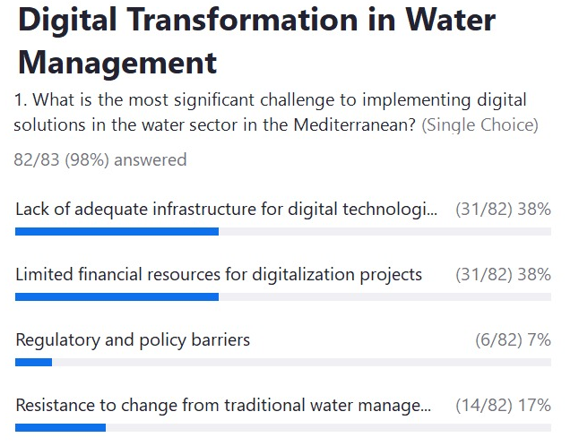
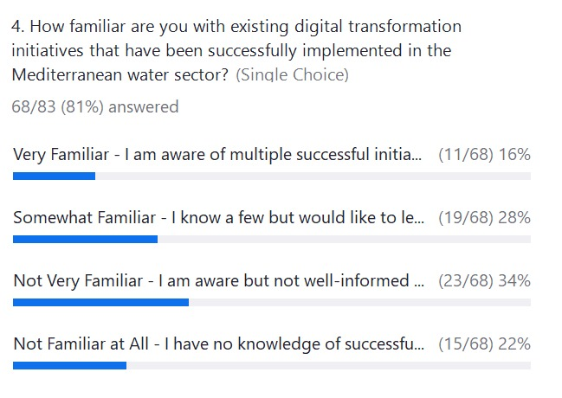
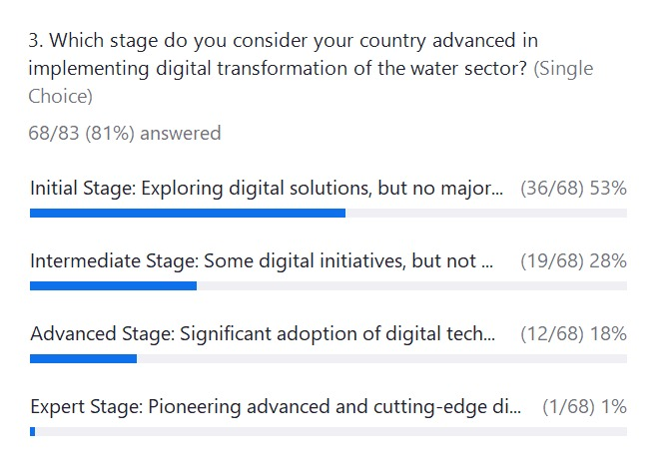
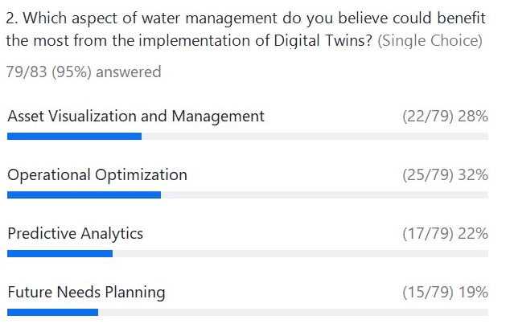
Key findings
We had a total of 178 people responded from Mediterranean countries including here Algeria, Egypt, Finland, France, Germany, Hungary, Ireland, Jordan, Lebanon, Morocco, The Netherlands, Palestine, Poland, Spain, Tunisia and Turkey.

Slide 12
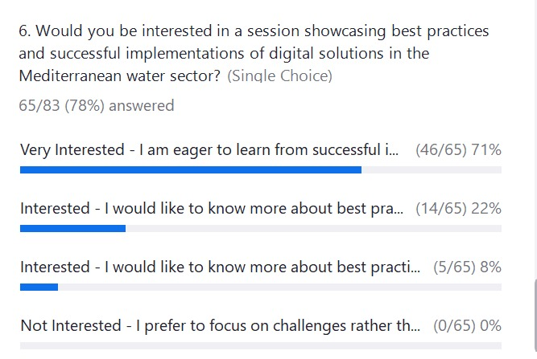
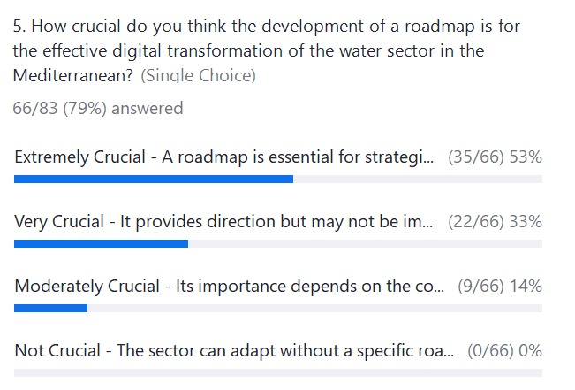
Key findings

Slide 13
Key Recommendations
1. Infrastructure Investment: Call for investment in modernizing water infrastructure to accommodate digital technologies.
1
2. Financial Support & Collaboration: Stress the importance of financial mechanisms and collaborative efforts between public and private sectors.
2
3. Policy Enhancement: Suggest developing supportive policies and regulatory frameworks to foster digitalization.
3
4. Capacity Building: Recommend establishing training programs and sharing best practices to build local capacities.
4
5. Stakeholder Engagement: Encourage active engagement of all stakeholders, including governments, NGOs, and the private sector, to ensure inclusivity and buy-in.
5
6. Implementation of Pilot Projects: Advocate for the launch of pilot projects inspired by the Spanish model, emphasizing the importance of monitoring, evaluation, and scalability.
6

Slide 14
Key messages
- Emphasize digital transformation as a key enabler for advancing the WEFE Nexus in the Mediterranean.
- Call to action for collective efforts, sharing of experiences, and strategic partnerships to leverage the full potential of digital transformation.
- Capacity Building: Invest in digital skills and training for stakeholders to ensure widespread adaptation and innovation.
- Policy Support: Develop supportive policies encouraging digital adoption for WEFE Nexus
- Scalability: Replicate successful digital projects for accelerated sustainability practices across the Mediterranean WEFE Nexus.
- Environmental Sustainability: Utilize digital tools for ecosystem protection, climate change resilience, and adaptation strategies.
- Innovative Financing: Champion creative financing models (PPP, impact investments) to foster technology deployment.
- Stakeholder Engagement: Include all relevant stakeholders in the digital transformation journey to meet diverse community needs.

Slide 15

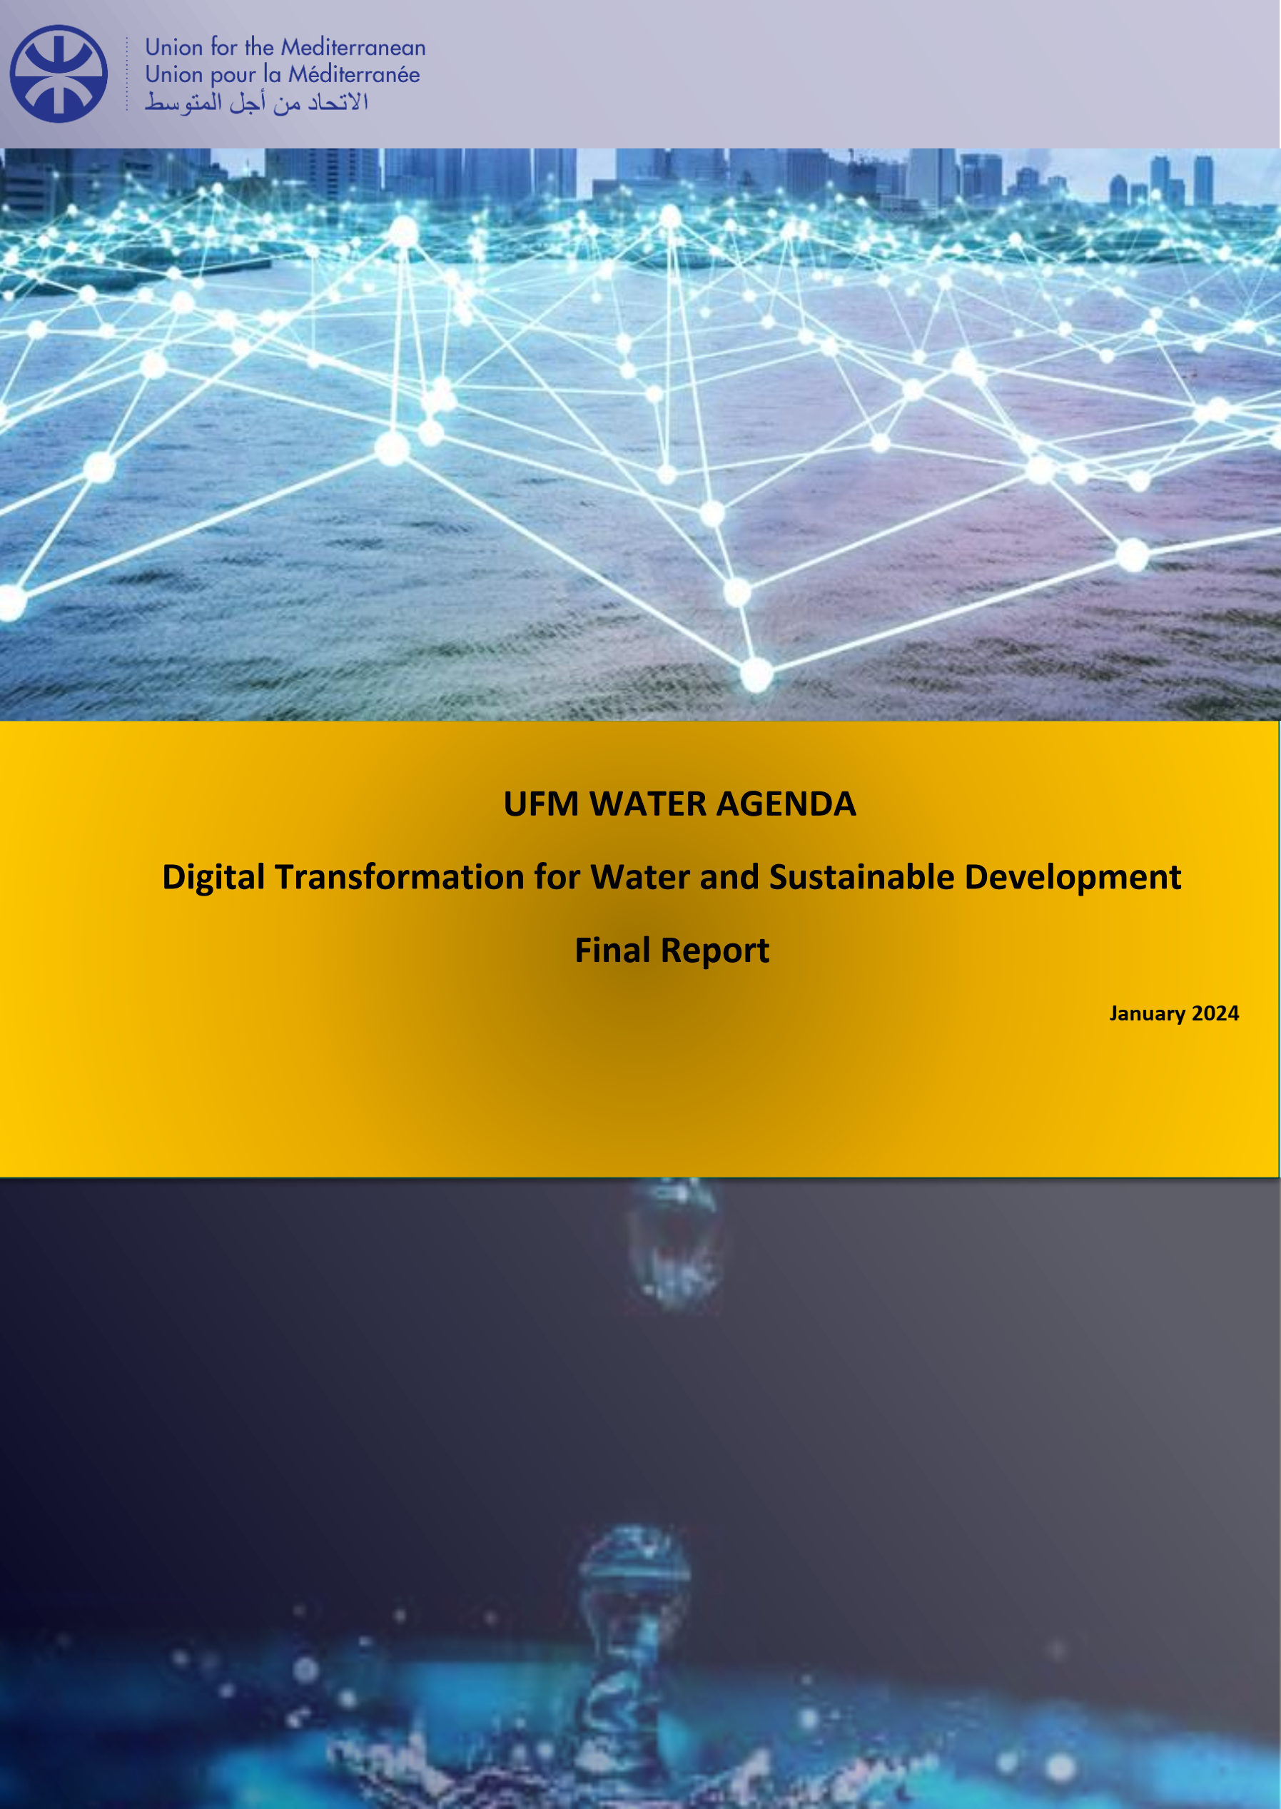

References

Slide 16


