Slide 1
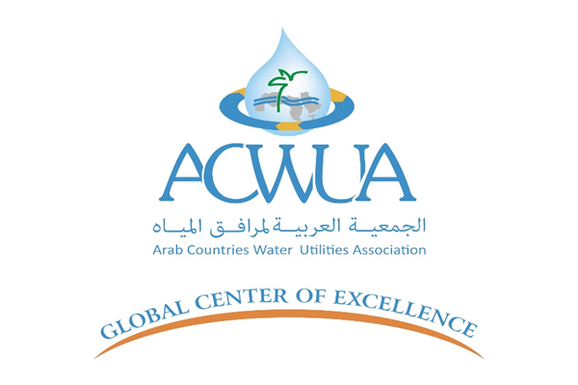


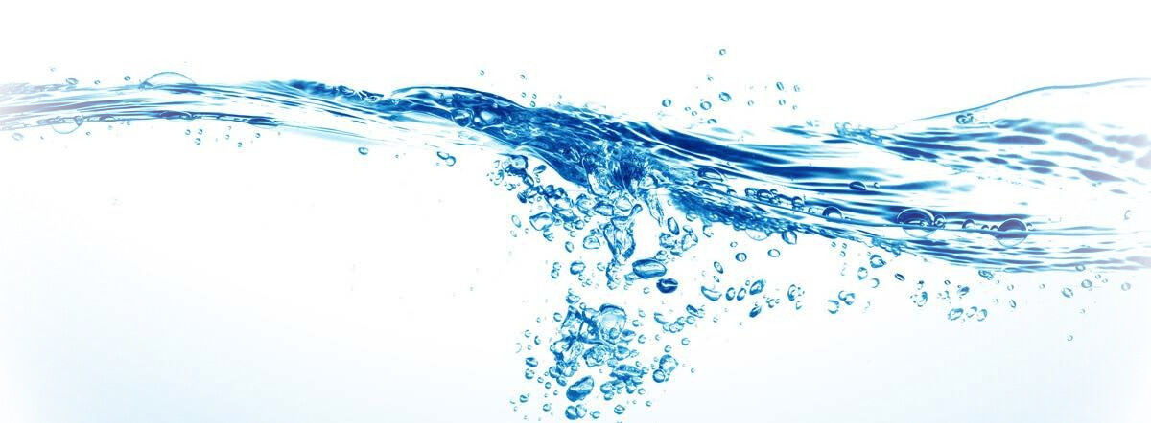
Automated Water Resource Monitoring
Hisham Maharmeh | 04.05.2025

Slide 2

Monitoring of Water Sources

Slide 3
Monitoring of Water Sources
Effective water source management requires continuous access to accurate data on both the quantity and quality of water. This information is critical for determining allowable usage and for evaluating whether current and future water needs can be sustainably met.
Monitoring involves collecting information and data at carefully selected points and at specific time intervals, in a way that reflects the current status of these sources and allows for the detection of trends and future developments.

Slide 4
Monitoring of Water Sources
Effective water source management requires continuous access to accurate data on both the quantity and quality of water. This information is critical for determining allowable usage and for evaluating whether current and future water needs can be sustainably met.
Monitoring involves collecting information and data at carefully selected points and at specific time intervals, in a way that reflects the current status of these sources and allows for the detection of trends and future developments.

Slide 5

Objectives of Water Sources Monitoring
Evaluate the available quantities of water sources for use in a given year or over time.
Clarify long-term trends in water quality changes to implement appropriate protection measures.
Identify trends in the changes in water source quantities due to climatic conditions or usage, and attempt to assess their future availability.
Detect any sudden changes in water quality, such as the presence of toxic substances.

Slide 6
Objectives of Water Sources Monitoring
Identify trends in the changes in water source quantities due to climatic conditions or usage, and attempt to assess their future availability.
Evaluate the available quantities of water sources for use in a given year or over time.
Clarify long-term trends in water quality changes to implement appropriate protection measures.
Detect any sudden changes in water quality, such as the presence of toxic substances.

Slide 7
Objectives of Water Sources Monitoring
Evaluate the available quantities of water sources for use in a given year or over time.
Identify trends in the changes in water source quantities due to climatic conditions or usage, and attempt to assess their future availability.
Clarify long-term trends in water quality changes to implement appropriate protection measures.
Detect any sudden changes in water quality, such as the presence of toxic substances.

Slide 8
Objectives of Water Sources Monitoring
Evaluate the available quantities of water sources for use in a given year or over time.
Identify trends in the changes in water source quantities due to climatic conditions or usage, and attempt to assess their future availability.
Clarify long-term trends in water quality changes to implement appropriate protection measures.
Detect any sudden changes in water quality, such as the presence of toxic substances.

Slide 9
Objectives of Water Sources Monitoring
Evaluate the available quantities of water sources for use in a given year or over time.
Identify trends in the changes in water source quantities due to climatic conditions or usage, and attempt to assess their future availability.
Clarify long-term trends in water quality changes to implement appropriate protection measures.
Detect any sudden changes in water quality, such as the presence of toxic substances.

Slide 10

Types of Water Sources Monitoring

Slide 11
Types of Water Sources Monitoring
Measuring rainfall amounts and other climatic elements.
Measuring surface water flow in rivers, valleys, and canals.
Measuring spring discharge.
Measuring inflow and outflow quantities in dams.
Measuring quantities extracted from groundwater wells.
Measuring groundwater levels and well productivity.
Monitoring water sources quality and distribution reservoirs.
Monitoring major water sources and transmission lines to protect them from vandalism.

Slide 12

Transition to Automation

Slide 13
Transition to Automation
The project of automating monitoring stations is one of the strategic projects of the Ministry of Water and Irrigation, aiming to transition from manual monitoring to modern technological monitoring through a network of stations distributed across the Kingdom.
These stations measure rainfall, and some also measure climatic elements such as evaporation, air temperature, solar radiation, and wind speed and direction. Some stations measure static water levels in wells, dam water levels, and wadi flows, which are critical inputs in water source monitoring.

Slide 14
Transition to Automation
The Ministry began transitioning to the automation system in 2010 through several projects, reaching a total of 307 automated stations distributed throughout the Kingdom.
2010
TeWaRON1 (27 Stations)
2011
BGR/ESCWA PROJECT (12)
2012
TeWaRON2 (35 Stations)
2013
TeWaRON3 (30 Stations)
2014
TeWaRON4 (25 Stations)
2015
TeWaRON5 (38 Stations)
2018
HSSP (140 Stations)
The importance of automating monitoring stations lies in expanding monitoring operations by expanding the monitoring network without manual observation, improving data quality, and providing near real-time data.

Slide 15
Transition to Automation
The Ministry began transitioning to the automation system in 2010 through several projects, reaching a total of 307 automated stations distributed throughout the Kingdom.
2010
TeWaRON1 (27 Stations)
2011
BGR/ESCWA PROJECT (12)
2012
TeWaRON2 (35 Stations)
2013
TeWaRON3 (30 Stations)
2014
TeWaRON4 (25 Stations)
2015
TeWaRON5 (38 Stations)
2018
HSSP (140 Stations)
The importance of automating monitoring stations lies in expanding monitoring operations by expanding the monitoring network without manual observation, improving data quality, and providing near real-time data.

Slide 16

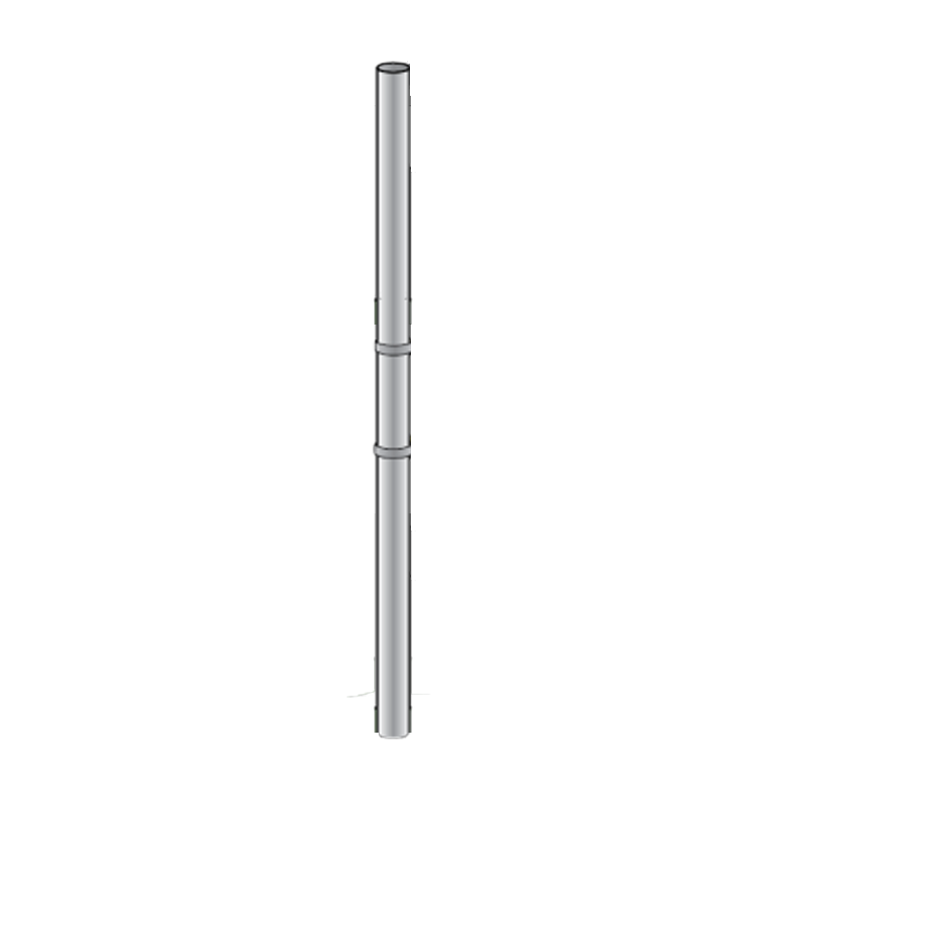
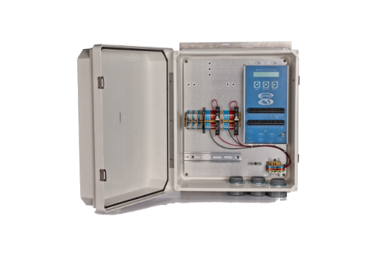
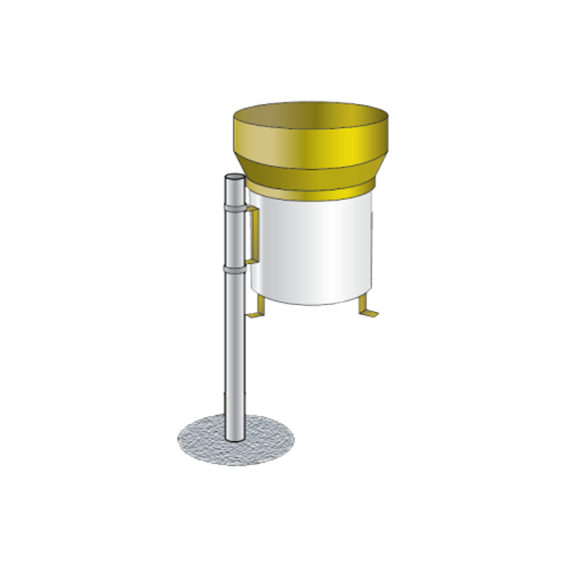

Purpose of Measurement:
One of the most important elements of the hydrological cycle for assessing annual water availability.
Determining whether a water year is dry, wet, or normal.
Estimating groundwater recharge and surface runoff.
Supporting drought and climate change studies.
Rainfall intensity data are important for flood studies and designing infrastructure.
Rainfall Quantity and Intensity Measurement

Slide 17
Types of Measuring Stations:
Manual stations measured daily at the same time.
Semi-automatic stations that store data graphically (rainfall intensity).
Cumulative stations that collect annual rainfall quantities.
Telemetry stations that measure rainfall quantities in real time or at set intervals, with programmable functions, remote data transmission, and electronic storage.
Groundwater Surface Level Measurement
Rainfall Quantity and Intensity Measurement
Purpose of Measurement:
One of the most important elements of the hydrological cycle for assessing annual water availability.
Determining whether a water year is dry, wet, or normal.
Estimating groundwater recharge and surface runoff.
Supporting drought and climate change studies.
Rainfall intensity data are important for flood studies and designing infrastructure.

Slide 18
Groundwater Surface Level Measurement
Rainfall Quantity and Intensity Measurement
Types of Measuring Stations:
Manual stations measured daily at the same time.
Semi-automatic stations that store data graphically (rainfall intensity).
Cumulative stations that collect annual rainfall quantities.
Telemetry stations that measure rainfall quantities in real time or at set intervals, with programmable functions, remote data transmission, and electronic storage.
Purpose of Measurement:
One of the most important elements of the hydrological cycle for assessing annual water availability.
Determining whether a water year is dry, wet, or normal.
Estimating groundwater recharge and surface runoff.
Supporting drought and climate change studies.
Rainfall intensity data are important for flood studies and designing infrastructure.

Slide 19
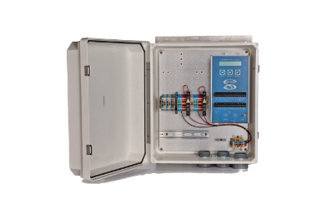
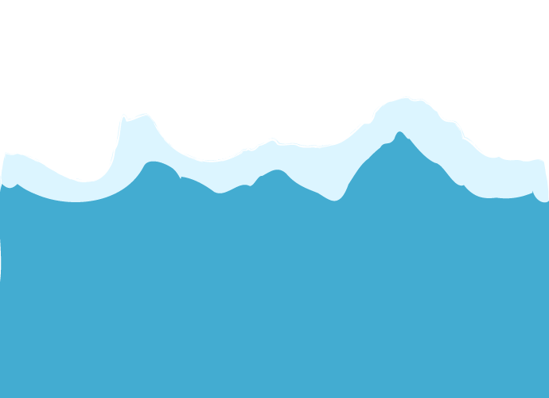
Groundwater levels in monitoring wells are measured to indicate the thickness of the saturated zone.
This measurement is essential to understand groundwater movement directions.
Measuring groundwater levels in production wells is important to determine the optimal pump depth.
Groundwater level measurements are crucial for groundwater exploration and for determining productivity and pumping costs.
Measurements are carried out using semi-automatic recorders, water level indicators (e.g., AmScope), telemetry recorders, or television inspection.
Types of Measuring Stations:
Manual stations measured daily at the same time.
Semi-automatic stations that store data graphically (rainfall intensity).
Cumulative stations that collect annual rainfall quantities.
Telemetry stations that measure rainfall quantities in real time or at set intervals, with programmable functions, remote data transmission, and electronic storage.
Groundwater Surface Level Measurement
WELL
AB1234
WELL
AB1234

Slide 20
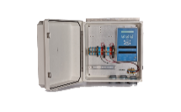
Climatic Elements Measurement
Groundwater Surface Level Measurement
Groundwater levels in monitoring wells are measured to indicate the thickness of the saturated zone.
This measurement is essential to understand groundwater movement directions.
Measuring groundwater levels in production wells is important to determine the optimal pump depth.
Groundwater level measurements are crucial for groundwater exploration and for determining productivity and pumping costs.
Measurements are carried out using semi-automatic recorders, water level indicators (e.g., AmScope), telemetry recorders, or television inspection.
WELL
AB1234
WELL
AB1234

Slide 21
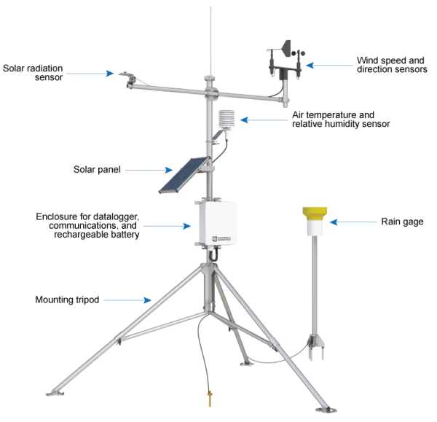
Meteorological stations measure key climate elements like maximum and minimum temperatures, relative humidity, wind speed, solar radiation, sunshine hours, and evaporation.
These elements are necessary for evaluating evaporation and transpiration losses from rainfall.
Stations are categorized based on technology used into manual, semi-automatic, and telemetry stations.
Manual stations require on-site personnel to read data; semi-automatic stations store data internally; telemetry stations store and transmit data remotely.
Groundwater Surface Level Measurement
Climatic Elements Measurement
يقاس سطح المياه الجوفية في ابار المراقبة ليعطي مؤشراً على سماكة الطبقة المشبعة المتبقية
هذا القياس مهم لمعرفة اتجاه حركة المياه الجوفية
قياس سطح المياه الجوفية في الابار المنتجة مهم لمعرفة العمق المناسب للمضخة
قياس سطح المياه الجوفية ضروري لعملية التنقيب عن المياه الجوفية وتحديد الإنتاجية وكلف الضخ.
يقاس سطح المياه الجوفية من خلال مسجلات شبه اوتوماتيكية و جهاز قياس سطح الماء (أمسكوب) و المسجلات التلمترية أو التصوير التلفزيوني.

Slide 22
Surface Runoff Measurement
Climatic Elements Measurement
Meteorological stations measure key climate elements like maximum and minimum temperatures, relative humidity, wind speed, solar radiation, sunshine hours, and evaporation.
These elements are necessary for evaluating evaporation and transpiration losses from rainfall.
Stations are categorized based on technology used into manual, semi-automatic, and telemetry stations.
Manual stations require on-site personnel to read data; semi-automatic stations store data internally; telemetry stations store and transmit data remotely.

Slide 23
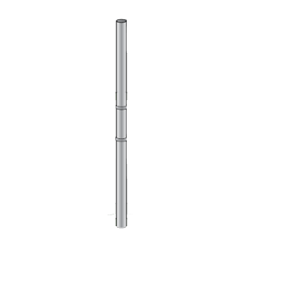
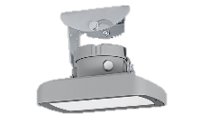



Measuring surface runoff in rivers and valleys is essential as it represents the main source of surface water and a component of the hydrological cycle.
Runoff in rivers and valleys is divided into baseflow and flood flows.
Measuring these quantities is crucial for understanding inflow to and outflow from dams, and therefore, for surface water availability assessments.
Measurements can be made using either fixed or mobile stations.
Climatic Elements Measurement
Surface Runoff Measurement
تقيس المحطات المناخية بعض اهم عناصر المناخ مثل درجات الحرارة القصوى والدنيا، الرطوبة النسبية، سرعة الرياح، الاشعاع الشمسي وساعات سطوع الشمس، والتبخر.
هذه العناصر ضرورية لتقييم كميات النتح والتبخر من الأمطار وبالتالي معرفة الفاقد منها.
تقسم هذه المحطات بحسب التكنولوجيا المستخدمة الى محطات يدوية وشبه اوتوماتيكية وتيليمترية
المحطات اليدوية يجب قراءة البيانات فيها من خلال موظف مقيم في المحطة اما شبه الاوتوماتيكية فيمكنها تخزين البيانات داخل وحدة تخزين بينما التلمترية تخزن وترسل البيانات عن بعد.

Slide 24

Measuring Water Levels in Dams
Surface Runoff Measurement
Measuring surface runoff in rivers and valleys is essential as it represents the main source of surface water and a component of the hydrological cycle.
Runoff in rivers and valleys is divided into baseflow and flood flows.
Measuring these quantities is crucial for understanding inflow to and outflow from dams, and therefore, for surface water availability assessments.
Measurements can be made using either fixed or mobile stations.

Slide 25
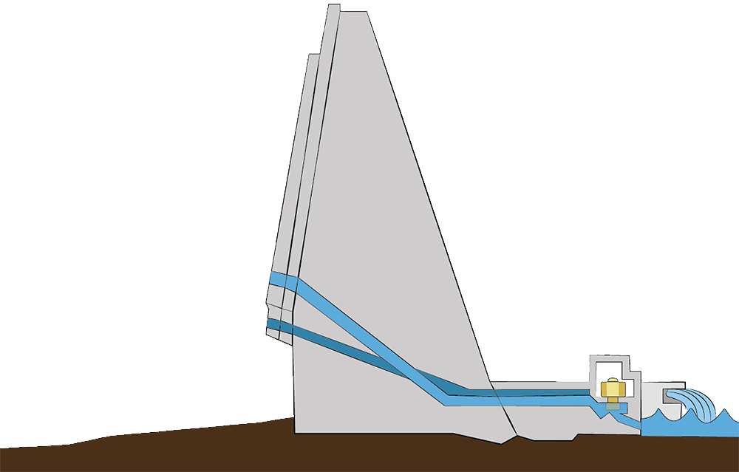
Measuring Water Levels in Dams
Measuring surface runoff in rivers and valleys is essential as it represents the main source of surface water and a component of the hydrological cycle.
Runoff in rivers and valleys is divided into baseflow and flood flows.
Measuring these quantities is crucial for understanding inflow to and outflow from dams, and therefore, for surface water availability assessments.
Measurements can be made using either fixed or mobile stations.
Dam water level measurements are critical for managing the dam in relation to water needs and flood control.
Each dam must have a water balance that shows inflows from valleys and rainfall and outflows through spillways, evaporation, seepage, and groundwater recharge.
Dams typically have curves showing the relationship between water elevation and storage volume.
Inflows are measured using river and valley measurement methods and are compared with the dam's water level, indicated by a graduated gauge installed at each dam (automated system implemented).
Outflows are measured similarly, using spillways or dam gates.
Typically, a weather station is installed near each dam to measure evaporation and rainfall.

Slide 26
Measuring Water Levels in Dams
Dam water level measurements are critical for managing the dam in relation to water needs and flood control.
Each dam must have a water balance that shows inflows from valleys and rainfall and outflows through spillways, evaporation, seepage, and groundwater recharge.
Dams typically have curves showing the relationship between water elevation and storage volume.
Inflows are measured using river and valley measurement methods and are compared with the dam's water level, indicated by a graduated gauge installed at each dam (automated system implemented).
Outflows are measured similarly, using spillways or dam gates.
Typically, a weather station is installed near each dam to measure evaporation and rainfall.

Slide 27
Dam water level measurements are critical for managing the dam in relation to water needs and flood control.
Each dam must have a water balance that shows inflows from valleys and rainfall and outflows through spillways, evaporation, seepage, and groundwater recharge.
Dams typically have curves showing the relationship between water elevation and storage volume.
Inflows are measured using river and valley measurement methods and are compared with the dam's water level, indicated by a graduated gauge installed at each dam (automated system implemented).
Outflows are measured similarly, using spillways or dam gates.
Typically, a weather station is installed near each dam to measure evaporation and rainfall.
Measuring Water Levels in Dams

Slide 28

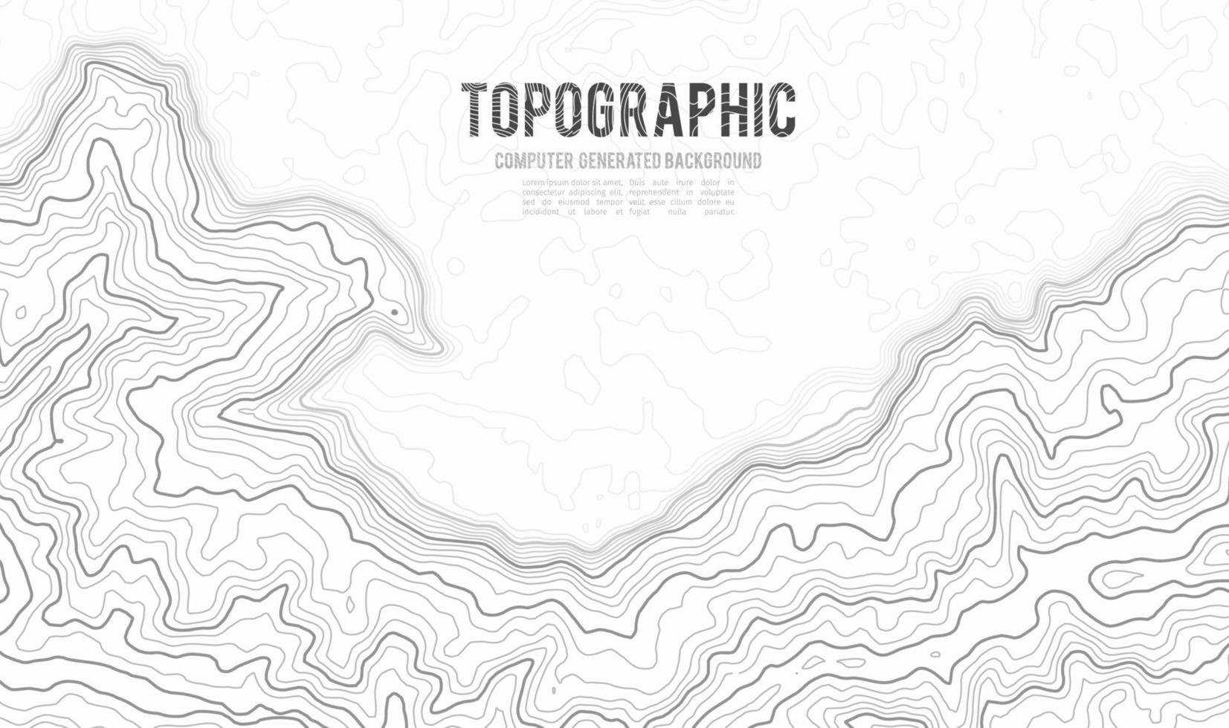
Stations Distribution Across the Kingdom

Slide 29
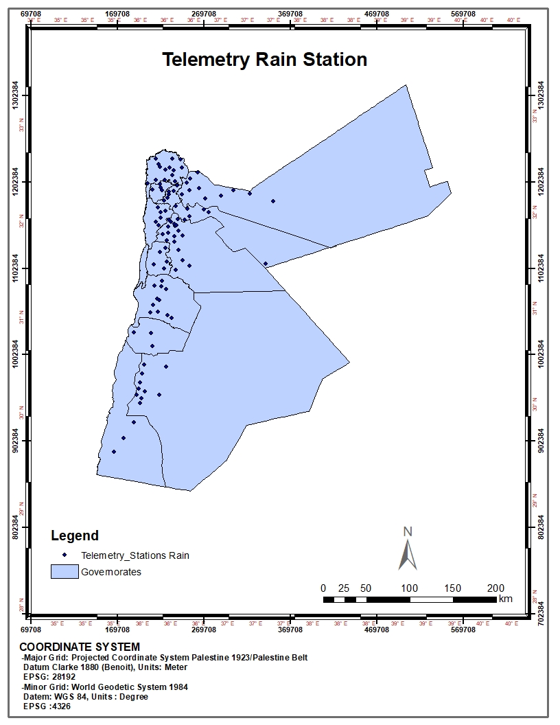
01

Slide 30
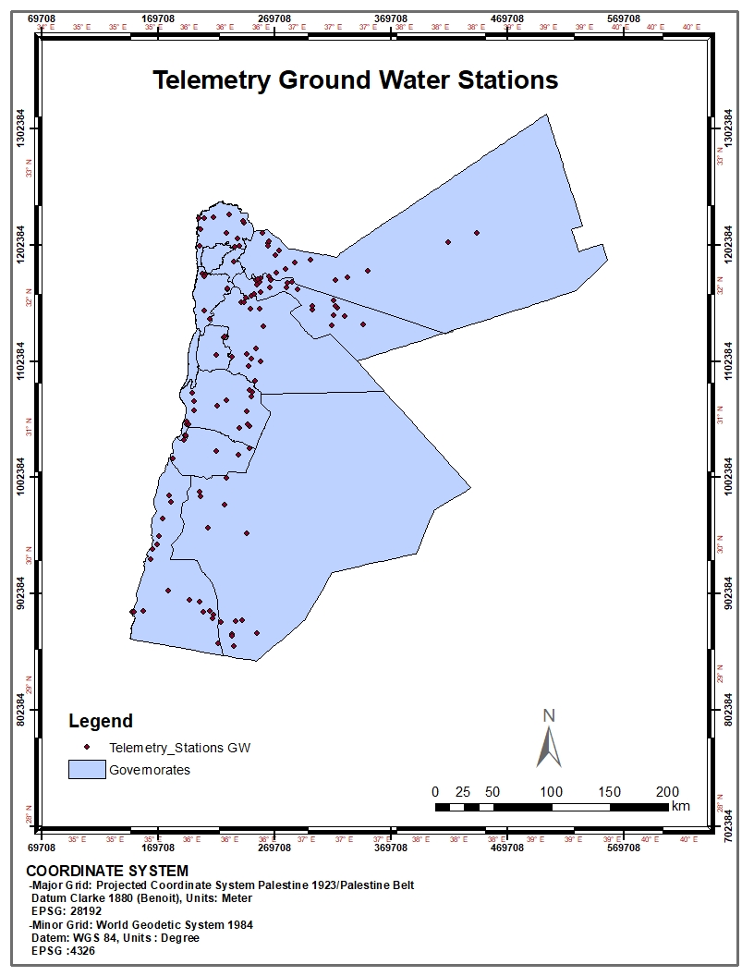
02

Slide 31
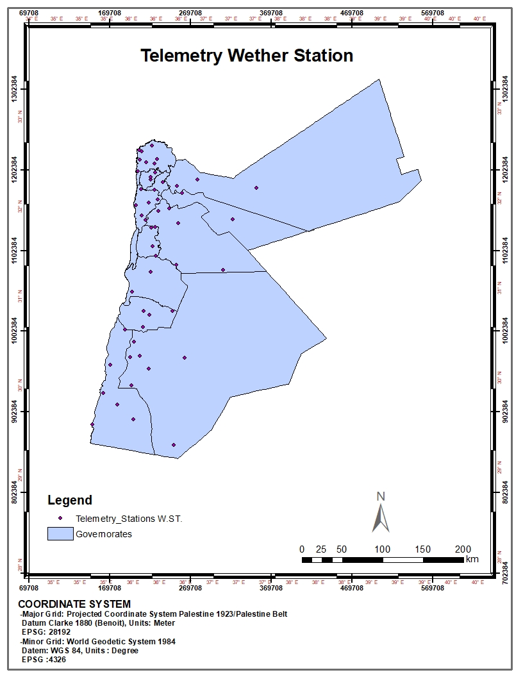
03

Slide 32
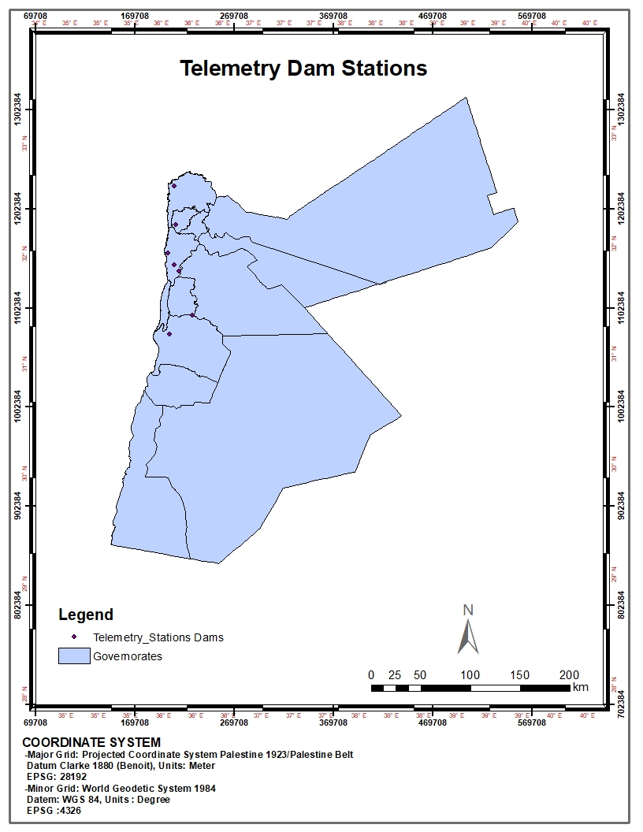
04

Slide 33

05

Slide 34

Data

Slide 35
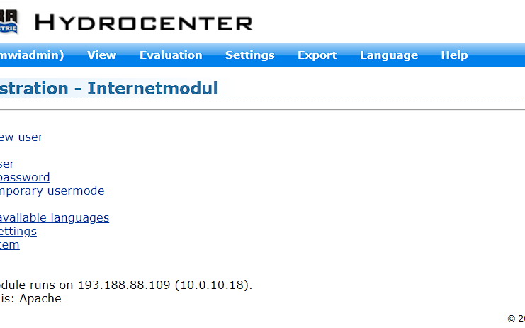
HYDROCENTER

Slide 36

Thank You
Hisham AlMaharmeh
hesham_Almaharmeh@mwi.gov.jo

