Slide 1


Establishment of the ARAB Water Regulatory Forum/Association
Roadmap; Opportunities and Challenges
Mohammad Said Al Hmaidi,
Water Sector Regulatory Council, Palestine

Slide 2
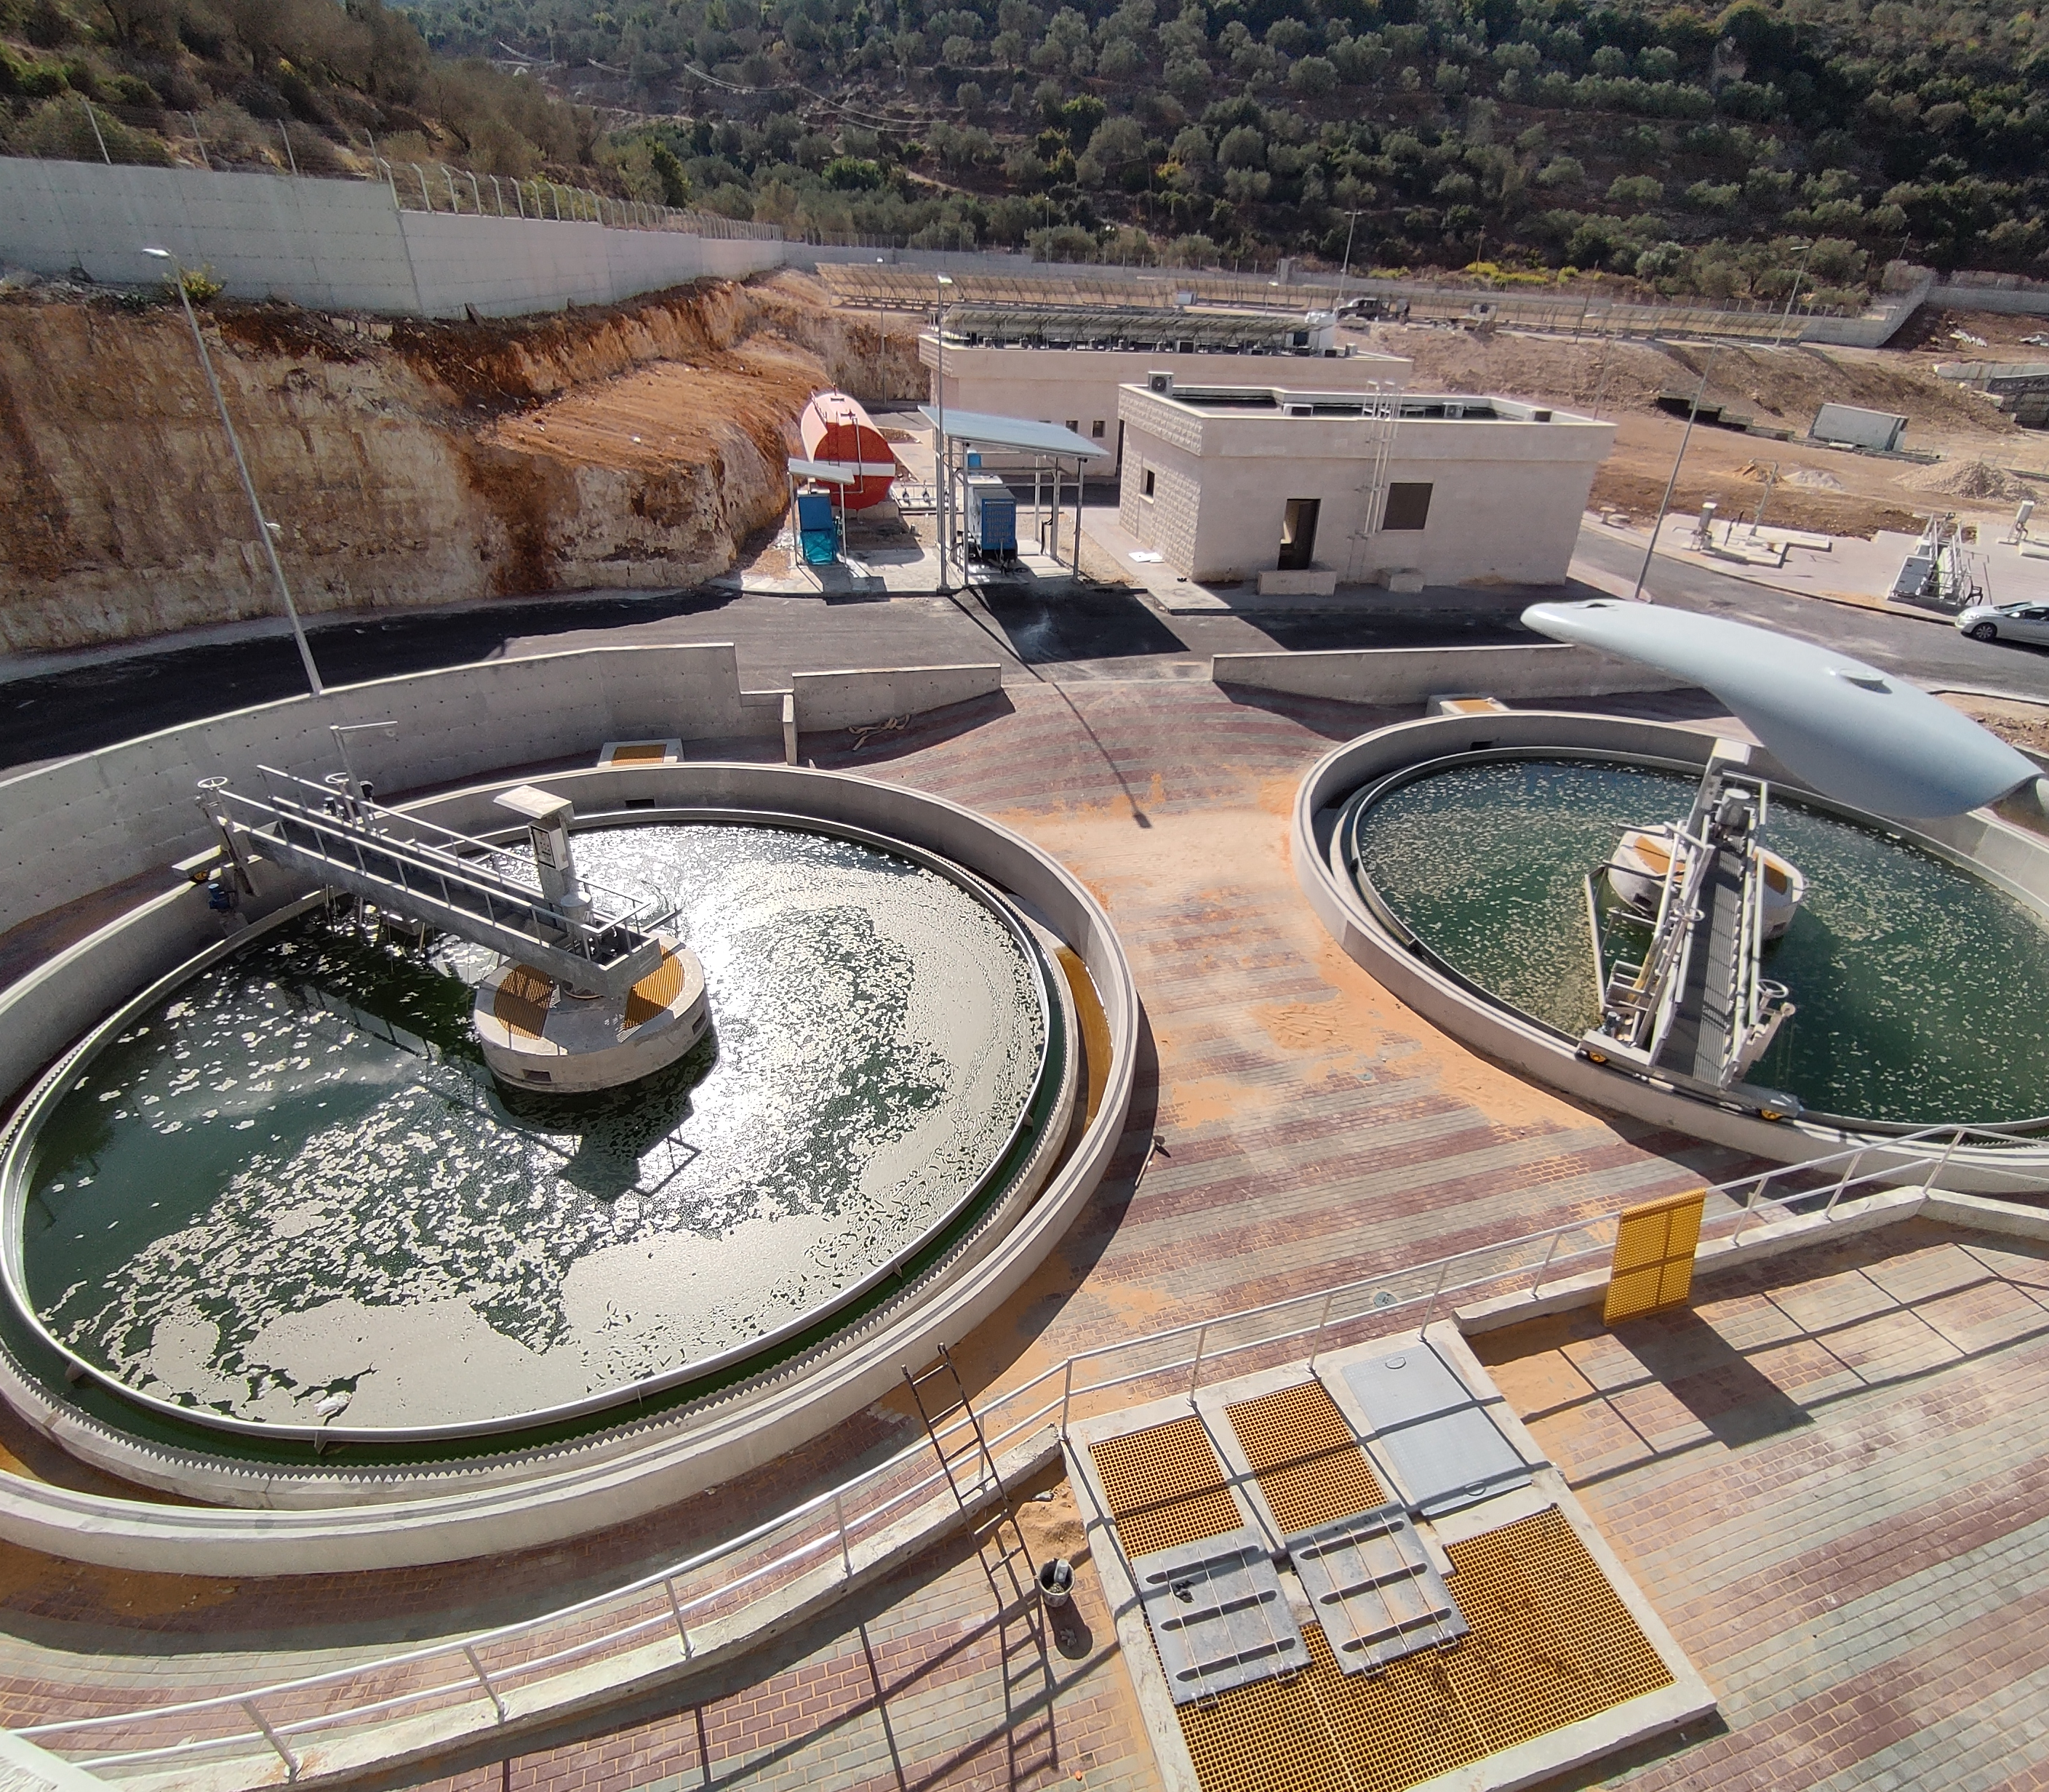
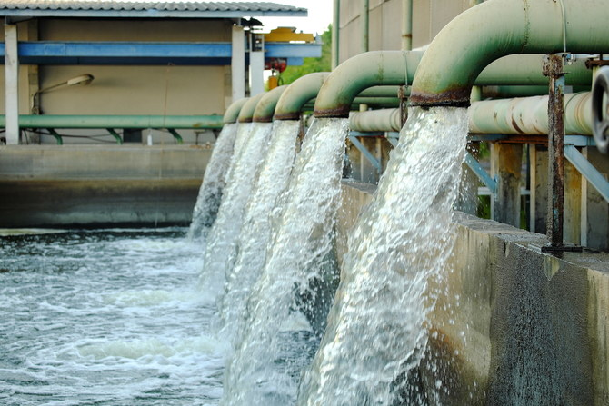
Outline
Overview of water and sanitation regulatory entities in the region
Rationale for eestablishment of the ARAB Water Regulatory Forum/Association
Envisioned goal and objectives
Envisioned outcomes
Composition proposal
Timeline and next steps
Questions for feedback / discussion

Slide 3
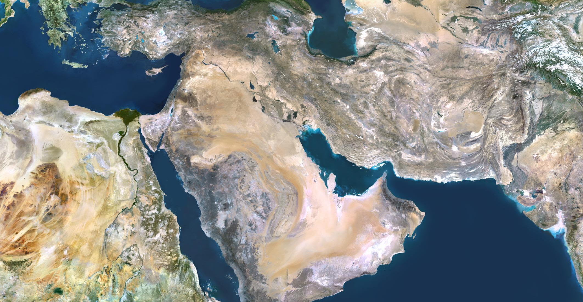
Water and sanitation regulatory entities in the region
So far, few Arab Countries have established Regulatory entities including:
Oman
Palestine
Jordan (under establishment)
EUA-Abu Dhabi,
Egypt
KSA

Slide 4

World -Wide Regional Regulators
ESAWAS: The Eastern and Southern Africa Water and Sanitation Regulators Association
WAREG: Europe
ADERASA:Latin America and the Caribbean
Danube water regulators
Network of Asia Regulators

Slide 5

Rationale
The Arab world is facing a number of challenges in the water and sanitation sector, most are common. These include:
On average, water availability is around six times less than the worldwide average.
Most MENA countries cannot sustainably meet their current water demand.
In many MENA countries, 85% of water is consumed by the agriculture sector.
Climate change is expected to bring an expected 20% reduction in rainfall and higher rates of evaporation that will make water scarcer.
Inadequately governed water resources management. With limited resources protection.
Aggressive competition from alternative providers (e.g., tanker trucks), undermining network services.
Paralysis of high-tech wastewater treatment plants.
Energy shortages and escalating energy costs of off grid generation.
Inefficient tariff structures, Low-cost recovery, limited ring fencing.
Tensions between communities.
Why is an ARAB Water Regulatory Forum/Association needed?
What are the main regulatory issues that the region is facing?

Slide 6
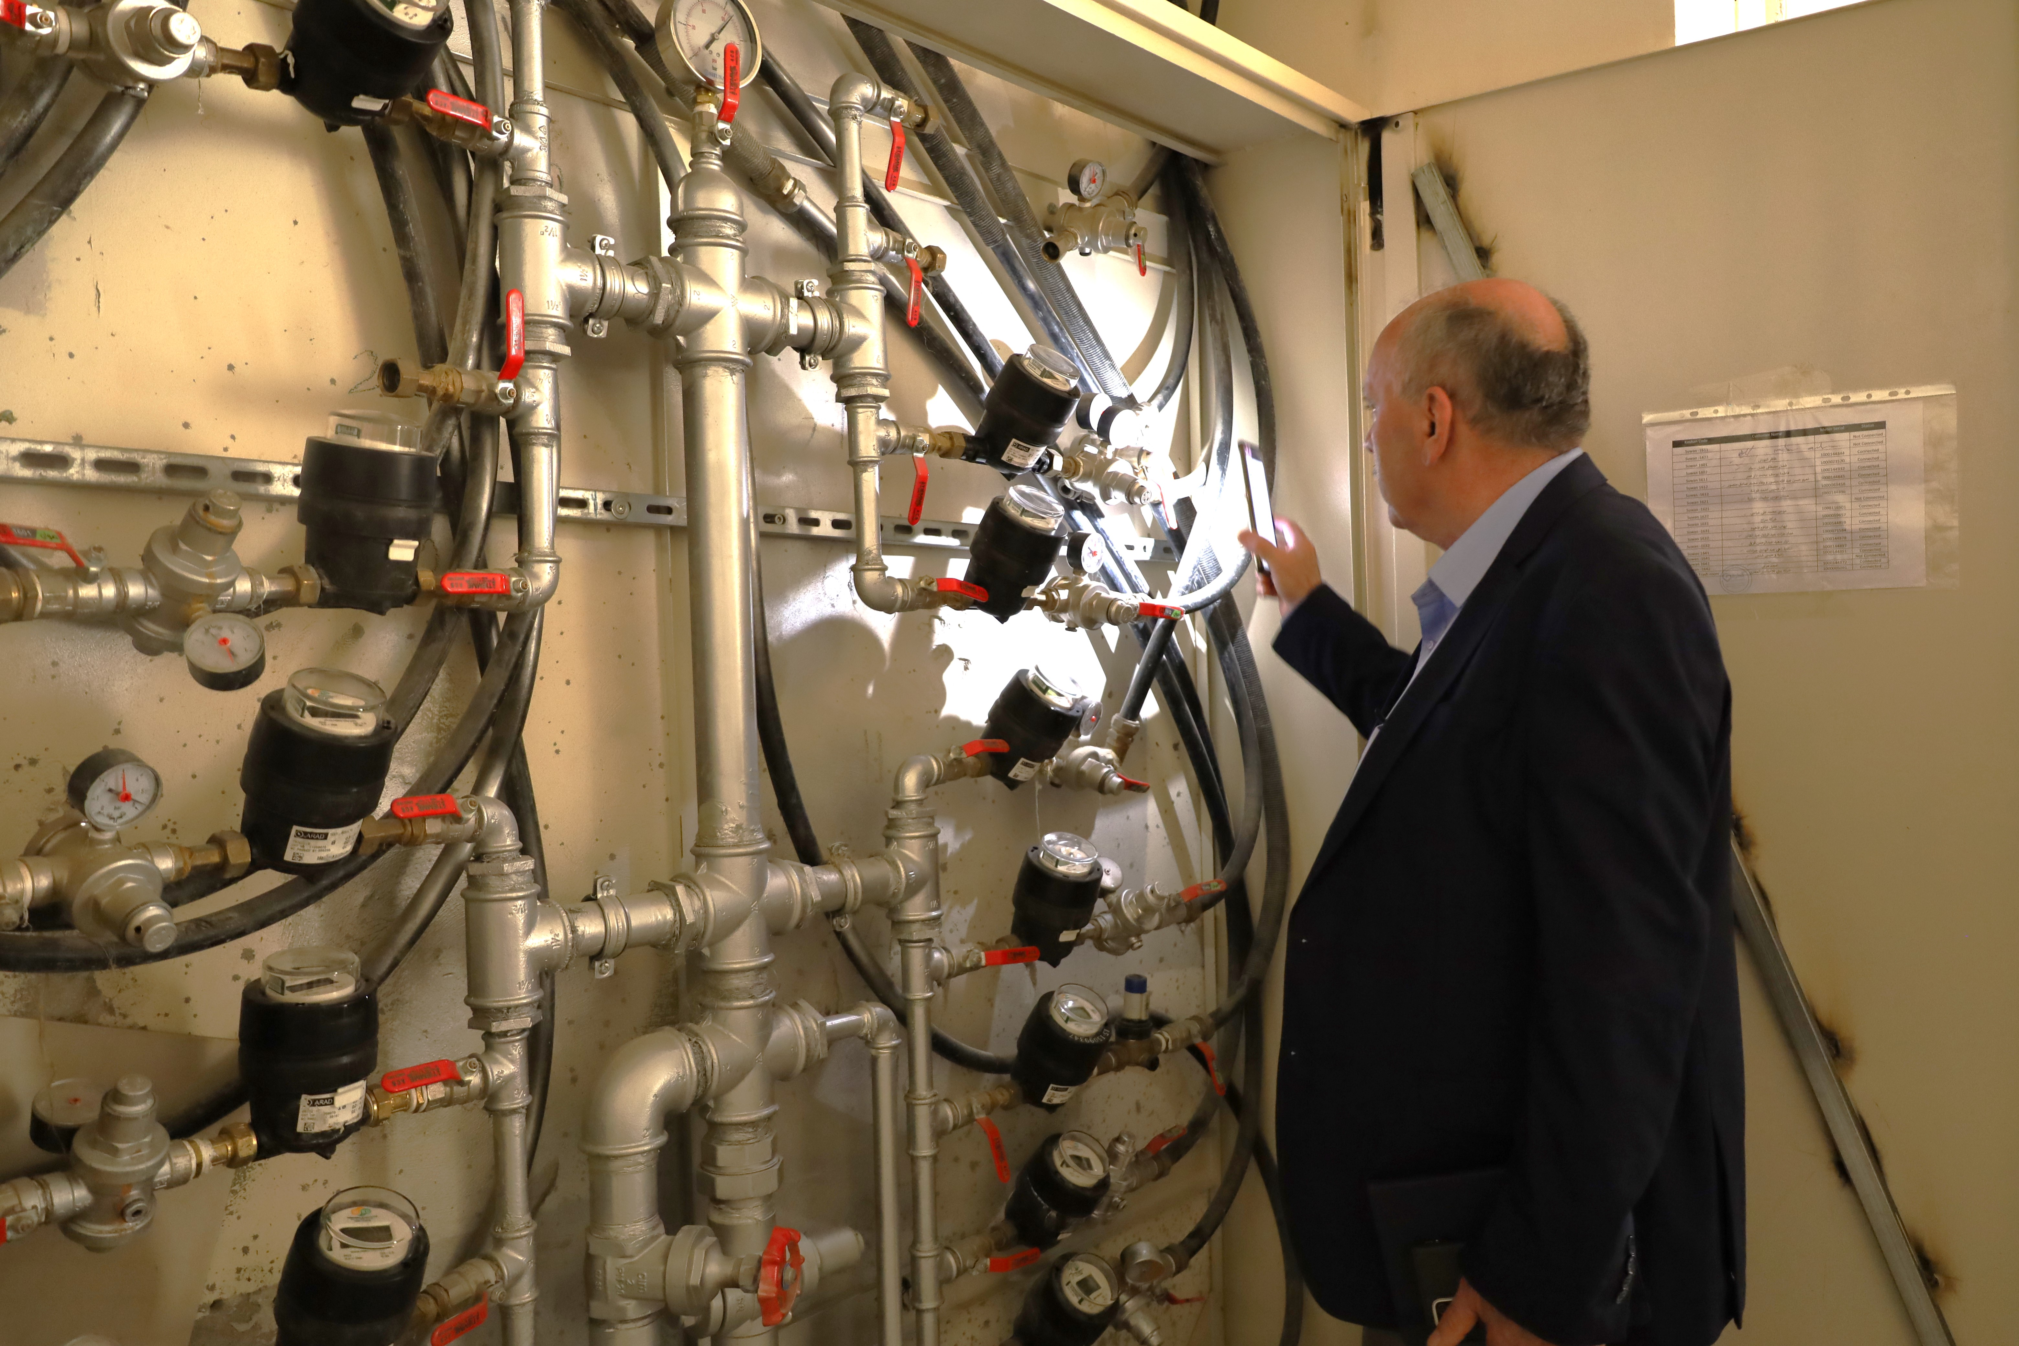
Rational:
Why is an ARAB Water Regulatory Forum/Association?
Brain drains and insecure access for staff.
Growing urban populations and increasing water demands.
High levels of non-revenue water.
Little or no infrastructure investment.
Limited adherence to governance principles.
Limited accurate, reliable, and continuous data.
Limited services targets, benchmarking reporting or operational inspections.
Destruction of infrastructure.
Mass movements of people.
Deteriorated water quality
Limited fee collection,
6

Slide 7
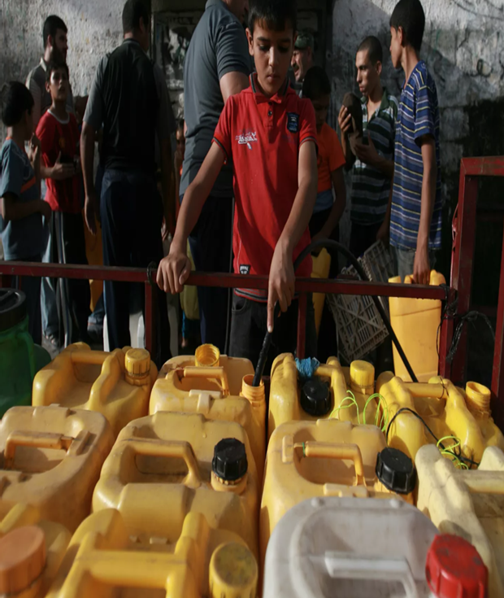
Rational:
Why Regulators?
Regulators are to monitor all matters related to the operation of water Service Providers including production, transportation distribution, consumption and wastewater management, with the aim of ensuring water and waste water service quality and efficiency to consumers at an affordable prices

Slide 8
Goal and objectives
Goal
Objectives
What are the objectives of the Forum/Association?
Building Arab capacity in the regulation of water and sanitation services
Establishing an Arab database on operational processes, and enhance data exchange
Identify and promote the adoption of best practices.
Standardize monitoring principles and standards if possible.
Standardization of KPIs for measurements and assessments among members.
Develop training manuals.
To enhance the use of regulatory data to complement household National Statistics survey data
To support Regulators to play a supportive role in working with service providers to help to achieve the SDGs.
What is the goal of the Forum/Association:
To strengthen bilateral and multilateral cooperation among water sector regulators in the Arab region aiming at enhancement of services efficiencies to the population at an acceptable quality and affordable prices.

Slide 9

Outcomes
What are the expected outcomes from the establishment of the Forum/Association?
Checklist of performance indicators
Checklist of operational process monitoring indicators
Checklist of indicators related to compliance with governance rules in water services
Performance Measurement Mechanism
Water Tariff Review Mechanisms
Mechanisms for setting annual goals for water services
Mechanisms of comparison in performance within the same country and between countries
Training Materials
Database
Annual report on the performance of service providers in the Arab world

Slide 10

Composition Proposal
All Arab countries are members of the Forum/Association general assembly through their regulatory bodies
General assembly membership is open to observers
A board of five members will be elected from the general assembly members including Arab League representative.

Slide 11
Next steps and timeline (draft, for discussion only)
2025
Month 1
Month 3
Month 6
Month 8
Month 12
Road Map
Presentation of 7th the concept to the 7th Arab Water Week and ACWUA GA and Board including objectives, establishment plan, proposed governance , and estimated budget including proposed financial sustainability plan.
Dissemination of concept note and first committee meeting to distribute work and tasks among members
Establishment body is announced.
This will be engaged in the preparation of the internal bylaws, governance tools, initial information collection
communication and coordination plans
Establish technical committees and Start the technical operations process
have the first Board meeting for preparation review and presentation of continuation plan

Slide 12

Proposed Governance structure
(Establishment Phase):
ACWUA GA approves the announcement and authorize the BOD to nominate the foundation committee.
The committee represents 5-7 Board members from within ACWUA Board and others,
The establishment committee works for a period up to 2 years, then calls for a GA meeting and an election of the Boards
All Arab countries are invited to join the GA,

Slide 13
Establishment committee initial works:
Start farther consultation with all Arab Countries, Including existing national regulators
Agree on forum official name and logo (Branding)
Suggest and propose a work plan for the two years
Suggest membership and approval mechanisms
Suggest a financial sustainability plan
Agree on future forum mission, vision ,objectives, structure, and mandate
Suggest meetings frequency and periodicity.
Discuss and suggest the legal status and draft foundational documents:
  Charter or constitution
  Internal Bylaws
  Memorandum of Understanding (MoU) among member states/regulators
  Internal technical committees.

Slide 14

Questions for feedback / discussion
What are the challenges being faced in similar establishments?
What financial sustainability plan was adopted?
Would a slim and smart body work?

Slide 15
Thank you
For more information, please contact:
Name: Mohammad Said Al Hmaidi
Title: Chief Executive Officer, CEO,
Email: mohd.hmaidi@wsrc.ps
Info@wsrc.ps
This presentation has been designed to be ACCESSIBLE, for a positive and inclusive user experience for all.

