Slide 1








Bridging Science and Cooperation for Efficient Wastewater Management: Collaboration by Aqaba Water, Columbia University, and GIZ
Enhancing Wastewater Treatment through Science-Based Approaches
Arab Water Week
Kartik Chandran, Columbia University April 4th, 2025

Slide 2
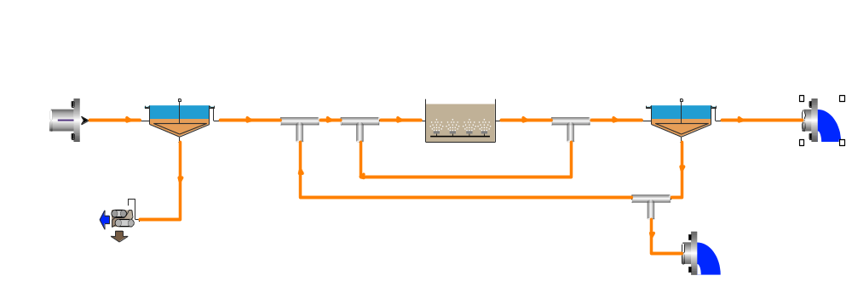
Motivation: Facilitate wastewater utilities to address more complex and challenging demands
Domestic
C, N, P
Regulations on tCOD
Industrial
SOC, M^{n+}
System
insults
Regulations on on tCOD,
t-N, t-P, SOC, M^{n+}
Current objectives require removal of more & specific individual components with greater reliability & predictability

Slide 3
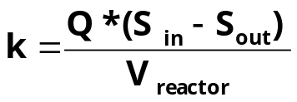
Evolution in characterization of biochemical waste treatment processes
Composition (Structure) + Activity (Biokinetic)
Domestic
C, N, P
Increased structure
Reqs. on tCOD
Effluent
Influent
WWTP Model
Industrial
SOC, M^{n+}
Reqs. on tCOD,
t-N, t-P, SOCs
IAWQ-1
IAWQ-2
IAWQ-3
X_{nitrosomonas}
X_{nitrobacter}
X_{PAO}
X_{archaea} ...

Slide 4
Proposed Project Outcomes
  Contribute to the protection of the surrounding environment, especially the marine environment, and enable commitment to the policy Zero Discharge to the Aqaba Gulf signed by the Jordanian government.
  Enhance the plant process performance, operational stability and cost efficiency by evaluating the impact of different operating conditions, wastewater streams or pre-processing strategies.
    Enable a fast response to adjust the treatment plant processes and prevent disruption of treatment operations
    Determine the source of the non-compliant discharge through a chemical analysis in the treatment plant laboratory.
    Prevent manhole flooding of the main sewer line in public areas and enhance sewer preventive maintenance planning.

Slide 5
Optimizing the operations of the aqaba wastewater treatment system
Proposed Study

Slide 6
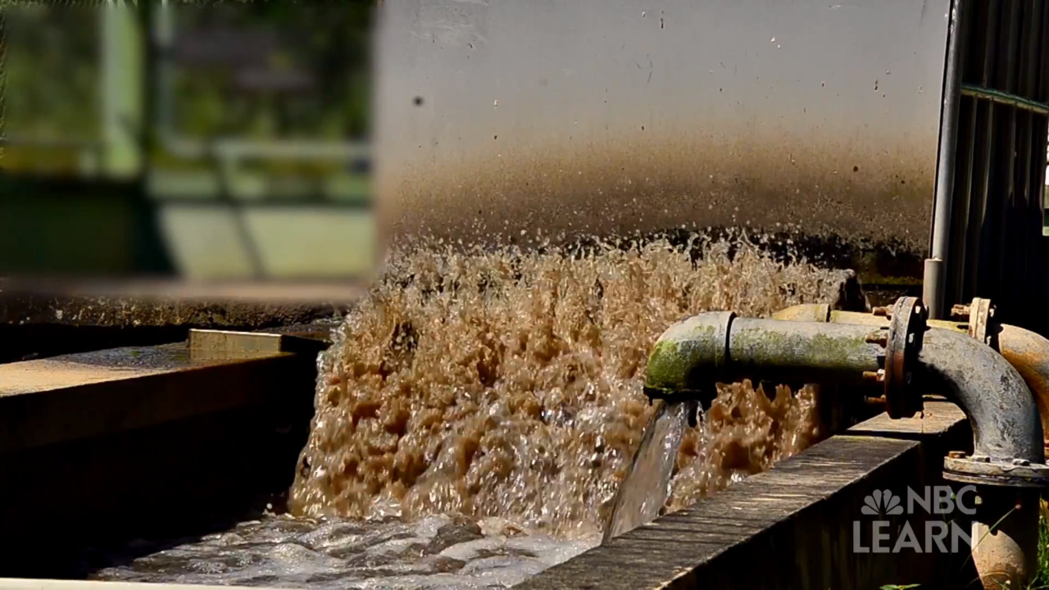
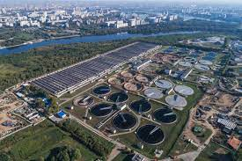

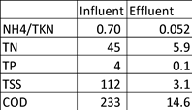
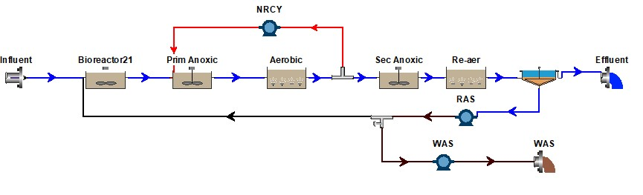
Overall approach
Step 1: Create a digital model of the Aqaba wastewater treatment and conveyance systems
Step 2: Calibrate the model by matching measured and simulated process data
Step 2: Using the calibrated configuration, simulate different scenarios to achieve discharge standards while
  Minimizing operating energy
  Minimizing the potential impacts of industrial contributions
  Other emerging considerations of importance to AW
Aim to build in-house capacity at Aqaba Water on modeling-based process analysis
Notes:
Show aerial image to Biowin

Slide 7
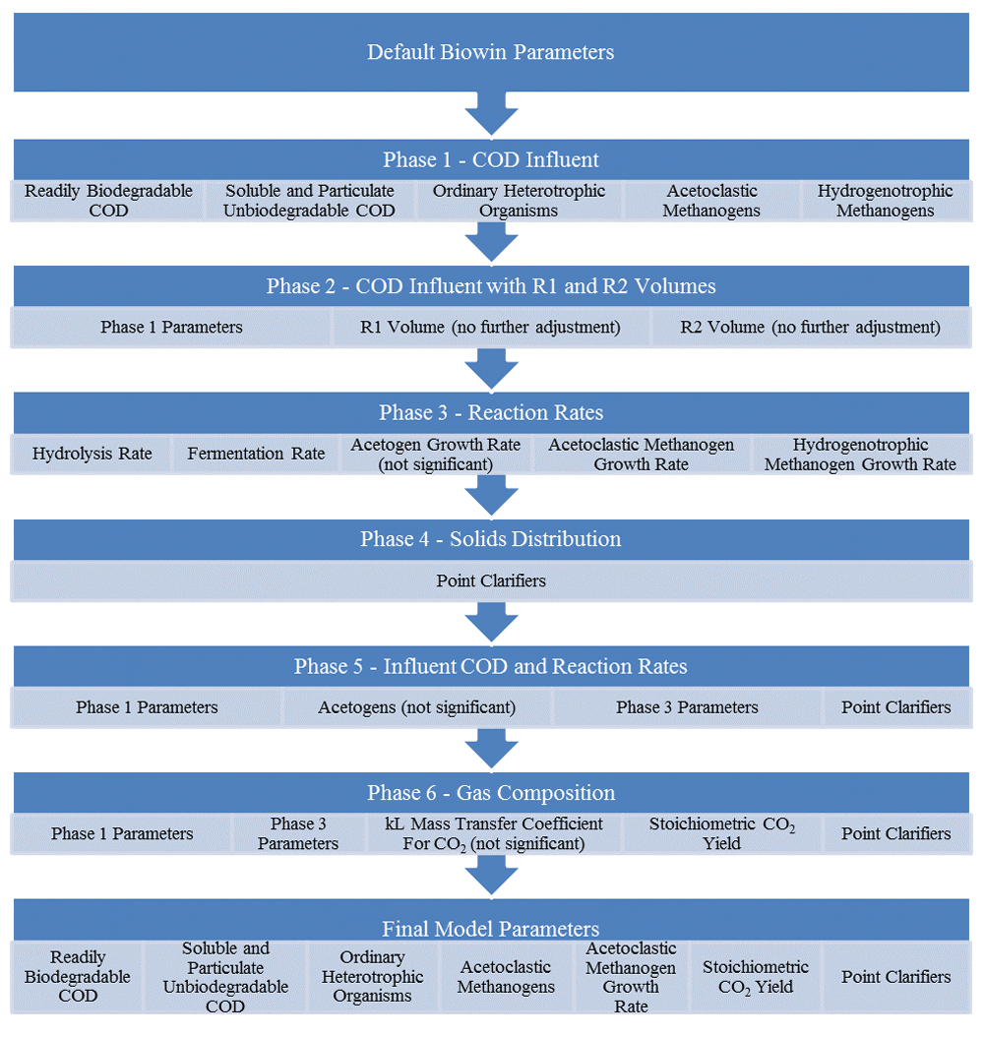
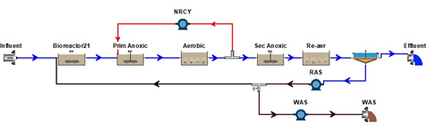
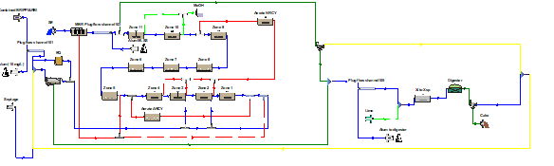
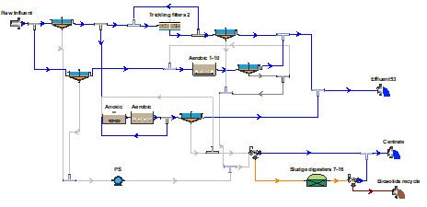
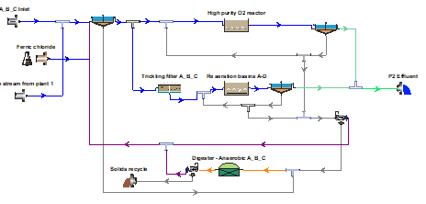
Similar related work
Model development and calibration
BNR
MBR
Water Reuse 1
Water Reuse 2
Shih J, Fanyin-Martin A, Taher E and Chandran K. Implementation and process analysis of pilot scale multi-phase anaerobic fermentation and digestion of faecal sludge in Ghana [version 1]. Gates Open Res 2017, 1:10 (doi: 10.12688/gatesopenres.12754.1)
Notes:
Figure 2. Model development chronology.
COD, chemical oxygen demand.
Shih J, Fanyin-Martin A, Taher E and Chandran K. Implementation and process analysis of pilot scale multi-phase anaerobic fermentation and digestion of faecal sludge in Ghana [version 1]. Gates Open Res 2017, 1:10 (doi: 10.12688/gatesopenres.12754.1)

Slide 8
Upgrading Wastewater treatment to BNR operations in NYC
Case Study I

Slide 9
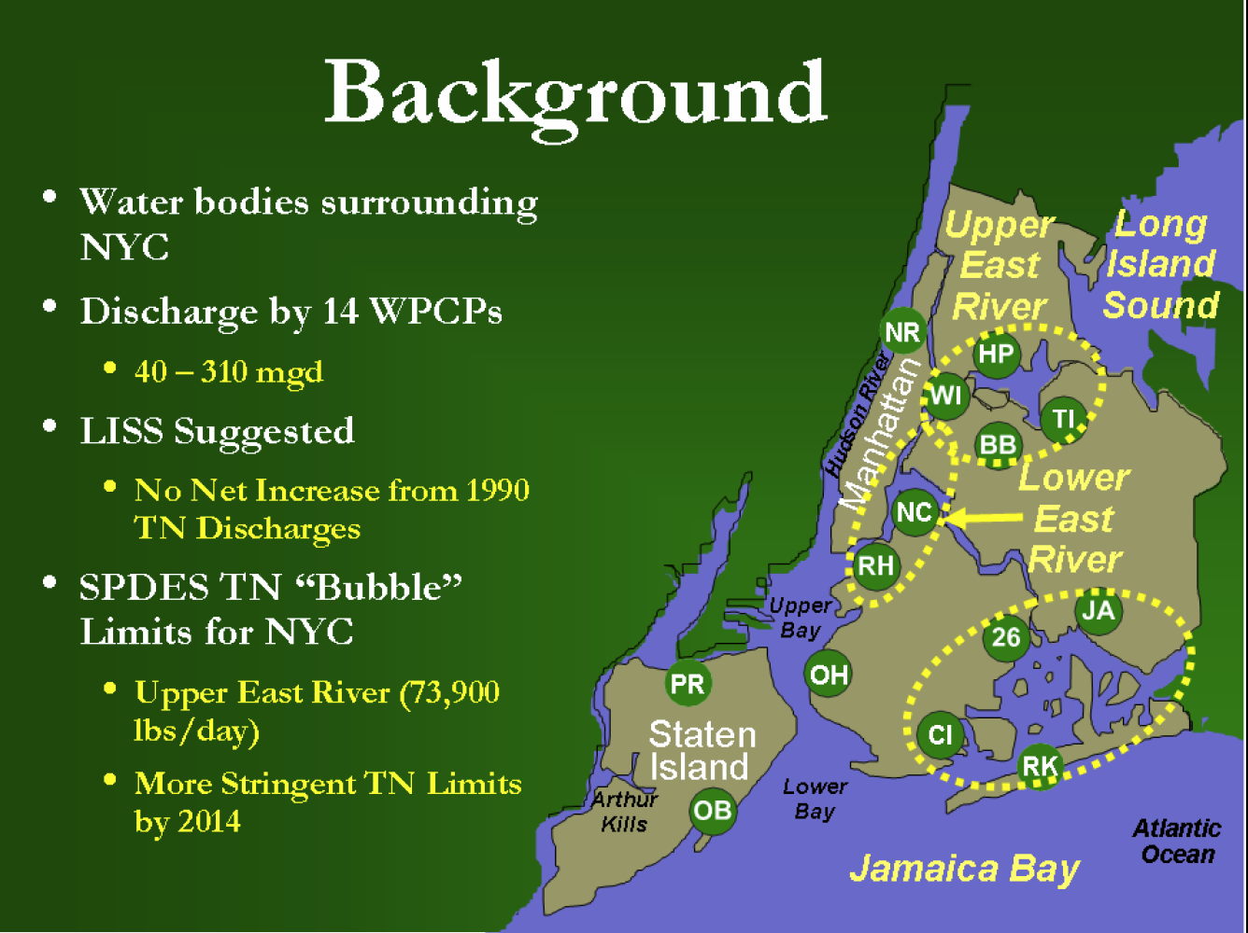
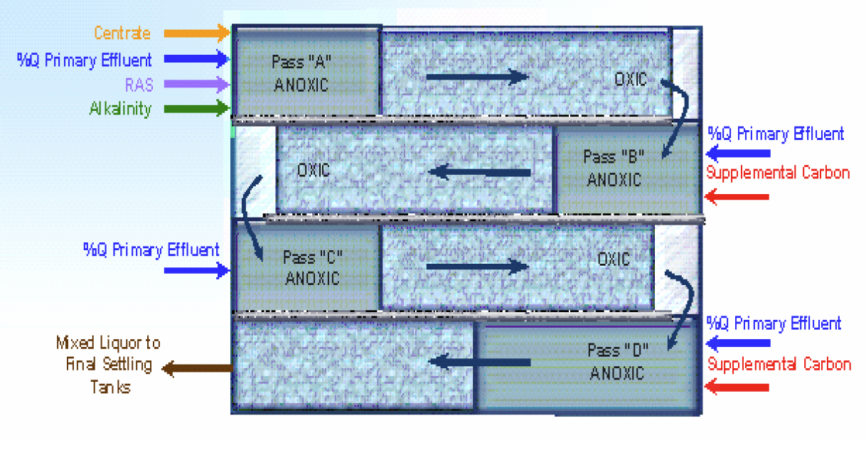
The drive to meet more stringent regulatory standards
Simulation-based process design to achieve enhanced BNR in NYC

Slide 10
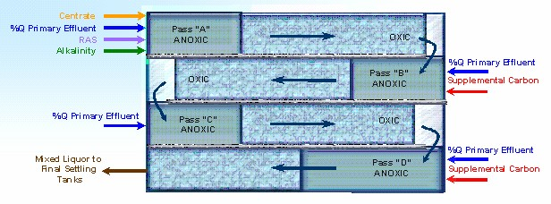
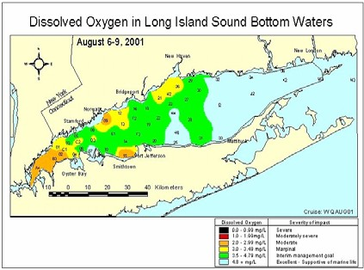
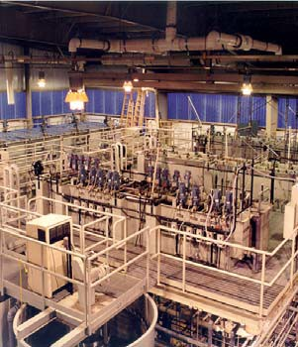
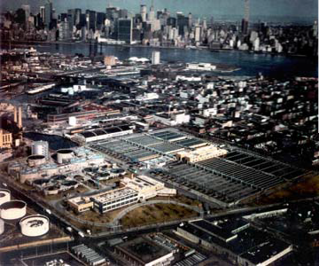
NYC-DEP - Metcalf & Eddy
Applied Research and Technology Partnership
Step Feed BNR Mode
Nominal HRT: 4 - 4.5 hrs
Centrate to Pass A
SRT ~ 8 days
Pass D MLSS ≤ 2500 mg/l
4 Pilot Plants : 18 - 72 gpm

Slide 11
Design and implementation of fecal sludge management in Ghana
Case Study II

Slide 12
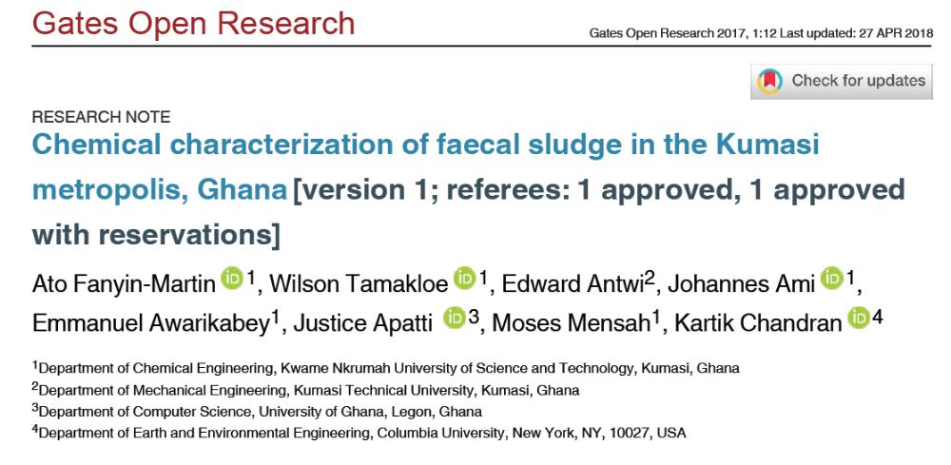
Fecal sludge fermentation to enhance sanitation

Slide 13
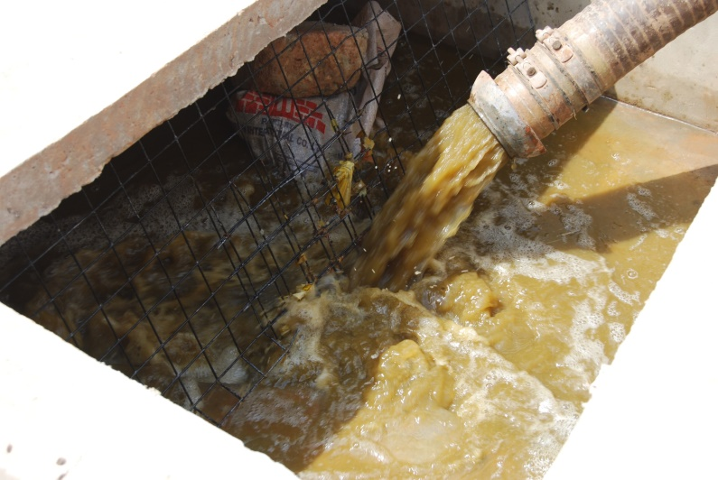
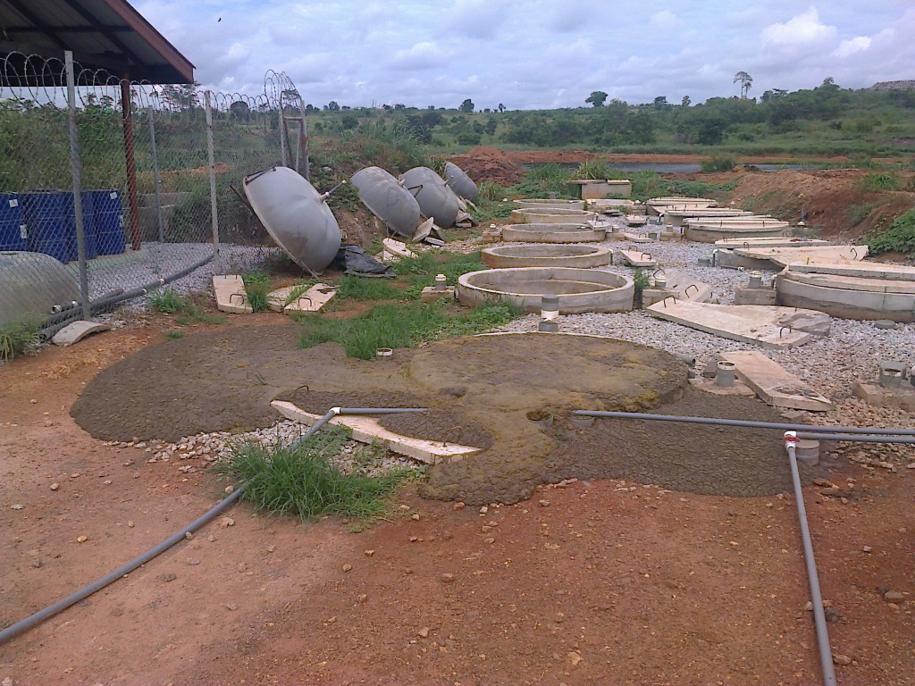
FS Characterization – Extreme Variability
 | Average ± SD
Total COD (mg/L) | 22,951 ± 19,499
Total VFA (mgCOD/L) | 1,417 ± 1,074
pH | 8.01 ± 0.27
Total Suspended Solids (mg/L) | 15,663 ± 16,867
Volatile Suspended Solids (mg/L) | 12,617 ± 13,328
Need to characterize beyond conventional parameters to enable process modeling
Notes:
Consistent with previous studies: high variability
Why variable:
Public toilets: latrines, septics (though still reported variability when define by toilet type)
Variable storage time: weeks, months, years
Influent microbes, need to characterize FS beyond conventional parameters
COD/N

Slide 14
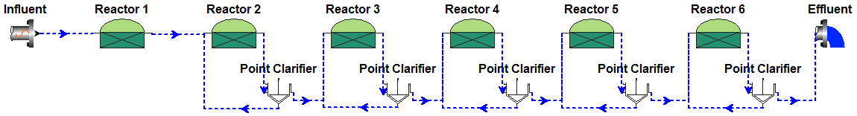
Unique insights from previous work
 | WW | FS
Readily Biodegradable (g/g COD) | 0.27 | 0.09
Soluble Unbiodegradable (g/g COD) | 0.08 | 0.09
Particulate Unbiodegradable (g/g COD) | 0.08 | 0.47
Ordinary Heterotrophic Organisms (g/g COD) | 0.01 | 0.05
Acetoclastic Methanogens (g/g COD) | 0.00001 | 0.015
Acetoclastic Methanogenesis Rate (1/day) | 0.3 | 0.1
CO₂ Yield (moles CO₂/moles acetate) | 0.7 | 1.2
Shih et al., 2017

Slide 15
In summary
Contact
Model-based process analysis can efficiently allow for process optimization
  Benefits depend upon regulatory and process goals
We propose to integrate upstream chemical monitoring to provide early-warning against upsets and thereby enhance the stability of treatment operations
Hydraulic characterization and monitoring is expected to provide further safeguards against flooding and related upsets.
Kartik Chandran
Professor
Earth and Environmental Engineering
Email: kc2288@columbia.edu
URL: www.columbia.edu/~kc2288/
Twitter: @kartikchandran1
GIZ, Aqaba Water Authority
Acknowledgements

Slide 16
Thank You

