Slide 1

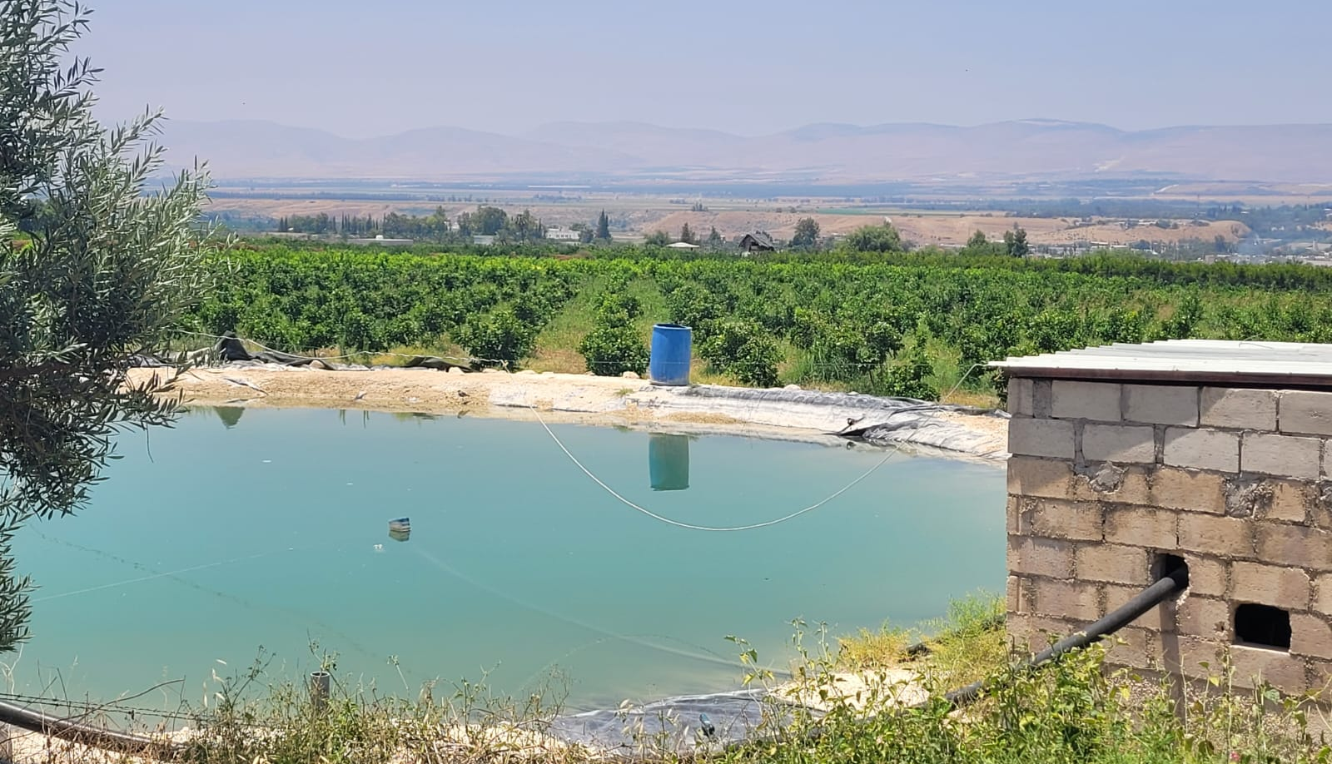

Monitoring agricultural water use and Irrigation scheme performance in the North Jordan Valley
Eng. Kholoud Bashtawi

Slide 2

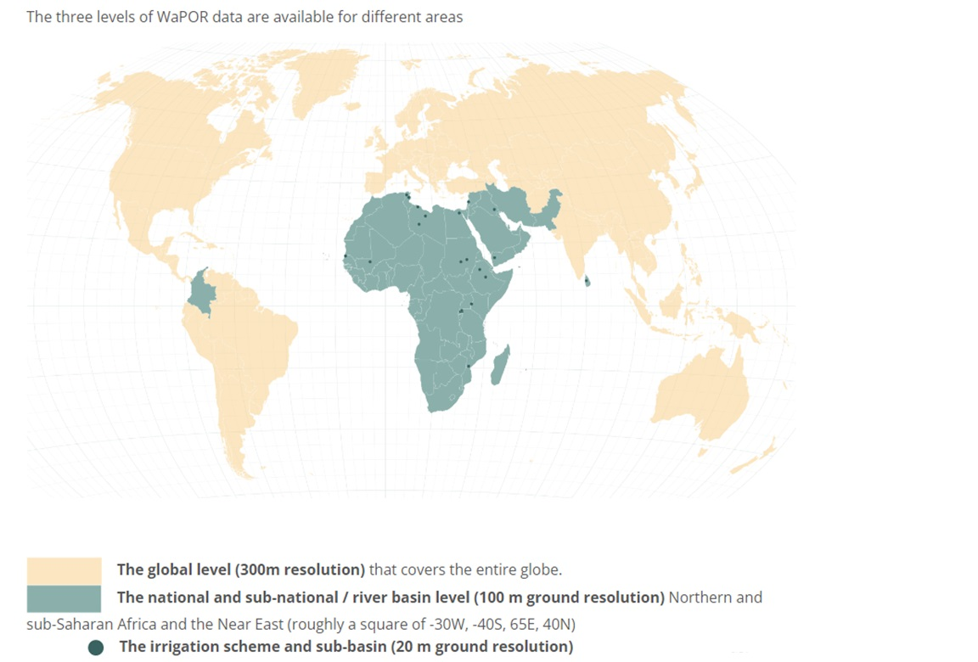

WaPOR Phase 2
https://data.apps.fao.org/wapor/?lang=en
Notes:
Here we need to speak about WaPOR database. the FAO portal to monitor Water Productivity through Open access of Remotely sensed derived data. It has three data levels which are continental (300 m) National (100 m) and sub-basin based (20 m). It covers Africa and the middle east

Slide 3

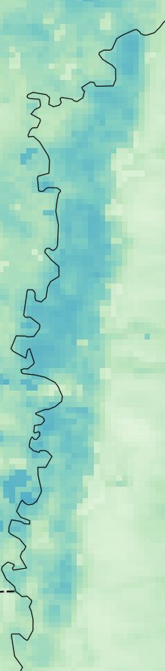
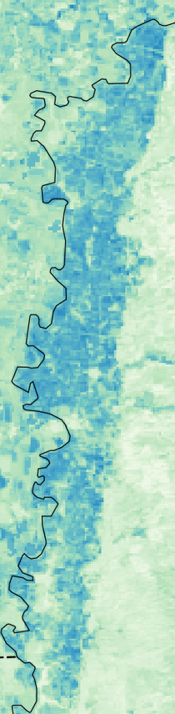
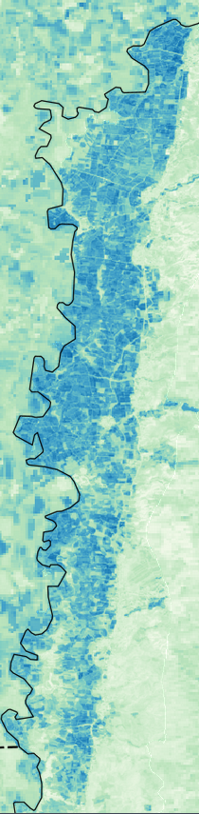
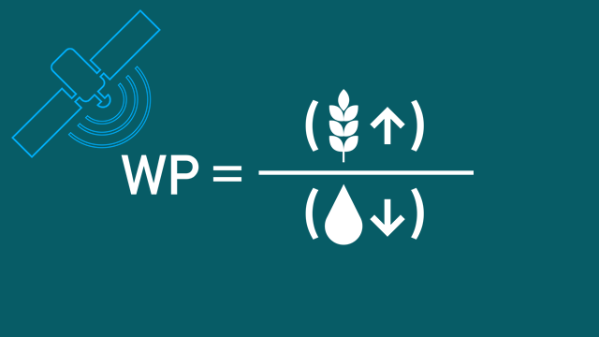


The WaPOR data
Database
Key data
Frequency
Spatial resolution
Near-real time
(10 days)
Crop water consumption
(actual evapotranspiration)
Monthly
2024
Yearly
Biomass
300m 100m 20m
Notes:
Here we need to focus on the key data and show the difference in spatial level and that for Northern Jordan Valley we have high resolution data at 20 meter to support irrigation assessments

Slide 4
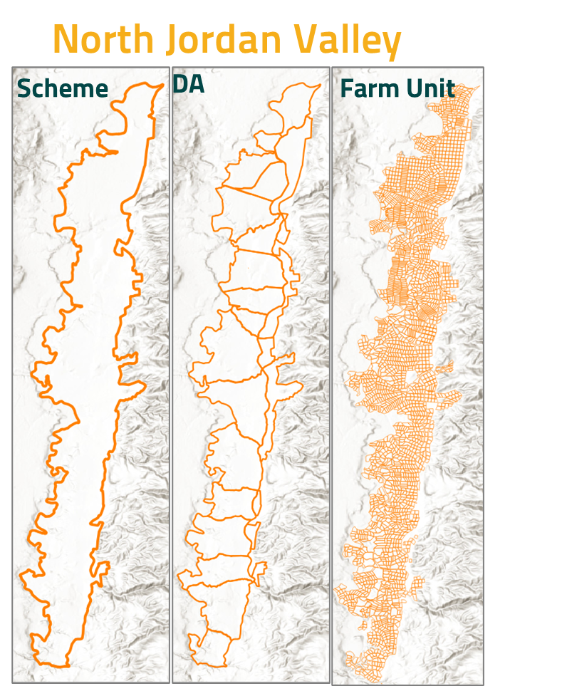
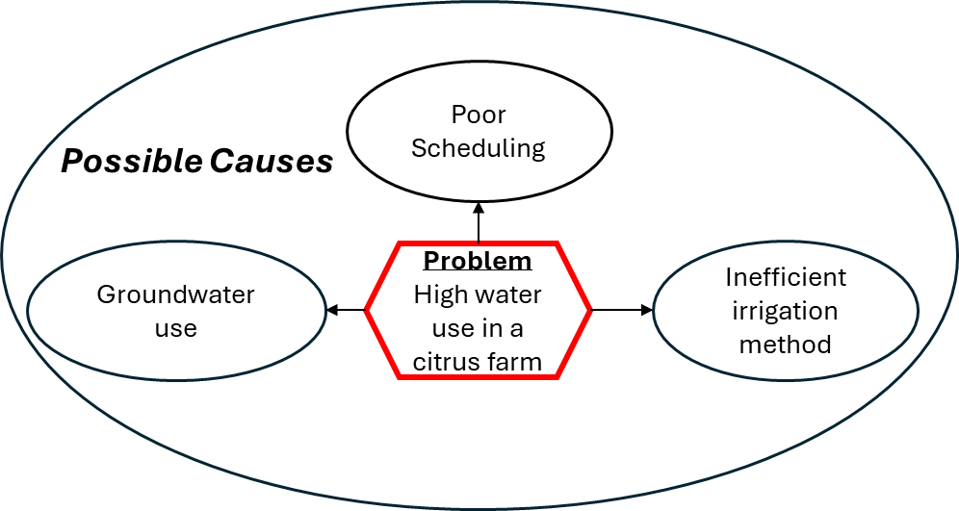
Irrigation Performance Assessment
  Monitor performance to identify shortcomings and take corrective measures
  Irrigation Performance Assessment Tool (IPAT)
    Continuous observations at close interval
    Check relevant indicators against target value
    Map performance gaps
    An example of cause – low performance
Notes:
Here we need to focus on our tool which is build in close collaboration with a team from the Jordan Valley Authority and the Ministry of Agriculture. We need just to read the text and then mention that the tool aims to assess the performance at three levels: the scheme, demand area and farm units

Slide 5
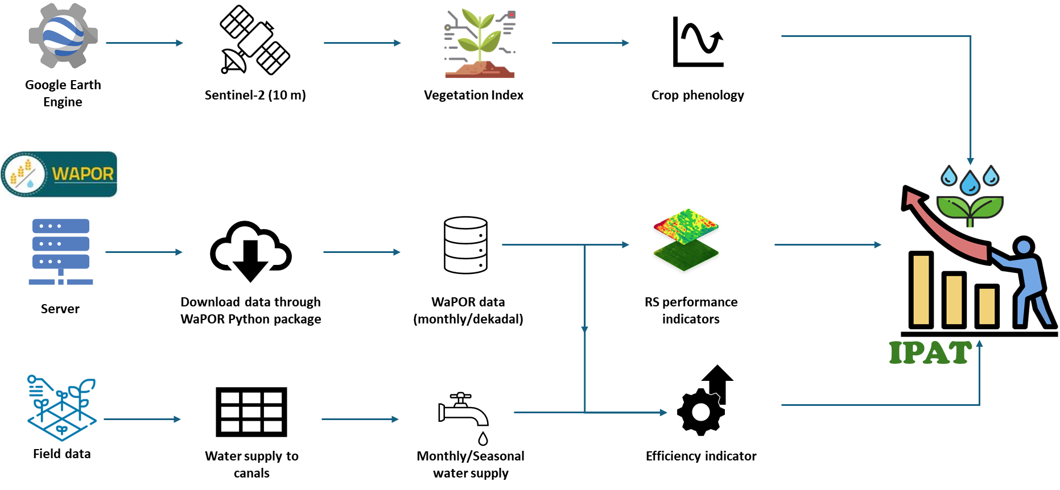
Irrigation Performance Assessment Tool (IPAT)
Notes:
Here we need to go through the data and scripting steps

Slide 6
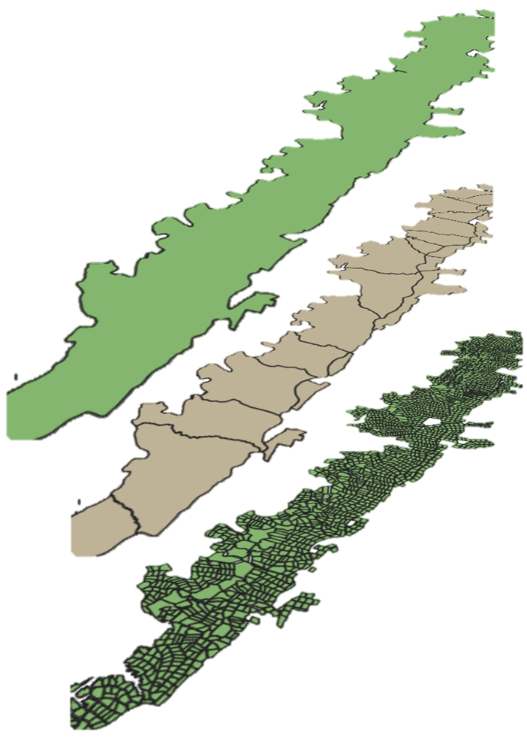

Scheme
IPAT & indicators
Crop Phenology
Crop water consumption
Irrigation Efficiency
DA
Monthly & seasonal
Ratio of crop water consumption (WaPOR) to water supply
Status of crop growth
Farm Unit (FU)
Scheme, DA, FU
Uniformity
Equity
Adequacy
Scheme, DA, FU
Sub-indicators from Crop water consumption
Uniformity - evenness of water consumption within an irrigated field.
Equity - evenness of water consumption between fields within an irrigation scheme with a homogenous crop
Adequacy - degree of agreement between the actual water use and crop water requirement
IPAT
Notes:
Here we need to shed light on the indicators in the left hand side graph and the sub-indicators in the text

Slide 7
IPAT – Results and Use

Slide 8
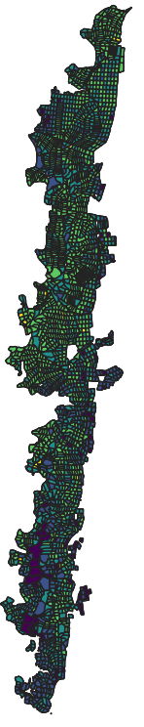
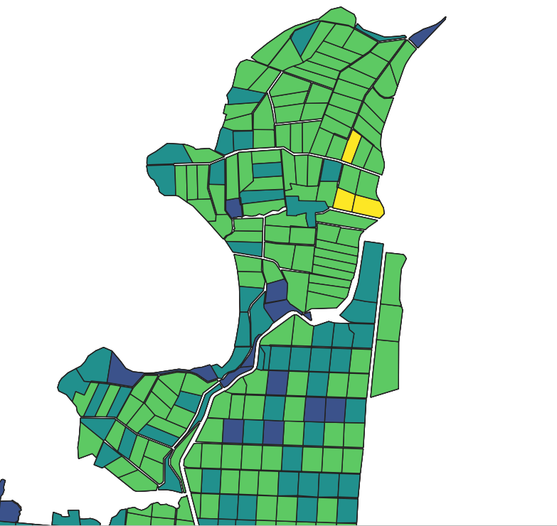
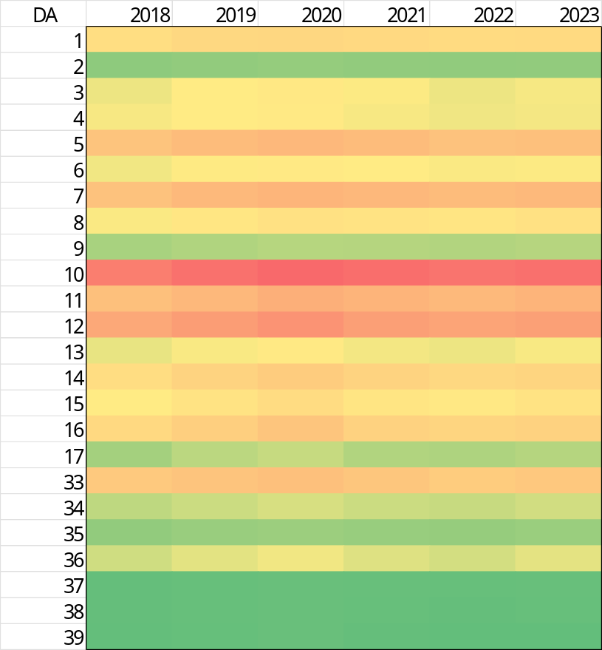
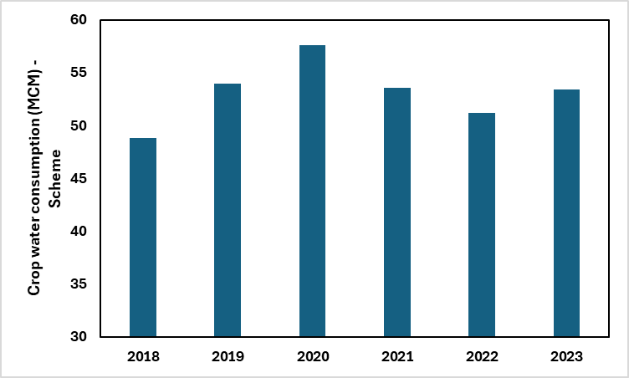

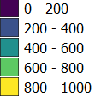
Seasonal Crop water consumption
7
Crop water consumption (MCM)
Scheme
0.1
Crop water consumption at Farm unit (mm)
DA
Notes:
Here we need to provide the range of crop water consumption across years at the scheme-DA and also the farm level

Slide 9
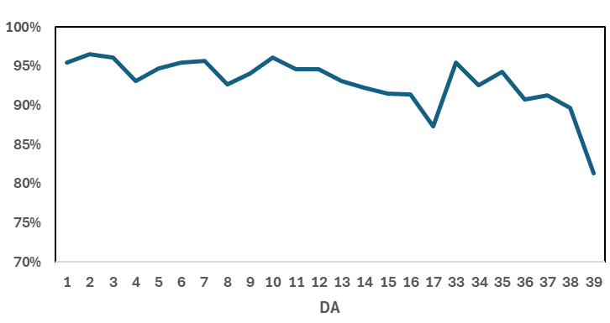
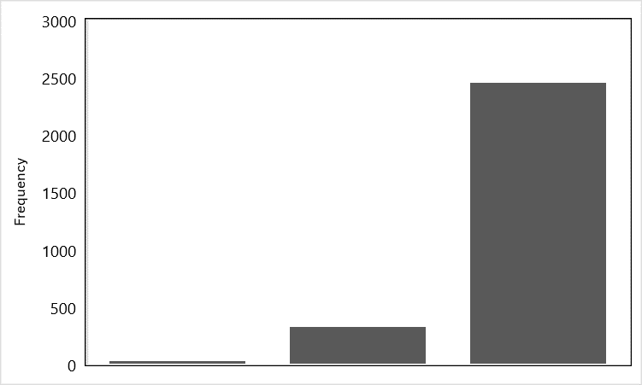

Seasonal Crop water consumption - Uniformity
DA
Farm Unit (FU)
96 %
Scheme
> 80 %
80 - 90 %
90 - 91 %
Uniformity - Evenness of water consumption within a spatial unit
Notes:
Uniformity here in the scheme seems to be high thanks to the efforts of JVA in managing the scheme effectively and delivering water equitably to the farms

Slide 10
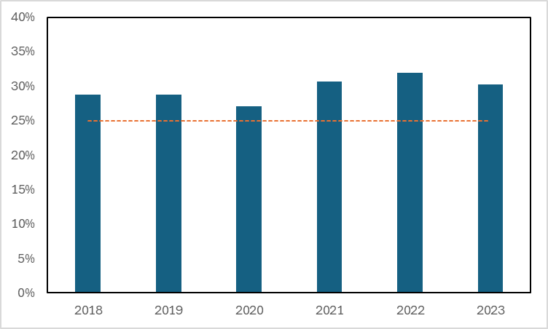
Seasonal Crop water consumption - Equity
}
Potential for improvement
96 %
Scheme
Equity - Evenness of water consumption across a spatial unit of the homogeneous crop (Considering Citrus as a dominant crop)
Notes:
Here the graph shows the scheme performs really well, and there is a room of beterrn 5 – 10% to improve water consumption uniformity

Slide 11
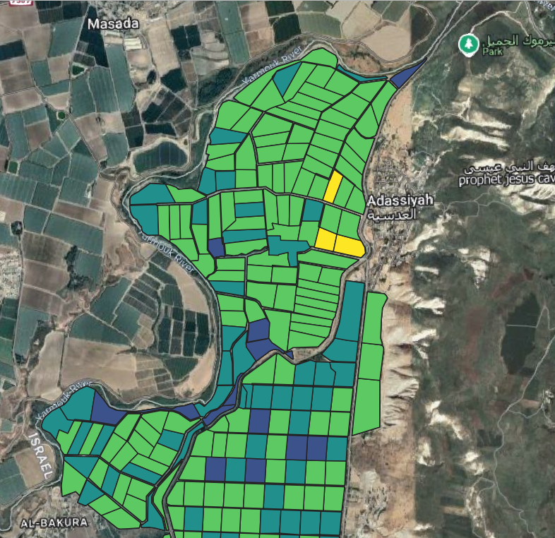
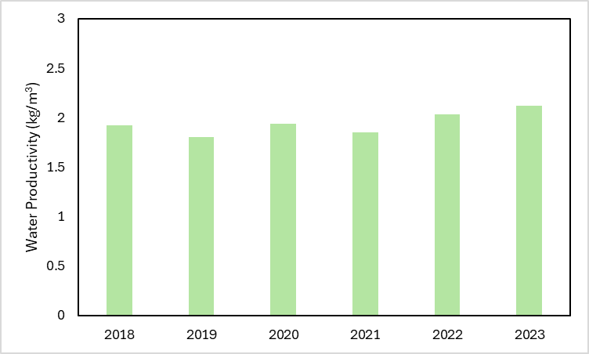
Irrigation Performance Assessment Tool (IPAT) - Productivity
crop yield per cubic metre of water consumption
Notes:
Here we show an example of an average farm water productivity which ranges between 1.9 – 2.3 kg/m3

Slide 12
Decision support using IPAT
1- Benchmark best performing farms at each DA
2- Identify reasons behind low performance in some farms (i.e., low supply, low on-farm efficiency)
3- Work with low performing farms through targeted interventions such as efficient irrigation systems, irrigation advisory, or increase supplies
Notes:
Here we show an example of an average farm water productivity which ranges between 1.9 – 2.3 kg/m3

Slide 13
Thank You

