Slide 1


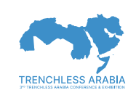
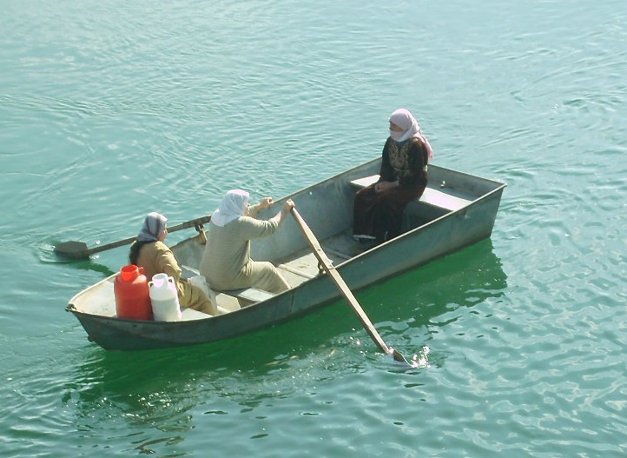
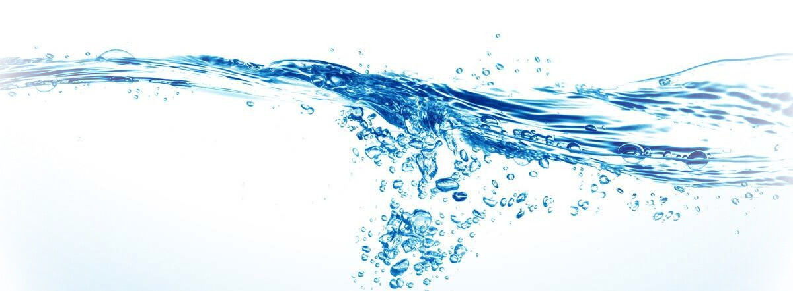
Changes in the water quantity and quality of the Euphrates river
are associated with natural aspects of the landscape
تَرتَبِطُ التَّغَيُّرات في كَميَّة وَ نَوعيَّة مياه نَحر الفُرات بالجَوانب للمَناظر الطَّبيعيَّة
Professor Luis Antonio Bittar Venturi
Dept. of Geography – University of São Paulo

Slide 4
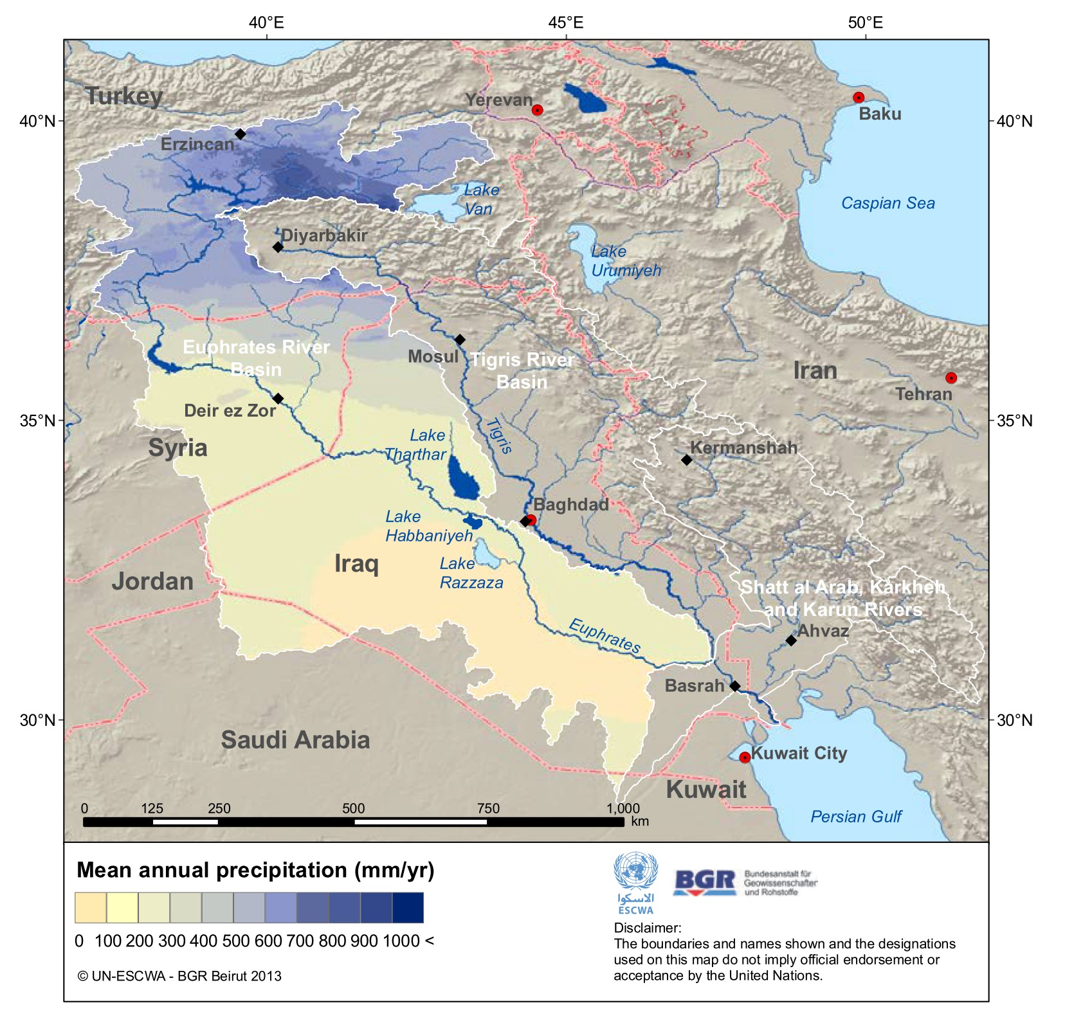
Characteristics of the Euphrates river basin
From upstream to downstream:
Precipitation
Tributaries
Temperatures
Evaporation rates
Irrigation needs

Slide 5
STATION | PERIOD | MEAN (BCM) | MINIMUM (BCM) | MAX. (BCM) | CVª [-]
Jarablus (Syria) | 1938-2010 | 26.6 | 12.7 | 56.8 | 0.33
 | 1938-1973 | 30.0 | 15.0 | 56.8 | 0.29
 | 1974-1987 | 24.9 | 12.7 | 34.1 | 0.27
 | 1988-1998 | 25.5 | 14.4 | 50.1 | 0.42
 | 1974-1998 | 25.1 | 12.7 | 50.1 | 0.34
 | 1990-2010 | 22.8 | 14.4 | 32.6 | 0.34
Hussaybah | 1981-2011 | 20.0 | 8.9 | 47.6 | 0.44
 | 1988-1998 | 22.8 | 8.9 | 47.6 | 0.54
 | 1999-2010 | 15.5 | 9.3 | 20.7 | 0.27
 | 1990-2010 | 16.8 | 8.9 | 30.7 | 0.39
Hit | 1932-1998 | 27.1 | 9.0 | 63.0 | 0.36
 | 1938-1973 | 30.6 | 15.1 | 63.0 | 0.30
 | 1974-1987 | 23.1 | 9.3 | 31.2 | 0.32
 | 1988-1998 | 22.4 | 9.0 | 46.6 | 0.51
 | 1974-1998 | 22.8 | 9.0 | 46.6 | 0.40
Hindiyah | 1930-1999 | 17.6 | 3.1 | 40.0 | 0.4
 | 1938-1973 | 19.8 | 6.6 | 40.0 | 0.35
 | 1974-1987 | 15.3 | 3.1 | 24.1 | 0.45
 | 1988-1998 | 13.8 | 7.7 | 27.9 | 0.48
 | 1974-1998 | 14.7 | 3.1 | 27.9 | 0.46
Inventory of Shared Water Resources in Western Asia (UN-ESCWA, 2013).
Decreasing of flow exists even before any dam construction.
Changes in the water quantity and quality of the Euphrates river are associated with natural aspects of the landscape. Water Policy (Venturi, L.A.B.; Capozzoli, C.R.)
https://doi.org/10.2166/wp.2017.077

Slide 6
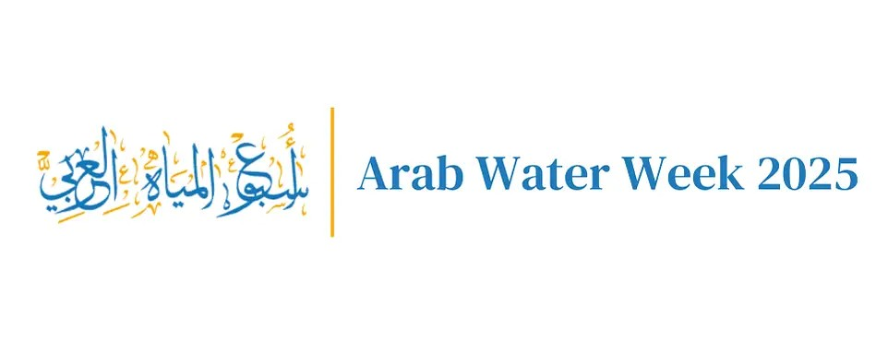
Quality of water جودة المياه
Laboratorial data showed:
Potability: same along Syrian stretch.
Salinity: increasing towards downstream
Analysis results | Jarablus | Abukamal
Conductivity | 302,0 | 651,0
TDS Total Dissolved Solids | 146,0 | 329,0

Slide 7
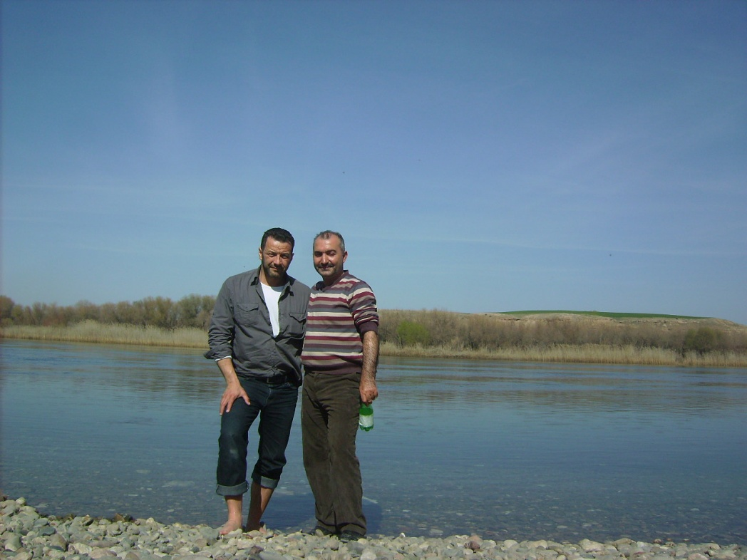
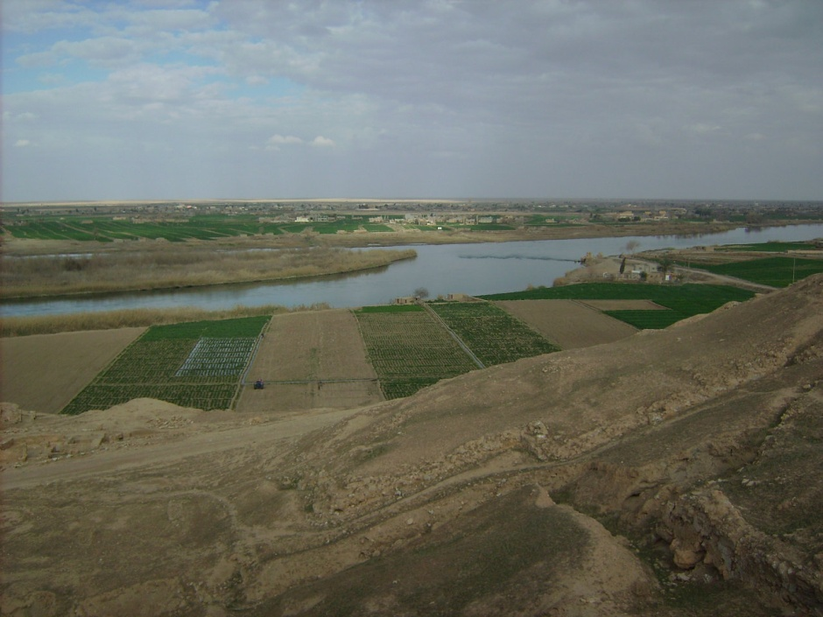
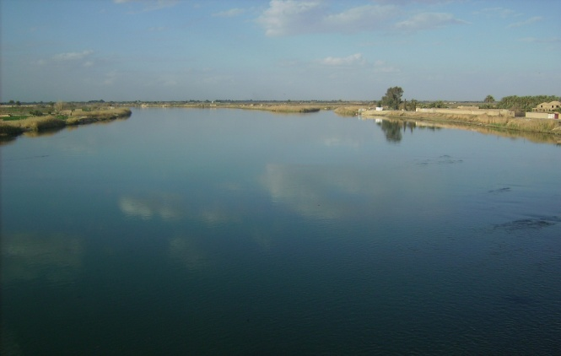
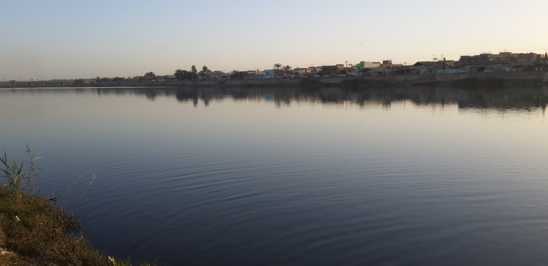
Empirical data
مُعطيات تجربية
Eufrates in Jarablus,
(Syria – Turkey border)
Deir Ez-Zor
Between Raqa e Deir-Ez-Zor
In Hilah, Babylon province (Iraq)
In Abu Kamal,
Near Syria-Iraq border)

Slide 8
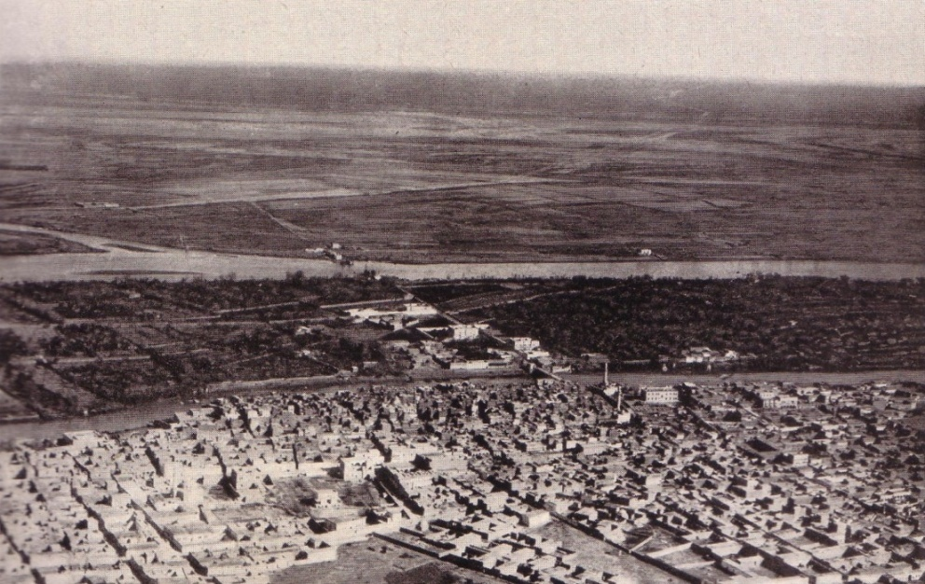
Euphrates in 1920. Same as today.
الفرات في١٩٢٠و كذلك حاليًا

Slide 9
RESULTS نَتائج
Damascus Protocol has been working, assuring a fair water sharing.
The river Euphrates has a regular flow, with a slight decreasing towards downstream due to the dryer climate in Syria and Iraq.
The water quality remain the same, although with aN increasing salinity downstream due to higher evaporation than precipitation.
Natural factors explain better the river hydrodynamics.

Slide 10
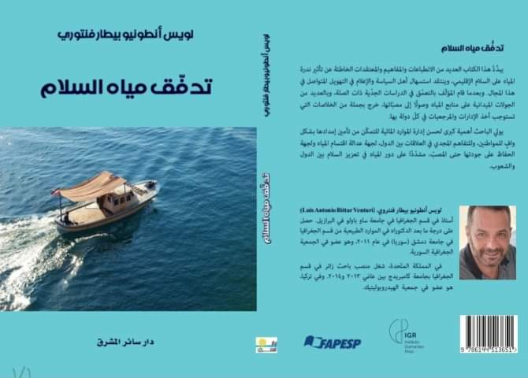

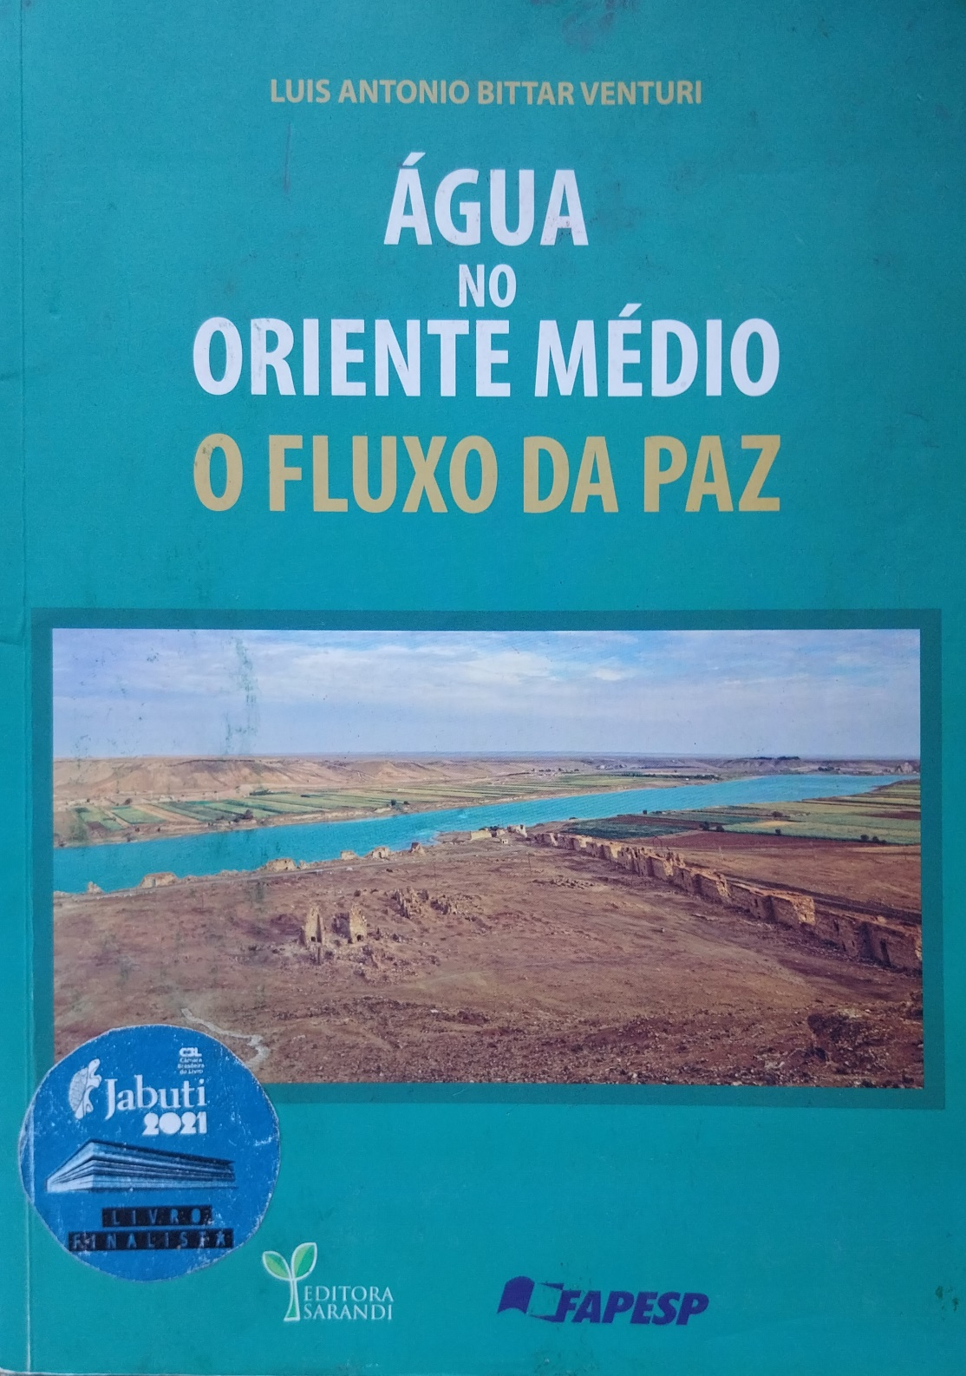

Slide 11
Thank you for your attention!
شكرًا جزيلاً لاِهتِمامكم
luisgeo@usp.br Phone: (+5511) 972 982 131

