Slide 1
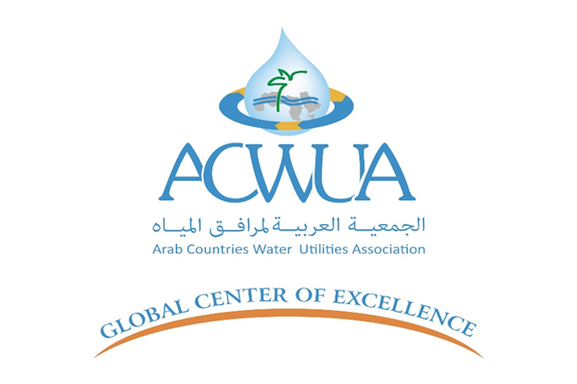

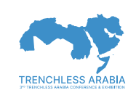
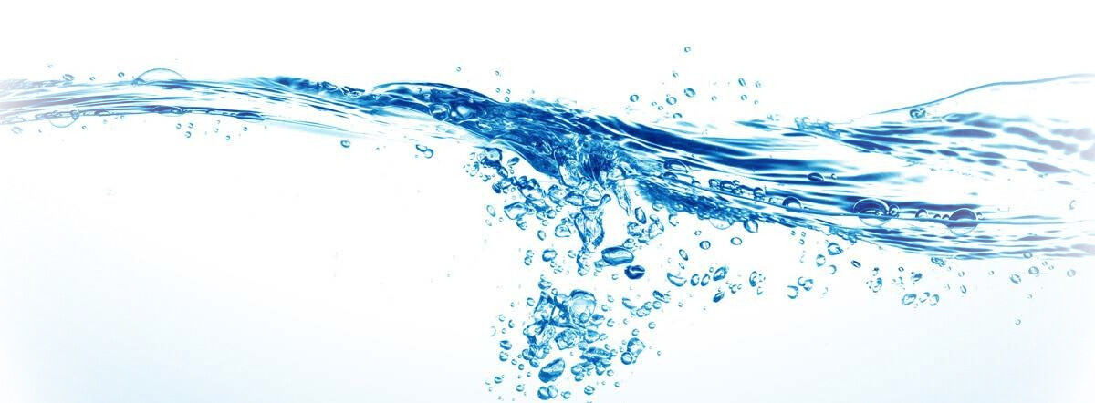
Water Convention as a Vehicle for Water Diplomacy
Dr. Luay Ali Hussien AlDalooi
4-6 May 2025

Slide 2
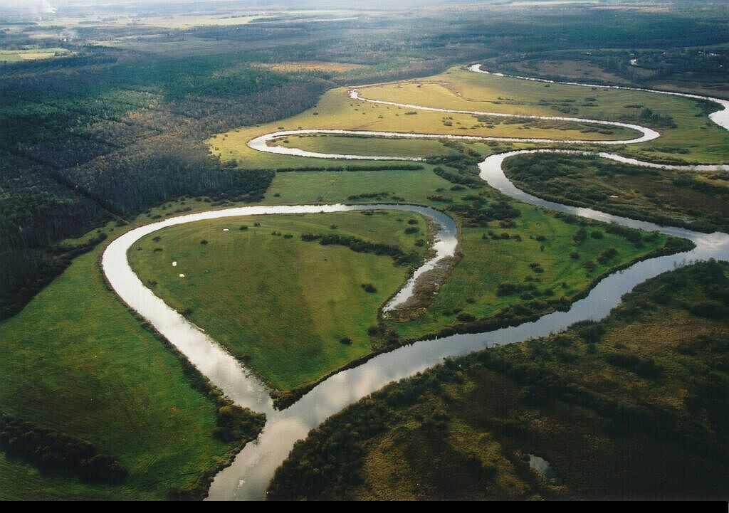
Aims of the Water Convention
The Convention on the Protection and Use of Transboundary Watercourses and International Lakes (Water Convention) is a unique legal and intergovernmental platform that promotes the sustainable use of transboundary waters.
Protection of transboundary waters by preventing, controlling and reducing transboundary impacts
Ecologically sound and rational management of transboundary waters
Reasonable and equitable use of transboundary waters
⇒ Conflict prevention
Conservation and restoration of ecosystems

Slide 3
The Convention: from Regional to Global
2003: Adoption of the amendment allowing all UN Member States to accede to the Convention.
2012: Blanket approval by the Meeting of the Parties for all future requests for accession
2013: Entry into force of the amendment.
1st March 2016, operationalization of the Amendment: all UN Member States can accede to the Convention.

Slide 4
Organization of work under the Convention
The Meeting of the Parties
  The highest decision body
The Bureau
  Organises the work between the MOPs
The Working Group on Integrated Water Resources Management
  Mainly focuses on inter-sectoral water management issues to prevent, control and reduce transboundary impact
The Working Group on Monitoring and Assessment
  Helps Parties bordering transboundary waters to establish and implement joint programmes for monitoring the status of transboundary waters
The Legal Board
  Assists the other bodies on legal questions related to the Convention and its Protocols
The Joint Expert Group on water and industrial accidents
  Joint group of the Water Convention and the Industrial Accidents Convention dealing with technical issues, e.g. safety guidelines for pipelines
The Task Force on Water and Climate
  Discusses adaptation to climate change and flood issues

Slide 5



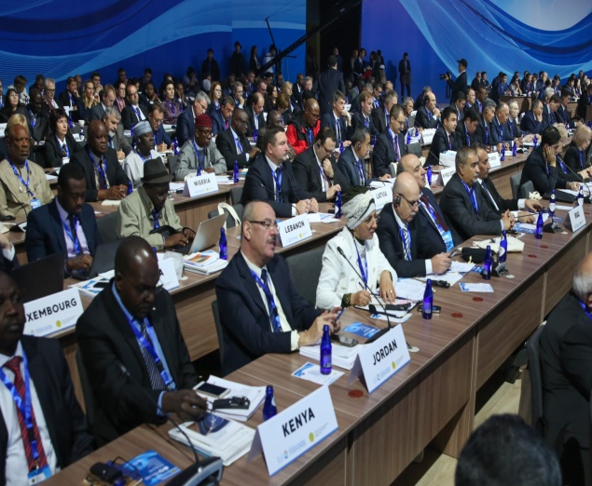





Institutional Framework
Meeting of the Parties (Art. 17) Secretariat (Art. 19)
Participation and exchange of experiences open to all interested countries
Decision-making (MOP) & participation in the Bureau: Parties only
Meeting of the Parties (MOP)
Implementación Committee
Water and Climate
Task Force
Water-Food-Energy-Ecosystems Nexus
Task Force
Bureau
Working Group on IWRM
Working Group on Monitoring and assessment
Secretariat of the Convention

Slide 6
The key insights of the Water Convention
1. Legal Foundation for Cooperation:
The WC codifies essential principles such as: Equitable and reasonable utilization, obligation not to cause significant harm, duty to cooperate, and polluter pays. These principles create a neutral and universally recognized basis for states to engage diplomatically over shared water resources, reducing potential for conflict.
2. Promotion of Reciprocity:
The Convention helps bridge geopolitical divides by emphasizing reciprocal obligations between upstream and downstream states. It highlights that harm can occur both upstream and downstream, and all parties share duties, such as notification and consultation over planned measures. However, this reframing of obligations encourages mutual trust and inclusive dialogue, essential for WD.
3. Framework for Dispute Resolution
By incorporating structured procedural rules (e.g., notification of planned measures, dispute resolution mechanisms), the Convention provides a predictable platform for handling tensions, facilitating peaceful negotiation rather than unilateral action.
4. Capacity Building and Institutional Support
The UNECE Convention in particular includes mechanisms for information exchange, joint monitoring and public participation. All these build the institutional and technical capacity necessary for sustained cooperation and help countries with weaker legal or diplomatic systems engage on equal footing.
5. Encouragement of Regional Integration
The Convention has been used as a model for regional agreements, especially in Europe and Africa (e.g., the Senegal River) and parts of Asia. It encourages harmonization of laws and policies and strengthening of basin-wide institutions, which strengthens regional water diplomacy netwo

Slide 7


Global Legal instrument and
Institutional Framwork
Progressive, step-by-step implementation of the Convnetion.
All countries start from different situations
Different paths to advance cooperation.
Implementation not in isolation => builds on existing initiatives, changing conditions, priorities… and opportunities
Offers assistance to countries in facilitating the negotiations of transboundary water agreements., e.g. the Chu-Talas, the Dniester, the Drin and the Kura river basins.

Slide 8
Water Diplomacy
Water diplomacy still lacks a commonly agreed definition.
Water diplomacy uses diplomatic techniques of negotiation, mediation and intercultural communication to promote sustainable development of water resources and transform the potential risk of competing demands and even conflict over water into forms of cooperation that extend beyond water and economics (Hefny, 2011).
The use of diplomatic instruments to existing or emerging disagreements and conflicts over shared water resources with the aim to solve or mitigate those for the sake of cooperation, regional stability, and peace.(Susanne Schmeier).
It is “ a deliberative process that addresses contested shared waters and seeks dividends beyond those specific to water.”(Mirumachi).
It focuses on establishing novel solutions founded on a scientific basis and sensitive to societal constraints to a wide range of water problems (Shafiq Islam)
The existing guidance builds primarily on context-specific examples, or on the activities of transboundary water cooperation and management.

Slide 9
Four key aspects of the water diplomacy.
POLITICAL: Inherently political process that goes far beyond water per se; part of wider diplomatic setting and geopolitics | The most strongly political track: critical hydropolitics; geopolitics; foreign policy; regional cooperation
PREVENTIVE: Peace mediation and conflict prevention | Preventive diplomacy; peace mediation and peace building; conflict resolution Multi-track Diplomacy; Integrative Diplomacy; Integrated Water Resources Management; knowledge co-production
INTEGRATIVE: Connecting multiple forms and levels of institutions and stakeholders and the different types of knowledge | Multi-track Diplomacy; Integrative Diplomacy; Integrated Water Resources Management; knowledge co-production
COOPERATIVE: Cooperation and good governance to promote reasonable and equitable water use. | Cooperative arrangements; benefit- sharing approaches; international agreements on shared waters; sustainability
TECHNICAL: providing an information basis for the diplomacy about water, related resources and the environment | The most strongly technical track: Information on hydrology, water quantity, quality and timing; knowledge production and products such as hydrological models and impact assessments.

Slide 10
Tracks of Water diplomacy
Analogous to conventional diplomacy tracks, water diplomacy procedures may adhere to many tracks. (SIWI 2019):
Track 1 | State-centred diplomatic process, embodied in an official bilateral or multilateral dialogues between officials of riparian States, involving high-level political leaders.
Track 1.5 | Governmental and non-governmental actors jointly work together towards resolving conflicts, issues at hand, or fostering the dialogues and collaborations.
Track 2 | Comprises an unofficial dialogue among non-State actors aimed at influencing official negotiation processes, involving individuals and private groups, who could interact more freely than high-ranking officials.
Track 3 | People-to-people diplomacy, driven by individuals and non-governmental groups to promote cooperation at multiple levels including community, local levels, as well as national and global levels.
Multi-track | A situation where different tracks of diplomacy taking place simultaneously.

Slide 11
Conclusion
WC and WD are intrinsically linked, with the Convention serving as a vital tool for fostering peaceful, cooperative management of shared water resources.
As water scarcity and climate change pose increasing challenges globally, strengthening water diplomacy rooted in legal frameworks like the Convention will be crucial for ensuring sustainable and equitable water use for future generations.
WC is supportive to water diplomacy action particularly for its parties. The Institutional settings of WC assists to bringing together development interventions and a wise-step preventive and actionable water diplomacy.

Slide 12
WC is supportive for WD
The Water Convention | Path of Water diplomacy
Encouragement of Regional Integration | POLITICAL
Framework for Dispute Resolution | Preventive (Convincible)
Encouragement of Regional Integration | Integrative
Legal Foundation for Cooperation and Promotion of Reciprocity | Cooperative
Capacity Building and Institutional Support | Technical

Slide 13
Thank you for attantion

