Slide 1




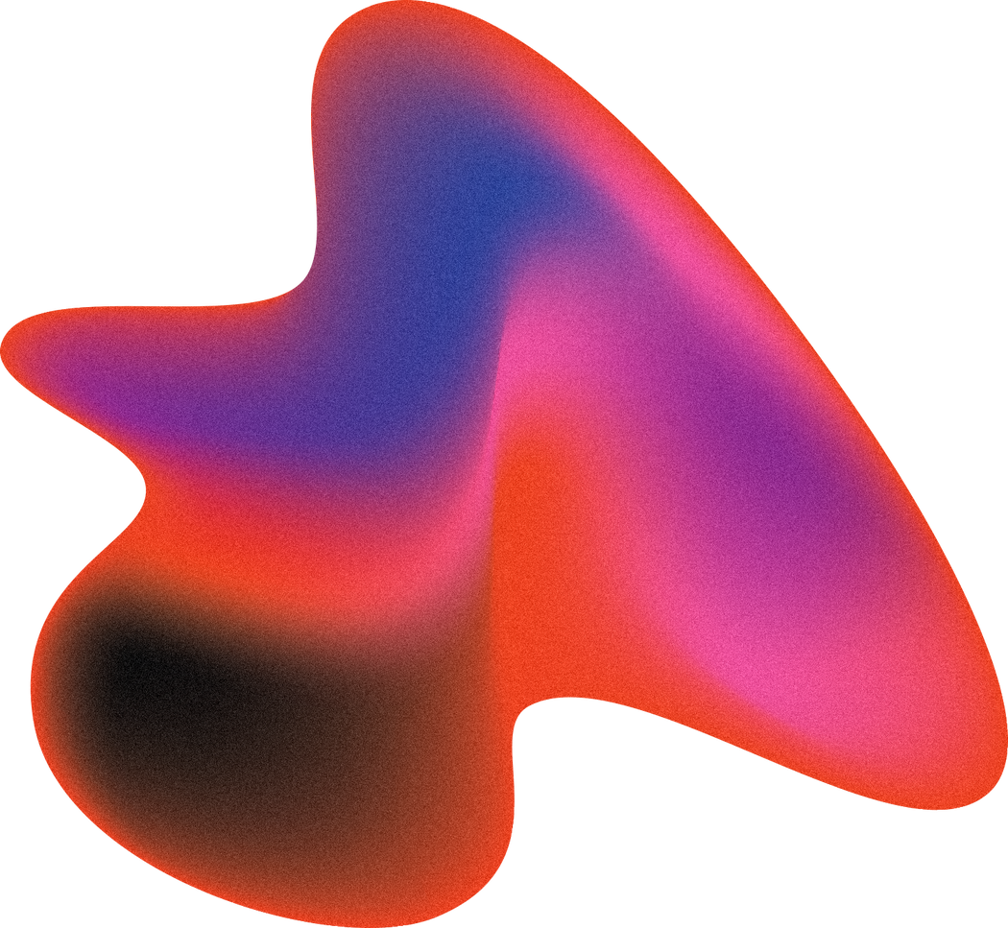
Cracking the Code of Forever Chemicals: AI-Powered Breakthroughs in PFAS Cleanup
Presentation By:
MOHD BASHEER TALA AL-HABASHNEH

Slide 2

Agenda
Introduction
Conclusion
Methodology
Results

Slide 3
Introduction
Per- and polyfluoroalkyl substances (PFAS) are persistent man-made pollutants that have contaminated urban water systems due to widespread use in products such as non-stick cookware, textiles, and firefighting foams.
These chemicals enter the environment through diffuse sources like rainwater runoff, wastewater discharge, and accidental spills.
Surface water, such as effluent from wastewater treatment, carries PFAS into groundwater via infiltration and percolation through soil.
Once in the groundwater, these pollutants can persist for decades, posing long-term risks to drinking water supplies and public health.

Slide 4
Governments, such as the U.S. Environmental Protection Agency (EPA), have recently set strict PFAS limits—down to 4 nanograms per liter in drinking water—and require that treatment materials be effective, stable, and safe for large-scale use.
What We Set Out to Achieve
Use artificial intelligence to predict the most effective and affordable materials for PFAS removal and degradation.
Simulate real-world groundwater contamination scenarios to evaluate the performance of these Artificial Intelligence (AI) selected materials in urban environments.

Slide 5
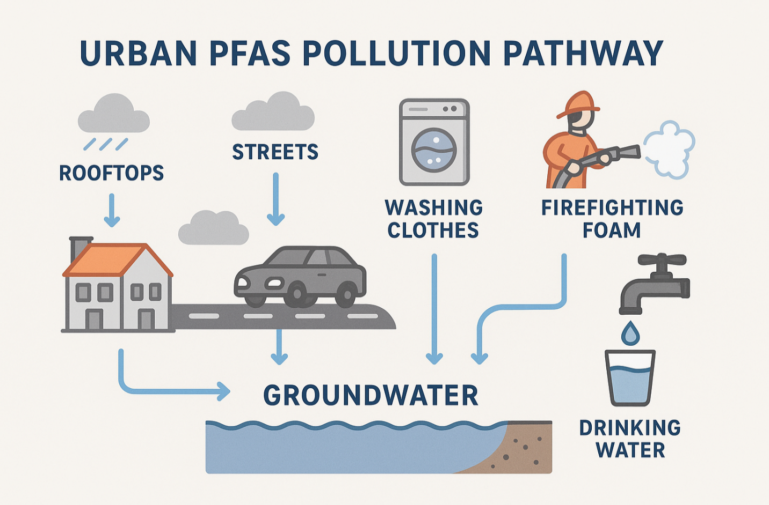
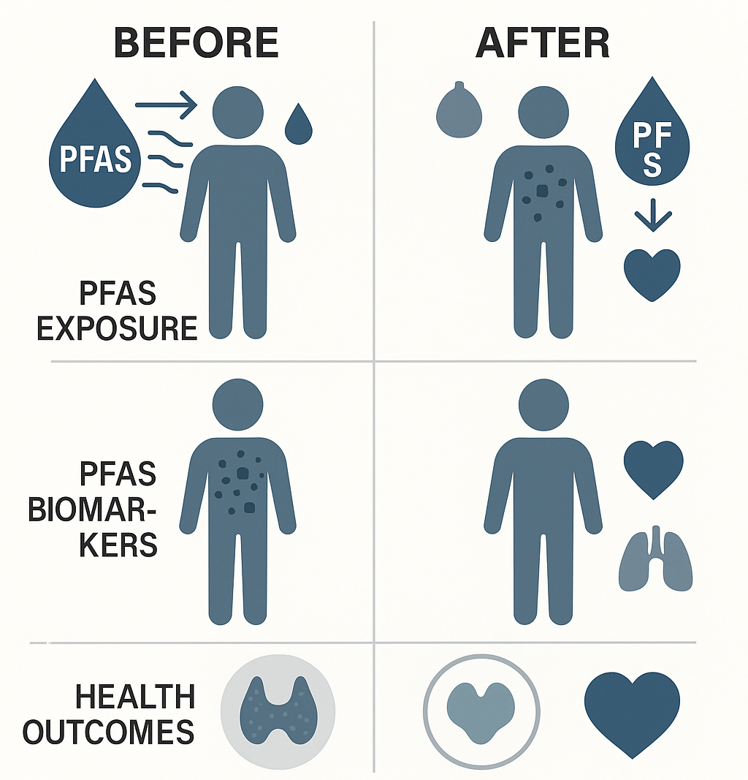
Figure 1 illustrates how PFAS move through cities into groundwater, while Figure 2 shows the health benefits of successful intervention, including reduced chemical buildup and improved organ function.
Our work offers smart, low-cost solutions for PFAS by using data and science to help cities act faster and more effectively.

Slide 6
Methodology
To tackle PFAS contamination effectively, we designed an end-to-end workflow combining AI-driven material discovery with real-world groundwater modeling.
PFAS Selection and Data Collection
AI Model Development
Smart Optimization and Feedback Loop
Virtual Screening of Materials
Groundwater Simulation (MODFLOW-6 + MT3DMS)

Slide 7
1. PFAS Selection and Data Collection
Our process began by selecting 8 representative PFAS compounds from trusted global databases (EPA, OECD, ECHA), based on structural diversity, environmental prevalence, and availability of physicochemical, adsorption, and degradation data.
This included both short- and long-chain compounds. For each PFAS, we extracted key features including molecular weight, hydrophobicity (log Kow), water solubility, pKa, adsorption behavior (log Kd, qmax), and bond degradation potential (C–F bond energy).

Slide 8
2. AI Model Development
These features formed the input for two AI models:
Adsorption Model (XGBoost): Predicted how well materials capture PFAS.
Degradation Model (Random Forest): Predicted how easily C–F bonds break.
We trained our AI models using trusted PFAS data and tested their accuracy to make sure predictions were reliable.
3. Virtual Screening of Materials
We digitally screened over 10,000 candidate materials: Each material was scored using a composite metric combining predicted PFAS removal, stability, reusability, and cost.
Top performers were selected based on these criteria

Slide 9
4. Groundwater Simulation (MODFLOW-6 + MT3DMS)
We then simulated the top AI-predicted materials in a realistic urban groundwater scenario using MODFLOW-6 and MT3DMS. Our setup modeled a 600 m aquifer contaminated by PFOS and PFBA near an old firefighting site.
5. Smart Optimization and Feedback Loop
Finally, we used Bayesian Optimization to reduce testing time and cost. We optimized:
pH
Material dose
Contact time
Selectivity (maximize PFAS removal, minimize other losses)

Slide 10
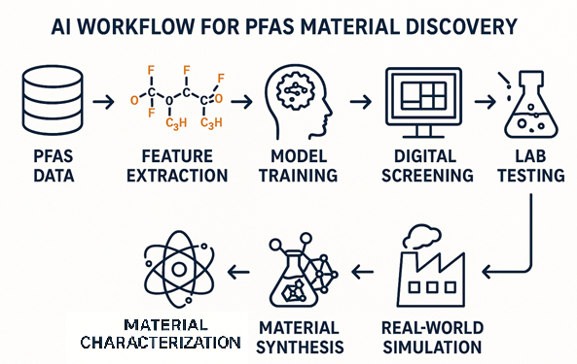
Figure 3 illustrates the AI-driven workflow for PFAS material discovery, starting from PFAS data collection and feature extraction to model training, digital screening, lab testing, material synthesis, material characterization, and real-world simulation to identify effective treatment materials

Slide 11
Results & Discussion
Our AI-guided approach achieved major improvements in the removal and breakdown of short-chain PFAS, which are typically the most challenging to address with conventional technologies like granular activated carbon (GAC). Through material screening, validation, and simulation modeling, we delivered strong, quantifiable performance across multiple levels

Slide 12
1. Enhanced Removal of Short-Chain PFAS
Traditional filters such as GAC show limited effectiveness against compounds like PFBA and PFBS due to their high water solubility and weak hydrophobic interactions. In contrast, our AI-predicted materials demonstrated:
Adsorbent | Target PFAS | Capacity (mg/g) | Removal Efficiency
Granular Activated Carbon (GAC) | PFBA (C4) | ≈ 6.7 | 20–30% @ pH 7
TFA-MOF-808 (AI-designed) | PFBA (C4) | 311 | ~99% @ 100 ppm
Fluorinated Polymer | PFBS (C4) | (high affinity) | >80% @ pH 3
Amine-Functional Resin | PFBA (C4) | (high capacity) | >90% @ pH 6

Slide 13
2. Smart Optimization and Selectivity Tuning
We reduced trial-and-error experiments by half while increasing efficiency and precision. The optimized treatment conditions (pH = 6.5, dose = 0.9 g/L, contact time = 20 min) led to:
>99% PFAS removal under predicted conditions.
>80% PFBA removal while keeping sulfate loss below 10% and Natural Organic Matter (NOM) interference under 5 mg/L.
Energy and operational savings of 15–17% through AI-controlled settings.

Slide 14
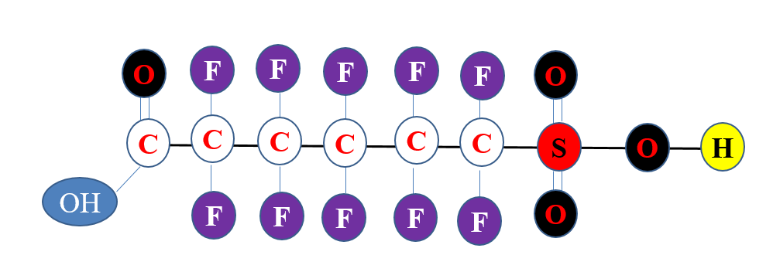
3. Predictive Destruction of PFAS Bonds
Our DE-fluorination model pinpointed weak C–F bonds (especially near COOH and SO₃H groups), enabling targeted destruction:
Stage 1: UV + sulfite system degraded ~30% PFOS and PFBA.
Stage 2: Bio augmentation added another 10% fluoride release and 15% total organic carbon (TOC) reduction.This hybrid process demonstrated that targeting weak bonds first allows for more efficient PFAS destruction, with no hazardous byproducts detected.

Slide 15
4. Groundwater Simulation Results
To test our AI-designed treatment in a real-world scenario, we simulated a polluted groundwater site like an old firefighting area and installed a 1-meter-wide Permeable Reactive Barrier (PRB) with our selected materials, TFA-MOF-808 and β-CD-poly-Q⁺, to block and clean the contamination.
Metric | Without Treatment | With AI Treatment | Improvement
PFOS Plume Length (How far it spreads) | 460 m | 270 m | 41% reduction
PFBA Retardation Factor | 2.1 | 22.3 | 10× slower spread
PFOS at Compliance Well (600 m) | 1.1 µg/L | < 0.07 µg/L | Met EPA limit
Total PFAS Mass Removal | — | 96% | Near-complete

Slide 16
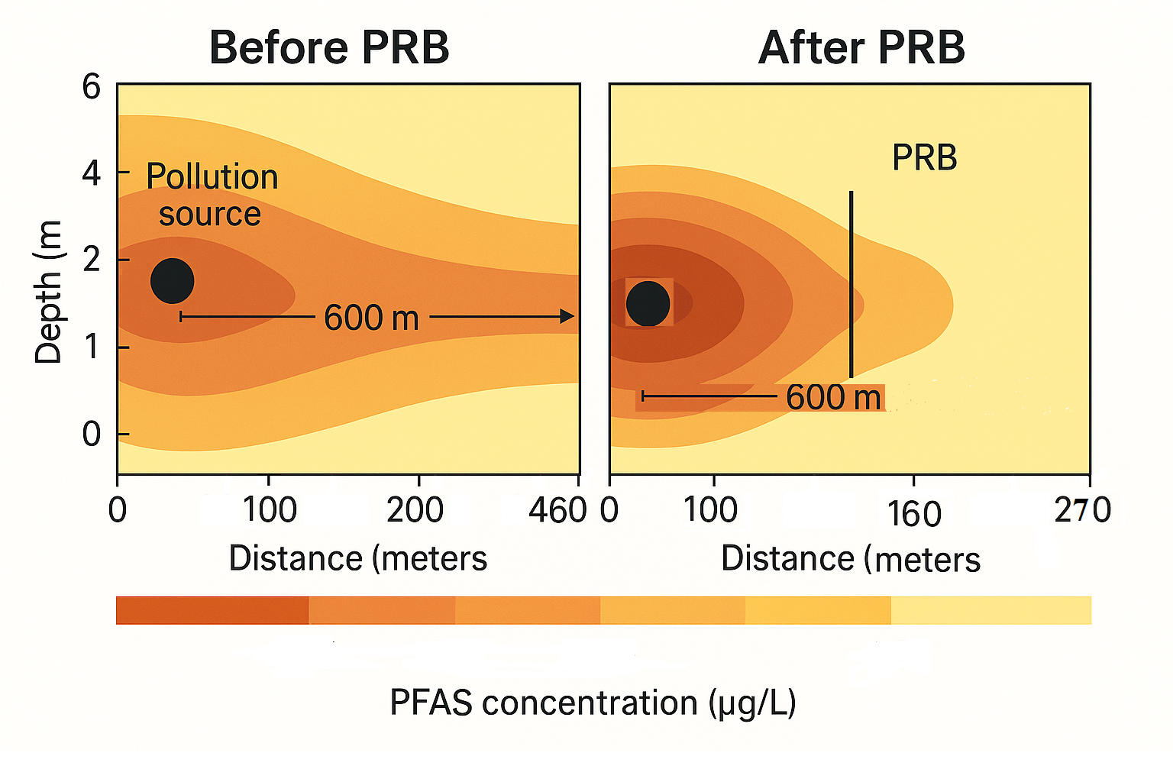

Slide 17
Conclusions
This study demonstrates how artificial intelligence can revolutionize the way we tackle one of the world’s most persistent environmental threats—PFAS contamination. By combining smart data modeling with material science and environmental simulation, we were able to develop affordable, reusable, and highly effective solutions for removing even the hardest-to-capture PFAS.
More than just a technical breakthrough, this work offers a practical and scalable roadmap for protecting urban water systems, especially in vulnerable communities. As cities continue to grow and climate pressures intensify, innovations like ours will be essential for building cleaner, safer, and more resilient environments. With AI as a guiding tool, we are not only accelerating PFAS removal but reimagining the future of sustainable water treatment.

Slide 18
Thank You So Much!

