Slide 1






The Global WOPs Community: CoP – MENA
Dr. Mai Wardeh, Program Management Officer, GWOPA
5 May 2025

Slide 2





What is GWOPA?
Enable WOPs to be well-known, effectively implemented, widely supported, and funded
The global network for public water and sanitation service providers and Water Operators’ Partnerships, hosted by UN-Habitat since 2009
Since 2020 located in Bonn, Germany
WOPs
Free membership for sector organizations and institutions & individuals
Membership
Advocates for WOPs as a peer support exchange on a not-for-profit basis
Not-for-profit

Slide 3
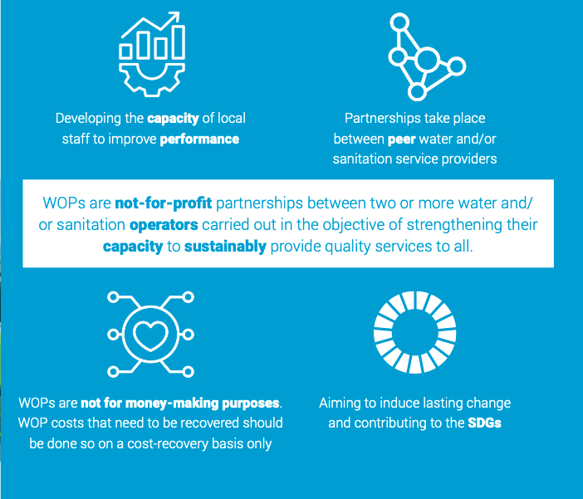
Water Operators’ Partnerships (WOPs)

Slide 4
The Global WOPs Community
Peer-learning, skills and capacity development of individuals beyond the WOPs projects and Programmes
Unite all WOP practitioners, platforms and programs in one place
Launch 2 years ago
Over 2,000 members as of today in one main group + closed programme-level groups + 10 thematic Communities of practice (CoPs) groups + NEW Regional groups
Space for easy communication, knowledge exchange and learning within and across projects in all regions in multiple languages
  Dissemination of existing knowledge products
  Co-creation of new tools and solutions
  Networking and matchmaking options

Slide 5
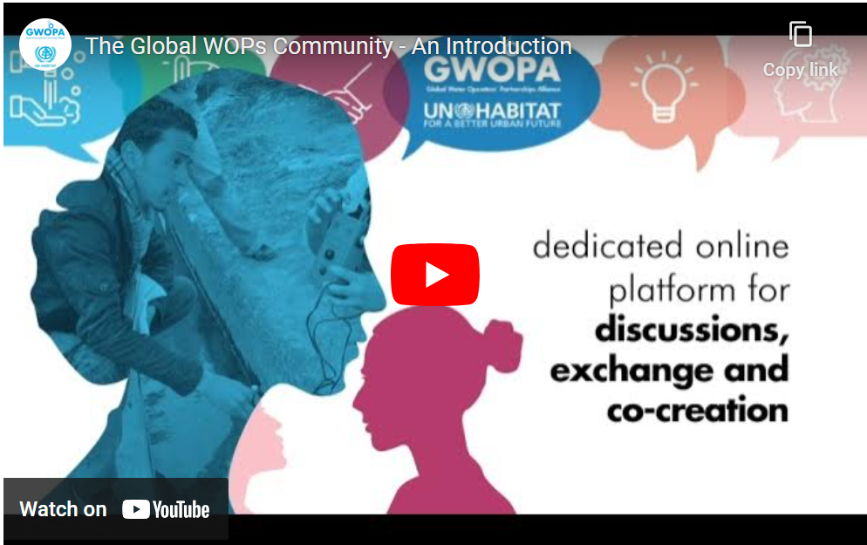
The Global WOPs Community with
Run in collaboration with
WaterWorX
An Inclusive
Not-for-profit/zero-cost
Co-owned space which is
Accessible to all

Slide 6





Global WOPs Community: Our vision
Connecting WOP practitioners from around the world, including water sanitation professionals/WOPs supporters to join forces towards SDG6
Intensified peer-learning, knowledge sharing and capacity development - accessible to all
Empowerment of individuals to connect and learn from one another beyond WOPs
Accelerate innovations and co-creation through thematic hubs
Inclusive and co-owned

Slide 7


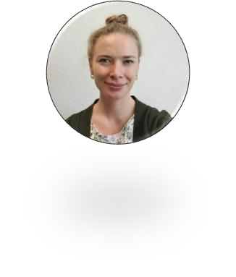
Community Structure
Community
“Co-owners”​
Global WOPs
Community​ Members
The Global WOPs
Community Members​
Hosted by the GWOPA Secretariat
Run in collaboration with WaterWorX
Managed by the GWOPA Community coordinators
Accelerated by WOP and COP Moderators
WOP Moderators​
WOP Programme &​
Project groups​
CoP Moderators​
Thematic CoPs​

Slide 8
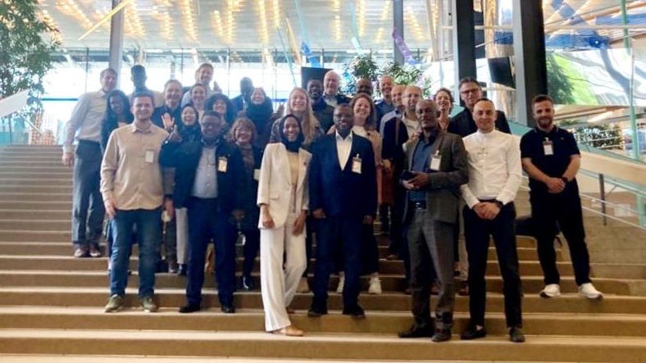
Moderators
Over 35 expert moderators for thematic and regional groups in the Global WOPs Community

Slide 9
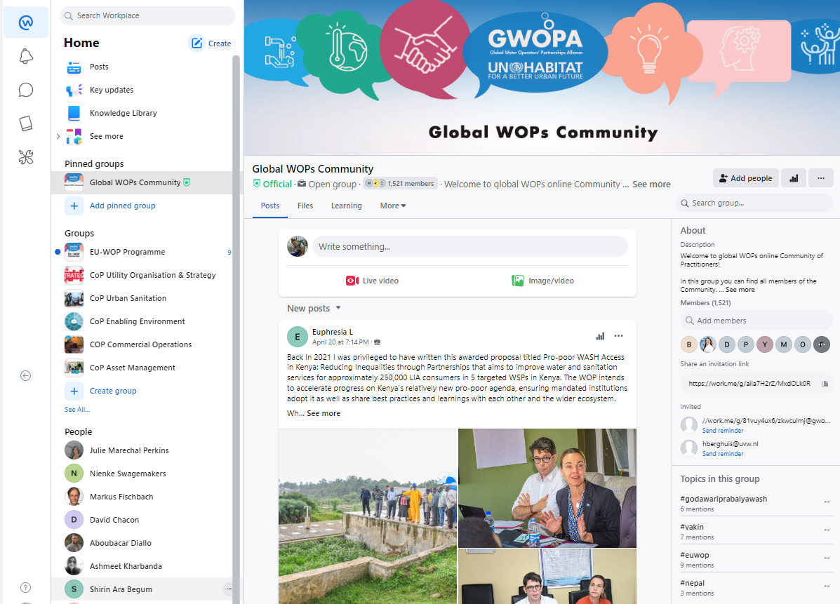

Slide 10
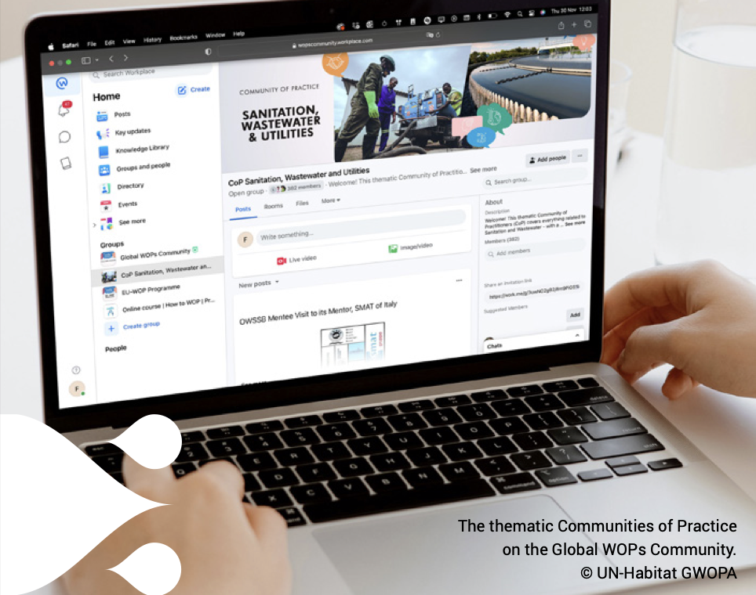
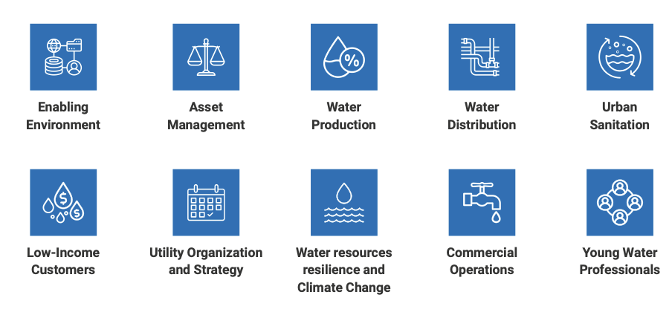
Thematic Groups

Slide 11
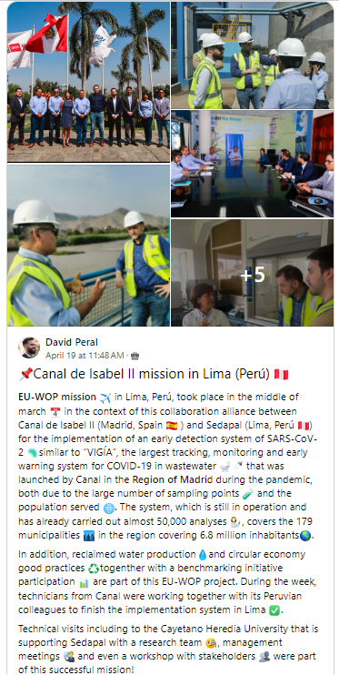
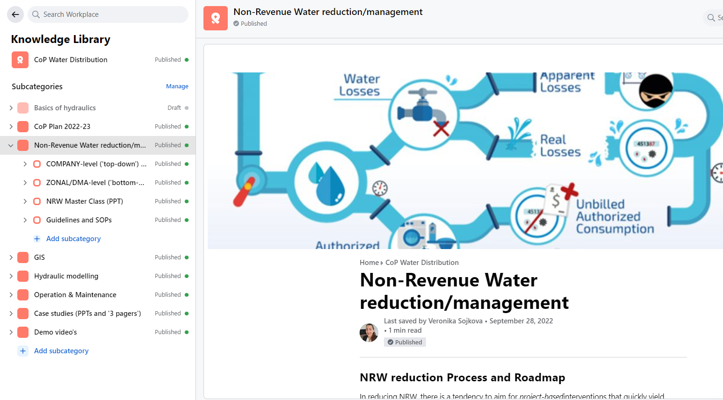
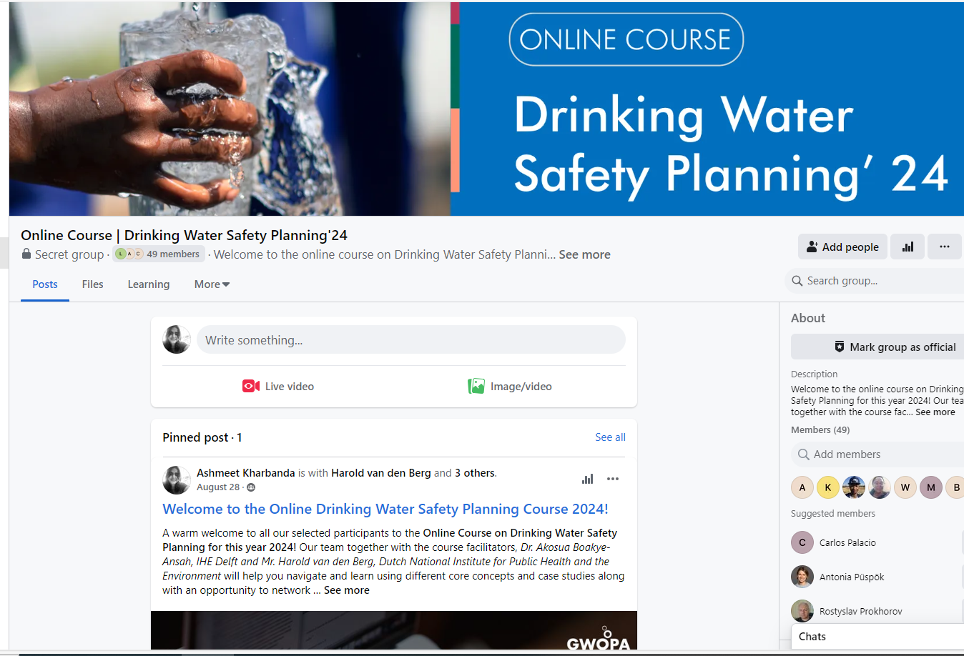
Co-creating and sharing knowledge on WOPs

Slide 12
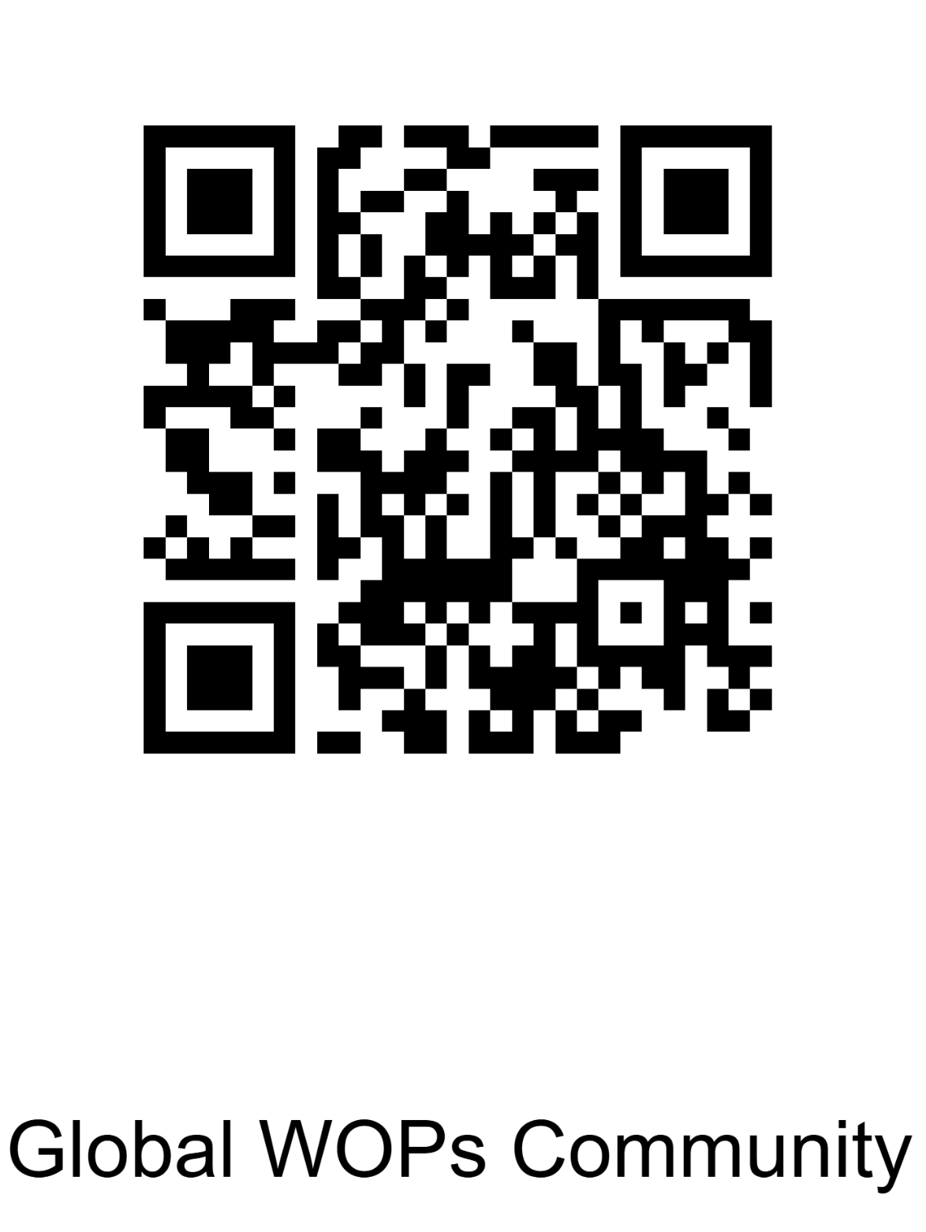
Feature of the Platform
📽 Live streaming & webinars
📚 Knowledge Library
🗣 Interactive forums & chat
📊 Analytics and engagement tracking
🔁 Multilingual Translation (100+ languages)
📱 Mobile accessibility
Know more about the

Slide 13
Why a CoP-MENA?
Objectives of CoP – MENA
🌍 Dedicated space for Arabic-speaking professionals
🤝 Regional collaboration & local knowledge exchange
📈 Build capacity on water scarcity, climate resilience, and service delivery
Strengthen collaboration in the region
Host trainings/webinars in Arabic
Curate & share region-specific best practices
Enable peer learning and innovation
Promote diversity and inclusivity
Notes:
Global Community – A Foundation:
Our Global WOPs Community, hosted on the Workplace platform, now connects over 2,200 members in 187 countries. It’s a space for peer learning, technical collaboration, and exchanging best practices across borders.
Now in MENA – Why This Matters:
With the MENA region facing acute water stress, climate-induced risks, and service gaps, there is an urgent need for localized exchange and capacity building.
That’s why we’re launching a dedicated Arabic-speaking Community of Practice to support utilities, practitioners, and decision-makers in this region.
Features & What to Expect:
This new CoP will be:
A space for trainings and webinars in Arabic
A hub for regionally relevant resources
A platform for joint initiatives and networking
And above all, a safe, inclusive community guided by GWOPA’s code of conduct

Slide 14

Join the Community now!
Register by filling the form
Receive Workplace invitation
Create your login credentials and get
started!
Register as Individual Member
Scan the QR code or fill the registration form via this link: https://encr.pw/zwAoG

Slide 15


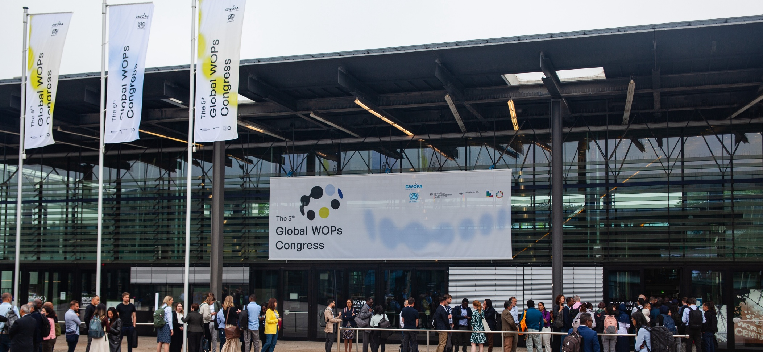
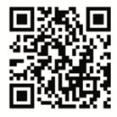
Save the date
The 6th WOP Congress 27-29 October 2025, Bonn, Germany
Launch of the CoP – MENA
Find out more about GWOPA
gwopa.org l www.un-habitat.org

