Slide 1




GIS Strategic Plan
Presenter: Dr.Moath Abu-Rumman
Date : 4/5/2025

Slide 2
GIS Strategic Plan by ICTD
نظم المعلومات الجغرافية
Geographic information system

Slide 3
content
  Purpose.
  Background .
  Current situation and water sector in context .
  Mission .
  Strategic initiative .
  Goals and objective .
  Standards across system.
  GIS consideration (editing , view )in water company and water administrative.
  Environmental scan (internal scan)for HW ,SW, communication
  Restructure GIS data and data model
  Documentation standard operation procedure ,work flow ,staff classification
  Training staff on new solution
  Recommendation

Slide 4
Purpose.
The purpose of GIS strategic plan is to define vision , standers , procedure , policies that will support and improve effectiveness and efficiency in GIS at ministry of water and irrigation .
This strategic plan will scan internal environment in MWI then evaluate current situation determine gap then present recommendation and solution as a proposal for future GIS in WAJ
This strategic plan will answer these question :
  Where we are ?
  Where we go ?
  What we have ?
  What we need ?

Slide 5
Background
GIS data was drawn and use paper map WAJ has worked on different gis project in different area and building digital layers through use customer document and paper map ,scanning and digitizing ,infield survey using hand held GPS , these project shift from paper map to digital map.
Gis software used in WAJ called ArcView then ArcMap different version and now they use ArcPro with ArcGIS enterprise server these from ESRI company supported by local company called infograph.
GIS STAFF IN administrative and water company belong to WAJ build Many layer , staff mange and maintain theses layers and some other staff they don’t do that
GIS paly major role in business

Slide 6
Current situation.
GIS is distributed database over water company and administrative managed under GIS staff in each area.
The main SW used in different area is ESRI SOFTWARE (SDE DATABASE ,ARCGIS SERVER,ARCGIS DESKTOP).
GIS STAFF manage and maintain different layer (water, sewer, facility, ..
SDE build on different DBMS three water company on oracle DBMS and other administrative on SQL DBMS or personal geodatabase or shape file .
GIS Water utility data model from ESRI customize in three water company in different way ,other administrative used data model from PMU .

Slide 7
water sector in context
See appindex

Slide 8
Mission .
The mission of WAJ GIS is to replicate distributed gis database to central database over communication technology to improve availability accuracy, increase efficiency by reducing redundancy , To support decision making and data transparency for people in country .

Slide 9
Strategic initiative
Increase cover range of GIS analytical for national strategic project
Standardized GIS data and Data base model to enable homogenies system that allow data and Geodata , system integration .
Increase accessibility for stakeholder and public to achieve transparency goal.
Continuing GIS as centralized spatial database .
Continuing innovation and creativity in using new technology at water sector GIS field .

Slide 10
Goals and objective
Standardized across GIS enterprise system .
GIS consideration (editing , view ) and role for parent and child (privilege).
Scan environment for (SW and HW ) update.
Restructure GIS data and data base model (customize).
Documentation of SOP’s and work flow.
Improve knowledge exchange
Integration with other system
Training staff (online, offline ,infield )
GIS Staff classification
Engage government sector and private sector building national database

Slide 11
Standards across system.
Heterogeneous system and database is biggest barrier when working with data over distribution database with different data model and different DBMS,
Each database management systems have different standers and don’t have an standard at all to get centralized and join data together.
It Most important to address standard set by GIS current system and future system to integrate and migration ,its not only communication .
Recommendation
  GIS standard committee representative from different water company and administrative set standard data model
  adapt and adoptive water utility data model from ESRI over all MWI ,three water company customize this model to business need.

Slide 12
GIS consideration
Manage and maintain (editing, load data, view)to GIS database its most important component to keep data up to date.
who will manage and maintain the data ?
Who will Control and monitor accuracy of data?
Where data will be stored?
Information and format of data (asbuilt) from contractor and other source like purchase department (asset management).
Recommendation :
  Each GIS staff in water company and administrative (manage and maintain )its own database monitor accuracy stored and backup DB and sure that one way replication process is done from chiled to parent.
  GIS staff in center will view ,analyses and control accuracy of centralized database(all data from all source) is replicated to center Database.
  Adrees standared data formate from external source .

Slide 13
Environmental scan for HW ,SW, communication
Directorate\company | Data model | DBMS | Software solution | Communication | Recommendation
MWI center | esri/pmu | SQL | ARCGIS SERVER,ARCGIS DESKTOP | available | Adopt esri datamodel and oracle DBMD
Yarmouk water | Customized ESRI | oracle | ARCGIS SERVER,ARCGIS DESKTOP | available
Aqaba water | Customized ESRI | oracle | ARCGIS SERVER,ARCGIS DESKTOP | available
Miyahuna | Customized ESRI | oracle | ARCGIS SERVER,ARCGIS DESKTOP | available
Balqa administrative dearalla and south sh | PMU | personal /shape | ARCGIS SERVER,ARCGIS DESKTOP | available | Adopt esri datamodel and oracle DBMD,ARC GIS SERVER
Karak administrative | PMU | personal /shape | ,ARCGIS DESKTOP | available | Adopt esri datamodel and oracle DBMD,ARC GIS SERVER
Maan administrative | PMU | personal /shape | ARCGIS DESKTOP | available | Adopt esri datamodel and oracle DBMD,ARC GIS SERVER
Tafela administrative | PMU | personal /shape | ARCGIS DESKTOP | available | Adopt esri datamodel and oracle DBMD,ARC GIS SERVER
Recommendation in table need coordination with IT

Slide 14
Restructure GIS data and data model
Different layer and data set with different structure The ArcGIS Water Utilities Data Model provides the foundation for a complete GIS solution needs of Water/Sewer.
The Water/Sewer ESRI Data Model is a collection of objects, feature classes and attributes defined for water and wastewater distribution networks.
ESRI support about 30 Data model for customers.
The ESRI model can be customize to meet project MWI business requirement.
Recommendation :
  GIS standard committee representative from different water company and administrative set and address customizing and restructure data model ,domain and data type.
  GIS committee can adapt and adoptive another data model like(Irrigation data model ,ground water data model ,land parcels ,raster , geology data model .

Slide 15
Work Flow, Documentation SOP ‘s ,
Workflow :is a model to represent real work(pattern ,repeatable activates )for further assessment set systematically to utilize resources in efficiency manner .
SOP’s :standard operation procedure assessment and agree from all water company and administrative .
Documentation :workflow and SOP’s can be documented as a knowledge data bas and all stakeholder can retrieve and learned.
Recommendation :
  GIS standard committee representative from different water company and administrative set workflow include replicate data from child to parent
  Set SOP’s and agree from all and each employee is responsible and accountable .
  Create knowledge database accessible from all stakeholder

Slide 16
GIS staff classification
GIS leadership/management :set vision and strategic business goal align with MWI strategy ( administrative manager , GIS manager).
GEO-enabled: access and leverage power of location using existing IT application(GIS viewer ,GIS user publisher) .
GEO-centric : use arc ARCGIS platform to create and share information product(Gis analyst , map designer ,data editor).
GIS administration /technical :responsible on application design and administration of the arcgis platform(DB admin, WEB admin, ARCGIS online “portal” admin, GIS app developer ,WEB developer, mobile app developer )
Recommendation :
  WAJ has different project structure water company and administrative different job specification and description its not barriers to centralized data .
  (WAJ center) required to select job position and build new structure with job description and specification according to above classification from ESRI customize to business requirement .

Slide 17
Training staff on new solution
Prepare schedule staff training is very important to ensure GIS platform utilized effectively .
ESRI provide data model discussion forum to share your ideas, thoughts, and questions with other users.
ESRI provide Case Studies to learn about best practices.
ESrI provide annual conference to exchange knowledge
Recommendation : training course minimum requirement
  (1)Introduction to Arcpro for GIS professional and Deploying (2) maintaining a multi user GEO database(3)Arc Gis 4:sharing content on the web (4)Arc Gis :user publisher work flow
  Quarterly support GIS staff with new knowledge .

Slide 18
Recommendation
Setup steering committee from administrative and water company manager
steering committee Annual review GIS strategic plan vision and strategic objective
Setup GIS standard committee representative(key persons GIS manager) from different water company and administrative.
GIS standard committee responsible and accountable to achieve strategic objective and standard .
GIS standard committee Quarterly meeting to evaluate current implementation of strategic plan and make correction action if need .

Slide 19
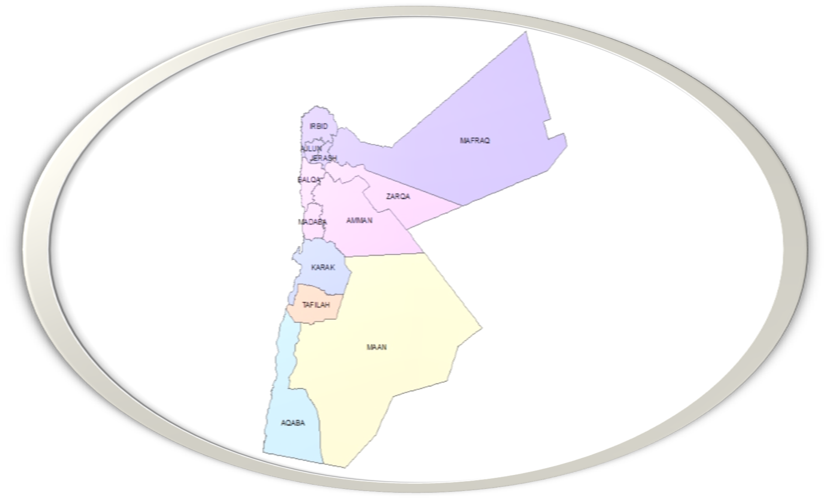
GIS geographic information system
Is a decision support system provide decision “structured decision” to manager to take decision. And we can say is a control system

Slide 20
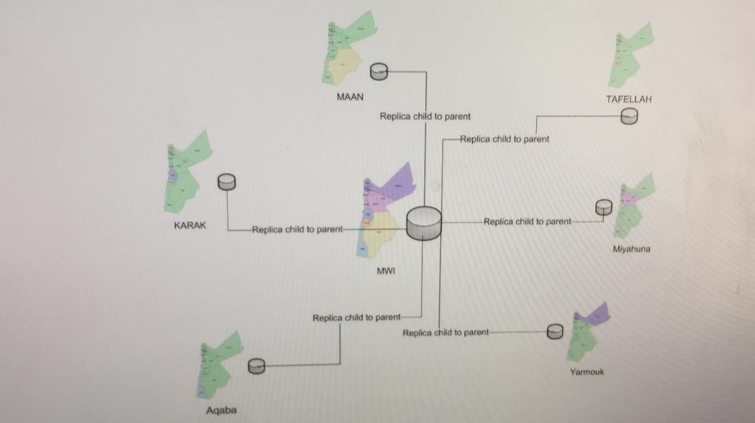
Current situation with out replica

Slide 21
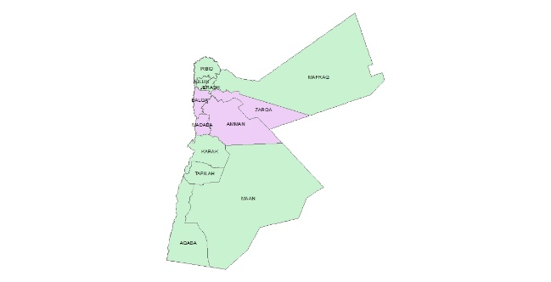
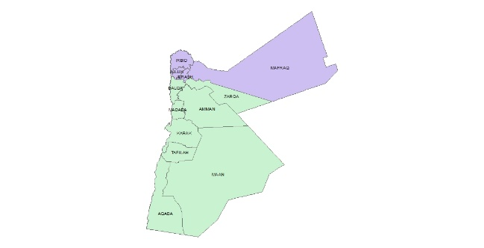
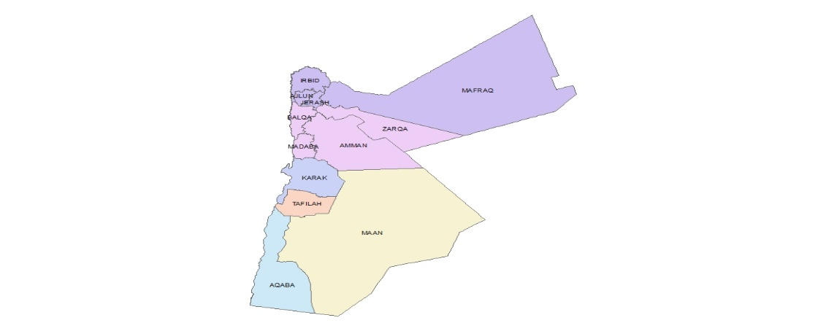
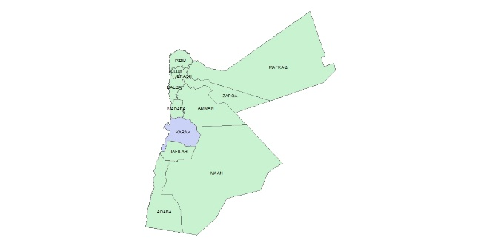
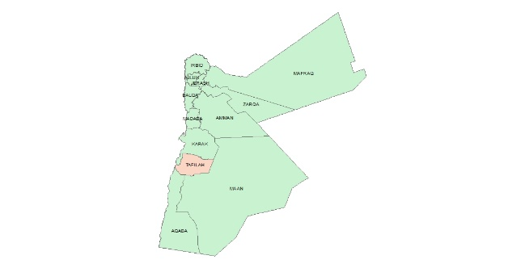
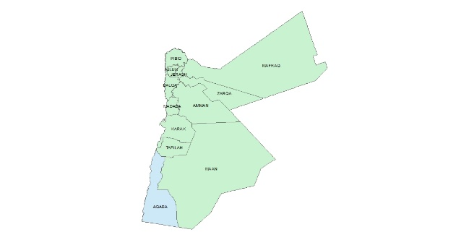

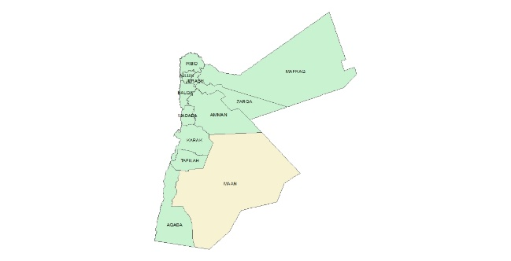
Replica data to center
Proposal
Current situation

Slide 22
Objectives
Define GIS as decision support system
Define the benefits of (GIS) based on typical business need
GIS activates
Feedback system for
GIS activities
Disadvantage for existing gis in water sector
Proposal for GIS in water sector
Conclusion

Slide 23
WAJ realizing the benefits of (GIS) based on typical business need
To offer : Produce standard maps ,study , shop drawing , as built
To develop water and sewer utility
To support different managerial level like Manage operations activities(reading route ,collection area, sewer complaints etc )
Update GIS databases with as built and digitizing
To maintain and sustainability of water and sewer system Integrate with other enterprise systems
Analyze network for planning and improvement projects

Slide 24
GIS activities
Install water and sewer asbuilt project on gis db
install and confirm water resources on gis db.
support study department gis data to make study.
Support all directorate required maps.
Install bulk meter on gis db
Install all facility on gis db
Update dls basempa on gis db for new subscriber
Connect subscriber with parcel location
Analyses data (density of complaints and area with out sewer ,etc

Slide 25
Digitizing
Digitizing:scanning a photo or a document – into bits and bytes, you are digitizing that object. Scanning a document into a digital archive creates a digitized version, encoded with ones and zeroes, without altering what is written in the document or activating it in a process.
Digitization refers to the process of converting physical objects into digital format. An example of this would be document scanning, where text from physical paper is converted into PDF or other digital formats, which are then stored in the computer.
Digitization’s purpose is to encode information in computers by converting from analog to digital format. The process mainly deals with recording data that can eventually be used in digital technologies.

Slide 26
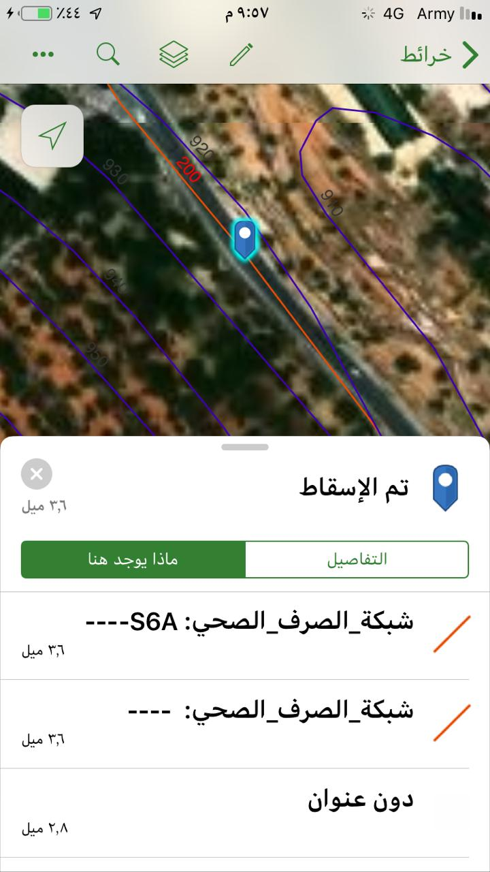
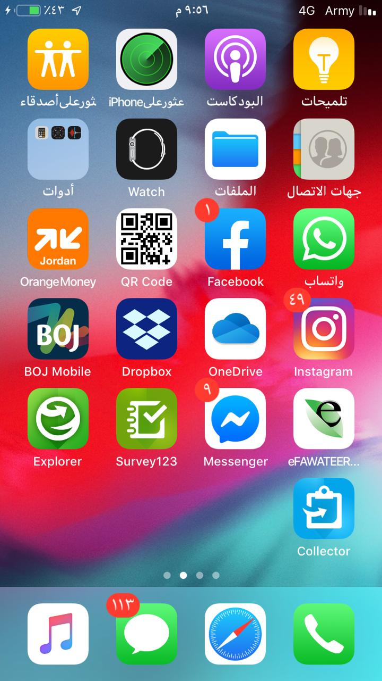
GIS in field(using esri explorer)

Slide 27
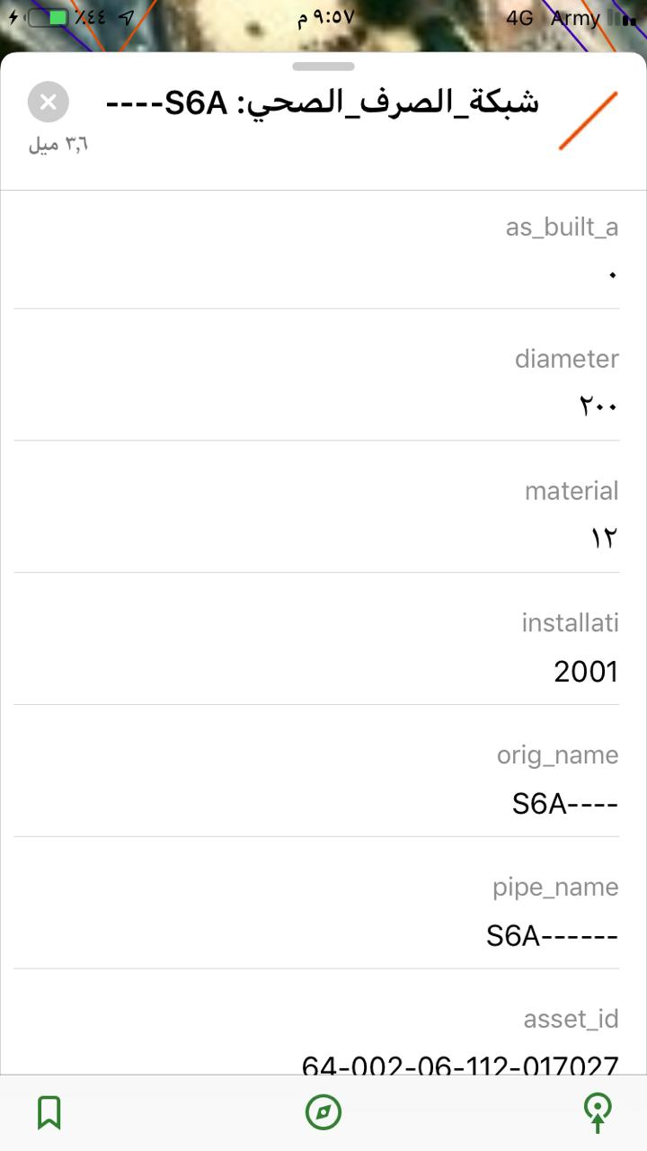
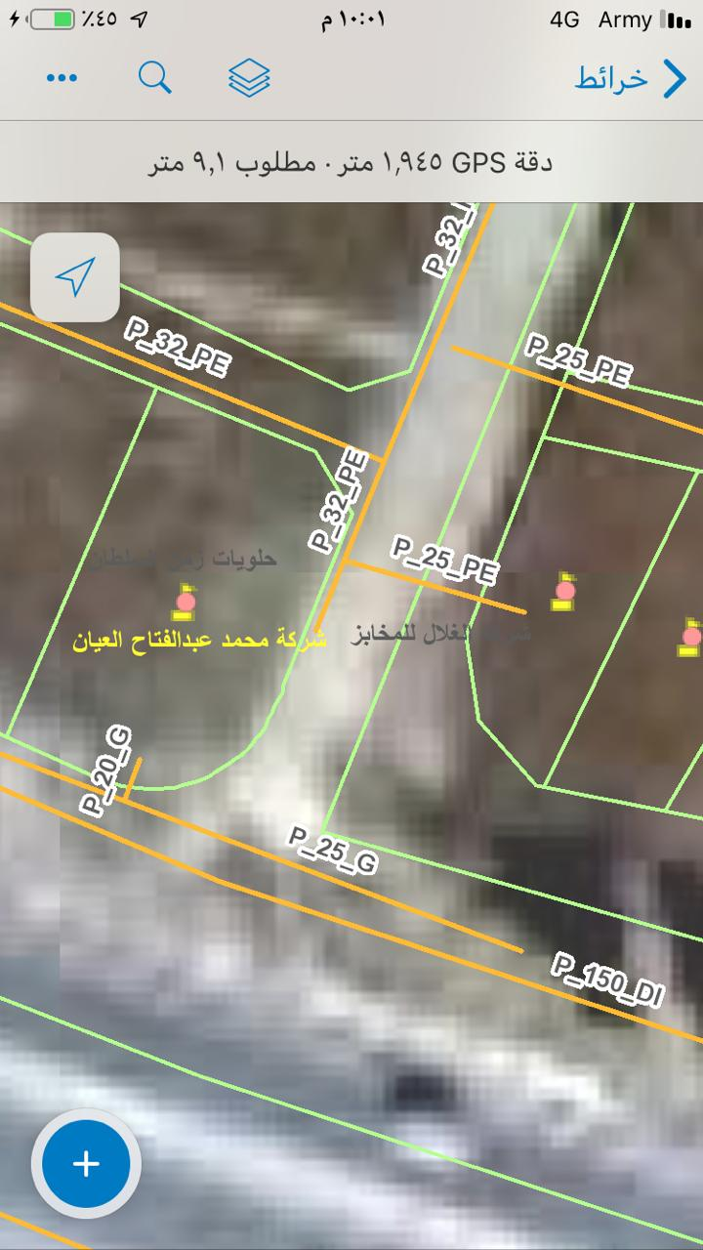
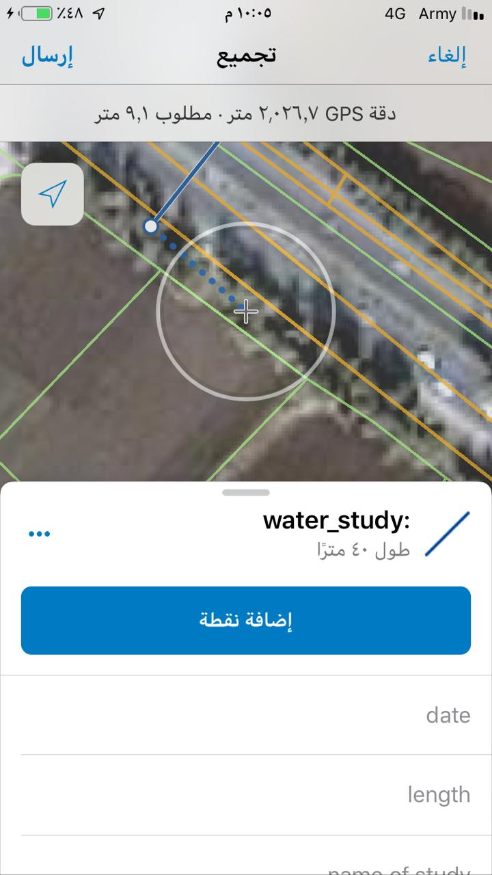
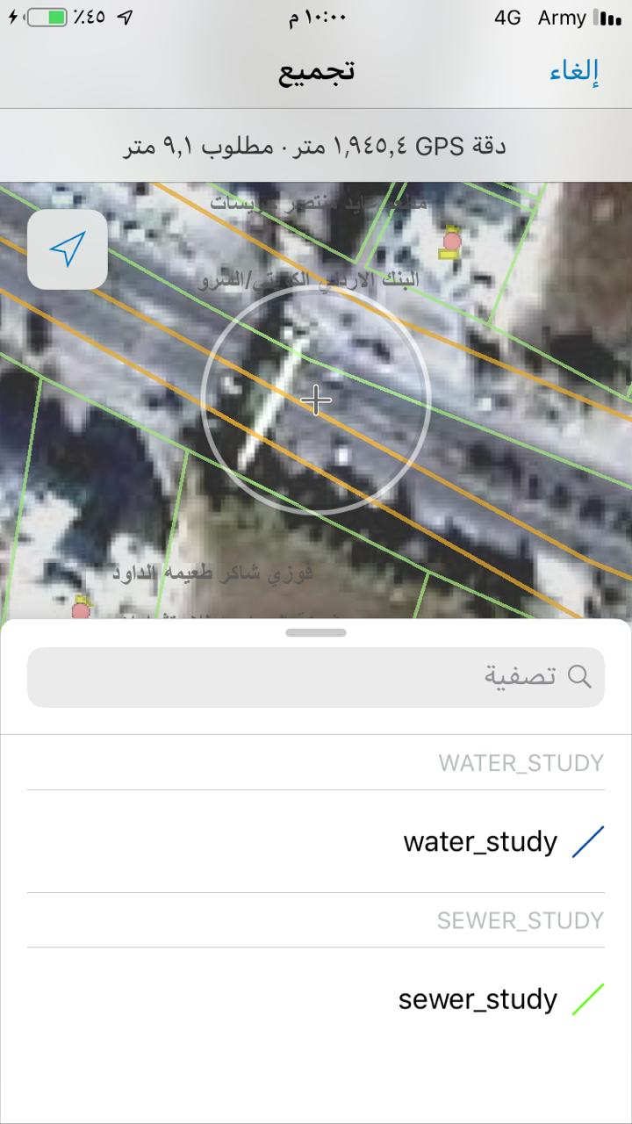
GIS in field(using collector)

Slide 28
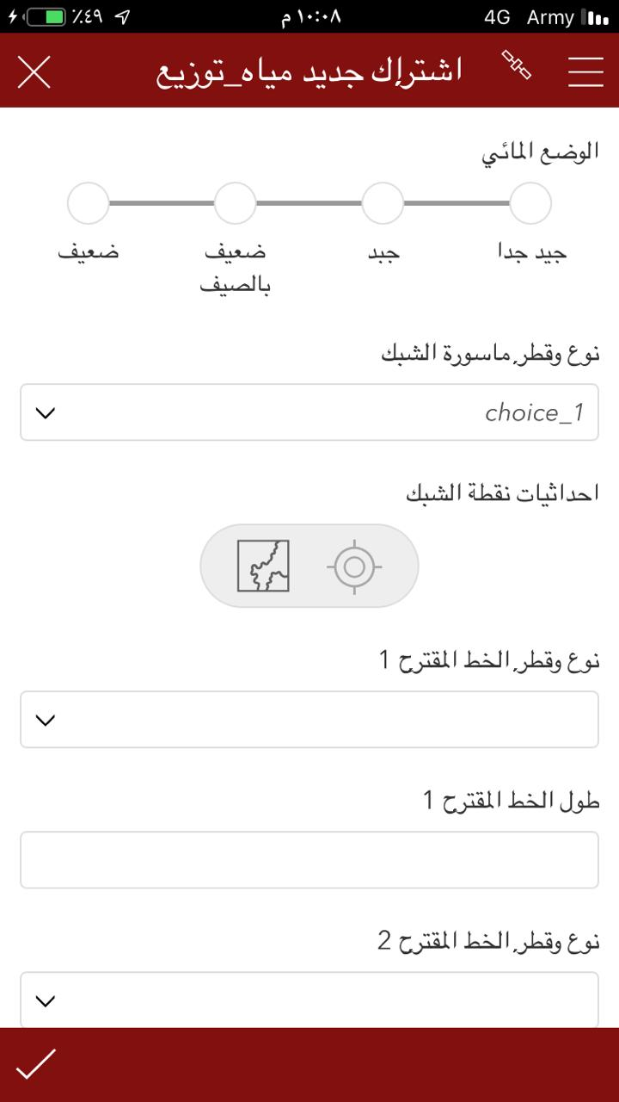
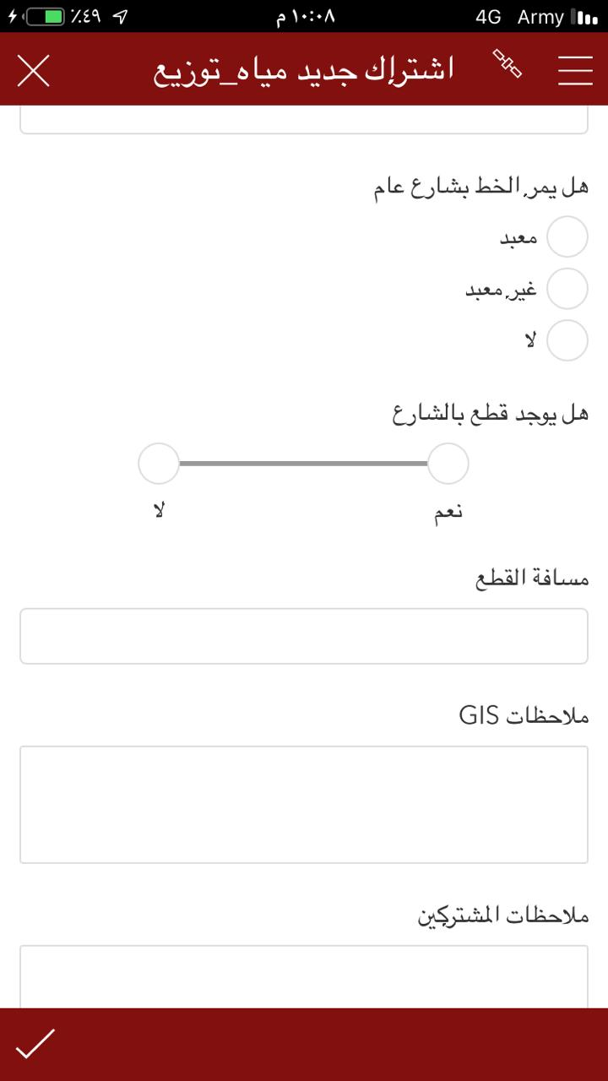
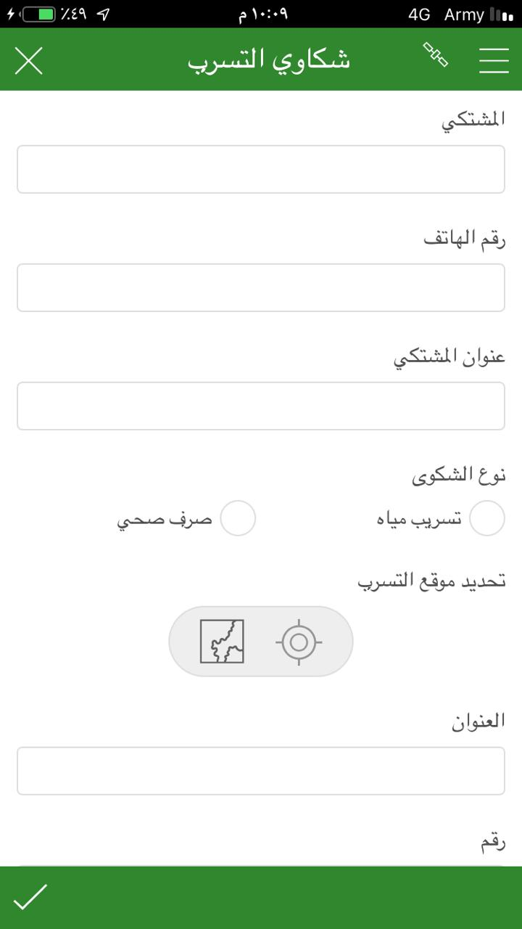
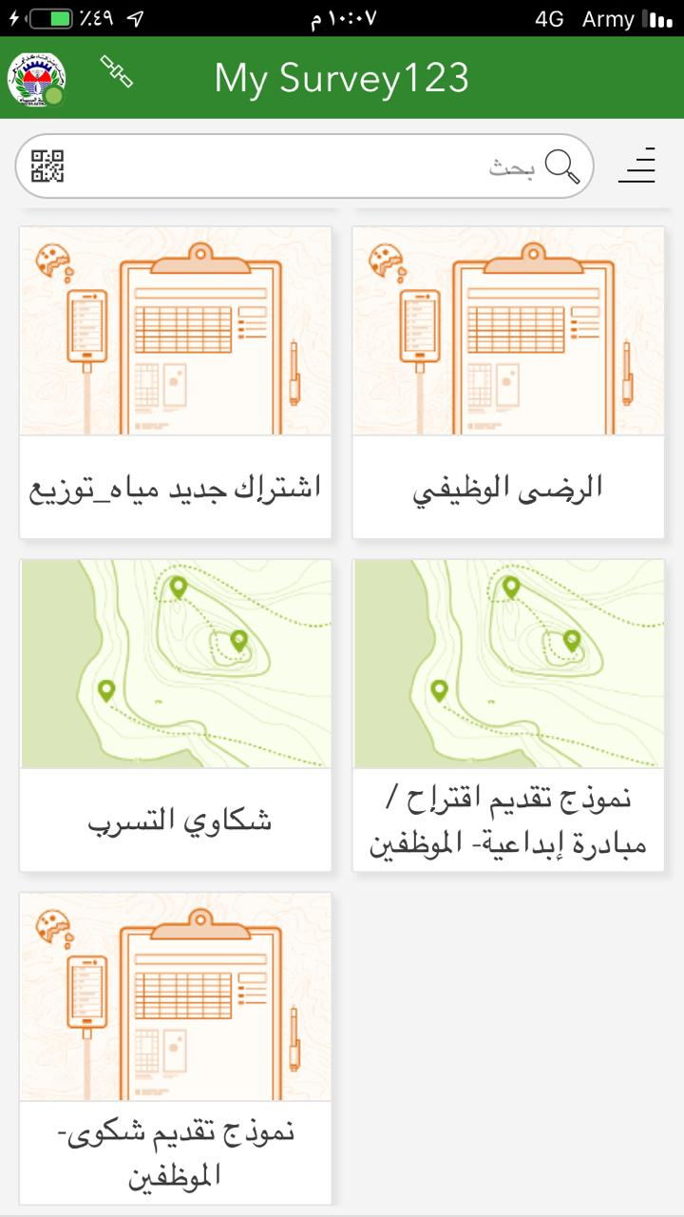
GIS in field(using survey123)

Slide 29
Digitalizing
Digitalizing:when data from throughout the organization and its assets is processed through advanced digital technologies,
digitalization is all about developing processes and changing workflows to improve manual systems. An example of this would be using digitized customer data from different sources to automatically generate insights from their behaviour.
Digitalization deals with information processing, or how digitized data can be used to improve workflows through automating existing processes.

Slide 30
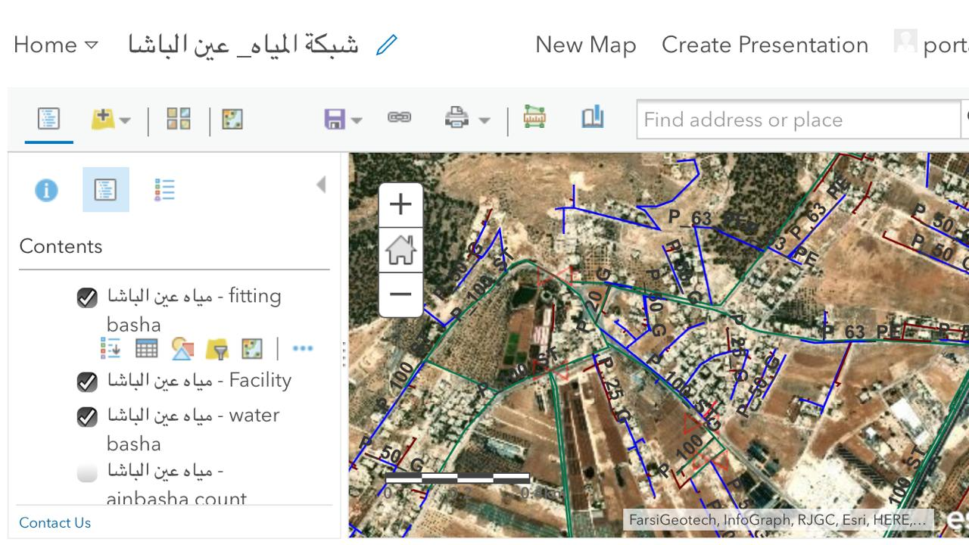
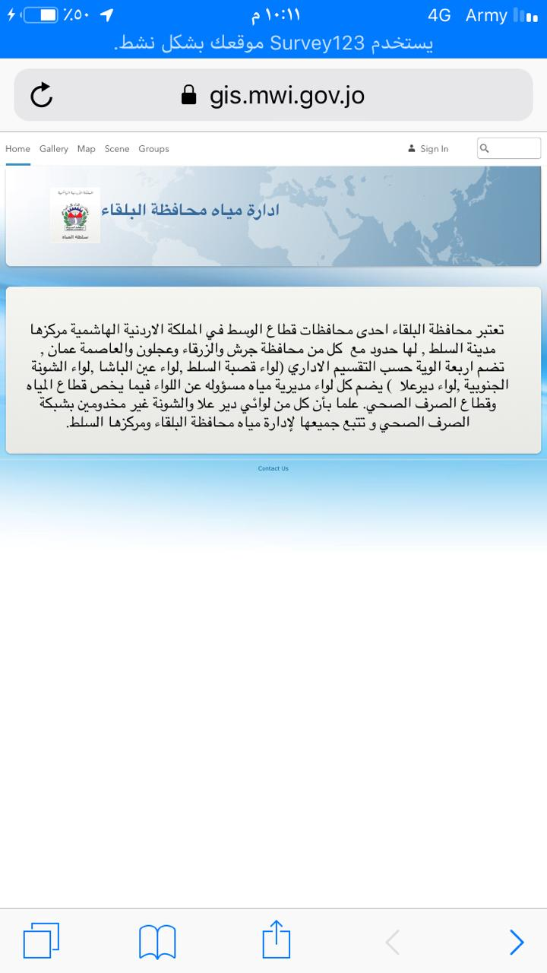
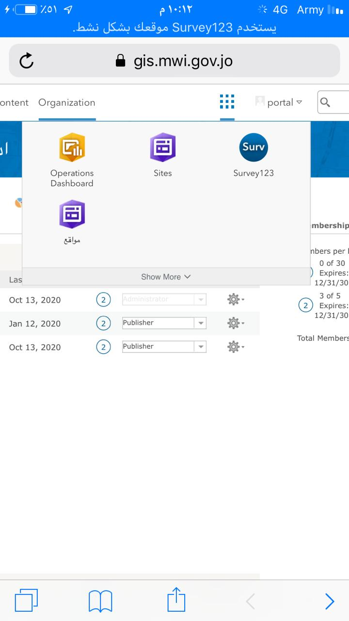
GIS enterprise server (web map ,portal,site,dashboard)

Slide 31
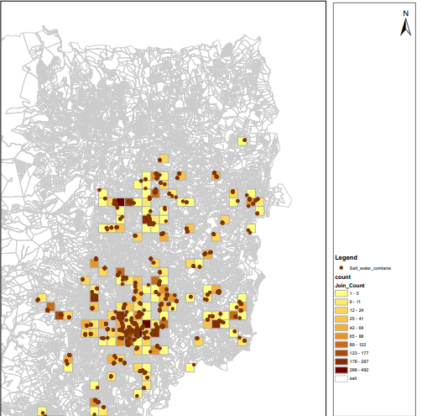
Density of complaints

Slide 32
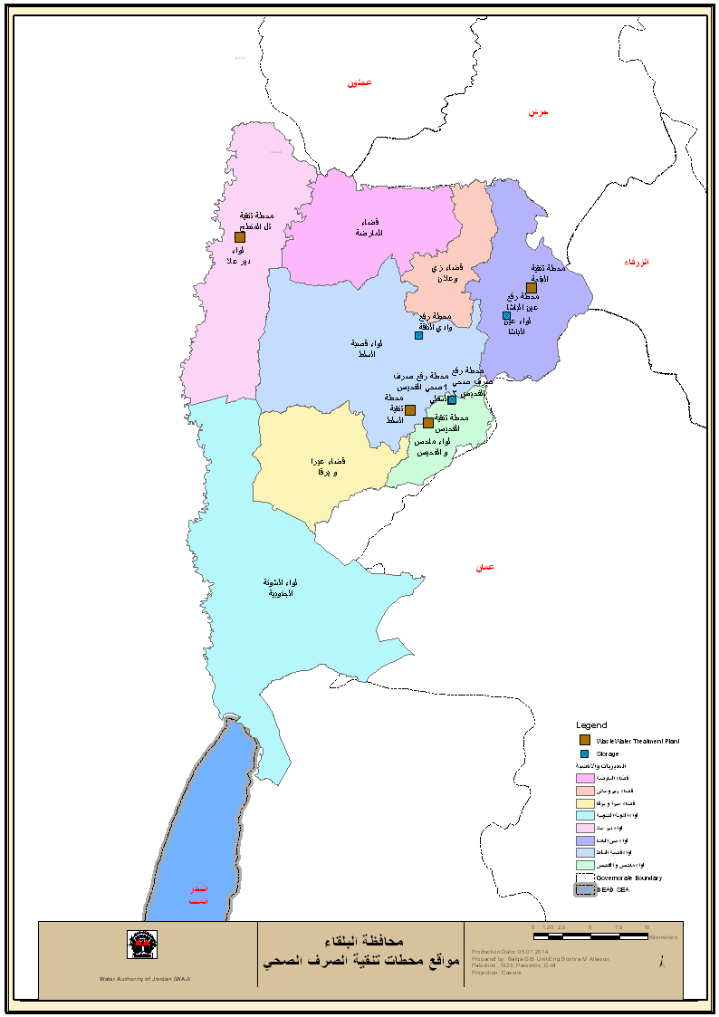
Treatment plant location

Slide 33
Digital transformation
digital technology is incorporated into all areas of the business to fundamentally improve efficiency in workflows and create value for customers. Cultural, organizational, and operational changes are implemented through the integration of digital technologies. Digital transformation allows businesses to adapt to ever-changing industry trends and landscapes.
digital transformation is all about leveraging knowledge and integrating it in all business areas to enhance engagement and create new value.
(dashboard BI ,AI patterns sliding (window slide hourly ,daily ,weekly ,seasonaly …)

Slide 34
Numbers in Next Slides didn't present Reality

Slide 35
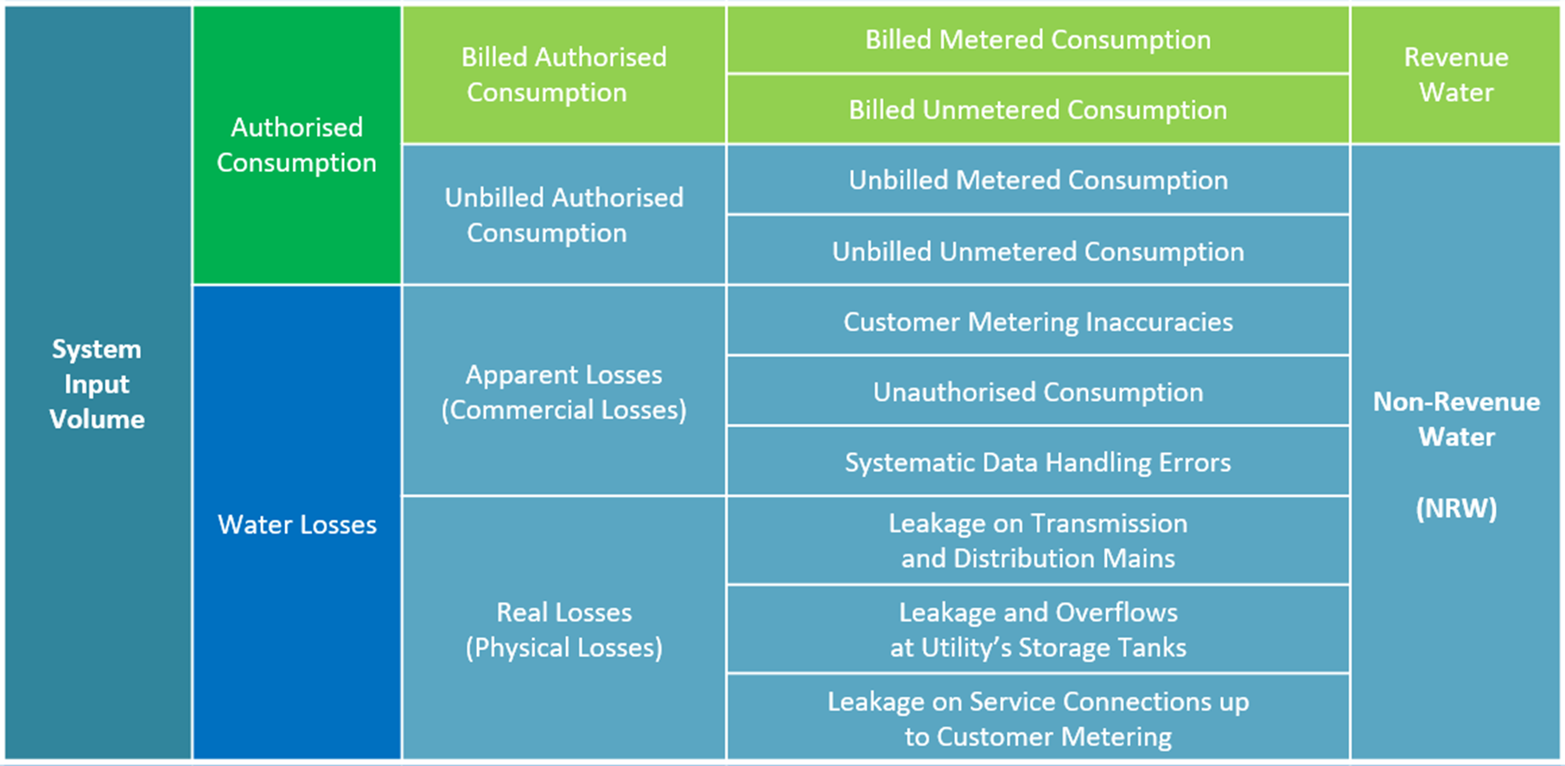
Integration GIS and SCADA to develop Business intelegancy Dashboard Balance Water sheet(Water losses –Real losses

Slide 36
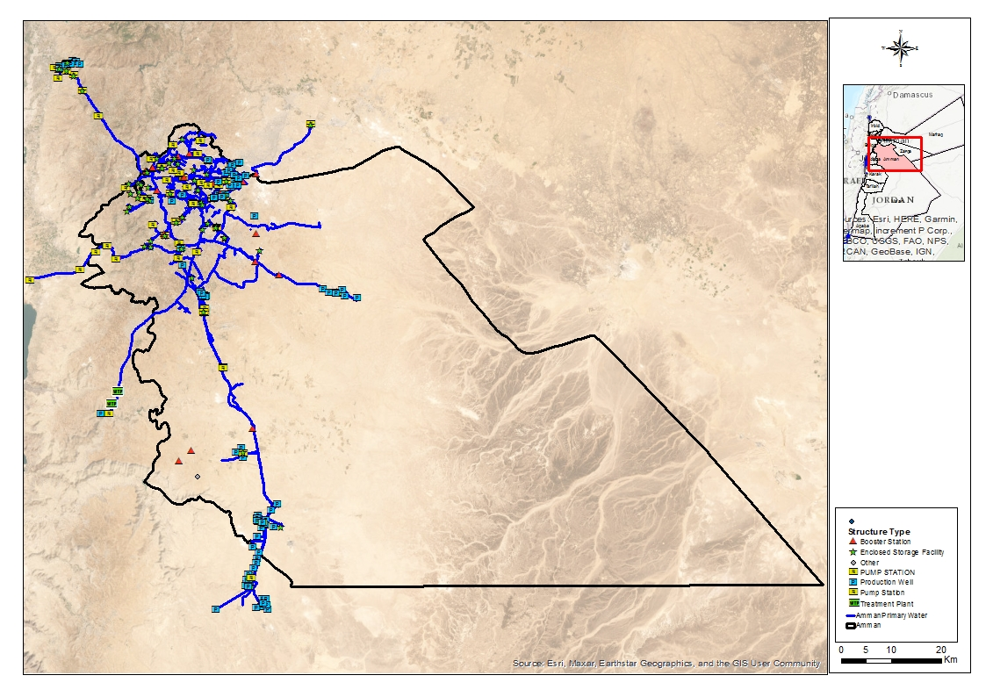
Amman Case Study

Slide 37
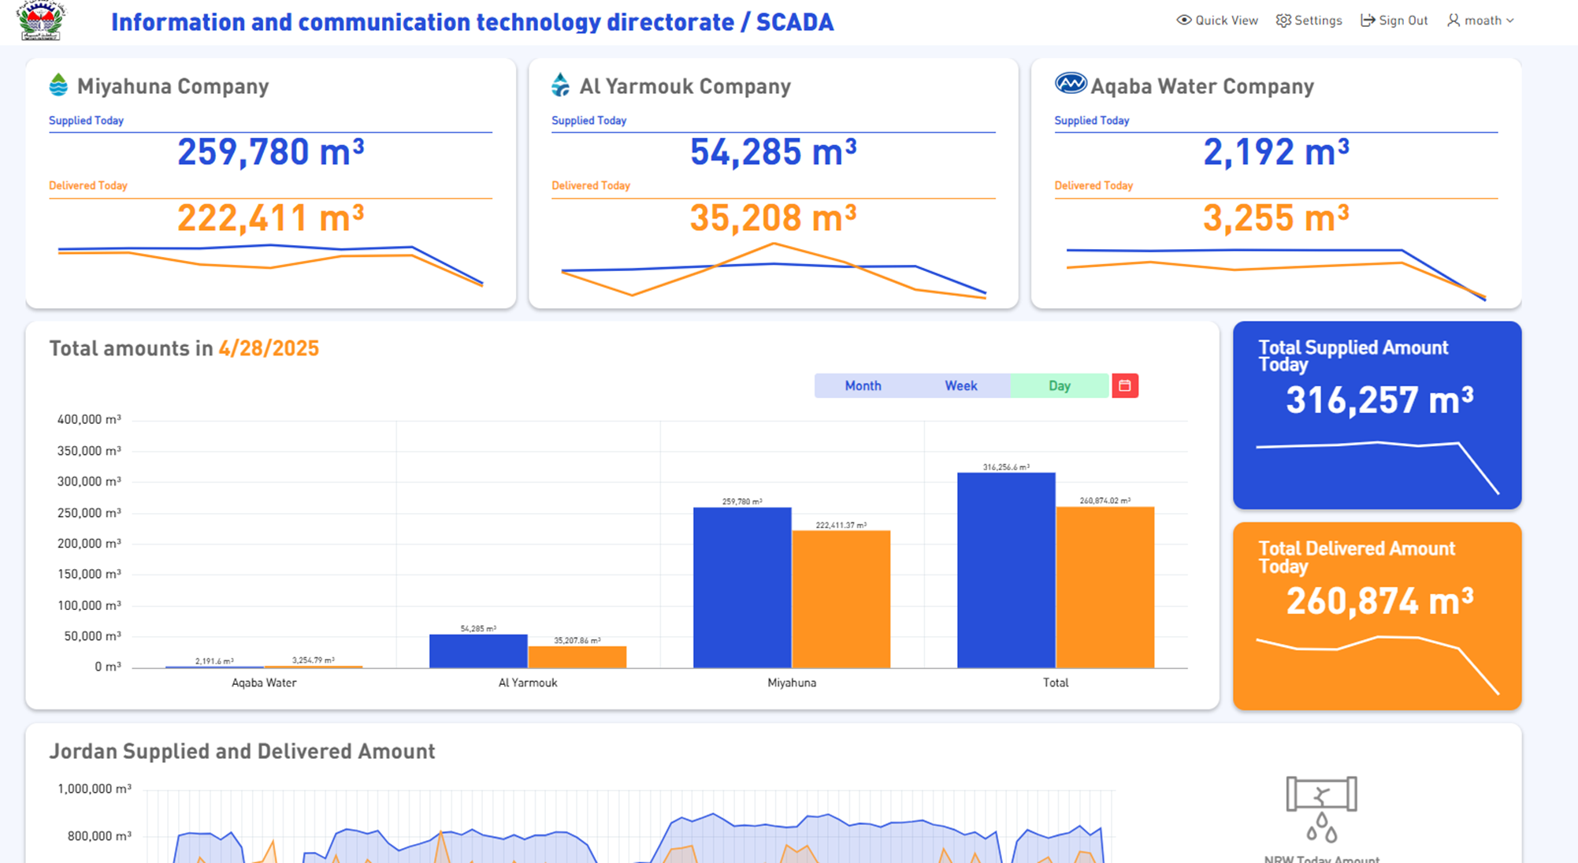
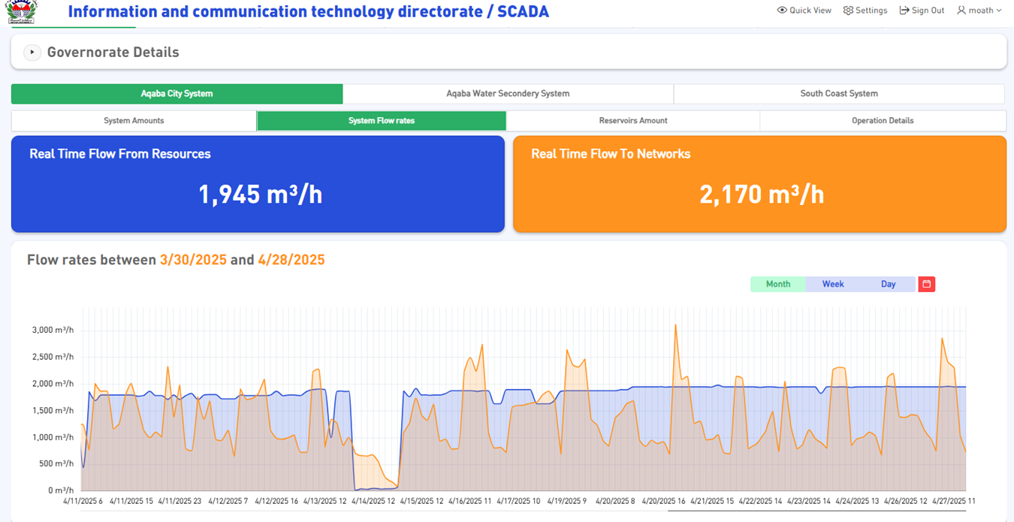
BI :Drill down Water loss
Numbers in Next Slides didn't present Reality

Slide 38
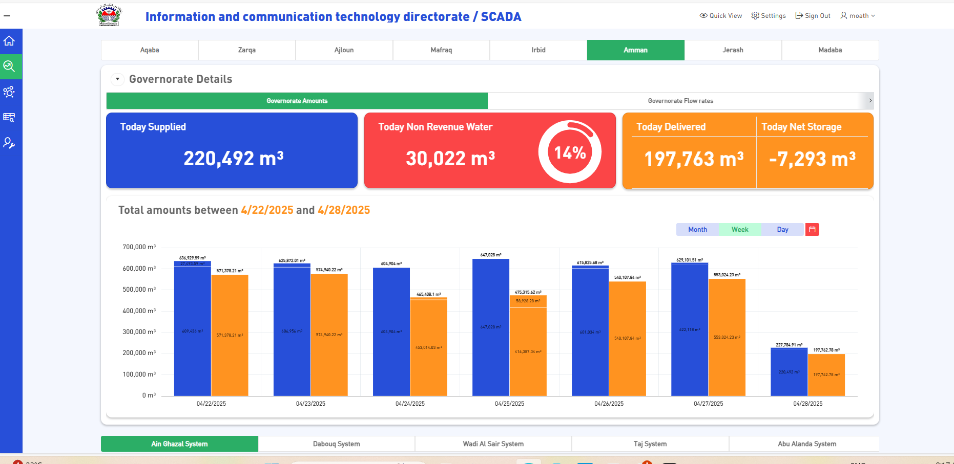
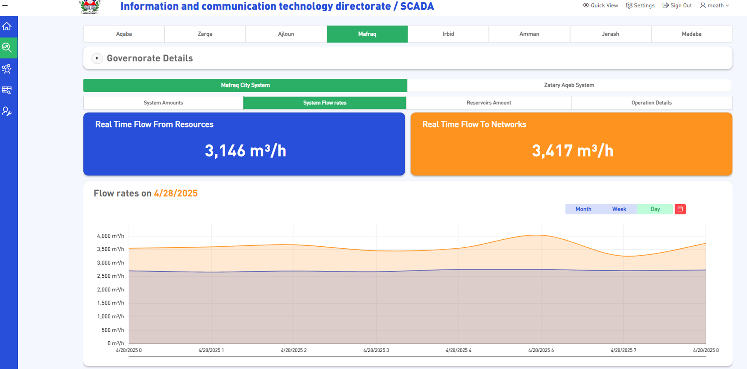
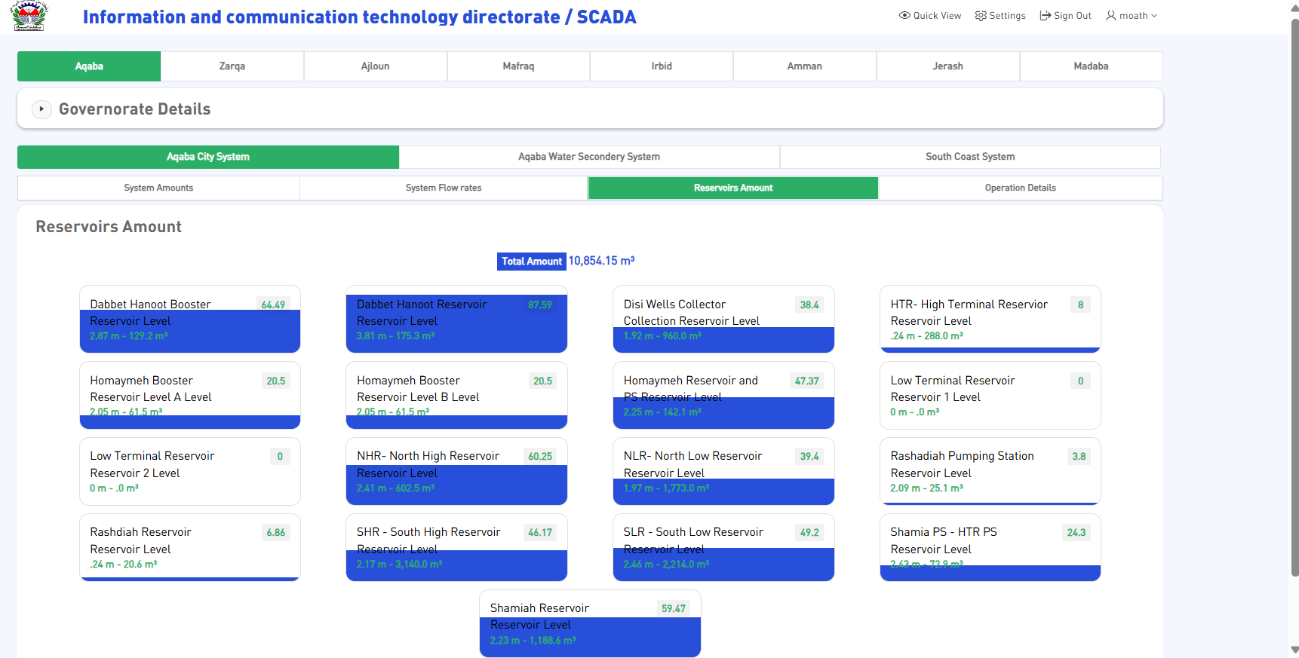
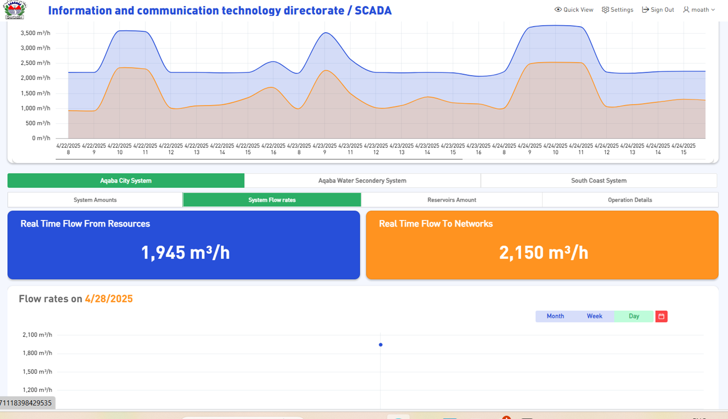
Governorate –water system – Reservoir

Slide 39
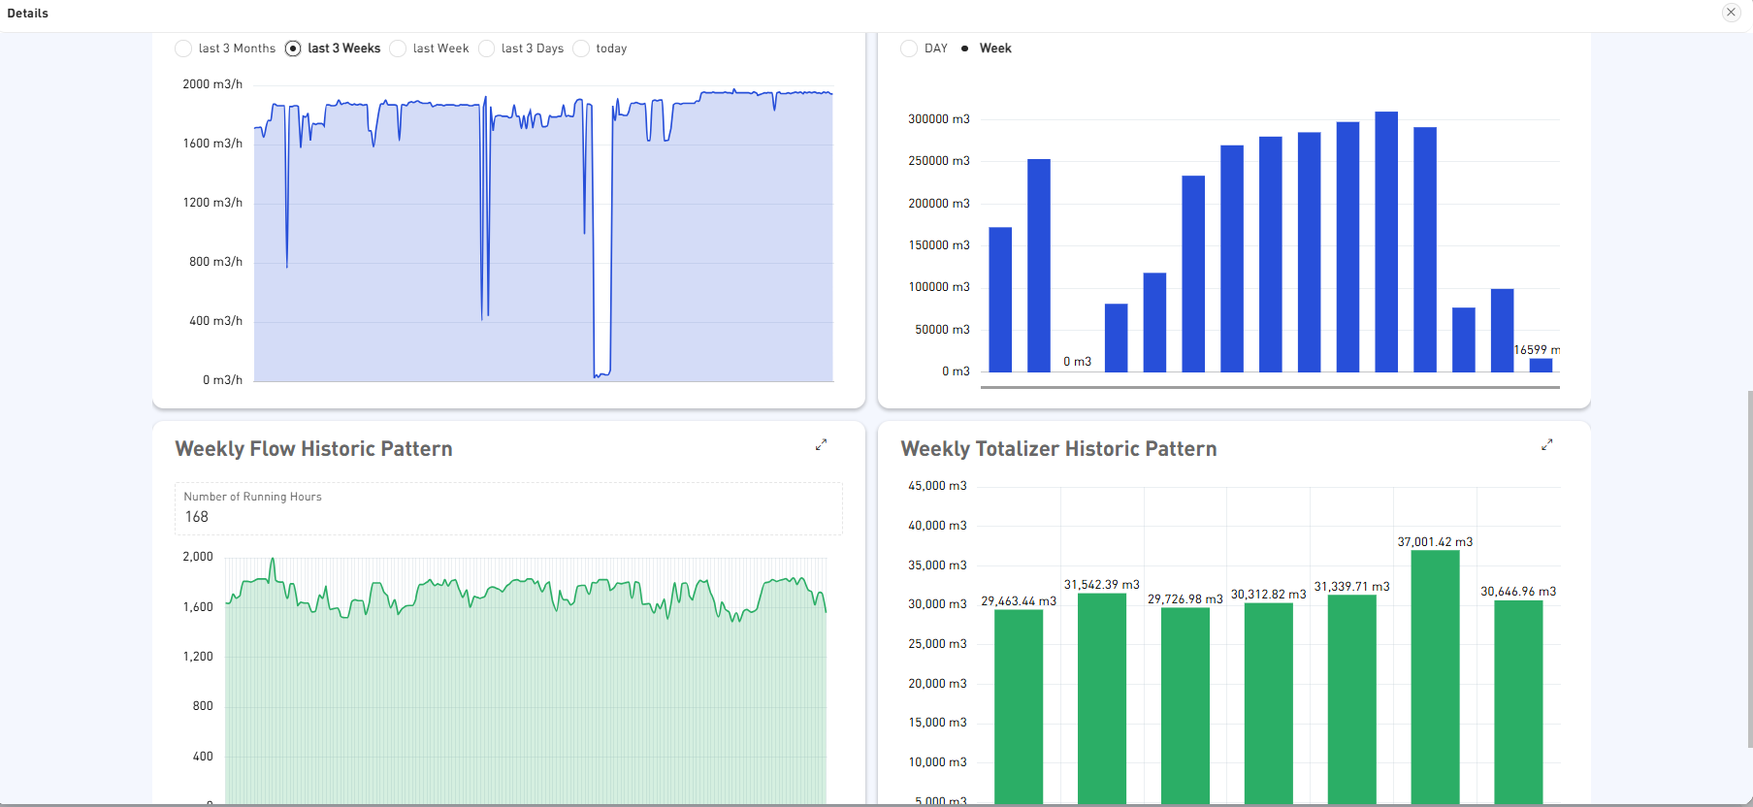
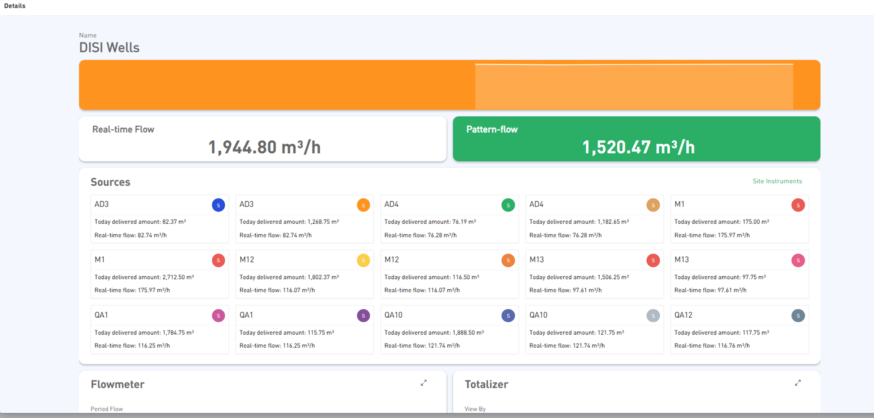
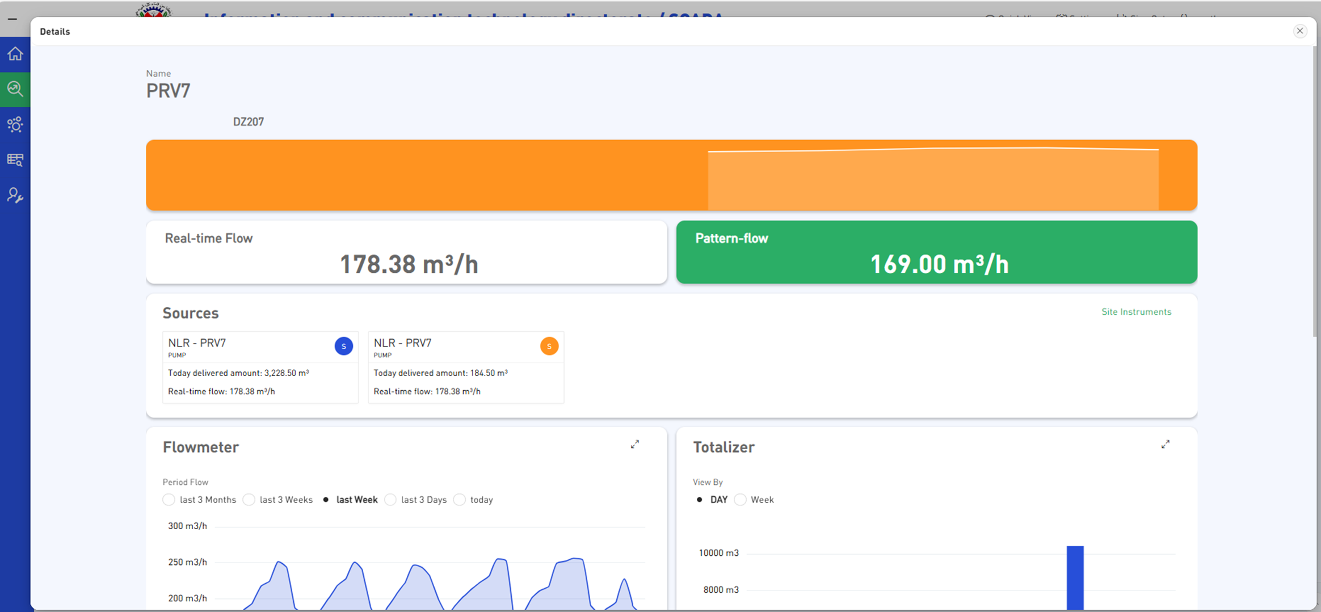
Patterns

Slide 40
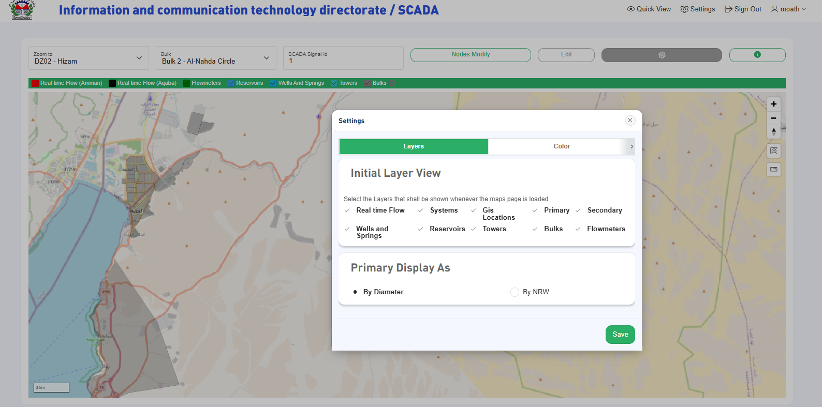
Drill down

Slide 41
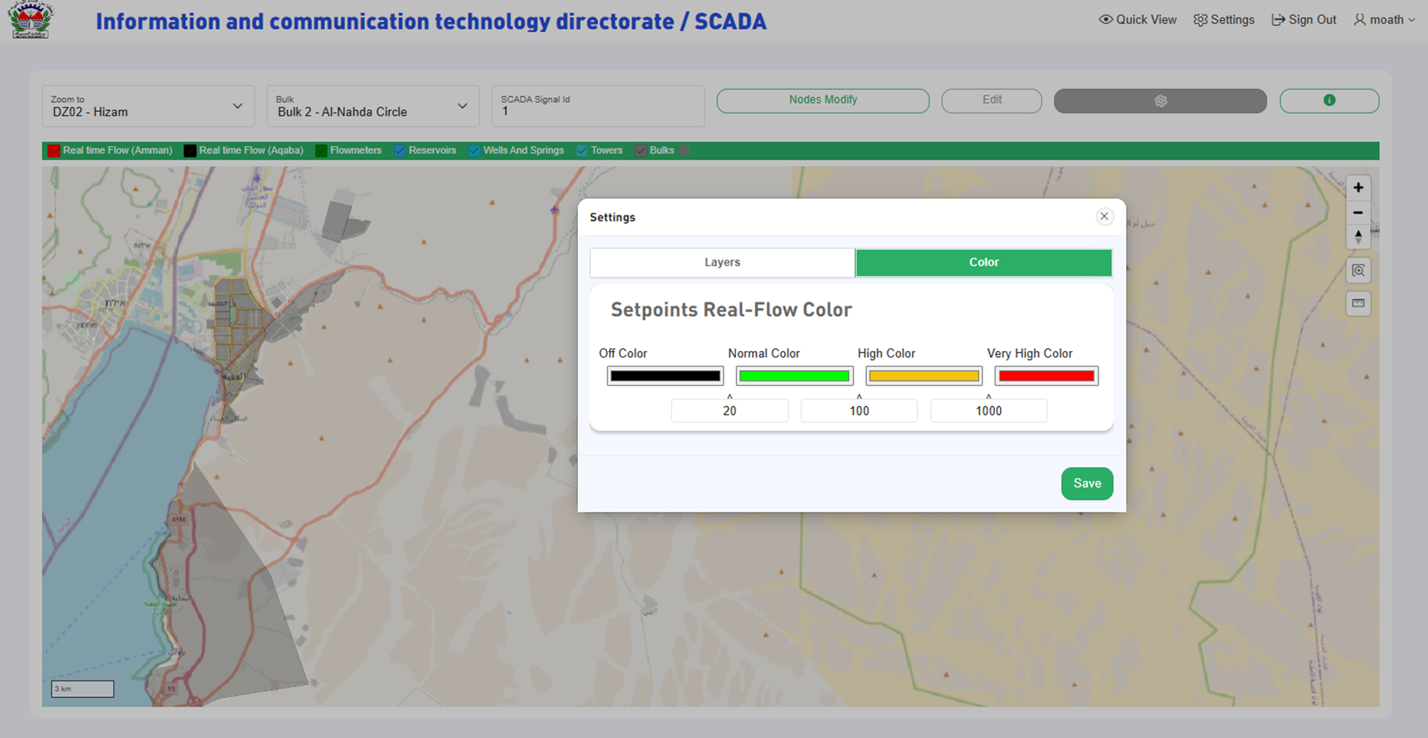

Slide 42
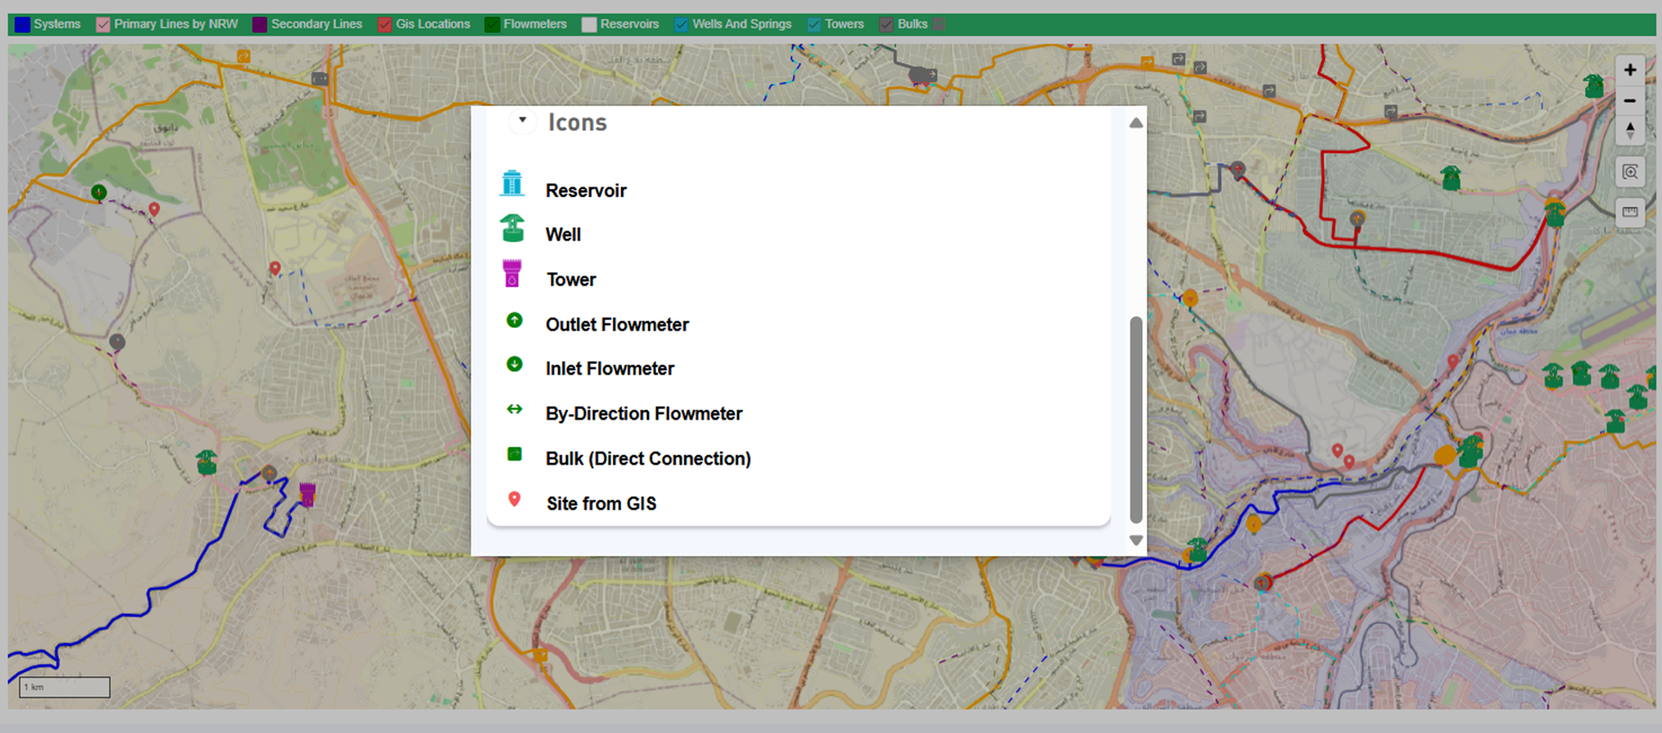
Facilities Symbols

Slide 43
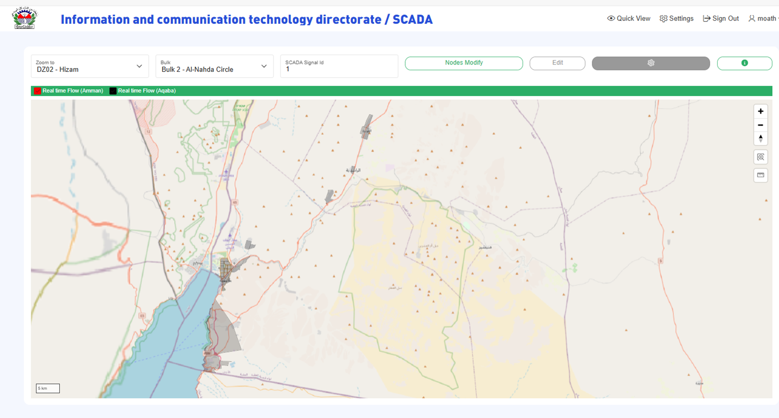

Slide 44
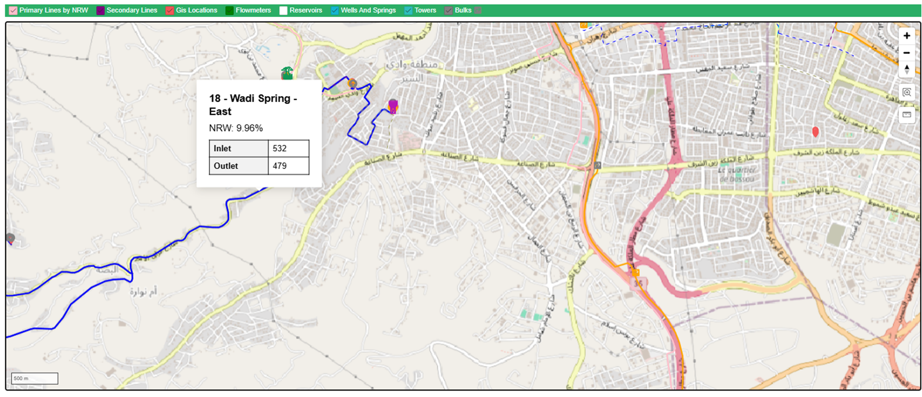
NRW

Slide 45
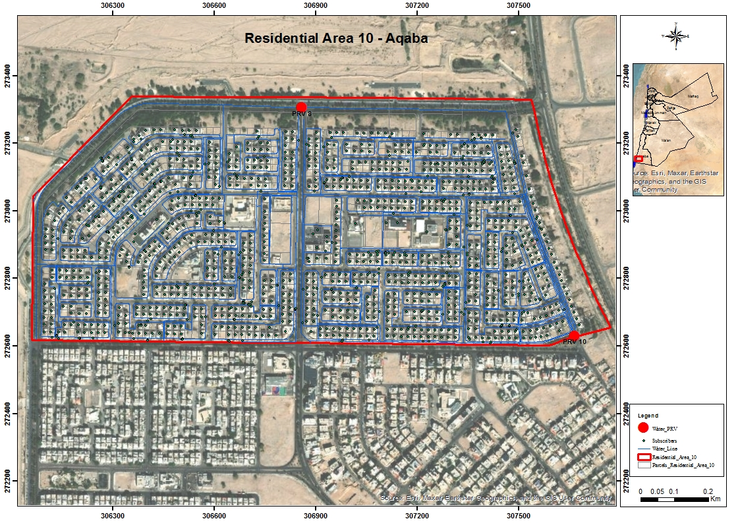
Aqaba Case Study \Cassandra DB Smart meter

Slide 46
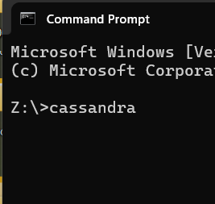
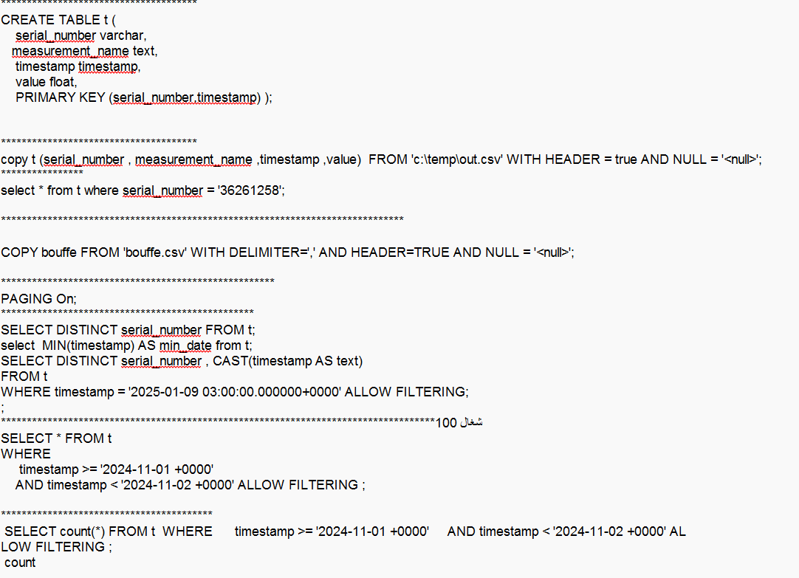
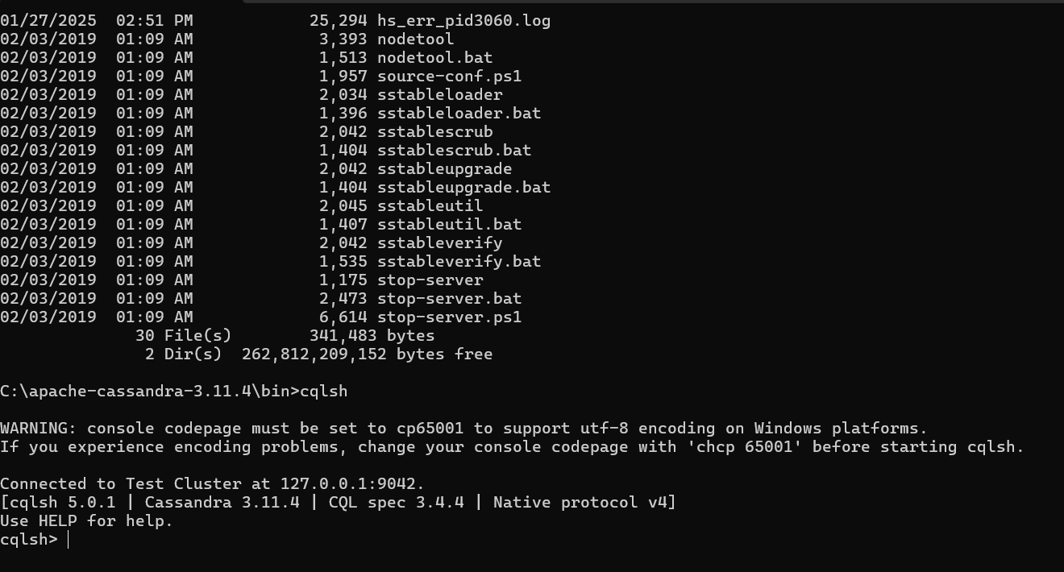
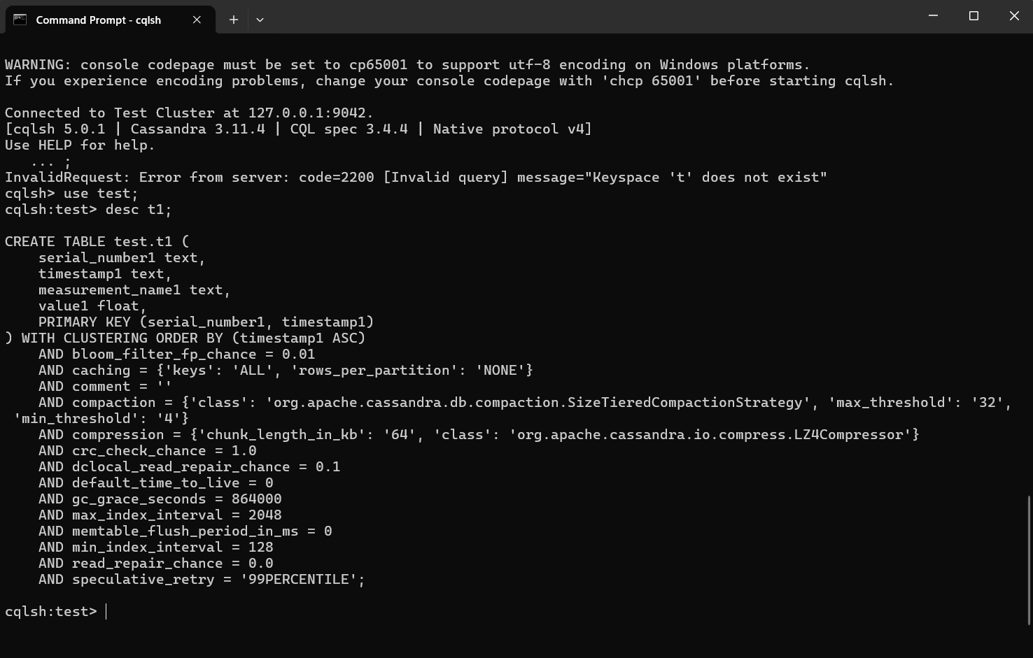
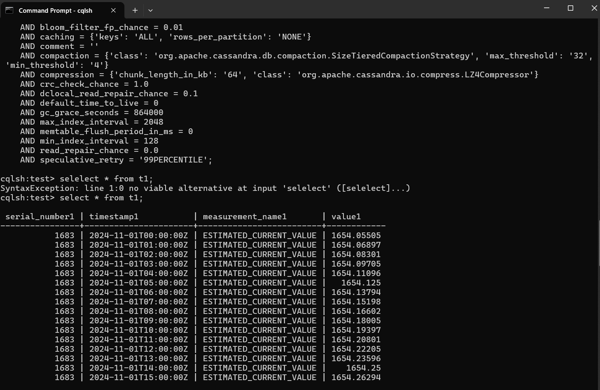
Big Data Cassandra DB

Slide 47
Feedback system for GIS
Connect to different system like:
SCADA System
bulk meter نظام عدادت المصادر الرئيسيه location of bulk meter layer
Billing system نظام الفوتره customer location layer
WISنظام المعلومات المائي well location layer
Call center provide Maintenance density layerكثافة الصيانه طبقة

Slide 48
GIS in water lifecycle system
Production :Ground water basinsالاحواض المائيه Dams السدود
Portable water
Water plant
Distribution
Operation
Gravity water sewer
Treatment

Slide 49
Disadvantage for existing gis (current situation )
Different database schema (all administrative area and water company own different database schema.
Different coordinate and projection system
Distributed database with different DBMS
Different gis software (license,opensource)
Out of date gis data
Not easy to maintain it.
Lately to analyses data from gis
More time and cost to collect GIS data from other administrative and water company

Slide 50
Proposal for GIS in water sector
Adapt and adoptive international GIS data model (water utility data model )best practice from esri.
Choose coordinate and projection system(Palestine 1923 Palestine Grid )Enterprise GIS solution support GIS server and DBMS centralized data access by all prates with privileges
Servers and additional pc and communication components .
infrastructure.
Training all stakeholder (related to system).
Documented standard operation procedure .

Slide 51
Conclusion
centralized information and standardized
information security
districted privileges
update data & on time analyses
on demand application and reporting
central maintenance and development
quality control assurance and integrity
information reliability
segregation of duties
provide decision maker accurate information
sustainability of system

