Slide 1

Decentralized systems for runoff water management in Amman
7th Arab Water Week

Slide 2
Contents
Background
Objectives
Study Area
Methodology
Results

Slide 3
Background

Slide 4
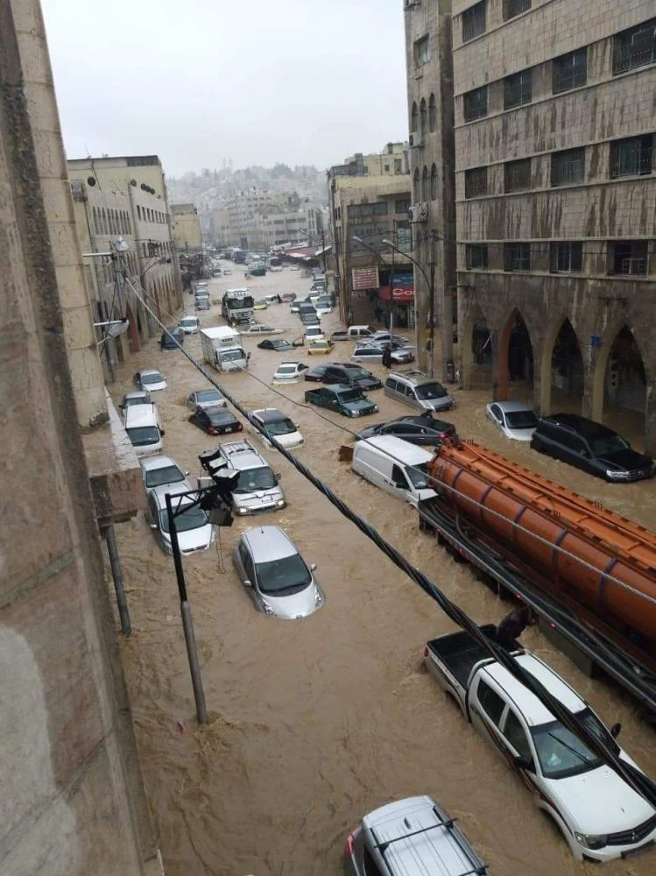
Background
Urban flooding is a growing global concern, driven by accelerated urban growth and insufficient stormwater infrastructure.
In Amman, this issue is further intensified by rapid population growth and the city's steep, hilly terrain—all of which have increased pressure on the drainage system and raised the risk of flash floods.
The scale of the floods in downtown Amman, Jordan in 2019. Source: https://alwatannews.net

Slide 5
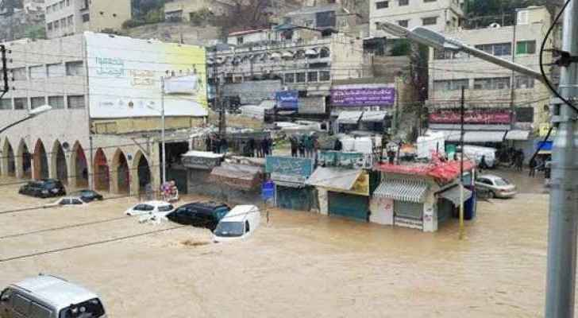
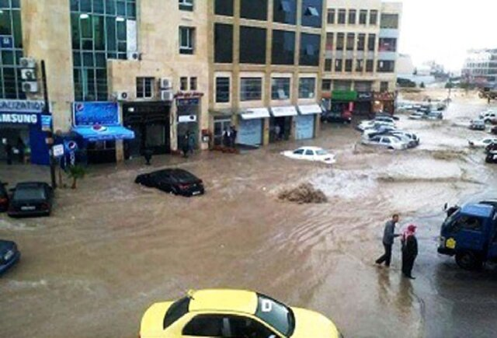
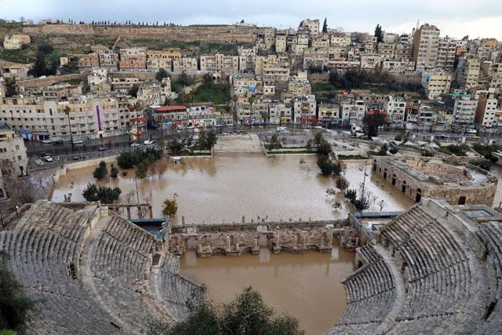

Slide 6
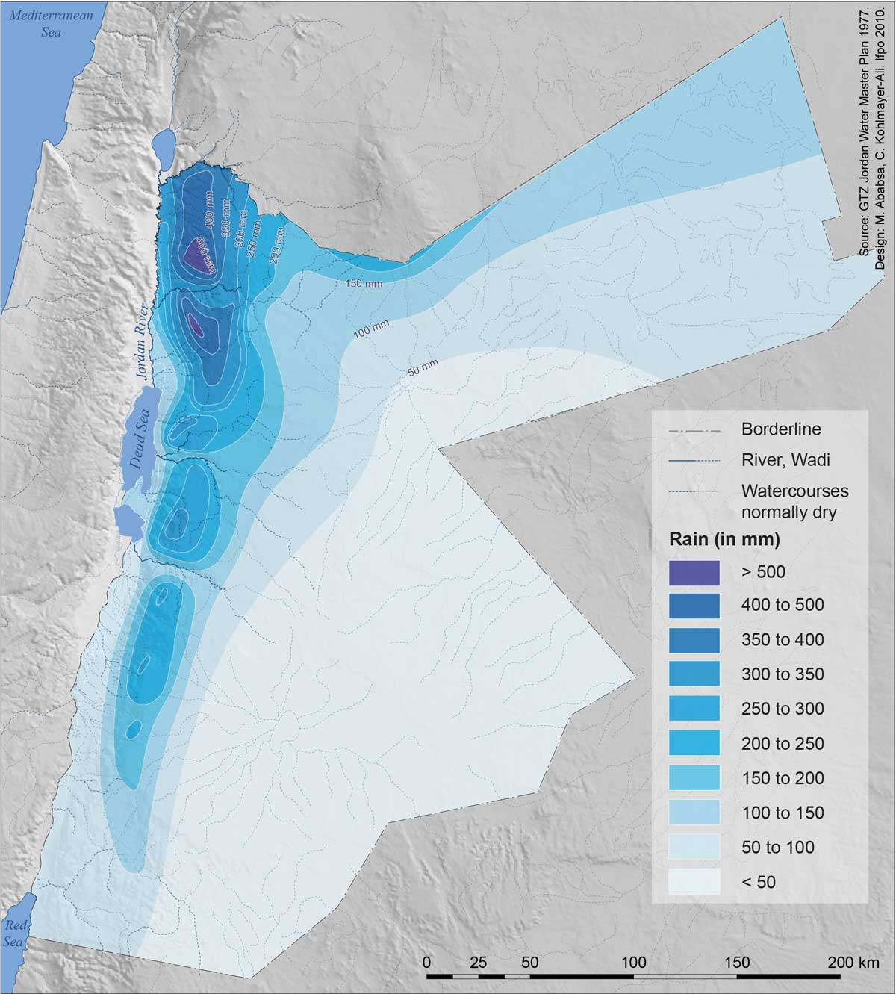
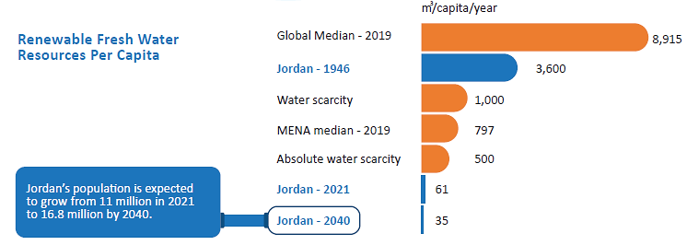
Source: National Water Strategy 2023 – 2040, https://www.mwi.gov.jo
Map of Jordan with Average Rainfall , source Atlas of Jordan

Slide 7
Objectives

Slide 8
Objectives
Evaluate the effectiveness of a decentralized rooftop harvesting system in reducing the runoff volume and peak flows during rainfall events in the selected sub-basin in Amman, using a Hydrological model.
Assess the economic feasibility of implementing decentralized water harvesting systems.
Develop guidelines and recommendations to promote decentralized water harvesting systems as a key flood control strategy in Amman.

Slide 9
Study Area

Slide 10
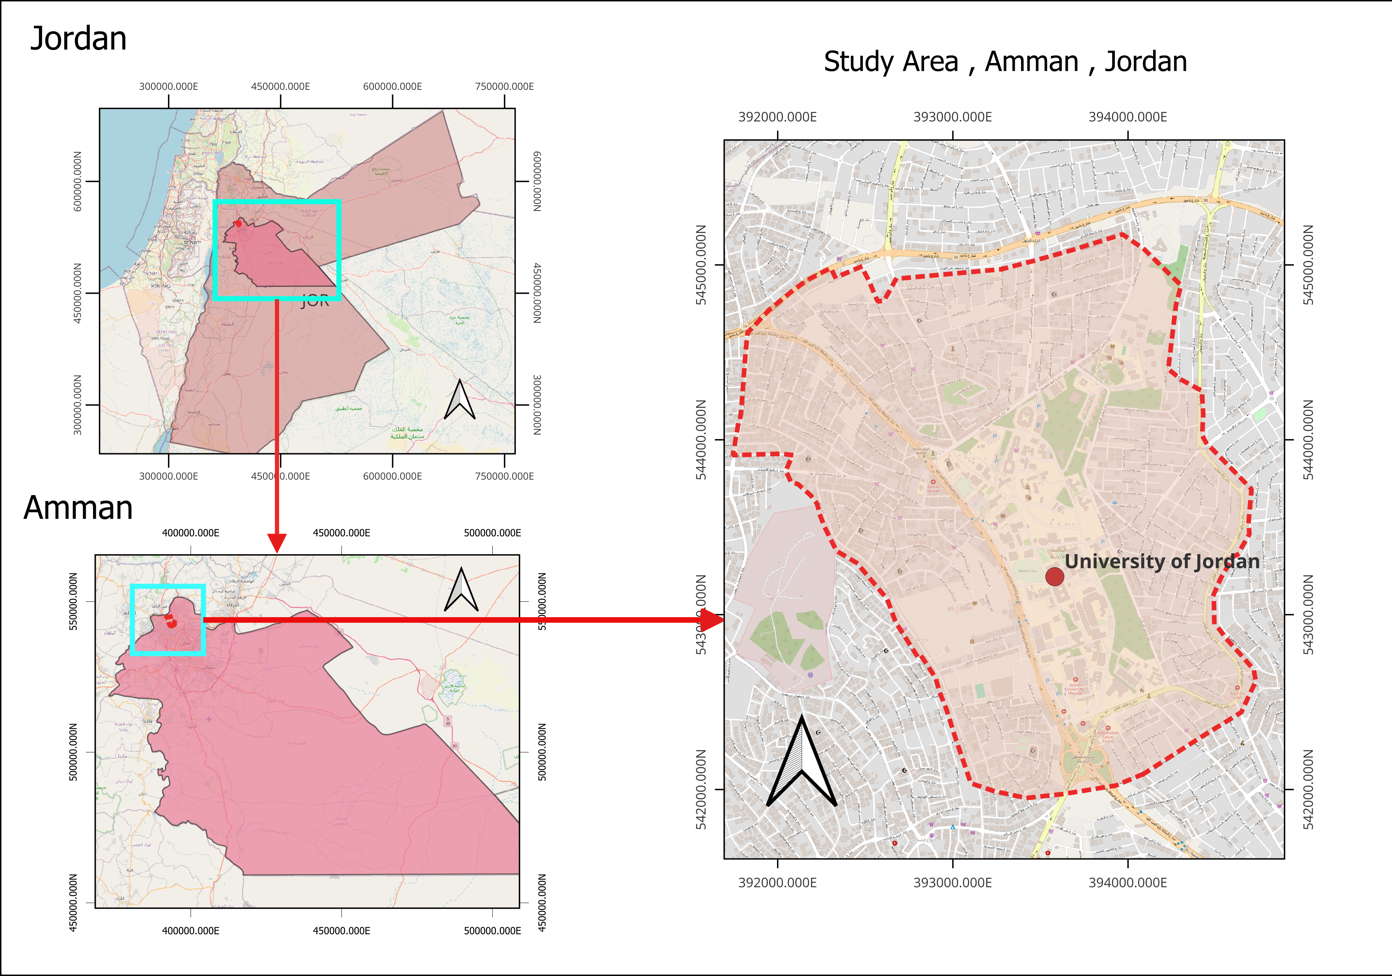
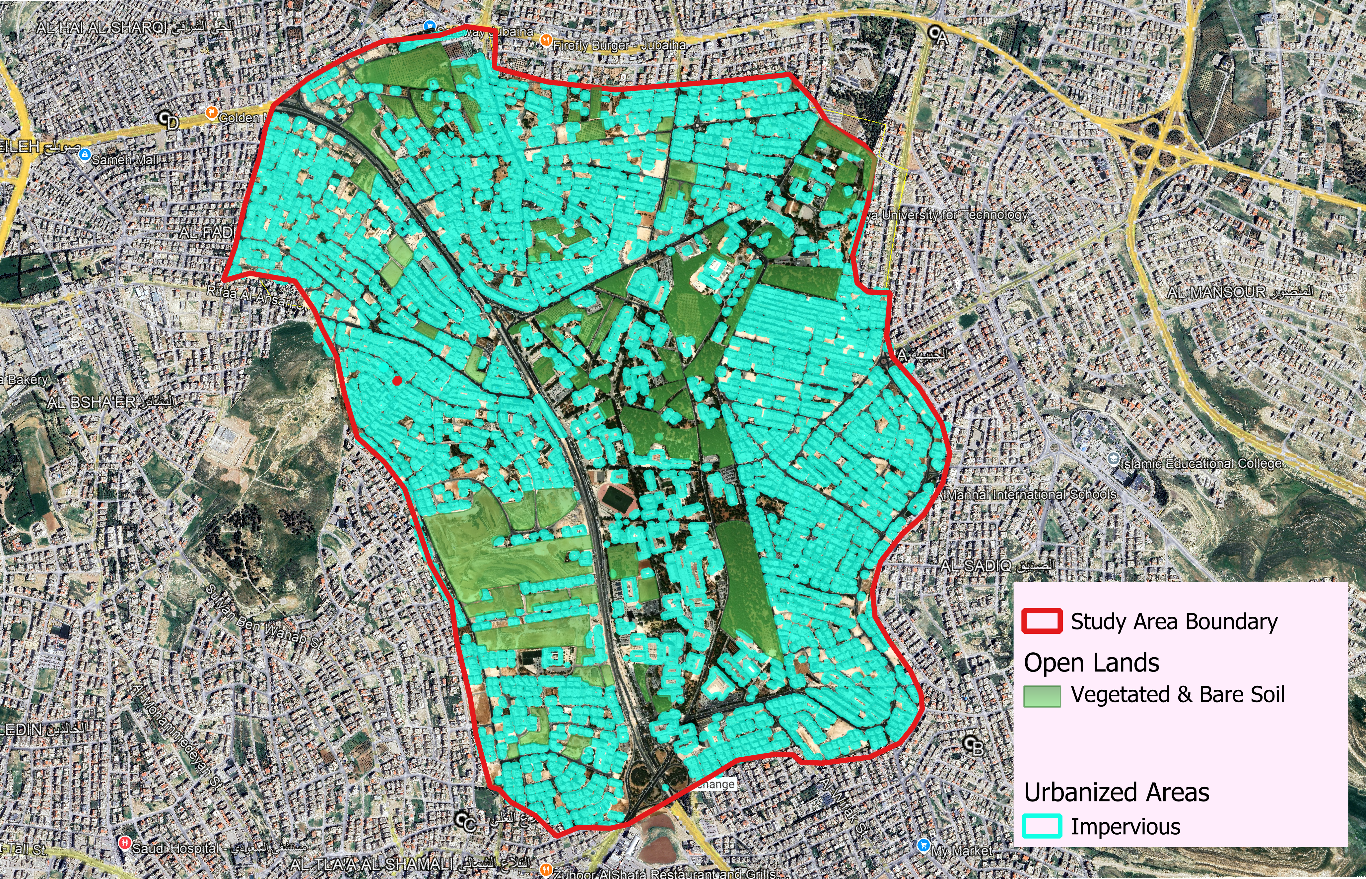
Study Area

Slide 11
Methodology

Slide 12
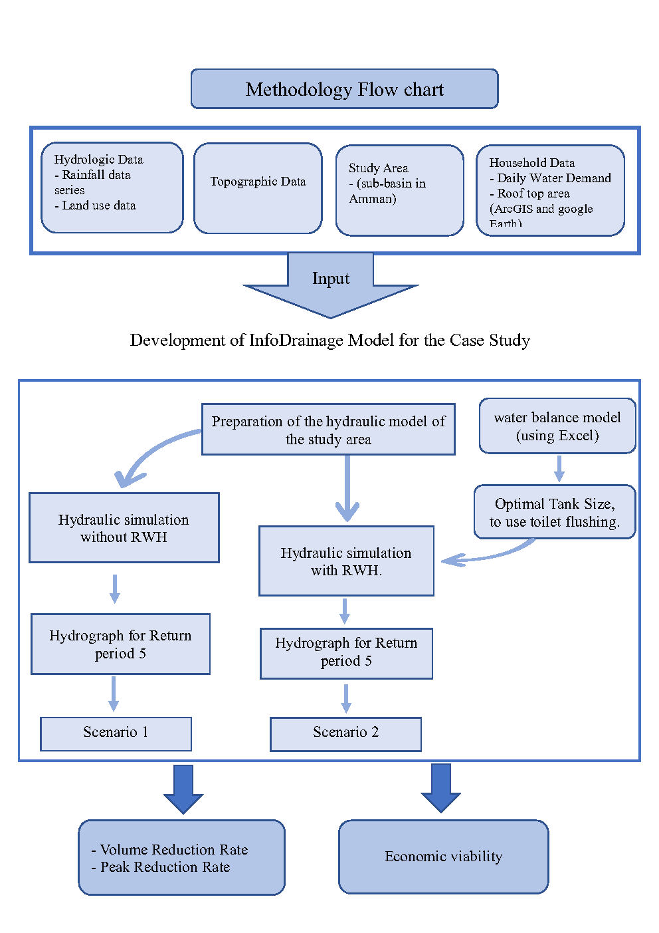
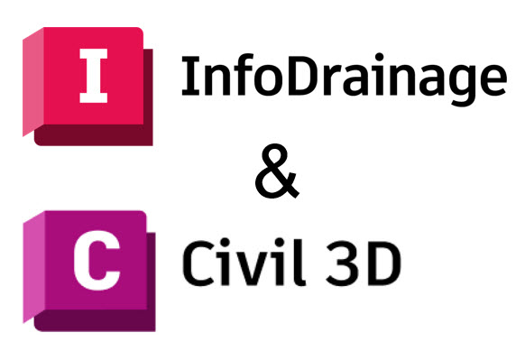
Methodology

Slide 13
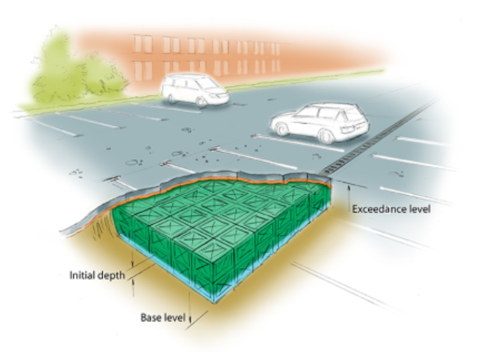
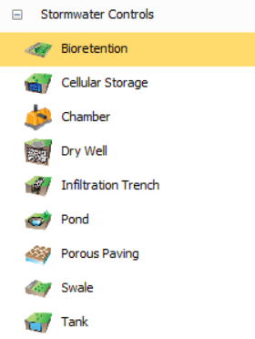
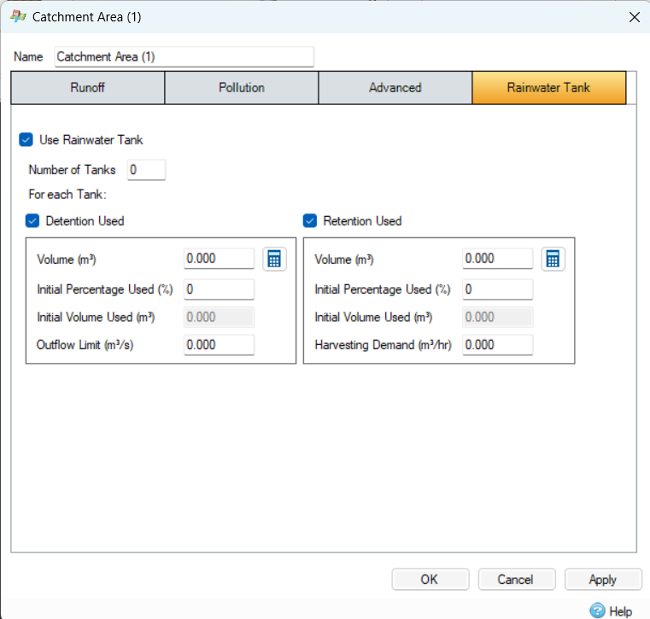
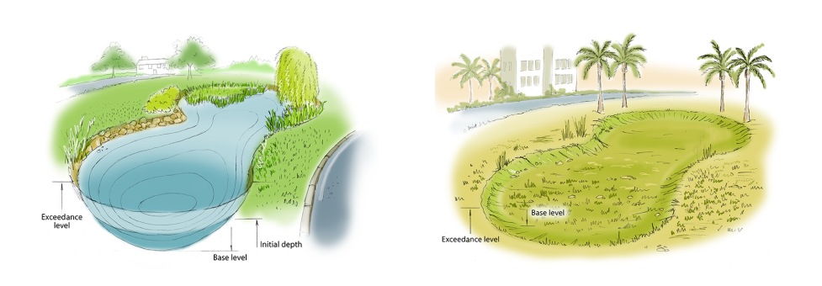
Methodology

Slide 14
Results

Slide 15
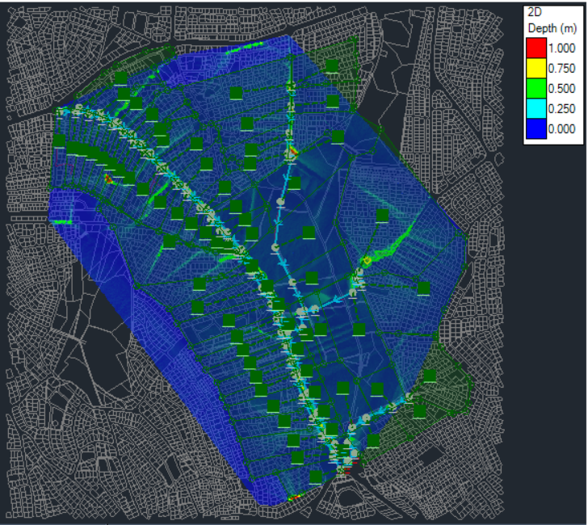
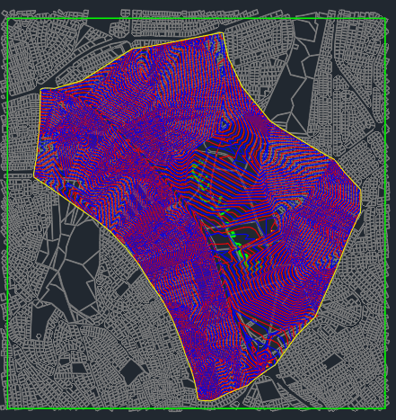
Results

Slide 16
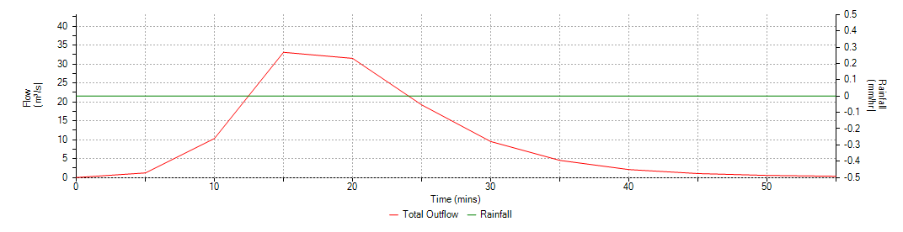
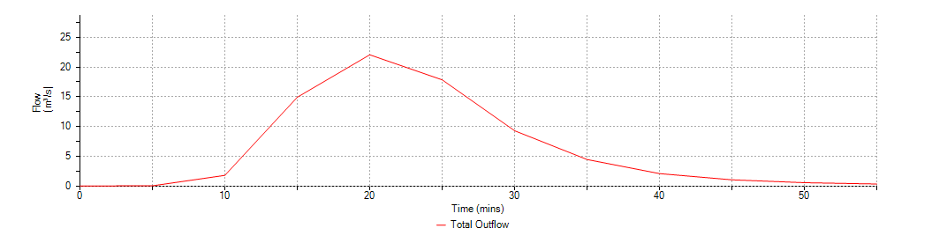
Results
Model Output – Without Rainwater Harvesting
Name | Max. Outflow (m³/s) | Total Outflow Volume (m³)
MH-Outflow | 33.170 | 21957.297
Model Output – With Rainwater Harvesting
Name | Max. Outflow (m³/s) | Total Outflow Volume (m³)
MH-Outflow | 22.067 | 21957.297

Slide 17
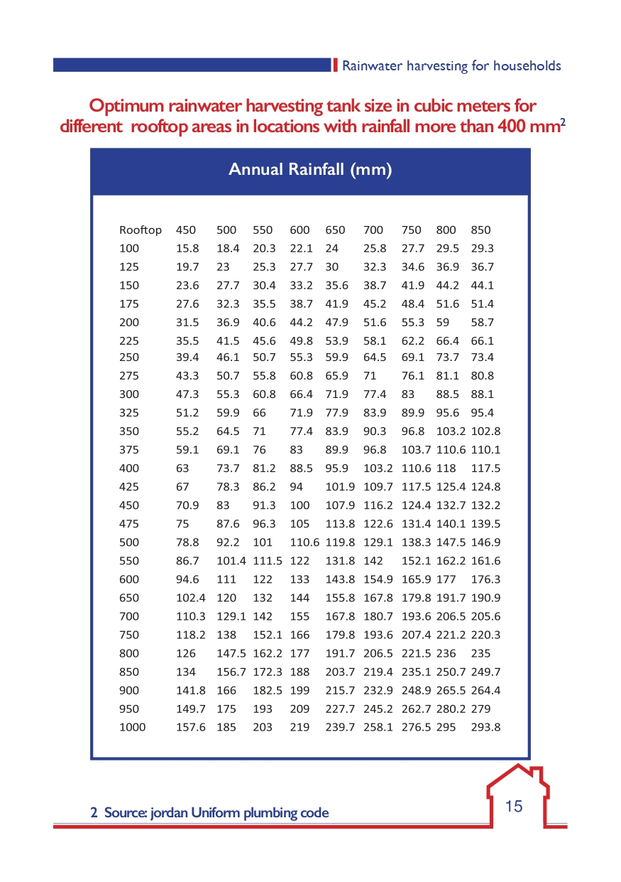
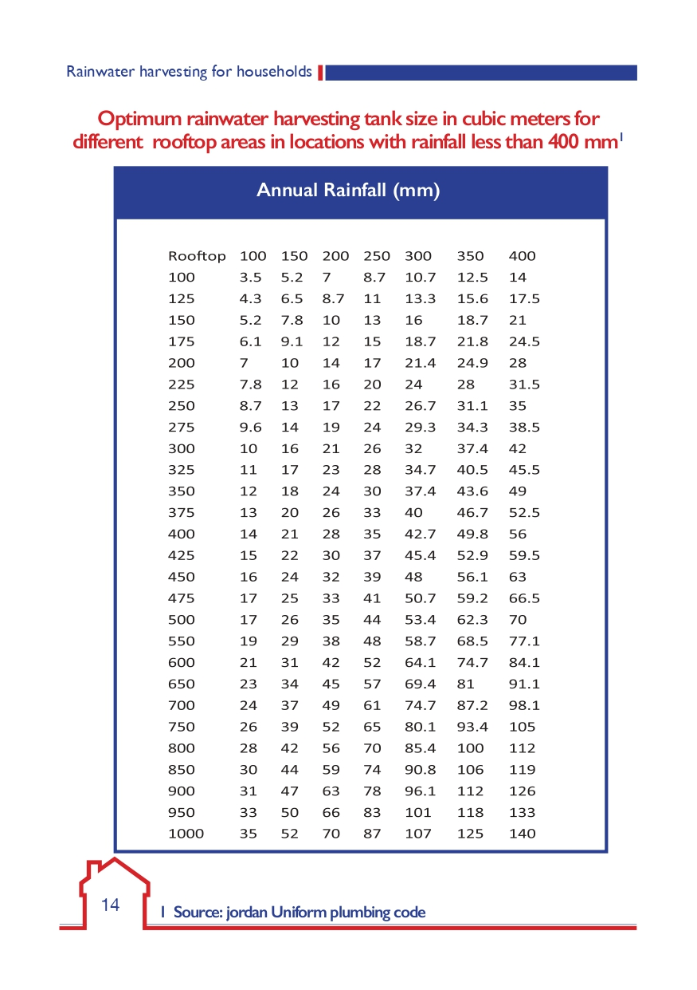
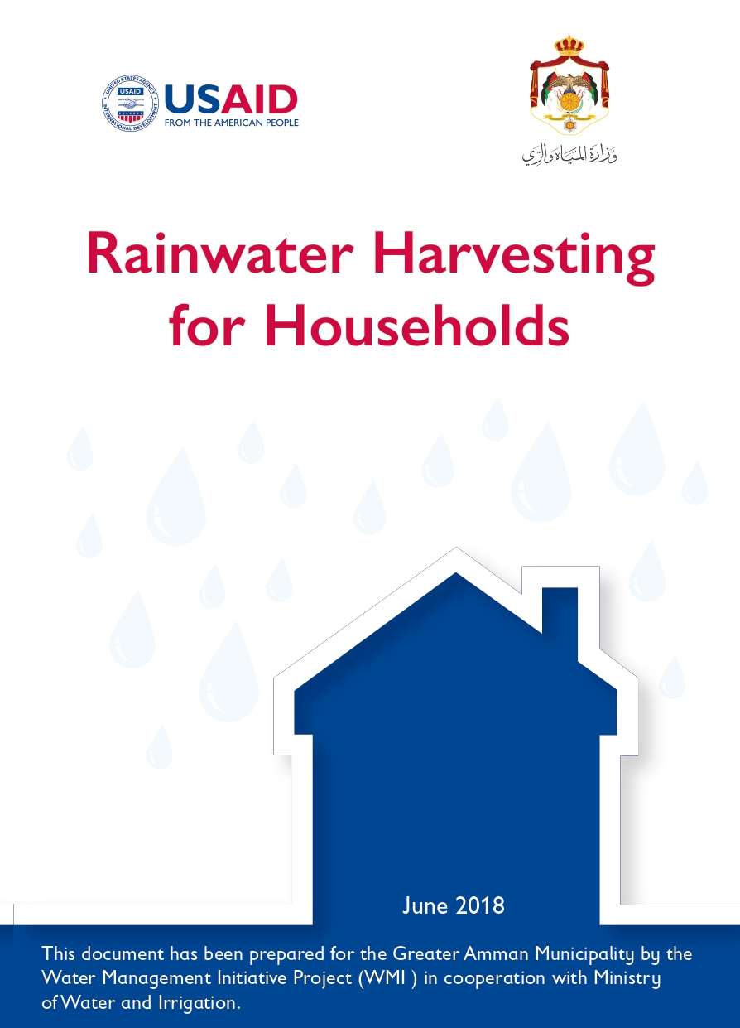
Source: WMI Report for Greater Amman Municipality, in cooperation with the Ministry of Water and Irrigation.

Slide 18
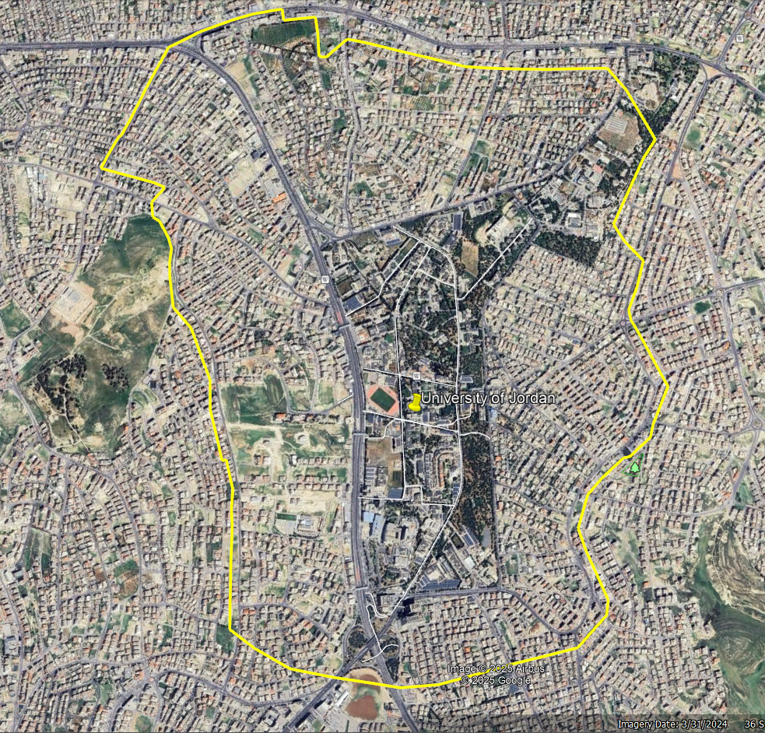

Slide 19
Thank You
Mohammad Abu Muslem
mhm8200888@ju.edu.jo
Mobile.:00962797756147
THE UNIVERSITY OF JORDAN SCHOOL OF ENGINEERING DEPARTMENT OF CIVIL ENGINEERING

