Slide 1




The Work Plan For Establishing The National Water Master Plan Unit (NWMPU)
Eng. Mohammad Diweri
Assistant Secretary General for Strategic Planning Affairs
Ministry Of Water And Irrigation /Jordan
May 2025

Slide 2
Outline
What is Water Master Planning
Need for NWMP Unit (NWMPU)
Objectives and Methodology
Gap Analysis
NWMP Unit Scenarios
NWMP Unit Roles and Responsibilities

Slide 3
Need for NWMP Unit (NWMPU)
Systematic review, update, and integration of NWMP
Keep planning aligned with evolving realities
Enable informed, evidence-based decision-making
Ongoing Support from GIZ WSG
institutionalization and digitalization of the NWMP
Identifying gaps & opportunities
Supporting the establishment of NWMPU for strategic, data-driven planning

Slide 4
What is a Water Master Plan ?
An instrument to plan for the future, based on
Assessments of the current situation,
Expected development during the planning horizon and
Gap analysis (including information gaps)
Assessment of
Available resources (conventional, non-conventional)
Key influencing factors (energy, costs, climate change, quality constraints)
Water demand (all sectors: municipal, agricultural, industrial)
Water supply infrastructure (supply network, energy grid)
Water allocation (use)
Water balance
Wastewater & infrastructure

Slide 5
Why do we need a Water Master Plan for Jordan ?
Groundwater overabstraction
Jordan’s groundwater is depleted rapidly, threatening infrastructure and risking dry wellfields by 2040.
Consequence: revised investment planning is urgently required
Climate Change
Climate change alters the Middle East's temperature and rainfall, but its impact on water resources hasn't been evaluated yet.
Consequence: CC must be considered in the resources forecast and investment planning
Water Quality Change
In addition to water shortages, Jordan faces worsening water quality, threatening public health and infrastructure, and increasing treatment and supply costs.

Slide 6
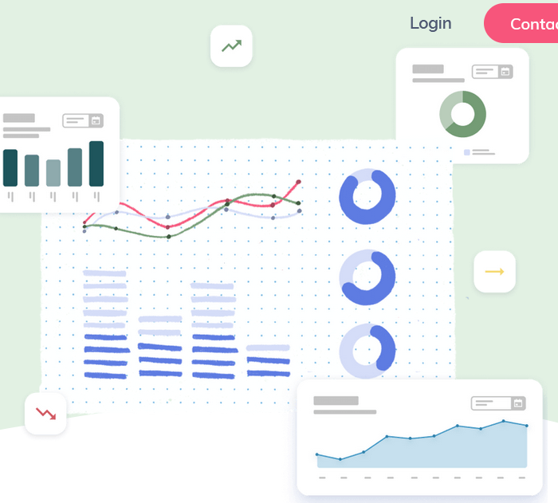
Objective:
for Establishing the National Water Master Plan Unit (NWMPU)
Transition NWMP-3 from hard-copy reports to an integrated digital platform (Version 2.0).
Digital Transformation of NWMP-3: From Paper to Platform
A Modern Approach for Efficient Decision-Making

Slide 7
Methodology Overview
1. Stakeholder Engagement (👥 Meetings)
2. Workflow Analysis (📊 Org Charts)
3. DSS Assessment (🖥️ WEAP/WIS/SCADA)
4. Skills Gap Analysis (🎓 Training Needs)
5. Reporting & ToR Development (📑 NWMP Unit Plan)

Slide 8

Current situation &Challenges Identified:
- Redundancies in workflows.
- Gaps in DSS integration.
- Staff training needs.

Slide 9

NWMP-3 Unit Proposal
Core Functions:
- Manage digital platform updates.
- Train staff on DSS tools.
- Align with MWI strategic planning.

Slide 10
Introduction to Gap Analysis
  Purpose:
  To understand the current state of the Planning, Strategies, and Policies Directorate.
  Scope:
  Organizational structure, human resources, electronic systems, and main processes.
Key Challenges:
Organizational Structure
Human Resources.
Electronic Systems.

Slide 11
Organizational Structure
  Lack of dedicated M&E Unit for NWMP.
  Absence of a dedicated Risk Management function.
  No institutionalized process for NWMP updates and operationalization.
Human Resources.
  Insufficient staffing levels are impacting efficiency.
  Need for professional development in specific areas (M&E, data analysis, etc.).
Electronic Systems.
  Difficulties in data collection, integration, and distribution due to diverse sources and formats.
  Lack of a central, reliable data repository.

Slide 12
Main Processes - Organizational Structure
  Lack of a Monitoring, Evaluation, and Learning (MEL) system.
  Absence of AI/BI tools for simulation and forecasting.
  Weak communication policies (internal and external).
  No executive program for NWMP implementation.
Main Processes - Human Resources
  Lack of risk assessment and mitigation tools.
  No guarantee of data quality and timely availability.
  Absence of standardized data analysis and reporting.
  Lack of task documentation and reporting.

Slide 13
Main Processes - Other Needs
  Need for legislative support for NWMP governance.
  Limited decision support tools.
  Lack of quality assurance and future foresight capabilities.
Summary of Gap Analysis.
Overall need for dedicated functions, improved data management, enhanced skills, and streamlined processes for effective NWMP implementation

Slide 14
NWMP Unit Scenarios :
Presenting two proposed structures based on the gap analysis
Scenario 1: NWMP Unit as a Section under the policies and strategic directorate
Scenario 2: NWMP Unit as a Directorate

Slide 15
Scenario 1: NWMP Unit as a Section
  Positioned within the existing Planning, Strategies, and Policies Directorate.
Strategy, Structure :
  Strategy: Leverages existing strategy but may dilute NWMP focus.
  Structure: Simple integration, limited autonomy.
Systems, Shared Values:
  Systems: Uses existing systems, potential limitations.
  Shared Values: Aligns with broader values, risk of diluted NWMP identity.
Skills, Style, Staff:
  Skills: Access to general skills, lacks specialization.
  Style: Policy-oriented leadership, limits innovation.
Staff: Leverages existing staff, potential overload

Slide 16
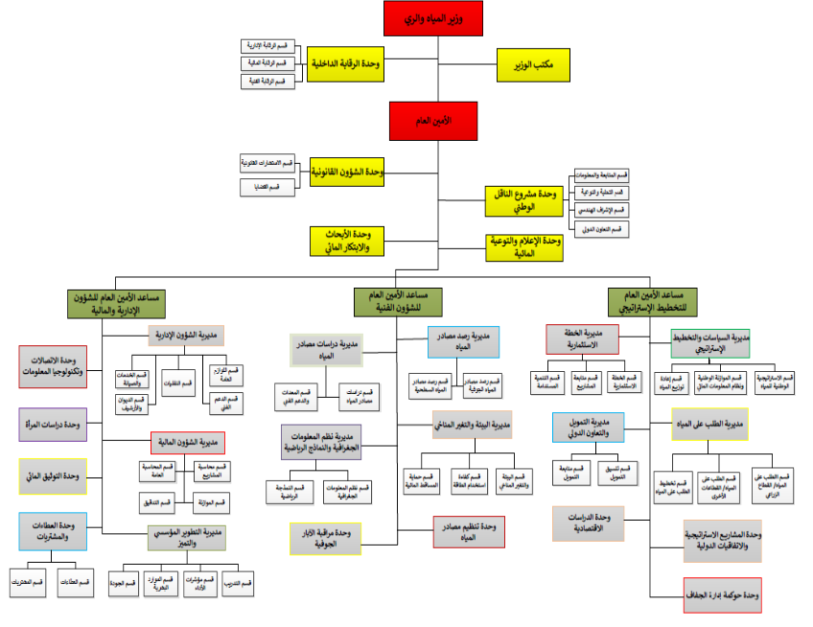
NWMP unit

Slide 17
Scenario 2: NWMP Unit as a Directorate
  Standalone entity reporting to the Secretary General’s Assistant for Planning.
Strategy, Structure :
  Strategy: Strong focus on NWMP strategy.
  Structure: Independent, clear mandate, higher complexity.
Systems, Shared Values :
  Systems: Opportunity for advanced, dedicated systems.
  Shared Values: Clear focus on NWMP values, potential cultural misalignment.
Skills, Style, Staff :
  Skills: Focus on recruiting specialized skills.
  Style: Tailored leadership for agility and innovation.
Staff: Dedicated, specialized staff, increased costs

Slide 18
NWMP unit

Slide 19
NWMP Unit Roles and Responsibilities :
Core Functions of the NWMP Unit Organizational Structure )
  Develop and implement MEL system.
  Manage risks using data and modeling.
  Develop and update the NWMP executive program.
  Utilize AI/BI tools for analysis.
Core Functions of the NWMP Unit (Human Resources)
  Ensure data quality and availability.
  Provide relevant training.
  Establish stakeholder communication.
  Disseminate NWMP updates.
Core Functions of the NWMP Unit (Electronic Systems)
  Develop Standard Operating Procedures.
  Standardize data analysis and reporting.
  Manage the digital NWMP platform.
  Integrate data systems (WIS, SCADA, WEAP).
  Facilitate inter-departmental collaboration.

Slide 20

Why a Digital platform for NWMP3?
- Faster access to data for decision-makers.
- Reduced costs (printing, storage).
- Easier updates & real-time collaboration.
- Sustainability (paperless approach).

Slide 21
  NWMP Digital Platform Version 2.0
  Goal:
  Centralized, real-time data access and decision support.
  Building upon existing V1.0.
  Key Functional Components:
  Data Visualization and Dashboards (interactive, GIS integration).
  Reporting and Analytics: (automated, scenario planning).
  Real-Time Monitoring:(SCADA and hydrometeorological integration).
  Decision Support Systems :(WEAP integration, forecasting).
  Key Design Principles:
  Data Security, User Experience, Scalability, Interoperability, Data Integration.

Slide 22
  Implementation Roadmap :
  Requirement Analysis:
  Development and Integration, Testing and Training, Launch and Monitoring.
Integrating Key Water Information Systems - WIS
  Role of WIS as the central data repository.
  Current status and USAID enhancements for integration.
Integrating Key Water Information Systems - SCADA & WEAP
  SCADA for real-time monitoring, need for upgrades.
  WEAP for scenario modeling, need for real-time data integration.
Future Improvements for Data Systems
  Seamless real-time data sharing.
  Enhanced predictive analytics and AI.
  Improved automation.
Integration with WIS, DSS, and NWMP Unit
  WIS as the central hub, seamless data flow, and integrated decision-making.
Phased integration plan
(Assessment, WIS, DSS, NWMPU, AI Dashboards, Training/Deployment)

Slide 23
Thank You

