Slide 1




Water Quality Management in Jordan
Muna Gharaibeh, M. Sc. Water Supply Engineering,
SG Advisor for Laboratories and Quality Affairs
Email: muna_gharaibeh@mwi.gov.jo
Rana Ardah, Manager of Water Studies/ Royal Scientific Society
Email: rana.aarda@rss.jo

Slide 2

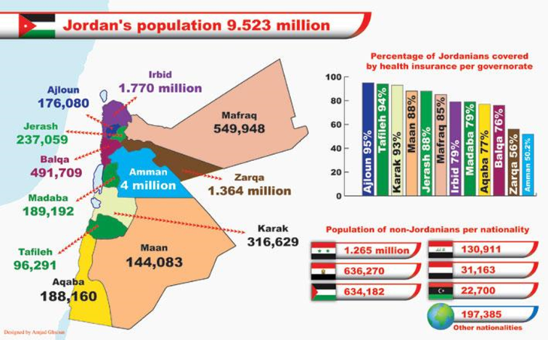
Water Sector challenges in Jordan
Per Capita Water share m3
61 in 2023 35 in 2040
Water Sector Challenges
Limited water resources
Climate change
Dependency on transboundary waters
Abnormal growth in population
Agricultural expansion
Rank: 2nd Water Poorest country
National census 2015

Slide 3
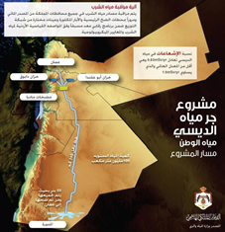
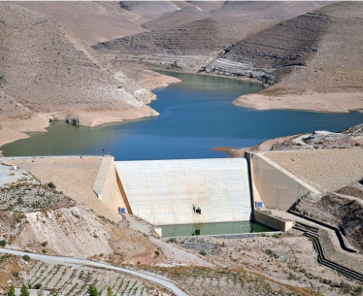
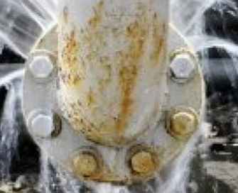
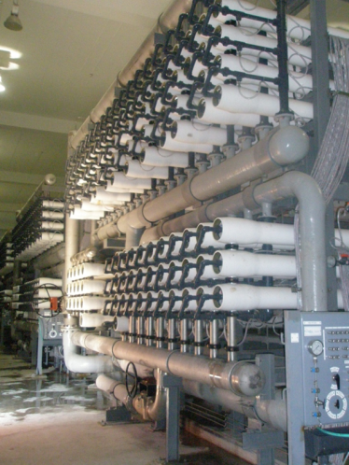
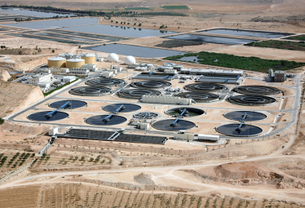
Water strategies-1
Al-Wala Dam Expansion, Madaba
Water
Strategies
Non renewable water
Water Treatment Desalination
BWRO + SWRO
Treated wastewater for agriculture
New dams projects
Non revenue water
Target reduction of NRW to 25% by 2025
As-Samra wastewater treatment plant in Zarqa
Wadi Ma`in Zara and Mujib Water desalination plant and conveyance system

Slide 4
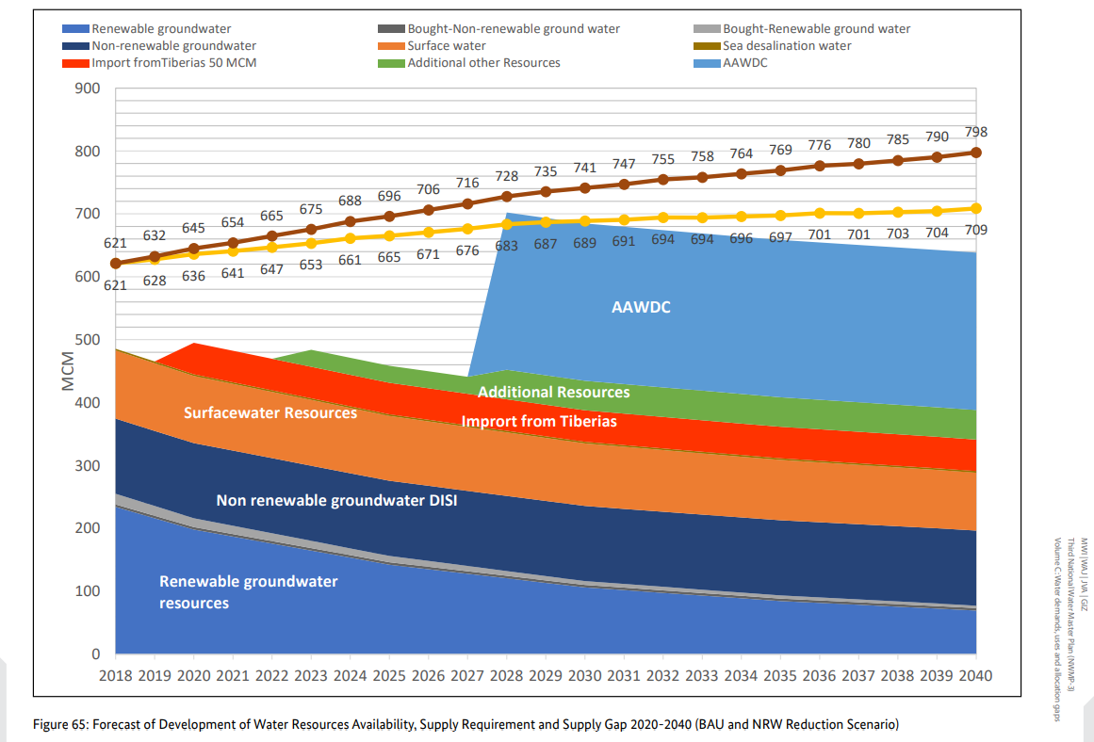
Water strategies- all solutions
Source: Third National Water Master Plan (NWMP-3) from 2023 to 2040

Slide 5

Water Scarcity but Clean from the tap
96% coverage with water networks
68% coverage with wastewater networks
Controlled and monitored Water Quality

Slide 6
Water and Wastewater Quality Management in Jordan
Ministry of Health (Control)
Public Health Law
Ministry of Water & Irrigation
Water Authority of Jordan
Central Labs (Monitoring & Control)
Yarmouk Utility
(Monitoring)
Aqaba
Utility
(Monitoring)
Ministry of Environment
Monitoring for decentralized WWT plants & Industrial WWT
Miyahuna Utility
(Monitoring)

Slide 7
Water Quality Management in Jordan
Role of Central Laboratories in Water Authority of Jordan (WAJ Labs)

Slide 8
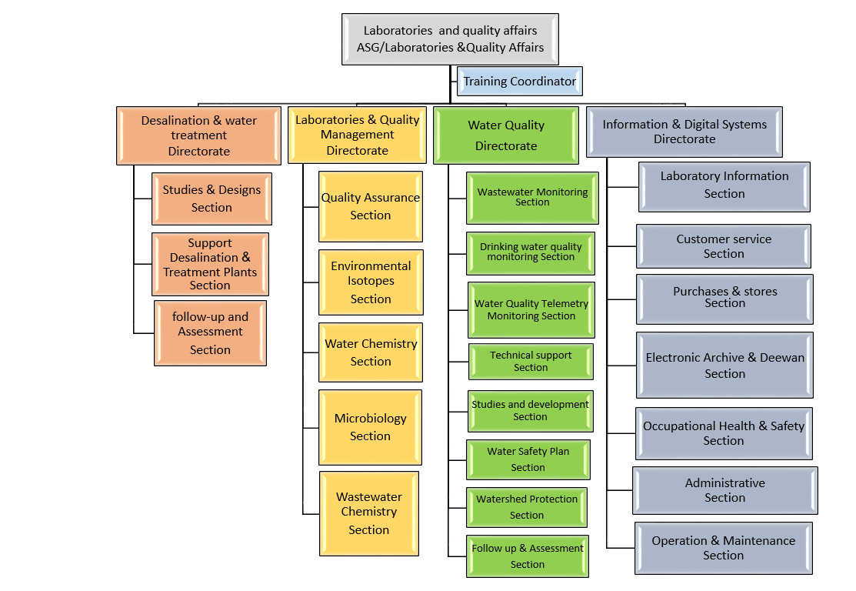
WAJ Labs Organization Chart

Slide 9
WAJ Labs Objectives-1
Drinking water supplied by Water Utilities shall comply with JS 286/2015 (Monitoring programs and permits procedures)
Public Wastewater plants effluents shall comply with JS 893/2021 (Monthly monitoring program)
Monitored main surface water bodies (Monthly monitoring program for main dams, Zarqa river & KAC) Telemetry monitoring
Monitored ground water quality (Annual monitoring program for 88 wells represent 12 basins)

Slide 10
WAJ Labs Objectives-2
Protected groundwater (Monitoring activities in protection zones (1 & 2) according to ground water protection instructions and apply water safety plans)
Produce credible , accurate & defensible results: best practices, latest technology and ISO 17025 accreditation
Technical support for Utilities in planning and management of desalination and treatment plants
Services for private sector, training and studies & research for projects (including isotopes studies)
To insure reliability, validity, security, and traceability of responsibilities, samples and results: using LIMS with latest updates

Slide 11
Laboratories Testing & Equipment
Water Chemistry Lab
IC, ICP, LC/MS/MS, HPLC, GC, GC with FID
Microbiology Lab
Biosystem, VITEK® 2 System
WWT Lab
Gamma spectrometer, Liquid scintillation counters, LGR instrument, ICP-MS, Alpha Spectrometer
Environmental Isotopes Labs
Major ions, heavy & trace metals, endocrine, herbs, pest, VOC
Bacteria, Viruses, Protozoa, PCR product, Microbial Identification,
Luminescence Tech, IC, ICP
BOD, COD, TSS, TDS, TN, TP, major ions, heavy & trace metals,
Ra226 &228, Gross Alpha , Beta, C14, Tritium, Lead 210, O18,C13, Deuterium, Th232, U238, Po210

Slide 12
Water Quality Management in Jordan
Role of RSS Labs

Slide 13
The National Project for Monitoring Water Quality in Jordan
Implemented by: Water and Environment Centre/ RSS in cooperation with Environmental Monitoring and Assessment Directory/ MoEnv.
Funded by: MoEnv.
Duration: One year (yearly renewed since 1986).

Slide 14
Project Summary
This project was launched in 1986 and is the first of its kind in terms of its wide coverage of different water resources and comprehensive tests.

Slide 15
Project Summary
Main Objective
The project, generally, aims at monitoring different water resources in Jordan to verify the quality of such resources and its suitability for different uses, among which is agriculture.

Slide 16
Project Summary
Specific Objectives
1. Document the change of water resources quality over time. For this particular purpose, the data base was developed.
2. Determine the important physical, chemical (organic and inorganic) and microbiological properties of the water in Jordan.

Slide 17
Project Summary
Specific Objectives
3. Identify the main reasons for water quality changes, whether such changes were positive or negative.
4. Identify pollution indicators for emergent situations and when necessary.

Slide 18
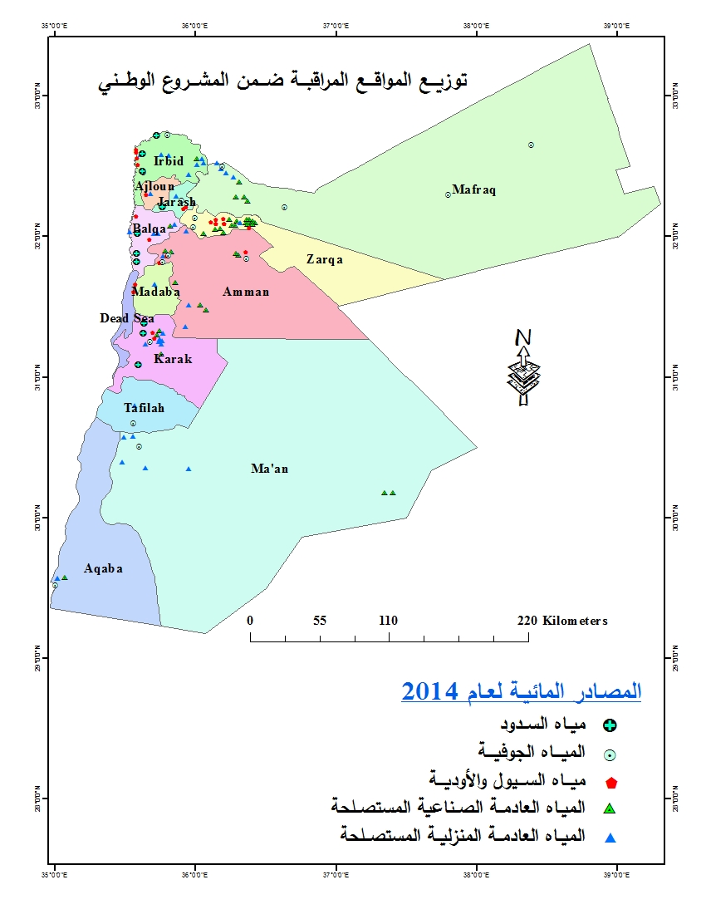
Project Summary
Monitored Sites

Slide 19
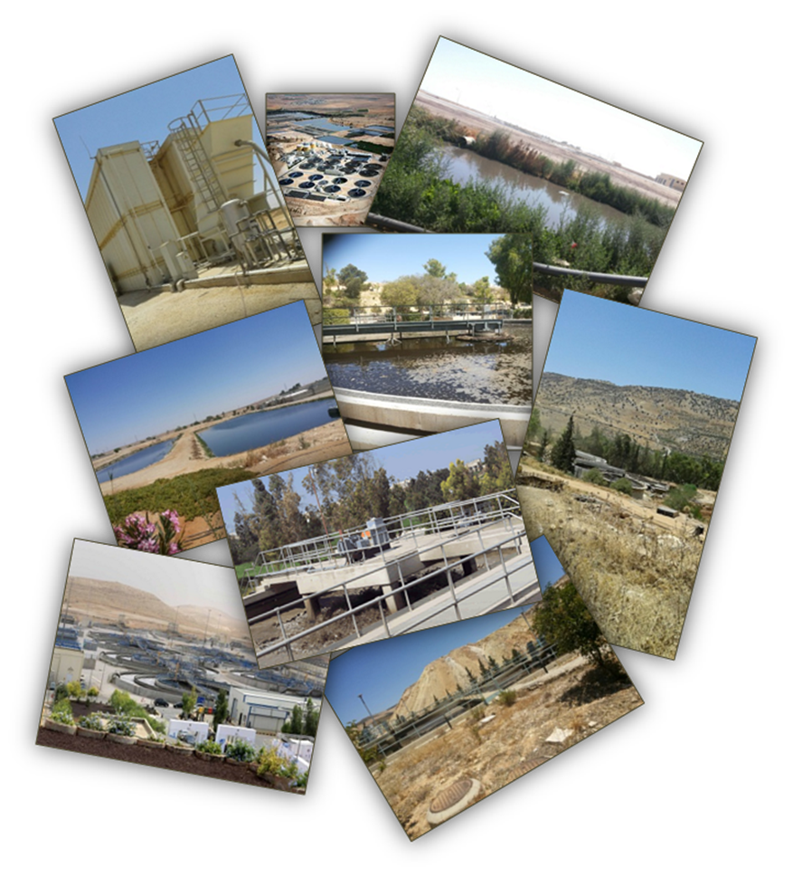
Project Summary
Monitored Sites

Slide 20
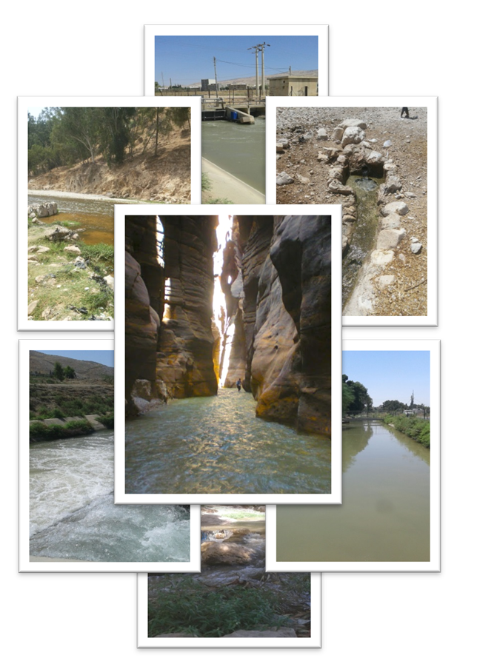
Project Summary
Monitored Sites

Slide 21
Project Summary
Methodology
Holding regular meetings between MoEnv. & RSS representatives to determine and approve the action plan and discuss different issues related to the monitored sites.
Grab water samples collection from the monitored sources (groundwater sources, surface water including streams and dams, domestic wastewater treatment plants’ effluents and industrial locations).

Slide 22
Project Summary
Methodology
Conducting field measurements for the monitored sources.
Preservation and transfer of the collected samples to RSS environmental laboratories according to the related standard methods.
Water samples analyses (Physical, chemical and microbiological) in RSS environmental laboratories.

Slide 23
Project Summary
Methodology
Assessment of analyses results according to the related Jordanian standards [Namely JS no. (1766/2014), JS no. (893/2006) and JS no. (202/2007)].
Reporting on monthly basis.
Collection of additional samples whenever specific pollution indicators occur (urgent samples).

Slide 24
Project Summary
Methodology
Data management and interpretation of final average results.
Reporting all findings (final comprehensive technical report at end of the contractual year) and providing conclusions and recommendations that would support decision makers in the preparation of national plans for the optimal exploitation of water resources in the kingdom.

Slide 25
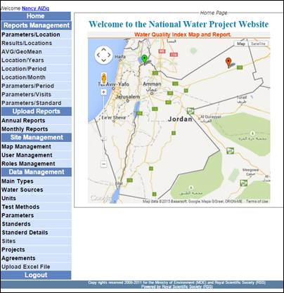
Project Summary
Data Bank System

Slide 26
Project Summary
Data Bank System
Oracle data base 10G R2.
Two servers; one at RSS and the other at MoEnv; for Disaster Recovery (DR).

Slide 27
Project Summary
Data Bank System
Increase the effectiveness of the project,
Facilitate the analyses procedures and save the data of results,
And manage the enormous data coming out of this vital project.

Slide 28
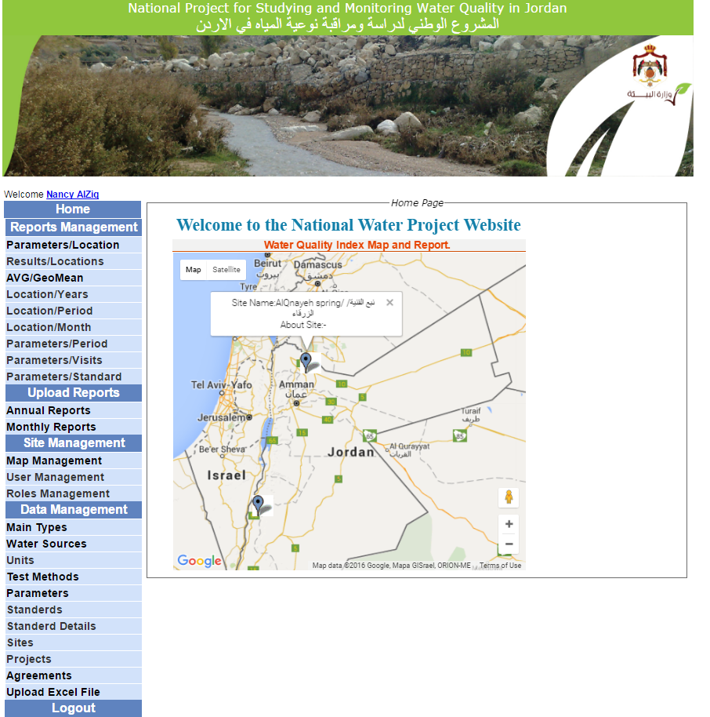
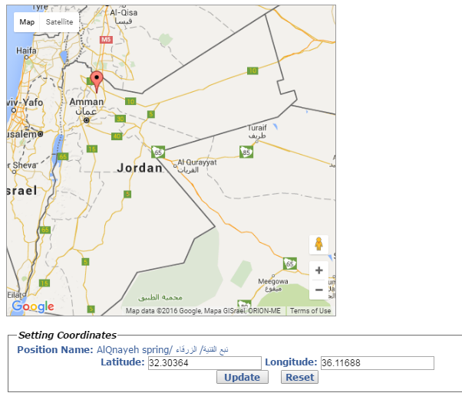
Project Summary
Data Bank System

Slide 29
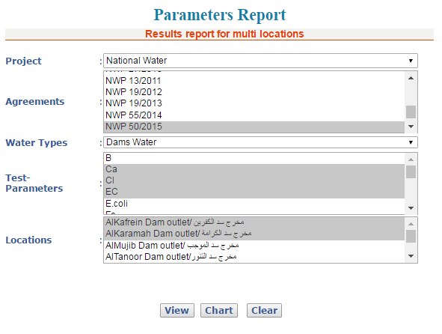
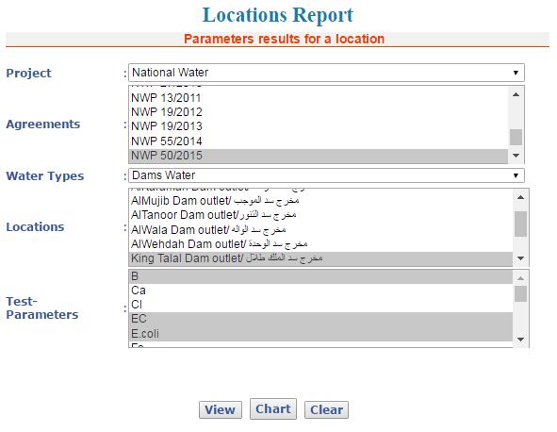
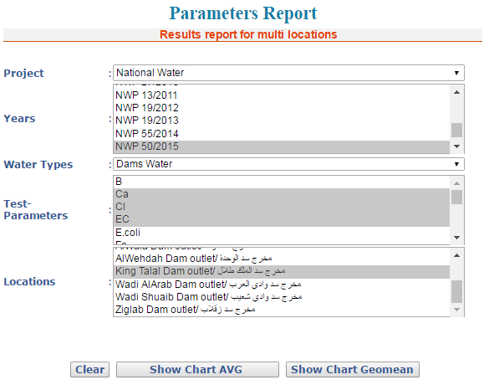
Project Summary
Data Bank System

Slide 30
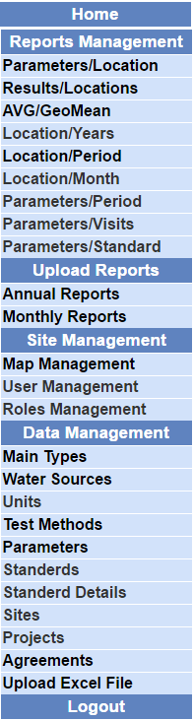
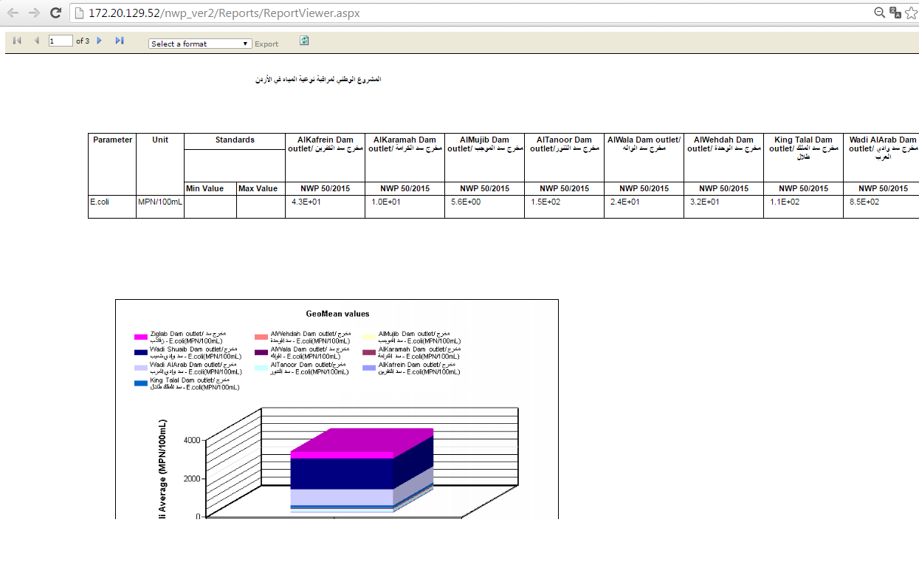
Project Summary
Data Bank System

Slide 31
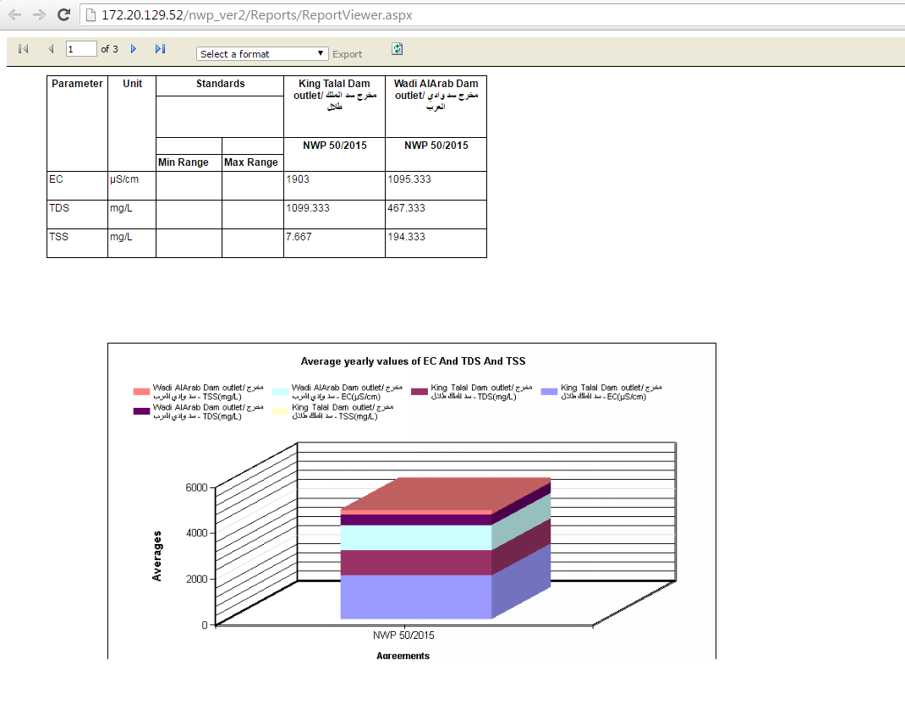
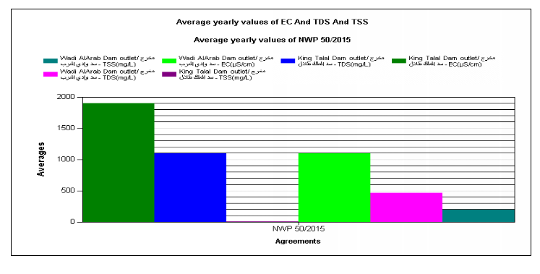
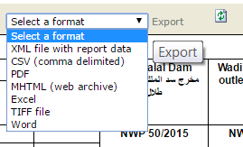
Project Summary
Data Bank System

Slide 32
Thank you

