Slide 1





Paul Harrison
Regional Export Manager

Slide 2



United by a Purpose - Halma Video
Halma is a FTSE 100 PLC group dedicated to making products that enhance and safeguard the quality of life for individuals and businesses around the globe. Halma are market leaders in specialist electronic, safety, and environmental technologies.
Halma comprise of approximately 50 companies across four specialist business sectors and operate in 23 countries with a significant presence in Europe, the USA, and Asia.

Slide 3

Leakage reduction strategy
Pressure
Management
Water Losses
Unavoidable Real Loss
Active
Leakage
Control
Improved
Repair time
Current Annual Real Loss Volume
Infrastructure
Management

Slide 4
Distribution Network
Hydraulic study
Production Area
DMA
Operation Area

Slide 5
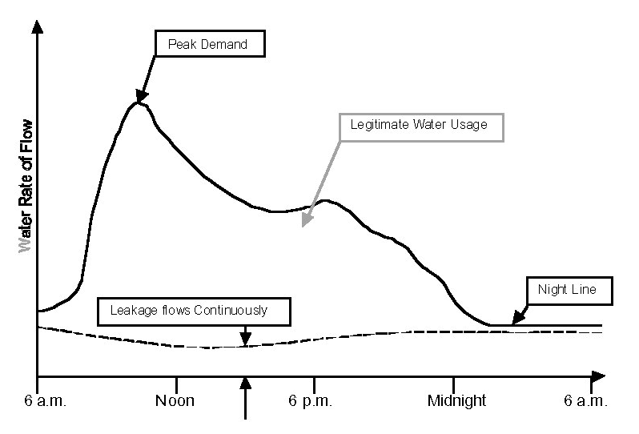
Typical Daily Flow Profile

Slide 6







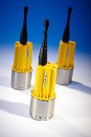
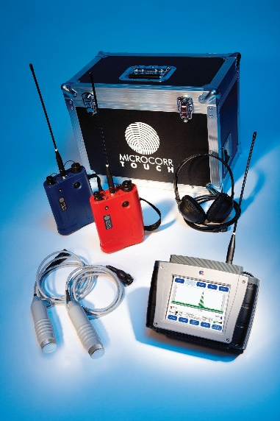
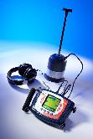

How To Find Leaks
CREATE
DMA
IDENTIFY
LEAK AREA
PINPOINT
LEAK
CONFIRM
POSITION
DIG &
REPAIR

Slide 7
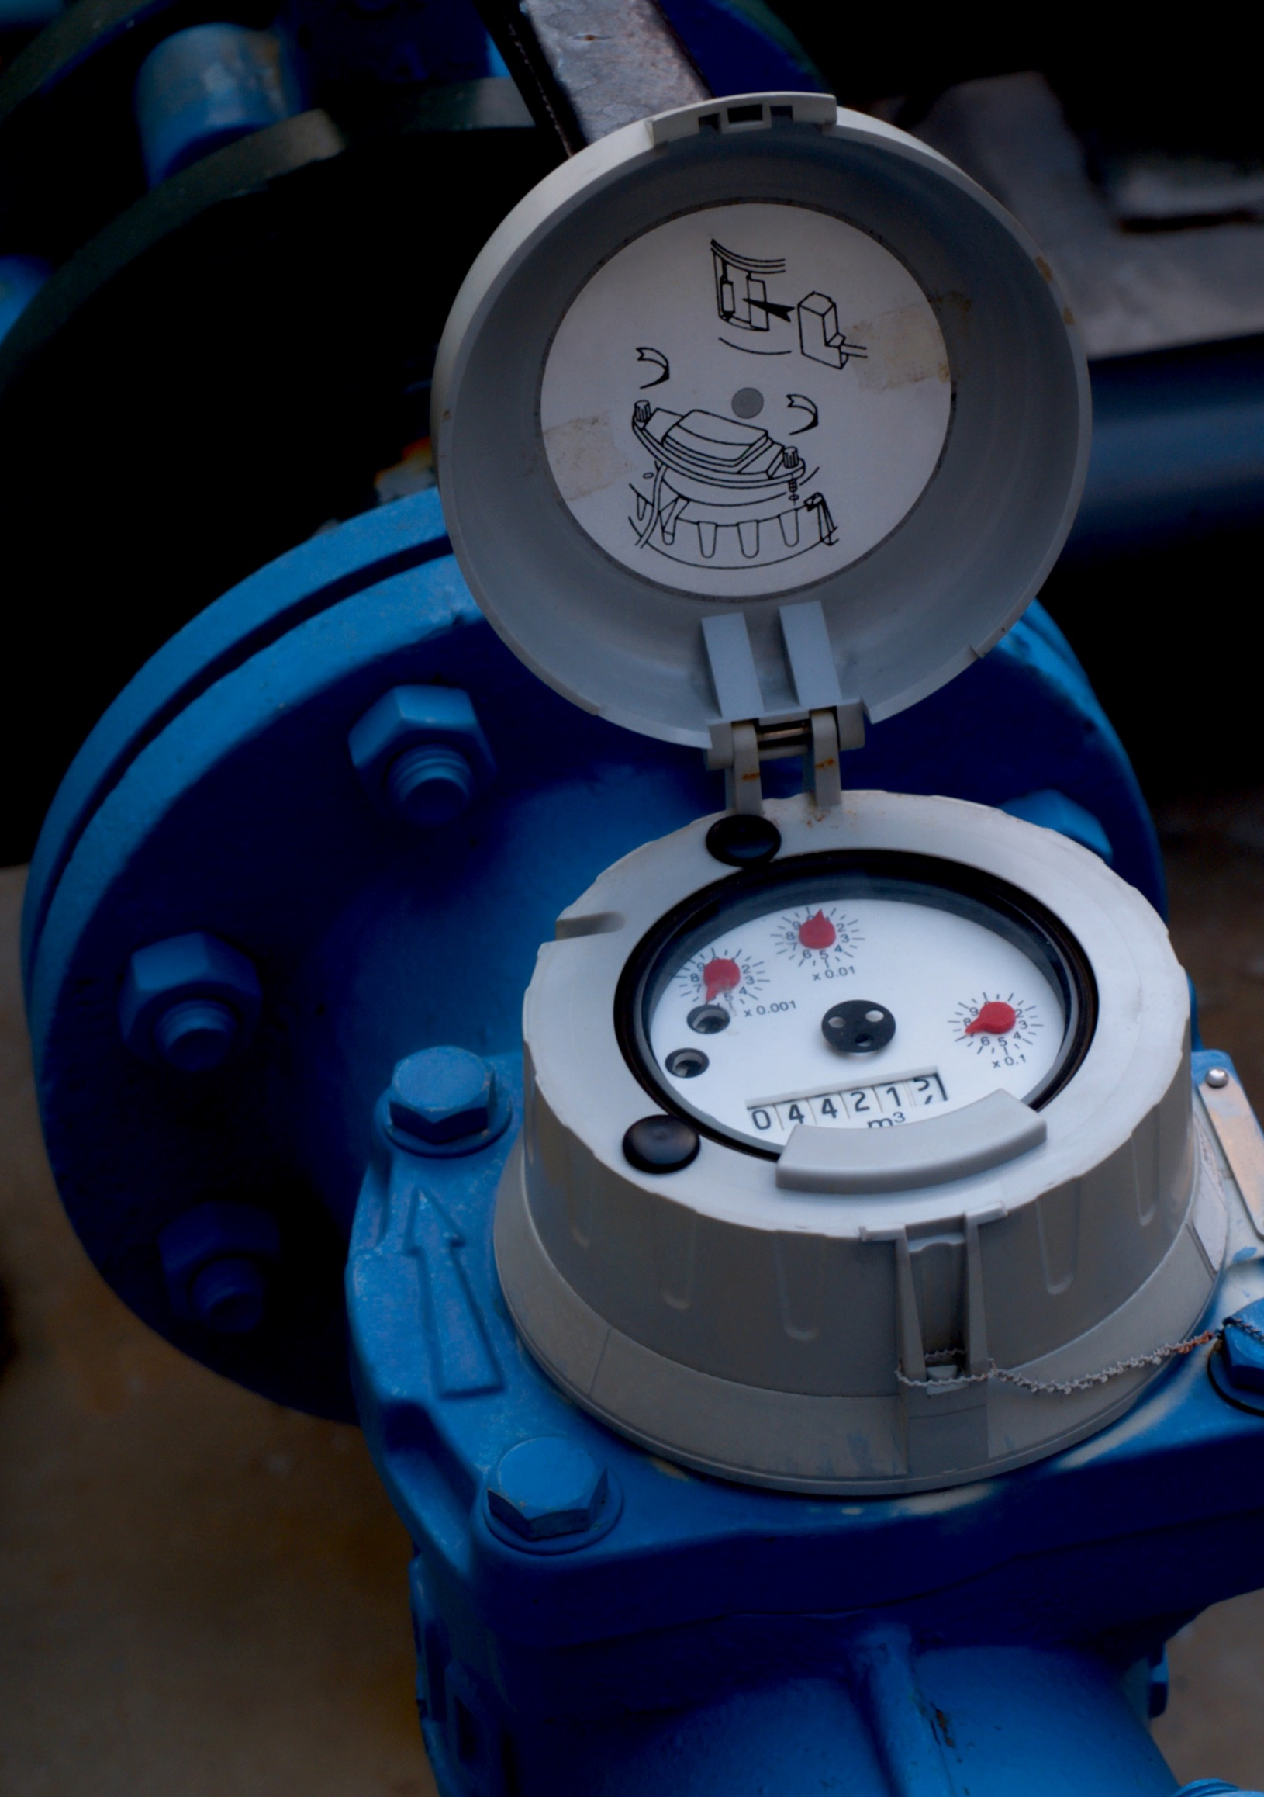
Flow & Pressure Logger Hardware

Slide 8
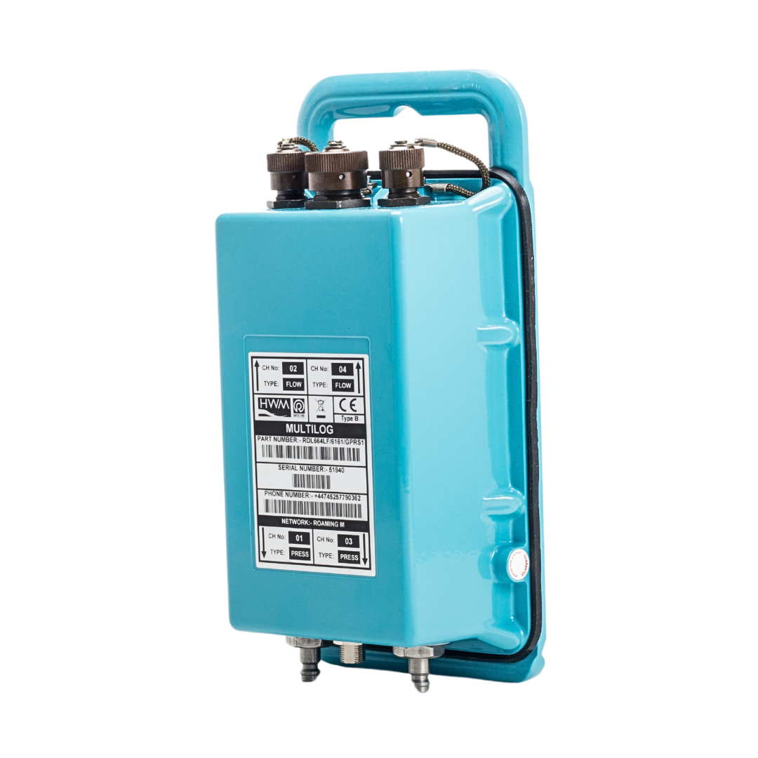

Flow & Pressure Loggers – MultiLog2
4 channel any digital or analogue combination channels
Flow, pressure (internal or external), depth, temperature, 4-20ma etc...
Internal/ External pressure 20bar as standard
0.1% accuracy for pressure
Secondary & Pseudo / PIT channel as standard
NB-IoT/LTE-M with 2G communication
External aerial
5-year battery life based on 2x calls per day
External battery packs/ power connection available
Reported battery level and signal level on every call
Down to 1 second logging interval main recording
Down to 25th second on secondary recording
Specific fast “window log” i.e. 2am - 4am, Minimum, Maximum & Average
2 million readings NVM
Count and Event Logging
HWM Global roaming SIM
Remotely configurable/ firmware upgradeable

Slide 9
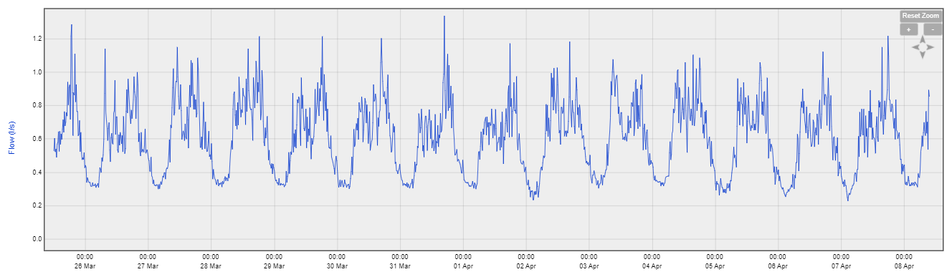
Secondary Channel Flow Logging
Alongside standard logging
Can be time limited
Would you do leakage in this DMA? MNF is around 0.3l/sec
Notes:
Looking at this DMA you will probably be getting ready to send out a leakage team to investigate.

Slide 10
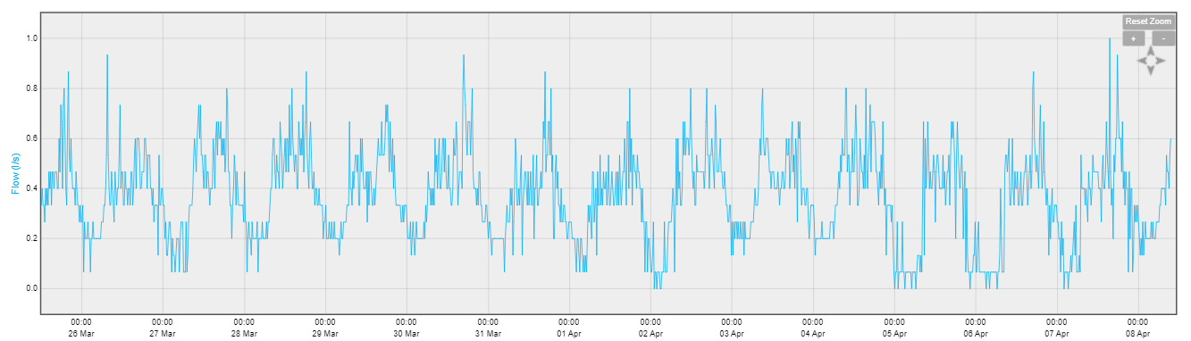
Secondary Channel Flow Logging
In this DMA, the MNF goes to zero
Notes:
Here the MNF goes to zero, you certainly would not be sending any leakage teams into this area. But wait.

Slide 11
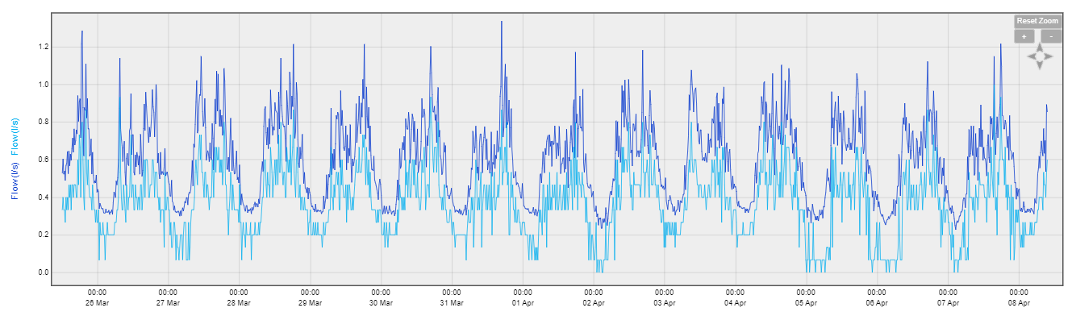
Secondary Channel Flow Logging
The previous two slides are the same DMA.
Here they are combines
Notes:
Channel 2 the darker line is the 15 min average data typically used in calculations. Where the light blue is the minimum 15 sec value in the same 15 minute period.
Using this secondary channel allows for better allocation of resources to find leakage.

Slide 12
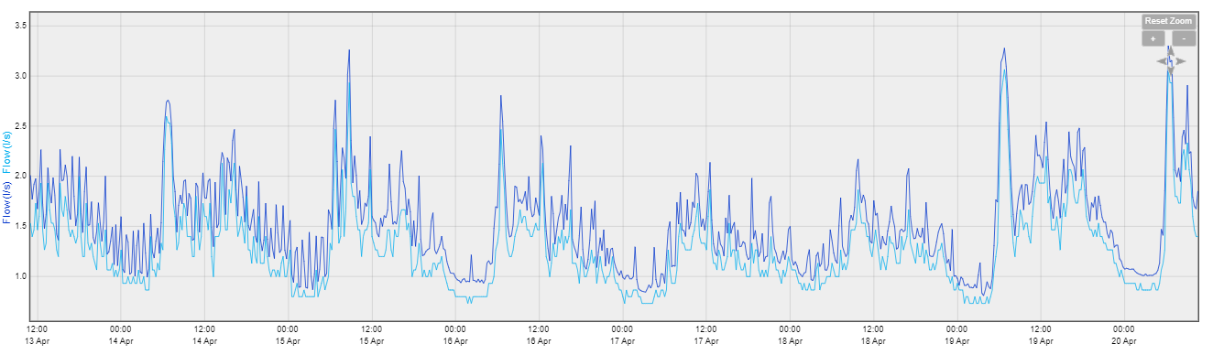
Secondary Channel Flow Logging
Difference is 0.1l/sec (12%)
Notes:
Another example showing a 12% reduction in MNF by using the secondary channel.

Slide 13
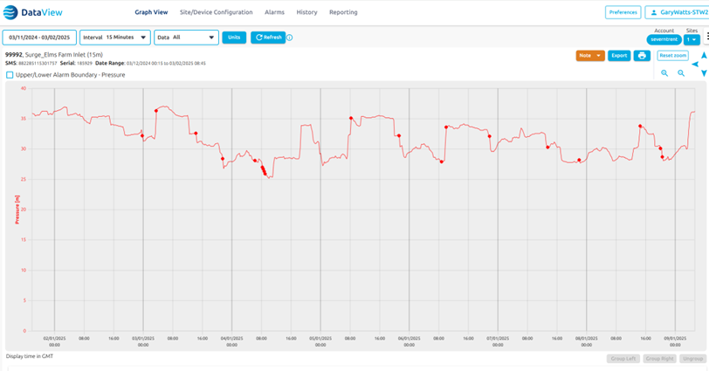

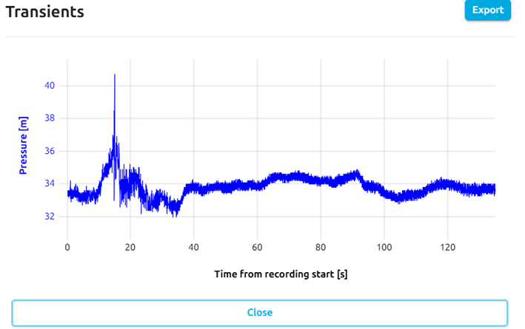

25Hz Transient Capture on Standard ML2
Transient Surge

Slide 14

Platform Hosting

Slide 15
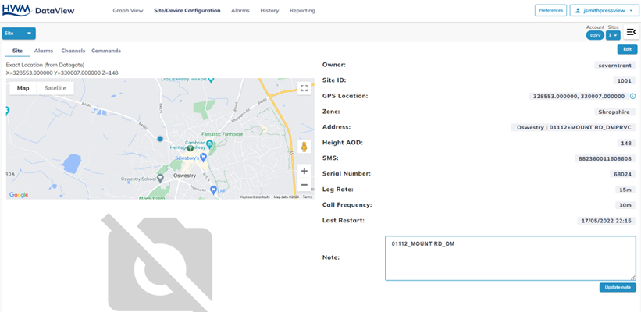

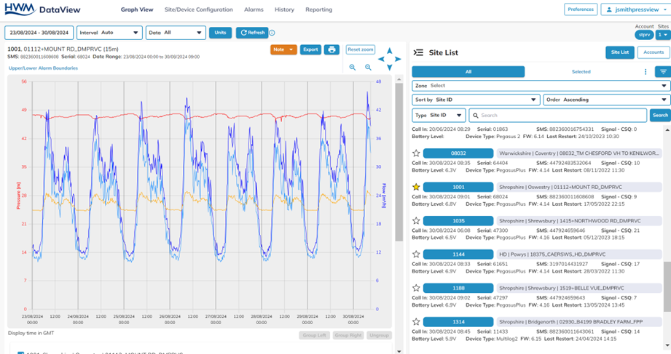
DataView Website Software

Slide 16
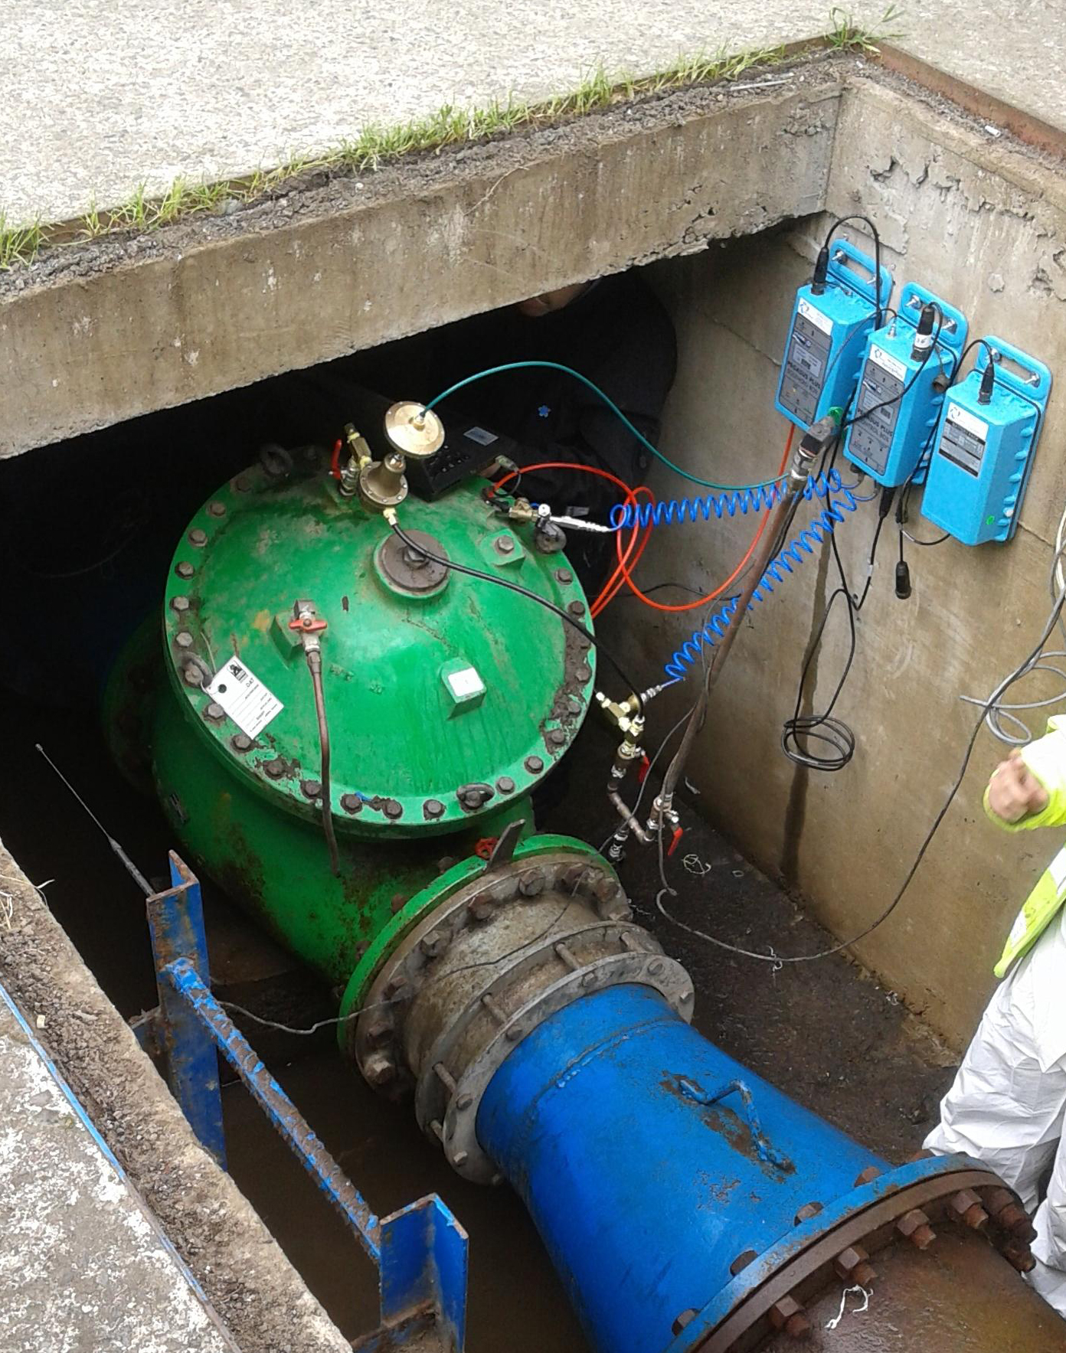
Pressure Controllers

Slide 17
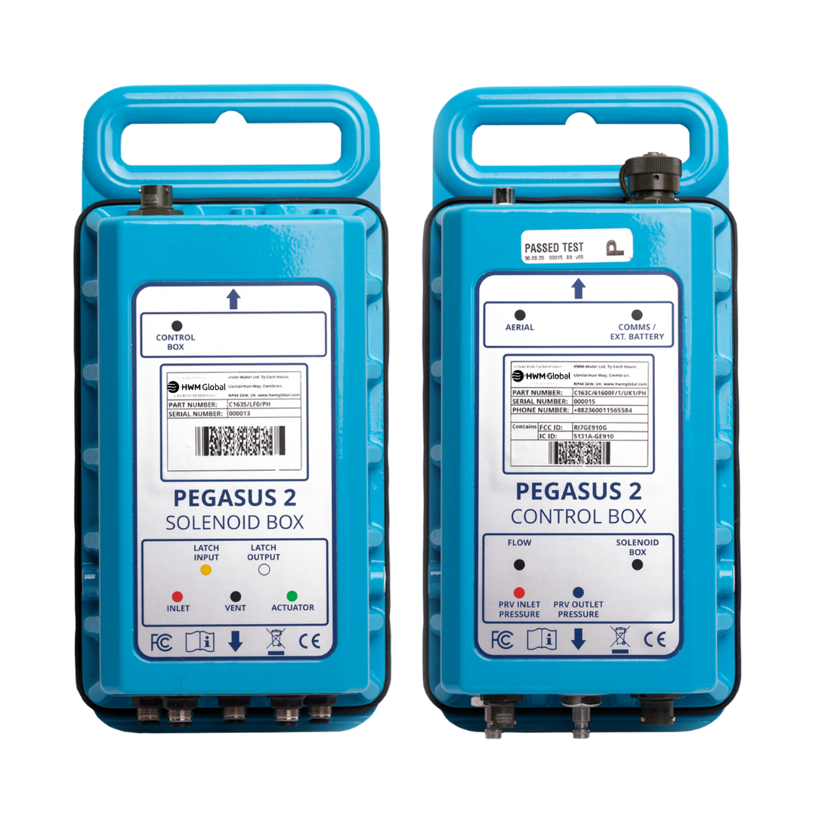
Pressure Management – Pegasus2
2x Pressure (internal or external) and 1x flow
Spare logging port for extra flow, pressure (internal or external), depth, temperature, 4-20ma etc...
Internal/ External pressure 20bar as standard
0.1% accuracy for pressure
Secondary & Pseudo channel as standard
NB-IoT/LTE-M with 2G fallback
External aerial
5-year battery life based on 2x calls per day
External battery packs/ power connection available
Reported battery level and signal level on every call
Down to 1 second logging interval secondary recording or 25Hz transient mode based on event.
HWM Global roaming SIM
Remotely configurable/ firmware upgradeable
IP68 fully submersible, not required to vent atmosphere

Slide 18
Key Benefits & Advancements
Works in Time, Flow, or Both
Learning mode
Active mode (Closed loop)
96 table point entry (if required)
Different tables for different days of the week
Latching solenoids to fully vent or fully close the PRV
Pressure set default fail safe on no flow
Timetable default fail safe on no flow
Calendar dates override
Previous saved tables stored
Alarm settings
Customer deadband setting
Actuation alarms for proactive maintenance
Signal and battery tracking levels
Installation in under 30 minutes
No need to change pilot or remove pilot rail
Works via the actuator with how the pilot was designed, not by inversing pressure under the pilot
Manual safety override
Fail safe with mechanical actuator settings

Slide 19
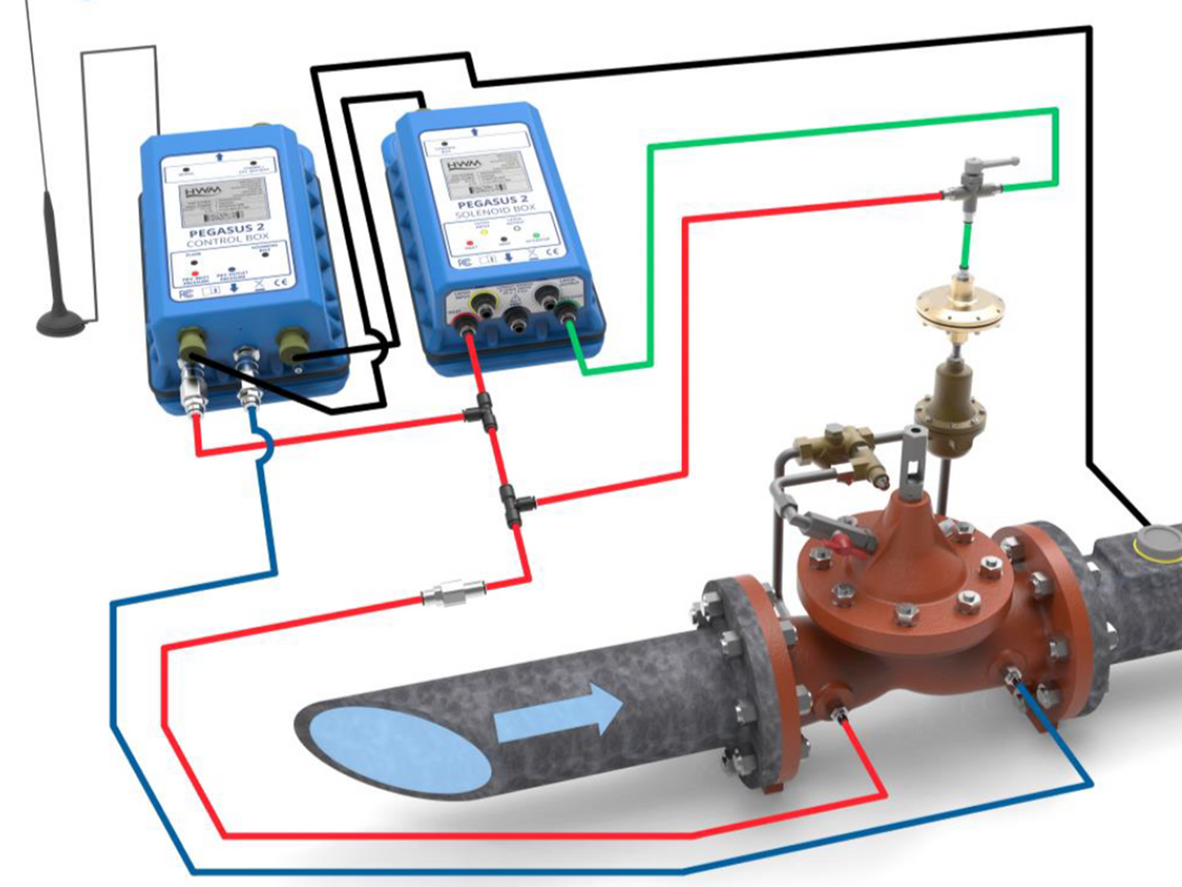
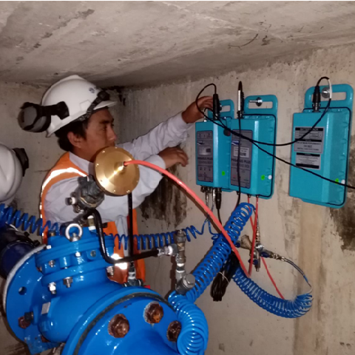
Pegasus2 Pressure Controller Installation
HWM Global look to connect an actuator to the existing PRV pilot by removing the existing fixing screw and replacing it with an actuator.
We will need pressure access points on the inlet and outlet PRV
No changes to the PRV pipe rail or PRV configuration are required for a Pegasus Installation. No bias chambers to base of pilot required.

Slide 20



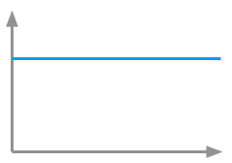
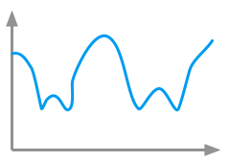
Fixed outlet PRV
Zone
PRV
Critical Point
Pressure
Pressure
Time
Time
Notes:
Highlights
- Describes how fixed outlet PRV’s give too much network pressure at minimum flow

Slide 21
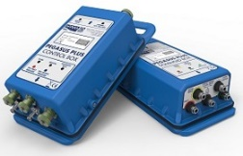
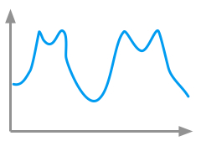
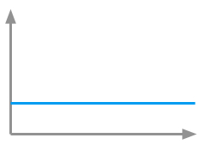
PRV with Controller
Zone
PRV With Controller
Critical Point
Pressure
Pressure
Time
Time
Notes:
Highlights
With effective PRV control we constantly adjust the position of the valve and therefore the downstream pressure to optimise the network pressure
Maintaining a constant pressure in the network irrespective of demand from customers

Slide 22
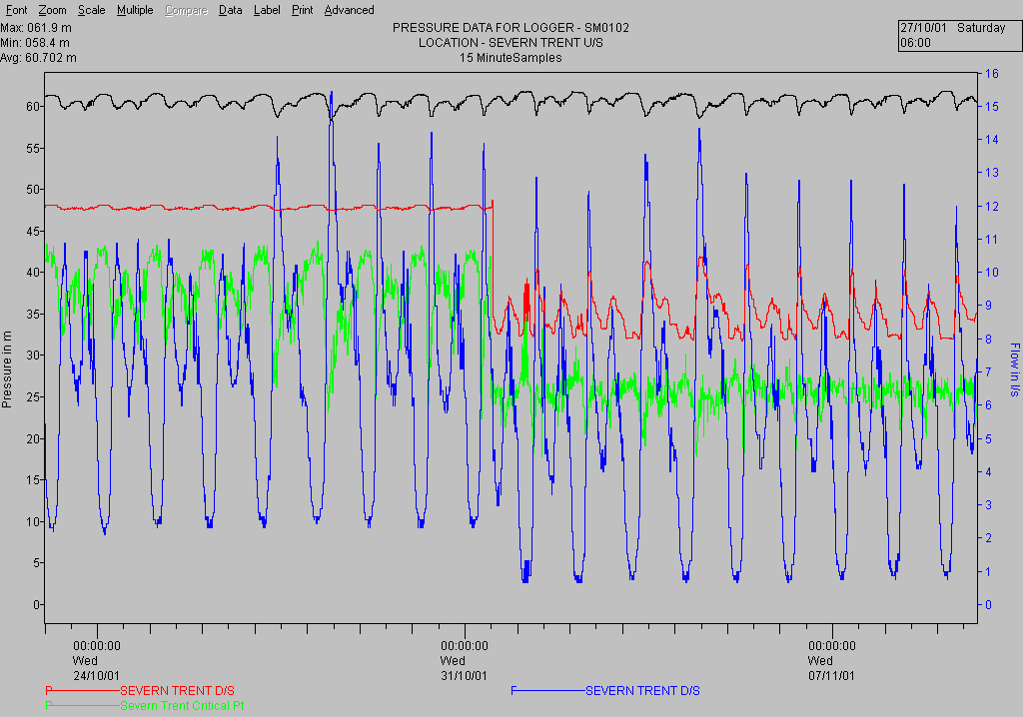
Why Control Pressure?
To save water by reducing pressure when demand is low (e.g. at night)
To reduce the quantity of water lost through leakage
To extend asset life by reducing burst frequency - Fewer burst pipes
To provide a more consistent service to the consumer

Slide 23
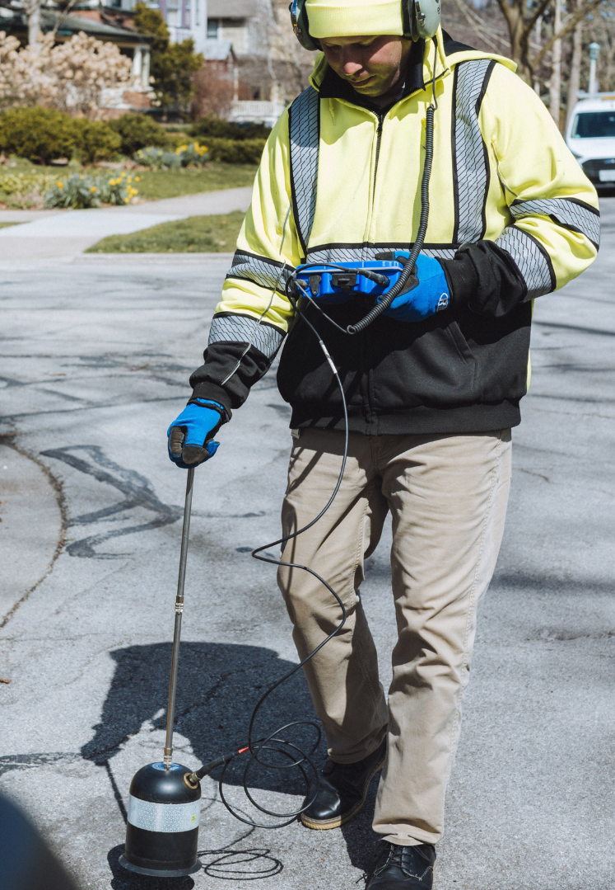
Leak Detection Products

Slide 24
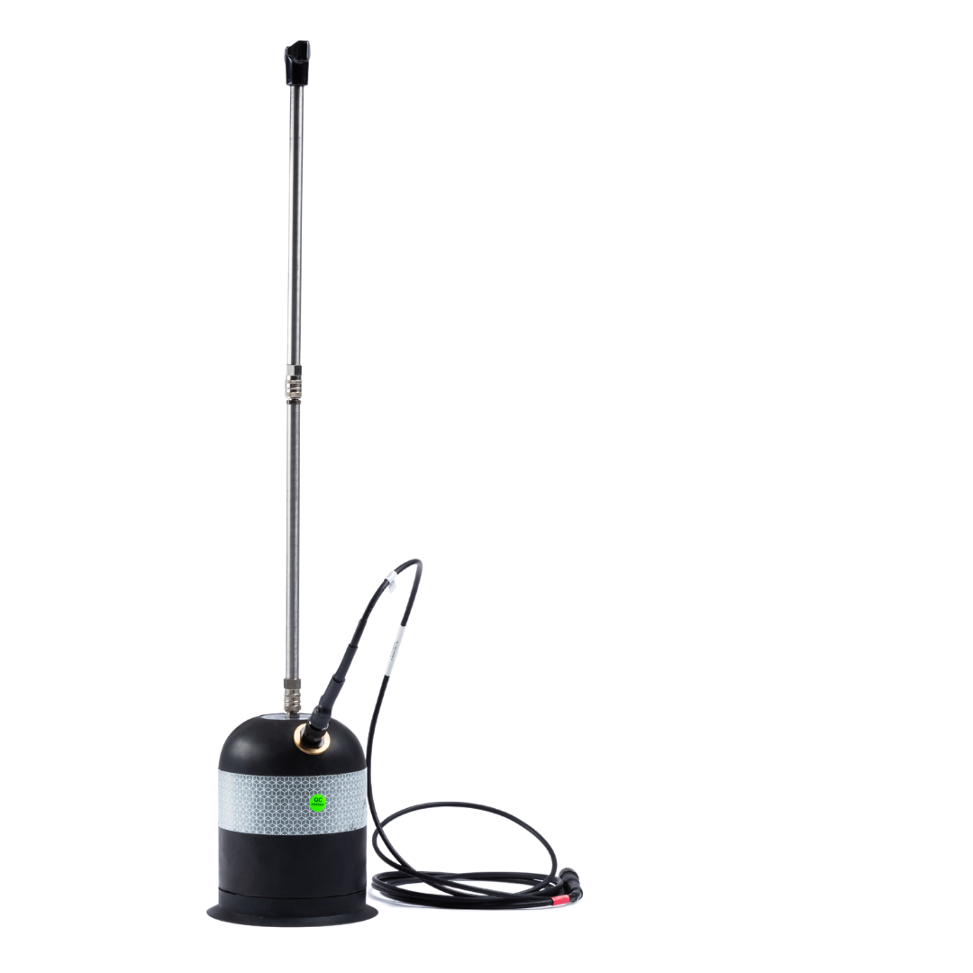
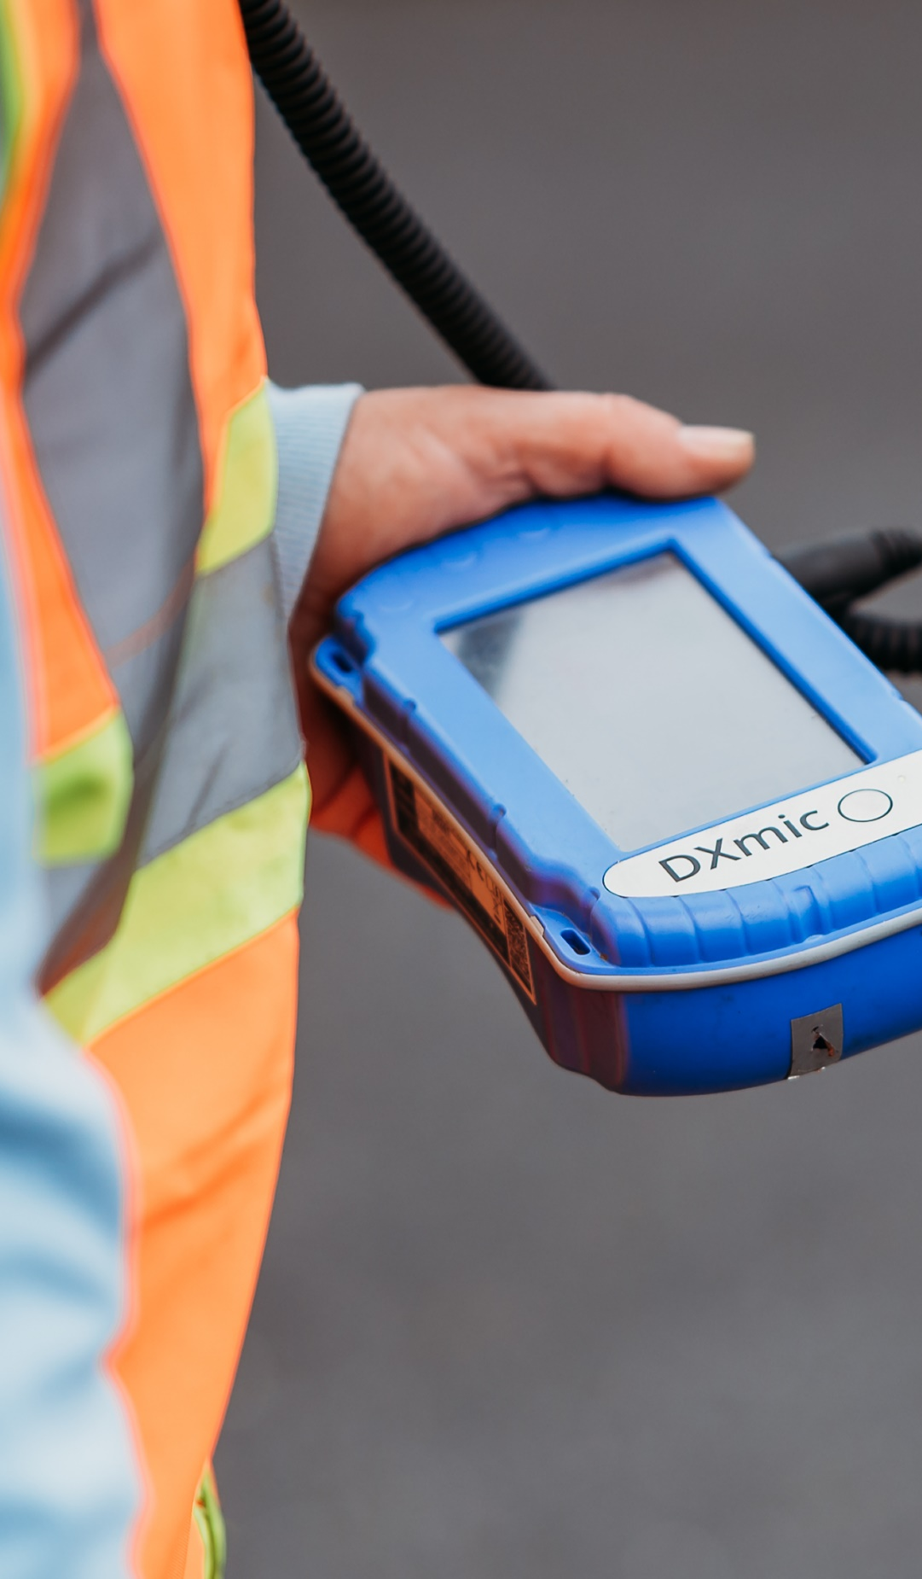
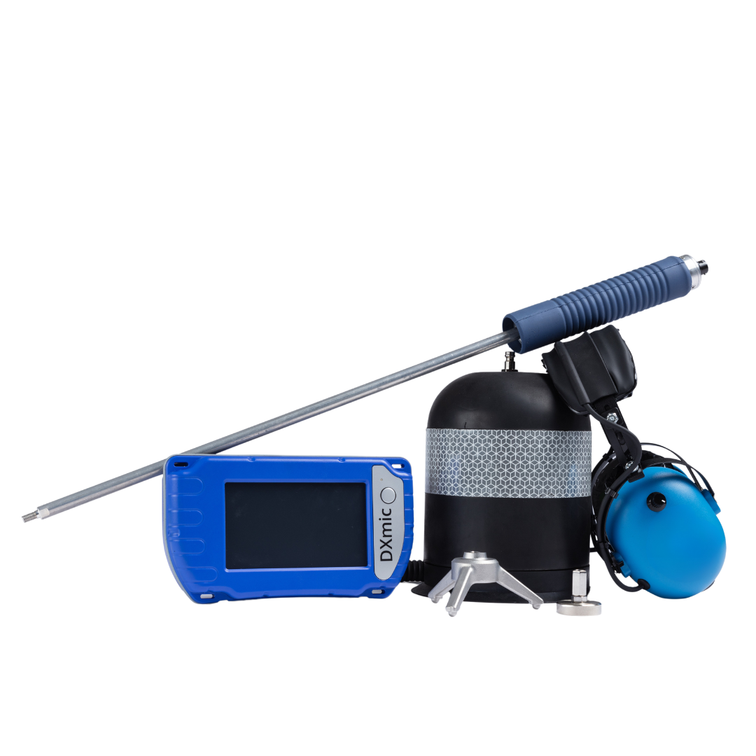
DXmic Pro
Digital Ground Microphone
DXmic is the latest generation digital ground microphone developed to precisely localise the position of a leak.
Delivering the highest quality sound, DXmic Pro incorporates a wide variety of features including auto filtering and frequency display to pinpoint a leak.
Improved automatic filtering: supported by frequency analysis display.
Safety Noise Level cut-off: ensures user is protected should probes be dropped or mishandled.
DXmic Pro App compatible: download results to DXmic Pro app and replay leak noise recordings.

Slide 25
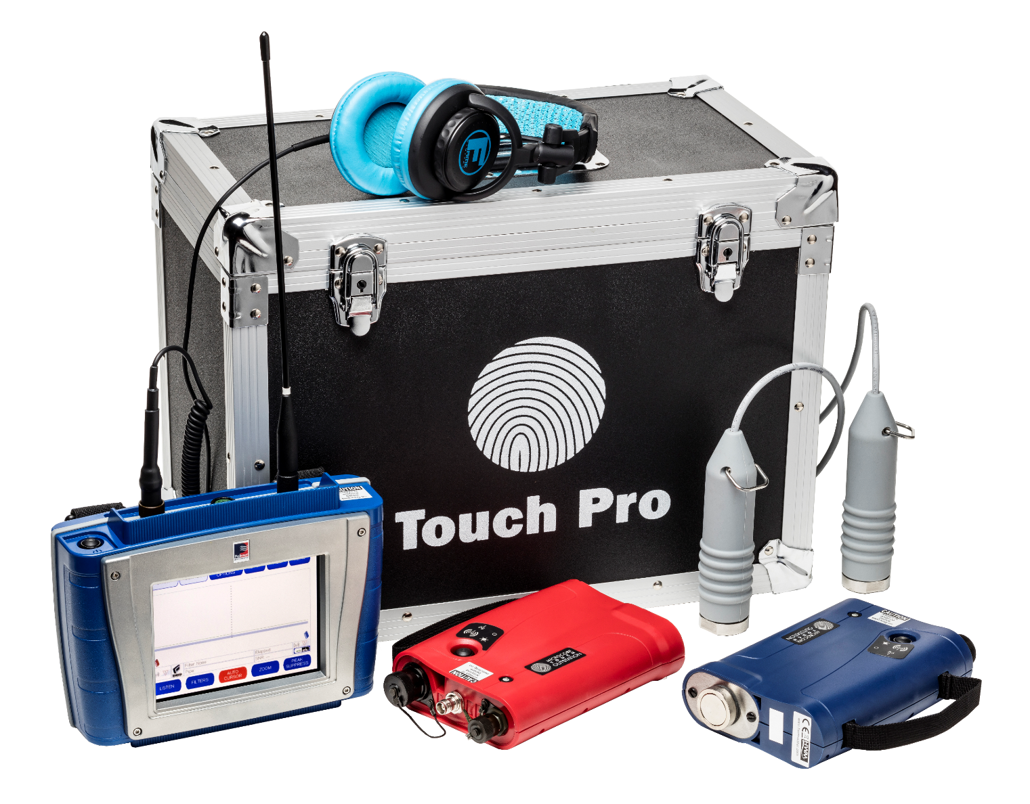
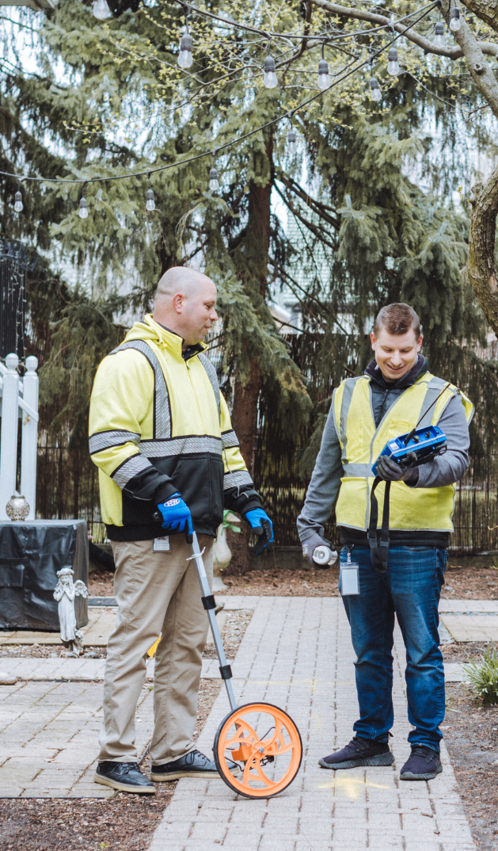
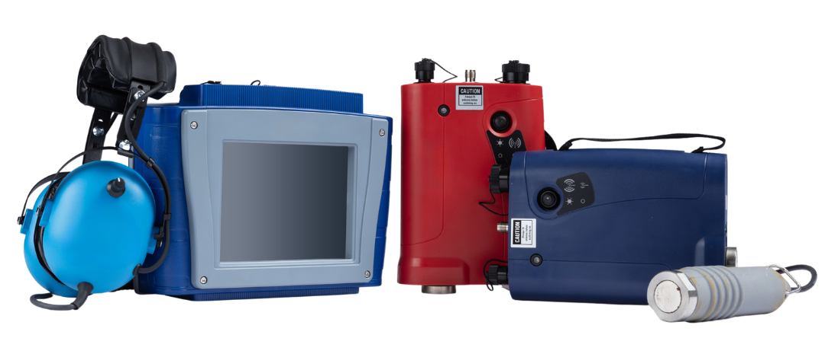
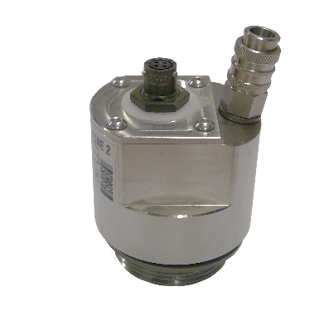
McTouch Pro Correlator
McTouch Pro is an advanced leak noise correlator designed especially for the more difficult leak detection situations, including plastic or large diameter pipes, with accelerometers or hydrophone connection

Slide 26
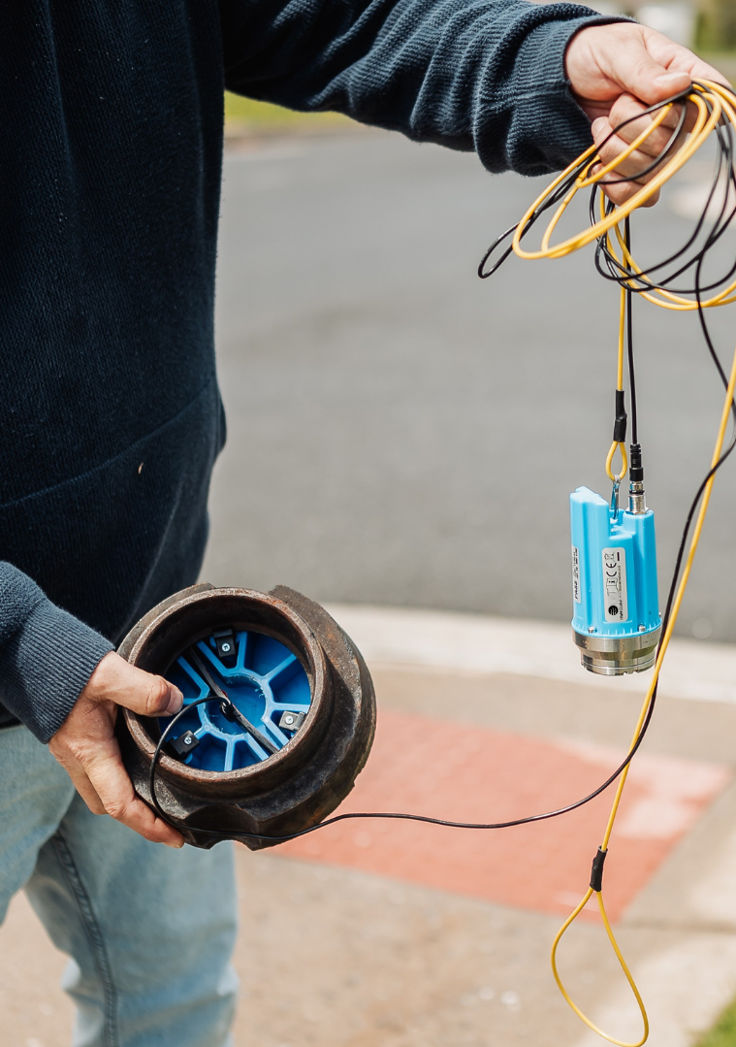
Acoustic Logging

Slide 27
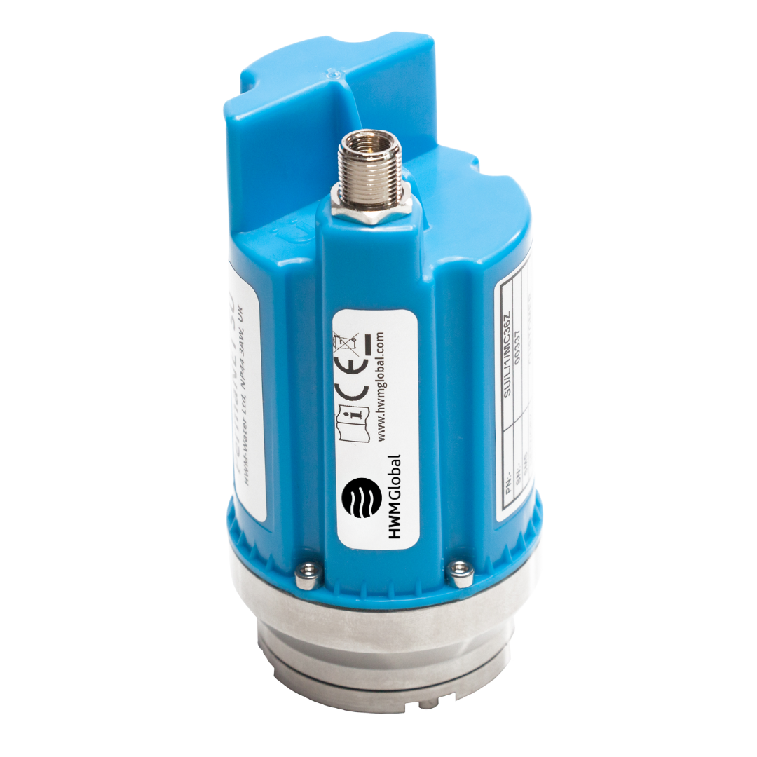
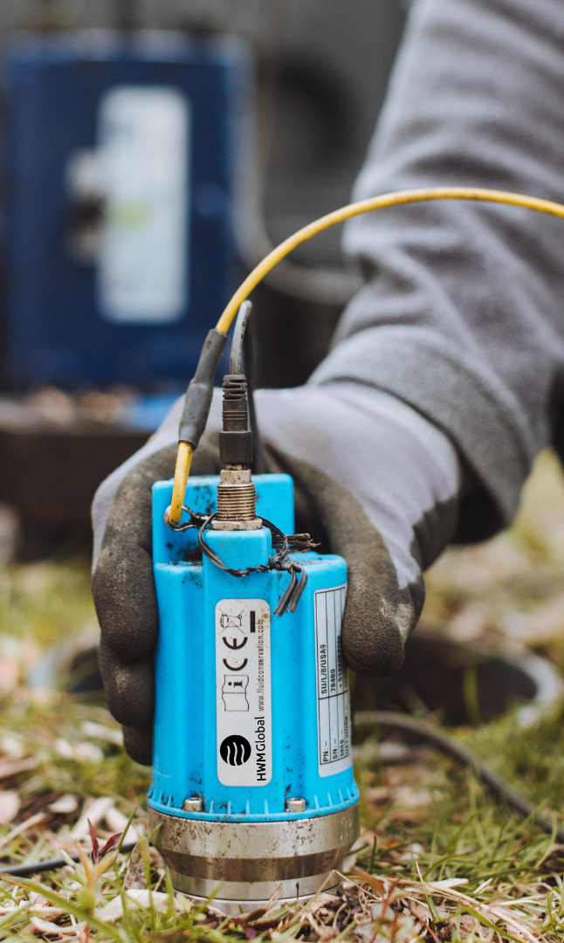
PermaNET SU
Correlating Telemetry Acoustic Logger
PermaNET SU is an award-winning correlating noise logger that combines a leak noise sensor and telemetry technology into a single compact unit.
PermaNET SU is fully compatible with PermaNET Web, combining to produce map-based display, GIS interface and full audio and correlation facilities.
Robust and durable: designed specifically for smaller and more challenging installation areas.
Installation confirmation: daily check to confirm logger orientation; will alarm if a problem is detected.
Easy to use: compatible with HWM Global Deployment app. Select features can be programmed through PermaNET Web.

Slide 28
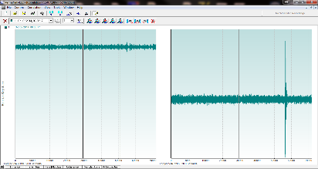

Audio Monitoring
Remote high quality audio monitoring to validate leak status or identify erroneous noise
Identifies other activity such as draw off and secondary noises
Without Leak
With Leak

Slide 29
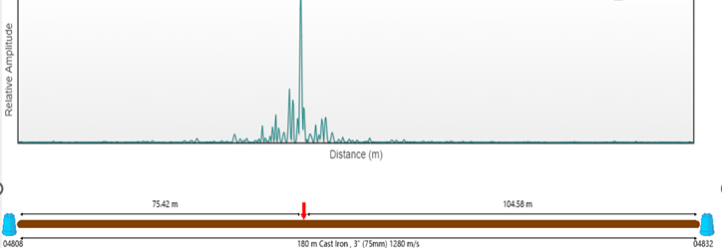
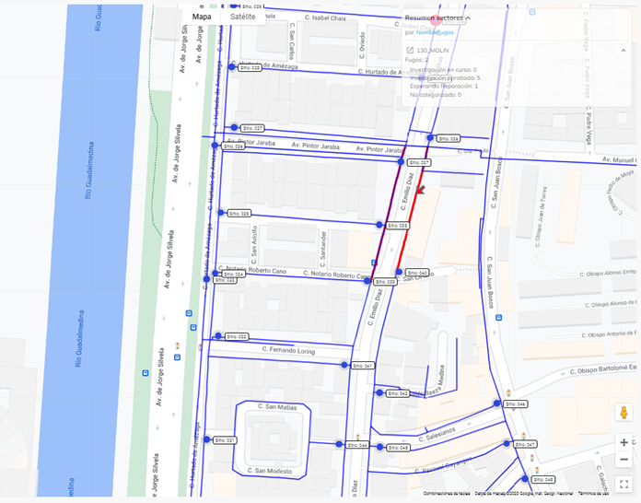
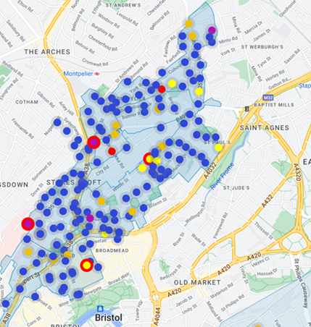
PermaNET Web Software

Slide 30
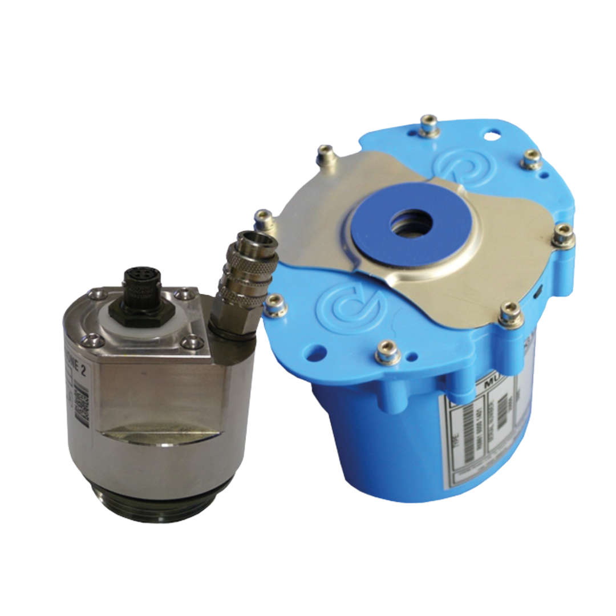
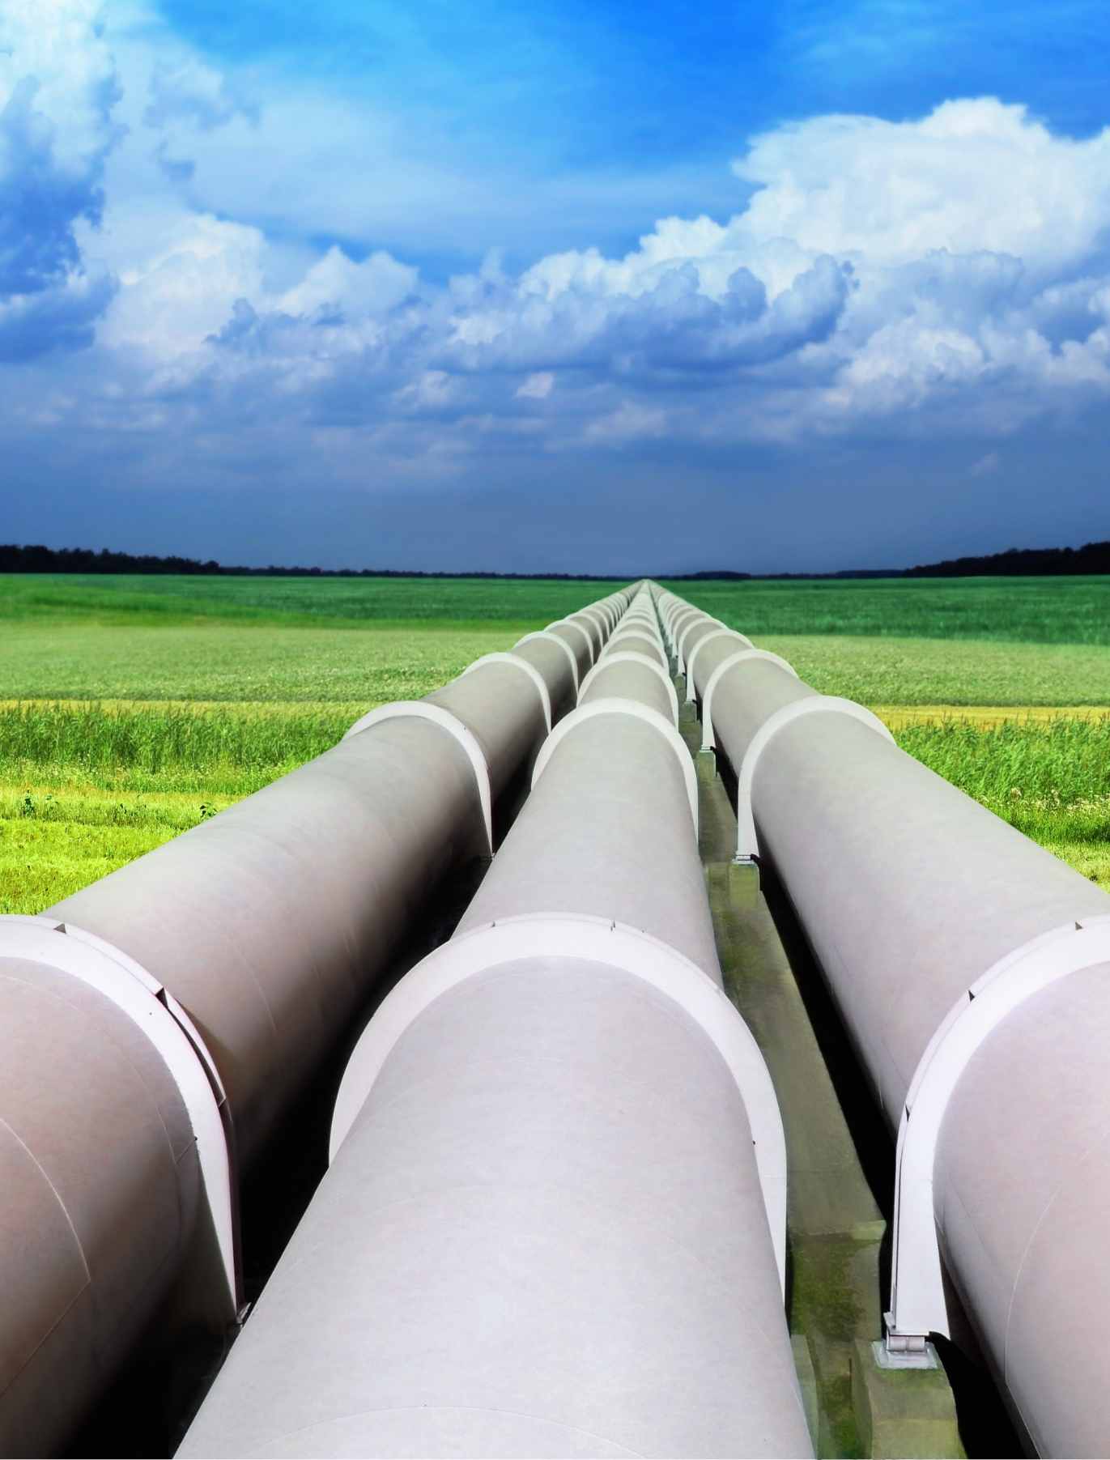
PermaNET TM GPS
Correlating Telemetry Acoustic Logger
PermaNET TM GPS is the innovative correlating noise logger for trunk mains.
PermaNET TM GPS is fully compatible with PermaNET Web, combining to produce map-based display, GIS interface and full audio and correlation facilities
With Pressure connector to log pressure and acoustic data, with GPS aerial for time sync.

Slide 31

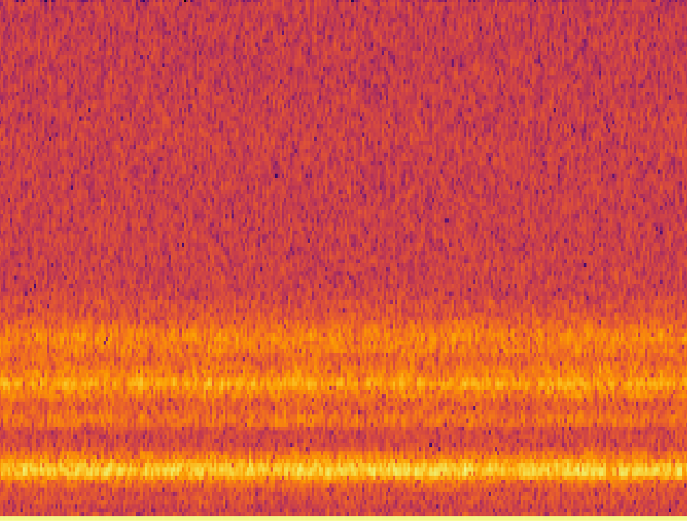
Integrating AI with Acoustic Data
Artificial Intelligence and Machine Learning algorithms are far more effective at analysing images than audio. As part of the process, we effectively turn the audio file in to an image. Spectrogram, a visual representation of the audio frequency spectrum against time.
Frequency
Time

Slide 32
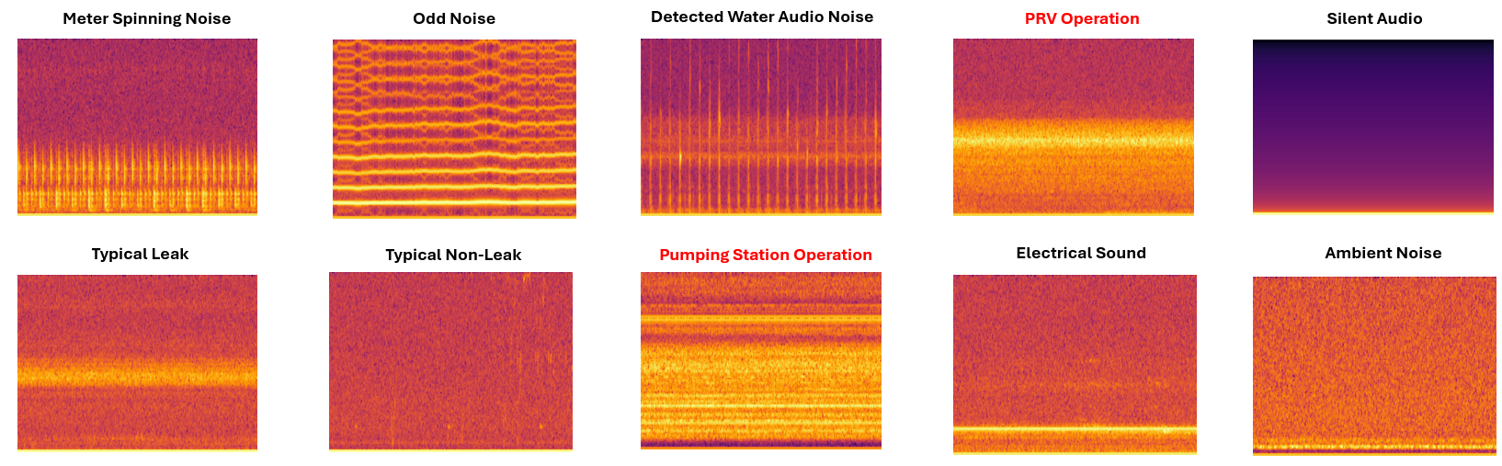
Integrating AI with Acoustic Data
AI powered Spectrograms: A Spectrogram is created from an HWM Global Permanent Acoustic File. Every Spectrogram reveals a Distinct Signature, Elevating Leak Detection Analytics and Minimising False Alarms.

Slide 33
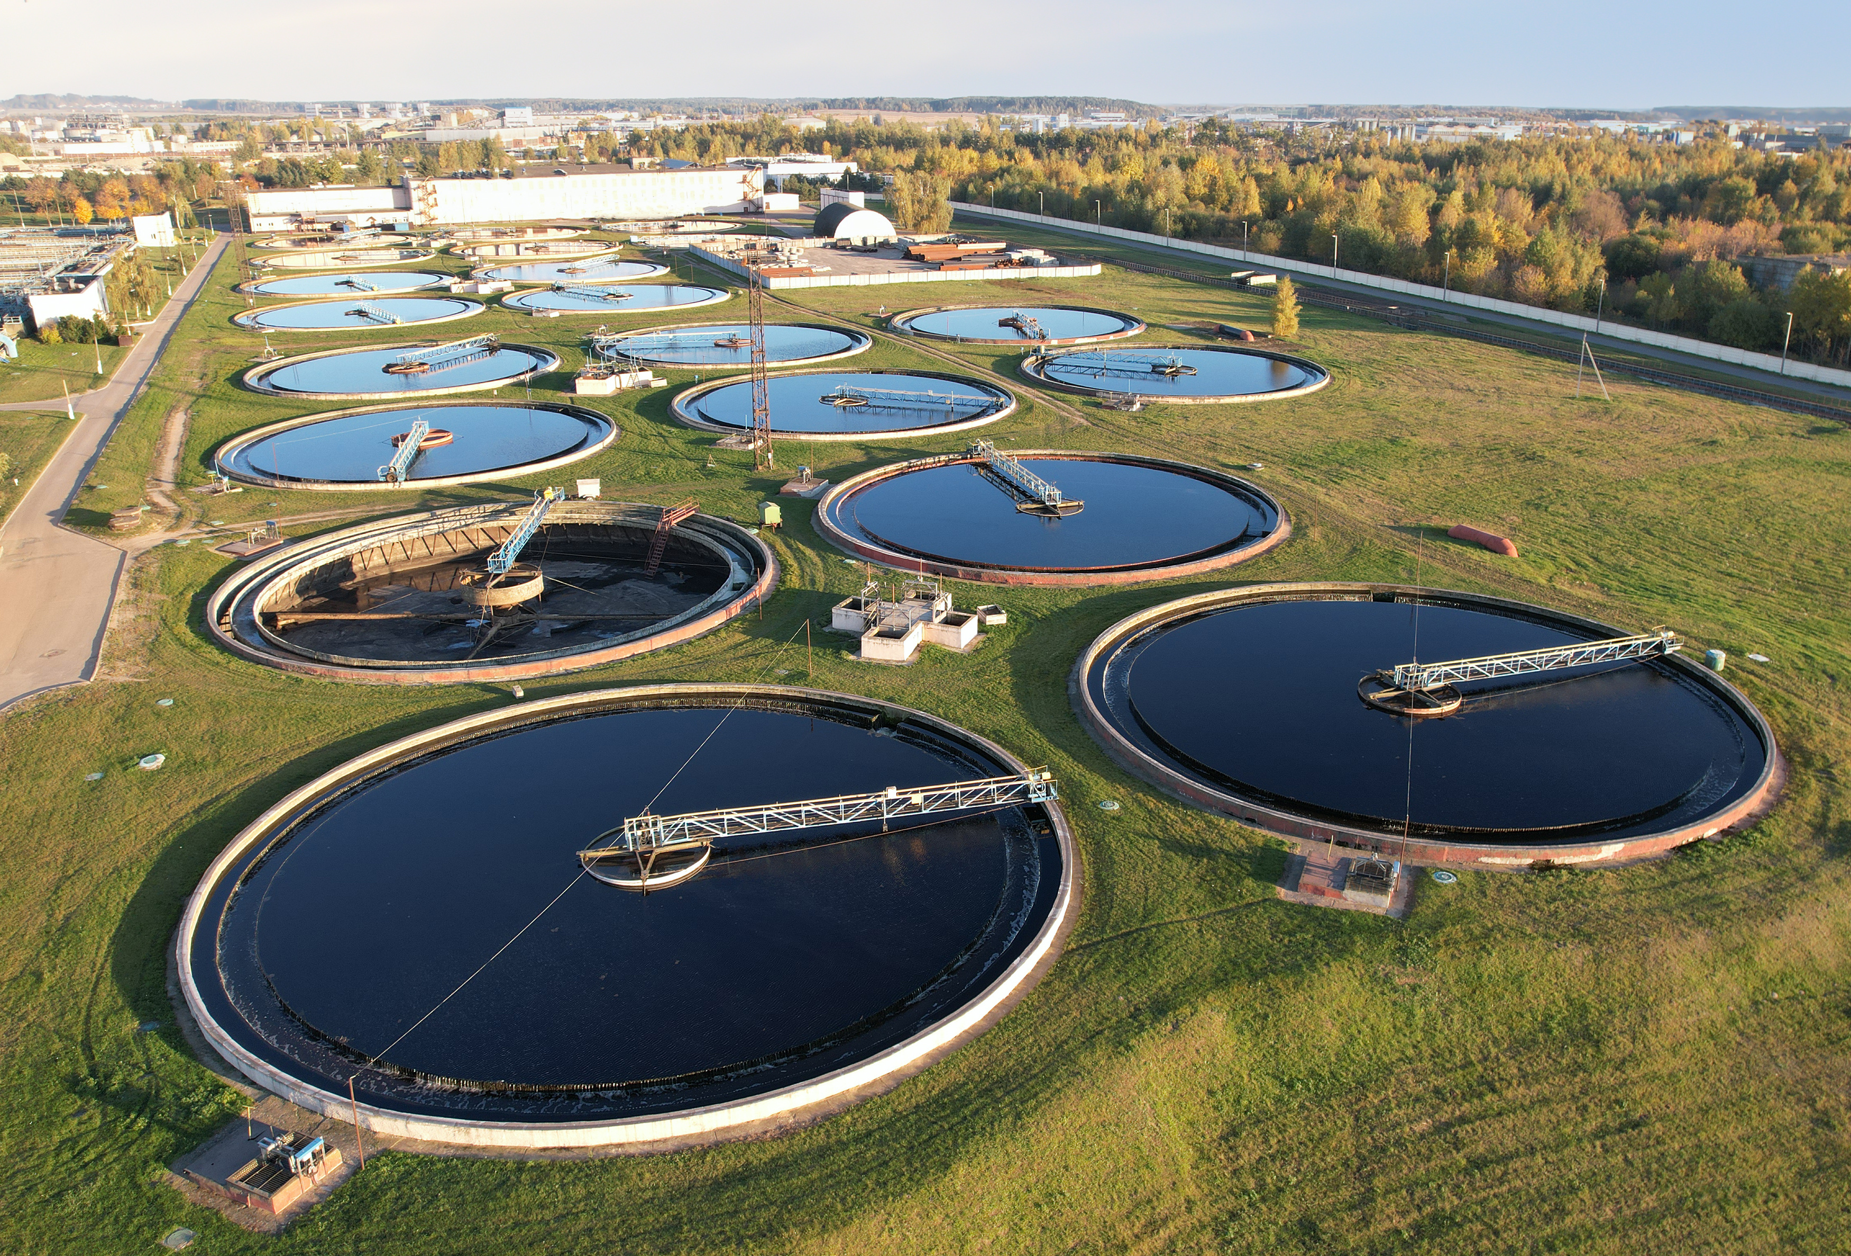
WASTEWATER SOLUTIONS

Slide 34
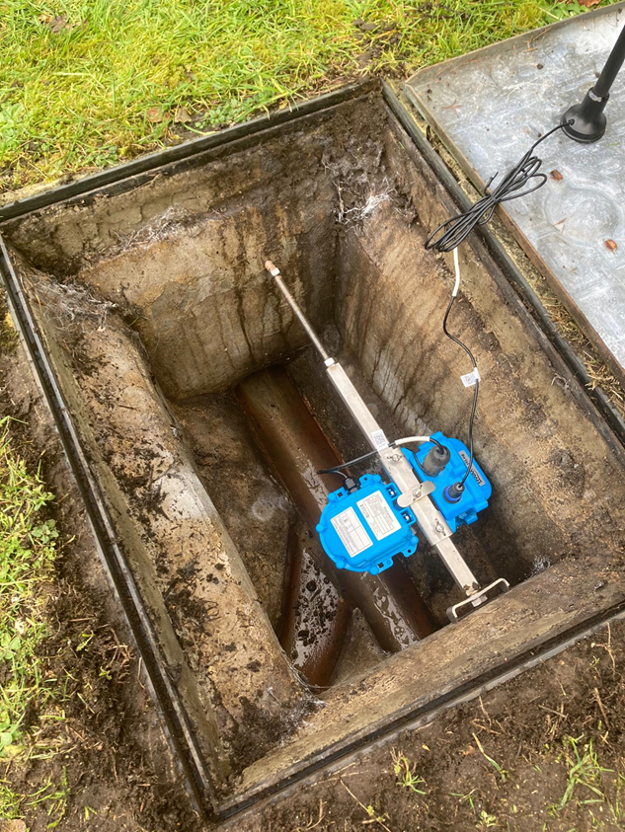
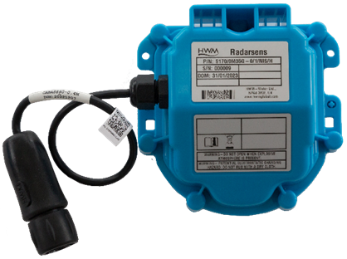
Radar Level Sensor
  Right first time
  Laser alignment tool
  Configured locally via bluetooth
  Signal Strength
  Sensor reflection tests

Slide 35
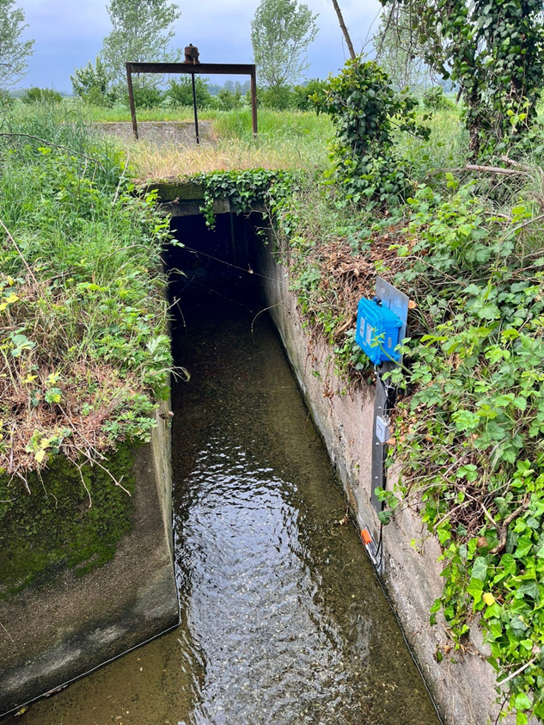
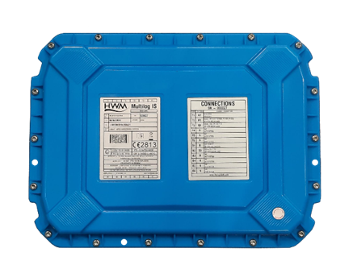
Multi-Input, Multi- Application ATEX Telemetry Data Logger
  Multi-channel
  Corrosion
  LTE-M
  NBIoT
  Compatibility

Slide 36



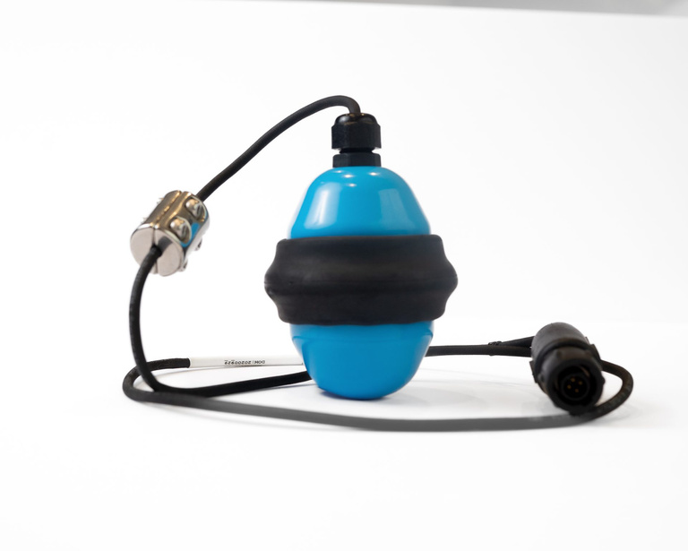
Kings Award for Enterprise
The King’s Awards for Enterprise are the most prestigious awards, honouring and celebrating business excellence across the UK. Kelly Macfarlane, Managing Director of HWM Global, stated:
“HWM is honoured to be awarded the King’s Award for Enterprise for Innovation 2023 for our multi-alarm digital float sensor, SpillSens.
“As a previous winner of the Queen’s Award, we are delighted to be recognised for innovation once again with one of the most prestigious awards for UK businesses.
“SpillSens was specifically designed to reduce the number of polluting spills from blockages in small diameter (domestic) sewers. We designed a low-cost, simple to install product suitable for mass deployment across the sewer network, to maximise its impact for water companies and the customers they serve.
“Recognition for excellence in innovating to solve real problems comes at a time when our Wastewater product portfolio has an urgent and critical role to play in supporting our water industry customers commitment to improve river and bathing water quality.”
Winners of the King’s Award for Enterprise for Innovation 2023 for our multi-alarm digital float sensor, SpillSens.

Slide 37


