Slide 1



Surface Water Quality Degradation
An Analysis of Salinity and Key Pollutants
Prepared by: Abdelrahman Alrefae,
Shahed khreisat and Joud Alnsour

Slide 2
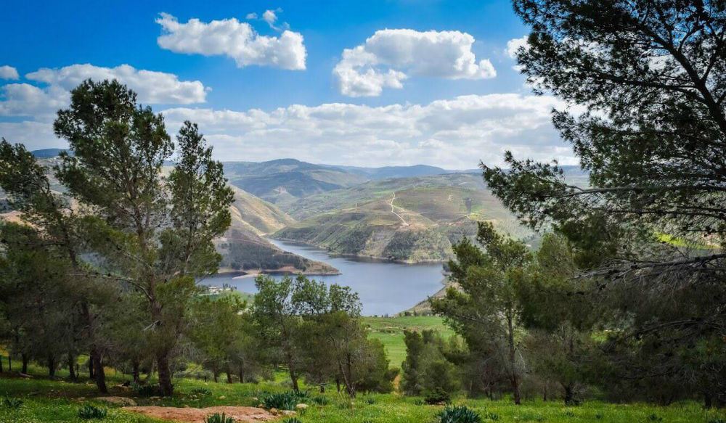

Slide 3

Trying to build a character of a superhero who get his/her power from the pure surface water!
Would he live in Jordan?

Slide 4
In Jordan there is:
17 major dams with a total capacity of 280.7 million m³
Tributaries: more than 10 rivers or small rivers

Slide 5
To help our superhero, we did a case study in one of the surface water in Jordan during the period from 2019 to 2024

Slide 6
In this case study, we did:
Analyze surface water pollutants from 2019 to 2024.
Assess pollutant variability and climatic impacts.
Estimate pollutant removal costs.
Develop a Pollutant Risk Index (PRI) using FAHP.

Slide 7
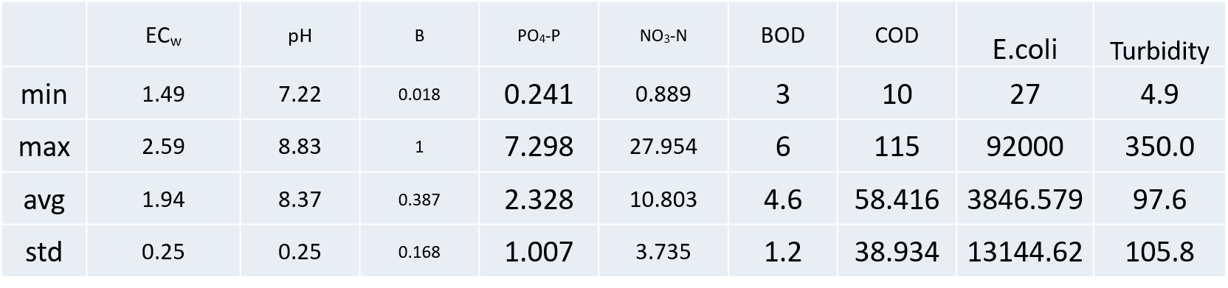
Data from the entire study period 2019-2024

Slide 8
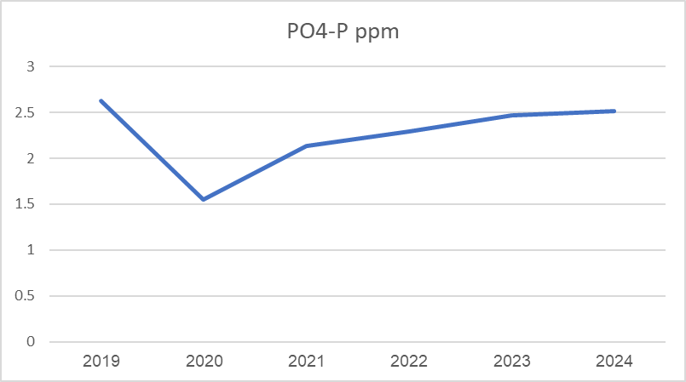
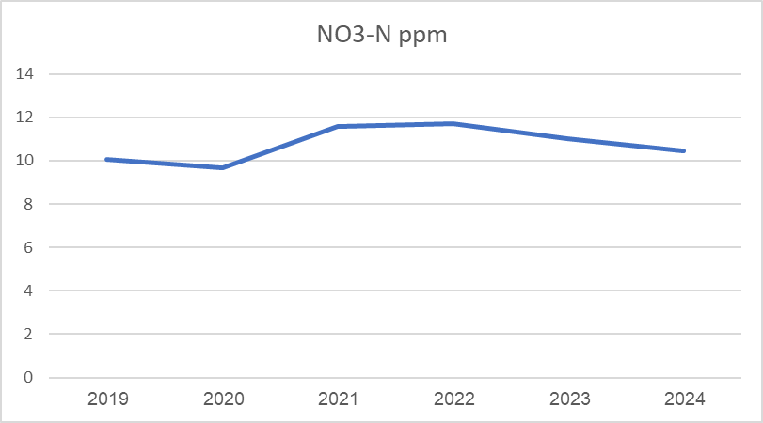
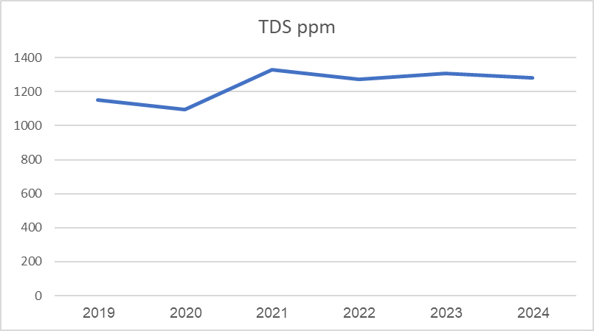
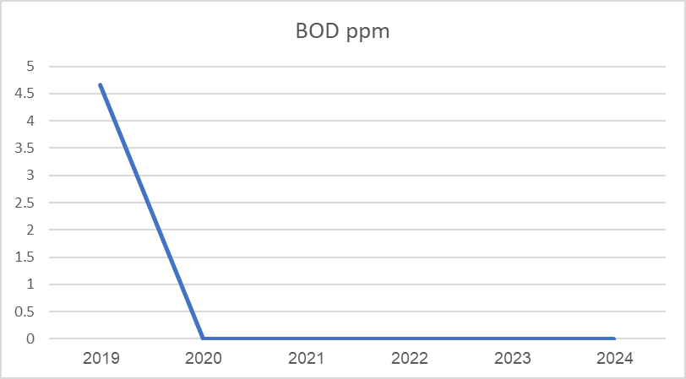
The Results are:

Slide 9
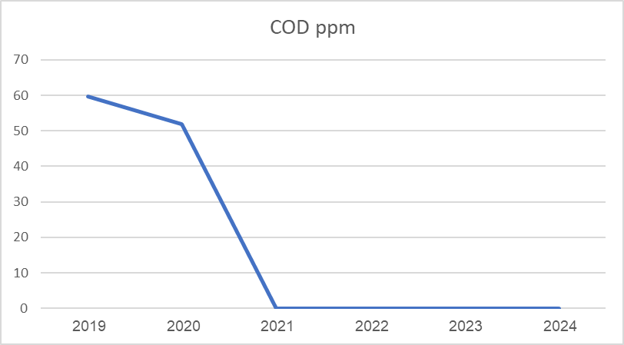
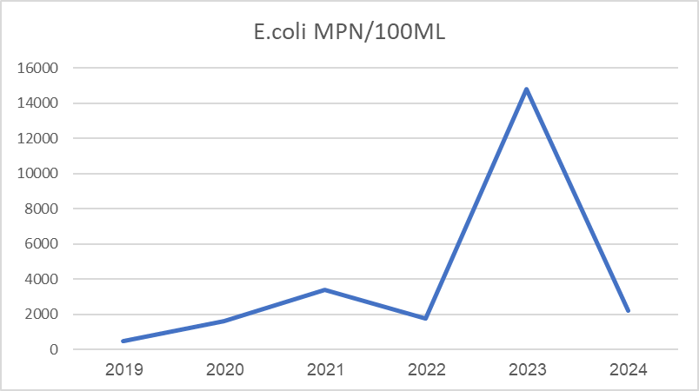
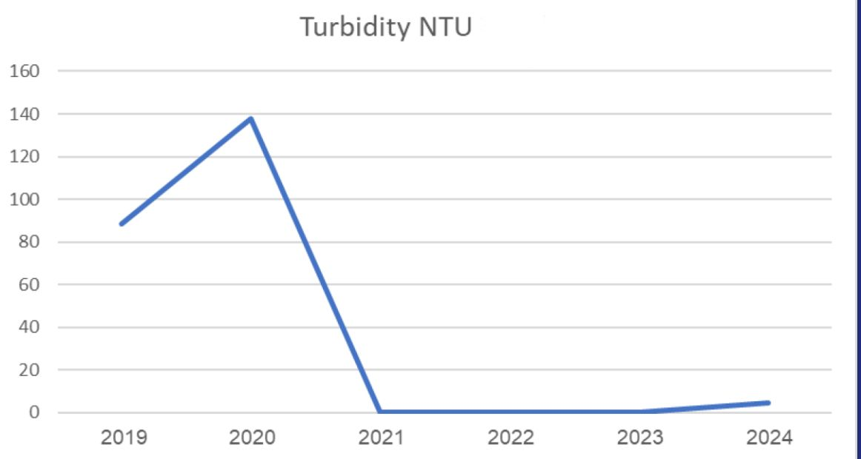
And:

Slide 10
Key Findings and Environmental Concerns:
Salinity & pH: Moderate salinity (ECw average 1.94 dS/m) and slightly alkaline conditions
Nitrate (NO₃-N): Average 10.8 mg/L, maximum 27.95 mg/L — exceeds safe drinking limits
Phosphate (PO₄-P): Average 2.33 mg/L — above acceptable thresholds

Slide 11
Organic Pollution Indicators:
  COD average 58.4 mg/L — approaching maximum allowable level
  Turbidity average 97.6 NTU — significantly exceeds the 5 NTU standard
Microbial Contamination:
  E. coli average 3846 CFU/100mL — far beyond the standard of zero

Slide 12
PRI
Following these statistics, Pollutant Risk Index was calculated using FAHP.
PRI was built on questionnaire where fuzzy fahp was used to assign weights.

Slide 13
  Why the numbers are like this:
Wast water (as after water treatments)
Agriculture negative practices
Social behaviours
Tributaries cleaning challenges

Slide 14
Our Idea
Smart Sedimentation Basins
for a Cleaner Future

Slide 15
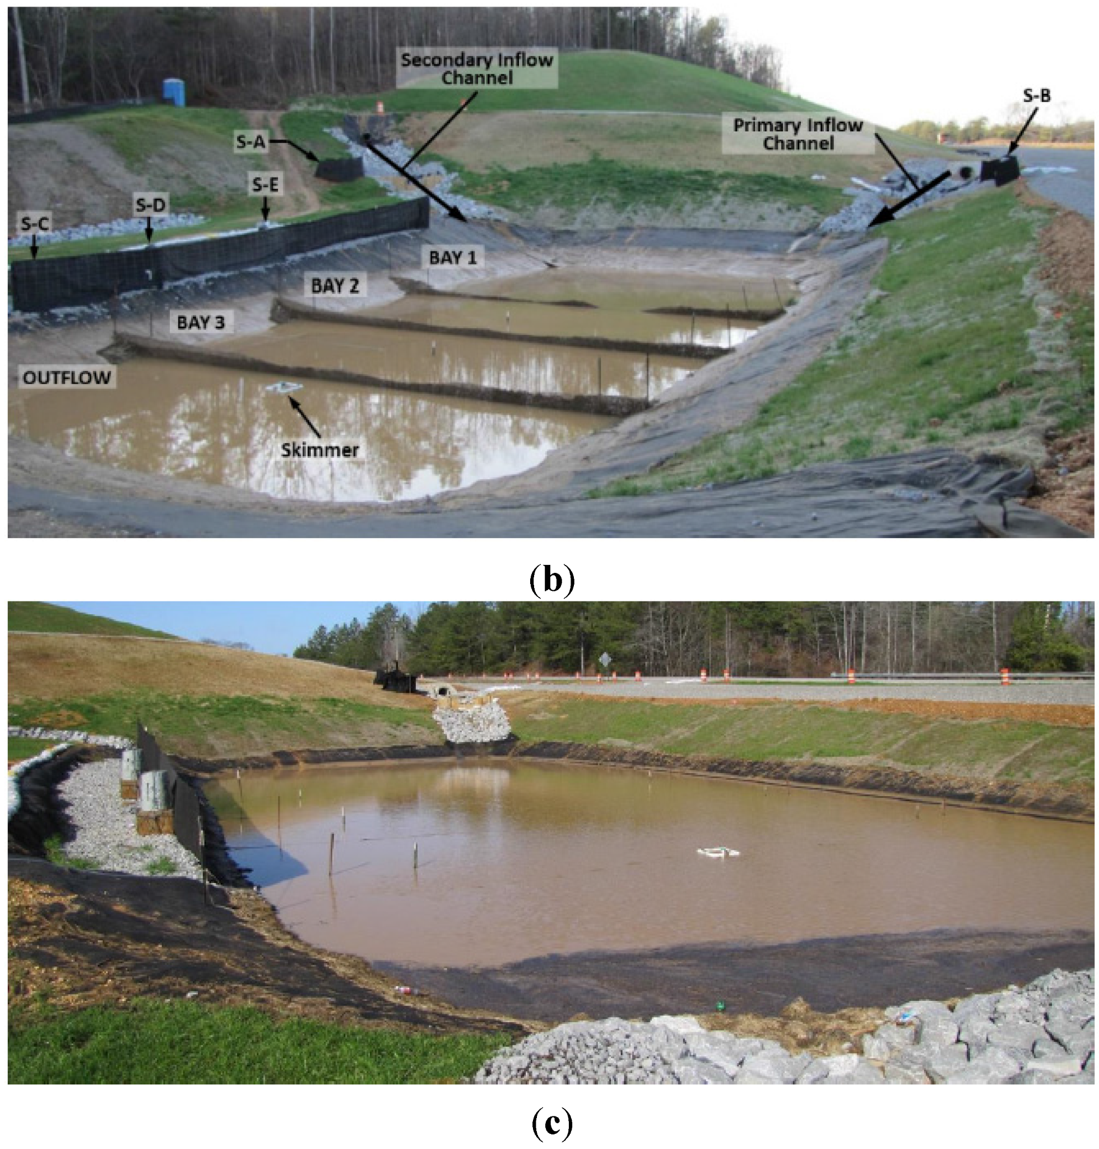

Slide 16
The main goal is to evaluate the effectiveness of sedimentation barriers in:
• Reducing silt and sediment load entering the dam.
• Improving water quality by trapping pollutants attached to

Slide 17
Expected Outcomes
• Quantifiable reduction in sediment load entering the Final outlet of water .
• Decrease in associated pollutants like phosphorus and organic

Slide 18
For our superhero, there is an urgent need for targeted surface water protection and sustainable management strategies.

Slide 19

Thank you

