Slide 1




Resilience & Innovation in Jordan’s Wastewater Sector – Contributions of German Jordanian Development Cooperation
Mintje Büürma – 4th May 2025

Slide 2
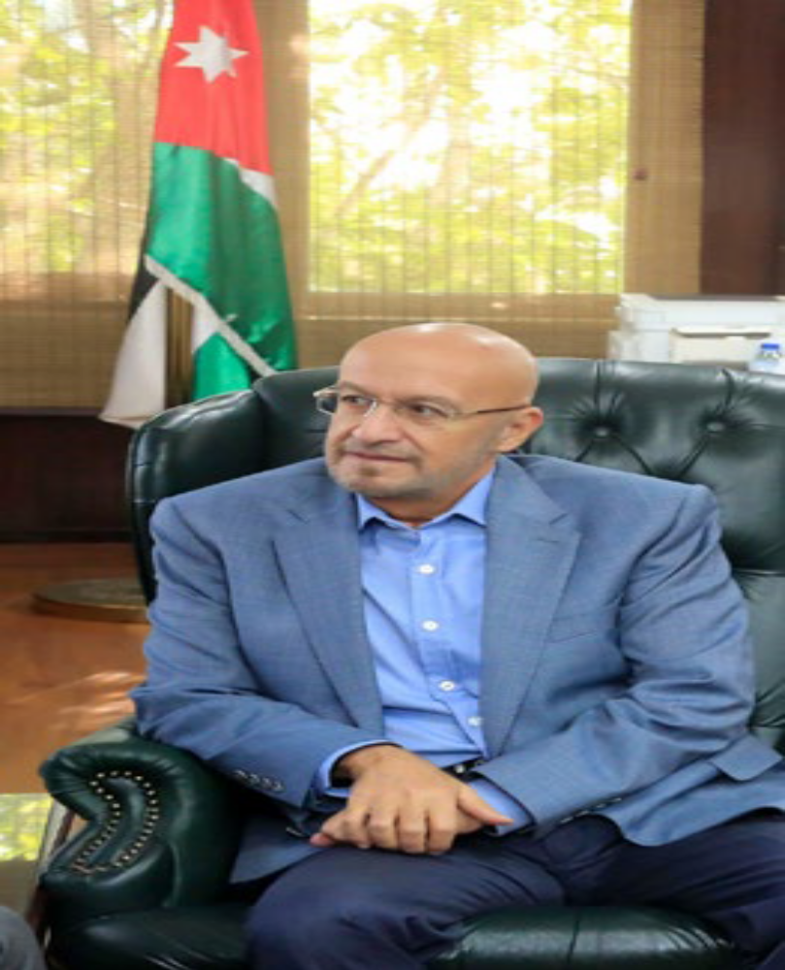
Managing future water sources and achieving
higher non-conventional water targets
will require us to continue expanding the
coverage of wastewater collection
and treatment systems.
HONORABLE ENG. RAED ABU SOUD
MINISTER OF WATER AND IRRIGATION IN JORDAN

Slide 3
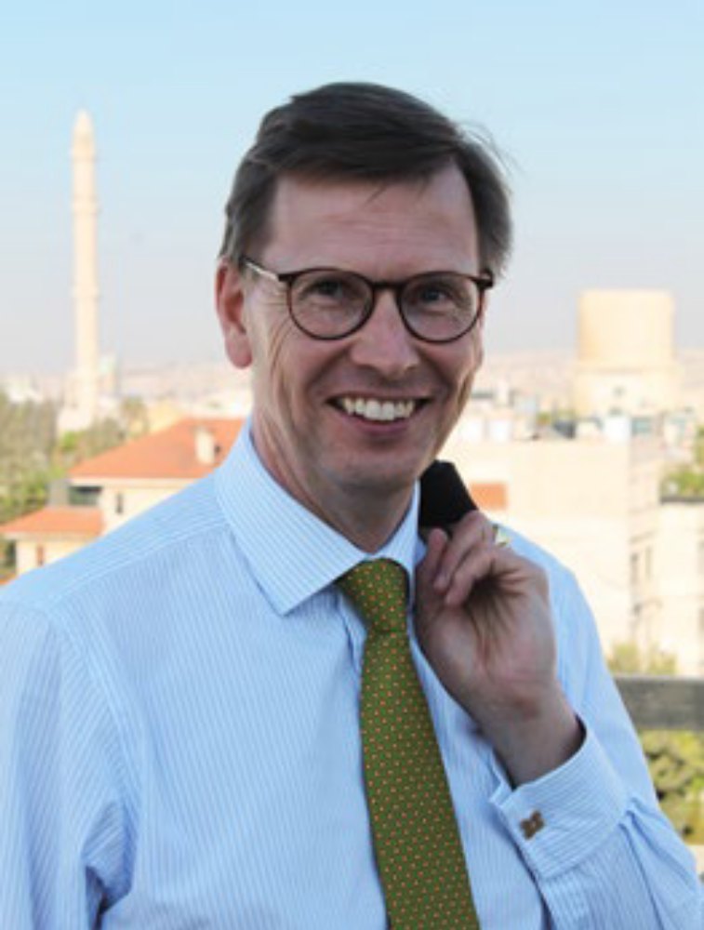
The treatment and reuse of wastewater
is an example of a strategy
which yields benefits across multiple sectors
and helps balance the needs of people,
nature and economic development.
DR. BERTRAM VON MOLTKE
AMBASSADOR OF THE
FEDERAL REPUBLIC OF GERMANY

Slide 4
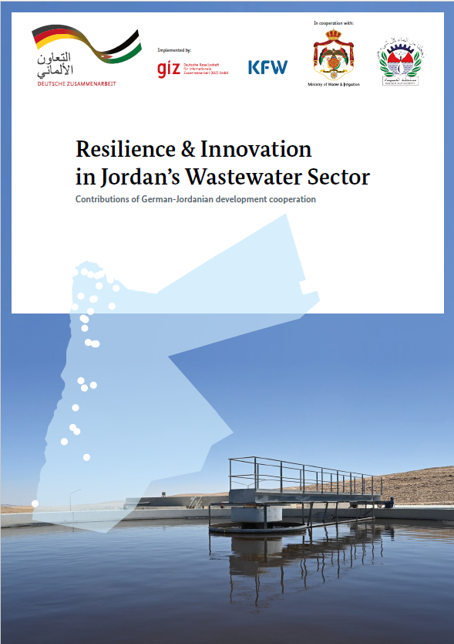
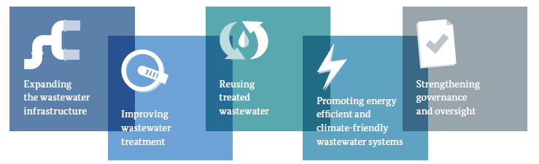
Resilience & Innovation in Jordan’s Wastewater Sector
Chapter 1: Every drop counts: Making the most of a precious asset
Chapter 2: Unlocking potentials: Focus areas of German-Jordanian Development Cooperation
Chapter 3: A resilient Future: Seizing opportunities, overcoming challenges

Slide 5
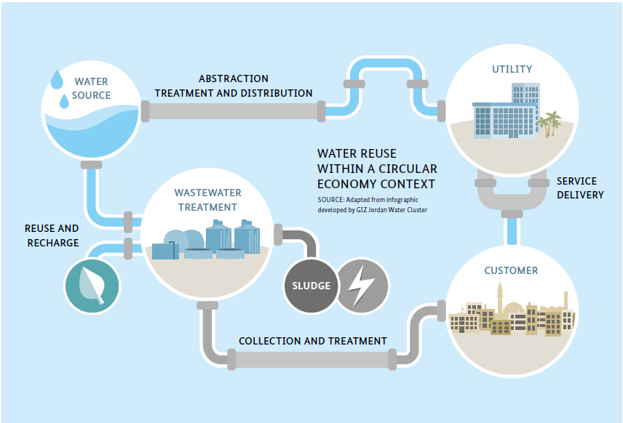
1: Every drop counts - making the most of a precious asset
Jordan – a water scarce land with increasing demand intensifying the pressure on existing water resources.
Jordan – A world leader in the use of reclaimed water, reusing more than 90% of treated wastewater per year.
Jordan – With ambitious aims for the future: by 2040 increase sewer connections to 80% and almost double the amount of non-conventional water used for irrigation.

Slide 6

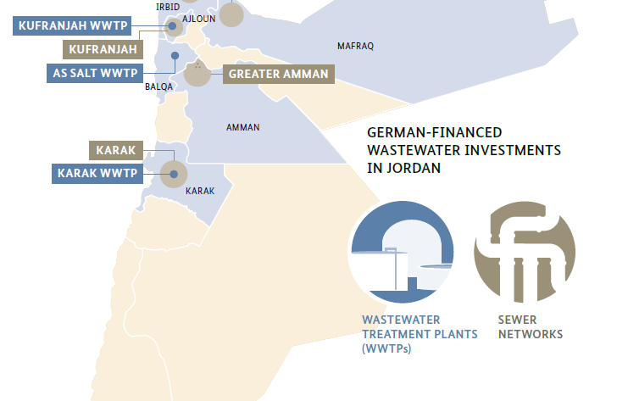
2: Unlocking potentials: Focus areas of German-Jordanian Development Cooperation
Investments in sewer networks and wastewater treatment plants (WWTPs) with a focus on the north of the country.
More than 850 kilometers of new sewer networks will serve an additional population of 470,000 people in Amman, Ajloun, Irbid, Mafraq and Karak.
Through construction, upgrading or rehabilitation of WWTPs in the Ajloun, Balqa, Irbid and Karak governorates, 2,5 times more wastewater can be treated per day.

Slide 7
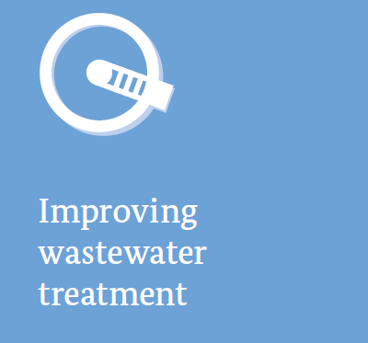
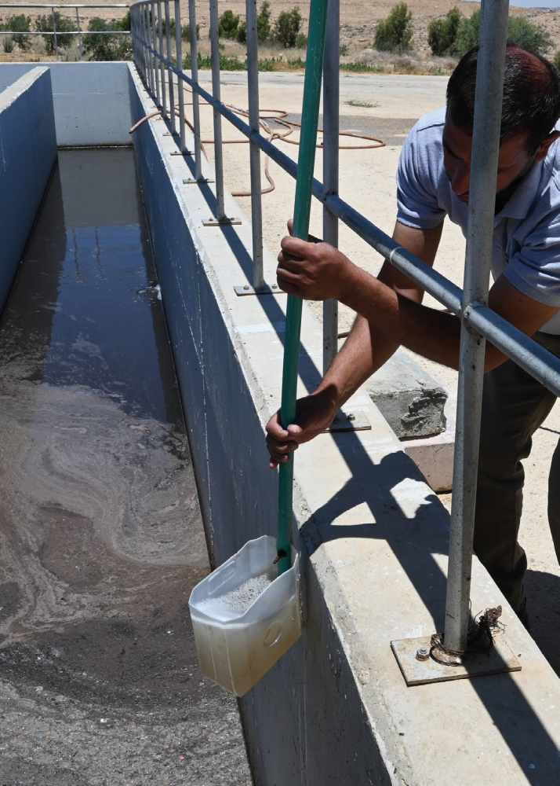
2: Unlocking potentials: Focus areas of German-Jordanian Development Cooperation
Technical Sustainable Management (TSM) – a quality management system for WWTPs:
    2022 a TSM unit was established at WAJ
    More than 20 TSM inspections done
Critical support for Operation and Maintenance to sustain operations and secure investments
    Institutionalisation of the Regional Technical Service Center in Yarmouk
Development of the wastewater workforce through a sector wide training needs assessment (TNA) and the establishment of the Water Training Center in Marka as a training hub for the water sector.

Slide 8
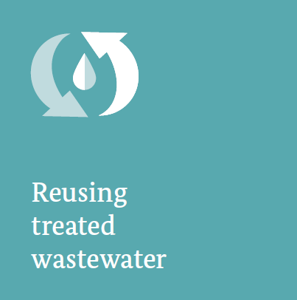
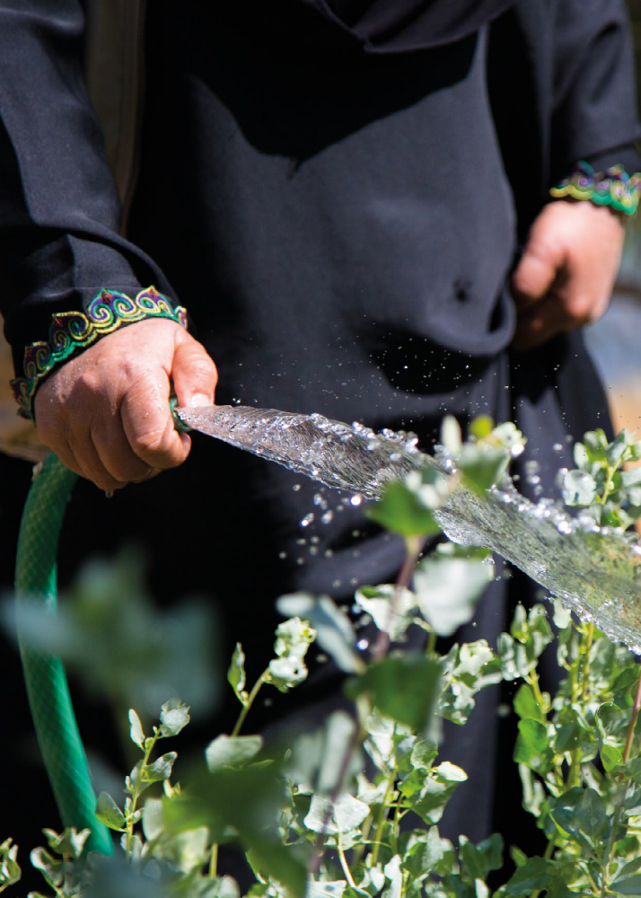
2: Unlocking potentials: Focus areas of German-Jordanian Development Cooperation
A major alternative source of water:
  Spotlight on As Samra WWTP, which produces 70 percent of all treated wastewater in Jordan.
A new reuse system in the north:
  Harness the growing volume of reclaimed water from the GDC supported WWTPs in the north and deliver it to farmers in the Jordan Valley.
Reclaiming water from ritual washing
  75% reduction in freshwater use through the introduction of greywater recycling in the largest mosque in Jordan.

Slide 9
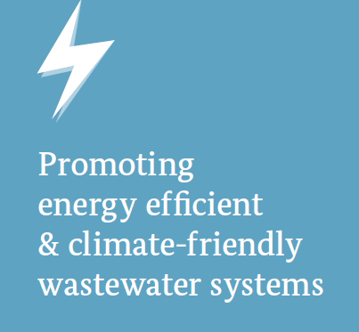
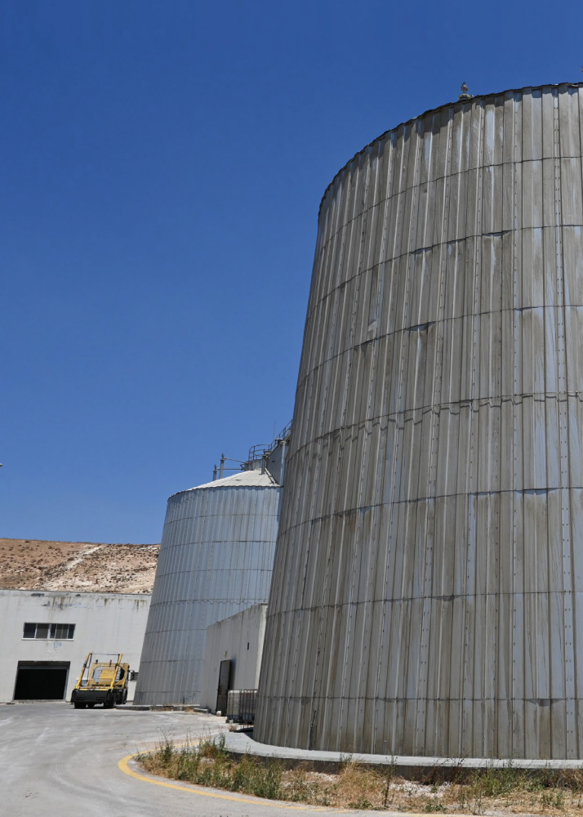
2: Unlocking potentials: Focus areas of German-Jordanian Development Cooperation
Wastewater systems are energy intensive:
Mainstreaming energy efficiency across cooperation measures.
Implementation of the Water & Energy Data Management System (WE-DMS) in water utilities and identification of energy savings through energy audits.
Harnessing the energy in wastewater to power operations through biogas-CHP systems and hydropower plants.
Exploring the potentials of sludge as a resource for carbon sequestration and the reduction of CO² emissions.

Slide 10
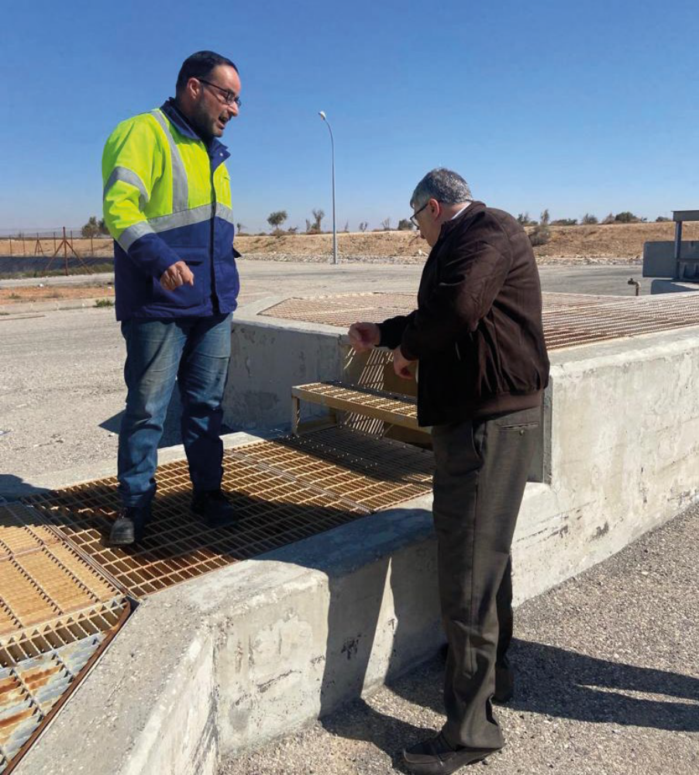
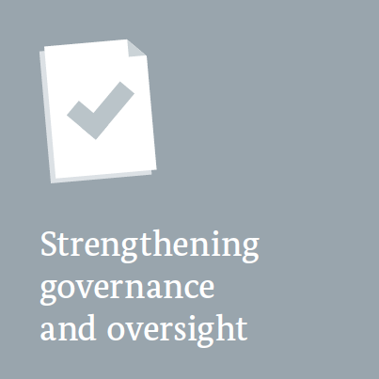
2: Unlocking potentials: Focus areas of German-Jordanian Development Cooperation
Strengthening of planning, monitoring and coordination functions within the MWI, WAJ and JVA.
  Support to water and wastewater master plans and strategies.
  Utility Performance Monitoring Unit reviews key performance indicators and publishes annual monitoring reports.
Supporting the water utilities to improve management and operational efficiencies, increase revenues and attain financial sustainability.

Slide 11
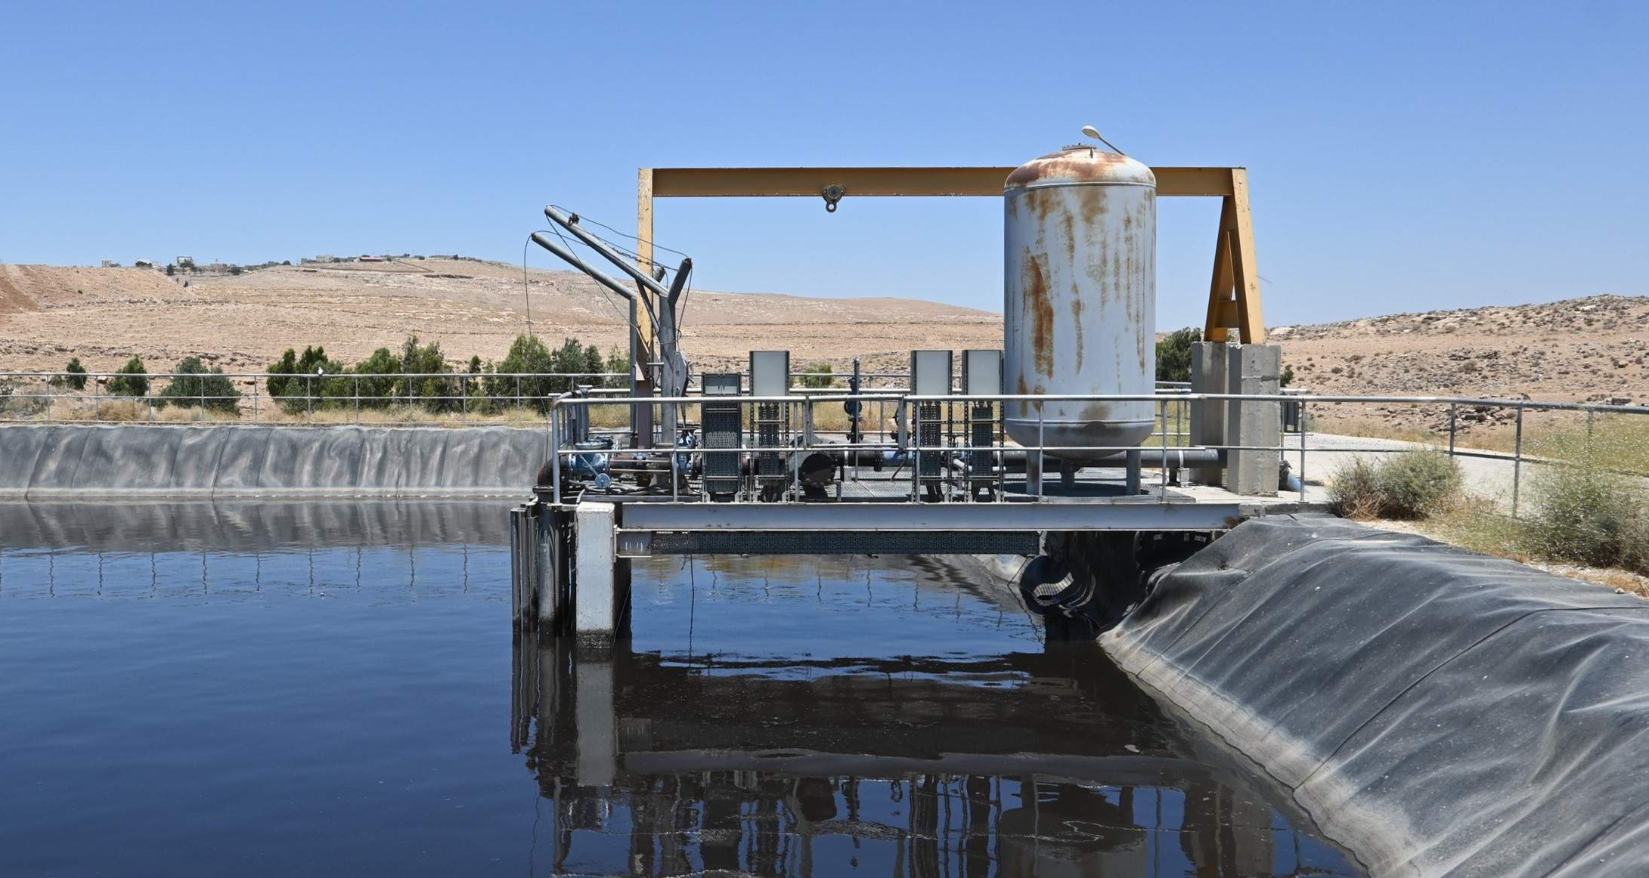
One Image
THANK YOU FOR YOUR ATTENTION

Slide 12
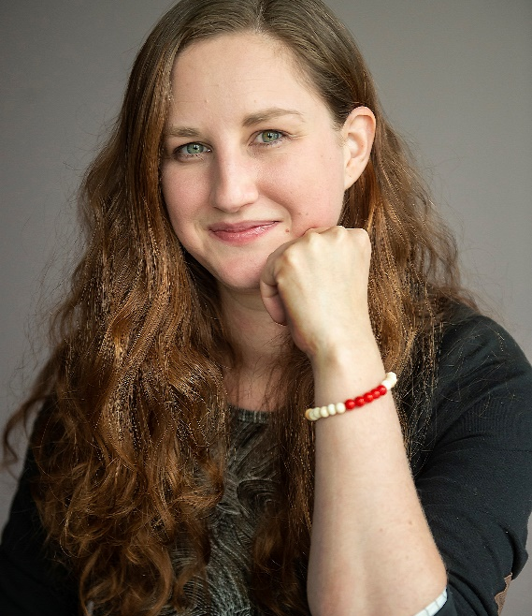
Mintje Büürma
Water and Sanitation Advisor, GIZ Wastewater Treatment, Reuse and Water Supply, Jordan
  E Mintje.bueuerma@giz.de
  F +962 (0) 7 9244 4462
I www.giz.de
gizgmbh
Photo credit slide 2,3 © Ministry of Water and Irrigation/ Water Authority of Jordan
Photo credit slide 4 © Embassy of the federal republic of Germany
Photo credits all other slides © GIZ
Resilience & Innovation in Jordan's Wastewater Sector
12

Slide 13
Deutsche Gesellschaft für
Internationale Zusammenarbeit (GIZ) GmbH
  Registered offices, Bonn and Eschborn
  Friedrich-Ebert-Allee 32 + 36
  53113 Bonn, Germany
  T +49 228 44 60 - 0
  F +49 228 44 60 - 17 66
  Dag-Hammarskjöld-Weg 1 - 5
  65760 Eschborn, Germany
  T +49 61 96 79 - 0
  F +49 61 96 79 - 11 15
  E info@giz.de
  I www.giz.de

