Slide 1



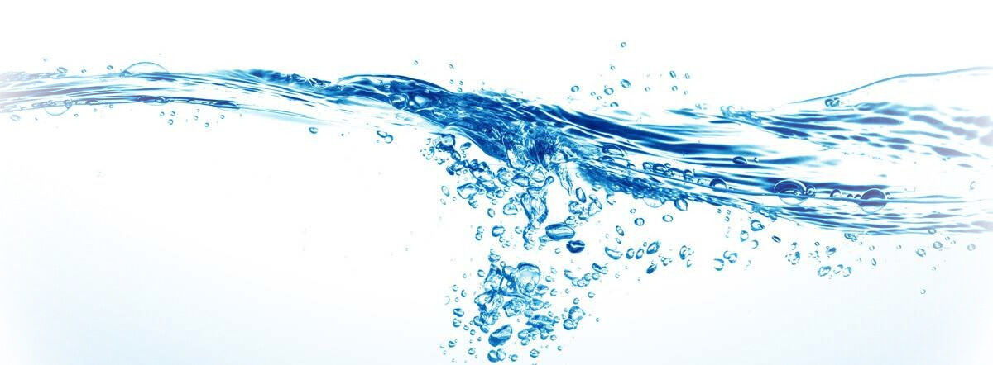
Emerging Desalination Technologies
Mohammed Rasool Qtaishat
Chemical Engineering Department, The University of Jordan, Amman, Jordan
CTO, AGSHYA., Innovation Cluster, King Abdullah University of Science and Technology, Jeddah, Saudi Arabia

Slide 2

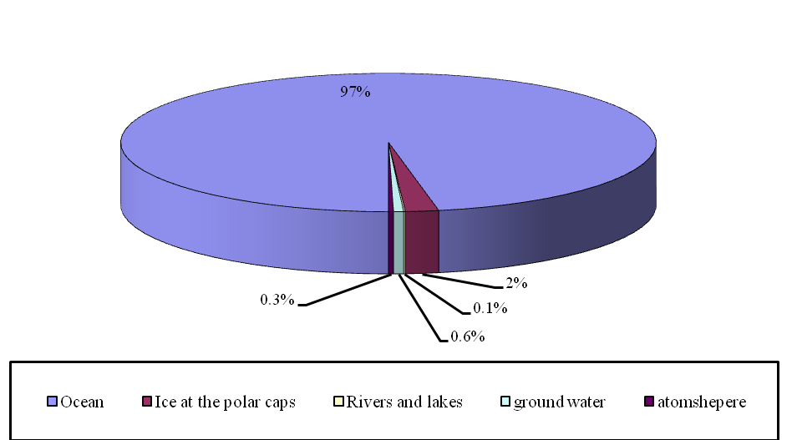
World water supplies
Oceans provide the largest possible source of water supply that will require desalination
25% of the people live within 25 km of the coast

Slide 3
Desalination Technologies
Currently employed Desalination technologies are classified into two categories :
Thermal Processes (phase change) such as multi-stage-flash (MSF) and multi-effect-distillation (MED).
Membrane Processes (no Phase change) such as Reverse Osmosis (RO)
133 countries 17,000 plants
~100 MCM/day
RO represents >60% of installed desalination plants
>52% of Desalination plants are in GCC countries
Market size $32 billion by 2025

Slide 4
Current technologies challenges
Energy requirements (High temperature or pressure)
Sophisticated pretreatment requirements
High cost
Environmental impact
Scaling and fouling
Brine management
Only 1% of fresh water is produced via desalination

Slide 5
Emerging desalination technologies

Slide 6
Forward osmosis

Slide 7
Competitive Advantages
Ability to treat high salinity water (up to 20% TDS concentration)
Lower energy requirement (does not require pressure) than conventional Reverse Osmosis (RO)
Reversible fouling
Less chemicals used
Rejection of boron
Coupling with RO for brine treatment

Slide 8
Electrodialysis

Slide 9
Competitive Advantages
Tunability
Tunability, here, means the ability to change the input and output
Low pressure operation
ED works by cross- flow separation using ion exchange membranes. ED operation pressure is 7 bar
Life Cycle Cost
Studies are showing 10 percent lower total lifecycle cost for brackish water of ED over RO, in addition to 30 percent reduction in energy use.
Easy Maintenance

Slide 10
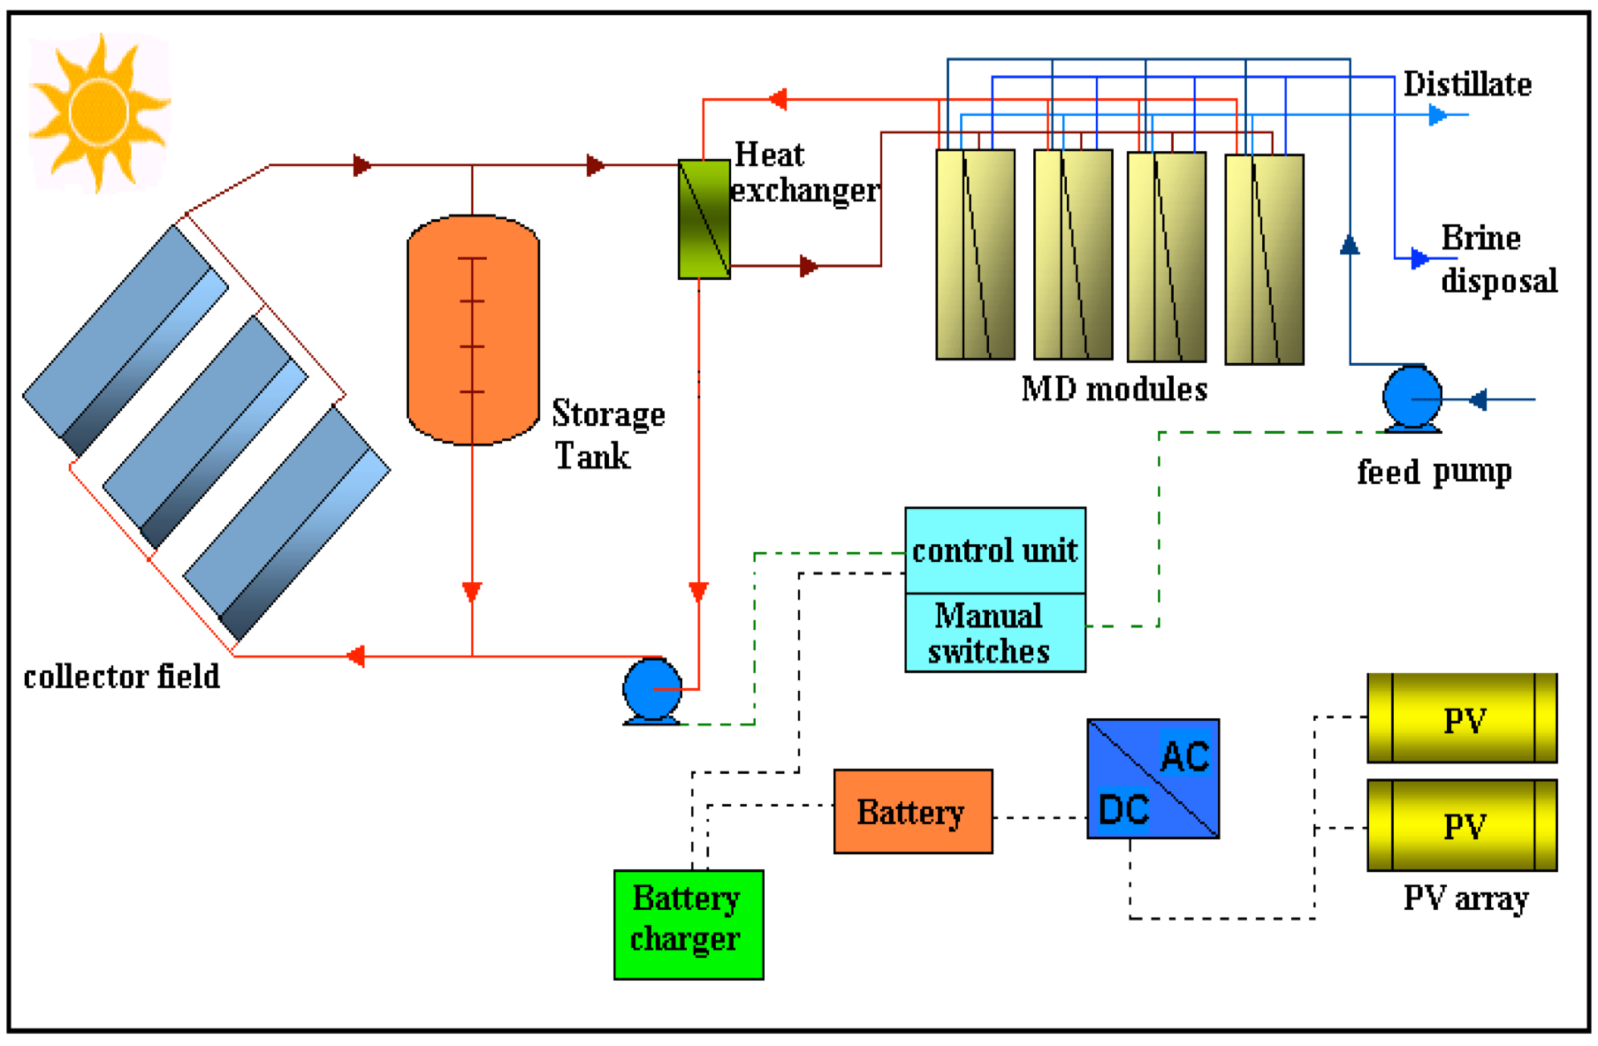
Membrane distillation
Heat and mass fluxes
Heat and mass fluxes
T
T
b,f
b,f
C
F
m,f
eed
T
m,
Permeate
m,f
f
C
m,f
F
T
eed
Permeate
C
b,f
C
J
m,f
w
C
Dry pore
T
T
b,f
J
m,p
b,p
w
Dry pore
T
T
m,p
b,p
Hydrophobic membrane
Hydrophobic membrane

Slide 11
Competitive Advantages
100% water purification of salty water regardless of salinity
Ability to treat high salinity water (even oversaturated water)
Coupling with waste heat or renewable energy
Integration with MSF or RO for brine treatment.
Lower energy requirements than conventional RO
Reduced vapour spaces compared to conventional distillation processes
Longer membrane life
No sophisticated pre-treatment required

Slide 12
Brine treatment by MD

Slide 13
Solar pond

Slide 14
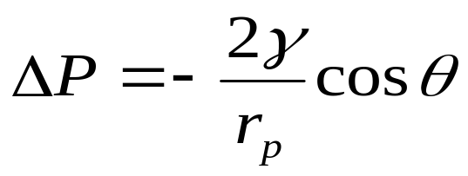
Membrane Distillation Disadvantages
The danger of membrane wetting.
Lower permeate flux compared to conventional desalination process.
Heat losses in large modules.

Slide 15
The Concept of Anisotropic Biporous Membrane
Kelvin equation:

Slide 16
Driving force gain because of the capillary effect
Kelvin equation:
 | r = 0.5 nm |  | r = 1 nm |  | r = 2 nm
T _{feed} | p_{s,r} (kPa) | ΔT (ºC) | p_{s,r} (Pa) | ΔT (ºC) | p_{s,r} (Pa) | ΔT (ºC)
25ºC | 25.8 | 41.0 | 9.05 | 18.0 | 5.34 | 9.12
40ºC | 50.7 | 41.4 | 19.2 | 19.0 | 11.8 | 9.14
60ºC | 115.0 | 43.2 | 47.9 | 21.0 | 30.9 | 9.79
80ºC | 227.1 | 40.3 | 103 | 21.0 | 69.4 | 9.72

Slide 17
Synthesis of polymeric thin films by interfacial polymerization

Slide 18
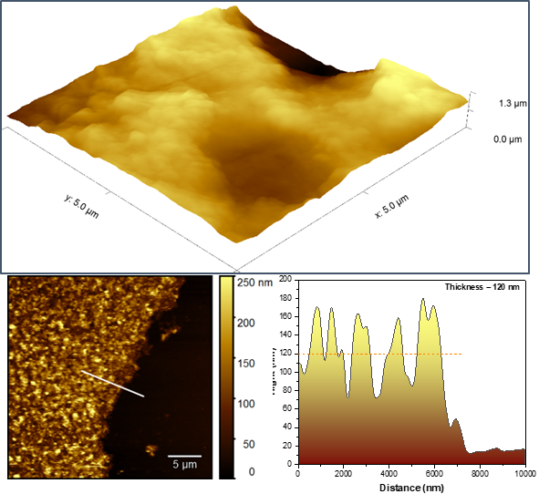
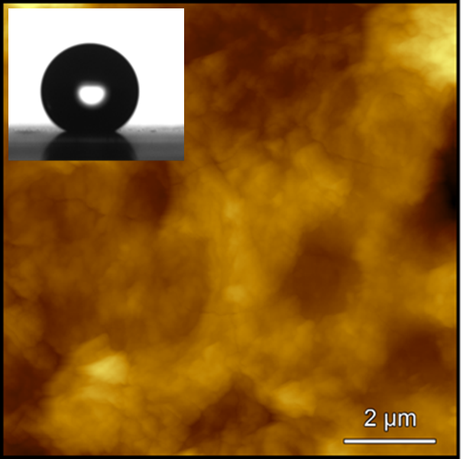
Membrane Characterization

Slide 19
Effect of polymerization time and concentration

Slide 20
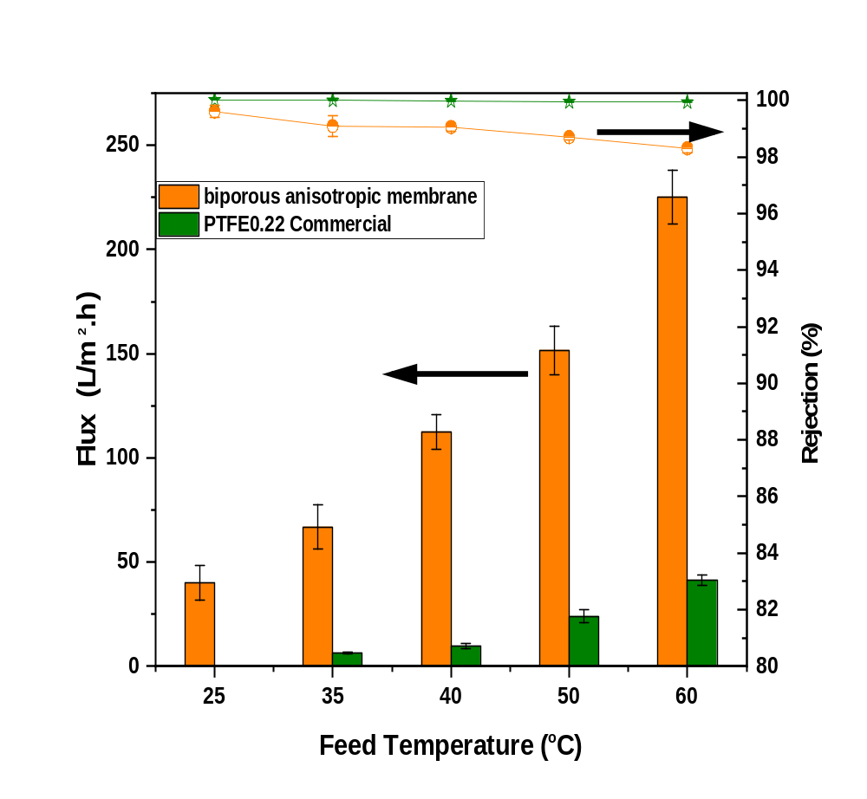
Membranes Performance

Slide 21
Membranes Performance

Slide 22
Conclusions
Energy-efficient low cost desalination is critical for sustainable development.
Innovation in research is key to bringing emerging processes to higher levels of technological maturity.
Emerging technologies showed great potential since they are more tunable and not energy intensive.
Emerging technologies can be used for brine treatment and zero liquid discharge desalination processes.
The new MD membrane enabled the operation of MD at room temperature and atmospheric pressure.
This novel membrane can make Desalination a highly energy-efficient process, and suitable for large scale module conditions.
Qtaishat et. al Scientific Reports 12 (1), 13564, (2022).
Qtaishat et. al Nature Communication 26 ( 2), 16781, (2025).
Qtaishat et. al. US Patent 11,779,885, (2023)
Qtaishat et. al. US Patent 63/724,772 (2025)
*Water crisis: how local technologies can help solve a global problem: https://www.nature.com/articles/d41586-023-02442-7 August 1st 2023

