Slide 1




West Irbid Wastewater Project – Stakeholder Participation and Outreach Programme
Rana Ardah/Royal Scientific Society
May 2025

Slide 2
Project Overview
Implementation:
Royal Scientific Society (RSS)
Financial Support:
European Bank for Reconstruction and Development (EBRD)
Lifespan:
36 months (starting April 2021)

Slide 3
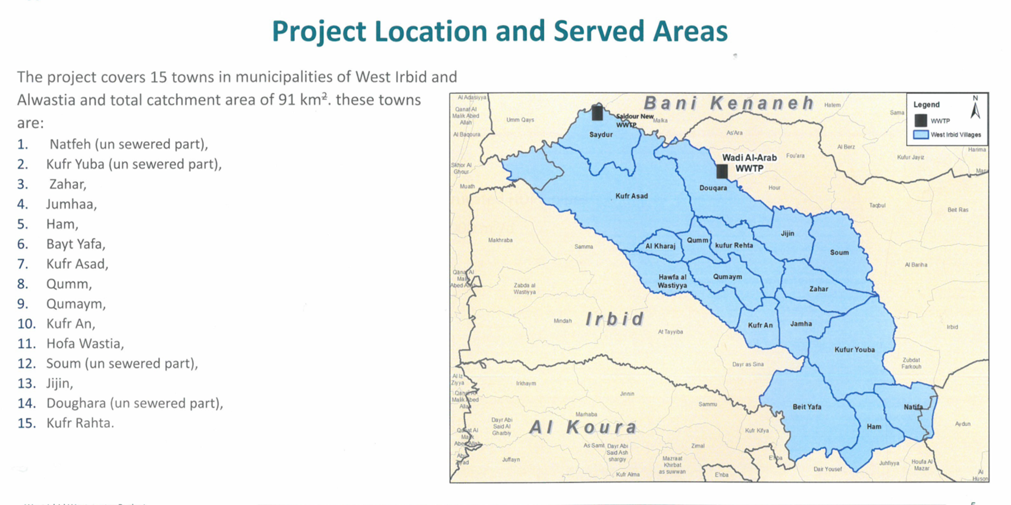
Project Study Area
The Project is serving Irbid Governorate, covering a catchment area of approximately 90 km².
The 15 included towns located in Al Wastiyah Municipality and West Irbid Municipality.
The total population of the 15 towns is over 116,000; about 18% of whom are Syrian refugees.

Slide 4
Project Goal and Objectives
Goal: Ensure the upgrading and construction of the wastewater infrastructure system in 15 town of West Irbid smoothly without any disruption to the affected communities
Objectives
Objective 1 Conduct capacity and needs- assessment of the affected communities. | Objective 2 Establish an Integrated Participatory Framework that allows all stakeholders and vulnerable groups getting involved in the project’s implementation. | Objective 3 Develop and implement a communication strategy, public awareness and behavioural change campaigns. | Objective 4 Develop a grievance and sustainable complaints register mechanism for the project.

Slide 5
Project Methodology
Objective 1
Conduct capacity and needs- assessment of the affected communities.
Activity 1: Mobilization, review all relevant literature and Inception report
Activity 2: Develop and implement a well-structured survey questionnaire
Activity 3: Conduct In-depth Interviews and Focus Group Discussions
Activity 4: Results’ Analysis and Goal Setting
Activity 5: Hold Needs Assessment Workshop (NAW)
Activity 6: Situational Analysis Report

Slide 6
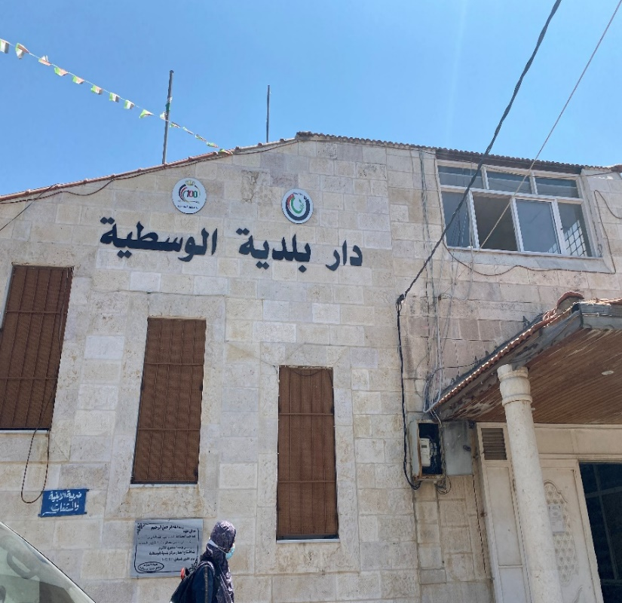
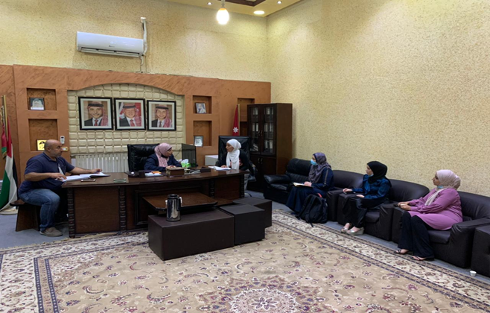
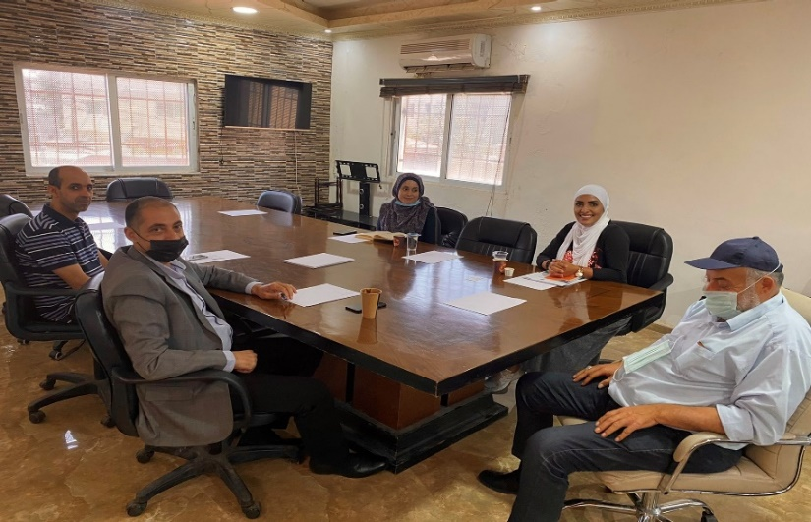
Municipalities Meetings

Slide 7
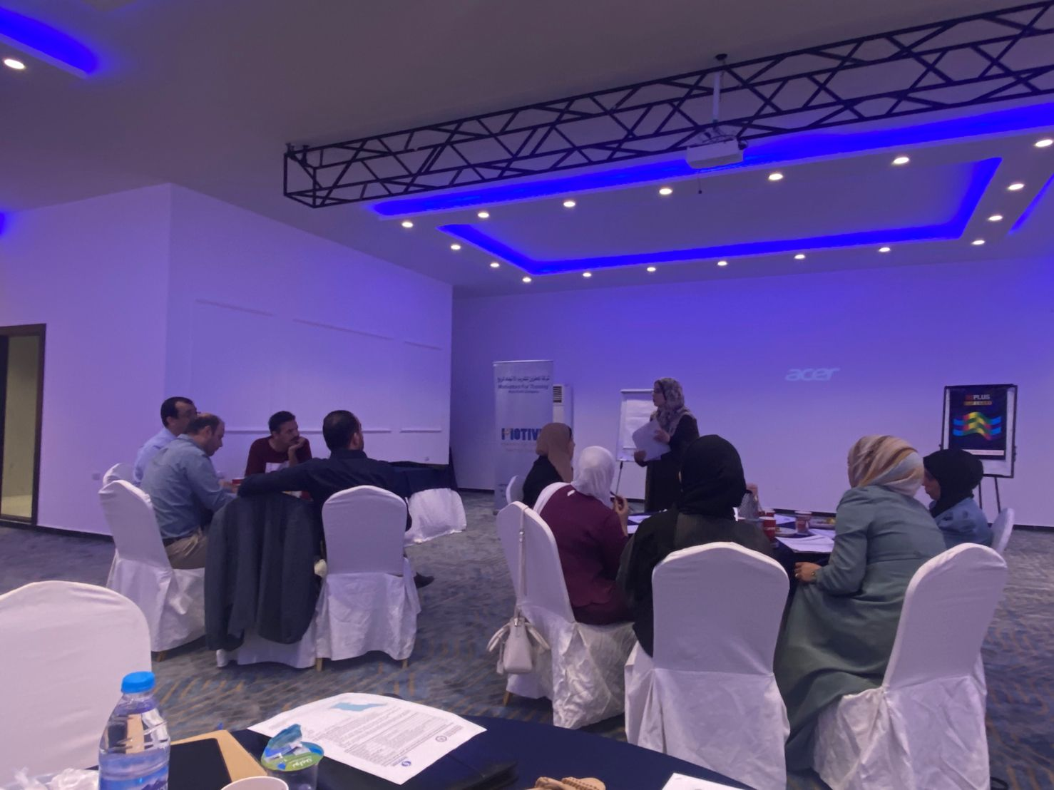
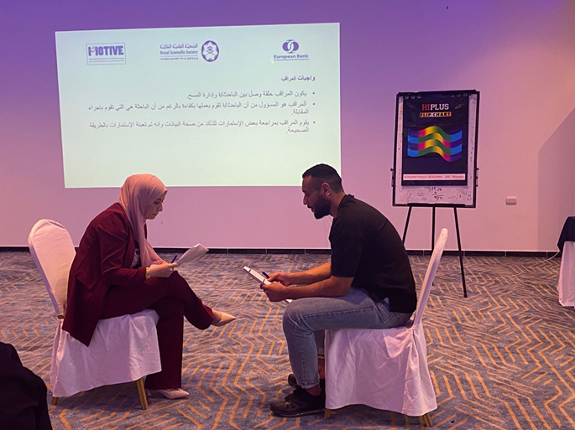
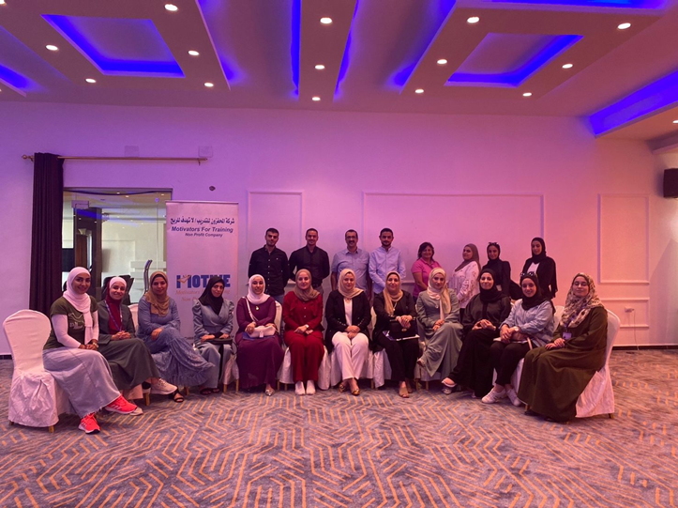
Enumerators Training

Slide 8
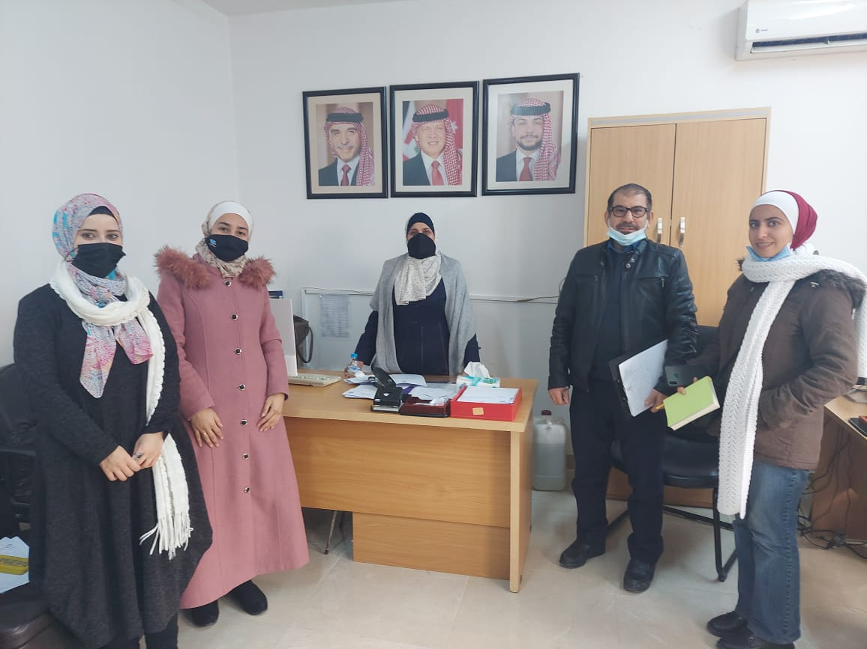
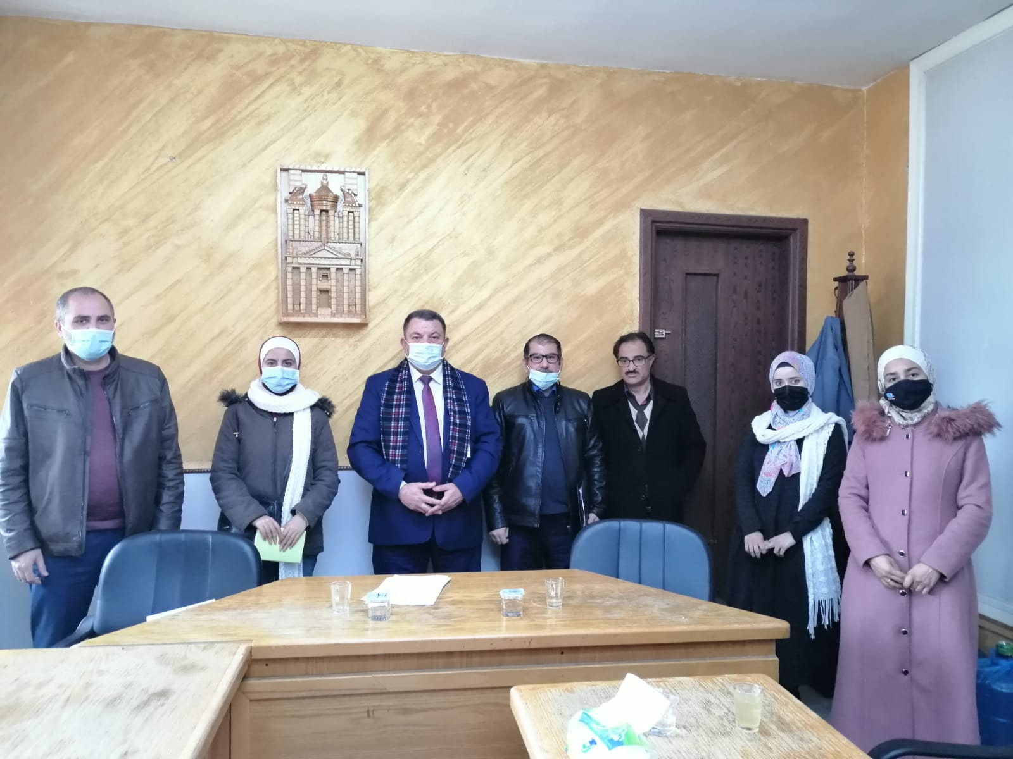
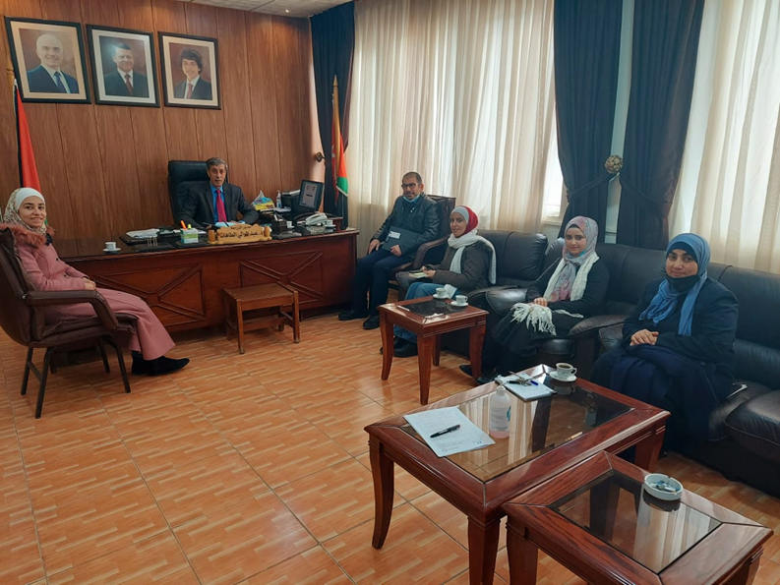
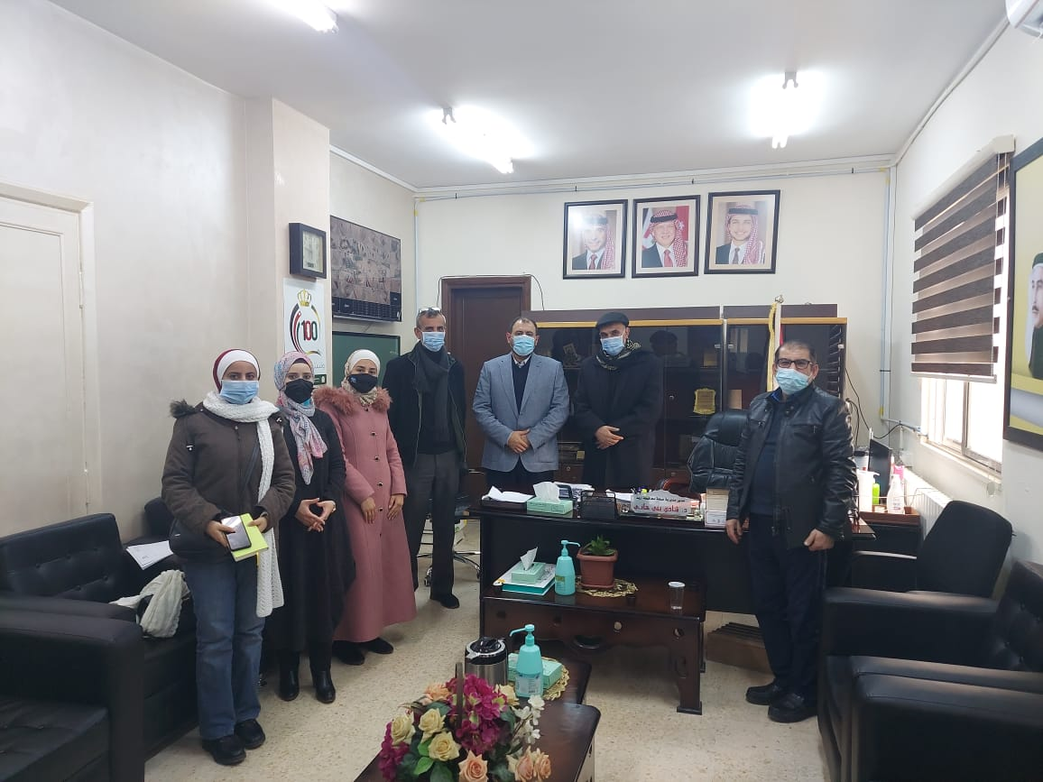
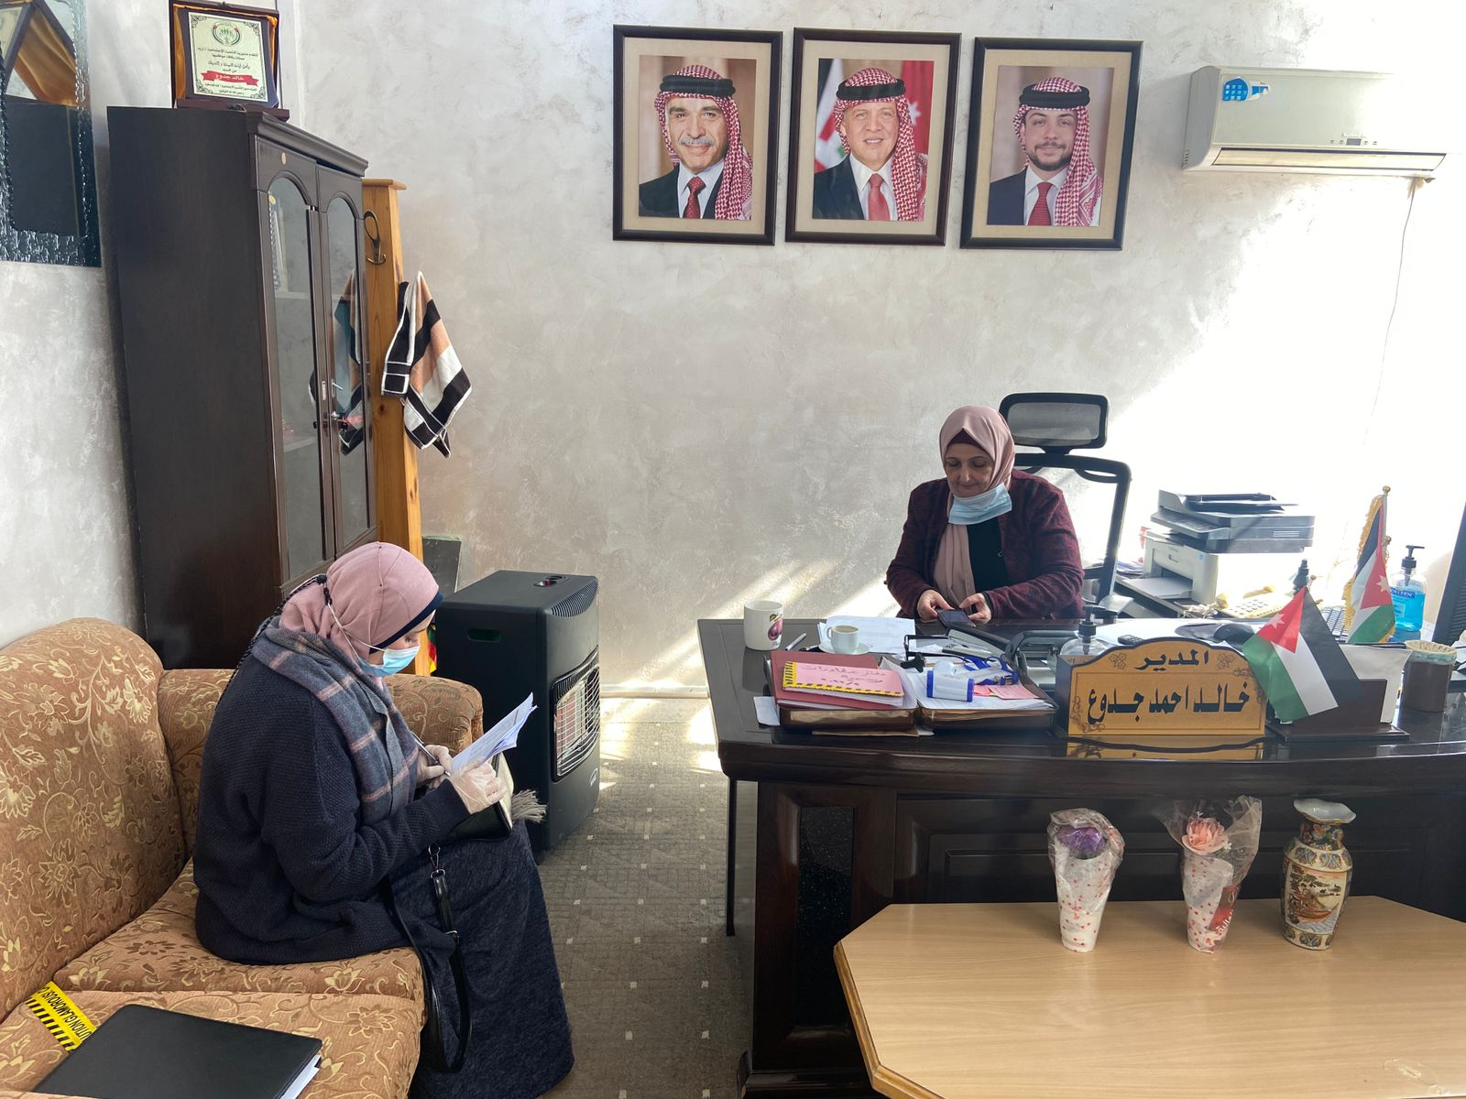
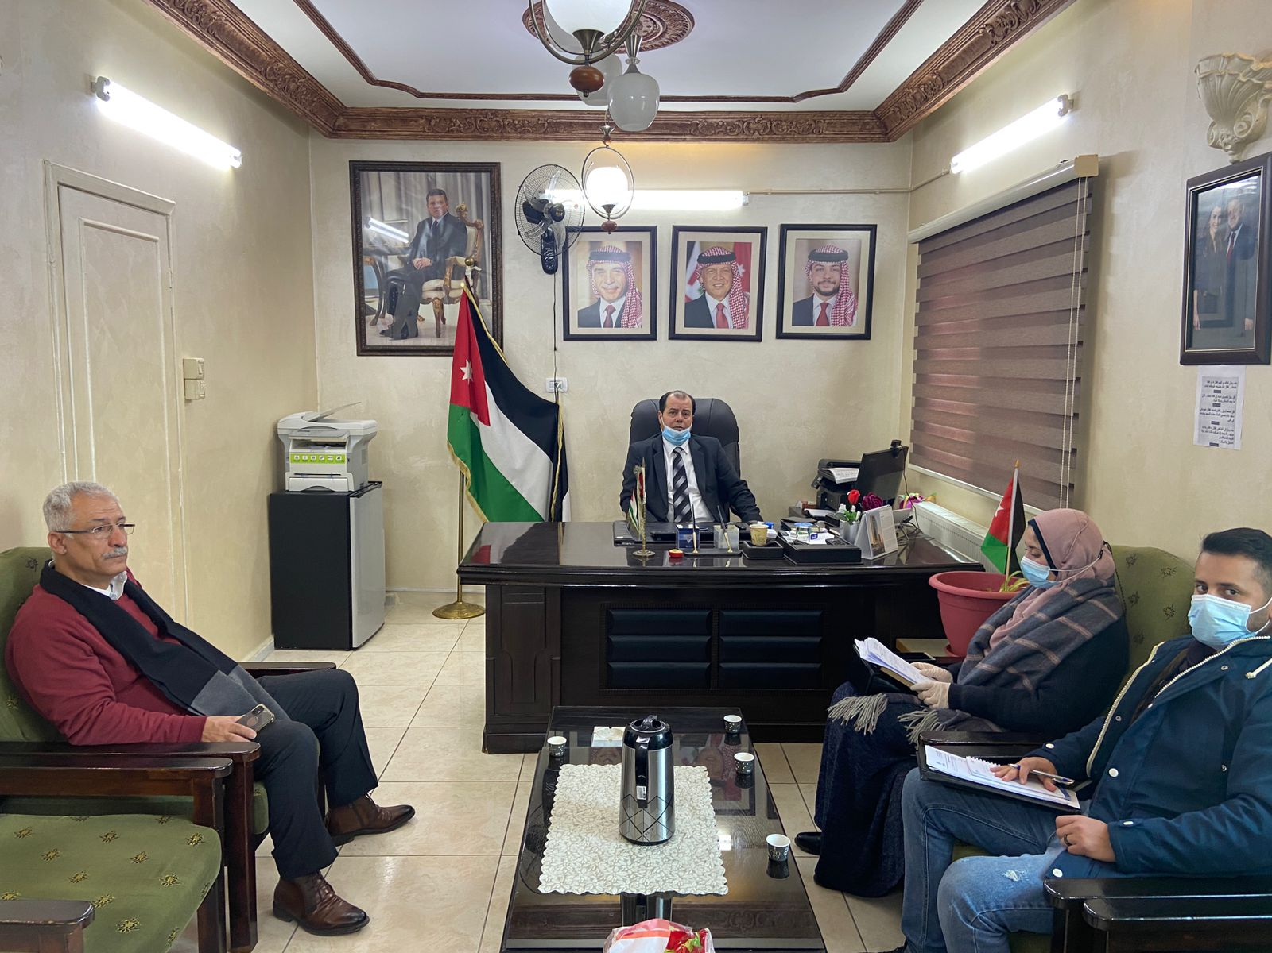
Key Informative Interviews (KIIs) with officials
Irbid Governorate, 1-2-2022
Directorate of education/West Irbid 1-2-2022
Irbid Directorate of Agriculture, 1-2-2022
Directorate of health/ Irbid,
1-2-2022
Social development directorate//Al-Wastiyyeh, 7-2-2022
Directorate of education/Al-Wastiyyeh,
1-2-2022

Slide 9
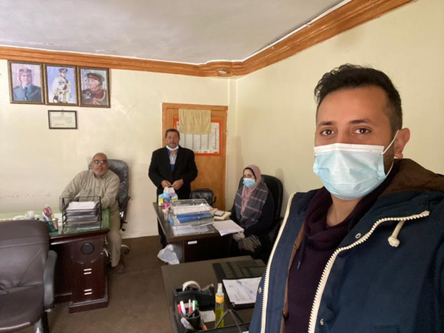
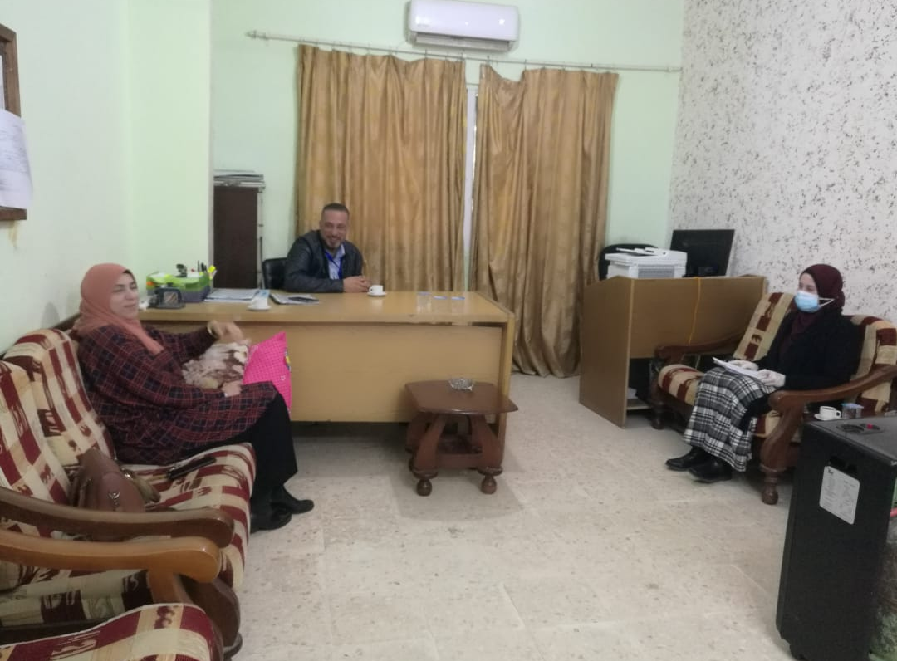
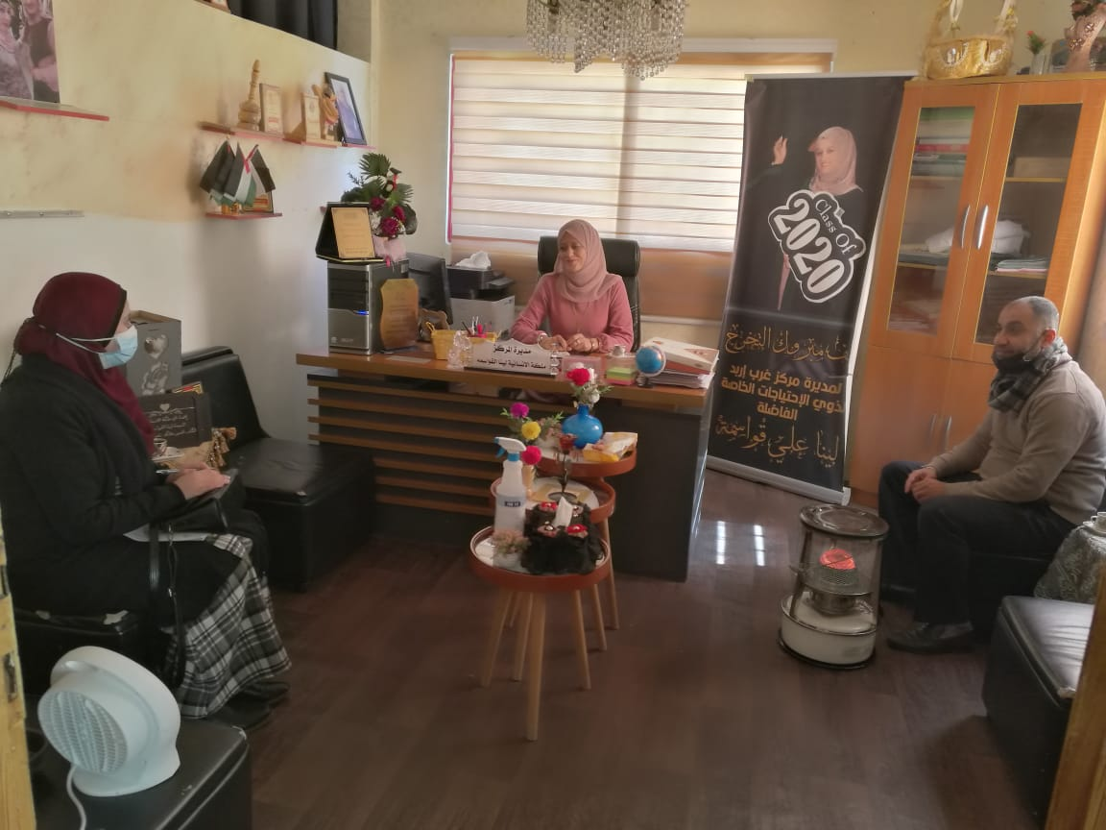
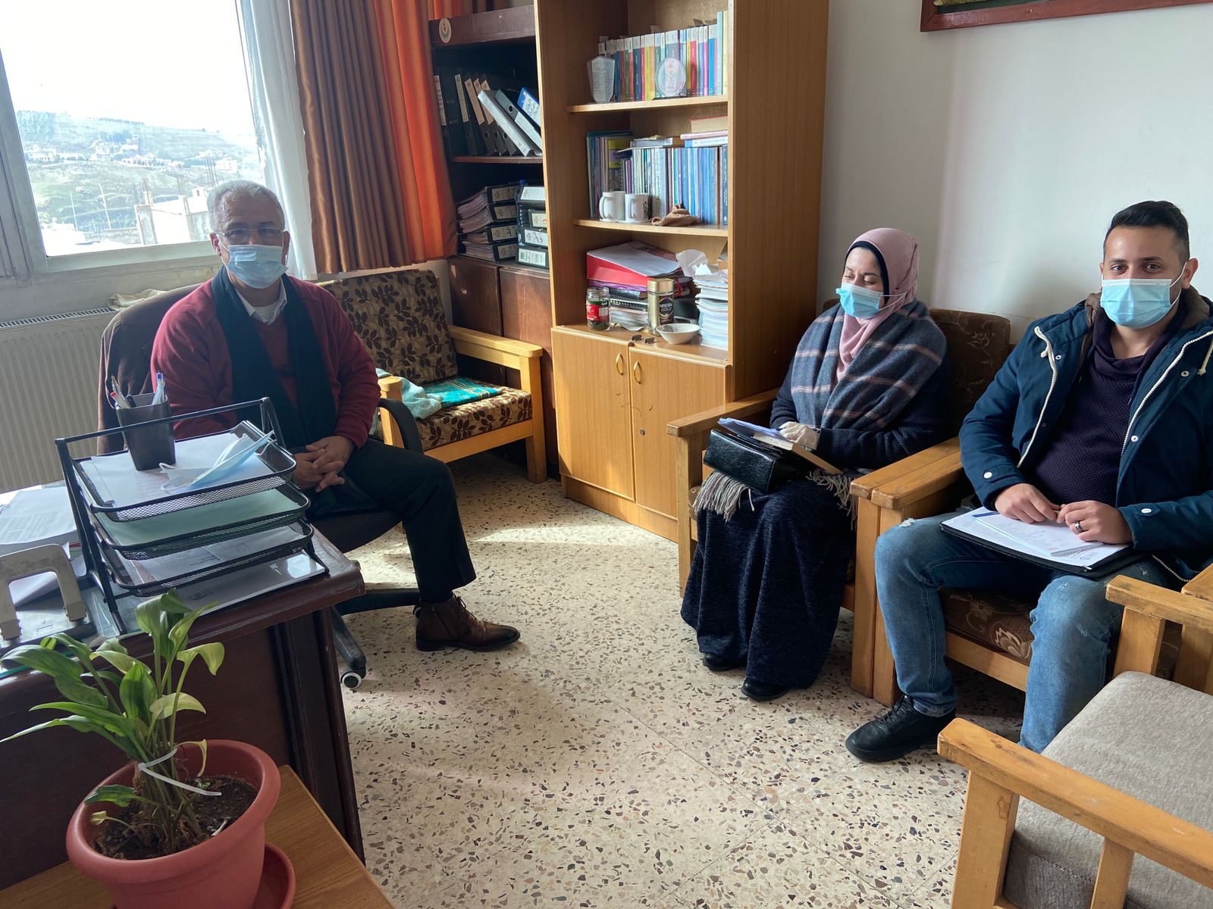
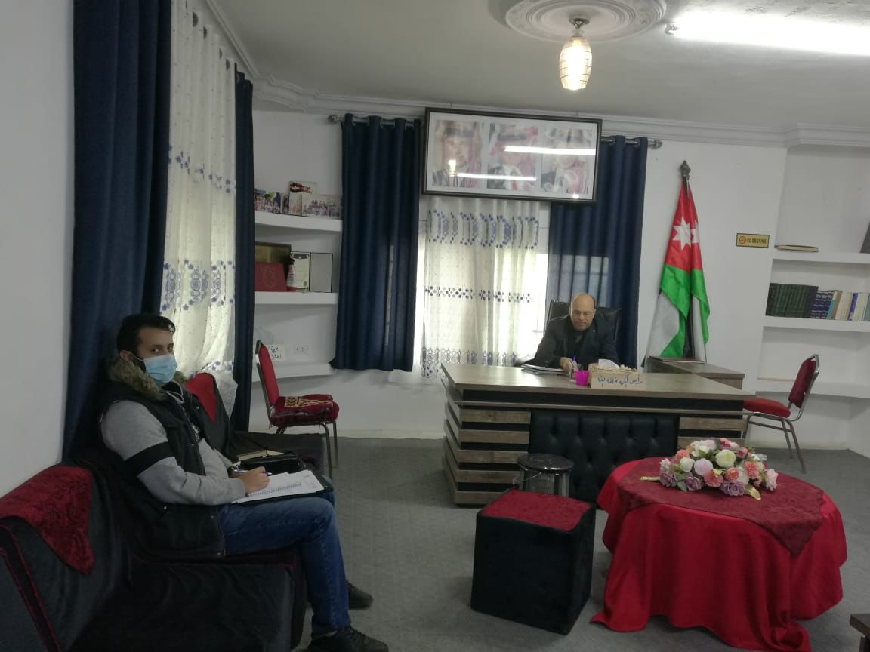
CBOs Meetings

Slide 10
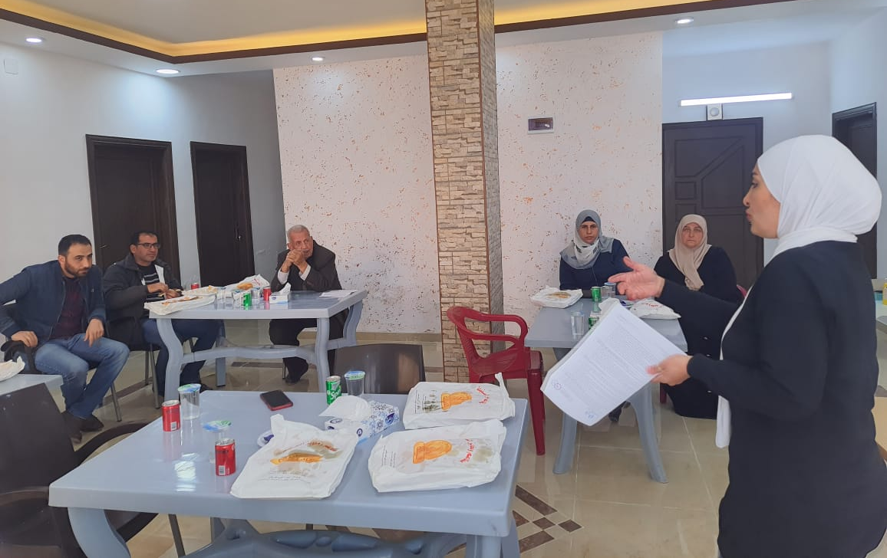
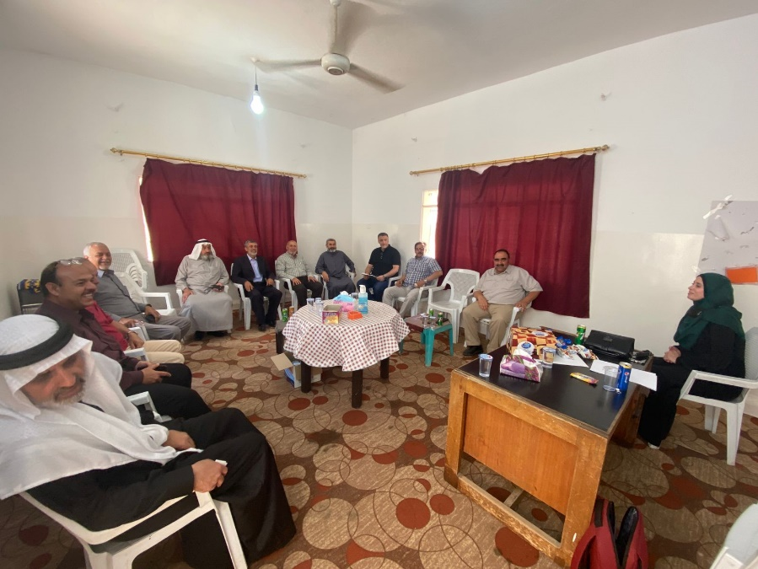
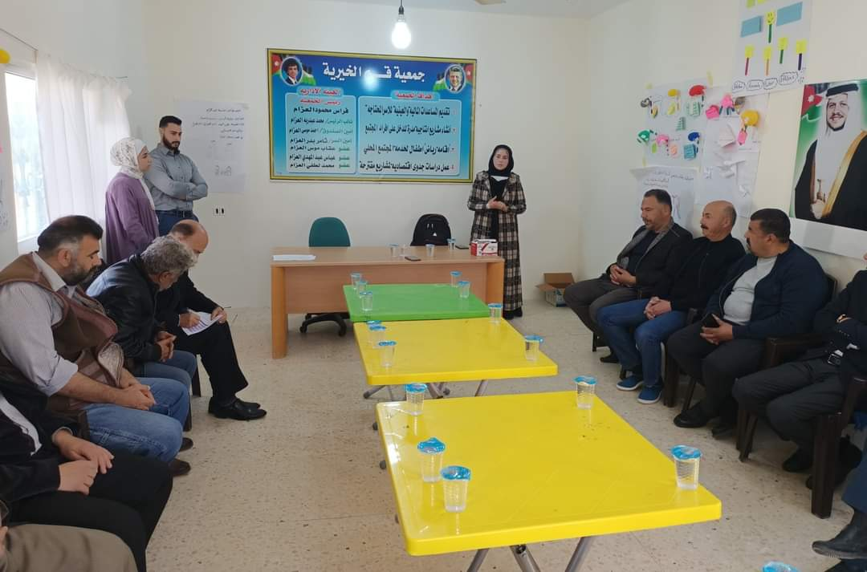
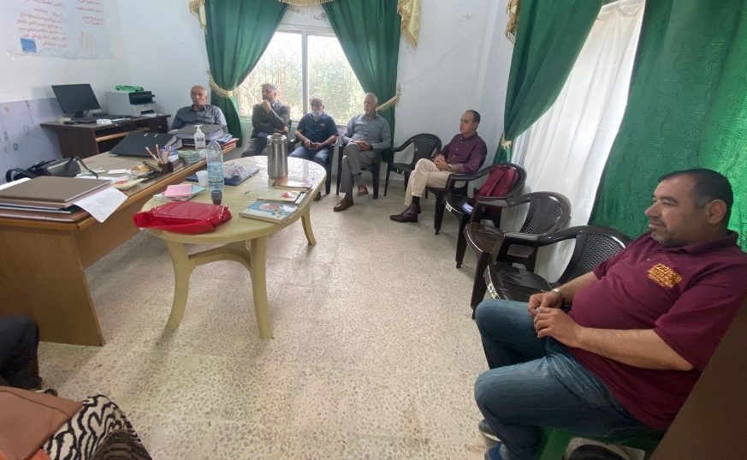
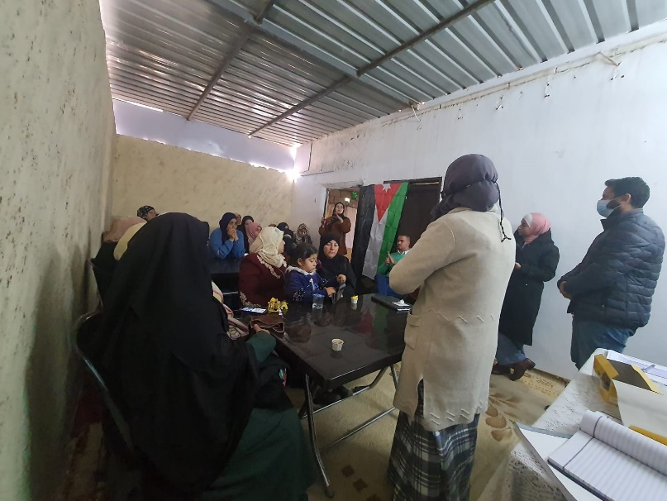
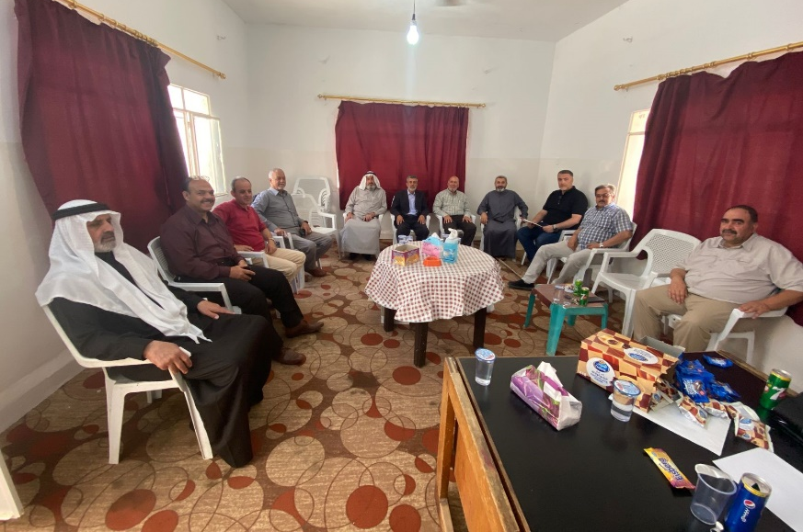
Focus Group Discussions (FGDs)

Slide 11
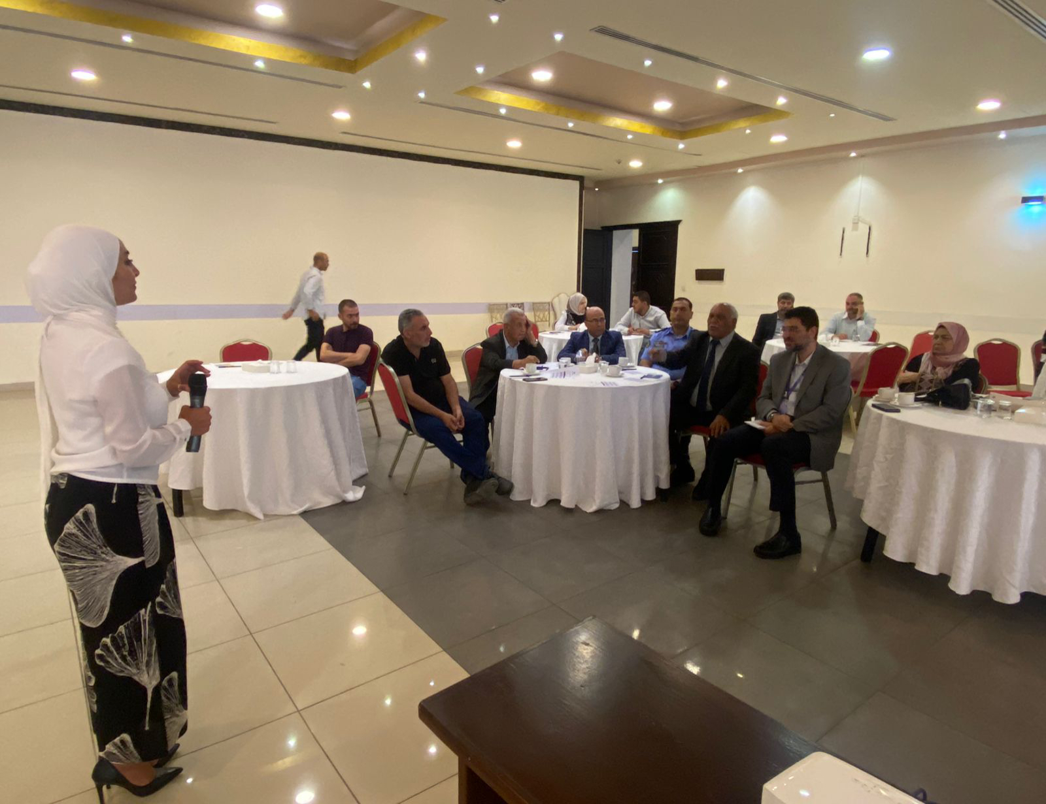
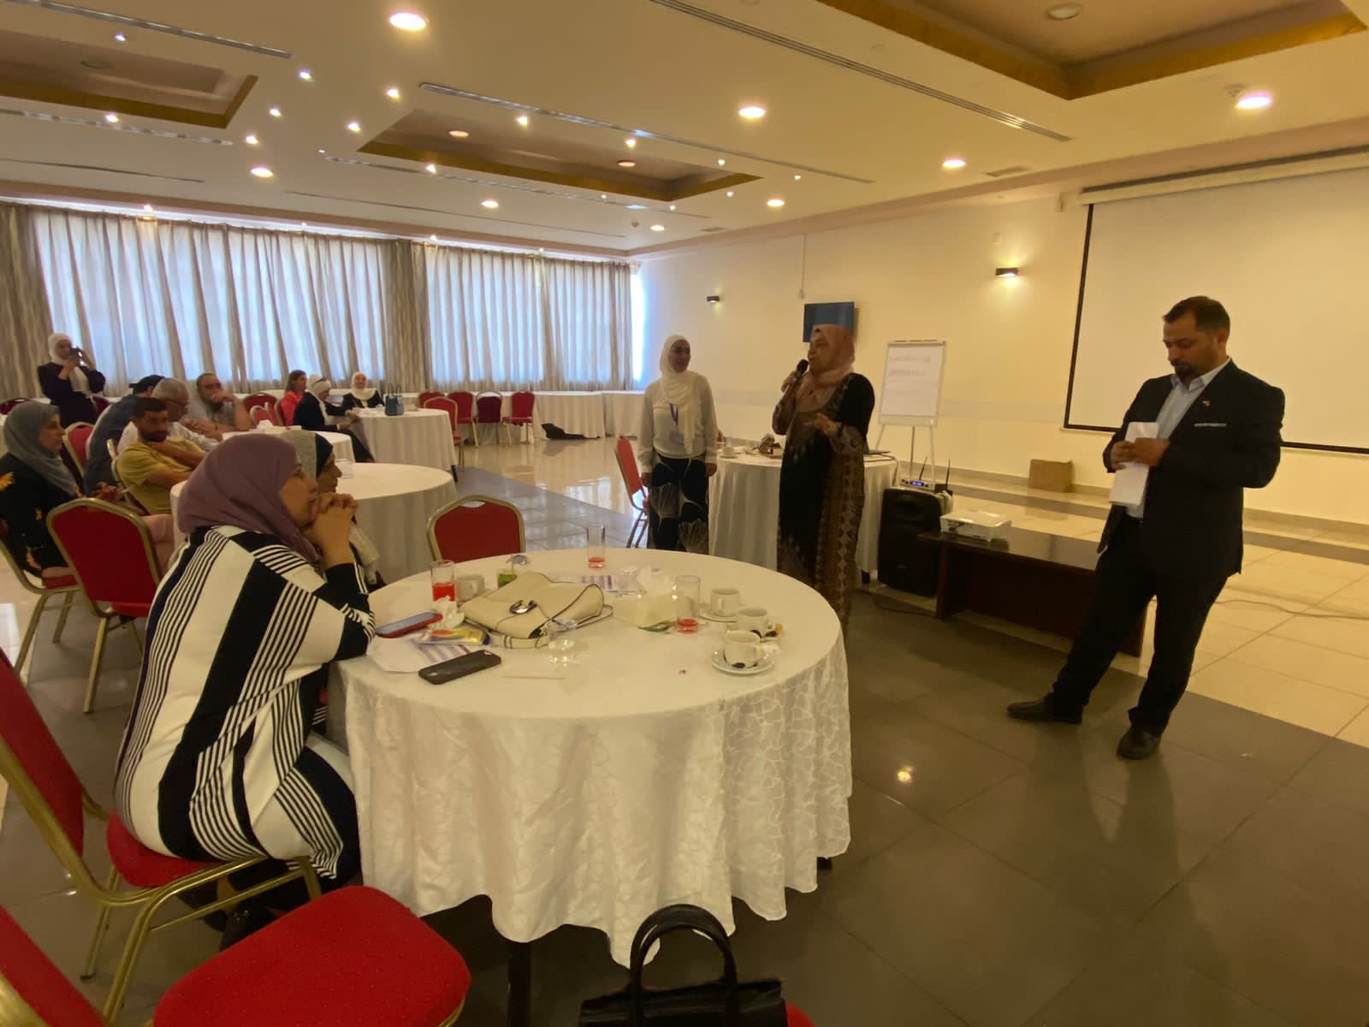
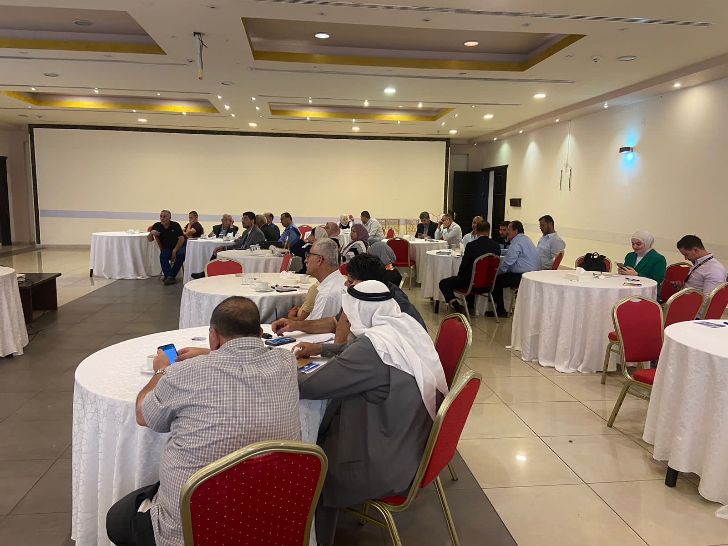
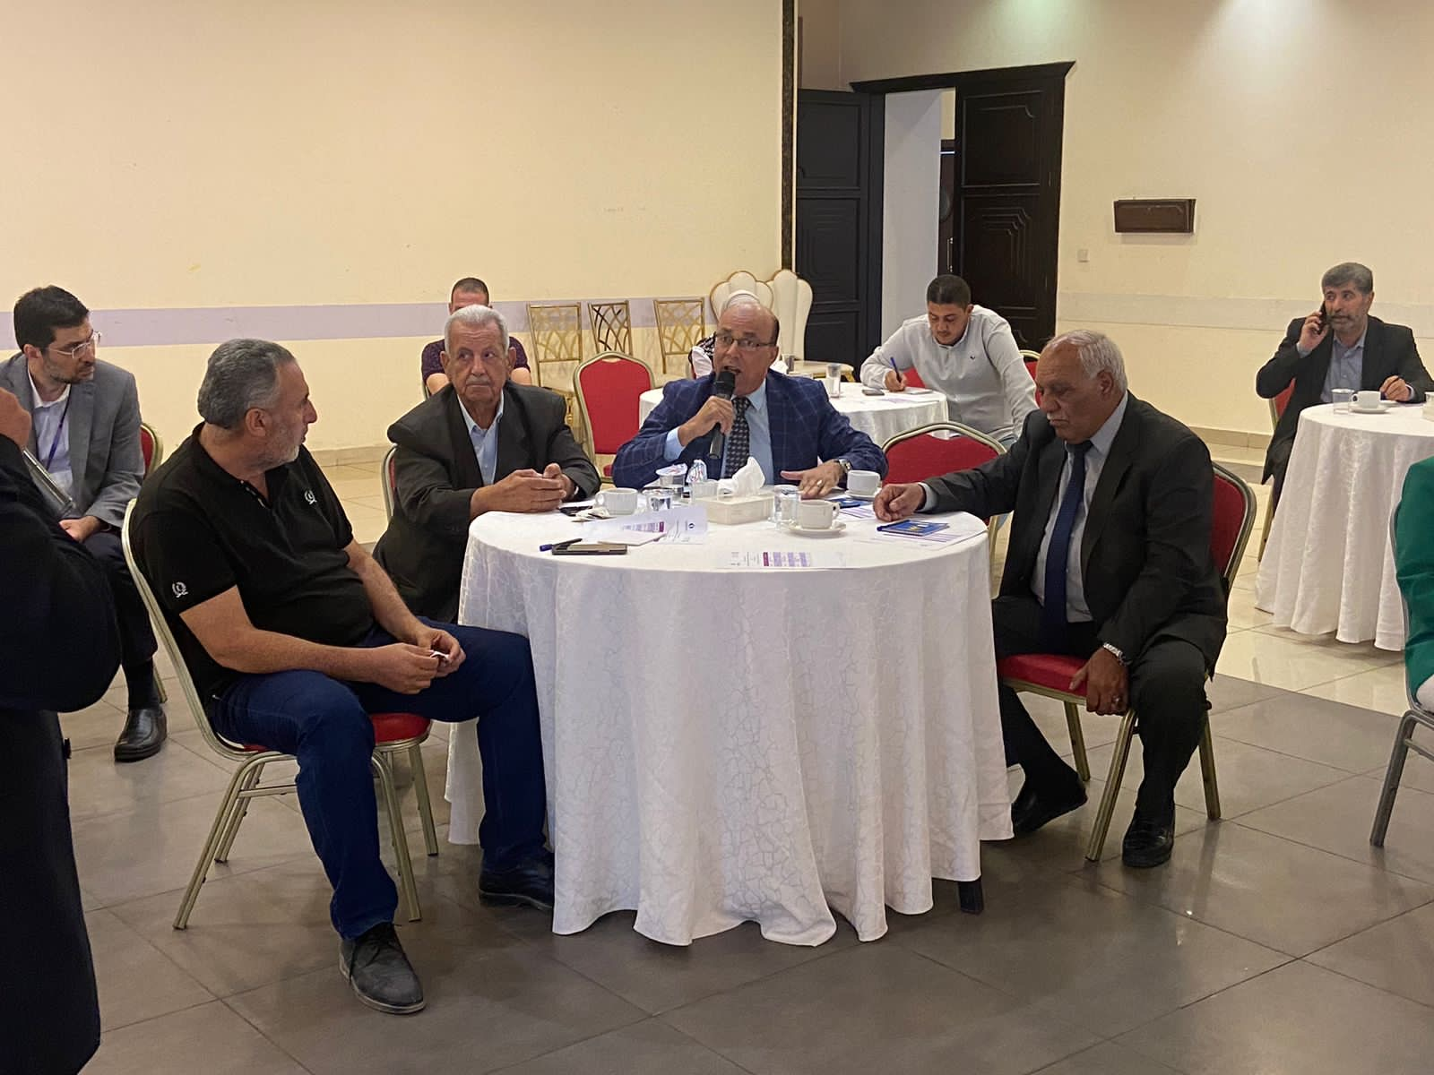
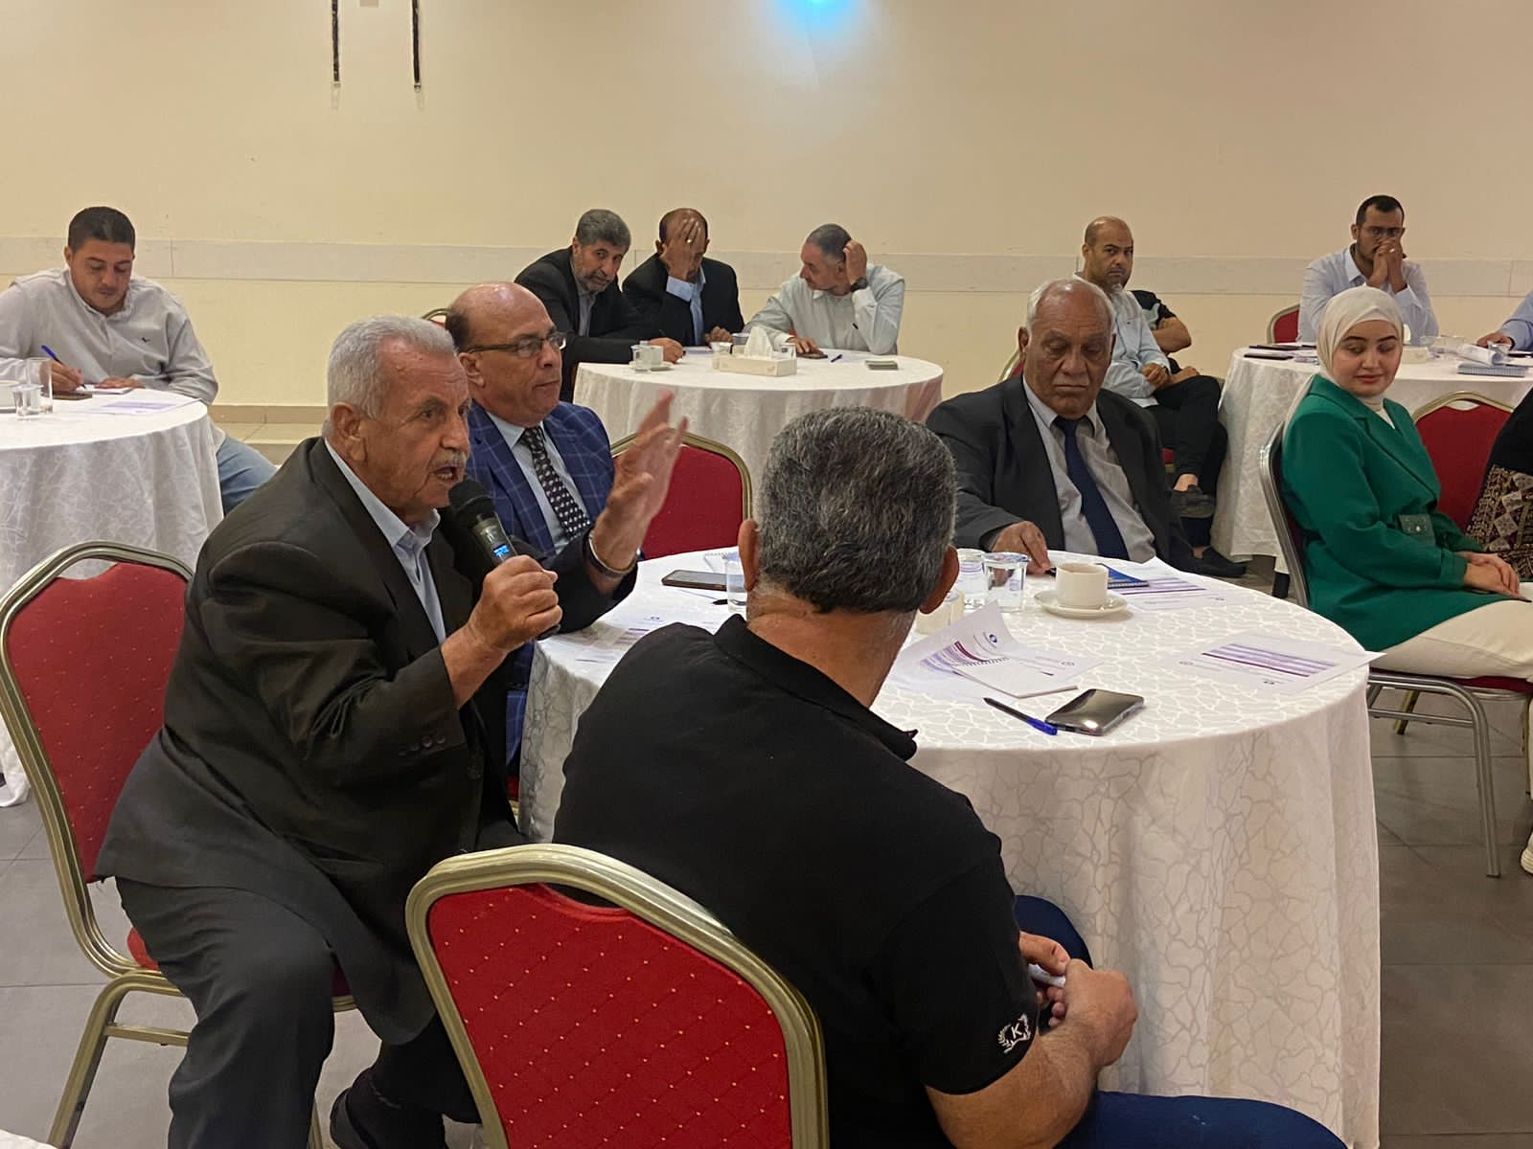
Needs Assessment Workshop (NAW)

Slide 12
Project Methodology
Objective 2
Establish an Integrated Participatory Framework that allows all stakeholders and vulnerable groups getting involved in the project’s implementation.
Activity 1: Formulate a Local Stakeholder Committee (LSC)
Activity 2: LSC field visits to the project’s site and Wadi Al-Arab Wastewater Treatment Plant

Slide 13
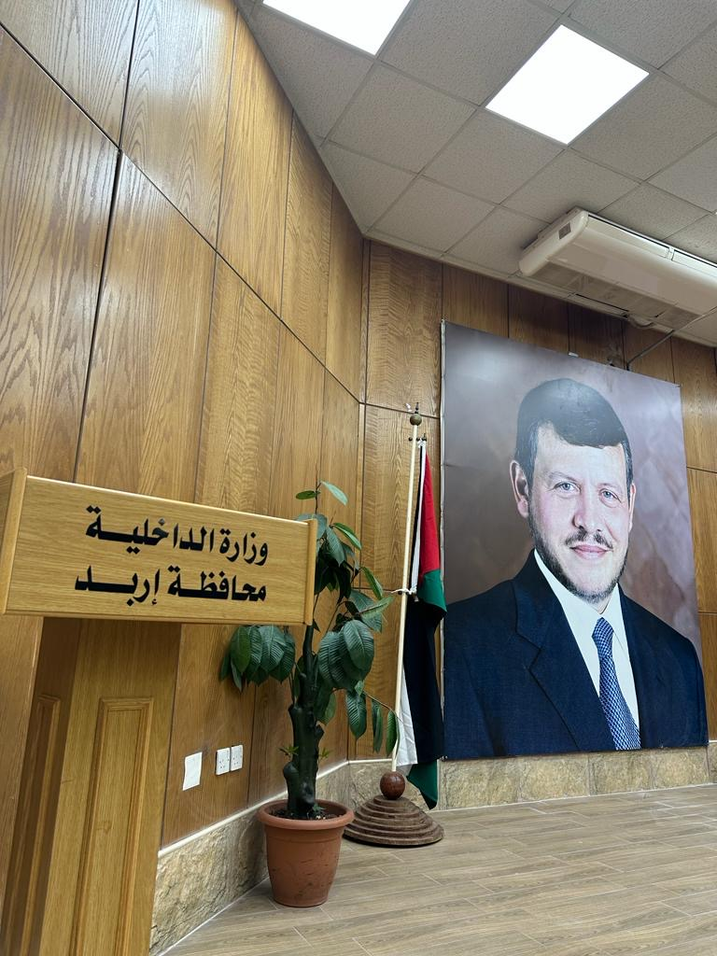
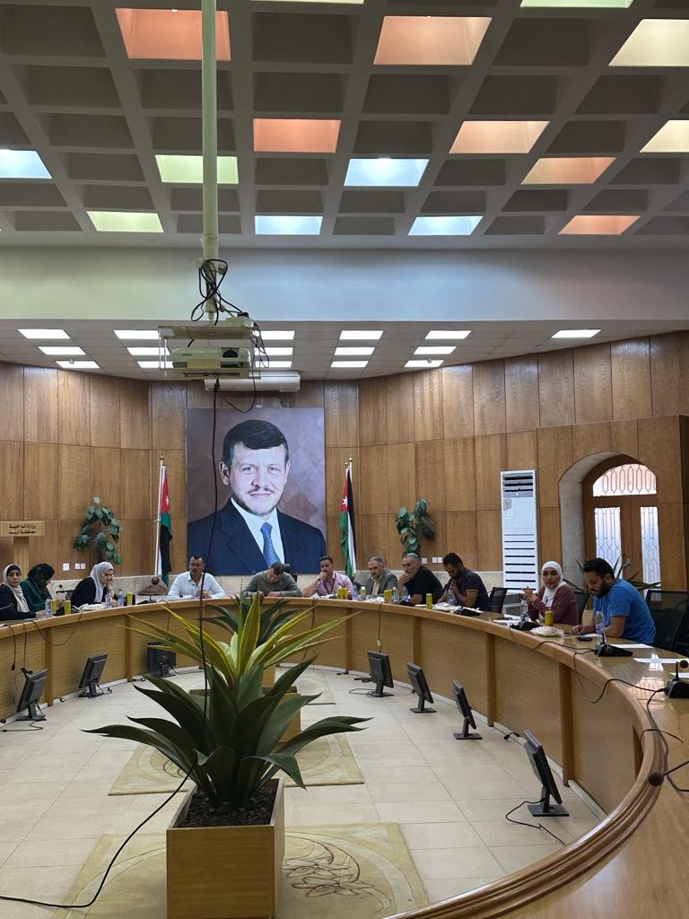
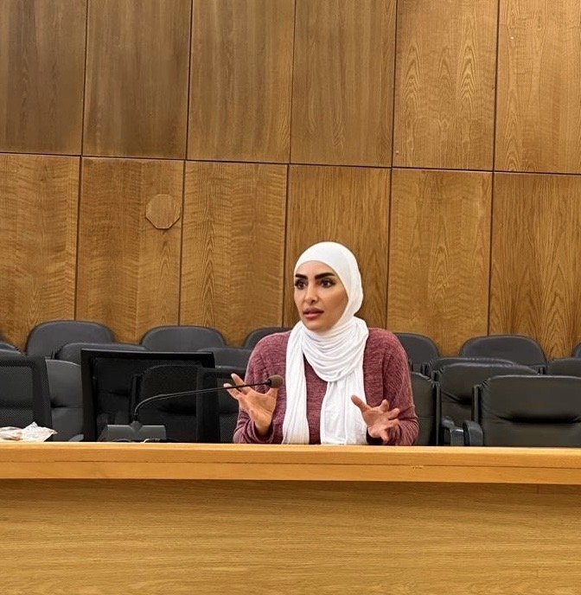
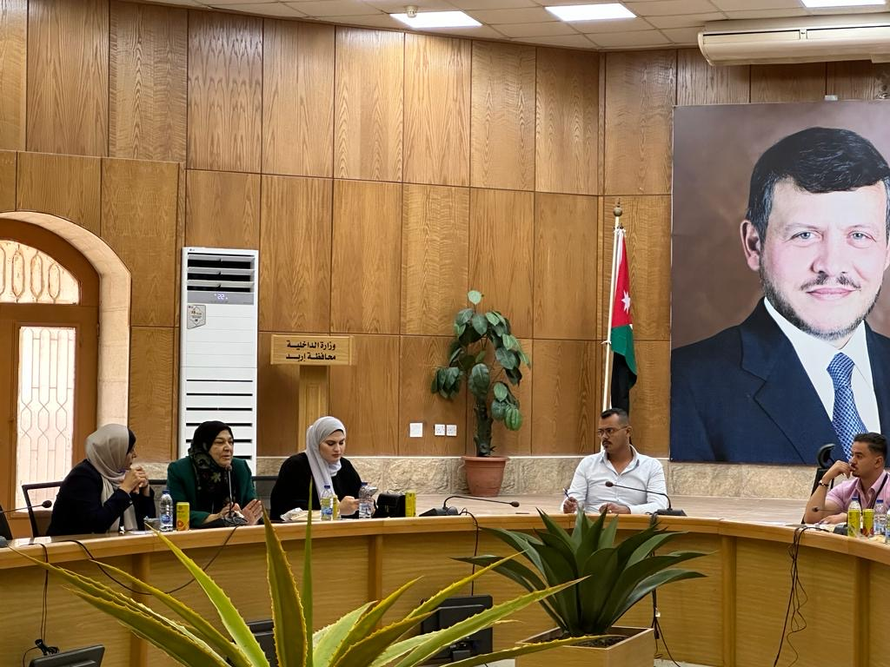
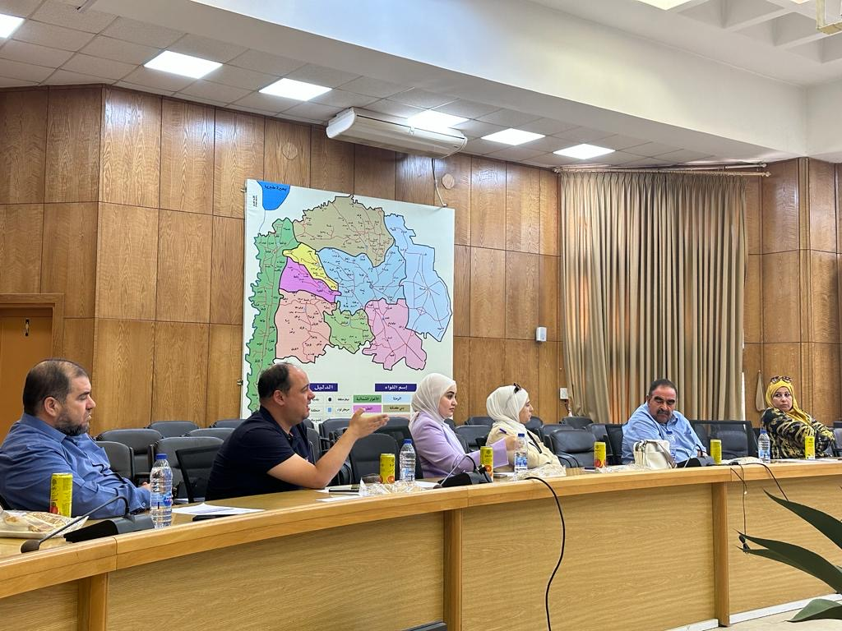
Local Steering committee (LSC)

Slide 14
Project Methodology
Objective 3
Develop and implement a communication strategy, public awareness and behavioural change campaigns.
Activity 1: Conduct Awareness Raising Sessions
Activity 2: Hold Behavioral Change Training of Trainers (TOTs)

Slide 15
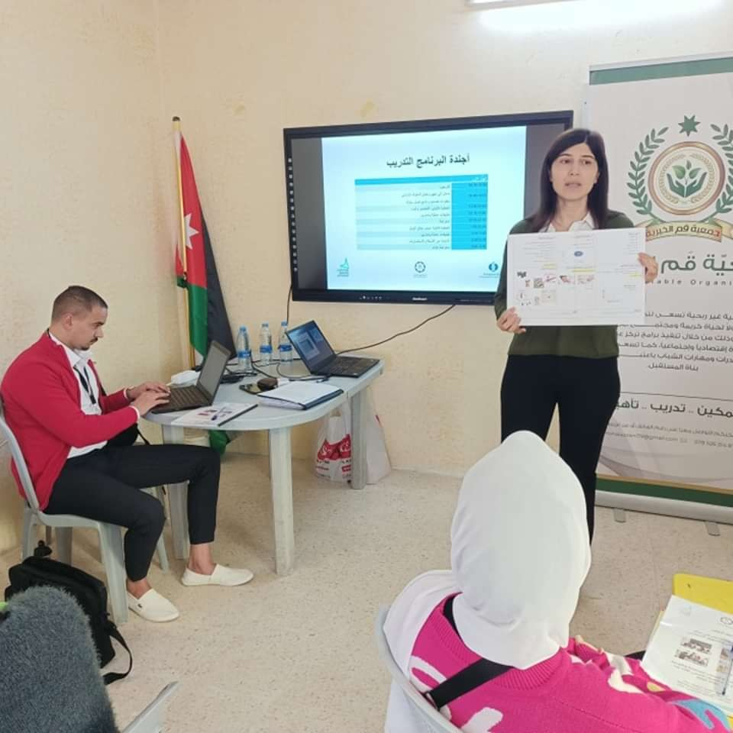
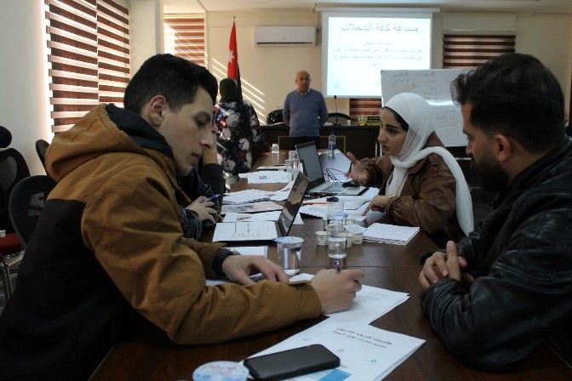
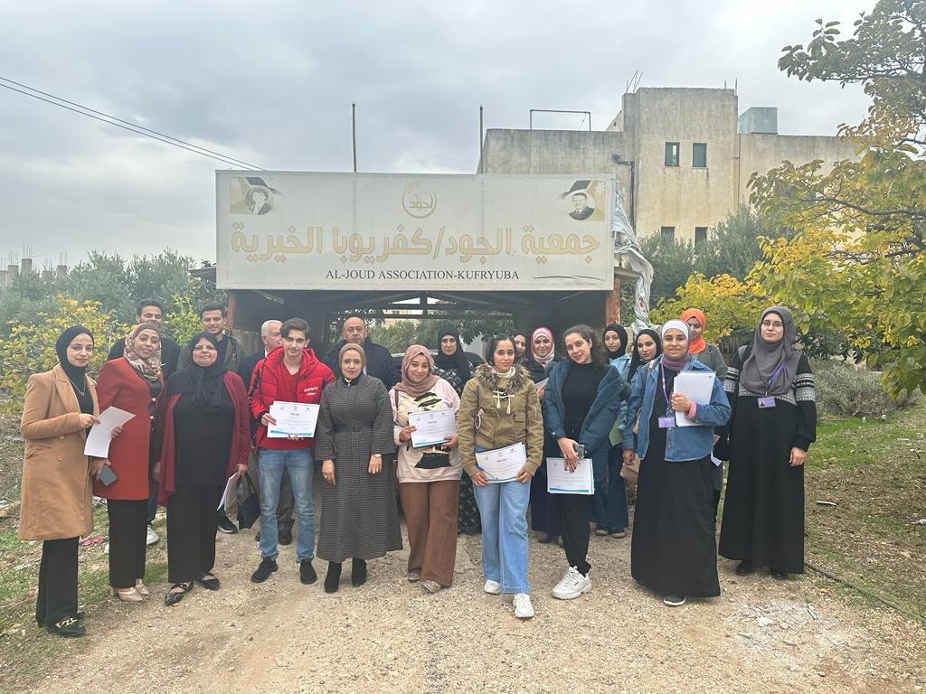
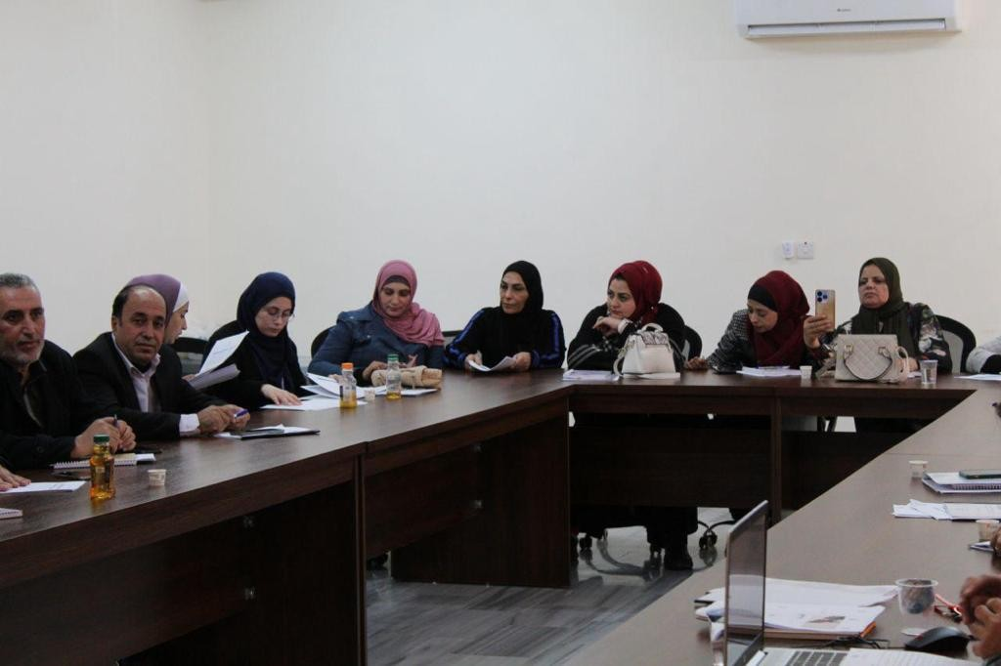
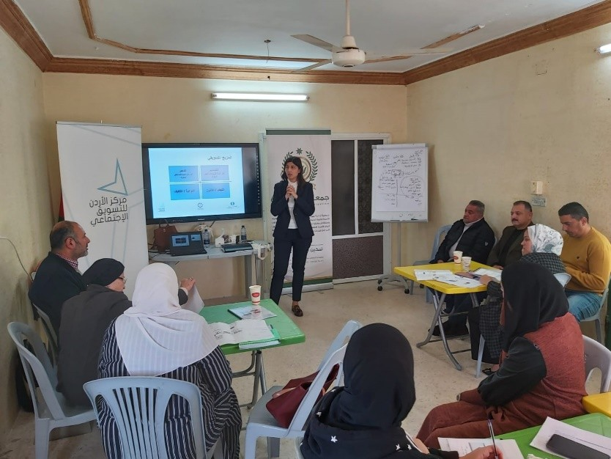
Awareness Sessions and TOTs

Slide 16
Project Methodology
Objective 4
Develop a grievance and sustainable complaints register mechanism for the project.
Activity 1: Conduct Community Info Sessions
Activity 2: Design and Implement a Marketing campaign

Slide 17
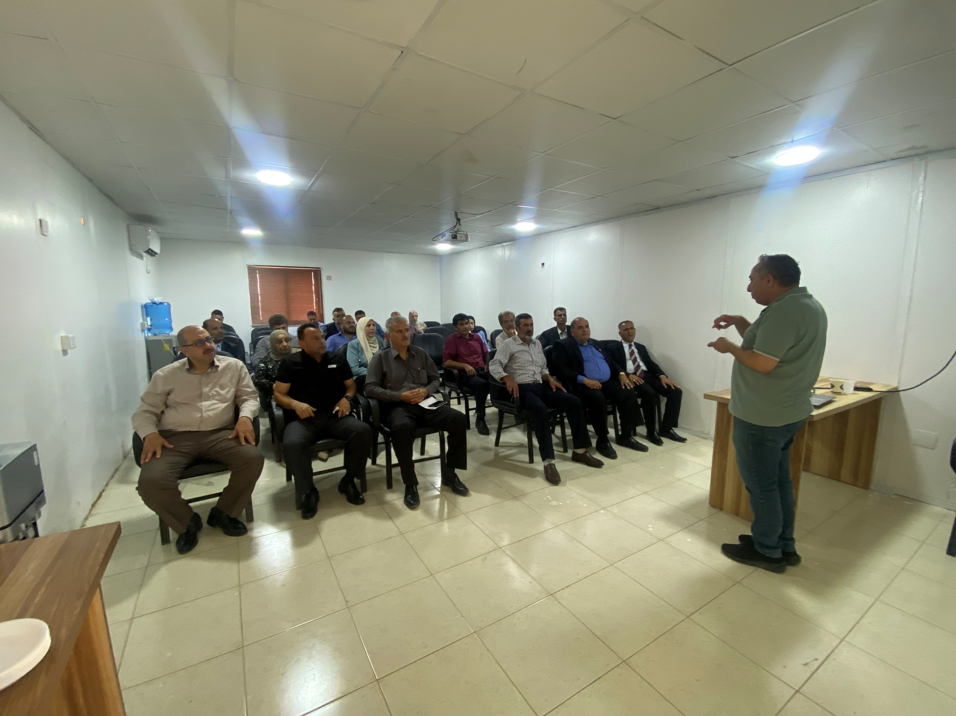
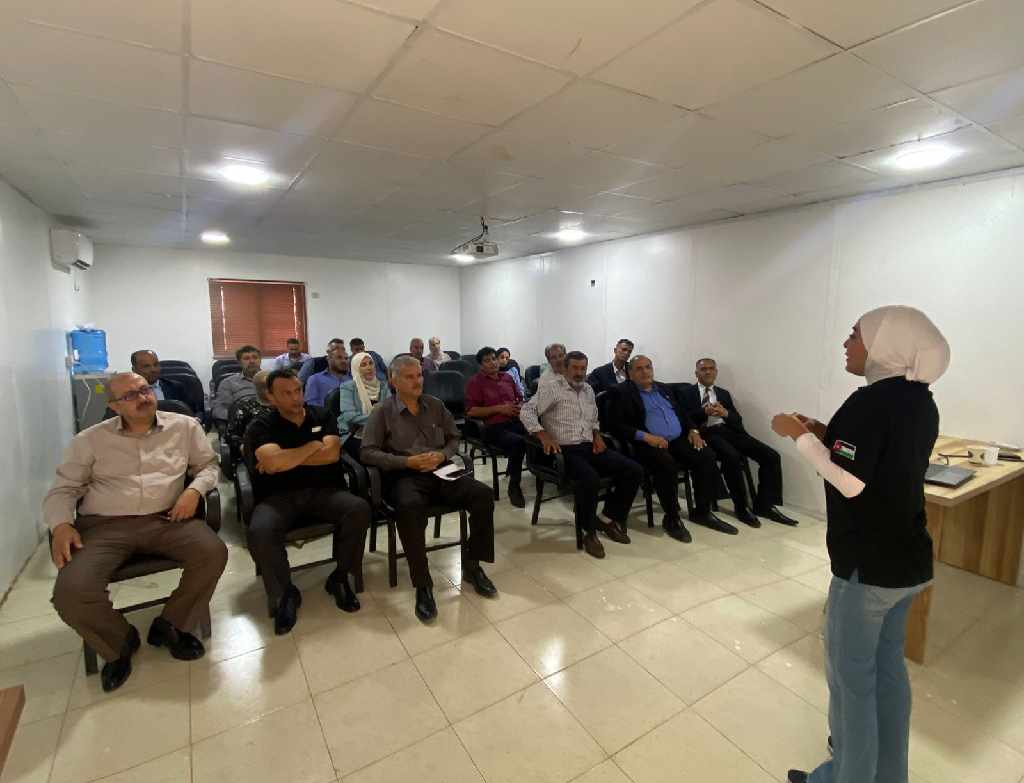
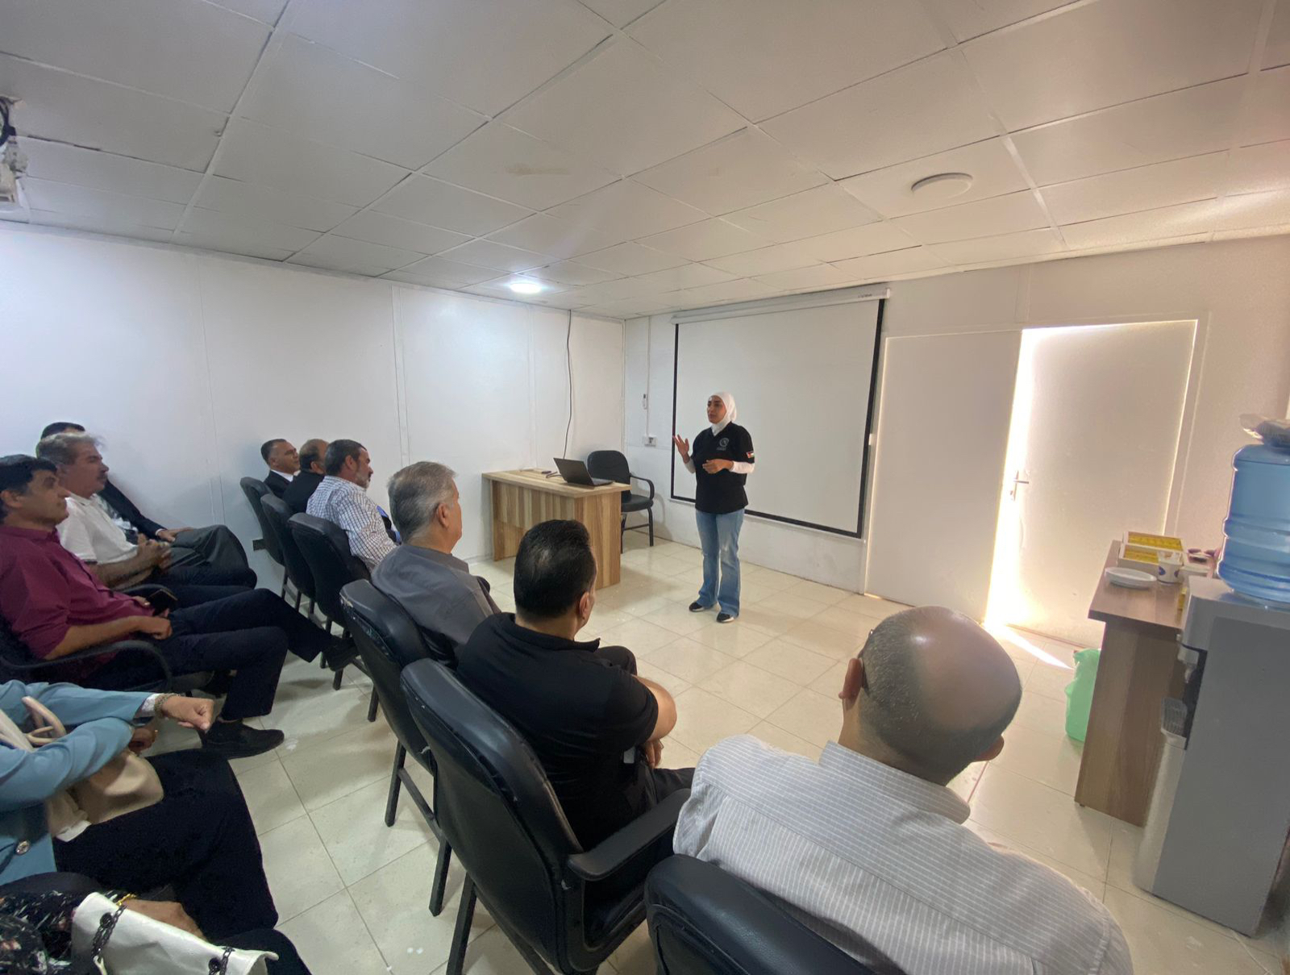
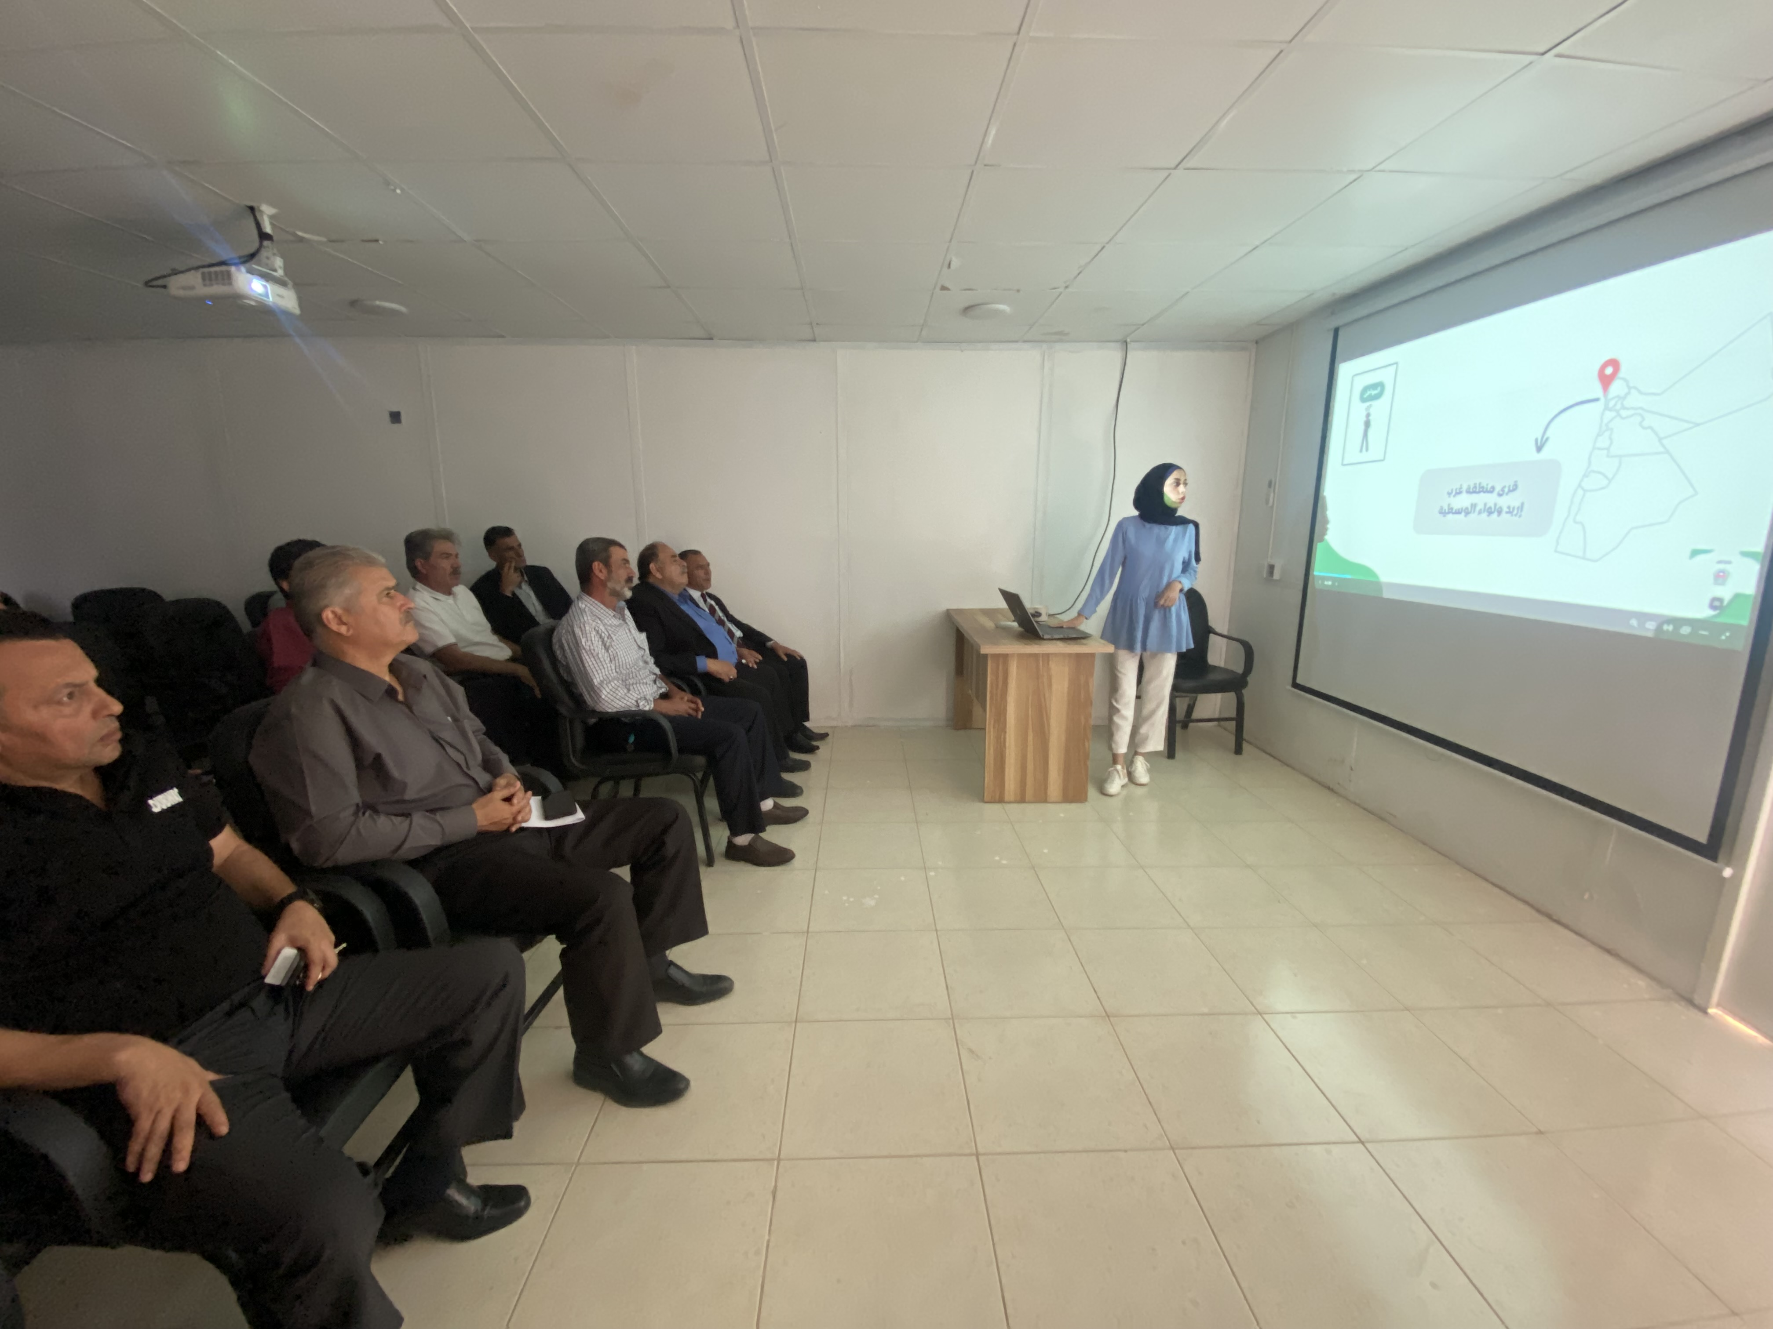
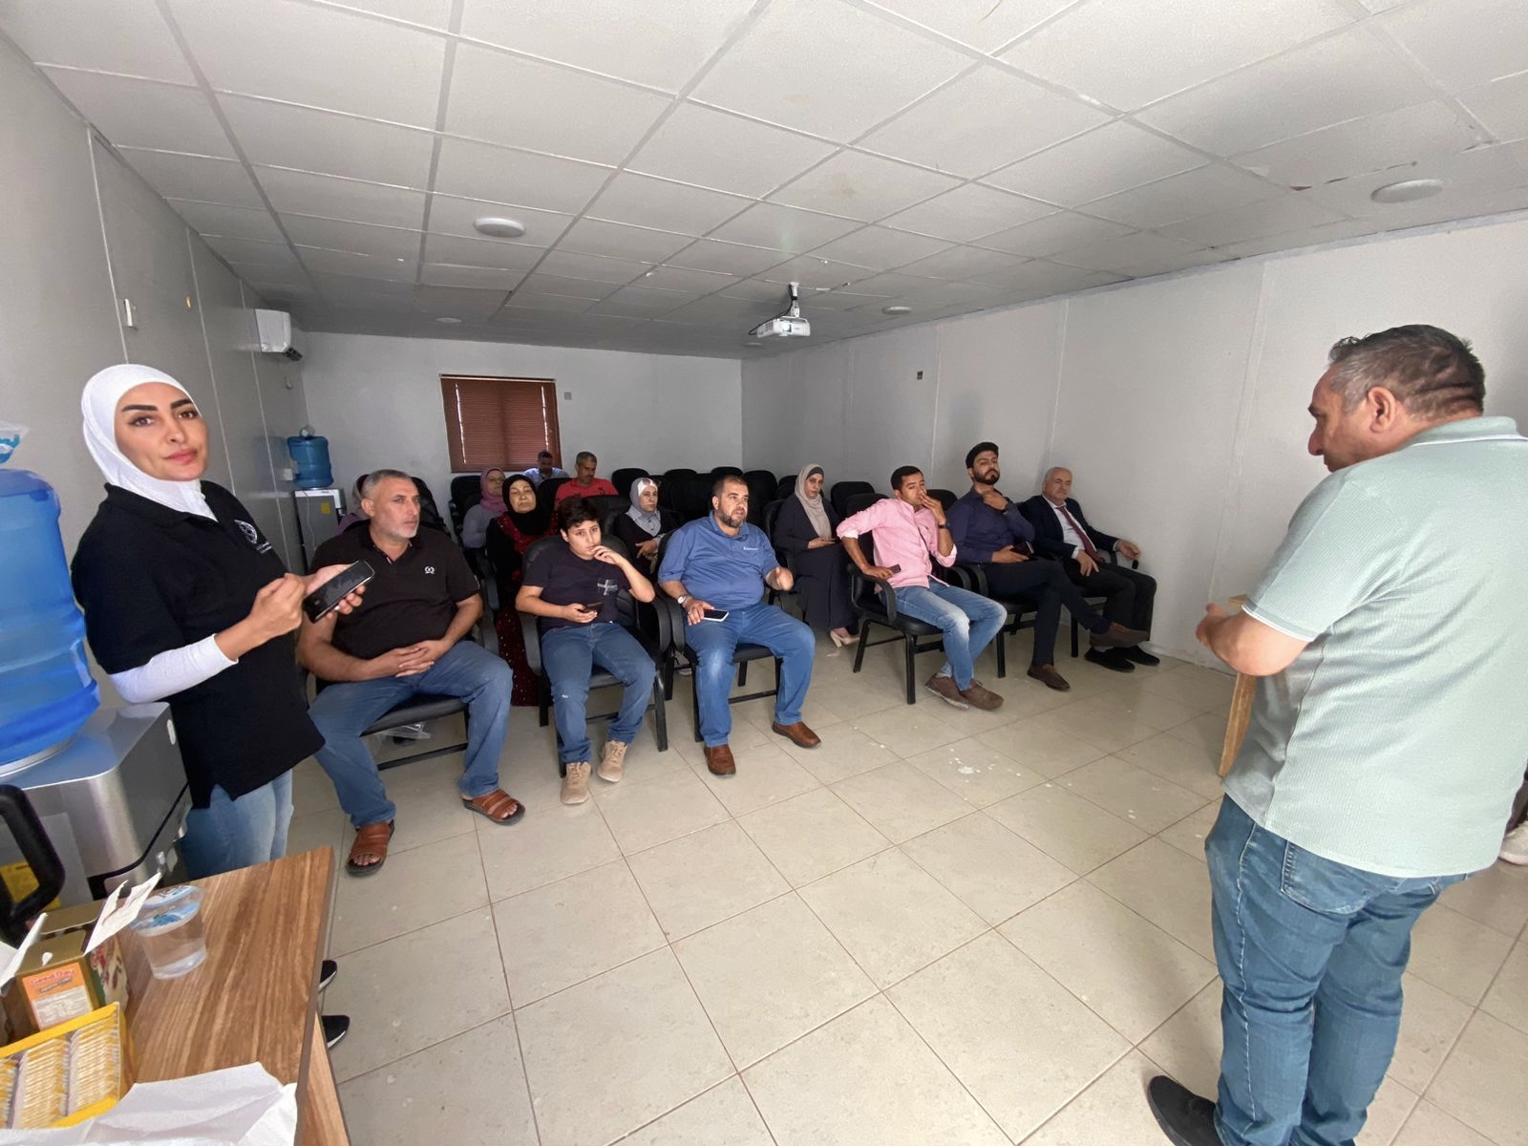
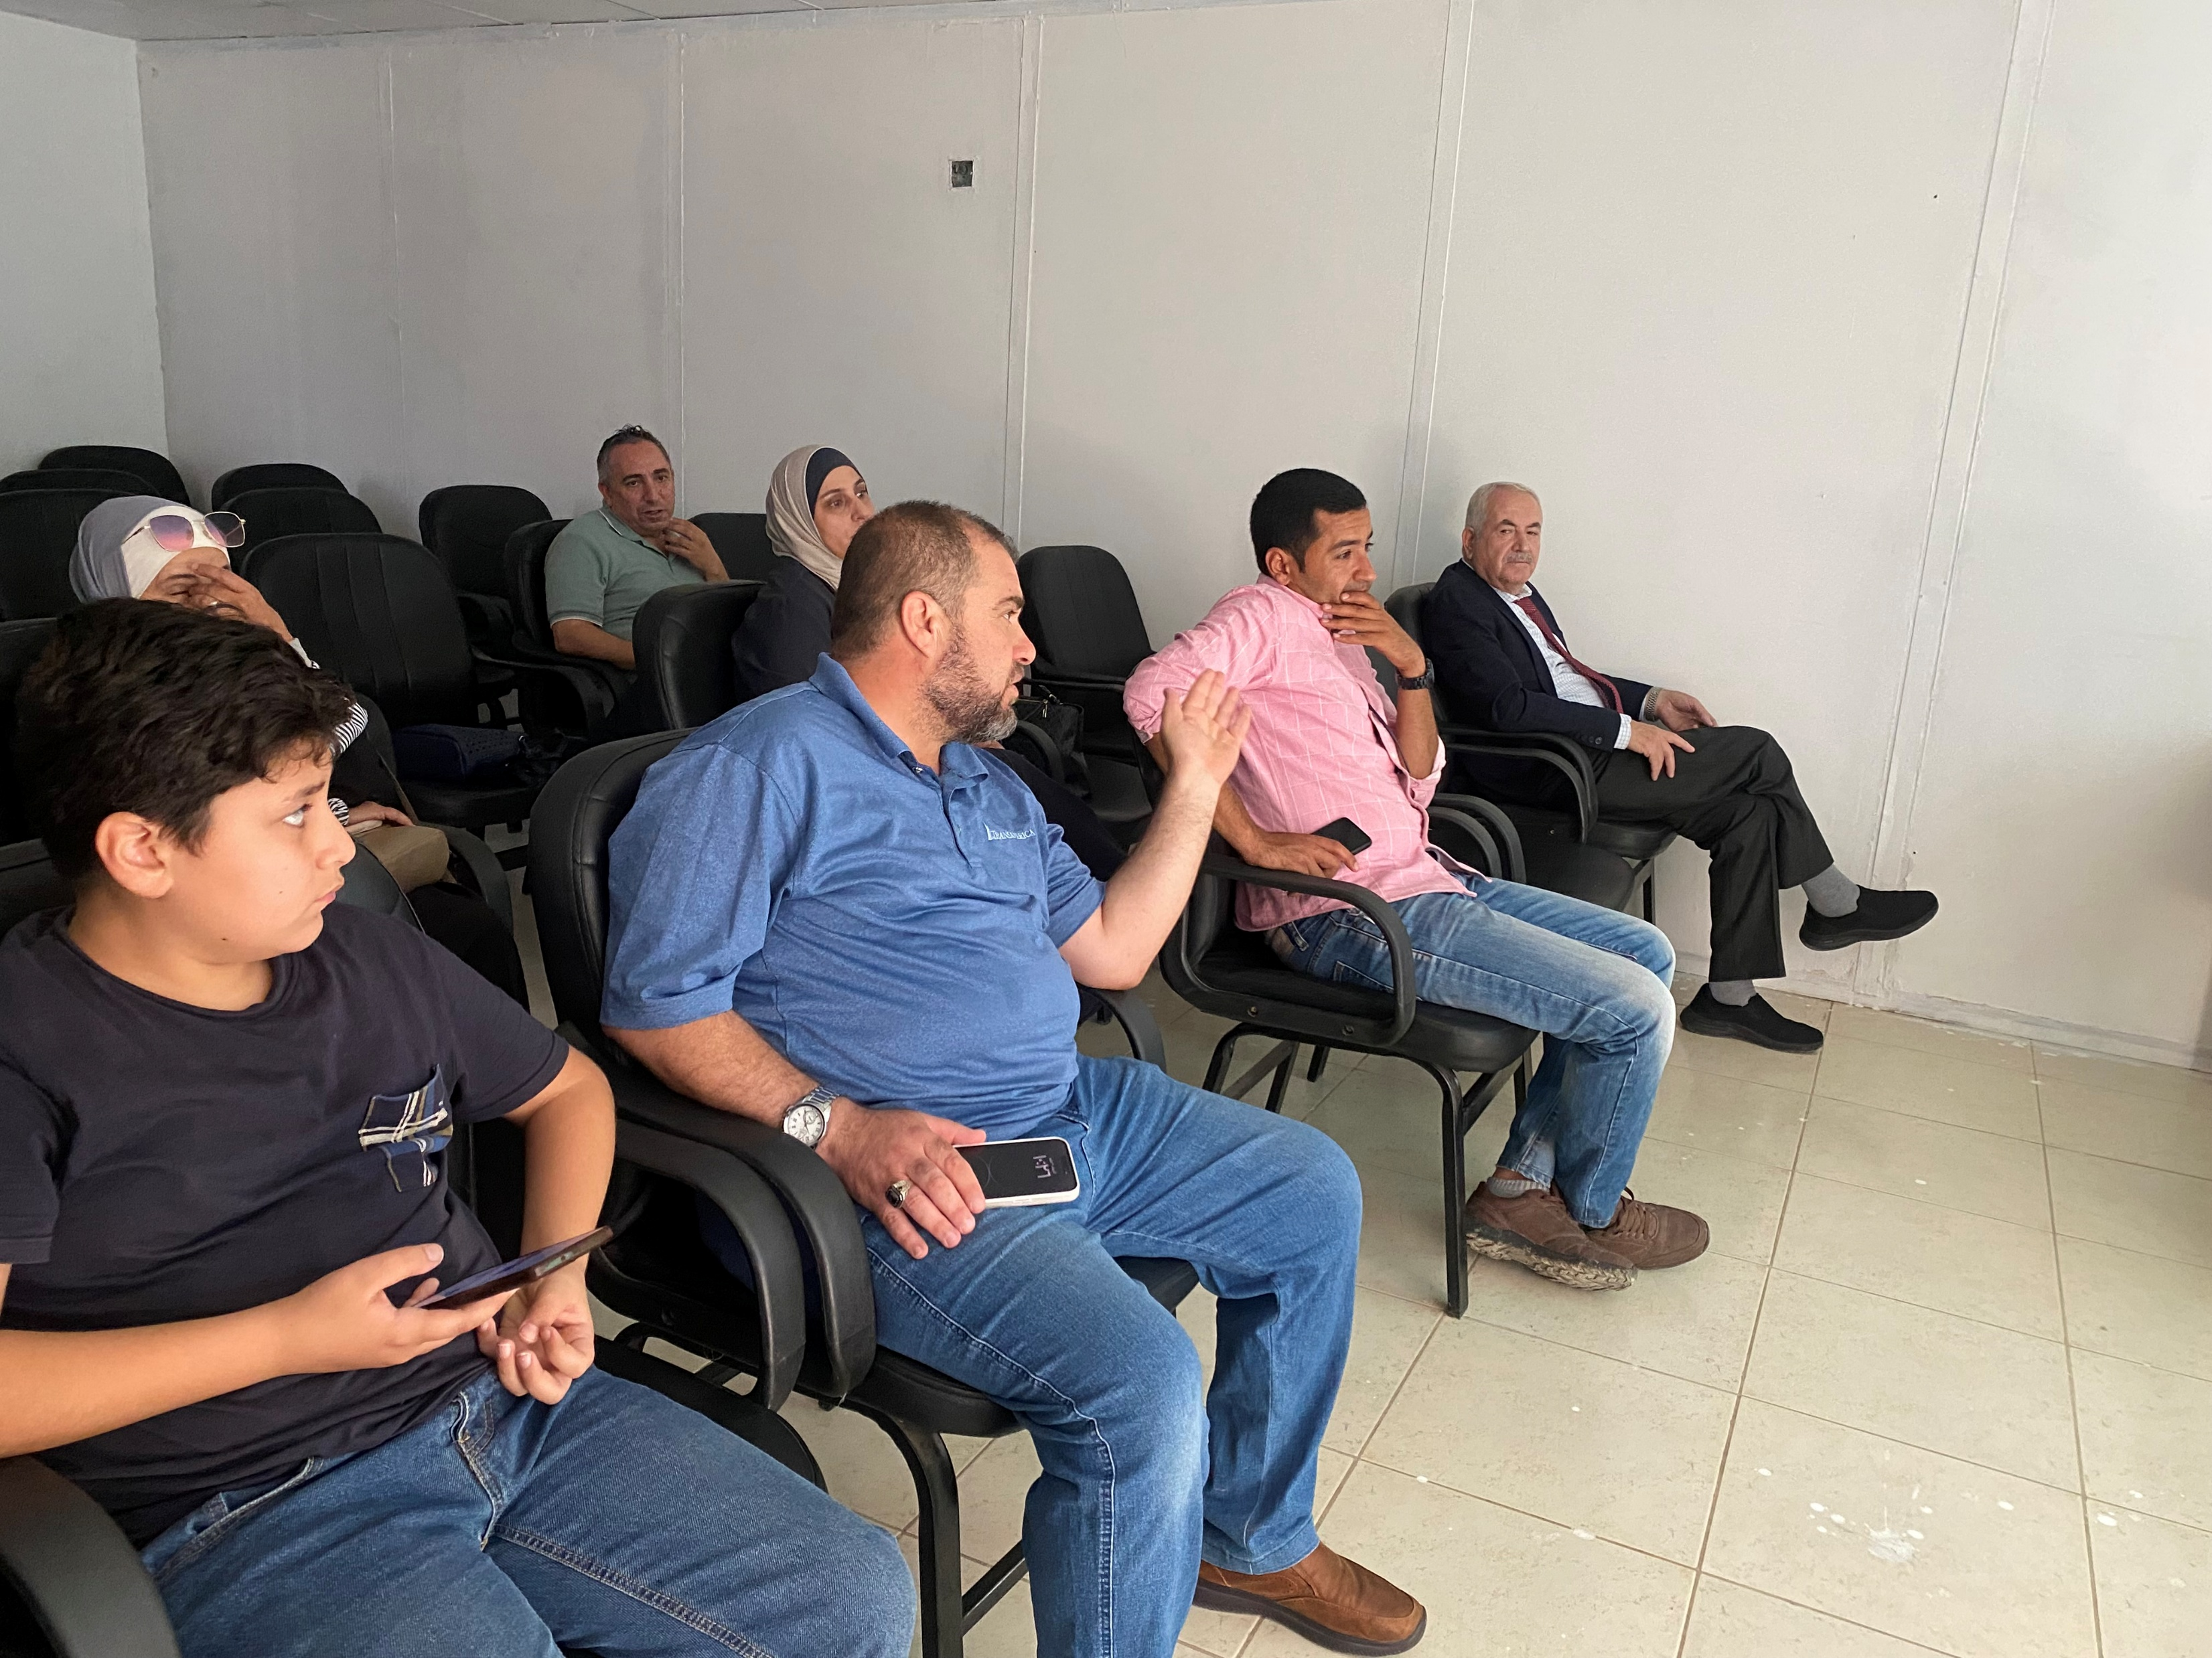
Info Sessions

Slide 18
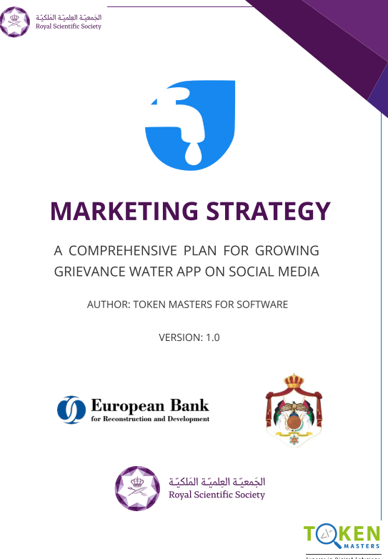
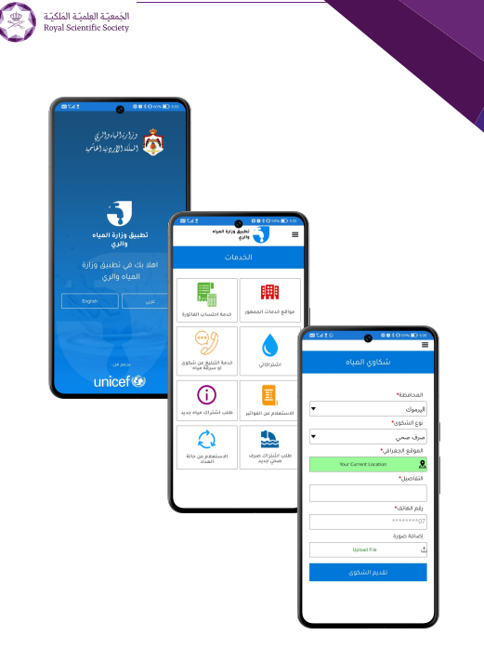
Marketing Campaign

Slide 19
Project Outcomes
6,060 HH
21 KIIs
15 FGDs
30 Awareness Sessions
5 BC TOTs
1 LSC

Slide 20
Thank You
For more information,
please contact us on:
rana.aarda@rss.jo

