Slide 1
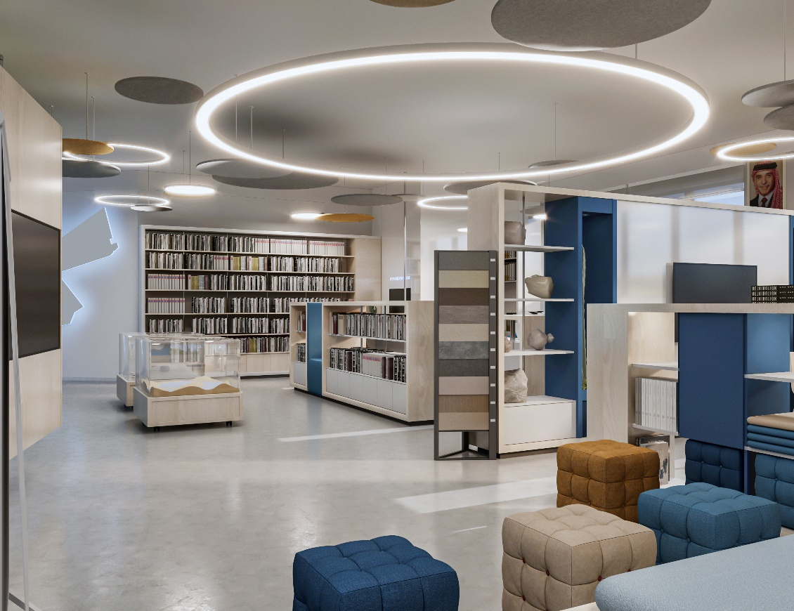

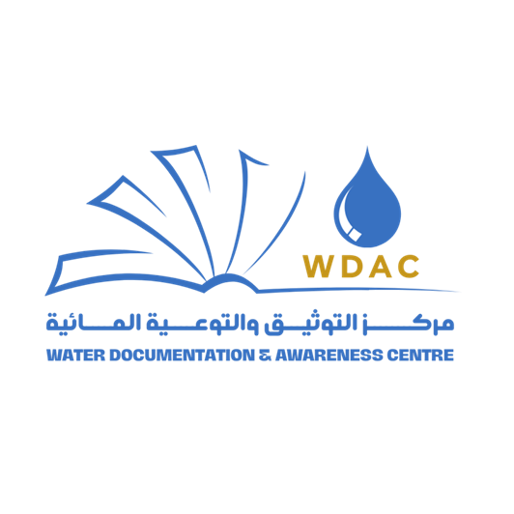
Water Documentation and Awareness Centre
(WDAC)
Rebecca Bahls

Slide 2
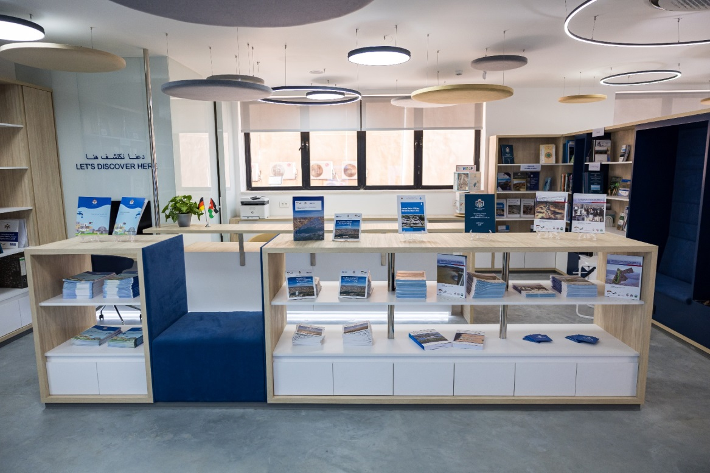
Idea behind the
Water Documentation and Awareness Center
Notes:
Physical and digital space

Slide 3
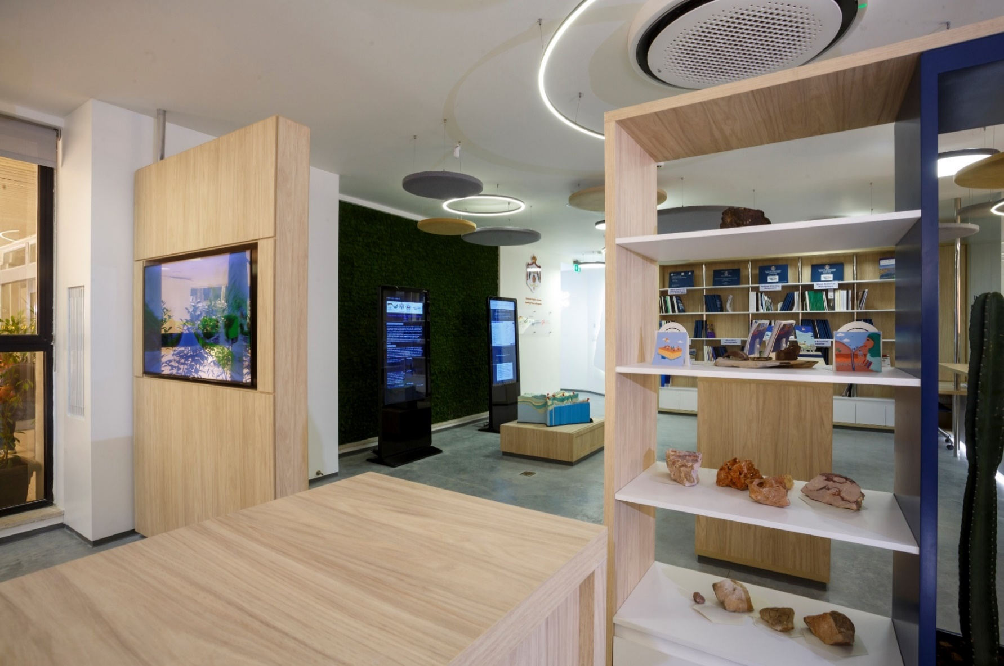
Aim of the Center
The WDAC aims to be a physical platform centralizing data, maps, models and studies as well as offering online access to the documentation and supporting knowledge-transfer and education on methods and technics necessary for surface water and groundwater studies.

Slide 4
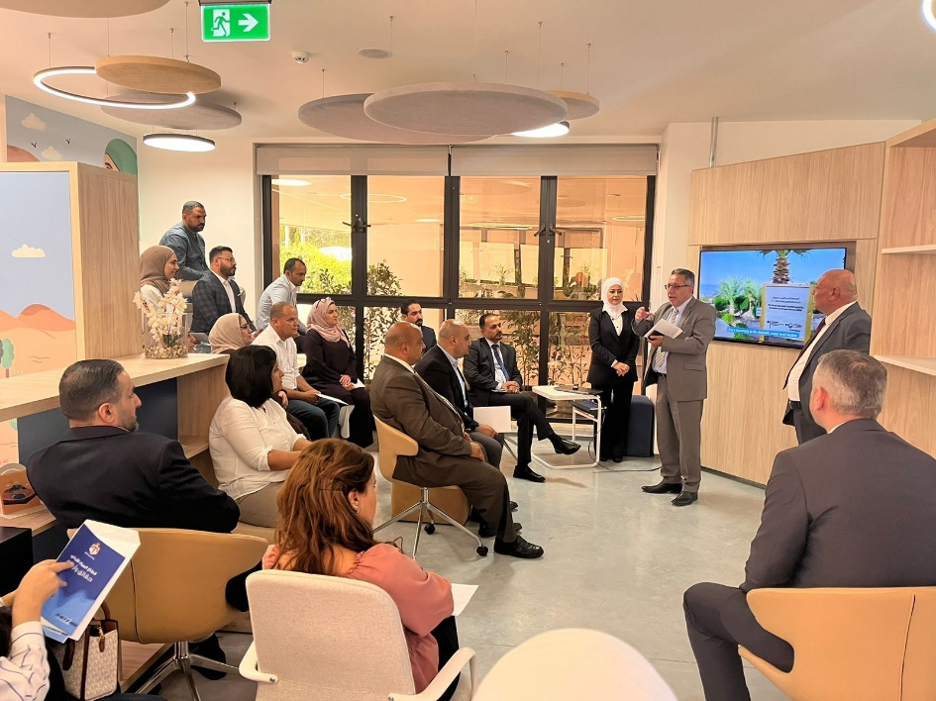
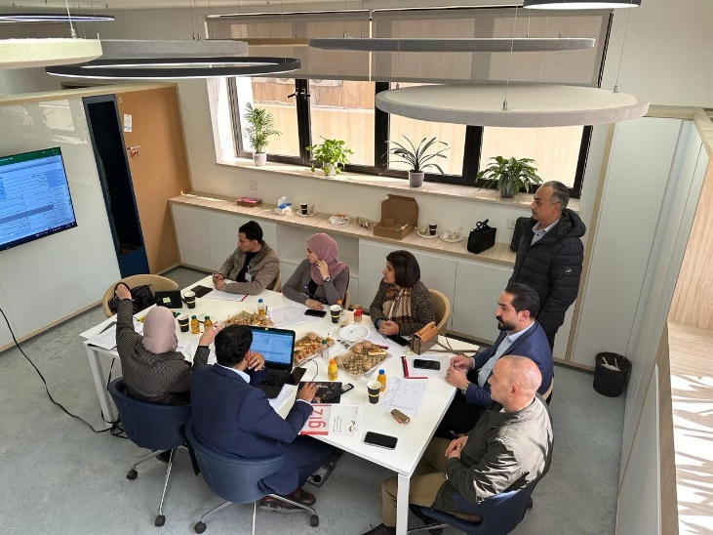
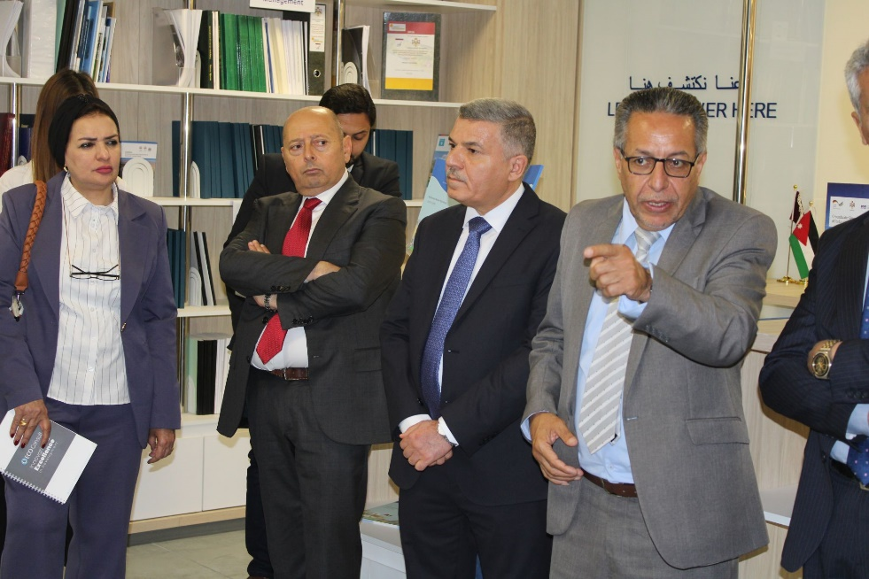
Target group
ministry employees, water sector experts, decision-makers, government officials, master students, and young scientists in the water sector.

Slide 5
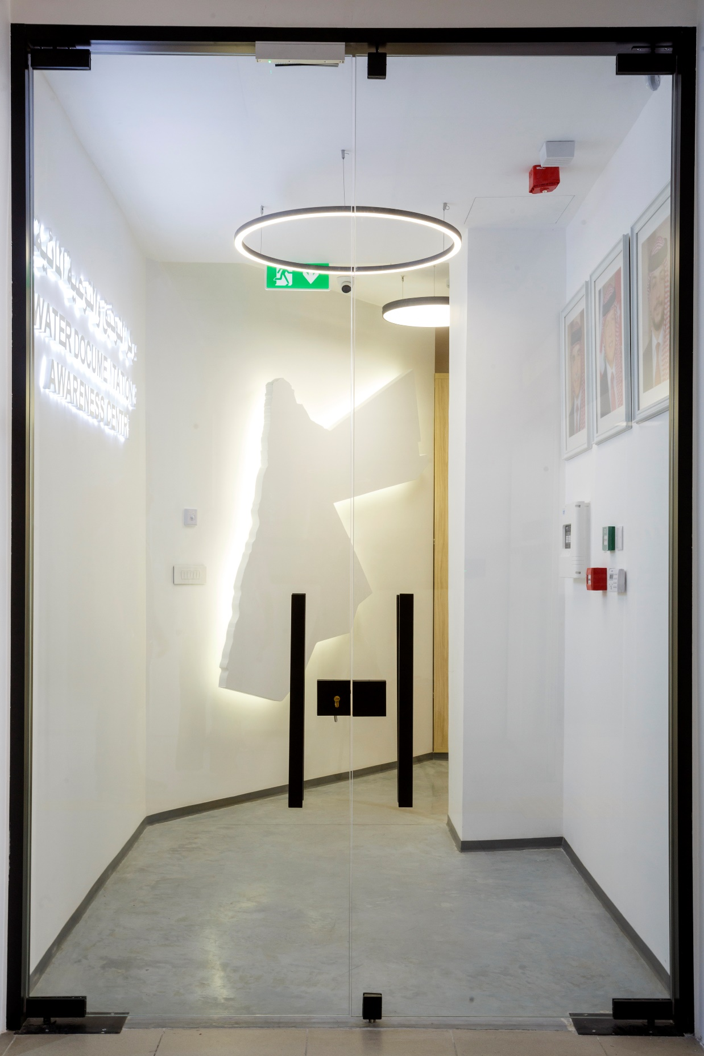
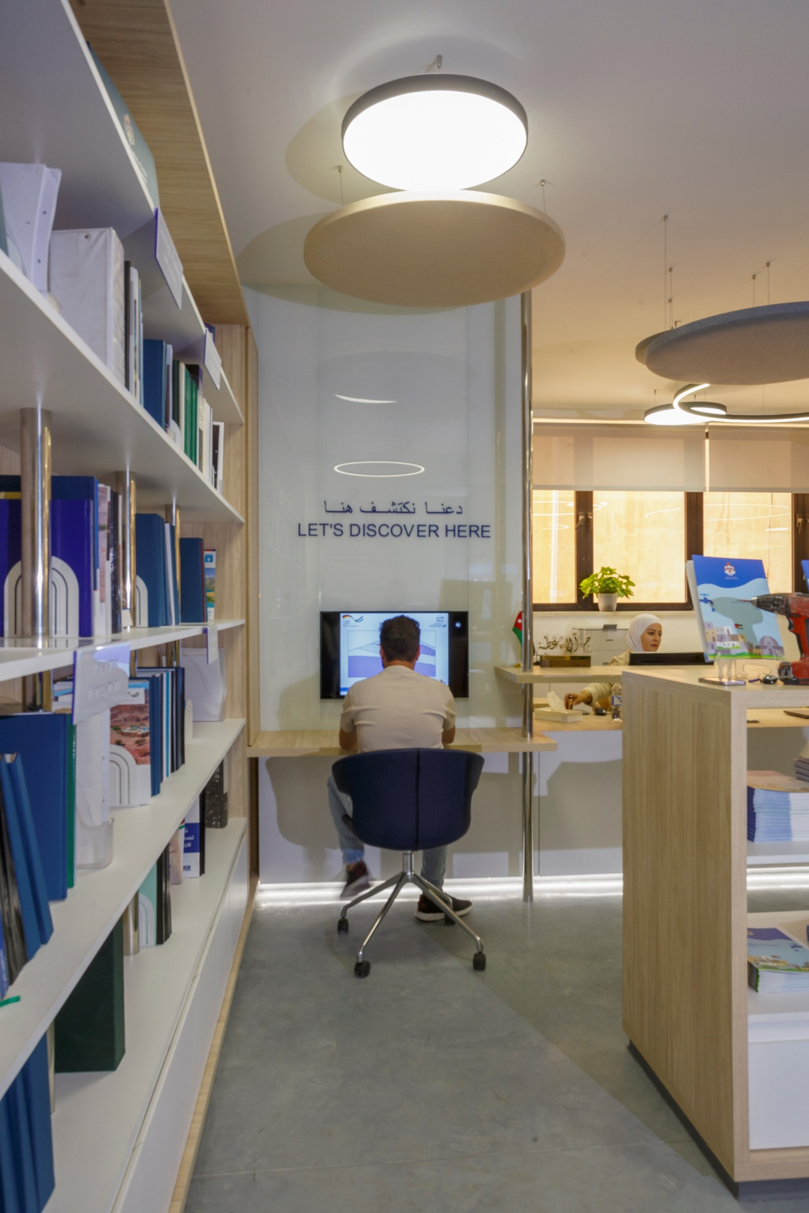
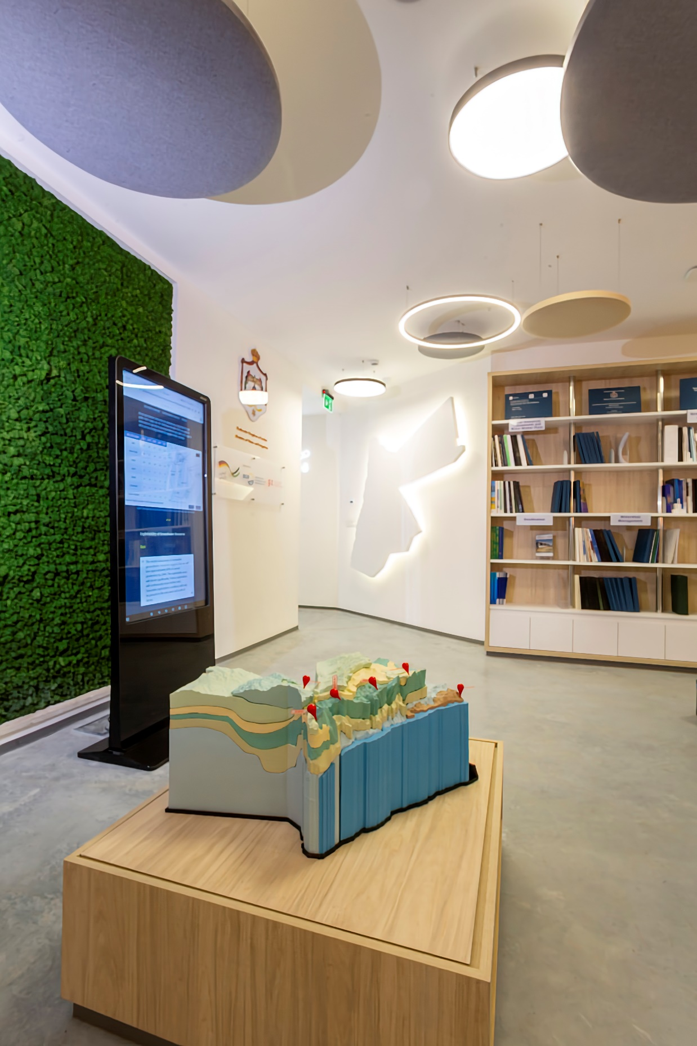
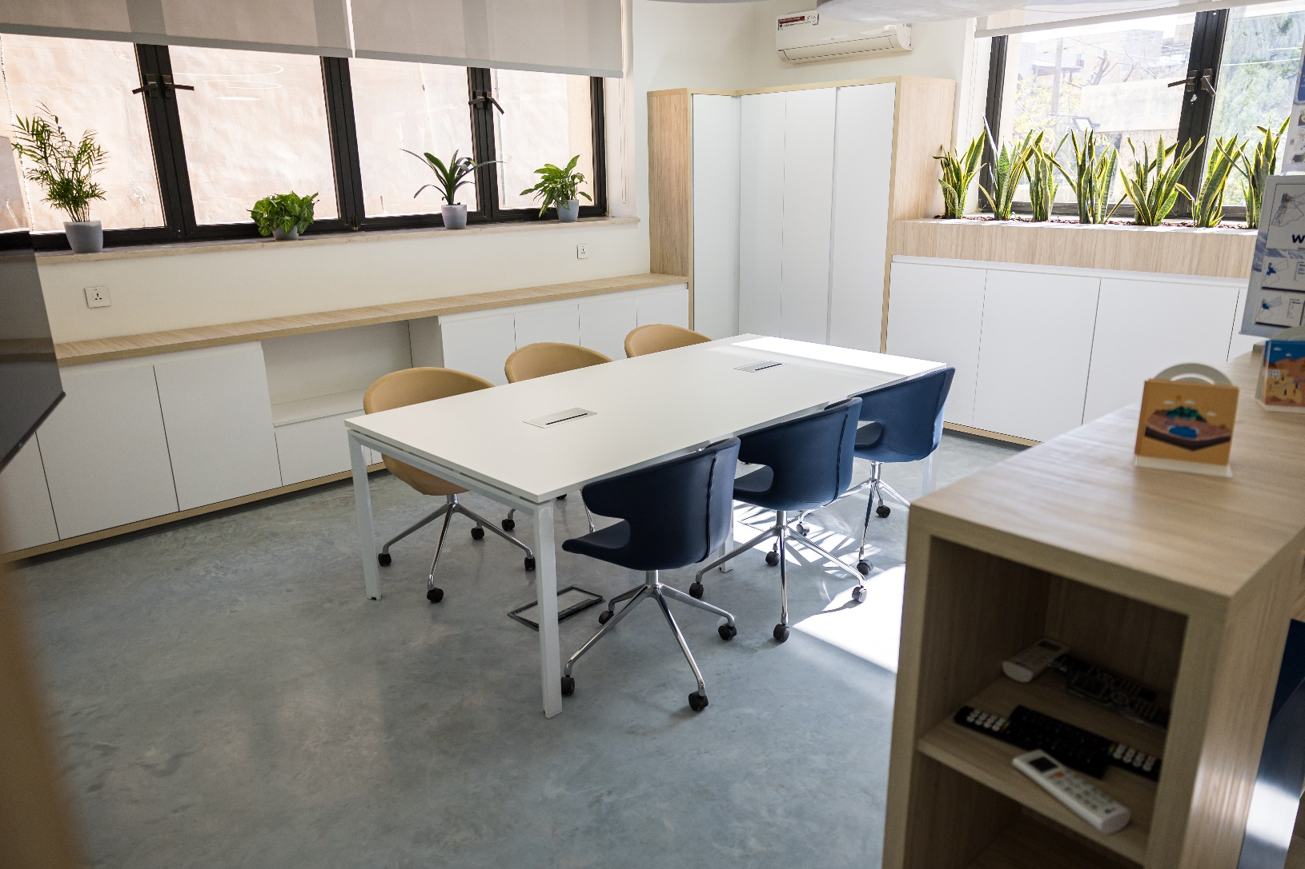
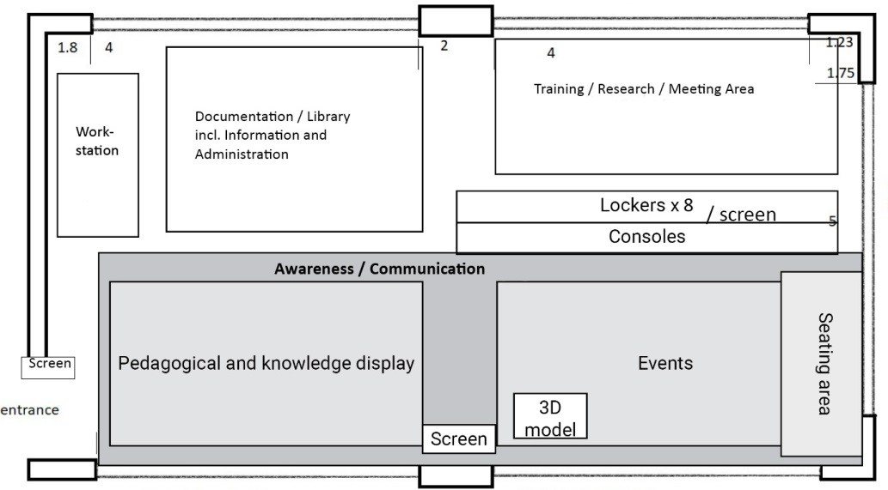
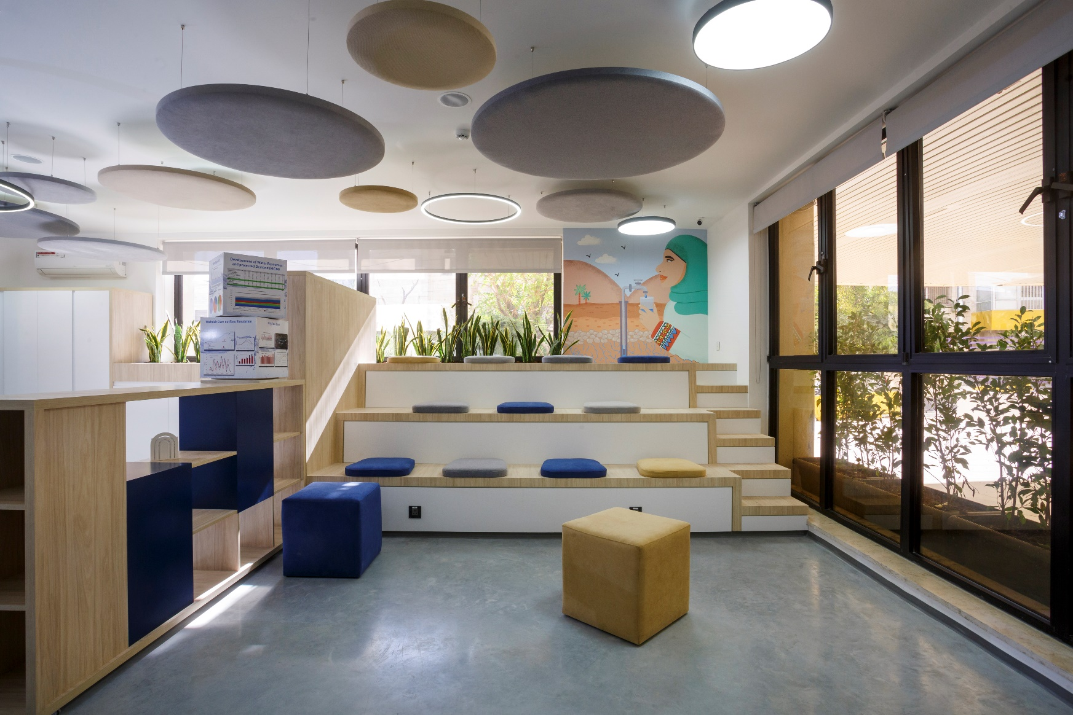

The Concept of the WDAC

Slide 6
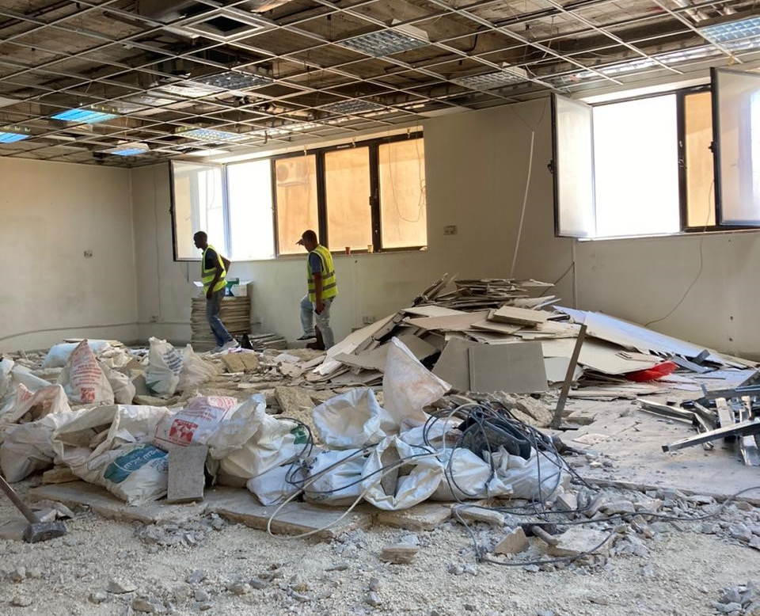
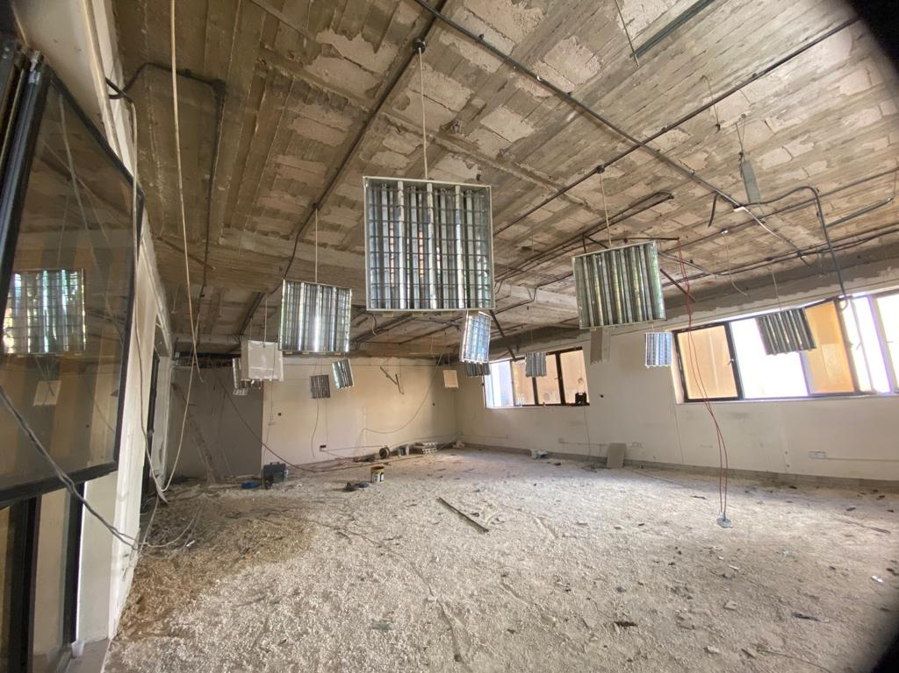
Implementation phase
Construction as part of the BGR Project Groundwater Resources Management

Slide 7
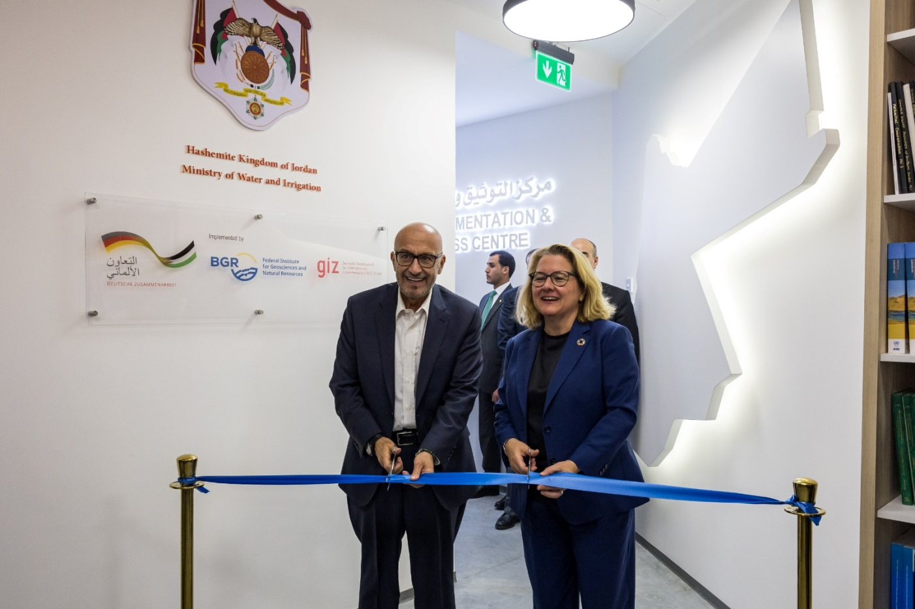
On November 7. 2023
the Jordanian Minister of Water, Raed Abu Al-Saud and
the German Federal Minister for Economic Cooperation and Development, Svenja Schulze, jointly inaugurated the Water Documentation and Awareness Centre

Slide 8
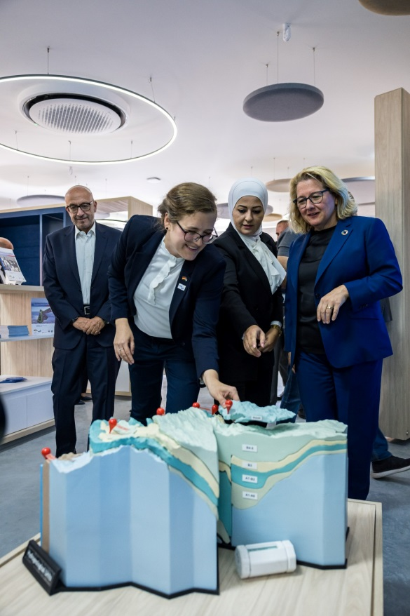
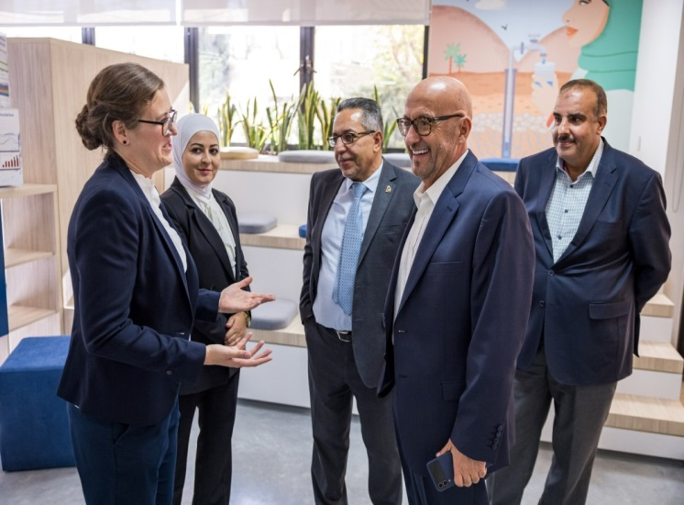
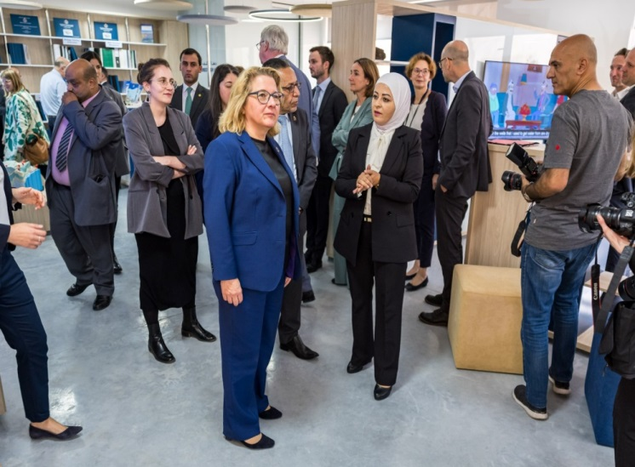

Slide 9
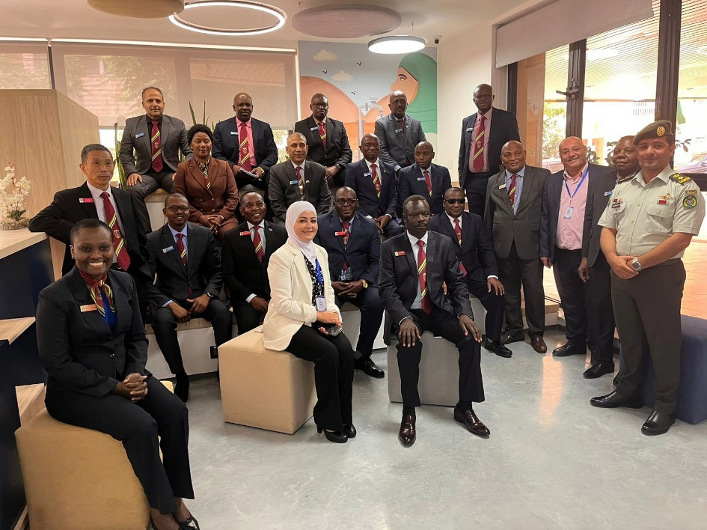
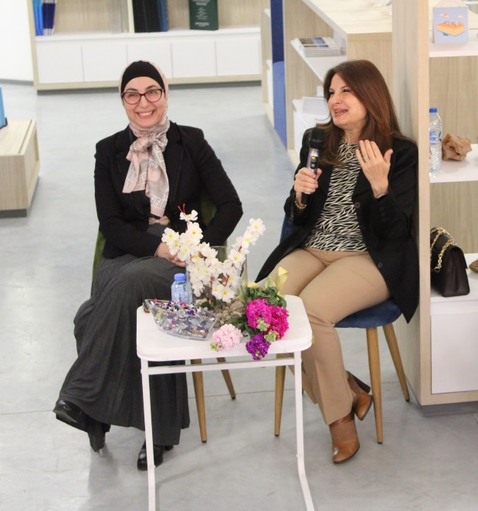
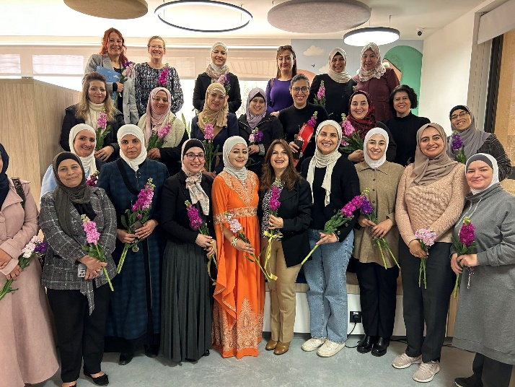
Events

Slide 10
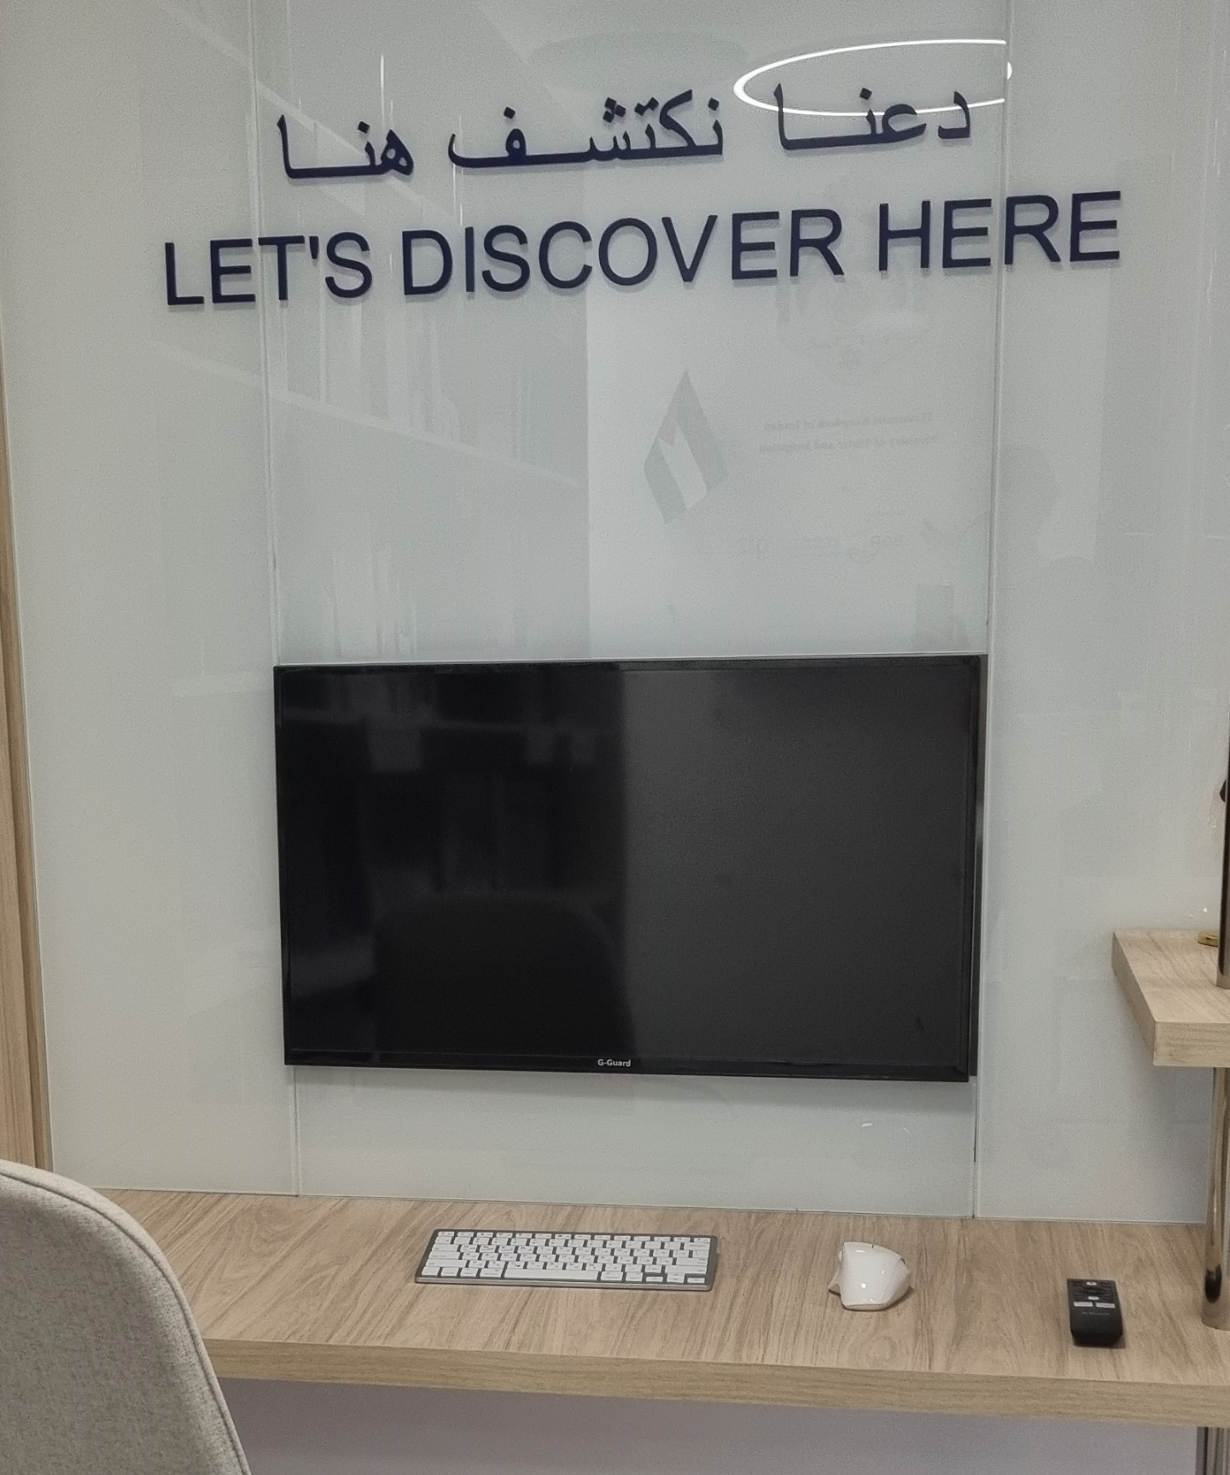

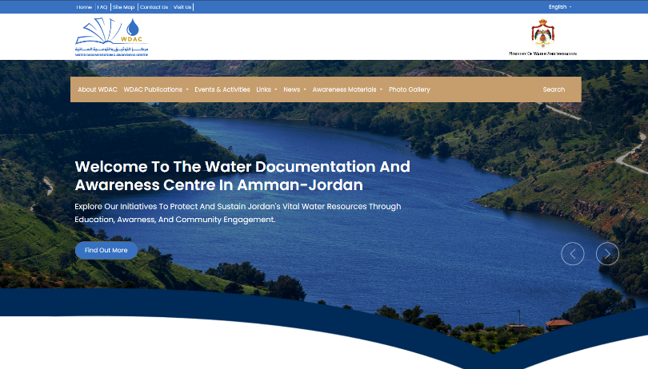

Slide 11
Thank you!

