Slide 1
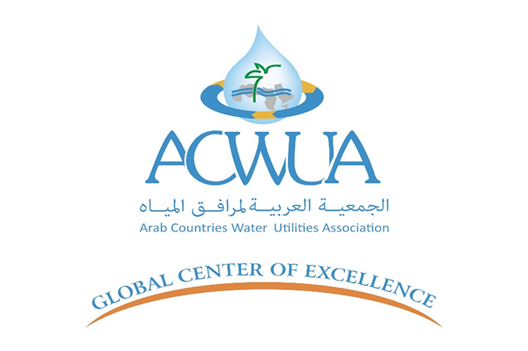



Investing in Renewable Energy:
A sustainable Solution to Water Supply Challenges in SLWE
Rola Sammoura, PhD – May 4, 2025
Assistant Professor - Industrial Engineering and Engineering Management Department - Faculty of Engineering - BAU

Slide 2

Introduction
Importance of water supply for communities
Water is vital for life.
South Lebanon Water Establishment (SLWE) is responsible for providing safe and potable water to all cities, towns, and villages in South Lebanon
Who is SLWE?
The South Lebanon Water Establishment (SLWE) is a public utility responsible for managing water supply and sanitation services in southern Lebanon.
Headquartered in Saida.
SLWE was established under Law No. 221 of May 29, 2000, which consolidated various regional water authorities to improve efficiency and service delivery .​

Slide 3
Problem Statement
Lebanese economic and social circumtances between 2020-till now
Electricity shortages in Lebanon: 2 hrs - 4 hrs per day
intermittent supply
Inflation:
2020 84%
2021 154.8%
2022 171.2%
2023 221.3%
International Monetary Fund, International Financial Statistics and data files.(World Bank open Data)

Slide 4
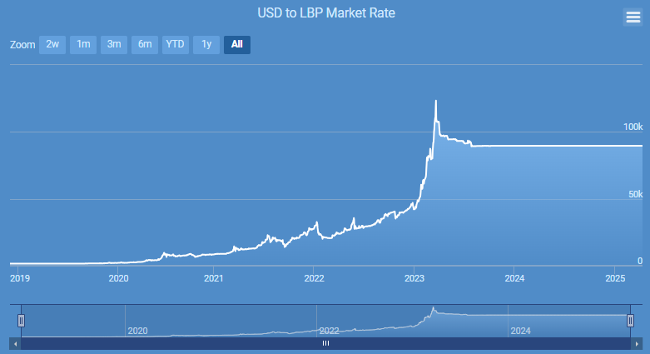
High diesel costs:
18,200 LBP per Gallon 2019
1,332,000 LBP per Gallon 2025
Average inflation rate of 104%
Weakness in Currency : 1$ = 1,500 LL in 2019
1$ = 89,700 LL in 2023

Slide 5
Shortage in water supply
Increase in Subscribers’ complaints:
In 2022, 80% of the registered complaints at SLWE call center were related to water outage
CHALLENGE : SOLUTION?????

Slide 6
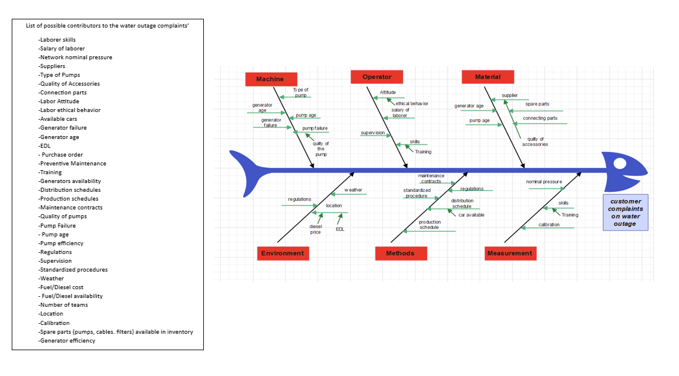

Slide 7
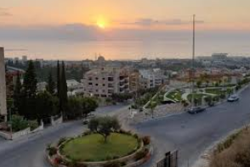
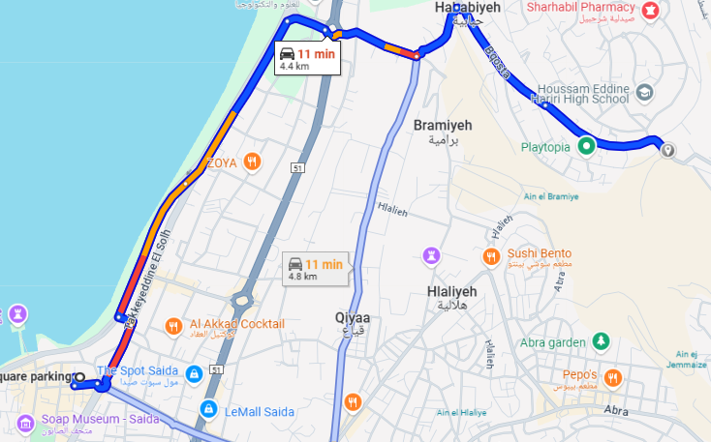
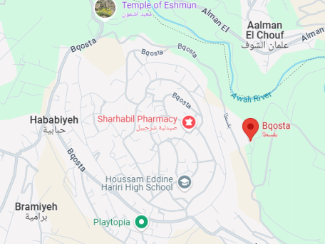
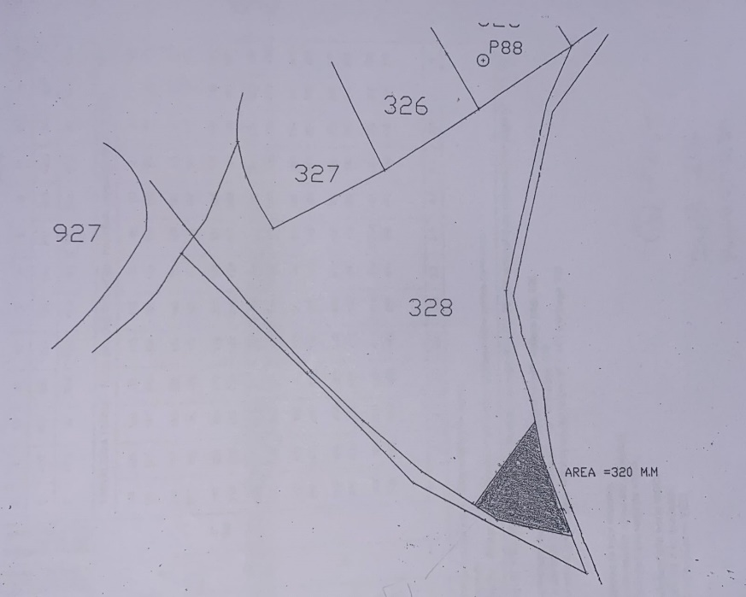
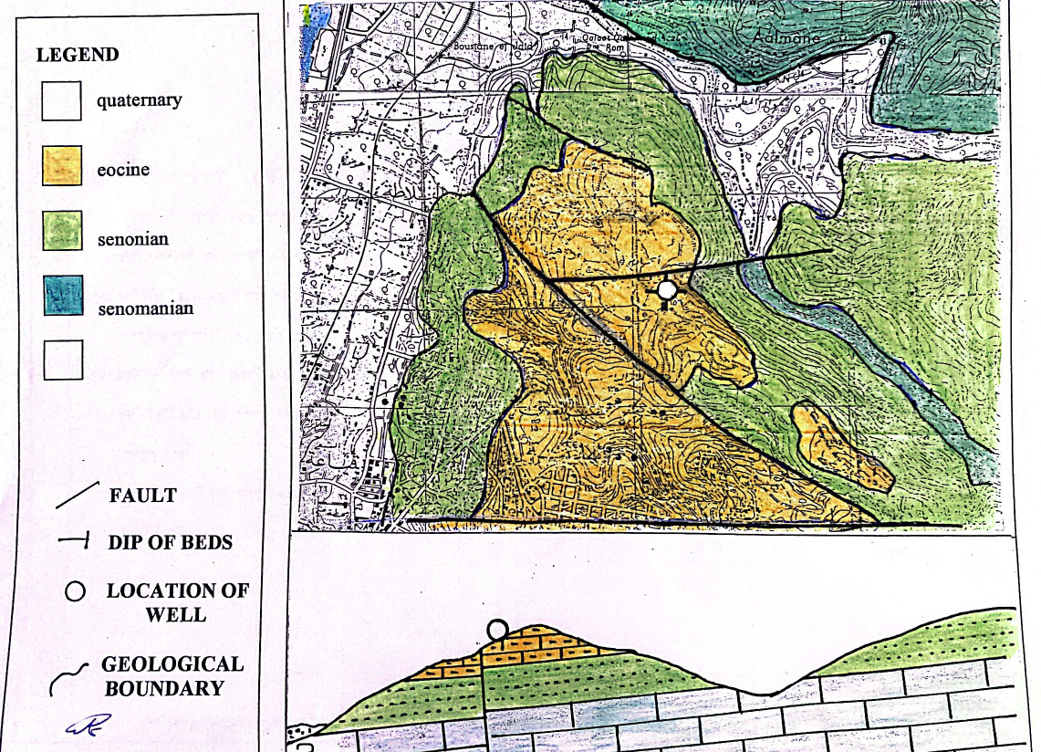
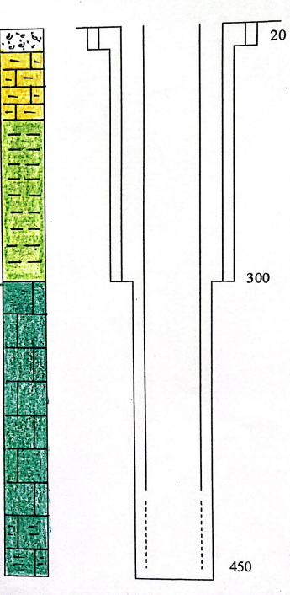
Case Study : Bqosta Water Pumping Station
Bqosta is a village in Lebanon's South Governorate's Sidon District.
It is 50 km from Beirut and only 4.4 km from Saida.
The Lebanese South Lebanon water establishment was
offered a land 320 m² in south Bqosta to construct water wells.

Slide 8
Data Collection
  Investment (capital) Costs
  Energy Costs
  Maintenance Costs
  Operational Costs
  Useful Life
  Demand and supply

Slide 9
Summary of Investment and Maintenance Costs of Bqosta Water Pumping Station
Capital Costs:
 | Water Pumping Station: |  | $288,983
 | Diesel Generator: |  | $3,185
 | PV Solar System: |  | $147,000
Energy Costs:
 | EDL: |  | $0.27 per kWh (+ 11% VAT +$0.6/kVA + $1.12 stamp)
 | Diesel + Transportation |  | $0.86/L - Consumption: 40 L/ hr ; $34.2 /hr
Maintenance Costs:
 | Diesel Generator:
 |  | Every 250 Hours (Oil Change & Filter Replacement):
 |  | Oil Change: | $100.00
 |  | Oil Filter: | $25.00
 |  | Every 500 Hours (Fuel and Air Filter Replacement):
 |  | Fuel Filter: | $50.00
 |  | Air Filter: | $25.00
 |  | Every 1,000 Hours (Cooling System Inspection & Load Bank Testing):
 |  | Cooling System Service: | $150.00
 |  | Load Bank Testing: | $200.00
 |  | Every 2,000 Hours (Coolant Replacement, Battery Check, General Service): | $150.00
 | PV Solar System:
 |  | Regular Inspections ( inverter and electric connections and wiring): | $100/ Visit | once per year
 |  | Cleaning: | $50 per cleaning session | twice per year
 | Pmping Station: |  | ≈ 1.5% of the capital cost

Slide 10
Operational Costs:
 | Supervisor | $1,550 per month
 | Operator/ worker | $700 per month
 | Capital cost | Useful life | Capital recovery
Well: Drilling and Casing | $98,708 | 40 | $2,468
Pumping system | $112,555 | 10 | $11,256
Concrete work | $22,300 | 50 | $446
Diesel Generator | $3,185 | 5 | $637
EDL subscription & installations | $15,420 | 50 | $308
PV solar system | $147,000 | 25 | $5,880
Locomotives | $40,000 | 10 | $4,000

Slide 11
Demand vs Supply:
Subscribers: 2500m³/day 70% of the water supply comes from Bqosta water pumping station
Non-Revenue water: 25% (GIZ Project 2012-2013 : Water Balance in Helaliye, Saida, SLWE)
Water Supply: 2,187.5 m³/day
Two pumps (ᶯ = 0.9%):
Pump1 60 m³/hr 80 hp
Pump2 65 m³/hr 100 hp
Water Supply per hr: 125 m³/hr
Operating hours: 18 hrs

Slide 12
Scenarios & Data Analysis
  Three main Scenarios ( sources of energy) are considered to operate the station, using:
  EDL (24 hrs supply)
  Diesel Generator
  PV solar Systems plus Diesel

Slide 13
Summary of the results under the three Scenarios
Senario1 | EDL
 |  | opearting hrs/day | 18
 |  | Cost/day | 634
 |  | days/year | 365
 |  | Energy cost/year | $257,121 | Energy cost/m3 | $0.32
 |  | Capital recovery (station) | $16,878
 |  | Operational cost | $27,000
 |  | Maintenance cost (station) | $4,095
 |  | Direct production cost/year | $305,093 | Direct production cost/m3 | $0.38
Senario2 | Diesel Generator
 |  | opearting hrs/day | 18
 |  | Cost/day | 599
 |  | days/year | 365
 |  | Energy cost/year | $218,453 | Energy cost/m3 | $0.27
 |  | Capital recovery (station + Generator) | $17,515
 |  | Operational cost | $27,000
 |  | Maintenance cost(station + Generator) | $10,961
 |  | Direct production cost/year | $273,928 | Direct production cost/m3 | $0.34

Slide 14
Senario3 | PV + Diesel Generator
 | Summer Season (days/year) | 240
 | PV | opearting hrs/day | 8
 | Diesel | opearting hrs/day | 9.5
 |  | Cost/day | $325
 |  | Energy cost/year (summer) | $77,976
 | Winter Season (days/year) | 125
 | Sunny | 90
 | PV | opearting hrs/day | 5
 | Diesel | opearting hrs/day | 12.5
 |  | Cost/day | $428
 | Not Sunny | 35
 | PV | opearting hrs/day | 0
 | Diesel | opearting hrs/day | 17.5
 |  | Cost/day | $599
 |  | Energy cost/year(winter) | $59,423
 |  | Energy cost/year (Diesel only) | $137,399
 |  | Capital recovery (PV) | $5,880
 |  | Maintenance cost (PV) | $200
 |  | Capital recovery (station + Generator) | $17,515
 |  | Operational cost | $27,000
 |  | Maintenance cost(station + Generator) | $8,414
 |  | Direct production cost/year | $196,407 | Direct production cost/m3 | $0.246
Source of energy | Opearting Hours /Year
Diesel Generator | 6,388
PV with Diesel Generator
PV solar system | 2,370
Diesel Generator | 4,018

Slide 15
Source of energy | Direct production cost/m3
EDL | $0.382
Diesel Generator | $0.343
PV with Diesel Generator | $0.246
28.3%
Source of energy | Energy Cost (Diesel only)
Diesel Generator | $218,452.500 | 37.10%
PV with Diesel Generator | $137,398.500 | $81,054
Savings
Source of energy | Energy Cost per hour
EDL | $36.24
Diesel Generator | $34.20
PV Solar System | $2.57

Slide 16
Conclusion
  The results of the study showed that the PV solar system combined with diesel operation is the most cost-effective option, with a direct production cost of $0.246 per cubic meter.
  The study clearly demonstrated that investing in photovoltaic (PV) solar systems significantly reduces the direct costs associated with water production by 28% when compared to traditional diesel generator-based systems.
  The investment in the PV solar system resulted in an 82% reduction in complaints between 2021 and 2023
  This study reflects the importance of renewable energy as a solution for both economic and energy problems
  The adoption of solar technology not only offers a more stable and predictable operational expense over time but also lessens dependence on fluctuating fuel (diesel) prices.

Slide 17
Recommendations
  Importance of Sustainability and Environmentally Friendly Solutions
  PV solar systems: Sustainable energy solutions
  environmental conservation solutions.
  By investing in sustainable technology, PV solar systems, we ensure not only cost-efficiency but also the protection of natural ecosystems for future generations.
  Policy and decision makers in various fields can benefit from these findings by making more informed strategic decisions that focus on the use of renewable energy, such as PV solar systems, as a sustainable solution in water pumping projects especially in areas facing energy and economic crises.

Slide 18
THANKS

