Slide 1
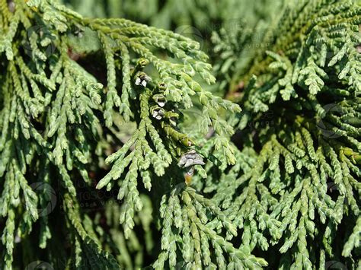

POTENTIAL ROLE OF PLATYCLADUS ORIENTALIS IN REDUCING URBAN PM2.5 AND PAHS
Enhancing Air and Runoff Water Quality in Amman

Slide 2
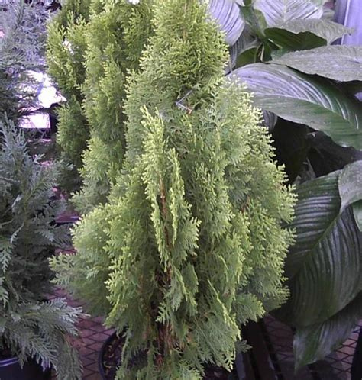

INTRODUCTION
  Urbanization increases PM2.5 and PAH emissions in Amman.
  PM2.5 is linked to respiratory illness and lung cancer.
  PAHs bind to PM2.5 and contaminate air and runoff water.

Slide 3

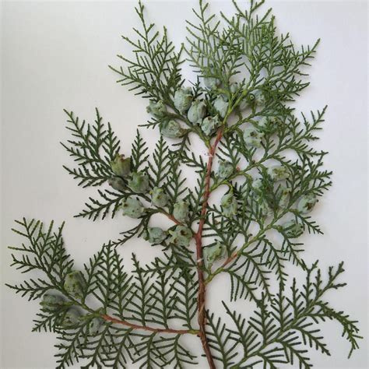
OUR VISION & MISSION
  Evaluate the ability of Platycladus orientalis to reduce PM2.5.
  Estimate impact on PAH runoff pollution.
  Focus on Al-Urddon Street, a traffic-heavy area in Amman.

Slide 4
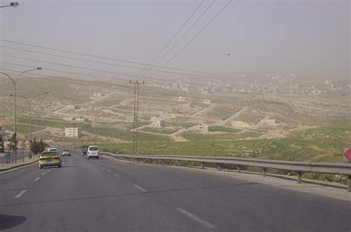
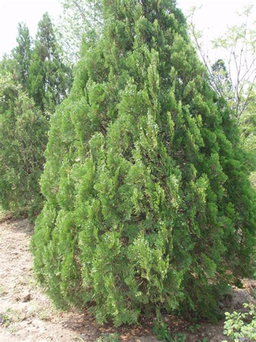
STUDY AREA & SPECIES
  Al-Urddon Street selected due to high emissions.
  Platycladus orientalis is drought-tolerant and locally adapted.
  High particulate trapping potential and robust growth.

Slide 5
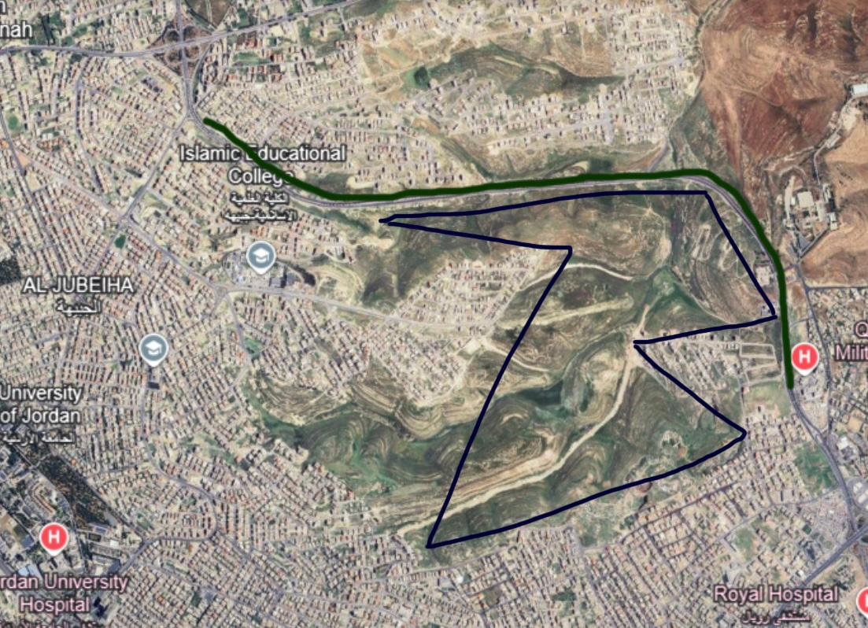
STUDY AREA

Slide 6
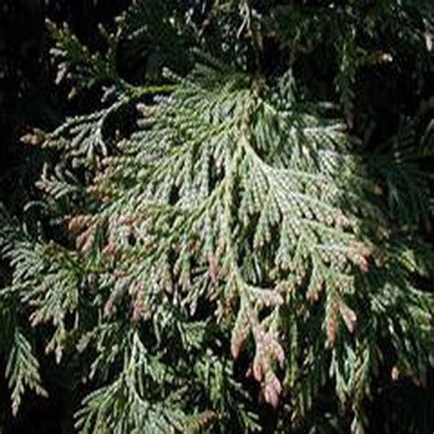
METHODS
PM2.5 concentration data from local monitoring (36 μg/m³).
Literature review on phytoremediation and air quality.
GPS mapping to locate planting area (1.78 km² strip).

Slide 7
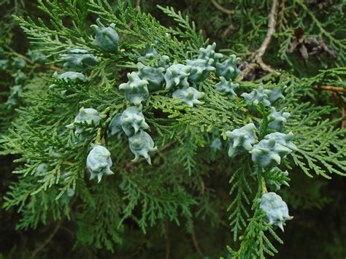
PM2.5 RESULTS
  Each tree captures ~78.6 g of PM2.5 annually.
  only one tree every 12 meter is planted along the street.
  This helps lower pollution below Jordan's 15 μg/m³ standard.

Slide 8
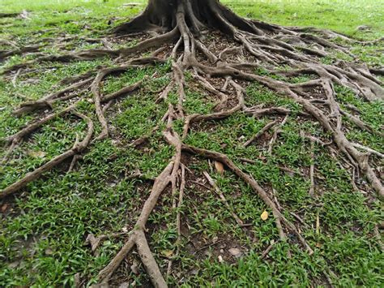
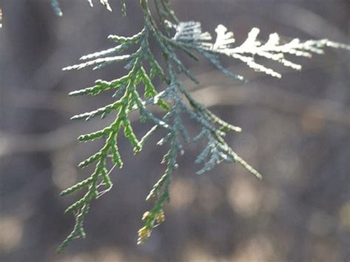
PAH RESULTS
  PAHs decrease as PM2.5 is captured by leaves.
  Root zones improve water infiltration and pollutant breakdown.
  Also enhances cooling, biodiversity, and urban aesthetics.

Slide 9
Temperature regulation via evapotranspiration reduces heat
ENVIRONMENTAL & SOCIAL CO-BENEFITS
Improved urban aesthetics encourages public engagement
Biodiversity support: Provides microhabitats for microorganisms and insects
Mental health boost: Proven links between green spaces and stress reduction

Slide 10
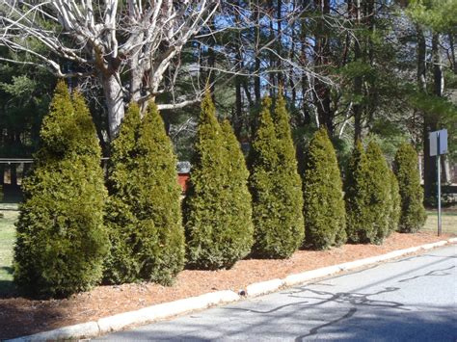
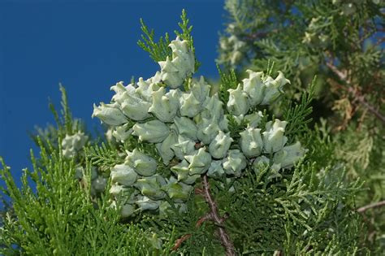
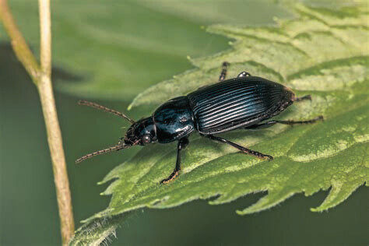
ENVIRONMENTAL & SOCIAL CO-BENEFITS

Slide 11

LIMITATIONS & Future Recommendations
  Limited local PAH degradation data.
  Need for land access and ownership resolution.
  Modeling accuracy affected by data gaps.
  Further research on environmental challenges.
  Combine green infrastructure with community awareness.
  Scale up based on validated success.

Slide 12

THANK YOU
Questions and discussion welcome
See numbered citations in poster.

