Slide 1








From Standards to Finance
Operational Business Models for DEWATS & circular resource approaches as climate change adaptation option in Agriculture, North Jordan
Dr.-Ing. Tatjana Schellenberg,
Regional Technical Manager at BORDA West and Central Asia
7th Arab Water Week, 4th – 6th May, 2025

Slide 2



























Findings from project performed under the NDC Action umbrella focusing on:
„DWATS as climate change adapation option for smallholder farmers in North Jordan“

Slide 3
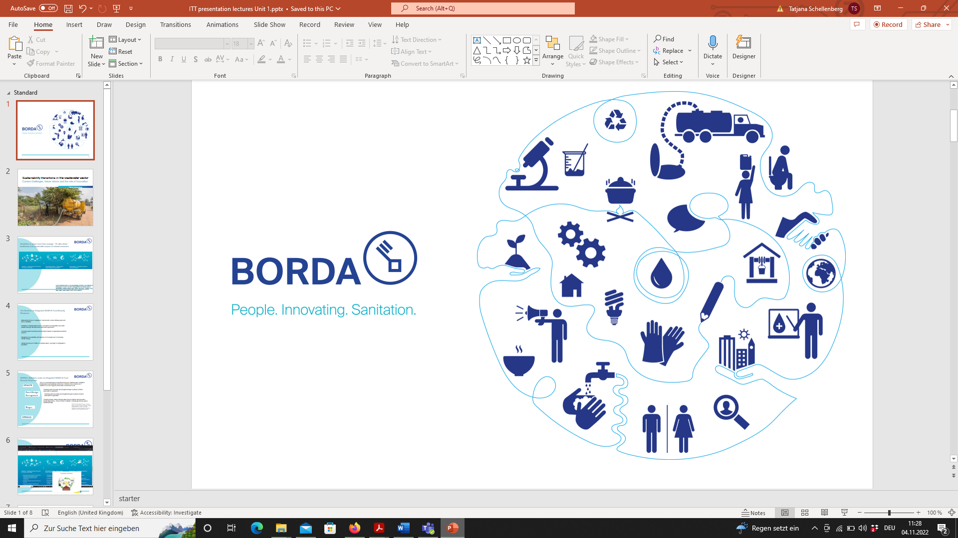

Short Introduction BORDA
People. INNOVATING. Sanitation.
Bremen Overseas Research and Development Association (BORDA), Not-for-profit German NGO founded in 1977
Expert organization in the field of sanitation, innovation, and integrated resources management / wastewater NEXUS
OUR MISSION
To improve the living conditions of disadvantaged communities and protect the environment through expansion of Basic Needs Services in areas of decentralized sanitation, solid waste and wastewater management, water and energy supply.
People. INNOVATING. Sanitation.

Slide 4
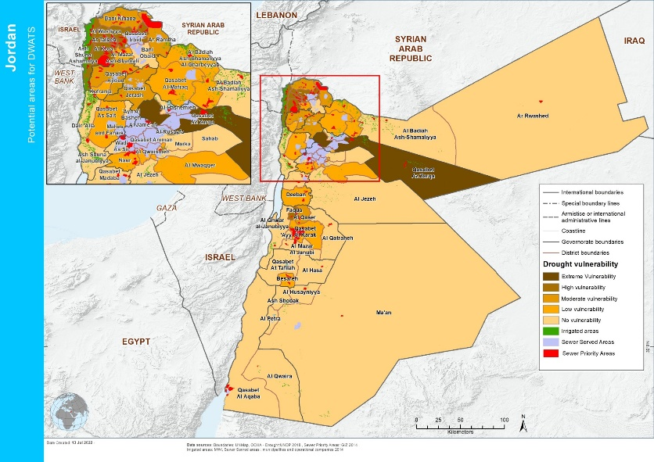
Project Overview & Objective
Problem Structuring &
Conceptual Background of NDC Project
416 mio. m³/a
of renewable water supply deficit in Jordan.
(UNEP, 2021 – NDC Action Project Report)
Jordans harsh climate perpetuated by climate change is increasingly affecting
→ Agricultural water supply & productivity, food security
→ Heightened poverty risk for smallholder farmers
Wastewater contains valuable water, nutrient, and energy resources & has immense potential to address rising environmental challenges / climate change mitigation
People. INNOVATING. Sanitation.

Slide 5









Short Introduction
Combat pollution & WASH related diseases via increased hygiene by decentralized wastewater, faecal sludge & solid waste management solutions & capacity building
DEWATS
Increase water security through recycling of treated nutrient rich wastewater for irrigation in agriculture
FSM/FSTP
Improve soil health & food security through innovative integrated resource approaches and recycling of nutrients
Address climate change through more sustainable nature-based sanitation with minimized resource inputs + enhanced resource outputs; & capture GHG to produce biogas
BIOGAS
Enable access to fertilizer through production of compost from recycling streams of organic waste & faecal sludge
DESWAM
Support broader sectoral development 4 all and address financial deficits, with robust systems that last, have a low O&M requirement, are low costs, and enable additional revenue streams via circular resource approaches
People. INNOVATING. Sanitation.

Slide 6












Principles: WW-WEF Nexus
Addressing rising water insecurity, land degradation & food insecurity, and climate change
through circular resource approaches, resource sensitive systems, and climate change adaptation/mitigation measures
Irrigation with treated nutrient rich wastewater; application of soil conditioning and fertilizing compost in agriculture
Collection, treatment & co-composting of organic waste & faecal sludge
Domestic / wastewater, cow dung, etc.
WWTP / DEWATS / FSTP / Biogas digestion, etc.
→ Treatment for safe reuse of water, nutrients & energy
→ Reduced material footprint & costs, while enhancing resource output + finances
People. INNOVATING. Sanitation.

Slide 7

Project Overview & Objective
Overarching Goal & Intervention
Enhance resilience of vulnerable smallholder farmers to climate risks & food insecurity
Adaptive measure: establishing decentralized wastewater treatment & use of non-conventional water source
Objective of this Project
This project aimed to address the gaps in assessment of market, technology, & potential business models to accelerate the adoption of decentralized wastewater treatment systems (DWATS) as non-conventional water source in Jordan.
People. INNOVATING. Sanitation.

Slide 8
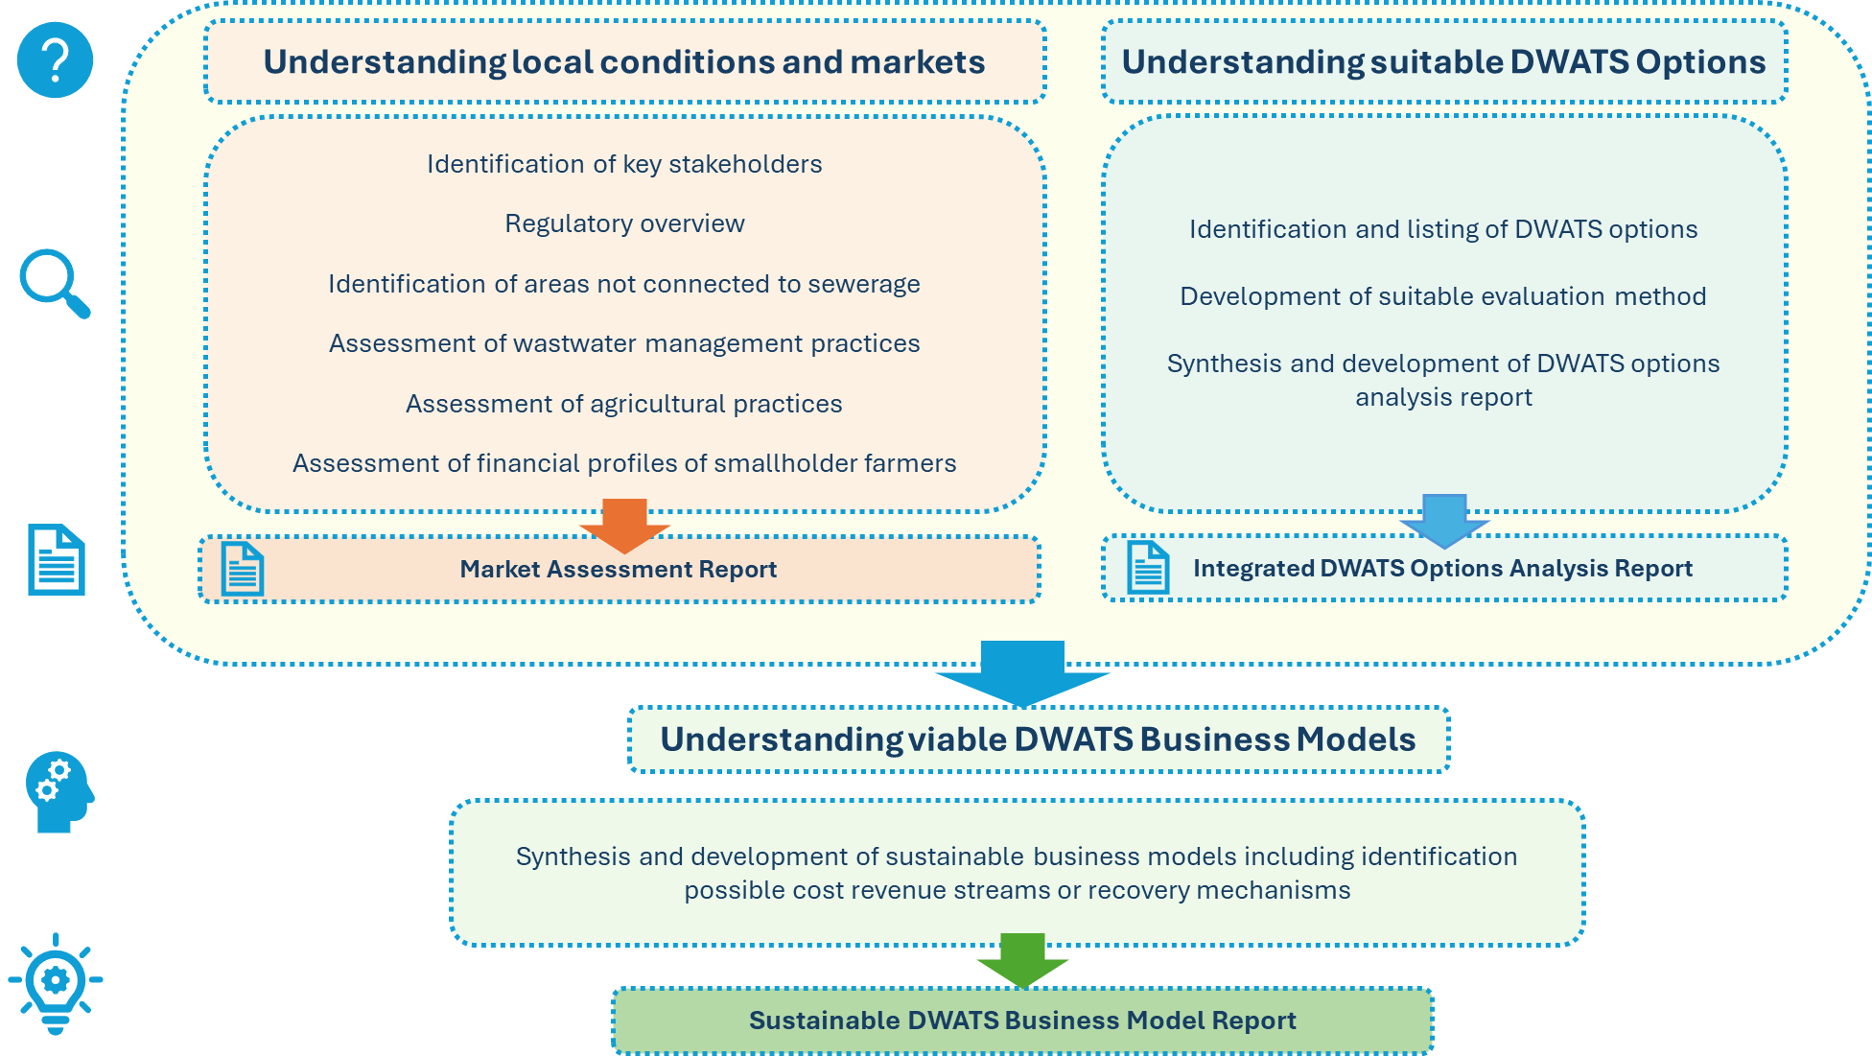
Breakdown of Intervention Components
People. INNOVATING. Sanitation.

Slide 9
OC 1: Results of Regulatory Overview
 |  | JS 893/2021 |  |  | JS 893/2006 |  |  | MWI, 2016 Systems <500 / <5000*
Parameter | Unit | Class A (parks, playgrounds and side roads inside cities) | Class B (Fruit trees, sides of roads outside the cities, and green areas) | Class C (Industrial crops, field crops, and forest crops) | Class A (Cooked vegetables, parks, playgrounds and side roads inside cities) | Class B (Fruit trees, sides of roads outside the cities, and green areas) | Class C (Industrial crops, field crops, and forest crops) | Infiltration trench for trees | Drip irrigation | Open irrigation
pH |  | 6-9 | 6-9 | 6-9 | 6-9 | 6-9 | 6-9 | 6-9 | 6-9 | 6-9
BOD5 | mg/l | 30 | 100 | 200 | 30 | 200 | 300 | - | - | -
COD | mg/l | 100 | 200 | 300 | 100 | 500 | 500 | 150 | 150 | 150
TSS | mg/l | 50 | 100 | 100 | 50 | 200 | 300 | 50 | 50 | 50
TN | mg/l | 70 | 70 | 70 | 45 | 70 | 100 | -/70* | -/70* | -/70*
NO3-N/NO3 | mg/l | 16 | 16 | 16 | 30 | 45 | 70 | - | - | -
NH₄ | mg/l | - | - | - | - | - | - | - | - | -
PO4-P/ PO4 | mg/l | 10 | 10 | 10 | 30 | 30 | 30 | - | - | -
E. Coli | MPN/100ml | 100 | 1000 | - | 100 | 1000 | - | - | 1000 | 100
→ Lack standards for small scale systems. While recommended in DWAM Policy (2016), 1 single set of standards remains.
People. INNOVATING. Sanitation.

Slide 10
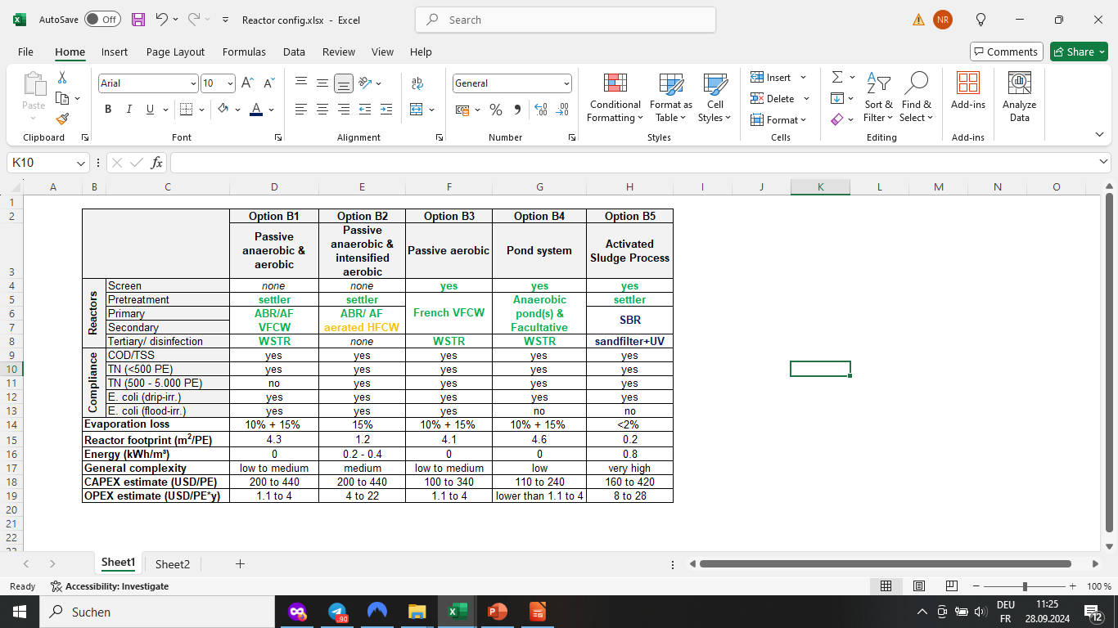
OC 2: Results Technology Options
Technology Evaluation performed for following pre-selected options under 2 regulatory scenarios :
Scenario B: MWI, 2016
Scenario A: JS 893/2021
Requires advanced denitrification
Large reactor volumes
Recirculation of ww
Additional aerators/pumps
Complex process control
Requires advanced P removal, dosing of precipitants & complex process control.
None stated on left, only advanced SBR process with additional processes for nutrient removal
People. INNOVATING. Sanitation.

Slide 11
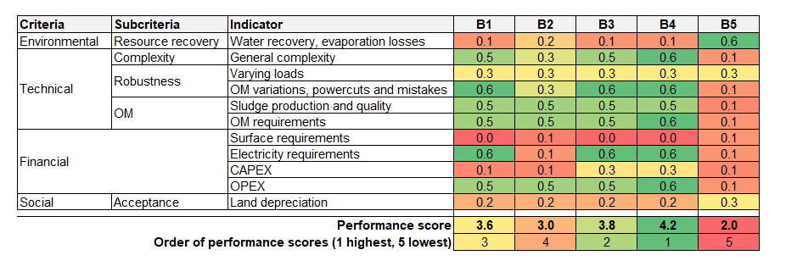
OC 2: Results Technology Options
Calculating performance scores/ Compare/ Evaluate (following the WSM as proposed by CLUES of Eawag)
Either technology could be the best applicable solution for a specific location
In general passive and nature-based solutions were found to score by far best with the selected criteria, which strongly emphasise O&M requirements
Varying indicator weights show that results are robust (performance scores stay in same order)
Conclusion: The best technology depends on context-specific needs, balancing cost, simplicity, and efficiency
People. INNOVATING. Sanitation.
Notes:
The final performance scores are shown here
With ponds scoring best and the high-rate SBR system worst
Either of these techn. could be the best applicable solution for a specific location

Slide 12
OC3: DWATS Business Models
Two Analysis Foci
Financial Feasibility Analysis
Focusing on DWATS options profitability and cash flows (CAPEX & OPEX in relation to revenue streams via treatment fees, service costs savings through avoided costs such as cesspit emptying, and selling of treated effluent for irrigation)
Economic Feasibility Analysis
Extends to environmental and social benefits, e.g. improved water quality, water value added through available water resources for irrigation and improved harvest, circular resources approaches (nutrients in TWW), public health, and job creation
Methodology: Monte Carlo Simulation; Benefit-Cost Analysis & Cost Effectiveness Analysis
Key Metrics: CAPEX & OPEX, NPV, IRR, benefit/cost ratios, AIC/AIB – CAPEX/OPEX, Total AIC/AIB, Payback period
Baseline: North Jordan, 5000 PE system size (only wwtp given regional focus), 30 years system lifetime, analysis for 2 scenarios: A (standards 2021) and scenario B (DWAM 2016),
People. INNOVATING. Sanitation.
Notes:
Financial Analayis:
Wastewater collection fees: 0,17USD/m³ (1-1,5% of disposable household income, Worldbank, etc)
Avoidance cost (cesspit emptying): 1USD/m³ (14USD per 14m³ tanker size)
Selling of treated effluents for irrigation: for simplicity assumed 0,14 USD/m³ (including irrigation infrastructure) – this is higher than now tarif of around 0,7 USD (50 fils/m³)

Slide 13
OC 3: Results DWATS Business Model
CAPEX & OPEX ranges estimate from OC2
Metric | Standards 2021 | Recommended standards DWAM 2016
 | Option A.1 | Option B1 | Option B2 | Option B3 | Option B4 | Option B5
 | Activated sludge + advanced nutrient removal | Passive anaerobic & aerobic | Passive anaerobic & intensified aerobic | Passive aerobic | Pond system | Activated sludge process
CAPEX (USD/PE) | 240 to 630 | 200 to 440 | 200 to 440 | 100 to 340 | 110 to 240 | 160 to 420
Max | 630 | 440 | 440 | 340 | 240 | 420
Min | 240 | 220 | 200 | 100 | 110 | 160
Avg | 435 | 330 | 320 | 220 | 175 | 290
OPEX (USD/PE*y) | 16 to 56 | 1.1 to 4 | 4 to 22 | 1.1 to 4 | <1.1 to 4 | 8 to 28
Max | 56 | 4 | 22 | 4 | 4 | 28
Min | 16 | 1.1 | 4 | 1.1 | 1 | 8
Avg | 36 | 2.55 | 13 | 2.55 | 2.5 | 18
People. INNOVATING. Sanitation.

Slide 14
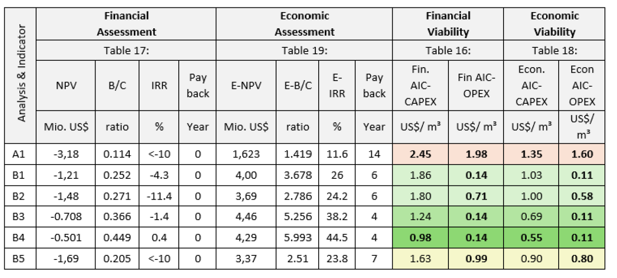
OC 3: Results DWATS Business Models
In Financial Analysis, none of options demonstrated financial viability under current fees, service cost avoidance and selling price of TWW
Low to high economic viability
High variance between standards scenario and respective technology options, while most viable option under scenario B - B4
People. INNOVATING. Sanitation.

Slide 15
Results: Summary
Financial and Economic Viability:
From a socio-economic perspective, investment in sanitation brings enormous return to population. 6 DWATS options analyzed using Benefit-Cost (B/C) Analysis & Cost-Effectiveness showed potential for long-term economic sustainability.
              While high economic potential, very high differences depending on standards and technology options.
              Overall socio-economic gains likely considerably higher, but persisting difficulty in overall assessment.
Sustainability & Cost Recovery:
operational Business models emphasize tariffs, user fees, and public-private partnerships (PPP) under circular approaches to ensure cost recovery. However, current restrictions in biosolids management and circularity.
Adaptation to Climate Change:
DWATS can support climate adaptation & agricultural resilience by providing reuse options for treated wastewater resources, aiding smallholder farmers in water-scarce regions. Further high potential for climate mitigation measures.
People. INNOVATING. Sanitation.

Slide 16






Results: Recommendations Forward
Adopt hybrid governance models, incorporating PPP, encourage private sector participation through financial incentives such as subsidies, tax reliefs, and incentivizing service contracts, etc.
A differentiated set of standards for smaller system capacities (as valid in other regions), along with considerations towards improved resource circularity in various applications // Nexus management → enabling wider climate mitigation
High % of unconnected localities in North of Jordan. If standards do not align with financial budgets or economies of remote areas & respective development plans, risk of inaction. Recommended gradual standardization along feasible development plans & budgets.
Conduct broad feasibility studies on local level for various communities to understand detailed and overall infrastructural solutions (including sewerage)
Implement a flagship pilot as living lab and demonstration site towards viable operational models, awareness campaigns, research for further scaling (e.g. low O&M intensive systems could be clustered), detailed financial analysis under integrated resource approaches, etc.
Need for elaborated Life Cycle Assessments/technology evaluation matrices to better understand climate mitigation measure + improve decision making to technology choice; inclusion of wider sustainability parameters & GHG mitigation
People. INNOVATING. Sanitation.
Notes:
In Irbid 50,8% unconnected households, in Jerash 41,4 unconnected households, and in Ajloun 46,9% unconnected
This makes 1,312,877 people not connected out of 2,633,900 total population

Slide 17
Thank you!
Any questions?
Dr.-Ing. Tatjana Schellenberg
Contact: Schellenberg@borda.org

