Slide 1




Current Situation of the GIS/ MWI Department and its development plan
Thair M. AL Momani May 2025

Slide 2
geographic Information Systems (GIS)
geographic Information Systems (GIS) are essential for groundwater management, offering powerful tools to visualize, analyze, and monitor changes in water resources.
Thanks to the technical support of the Federal Institute for Geosciences and Natural Resources (BGR) we were able to develop key groundwater maps that enhance decision-making and resource sustainability.
Key Benefits of GIS in Water Management:
• Visualizing groundwater levels and flow directions over time.
• Monitoring extraction from main well fields.
• Tracking water level changes at monitoring wells and identifying aquifer outcrops.
• Assessing saturated zone thickness for storage evaluations.
• Mapping groundwater depth to support planning and protection efforts.

Slide 3
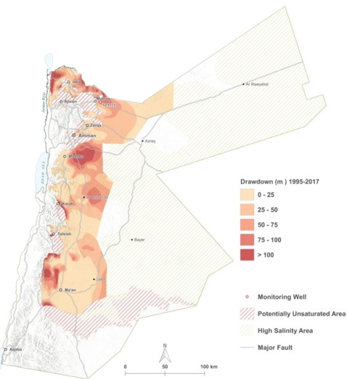
Groundwater Drawdown Map
The groundwater drawdown map illustrates the areas where significant decreases in groundwater levels have occurred over time, typically due to excessive extraction.
This information is crucial for assessing the impact of groundwater use, planning recharge initiatives, and implementing sustainable water management practices.

Slide 4
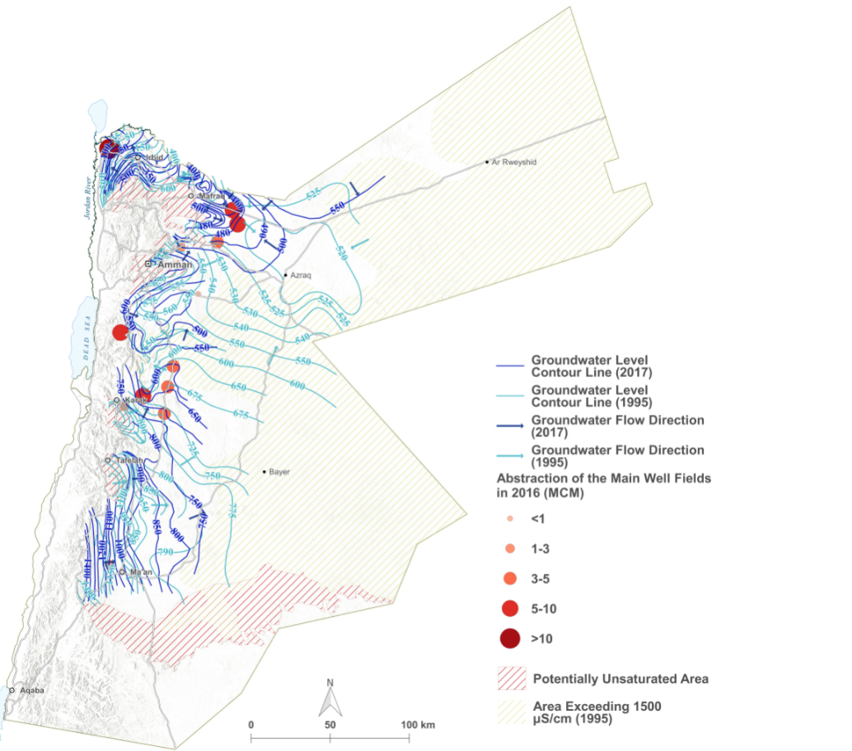
Groundwater Level Contour Maps and General Flow Direction (1995 & 2017)
These maps allow for the comparison of groundwater trends over time, revealing changes in water table levels and shifts in groundwater flow patterns. Such insights are vital for assessing aquifer health, understanding recharge-discharge dynamics, and planning groundwater extraction sustainably

Slide 5
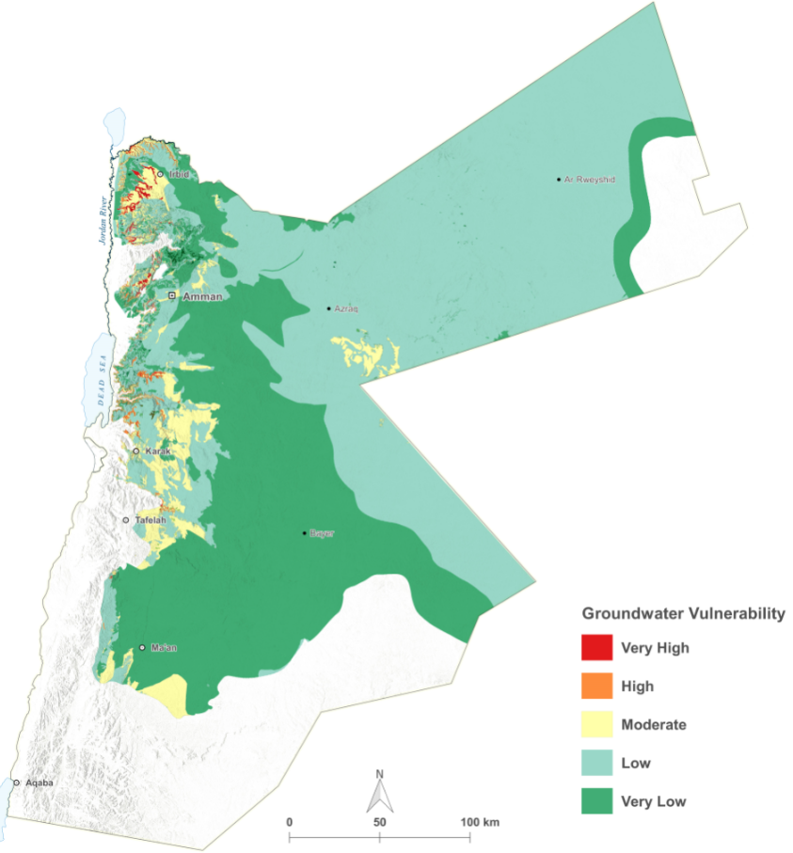
Groundwater Depth Maps
Depth-to-water maps assist in understanding the accessibility of groundwater resources, estimating pumping costs, and identifying areas at risk of groundwater decline or contamination.

Slide 6
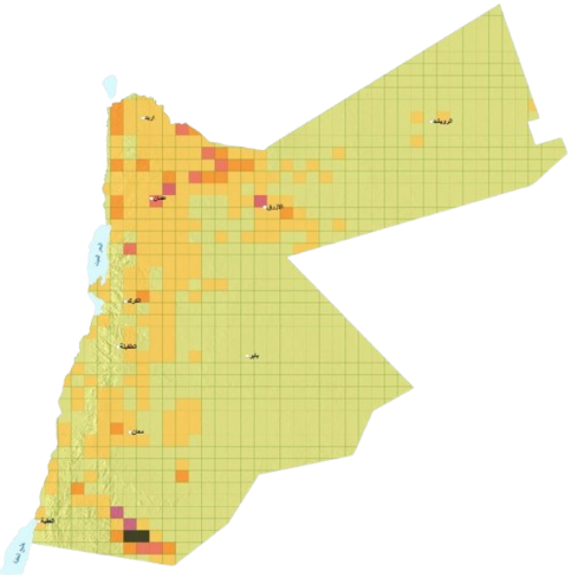
Current Functions and Workflows
The GIS Department undertakes key responsibilities:
Geospatial Data Collection and Management: Systematic gathering, updating, and storage of spatial data.
Mapping and Cartography: Creation of thematic maps for groundwater, climate monitoring, and Wells productivity.
Spatial Analysis: watershed delineation, and impact analysis.

Slide 7

Current Functions and Workflows
The GIS Department undertakes key responsibilities:
GIS-Based Decision Support: Tools assisting strategic and operational decisions.
Database Management and Integration: accessible, and consistent data repositories.
Collaboration: Partnerships with governmental, academic, and international entities.

Slide 8
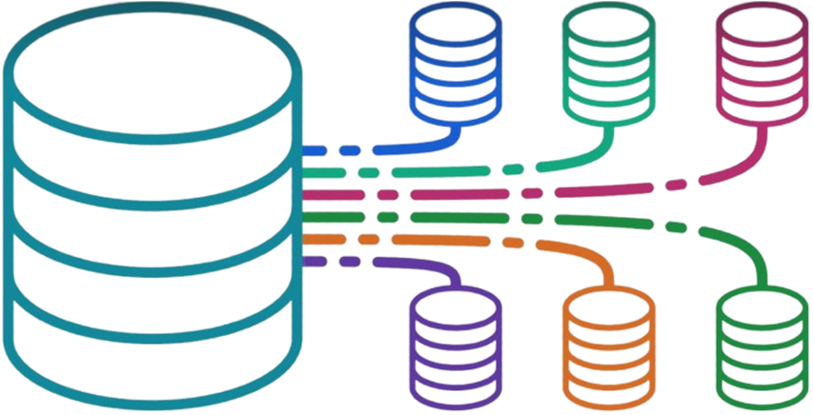
Available Data
The GIS section manages and develops two main types of data:
Regularly Updated Datasets This data is created within the organization through internal correspondences and communications. It involves collecting data, processing it, and integrating it into GIS databases.
External Update Required This type of data is obtained in collaboration with external entities. The GIS team sends official requests to these organizations, obtains data in different formats (such as shapefiles, Excel, ..), and processes it to be compatible with the internal GIS systems..

Slide 9
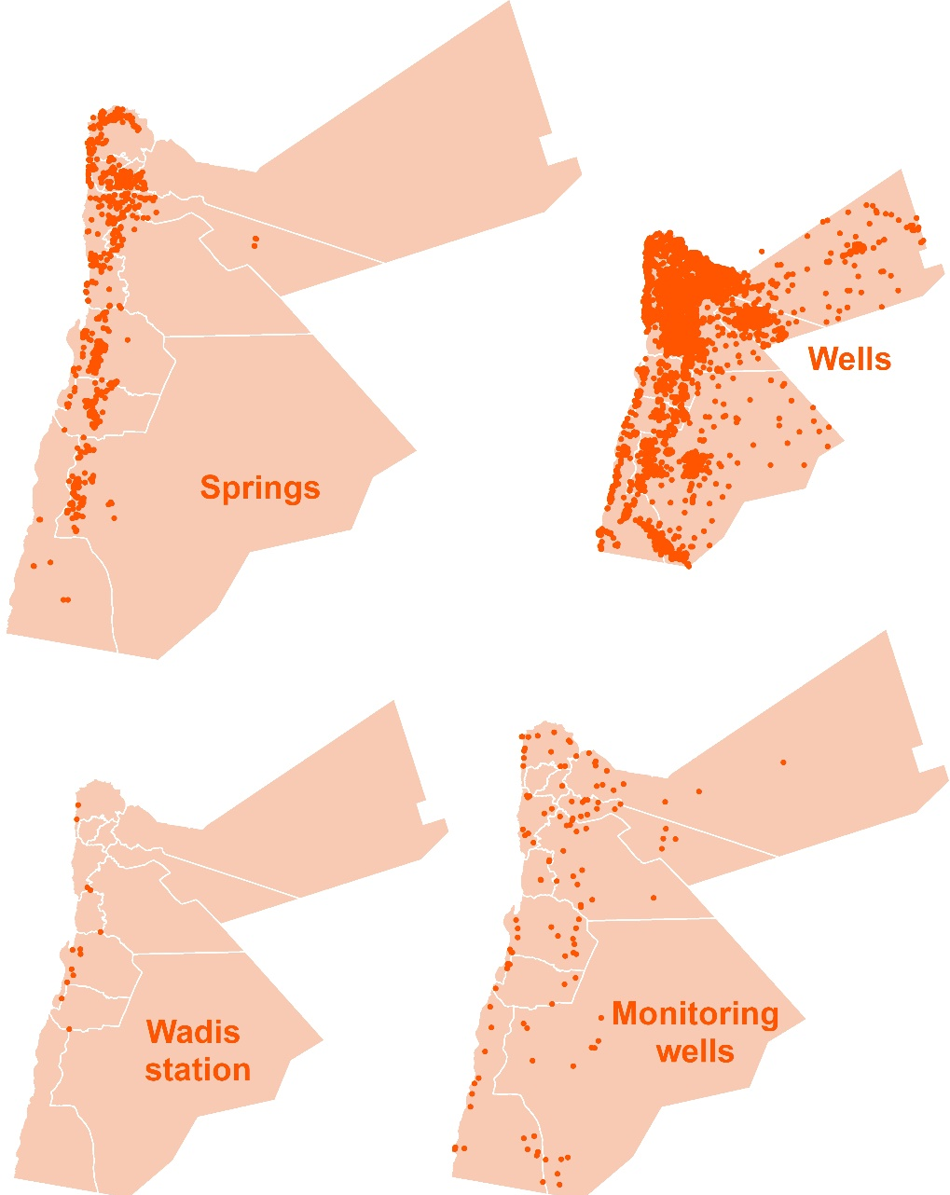
Available Data - Regularly Updated Datasets
The GIS Department maintains and regularly updates:
Wells: Locations, depths, water levels, operational status.
Springs: Discharge volumes, seasonal changes, geographic spread.
Climate Stations: Historical and real-time data on temperature, rainfall, and humidity.
Telemetry Stations: Live hydrological monitoring.
Manual Monitoring Stations: Water quality and level measurements.
Runoff Stations: Surface water movement and watershed data.

Slide 10
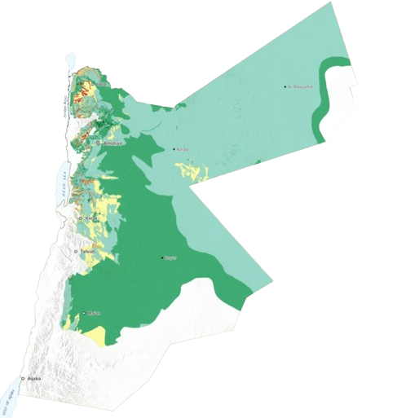
Available Data - External Update Required
Datasets requiring collaboration and external updates include:
Dams: Capacity, condition, water levels.
Excavations and Canals: Infrastructure status.
Digital Elevation Models (DEMs): High-accuracy terrain data.
Wadis: Seasonal riverbeds and hydrological significance.
Wastewater Treatment Plants: Locations, capacities.
Water and Sewer Networks: Distribution maps and performance indicators.
Desalination and Pump Stations: Operational data.
Water Facilities: Reservoirs and distribution hubs.
Topographical data: Contour lines, soil types, geological faults.
Administrative Boundaries and Hydrological Features: Basins, watersheds, isohyets.
Land Use and Land Cover: Urbanization and vegetation dynamics.
Vulnerability map

Slide 11
Current Situation and Challenges
The department faces several challenges:
Limited Technical Resources: Outdated computers, weak network infrastructure.
Old GIS Software: Restricts use of advanced tools like AI and cloud GIS.
Fragmented Data Management: Lack of a centralized system causing inefficiencies.
Manual Processes: Absence of automation for spatial analysis and cartography.
Outdated Datasets: Delayed updates affect decision-making accuracy.

Slide 12
Current Situation and Challenges
The department faces several challenges:
Data Security Gaps: Risk of unauthorized access and cyber threats.
Lack of Advanced Decision Support: No integrated predictive and scenario-based analysis tools.
Limited Integration: Insufficient data sharing with national and international platforms.
Skills Gap: Need for advanced training in AI, Remote Sensing, Python scripting, and cloud-based GIS.

Slide 13

Alignment with National Strategies
The department’s digital transformation aligns with:
National Digitalization Strategy:
- Drive digital transformation across sectors.
- Foster innovation, accessibility, and service efficiency.
National Cybersecurity Strategy:
- Protect digital assets and infrastructure.
- Enhance technical capabilities and collaboration for cybersecurity.
Both frameworks aim to ensure secure and sustainable digital evolution.

Slide 14

Future Vision for the GIS Department
Establish a fully equipped GIS office furnished with essential infrastructure, including workstations, large display screens, mapping tools, and specialized GIS hardware and software, to support operational efficiency and data visualization needs.
Building a Centralized GIS Platform: Seamless data integration and real-time updates.
Design and implement a unified and flexible data model that facilitates seamless integration with national and international standards, while supporting future expansions and the development of various GIS applications.
Develop secure and user-specific data dissemination applications to ensure efficient sharing and accessibility of spatial information within the water sector, based on clearly defined access permissions.

Slide 15
Future Vision for the GIS Department
Establish and cultivate a highly skilled technical team capable of performing database management, application development, data quality assurance and control, and sustaining GIS operations according to best practices.
Ensure high standards of data quality and adopt standardized work methodologies to guarantee the accuracy, consistency, and reliability of all geospatial and non-geospatial datasets.
Continuously adapt to rapid technological advancements worldwide, especially emerging technologies in the GIS and water management fields, to maintain a leading position in digital transformation initiatives.

Slide 16

Conclusion
The GIS Department is a strategic enabler for effective water resource management and sustainable development.
Investing in GIS modernization will lead to smarter operations, stronger planning capabilities, and enhanced service delivery aligned with national goals.
We extend our sincere thanks to GIZ for their future support in helping us develop and enhance our GIS capabilities to achieve a more advanced and sustainable water management system

