Slide 1



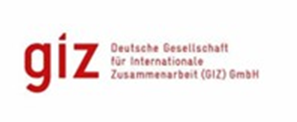


Advancing Sustainable Sanitation in Jordan: Lessons from Project Evaluation and Technical Innovations in Wastewater Treatment Plants
7th Arab Water Week
Jordan – Dead Sea

Slide 2



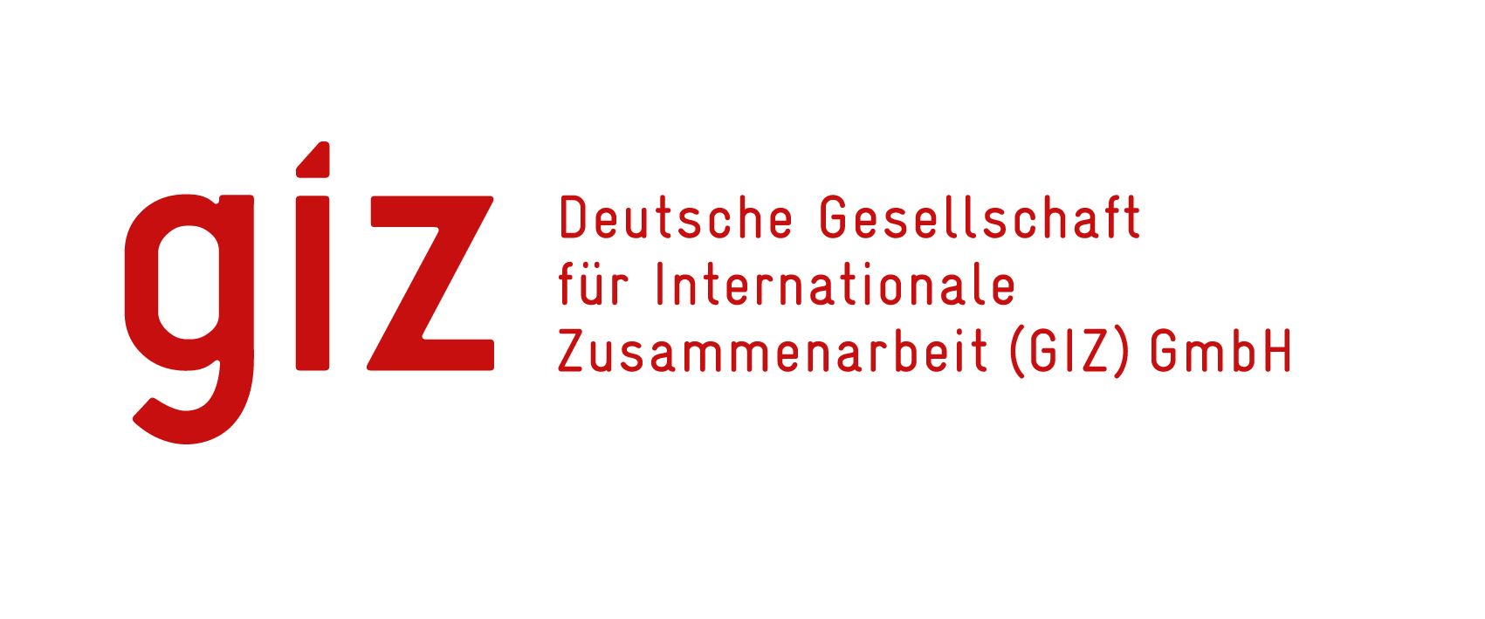
Sustainable Sludge Management in Jordan
Unlocking the potential of sludge in Jordan

Slide 3



Project Level Outputs
Improving environmental and economic sustainability of sewage sludge management in Jordan
CO2
Demonstration of Upcycling Solutions and reduced CO2eq
Markets for Upcycled Products & reduced costs
Regulatory Framework and Enabling Conditions
Notes:
Suhaib

Slide 4
Output 1: Demonstration of Upcycling Solutions
Achievements
Mapping of sludge product. & site location for implementation is determined.
Feasibility and Technology selection.
Design and tender documents for SDGH for Wadi Musa and Muta Mazar WWTPs are finalized
Pelleting plant at Muta Mazar is producing.
Sludge quality profile is created and ongoing.
Technical Visit was conducted for sludge upcycling technologies in Germany.
Construction of a solar drying plant in Muta Mazar.
Sludge quality analysis until January 2025.
Notes:
Suhaib

Slide 5
Output 2: Markets for Upcycled Products
Achievements
Pyrolysis Prototype results have been reported and shared with partner (Biochar meets IBI and WBC Guidelines).
Samples of Sludge Pellets were produced.
Market Assessment Study (incl. Export of Biochar) has been prepared and approved
Promoting sales in the national market, especially of sewage sludge pellets.
Promoting sales in the national market, especially of sewage sludge pellets.
80 kg Biochar was provided to NARC for further research of Biochar reuse in land application.
Notes:
Suhaib

Slide 6
Output 3: Regulatory Framework and Enabling Conditions
Achievements
Arab Water Week – Regional Dialogue
Draft Biochar and Energy Carrier for Industrial Reuse Standard Recommendations approved by Steering Committee and submitted to JSMO
Draft Standard Recommendations for sludge and biochar reuse in land application approved by Steering Committee and submitted to JSMO
Supporting WAJ Labs in developing SOPs and equipment
Initial Carbon Market analysis for biochar.
Follow up with JSMO on Standard Approval
Support in establishing Coordination Mechanism within WAJ on Sludge Management
Dashboard prototype for sludge mapping handover to WAJ Governance Platform
Notes:
Nadine

Slide 7
Reflecting on The Evaluation of Sustainable Sludge Management Project:
Key Findings and Recommendations
Bassam Hayek and Hans Hartung – 5/5/2025

Slide 8
Central Project Evaluations
Purpose
Context
Assessment of projects implemented by GIZ on behalf of BMZ
Analyse achievement of results, steering processes, stakeholder relationships, the quality of service delivery and the links between results (hypotheses)
80-100 central project evaluations per year
Reports will be available online: www.giz.de/knowing-what-works - GIZ evaluations in the GIZ database for evaluations
Support evidence-based decision-making
Promote transparency and accountability
Facilitate organisational learning

Slide 9
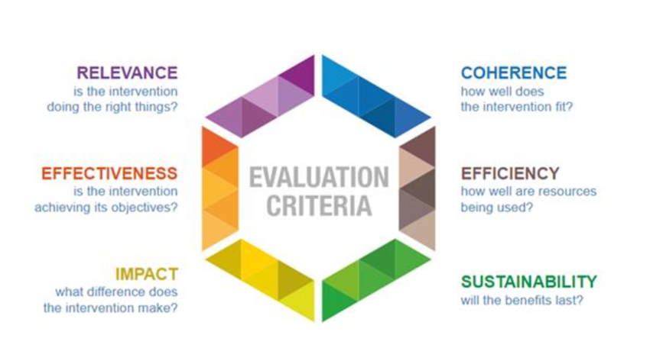
OECD Evaluation Criteria

Slide 10
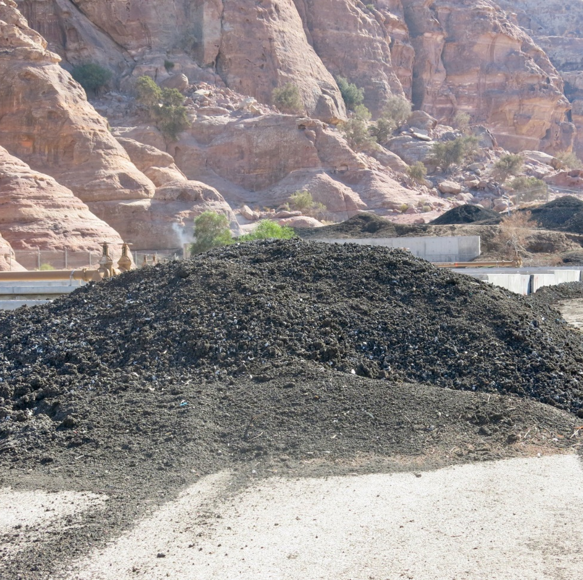
From problem to solution
The project tackled a very pressing issue facing the wastewater sector.
Sludge has been known to be a burden and causing negative environmental effects.
105 kton of sludge (dry basis) per year!
Photo by Hans Hartung 2024

Slide 11
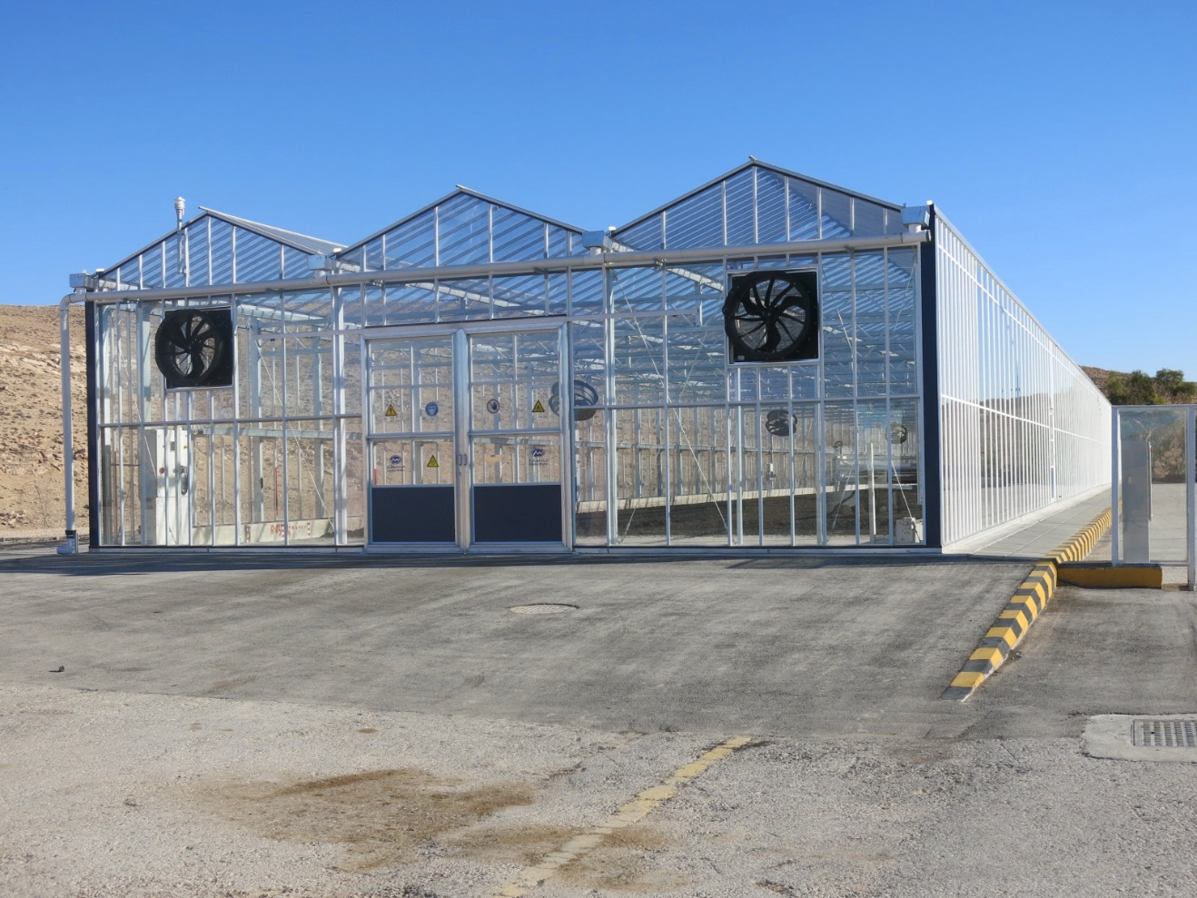
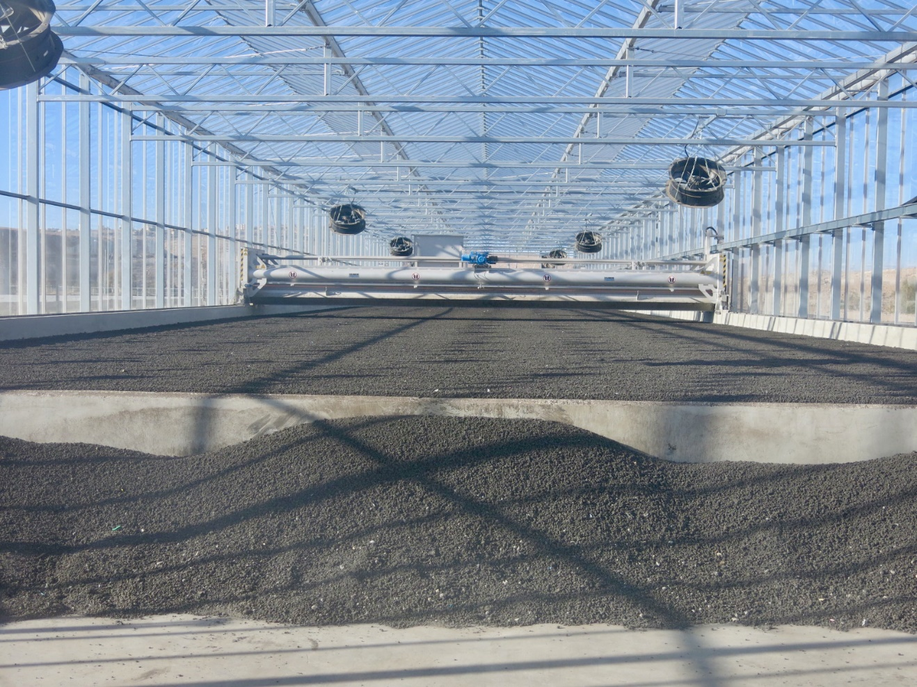
Technical support to enable solutions
Photos by Hans Hartung 2024
Sludge drying in green house achieves 90% dryness and thus allows for the reuse of sludge.

Slide 12
For the first time
Sludge as an energy carrier in industry
Universities started research on sludge pyrolysis and new reuse options engaging students
Dashboard for the data of sludge at WWTPs enabling bigger view and planning for sludge
Sludge became a key topic in the National Water Strategy 2023 – 2040.
A regional dialogue on sludge management was started and was adopted by the Arab Water Council
The project at WAJ became a source of information for interested parties working on sludge management.

Slide 13
Success factors
Team work and support by WAJ and utilities
National Committee resumed work and cooperated well on sludge management solutions
Effective capacity building activities including training and study tours that furnished for reaching common agreements on solutions.
Open to other opportunities and cooperation with donors.

Slide 14
Key Recommendations
Reduce generation of sludge at source; aerobic vs anaerobic treatment.. Assess the options and form the road map for further applications.
Incentivise innovative solutions for sludge management and reuse
Develop further local capacity to enable fabricating the green house technology locally and thus eases the investment cost.
Sustain the experience via training and staffing.
Future applications may benefit from Carbon Credits and engaging the private sector.

Slide 15
Thank you
We will be happy to receive few questions.

Slide 16
Technical Sustainable Management (TSM)
GIZ Jordan

Slide 17
What is TSM?
Technical Sustainable Management is a system addressing:
Management
  Quality management system which guides managers to fulfill their legal obligations
Evaluation
  Performance of facilities is monitored and evaluated based on TSM requirement catalog
Benchmarking
  Benchmarking wastewater utilities
Certification
  Quality label for legal and technical requirements

Slide 18
Objectives of TSM Jordan
  Ensure sustainable operation of WWTPs.
  Guarantee compliance with Jordanian environmental and safety regulations.
  Foster institutional accountability and performance.
  Promote transparency, documentation, and continuous improvement.

Slide 19
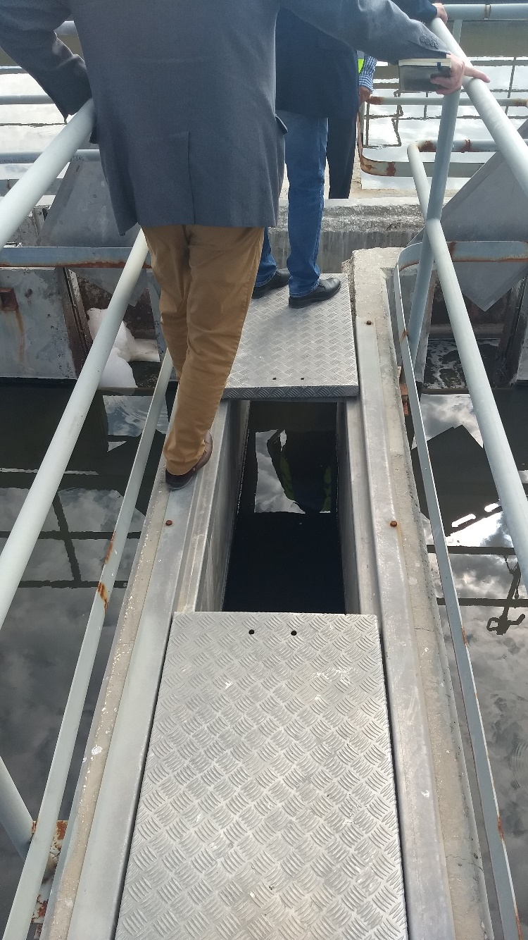
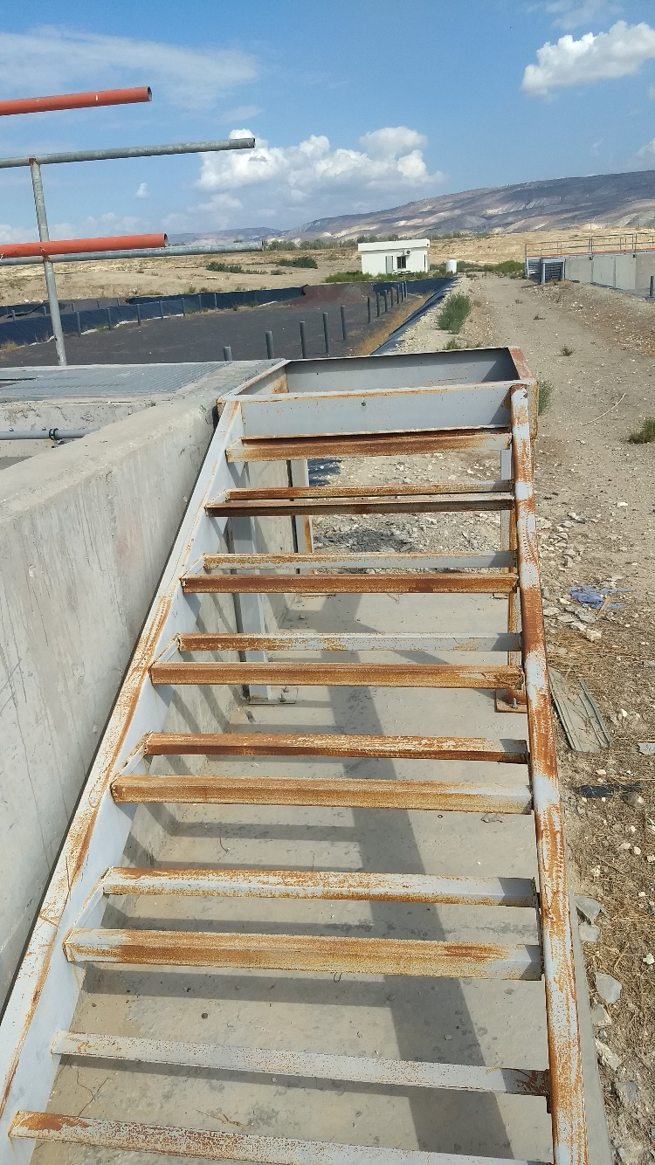
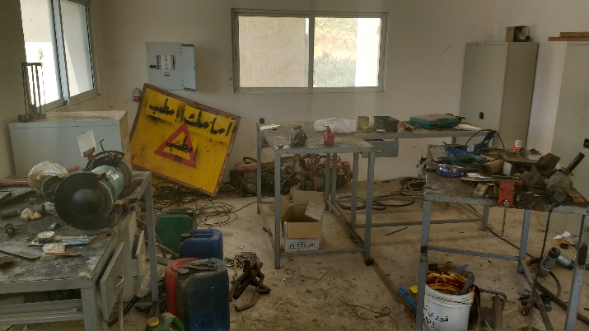
TSM Implementation in YWC WWTPs:
Started in 2017.
YWC supported the development of the TSM Guidelines and the TSM Requirement inspection booklet.
TSM inspectors were trained from YWC and expanded to other water utilities.
A focal point for TSM YWC was appointed.
Out of 12 WWTPS, 9 WWTPs received TSM certificates, according to the following pillars:
( Human Resources, Occupational Health and Safety, Operation, Maintenance, Quality Control/Assurance, Energy Efficiency).

Slide 20
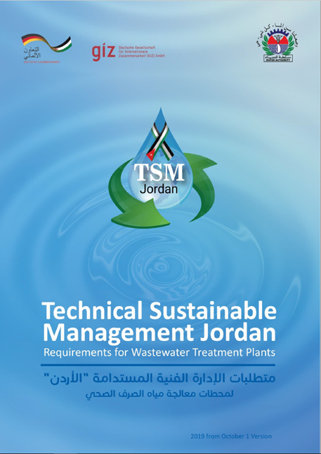
TSM-Jordan – Requirement Catalogue

Slide 21
Human Resources (H) | Occupational Health and safety (OHS) | Operation (O) | Maintenance (M) | Quality Assurance / Quality Control (Q) | Energy Efficiency (E)
8 Questions | 13 Questions | 9 Questions | 8 Questions | 4 Questions | 2 Questions
138 pages
English / Arabic
44 TSM questions in total
6 TSM pillars

Slide 22
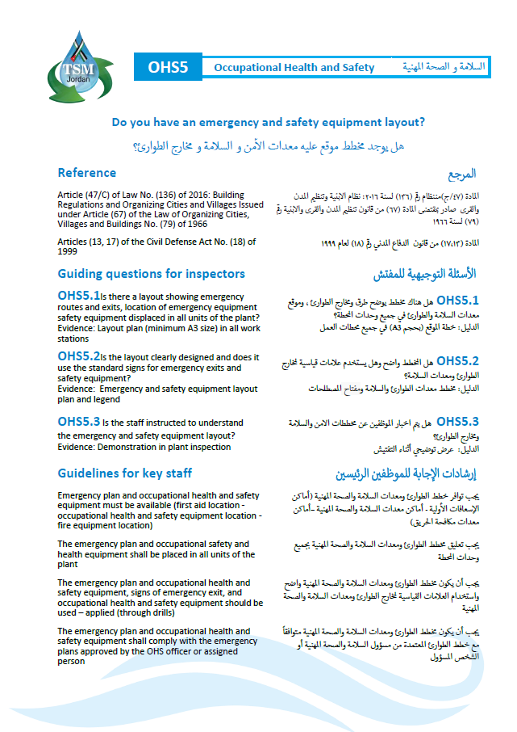
TSM Jordan Terminology - Example
TSM Question
Reference
Guiding Questions for Inspectors
Evidence
Guidelines

Slide 23
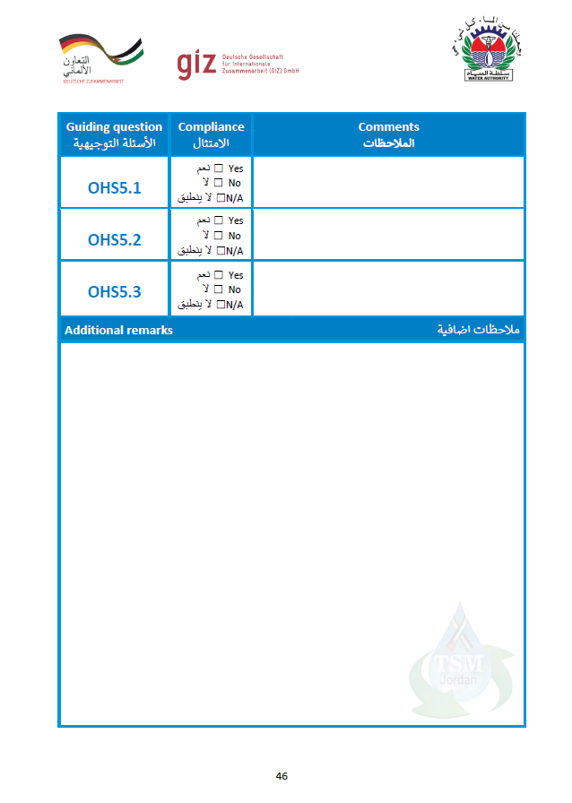

Slide 24
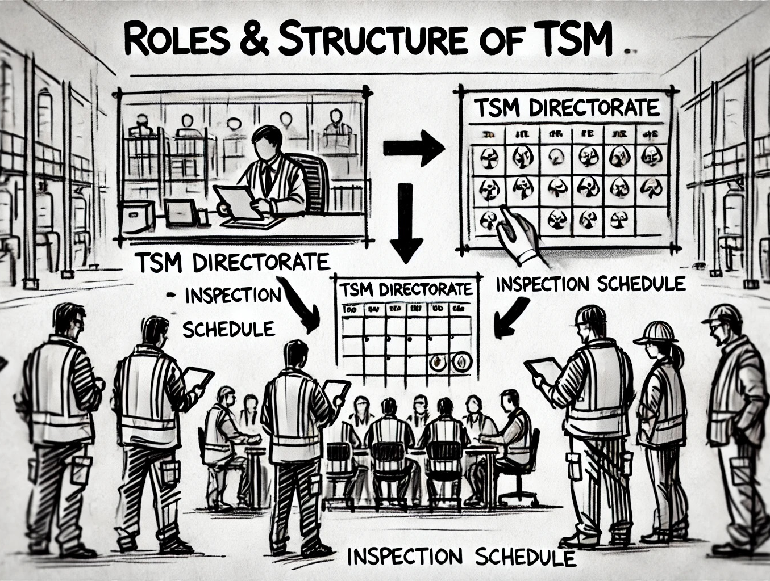
Roles & Structure
TSM Directorate:
  Located within WAJ.
  Manages implementation, inspection scheduling, certification.
TSM Focal Points:
  Appointed from water utilities.
  Coordinate between plants and TSM Directorate.
Inspectors:
  Trained experts performing on-site evaluations and audits.

Slide 25
Certification Process
Two-stage evaluation:
Document Review
Site Inspection
Certification Levels:
Gold: 98–100%
Silver: 95–97.99%
Bronze: 90–94.99%
Results documented and shared with WWTPs.

Slide 26
Key Achievements (Since 2022)
Water Utility | Inspections | Certified WWTPs | Gold | Silver | Bronze | Failed | Recertified
Yarmouk Water Co | 11 | 10 | 0 | 3 | 6 | 2 | 5
Miyahuna | 4 | 3 | 3 | 1 | 0 | 0 | 1
Aqaba Water Co | 5 | 4 | 2 | 2 | 0 | 1 | 2
Total | 20 | 17 | 5 | 6 | 6 | 3 | 8

Slide 27
Highlighted WWTP Achievements
Aqaba WWTP: 100% score – Gold (2024)
South Amman: 99.12% – Gold (2024)
Mahes & Fuheis: 98.23% – Gold (2024)
Wadi Musa: Improved from 80.15% (fail) to 96.43% – Silver (2023)
Wadi Hassan: Multiple certifications and recertification cycles

Slide 28
Impact of TSM
Standardized quality benchmarks across wastewater plants.
Enhanced staff capacity through structured training.
Reduction in operational risks via regular inspection.
Promotes Jordan’s sustainable water strategy aligned with national water plans.
Economic Impact
Enhanced Capacity
Environmental Impact
Legislative Impact
Environmental Impact
Legislative Impact

Slide 29
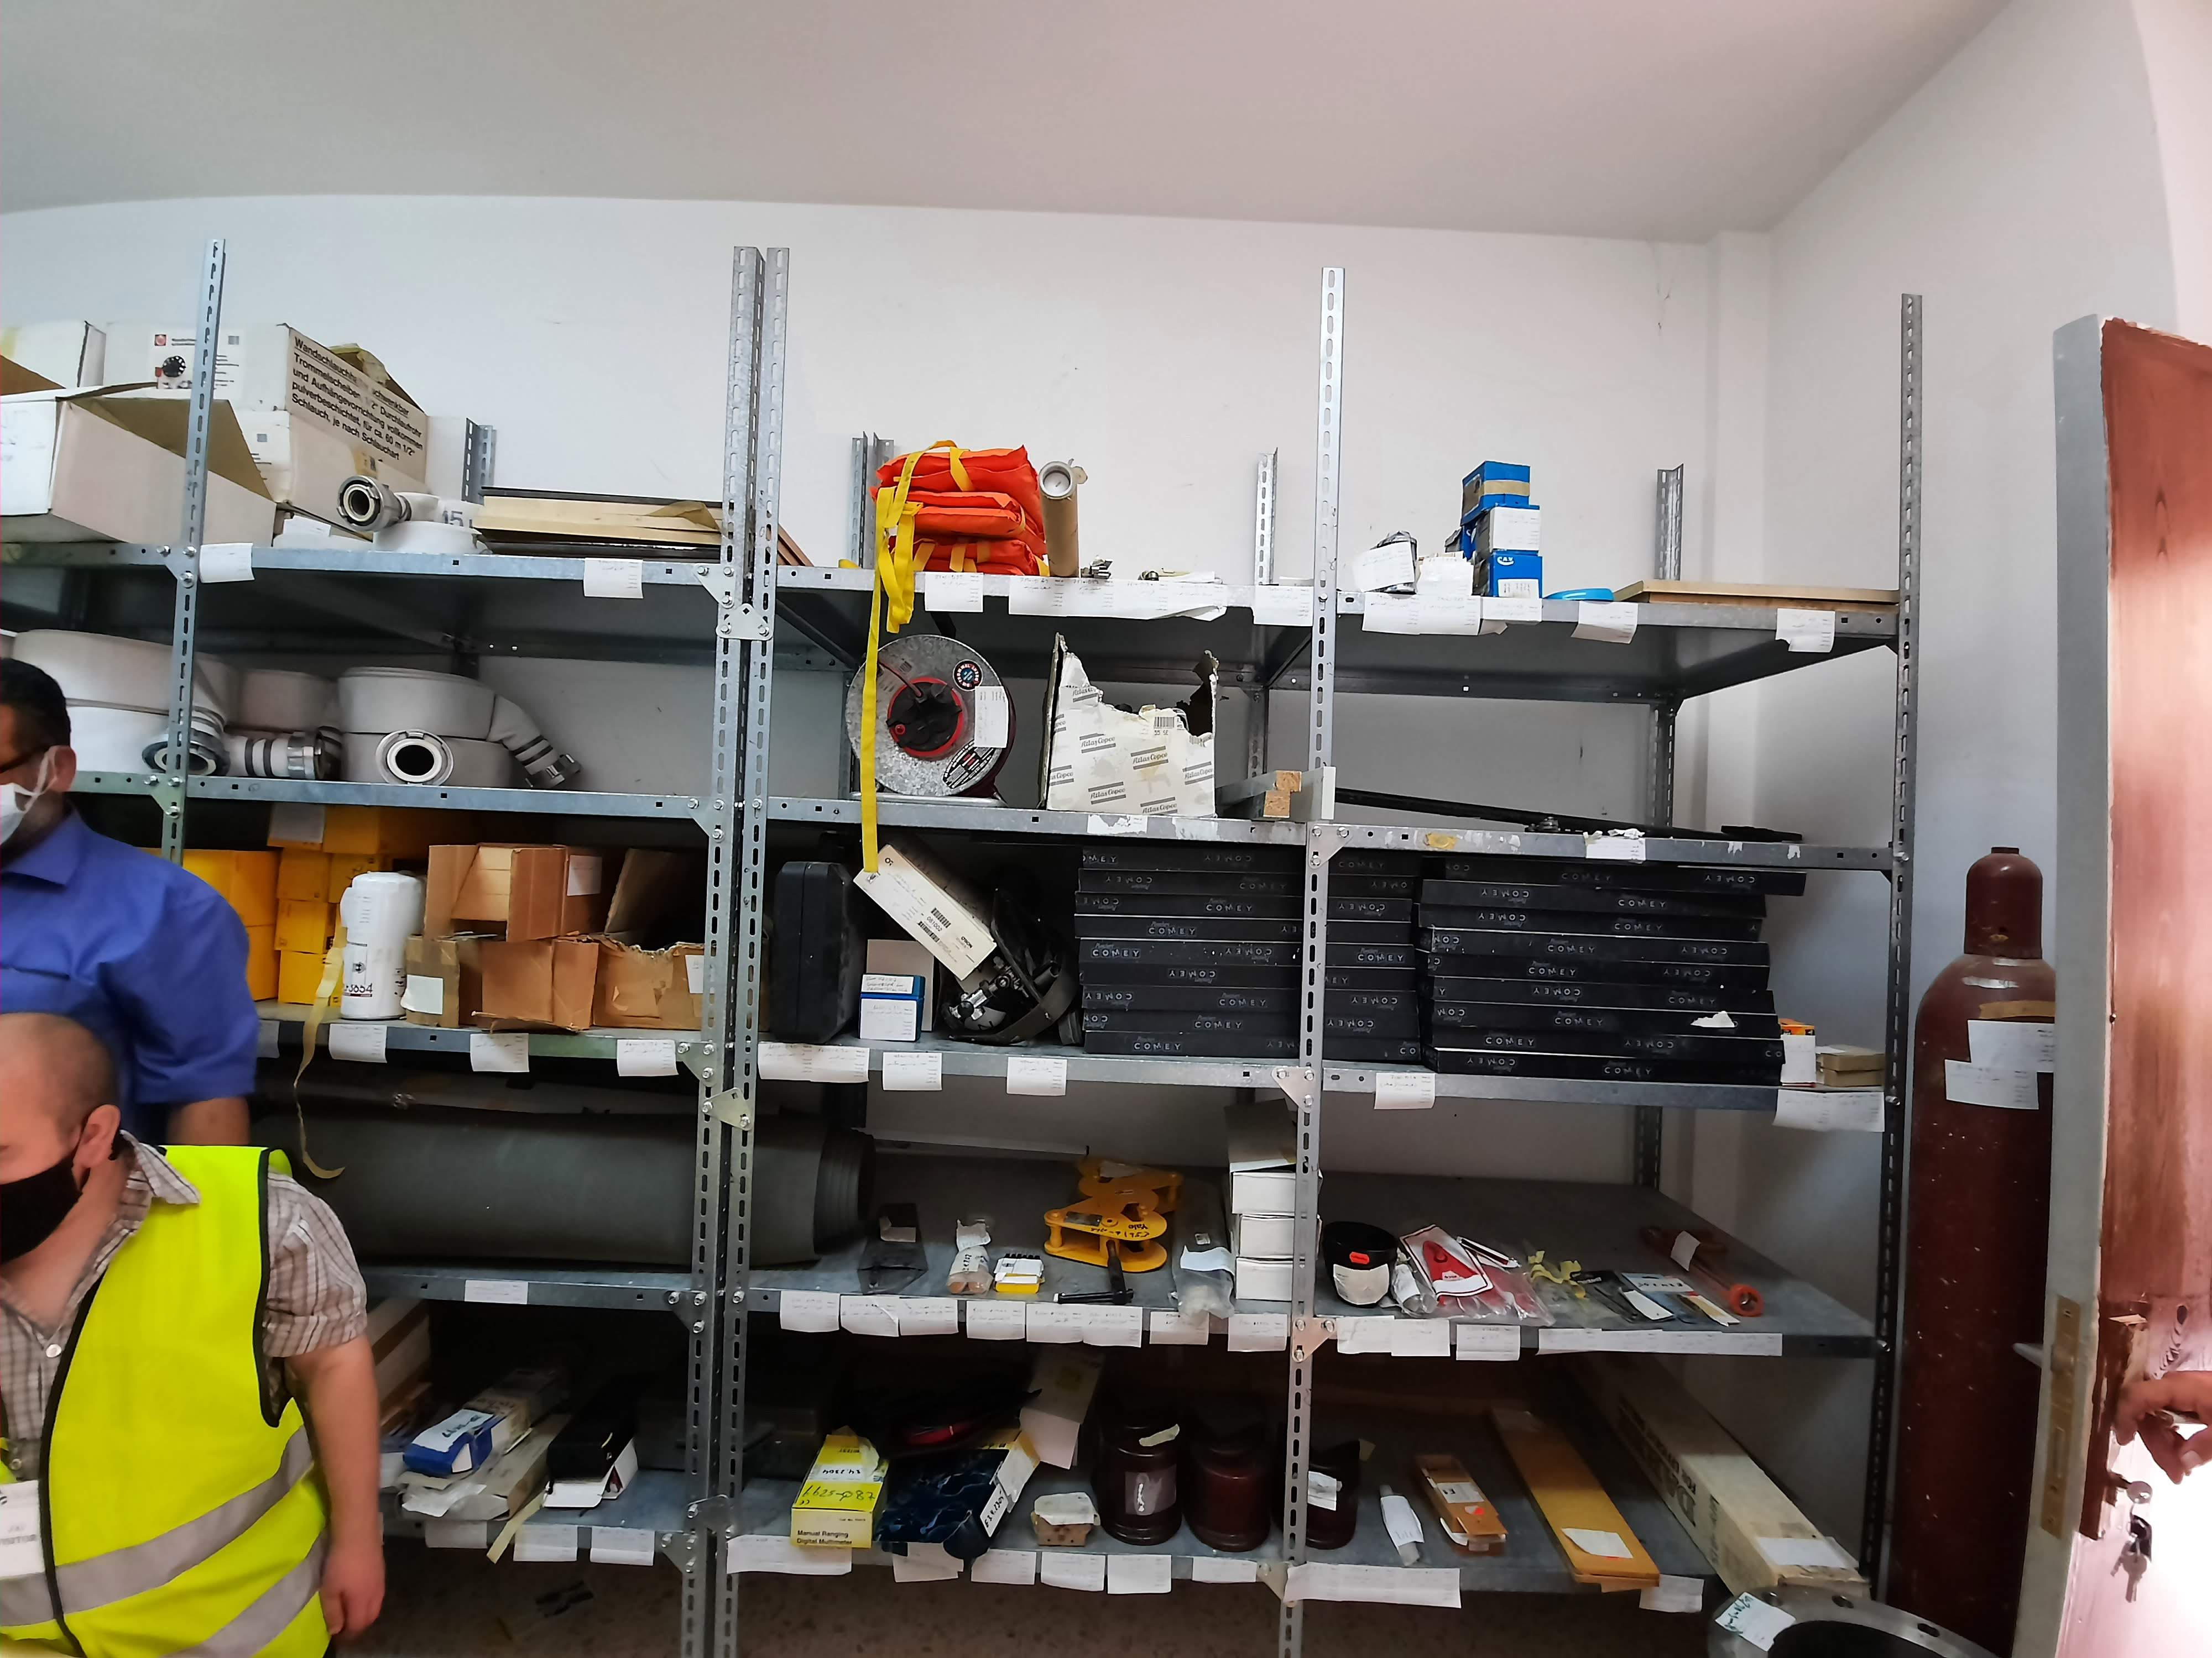
Challenges
The YWC Wastewater department is currently encountering the following challenges to fully comply with the TSM requirements:
Most wastewater treatment plants (WWTPs) are reaching their design capacity and struggling to handle additional wastewater.
There is a shortage of staff available to properly manage the wastewater sector.
The department has a limited budget for the operation and maintenance requirements.
There is a lack of regular updating on specific knowledge, especially in new technologies such as digesters and dewatering systems due to staff reallocation or retirement strategies.

