Slide 1




Advanced Water Solutions
7th Arab Water Week & 3rd Trenchless Arabia
AL-WEFAQ CONTROL SYSTEMS BOOTH “A16”

Slide 2


Table of Contents
01
About Us
02
Next-Gen Infrastructure
03
04
05
06
QLog Data Logger
Qlog Key Feature
Qlog Technical Specs Brief
Our Water Sector Experience

Slide 3
01
About Us

Slide 4

About Us
Al-Wefaq Control Systems is a leading provider of advanced automation and monitoring solutions, specializing in the design, integration, and support of SCADA systems, Remote Terminal Units (RTUs), and IoT technologies. With a strong foundation built over years of expertise, Al-Wefaq has become a trusted partner in the water, wastewater, and infrastructure sectors across the region.

Slide 5

Our mission is to empower utilities and industries with innovative, reliable, and energy-efficient solutions that drive operational excellence. By combining deep technical knowledge with a commitment to quality and customer satisfaction, Al-Wefaq continues to contribute to the development of smarter, more resilient infrastructure for a sustainable future.

Slide 6
02
Next-Gen Infrastructure

Slide 7
Next-Gen Infrastructure
SCADA Systems
RTUs (Remote Terminal Units)
Smart Water Solutions [Artificial Intelligence]
Empower Infrastructure through Innovative Automation
Brain of remote operations, coordinating data, control, and decision-making across the entire network
Backbone of remote monitoring.
Nervous system of modern infrastructure — learning from data, predicting issues before they happen, and optimizing operations in real time

Slide 8
03
Our Water Sector Experience

Slide 9



Our Water Sector Experience
23 years working with..
Partnerships with..
Commitment to
Water distribution networks
Wastewater treatment plants
Remote well and reservoir monitoring
Utilities
Municipalities
Leading Manufacturer
  Reliable
  Scalable
  Energy-efficient Solutions

Slide 10
04
QLog Data Logger

Slide 11
QLog Data Logger
Quality
Intelligence
Logging

Slide 12






QLog Data Logger
A compact, Rugged datalogger built specifically for:
Pressure Monitoring
Flow Monitoring
Water Quality Sensors
Leak Detection
(pH, turbidity, chlorine)

Slide 13
05
QLog Key Features

Slide 14
QLog Key Features
01
Ultra-low power with Enhanced battery life
04
Flexible inputs
Analog, Digital, Pulse, RS485 Modbus.
02
Multiple communication modes
4G/5G/NB-IoT, LoRaWAN
05
Cloud integration ready
MQTT, HTTPS or On Premise
03
Easy deployment
"Plug & Monitor" philosophy

Slide 15
06
QLog Technical Specifications Brief

Slide 16

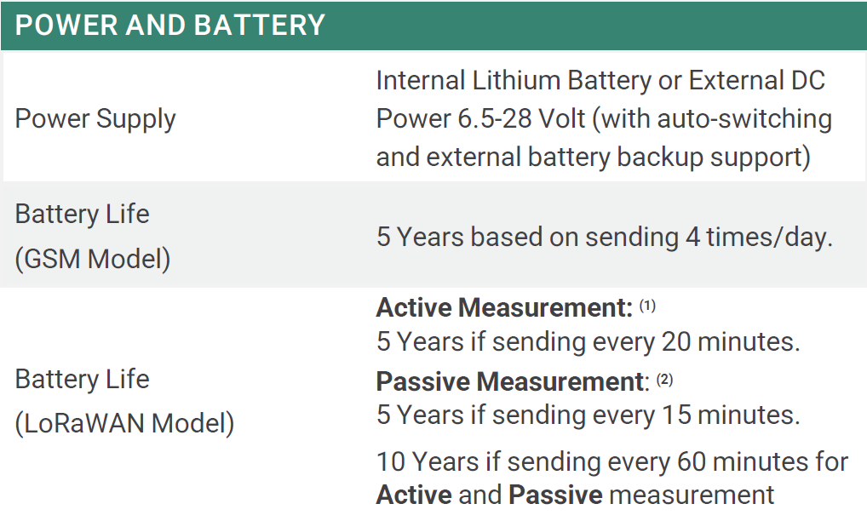
QLog Technical Specifications Brief

Slide 17
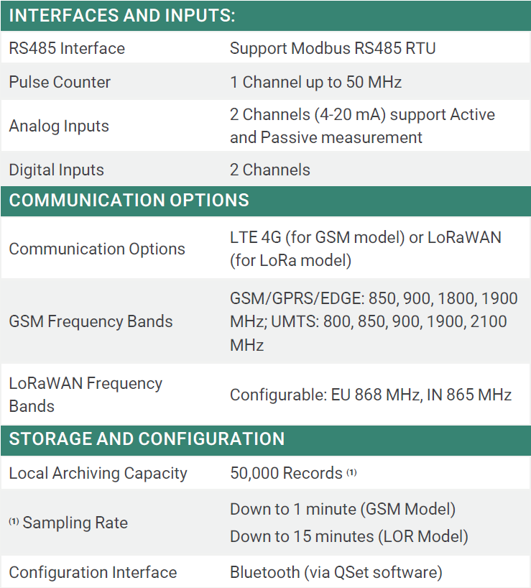
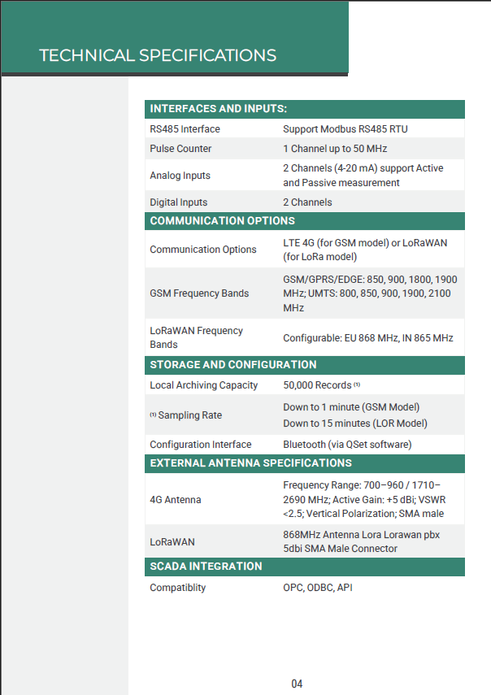
QLog Technical Specifications Brief

Slide 18
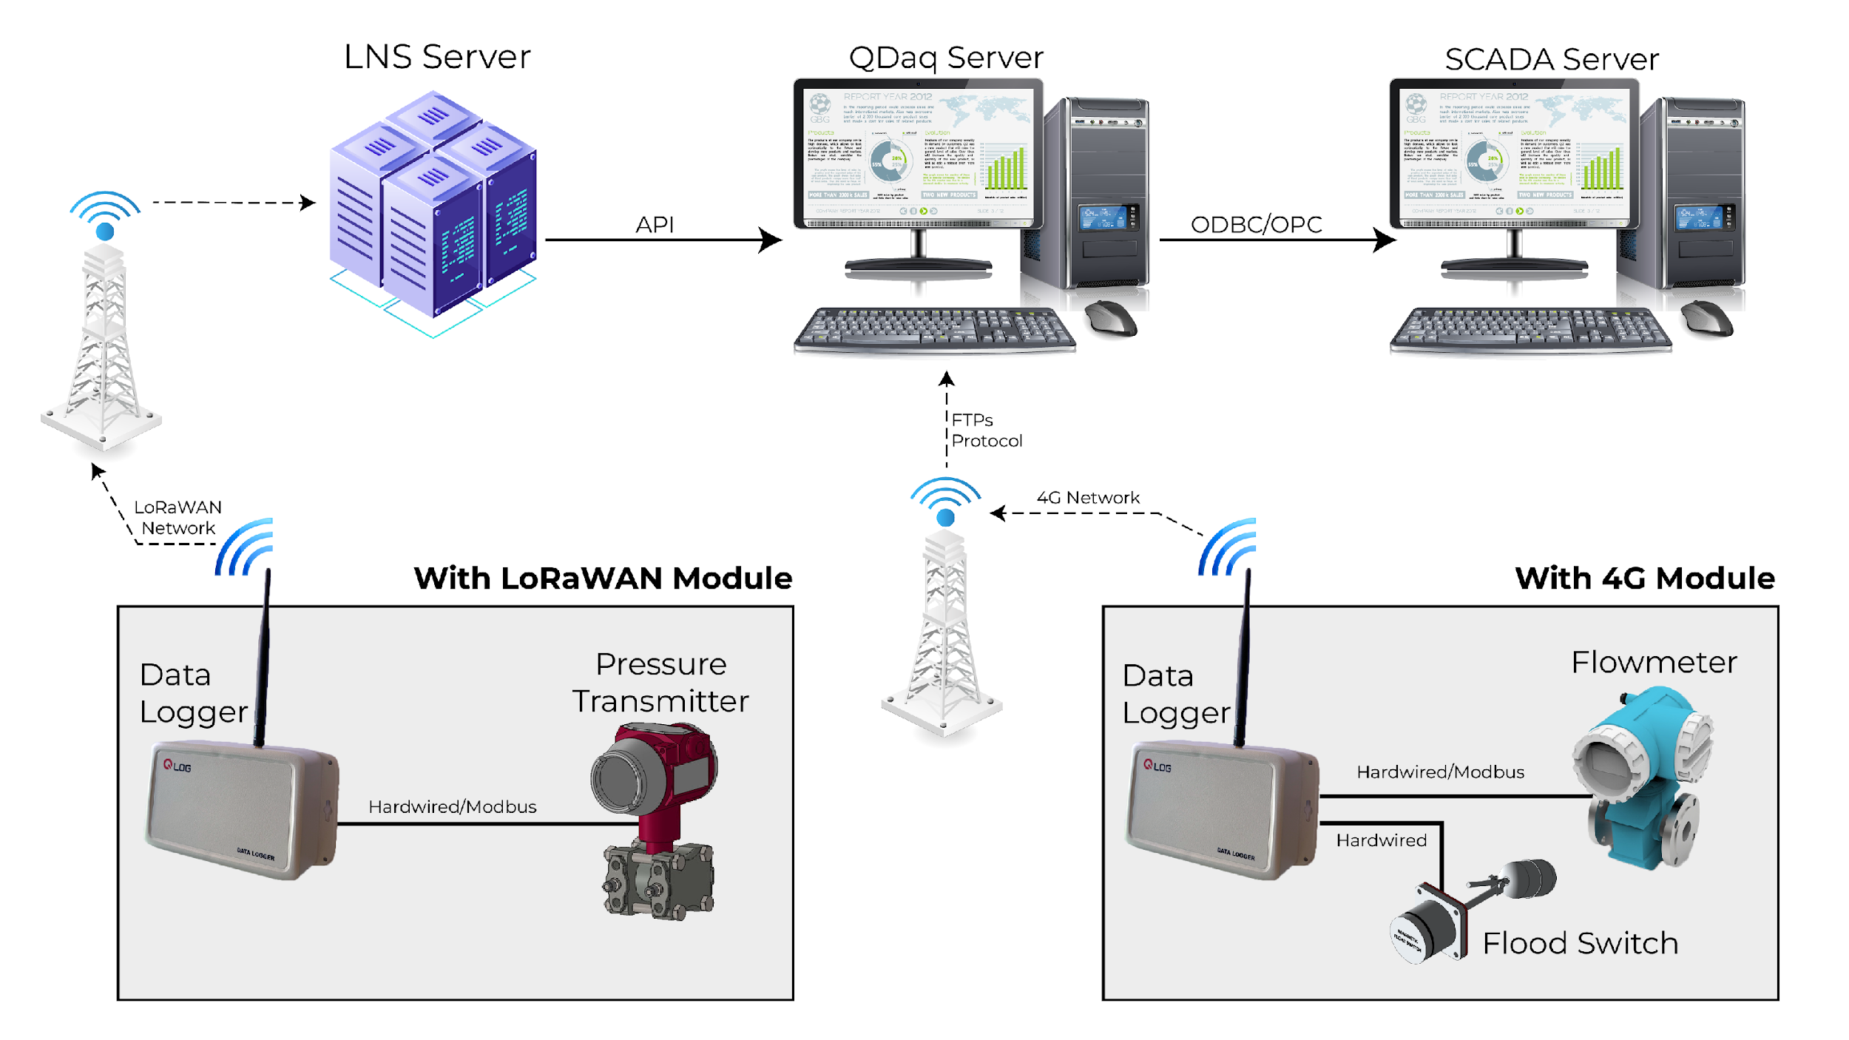
QLog System Architecture

Slide 19

THANKS
Let's work together to shape the future of water management!
AL-WEFAQ CONTROL SYSTEMS
BOOTH “A16”
Amman, Jordan

