Slide 1
Economics of Irrigation Water
Cost Recovery in Irrigation Water in JVA
Ministry of Water and Irrigation
Jordan Valley Authority
The 7th Arab Water Week
Khali – AL-Absi
May 4-6 2025

Slide 2
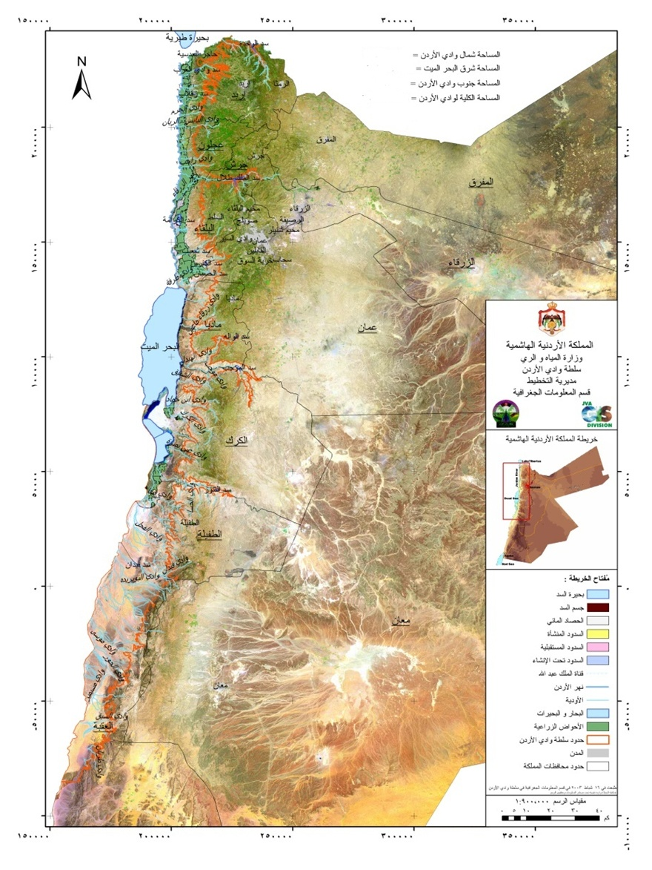
Historical Context: the Jordan Valley before the 50’s
Location
Part of Great Rift Valley: It is 120 Km long and 15 Km wide, it runs from Lake Tiberius in the north to the northern Dead Sea in the south. It runs for an additional 155 Km south Dead Sea to Aqaba, an area also known as Wadi Arabah
Its total area is about 1185 Km square.

Slide 3
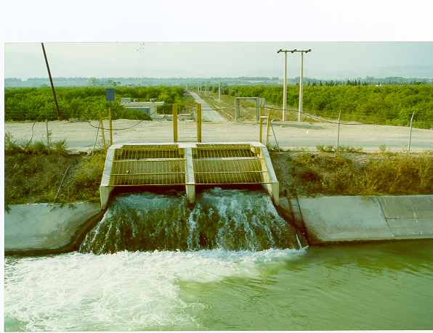
The First Water Project in JV
- In 1958, 69 Km long canal was constructed.
- One km long diversion tunnel running underneath the mountain between the Yarmouk River and the Village of Adasiyeh.
- Lateral canals is branch off the main canal to reach the farm land to irrigate about 11,700 ha in NJV.
- The ambition to constructed a 110 km canal along the whole JV.
- Land distribution scheme was lunched in 1962 according to the terms of the East Ghor low for braking up large holdings.

Slide 4
Shared Water Resources Quantities (MCM) in JV North Part 2023
Source | Quantity (MCM) | %
Yarmouk - KAC | 10.6 | 22.2%
Yarmouk – Wehadha Dam | 23.7
Mukhebha Wells | 15 | 10%
Tiberius | 105 | 68%
Total | 154.2

Slide 5
Dams in
Jordan
2023
Dam | Water storage MCM (end of 2022) | Inflow MCM | Outflow (MCM) | Water Storage (end of 2023)
Weheda | 5.53 | 23.7 | 25.4 | 3.857
Wadi Al-Arab | 4.9 | 8.804 | 7.83 | 5.89
Zeglab | 0.939 | 1.321 | 1.609 | 0.653
Kurfranja | 1.801 | 3.74 | 3.28 | 2.253
Talal | 21.546 | 148.5 | 133.745 | 36.25
Karama | 22.83 | 2.02 | 1.588 | 23.2
Wadi Shueib | 0.731 | 9.102 | 9.377 | 0.467
Kafruin | 3.6 | 10.657 | 10.33 | 3.94
Zarqa Maan | 0.214 | 0.867 | 0.895 | 0.186
Wala | 0.169 | 36.18 | 29.58 | 6.77
Mujeib | 3.64 | 48.93 | 30.341 | 22.24
Tanour | 3.38 | 7.211 | 2.153 | 8.44
Ibn Hammad | 0.054 | 0.961 | 0.636 | 0.379
Fedan | 1.22 | 3.149 | 1.212 | 3.161
Lajoon | 0.137 | 0.286 | 0.254 | 0.168
Total | 70.7 | 305.43 | 257.98 | 117.8

Slide 6
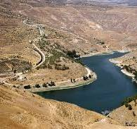
Talal Dam

Slide 7
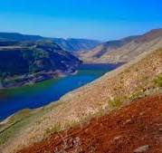
Al- Wehada Dam

Slide 8
Water Resources in Southern Jordan Valley
Source | Flow | Released Water | Irrigation | Industrial | Losses (MC)
Water | L/S | CM | Sold water CM | Sold Water CM
Wadi Hasa | 749.3 | 23.3 | 20678845 | 420526
Wadi Fifa | 111.3 | 3.5 | 3379993 | 0
Wadi khnezerh | 49.3 | 1.5 | 1470214 | 0
Wadi bin Hammad | 223.8 | 7.00 | 5996083 | 748017
Wadi Karak | 95.7 | 3.00 | 2852543 | 0
ThraaWadi | 52.2 | 1.6 | 1520330 | 0
Sub Total |  | 39.9 | 35.9 | 1.16 | 2.8
Mujeib Carrier |  | 8.6 | 4.2 | 4.0 | 0.46
Grand total |  | 48.5 | 40.0 | 5.1 | 3.2

Slide 9
Water Uses from JV Water Resources for Different Sectors (2023)
Sector | Quantity (MCM)
N&MJV for Irrigation (Dead North | 161.7
KAC- Amman | 79
South carrier (House Hold) | 35.2
KAC- Irbid (House Hold) | 8.3
Southern JV (irrigation | 40.1
Industrial Uses | 5.2
Total | 330

Slide 10
Percentage of different Sectors Uses from Water Released
Sector | % of Water Provide
Irrigation | 61.7%
Household | 37.7%
Industrial | 0.011%
Total | 99.5%

Slide 11
Irrigation Water Tariff in 1994
Water Tariff ( Fills/m3) | Consumption Category(m3/FU)
8 | Zero - 1000
12 | 1001- 2000
20 | 2001-3000
35 | > 3000

Slide 12
Modified Water Tariff Since 1995
 | Water Tariff ( Fills/m3) | Consumption Category(m3/FU)
 | 8 | Zero – 2500
 | 15 | 2501- 3500
 | 20 | 3501 – 4500
 | 35 | > 4500

Slide 13
Relevant Concepts
- Irrigation Water Tariff
- Irrigation Water Prices
- Discrimination Pricing Policy
1- Price Elasticity of Demand

Slide 14
Cost Recovery in JVA
Water as a Public Good VS Economic Good
Financial analysis Vs Economic Analysis
Operation and Maintenance Cost
Total Revenues

Slide 15
Relevant Concepts
Water as Economic Good (What are the Consequences)?
Water as a Public Good( What are the Consequences)?

Slide 16
JVA could be Considered as a Pure
Monopolist
Means
JVA able to Determine
-Prices or tariff of Irrigation Water
-Quantity Delivered for Irrigation Water

Slide 17
JVA Market Structure
JVA practice a Natural Monopoly Role in
Producing, Managing and Distributing Irrigation Water in Jordan Valley
There is no Competitor for JVA in Irrigation Water in Jordan Valley

Slide 18
Cost Recovery Computations
Assumptions:
1- JVA will be Considered as an Industry.
2- JVA has a Development Purpose rather than Profit purpose.
3- JVA should reach Breakeven Point where ( Pw=AVC=Mc).
4- Total Revenues will be Computed regardless the Activity Performed.
5- Total Variable Cost will be computed Regardless the Administration.
6- Total variable Cost comprise :(Salaries and Operation Cost)
7- JVA Produce Water used as input for:
- Irrigation Sector
- Industrial Sector

Slide 19
Assumptions
8- JVA Produce Water Used for Drinking Purposes , So Provided Water could be treated as:
- Input ????.
A commodity????
9- JVA will not Consider Revenues Pumped to WAJ.
10- JVA will not subtracts O&M associated with pumping water to WAJ.
11- JVA Consider the same Cost / m3 Produce Regardless the purpose of Delivery.

Slide 20
JVA Operation and Maintenance Cost for 2020 2023
2020 |  | 2021 | 2022 | 2023 | %
Item | Value (MJD) | Value (MJD) | Value(MJD) | Value(MJD)
Salaries | 10.079 | 10.27 | 10.36 | 10.77 | 48.3%
Electricity | 3.869 | 3.62 | 2.29 | 4.71 | 21.1%
Fuel | 0.3996 | 0.520 | 1.01 | 0.748 | 3.4%
Tiberius Water Pumping | 1.71 | 2.29 | 1.4 | 2.07 | 9.3%
Spare Parts | 0.678 | 0.878 | 0.795 | 0.880 | 3.9%
Services Contracts (S&G) | 0.619 | 0.470 | 0.470 | 0.615 | 2.8%
WUAs Cost | 0.584 | 0.596 | 0.733 | 0.642 | 2.9%
RSS Contract Electric Gen | 0.466 | 0.803 | 0.425 | 0.552 | 2.5%
Dams Maintenance | 0.391 | 0.126 | 0.371 | 0.451 | 2.0%
Others | 0.4794 | 0.903 | 0.634 | 0.822 | 3.7%
Total | 19.3 | 20.177 | 18.5 | 22.3 | 100.0%

Slide 21
JVA Revenues (MJD) for 2020- 2023
(Billed)
2020 |  | 2021 | 2022 | 2023 | % (2023
Item | Value | Value | Value | Value | %
Industrial Water | 3.48 | 2.38 | 1.74 | 2.92 | 30.6%
Irrigation Water | 2.10 | 1.82 | 1.78 | 1.95 | 20.5%
Power | 0.641 | 0.65 | 0.668 | 0.785 | 8.2%
Others | 1.60 | 2.7 | 2.89 | 3.88 | 40.7%
Total | 7.8 | 7.5 | 7.08 | 9.53 | 100.0%

Slide 22
Cost per CM / O and M cost without Investment Cost
The Average Cost per CM in Jordan Valley Authority is estimated to JD/CM =110.5 Fills/ CM with respect to Irrigation Water
The cost was estimated with out including annual deprecation Cost.
The cost is varied according to the annual operation and maintenance cost
The cost is varied according to the total water quantity produced and distributed to different uses.
The calculations exclude Water delivered for domestic uses and industrial water
The cost per CM include all the released water= 67.5 fills / CM
Average Water Tarff /Cm = 10 fils/Cm

Slide 23
Financial Situation in Jordan Valley
2023
Total Annual Revenues – Total Annual operation and maintenance Cost
9.5 – 22.2= 12.7 MJD
Deficit = 12.7 JD = Equal the Indirect Subsides for Farmers in JV.

Slide 24
Measures Taking by JVA to cope with Water Shortage
- Introduction of Water User’s Associations
- Prohibited new banana plantation.
- Stop irrigated new farm units.
-Use of non conventional water resources (reclaimed and brackish water).
- Reduce water quota for Agriculture, (50% of CWR).
- Farmers compensation for uncultivated land.
- Increase irrigation water tariff in 1995.
- Prohibited illegal ground water abstraction in JV.
- Provide household sector in Amman with 100 MCM annually.
- Encourage the plantation of less water consumed crops
- Study the possibility to restructure irrigation water tariff as a tool to increase water use efficiency .

Slide 25
THANKS for ATTENSION

