Slide 1




Advancing Water Security and Infrastructure in Oman
Sultan Al Salami Date: 4- 6 May 2025

Slide 2
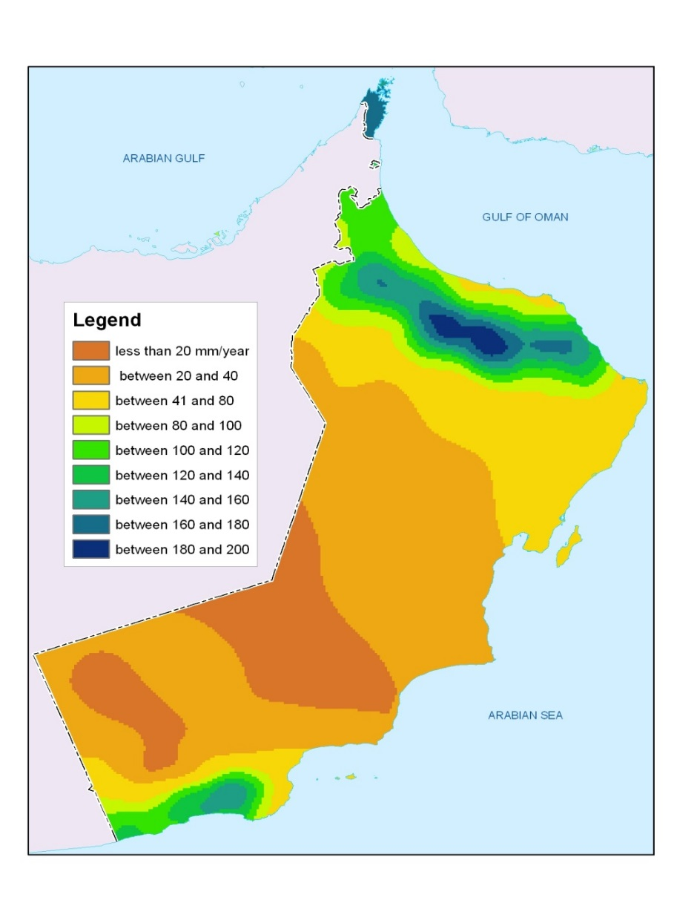



Overview of Water Situation in Oman
  The location of the Sultanate is within dry and semi-dried countries with annual share of 375 m3/ capita.
The average annual rainfall is less than 100 mm,
Jabel Al Akhdar 350 mm
Desert less than 50 mm per year
Rain is the main source of fresh water in the Sultanate of Oman
83% of total water use is in Agriculture .
The average water resource deficit is estimated to be 316 million m3
Drought of more than five years period is common

Slide 3



WATER SECTOR IN OMAN
Ministry of Agriculture, Fisheries and Water Resources
Policy Maker
Regulator
Operators

Slide 4
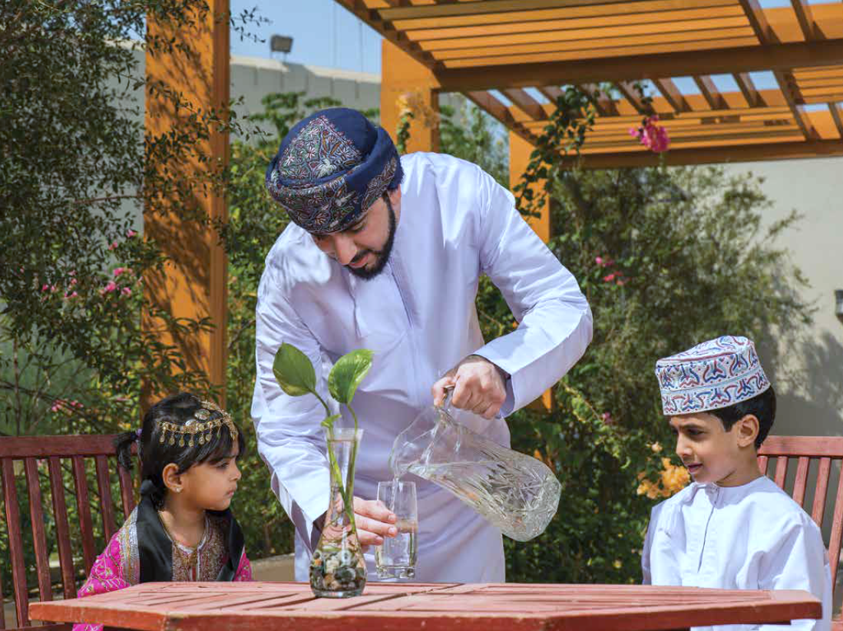






About us
Oman Water and Wastewater Services Company was established based on the Royal Decree (2020/131) on 9 December 2020. The Royal Decree stated that Oman Water and Wastewater Services Company to provide Water and Wastewater services in all governorates in the Sultanate except Dhofar Governorate.
To implement the transfer scheme, approved by Oman Investment Authority, OWWSC received the assets and responsibilities assigned to it on 1 June 2021. OWWSC was granted the right to develop, design, implement, operate and maintain potable water and wastewater facilities and it is an Omani closed joint stock company registered under the Commercial Companies Law in the Sultanate of Oman.
2002
2021
2023
1980
2018
Electricity Policy
Ministry of Electricity and Water
Public Authority of Water

Slide 5
Vision
To be a leading water utility, contributing to the sustainable development of Oman
Mission
Committed to serving the society by providing safe reliable and sustainable water and wastewater services

Slide 6
OUR ROLE
Oman Water and Wastewater Services Company, through an ambitious vision and solid values, aims to be a leading service institution in the water and wastewater sector. The company intends to apply best international practices to contribute to achieving the Sultanate sustainable development by improve system and facilities of the water and wastewater sector and presenting the best innovative solutions to provide sustainable, safe and reliable services to customers.
The company targets to reduce the pollution resulting from traditional wastewater system, prevents the spread of diseases, as well as protects groundwater surceases from depletion or pollution.

Slide 7
NWS Integrated Master Plan with other Strategies
01
Oman Vision 2040
02
Water National Strategy
03
NWS Strategy
04
IMP

Slide 8

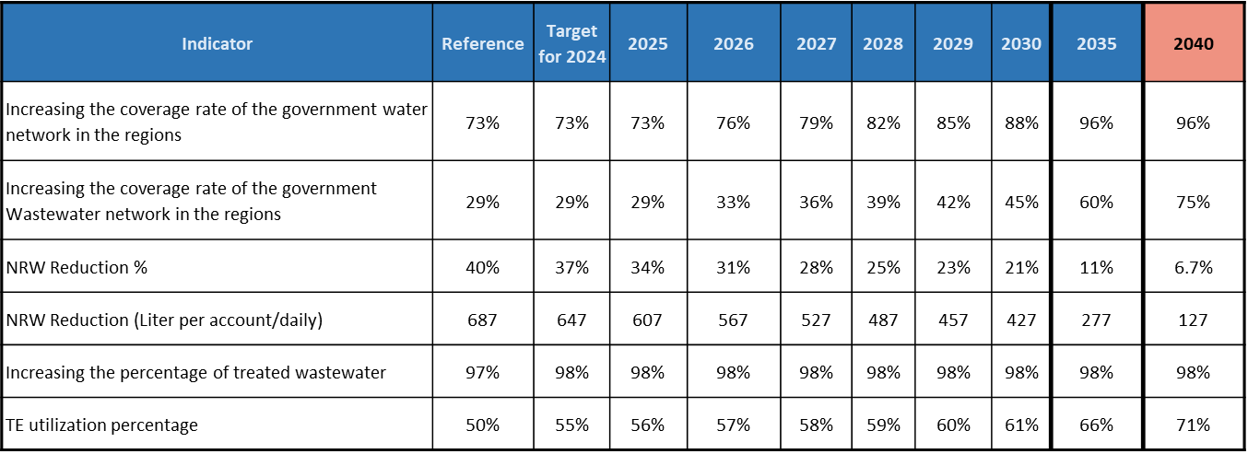
Oman Vision 2040 KPIs

Slide 9
Strategic Projects
Related to water Security & ensuring continuity of supplies
- Main Transmission lines
- Main Pumping stations
- Main Strategic Reservoirs
Distribution Networks
Construction of new distribution systems and expansions to increase coverage
- Distribution network projects
Others
Projects of comprehensive nature
- SCADA systems
- Small & Medium CAPEX
- Consultancy projects
- Rehabilitation projects
Types of Water Projects

Slide 10
Sewage Treatment Plant (STP)
Sewer Network
Treated Effluent Network
Others
Types of WW capex Projects

Slide 11

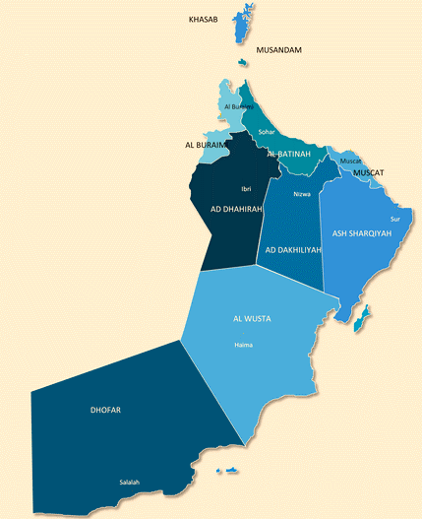
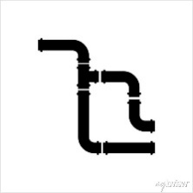




OWWSC- Water Sector at a Glance
OWWSC Responsible Area
Total Network Length (Km)
2023 2024
21,491 24,198
13 % increase
Network Length (Km) in 2024
Transmission Distribution
4,636 19,561
Water Active accounts (Thousands)
2023 2024
717 736
3 % increase
Number of Nonlinear Assets
Reservoirs Desalination Plants
390 55
Total Water Production
(Million Cubic meters)
2023 2024 (up to Nov.)
449 409
Total Water Sourced
(Million Cubic meters)
2023 2024 (up to Nov.)
1.26 1.22
Capex Projects Expenditures
(Million Omani Rials)
2023 2024
      114 166
      46 % increase
Map is not for
Political Boundaries

Slide 12

OWWSC- Wastewater Sector at a Glance
OWWSC Responsible Area
Total Sewer Network Length (Km)
2023 2024
5,059 5,206
3% increase
Total TE Network Length (Km)
2023 2024
482 614
27% increase
Number of Costumers
Wastewater Costumers
2023 2024
220,814 226,652
3 % increase
Number of Nonlinear Assets
STP PS/LS/VS
59 107
TE Costumers (Muscat)
2023 2024
185 228
Total WW Flow
(Thousand Cubic meter)
2023 2024
269 274
2% increase
Total TE Production
(Thousand Cubic meter)
2023 2024
263 265
1% increase
Capex Projects Expenditures
(Million Omani Rials)
2023 2024
16 22
38 % increase
Map is not for
Political Boundaries

Slide 13
NWS Ongoing Investments
Total invested= 441,000,000 O.R
OWWSC Responsible Area
Water Capex Projects Expenditures
2022-2024
339 M.O.R
(Million Omani Rials)
Wastewater Capex Projects Expenditures
2022-2024
102 M.O.R
(Million Omani Rials)
Map is not for
Political Boundaries

Slide 14


Summary of Integrated Master Plan Investment Program (up to 2050)
Total Number of Water Project
Total Number of WW Project
Total Number of Integrated Project
139
192
79
410 Projects
Total CAPEX of Water Project
Total CAPEX of WW Project
Total CAPEX of Integrated Project
11.1 B OMR
2.0
7.2
1.8
B OMR
B OMR
B OMR
Current Coverage - 2024
Oman Vision Target vs IMP Recommended Target
% of Water Coverage
% of WW Coverage
Water
72.4%
31.7%
WW
*11.1 B OMR is the required CAPEX to achieve Oman vision targets including all the projects, DPs and STPs
Expected Coverage

Slide 15







Summary of Water Investment Program
2025-2027
Number of Projects
113
Total Network Length
8,212 (Km)
Pump Stations
Total Number:90
Estimated CAPEX
902 M.O.R
(Million Omani Rials)
Reservoirs
Total Number of Sites:202
Total Volume m3: 18,13,530
New Initial Costumers
~162 (Thousand)
~8% increase/year
Estimated Construction cost (81 projects)
863
(Million Omani Rials)
Estimated Design cost (32 projects)
39
(Million Omani Rials)
Time Frame of the Program
2025-2027

Slide 16
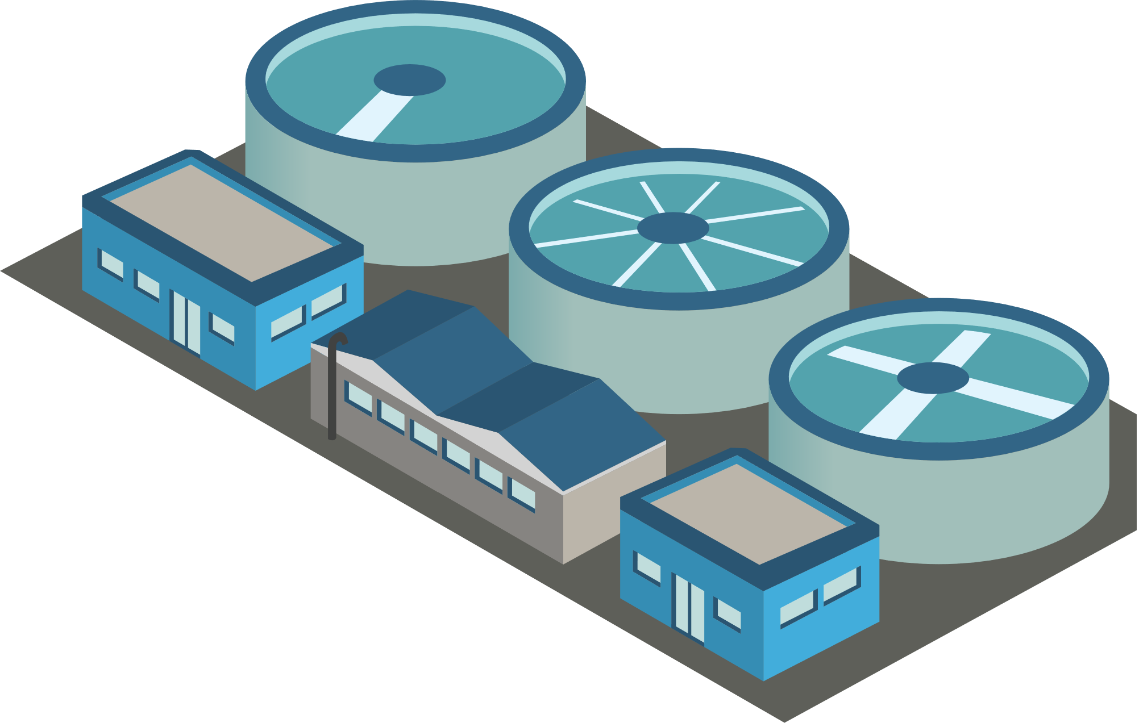
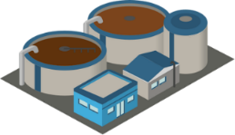
Summary of Wastewater Investment
Program 2025-2027
Number of Projects
112
Total Network Length
~1,500 (Km)
STPs Project Value*
250
(Million Omani Rials)
Estimated CAPEX
460 M.O.R
(Million Omani Rials)
New Initial Costumers
~42 (Thousand)
~18% increase/year
Estimated Construction cost
(77 projects)
420
(Million Omani Rials)
Estimated Design cost
(35 projects)
40
(Million Omani Rials)
Time Frame of the Program
2025-2027

Slide 17
Thank you

